Slide 1
PROFESIONAL CERTIFICATION PROGRAM FOR DISASTER MANAGEMENT
Presented by
Dr. Sugimin Pranoto
Head of PCA-DM
6 August 2015

Slide 2
Vision and Mission of PCADM
Vision
To provide competent human resources, professional, certified professional competence, high integrity and ethics on disaster management
Mission
To develop standard of professional competency in disaster management
To develop the schemes of professional certification in disaster management priority
To build cooperation with foreign professional certification agency for disaster management
To build cooperation with line Agencies/Ministry and international non-governmental organization in increasing human resources capacity on disaster management
To implement professional competence certification in disaster management according NCDM

Slide 3
Background
Profesional Certification Agency for Disaster Management (PCA DM) established based on the National Agency for Disaster Management regulationNo 7 Year 2014, and it’s part of the development of a new paradigm in preparing competent and quality human resources based on demand driven and competency based training.
PCADM is an independent institution and autonomous status, which has the tasked to assess the ability of Humanitarian workers and volunteers and or the parties engaged in disaster management in according with the Indonesian National Working Competence Standard of Disaster Management (SKKNI)
Lack of Humanitarian workers and volunteers competency in handling disaster: (Tsunami, earthquake, flooding, land slide etc).
Competency test in disaster management is needed in order to fullfill personal competent and to anticipate the global competition as well as to fit with the best quality of Disaster Management services.
Certificates of competence is an award of recognition of competency in disaster management

Slide 4
Regulation
Regulation | Implementing Agency
The Disaster Management Law (No 24/2007) Goverment regulation on disaster management (No. 21/2008) The National Disaster Management Agency (No. 7/2014) | BNPB (NDMA)
Presidential Decree No. 8, 2012 (National Qualification Framework) | BNSP (NPCA)
Government regulation of the national professional certification agency (No. 23/2004)
ISO 17024 is an International Standard which sets out criteria for an organization's certification program for individual persons
The National Profecient Certification Agency (BNSP) No Kep.479/BNSP/V/2015 (BNSP provide licence to LSB PB) | LSP PB (PCADM)

Slide 5
PCA DM PROGRAM AND ACTIVITIES
Program | Activities
Strengthening the PCADM | To establish Standar, Procedure, Manual To appoint assessment center office (TUK) To develop National Standard Competency in disaster management To develop MUK program in line with INWCSDM/SKKNI To recruit Assessors in every province
Collaboration with ministerial /line agency, profesional association and university, collage and training center | To conduct MOU/working partnership: BNPB Training Centre Training Center provider Indonesian Red Cross(PMI) NGO Private company,etc.
Competence test (at least 300 participarts in 2015) | To assess National Disaster Mitigation Agency employee To assess local Disaster Mitigation Agency employee To assess whoever interested to get competency certificate

Slide 6
EDUCATION AGENCY AND COMPETENCY CERTIFICATION RELATIONSHIP
EDUCATION AND TRAINING COMPETENCY BASED
COMPETENCY SERTIFICATION
INDONESIAN NATIONAL WORKING COMPETENCE STANDARDS (SKKNI)
COMPETENCY BASED EDUCATION
PROFICIENT CERTIFICATION
. EDUCATION AGENCY
. TRAINING CENTRE
PROFESSIONAL CERTIFICATION AGENCY (LSP)

Slide 7
Competency Certification Schemes (8 Professions and 20 Occupancy)
No | Professions | Occupancy
1 | Shelter | Manager, Coordinator, Operator
2 | Water and Sanitation | Manager, Coordinator, Operator, Sanitation Service s Operator
3 | First Aid | Coordinator, Operator
4 | Data and Information Centre | Manager, Coordinator, Operator
5 | Search and Rescue | Manager, Operator
6 | Logistic Support | Manager, Operator
7 | Rapid Assessment | Coordinator, Operator
8 | Emergency Services | Incident Commander, Field Commander

Slide 8
AGENCY RELATIONS IN DISASTER MANAGEMENT
BNPB
BNSP
LSP PB
TUK
TUK
TUK
TUK
BNPB : National Disaster Management Agency
BNSP : National Profecient Certification Agency (ISO 1724)
LSP PB : Profesional Certification Agency for Disaster Mangement licenced by BNSP
TUK : Assessment Centre Office, it could be a college, training centre, humanitarian organizations which comply to LSP regulations
TUK Sentul has been established, TUK Indonesian Red Cross/PMI in Central Java (Solo and Semarang) already verified.

Slide 9
PCADM Organization Structure
Steering Committee
Head of PCADM
Deputy Head of PCADM
Secretary
Adm Division
Financial Division
Assessor Team Division
Standardiza-tion Depart
Sertification Depart
Quality Depart
Accredition
Depart
Cooperation and information Depart
Assessment Center office Coordinator

Slide 10
Certification Process
competency assessment participant
1
Registration
1
LSP PB
1
Assign Asessor
Certification Committee
Assessmet (to assess their experties & capability)
Pre-Assessment
(to Check APL1, APL2)
Recommendation
LSP PB
Certificate awarded
Certificate of Competence
Participant Competence
Surveillance (3- year)

Slide 11
Benefit of Certificate Competency
Increasing Humanitarian Workers and volunteers confidence in helping humanitarian activities
Helping Humanitarian Workers and volunteers the fulfilment of office stipulation
Helping Humanitarian Workers and volunteers competency and recognition across line agencies.
Helping Humanitarian Workers and volunteers opportunity into worker global competitive.

Slide 12
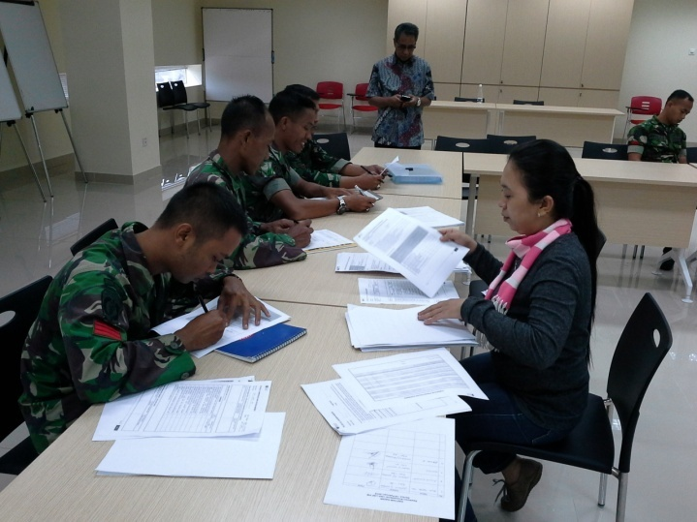
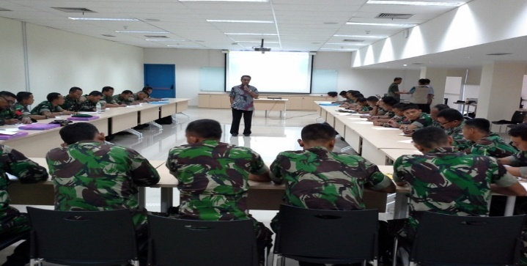
THANK YOU

