Slide 1
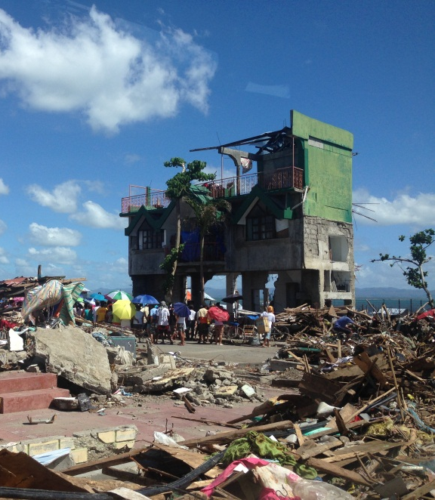
Commitments and the way forward
Disaster Law Commitments
Lucia Cipullo
Regional Disaster Law Delegate

Slide 2
True or False?
If you have a good disaster management law, your legal framework for DRR is complete?
Answer: False
Notes:
False – when it comes to DRR, this is a cross cutting issue which can be addressed not only in a national DM law, but also the relevant sectoral laws and regulations, such as building codes, land use plans, water management legislation etc.

Slide 3
True or False?
Can laws and regulations promote DRR and help make communities more resilient?
Answer: True – but how?

Slide 4
Making communities more resilient: role of Disaster Risk Management laws
DRM law
Makes DRR a national priority
Supporting DRR education and awareness
Allocate adequate resources at local level
Defining local roles and responsibilities
Notes:
IFRC and UNDP undertook research in 31 countries – should have the summary report in your packs.
Found that the overarching DRM law is essential for providing a legal basis which spells out DRR as a national priority - as was directed by the HFA.
Secondly, these laws are particularly important for establishing institutions and roles and responsibilities for disaster risk management, at the national level as well as the local level.
Thirdly, can allocated adequate resources to be spent at the local and community level.
And importantly, many of theses laws, have promoted better awareness and education on disaster risk reduction. For example, nineteen of the countries we reviewed require public authorities to conduct community education activities on DRR, seven require DRR to be part of the school curriculum, and a couple, such as Mexico and the Philippines, establish special training facilities for public sector workers.

Slide 5
True or False?
Were there any outcomes or commitments from the 6th AMCDRR regarding laws and legislation?
Answer: Yes – what do they say?

Slide 6
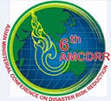
6th AMCDRR Outcomes and Commitments
Bangkok Declaration on DRR: encourages the development of and the enforcement of laws and regulations to reduce exposure to risk and enhance resilience at local levels
RCRC Statement of Voluntary Commitments:
To strengthen community-local govt. partnerships, legal frameworks and accountability mechanisms
Calls upon govt, private and public sector to ‘review and strengthen the implementation of legal frameworks to create an enabling environment for building community resilience’

Slide 7
True or False?
Do National Societies in South East Asia have any global commitments to advocate for stronger laws for DRR?
Answer: Yes

Slide 8
South East Asia Disaster Law Pledge
2011 International RCRC Conference: South East Asia National Societies made a joint pledge to strengthen disaster laws
Committed to:
review legal frameworks DRR and disaster response and support governments to develop improved legislation, policy and procedures
advise their governments on the development of legislation which empowers communities to become safer and more resilient through increased participation in DRR activities
32nd International Conference in 2015: opportunity to report on what you have been doing and further advocate (see snapshot)

Slide 9
True or False?
Do National Societies AND states in South East Asia have any global commitments (voluntary or binding) to advocate for stronger laws for DRR?
Answer: Yes

Slide 10
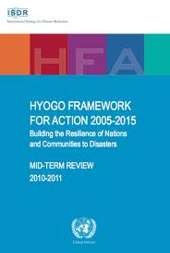
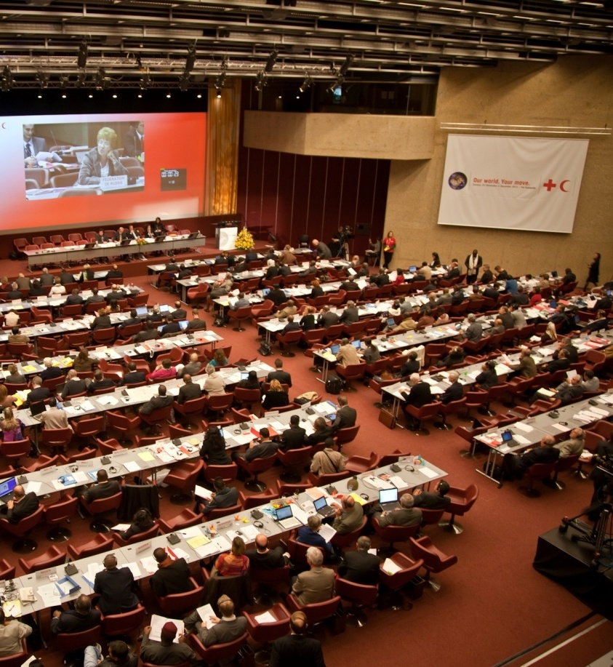
Global commitments
HFA Priority 1 – to make DRR a national and local priority through: “policy, legislative and institutional frameworks for disaster risk reduction”
Resolution 7 - International Conference of the RCRC in 2011: states, NS, IFRC, UNDP etc. to review and promote legal frameworks for DRR
Notes:
The Hyogo Framework for Action called for governments to make DRR a national and local priority through ‘legislative frameworks’. However, mid term reviews of the HFA found that implementation had been slow at the community level, with many gaps remaining. There was also a lack of clear information and analysis of the role of legislation, and precisely how it could be making DRR a priority at both the national and local levels.
2. In November 2011, state parties took up this issue at the 31st International Conference of the RCRC, adopting Resolution 7, which encouraged states, with support from the national RC societies, the IFRC, UNDP and other relevant partners to review existing legislative frameworks for disaster risk reduction.

Slide 11
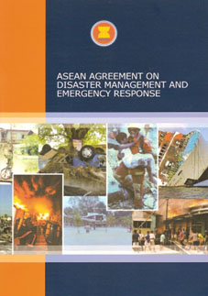
Regional Commitments
AADMER Agreement: binding agreement that provides regional cooperation mechanism for disaster management and response, including risk reduction
Governments in SEA must take legislative measures to implement the AADMER - NS can advocate for this and take part in this process
How?
Engage in the development of new laws
AADMER advocates programme
Advocate for better implementation at local level
Disseminate awareness about disaster risks and how laws address them

Slide 12
How to promote / develop better legal frameworks for DRR? We have the tools…
DRR Checklist and handbook to guide the review and development of laws and regulations for DRR
DRR and Law study – information and key findings about role of law in DRR
Notes:
When considering your planning and advocacy ideas, remember that there are tools that can help inform you and also guide your work (both NS and governments).

Slide 13
Group discussion
How does your NS/NDMO prepare for and engaged in these conferences? Do you have a particular strategy or approach?
How do you de-brief after these conferences, and how do you plan to implement the recommendations or resolutions at the country level?
How does your National Societies and NDMOs engage with each other as part of these events? Do you undertake any joint planning or de-briefing?
How can we bring the concerns of local communities to these forums and ensure their needs/concerns are represented?
Does your National Society encourage youth or volunteers to participate?

