Slide 1
Resilience
Commitments and Way Forward
Indira Kulenovic, APZ DMU Resilience Coordinator

Slide 2
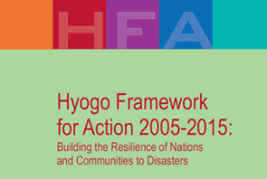
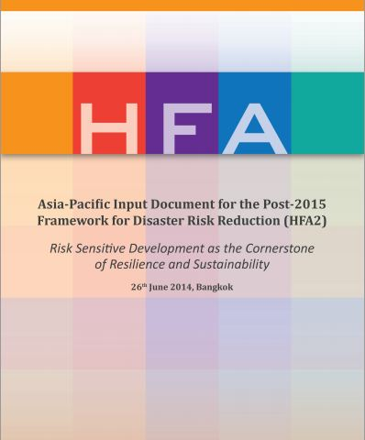
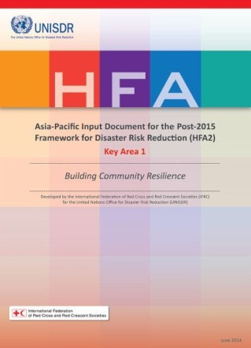
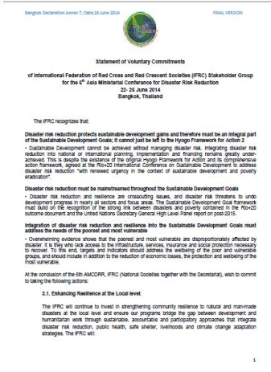
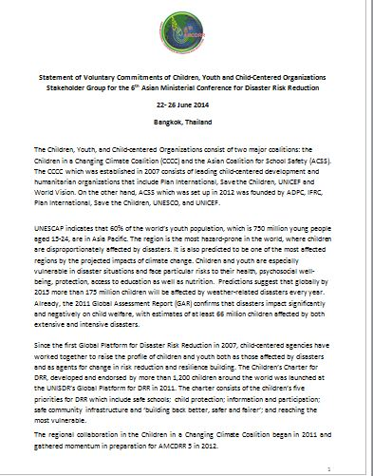
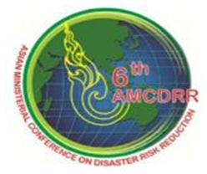
Global Commitments & Regional Inputs
AP Input
Document
For HFA2
Building
Community
Resilience
RCRC
COMMITTMENTS
Youth & Children
COMMITTMENTS

Slide 3
RCRC Commitments at the 6th AMCDRR
The IFRC committed to continue to invest in strengthening community resilience to natural and man-made disasters at the local level and ensure our programs bridge the gap between development and humanitarian work through sustainable, accountable and participatory approaches that integrate disaster risk reduction, public health, safe shelter, livelihoods and climate change adaptation strategies
Input Paper

Slide 4
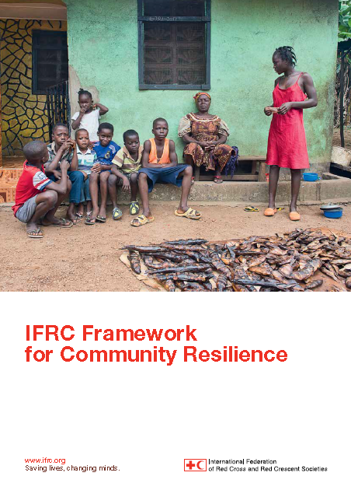
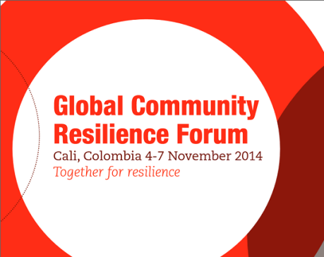
Global Commitments (Nov 2014, Cali)
IFRC Framework for Community Resilience
Key principle objective to:
“Establish a foundation on which all
IFRC programmes, projects, interventions
and actions, across the contexts, which
contribute to the strengthening community resilience can be created,
developed and sustained.’”
One Billion
Coalition
for
Resilience

Slide 5
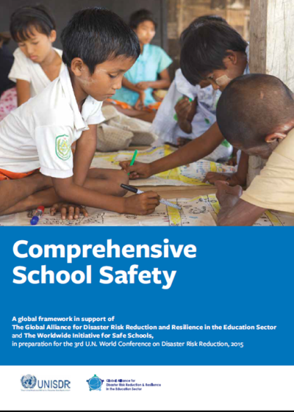
Global Commitments Regional Inputs

Slide 6
Asia Pacific Conference, Beijing (Oct 2014)
Call for Innovation
Youth Commitments to engage in DRR and School Safety

Slide 7
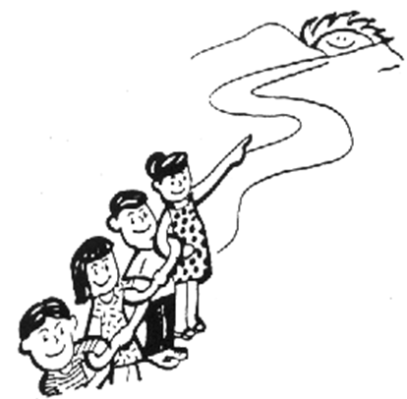
Way Forward
Implementation of commitments
(specifically those related to our region such as RCRC/Children & Youth Voluntary Statement of Commitments – 6th AMCDRR, Beijing Declaration and Commitments, Global Framework on Community Resilience – unpacking and adaptation to regional, national, community level, Comprehensive School Safety Framework…)
Synchronization, alignments and
(i.e: HNSs, CDs, RD, PNSs planning alignment to ensure complementarities in implementation of commitments, maximum utilization of resources available and scaled up impact)
Multi-stakeholders Partnerships

