Slide 1

Process Related Case Study of
Community Flood Resilience Program
PMI – IFRC – Zurich Insurance

Slide 2
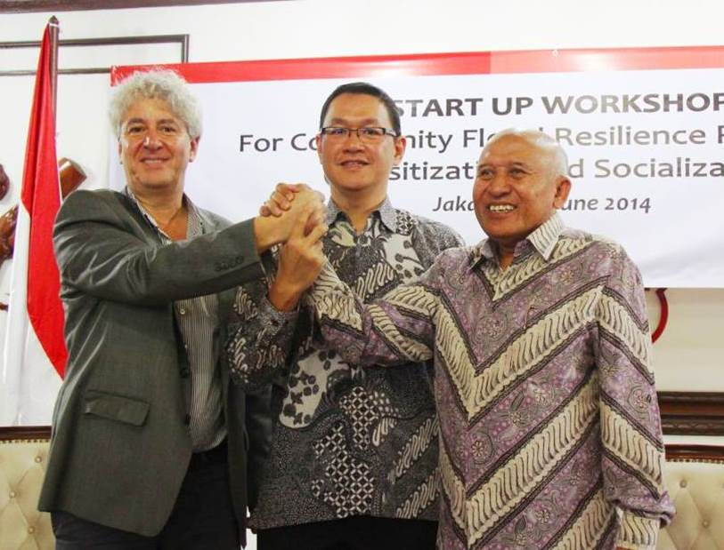
Vision:
A Partnership between PMI, IFRC and Zurich Insurance to provide the best effective model for the implementation of a Community Flood Resilience Project. The partnership aims to effectively reduce the risk of flood and enhance overall resilience of vulnerable communities along 3 targeted rivers.

Slide 3
The Objectives
Increasing the safer and resilience of communities such that their knowledge and coping mechanisms are increased.
Increasing the effectively of solution for disaster risk reduction efforts
Influence policy makers and donors on disaster risk reduction policies.

Slide 4
Basic Foundation
Partnership based on mutual trust, based on shared values and purpose, that combines risk expertise of Zurich Insurance and long experience of IFRC and PMI in community programming.
Strong relationship at the HQ and local levels
Everyone contributes the best. All partners contribute in the areas they are good at, and dedicate fully the agreed time and resources to manage the partnership and project effectively.

Slide 5
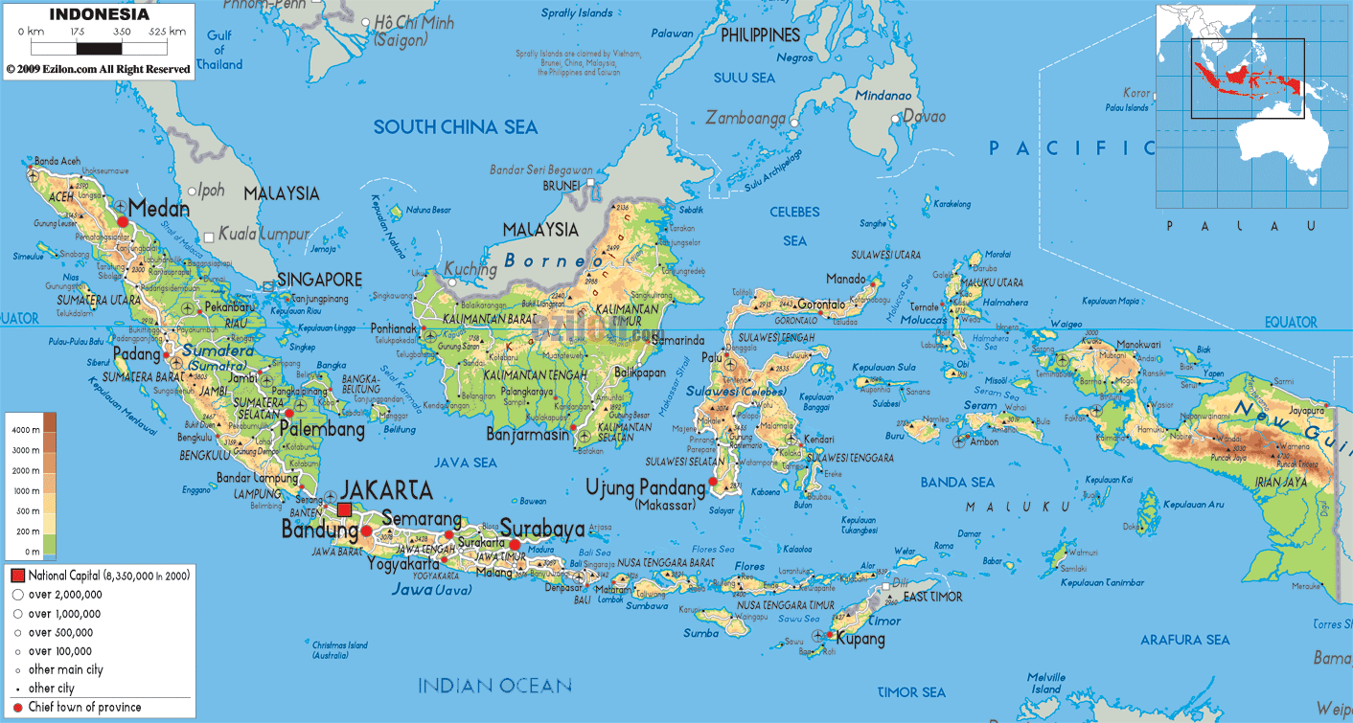

Slide 6
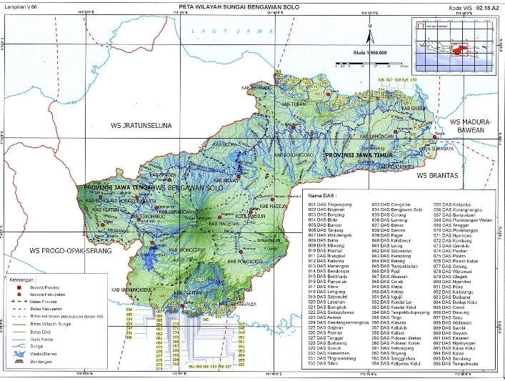
Community Flood Resilience Based on River Flow
Innovation & Solution > 1 River: 1 Planning and 1 management
1 Structure of CFR
1 Contingency Plan
1 Community Based Early Warning System
1 Platform
1 Advocacy, Socialization and Dissemination Effort
1 Road Map
Integrated Tools – Baseline Survey, VCA, Mapping of Risk, hazard, vulnerability, and Capacity
Integrating DRR and CCA for Mitigation Efforts

Slide 7
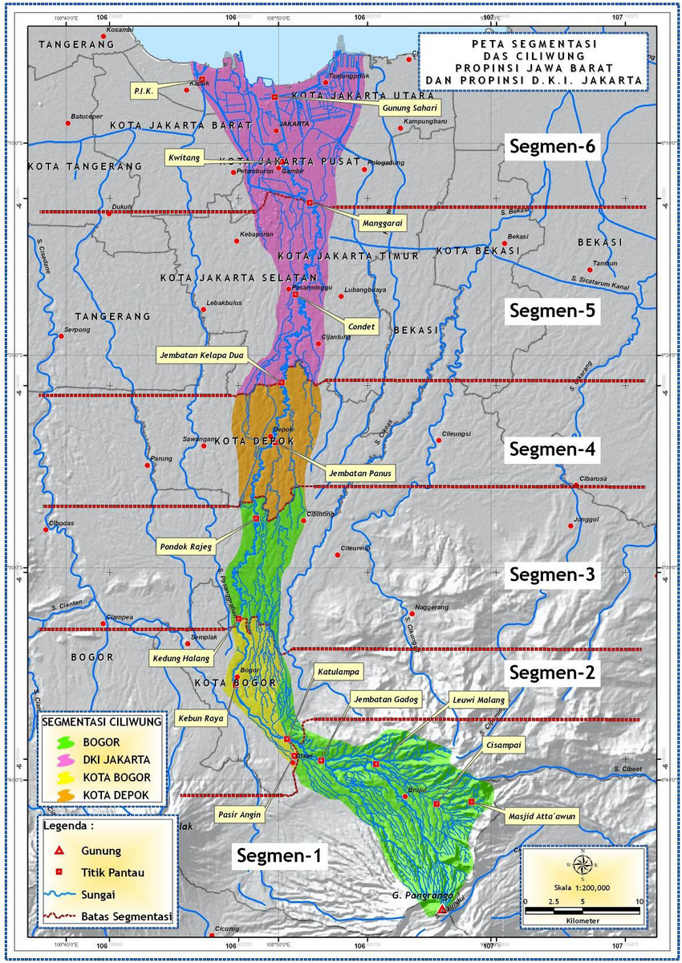
Program Area
1. CILIWUNG RIVER
Downstream
JAKARTA Province
SOUTH JAKARTA District
Upstream
WEST JAVA Province
BOGOR District

Slide 8
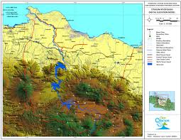

Program Area
2. CITARUM RIVER
WEST JAVA Province
KARAWANG District
UPSTREAM
WEST JAVA Province
Bandung District

Slide 9
Program Area
3. BENGAWAN SOLO River
DOWNSTREAM
EAST JAVA Province
Bojonegoro District
MIDDLESTREAM
CENTRAL JAVA Province
SOLO District
UPSTREAM
CENTRAL JAVA
Wonogiri District

Slide 10
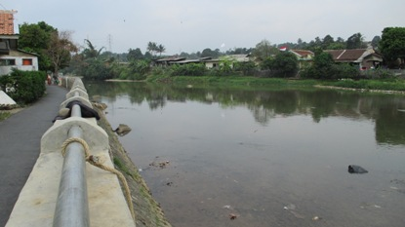
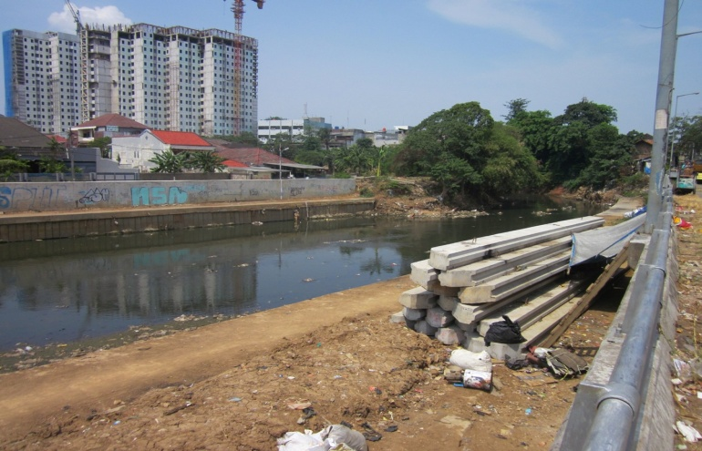
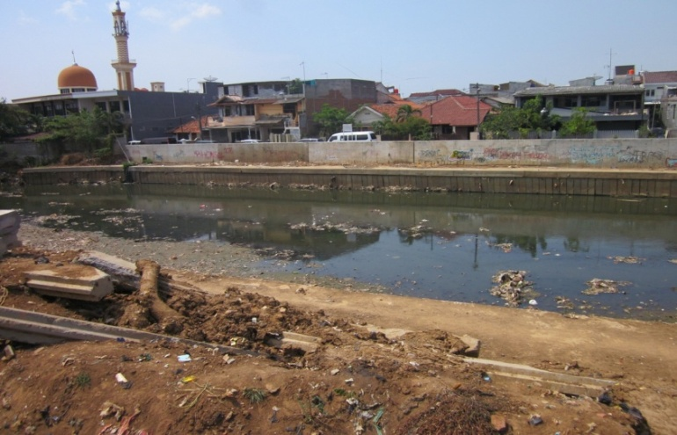
Program Overview:
Project covers:
Three rivers: Ciliwung, Citarum & Bengawan Solo
  4 Provinces
    7 Districts
      21 Communities

Slide 11
Strategy and Approach
Partnership
Mutual Trust
Advocacy
Developing Capacity
Community Empowerment
Participative
Suistanibility
5 Capital for CFR
Human Resource
Financial
Social
Physical
Environment & Natural Reources

Slide 12
Recruitment and CBAT Training
KAP & Baseline Survey
VCA
Flood Resilience Mitigation Planning
Mitigation to Reduce Risk
HVCR Mapping
Endline Survey
Supervision and Monitoring
Promotion
Reporting and Updated Progress Achievement
Volunteer Mobilization
Advocation

Slide 13
Time Frame
5 Years Duration
6 Month
12 Month
18 Month
24 Month
30 Month>>
5
Monitoring, Supervision, Evaluation and Sustainibility
4
CFR efforts.
3
Promotion and Working Plan advocacy for Community and Local Government
VCA, Baseline, Risk Mapping, Participatory Planning
2
1
Preparation, Dev document, recruitment, etc…
Partnership,. Advocacy, Socialixzation, Sensitize and Gather the Mutual Trust

Slide 14
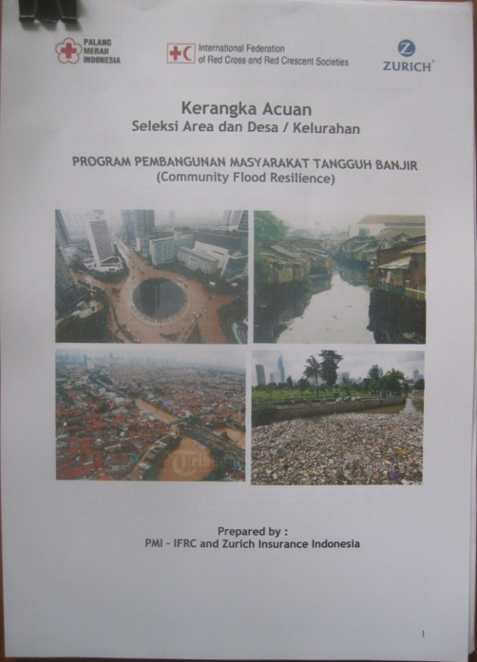

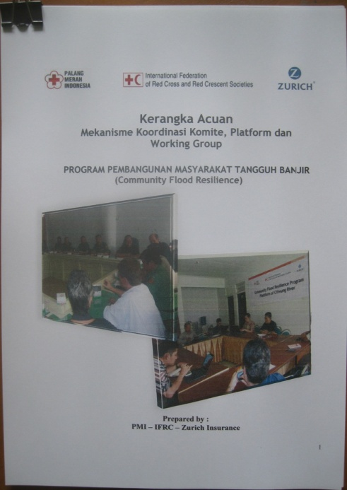
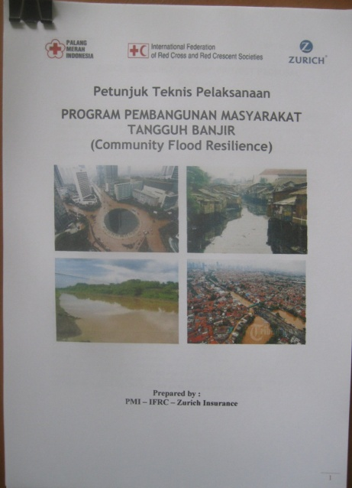
Achievements
Integrated methodologies, guidelines and tools have developed and prepared.
  Basic conceptual framework on resilience
  Operational guideline of CFR
  Guidelines for fund transfer and reporting
  Guidelines for Setting up CFR Platform and Working Group
  ToR for Selection area
Notes:
Similar to other software GIS systems QGIS allows users to create maps with many layers using different map projections. Maps can be assembled in different formats and for different uses. QGIS allows maps to be composed of raster or vector layers. Typical for this kind of software the vector data is stored as either point, line, or polygon-feature. Different kinds of raster images are supported and the software can perform georeferencing of images.
QGIS runs on multiple operating systems including Mac OS X, Linux, UNIX, and Microsoft Windows. For Mac users, the advantage of QGIS over GRASS GIS is that it does not require the X11 windowing system in order to run, and the interface is much cleaner and faster. QGIS can also be used as a graphical user interface to GRASS. QGIS has a small file size compared to commercial GIS's and requires less RAM and processing power; hence it can be used on older hardware or running simultaneously with other applications where CPU power may be limited.^{[citation needed]}

Slide 15
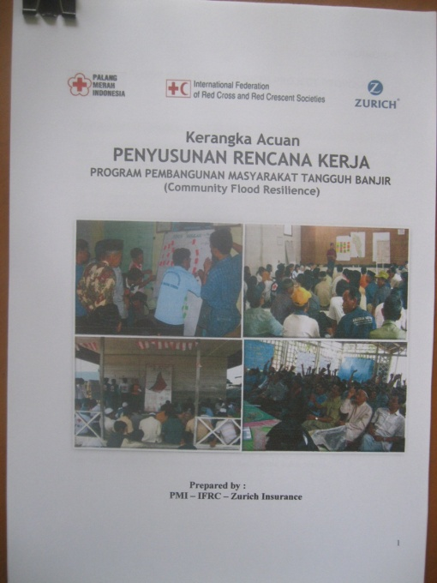
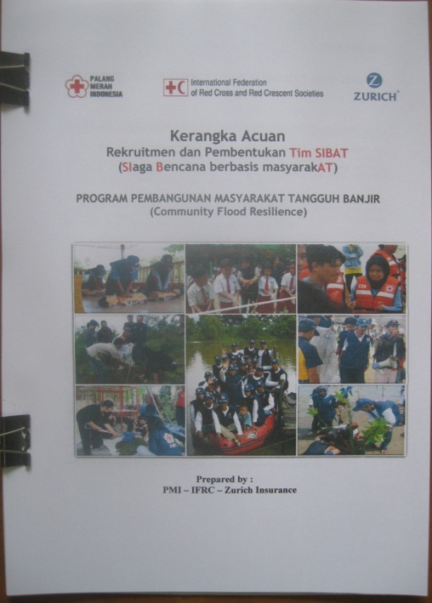
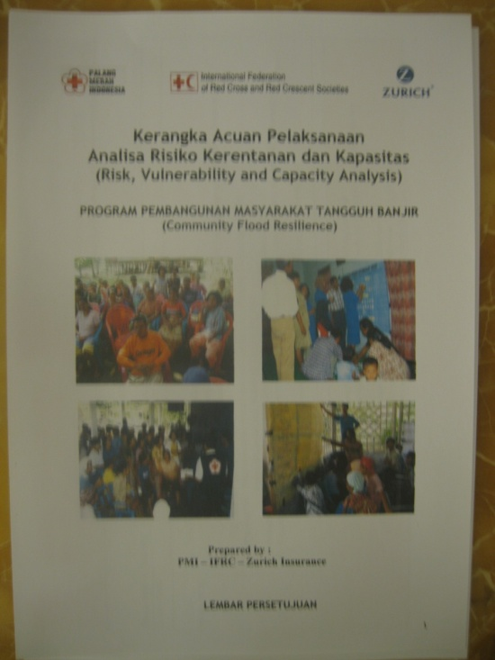
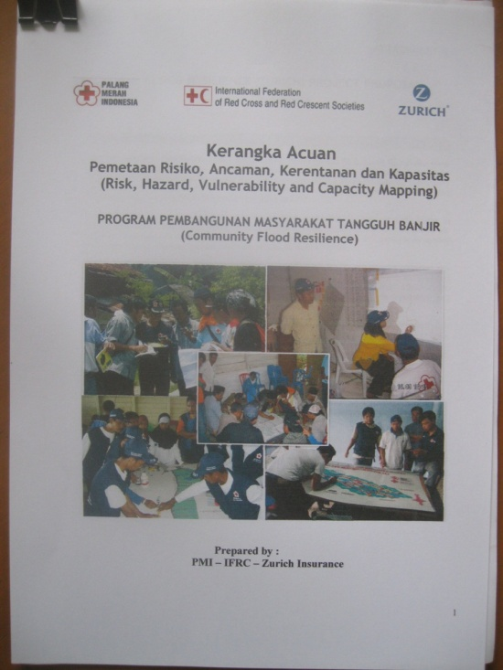
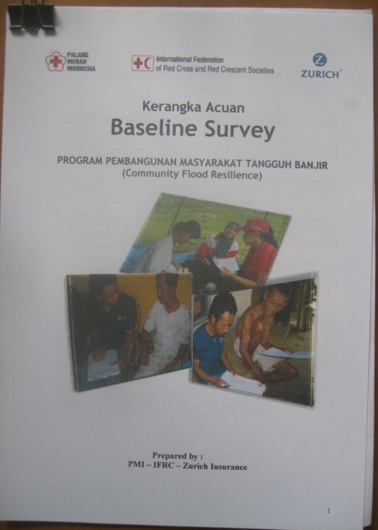
Achievements
Integrated methodologies, guidelines and tools have developed.
  ToR for CBAT Recruitment and Management
  ToR for Baseline
  ToR for VCA
  ToR for Risk Mapping
  ToR for Integrated Planning for CFR at community
Notes:
Similar to other software GIS systems QGIS allows users to create maps with many layers using different map projections. Maps can be assembled in different formats and for different uses. QGIS allows maps to be composed of raster or vector layers. Typical for this kind of software the vector data is stored as either point, line, or polygon-feature. Different kinds of raster images are supported and the software can perform georeferencing of images.
QGIS runs on multiple operating systems including Mac OS X, Linux, UNIX, and Microsoft Windows. For Mac users, the advantage of QGIS over GRASS GIS is that it does not require the X11 windowing system in order to run, and the interface is much cleaner and faster. QGIS can also be used as a graphical user interface to GRASS. QGIS has a small file size compared to commercial GIS's and requires less RAM and processing power; hence it can be used on older hardware or running simultaneously with other applications where CPU power may be limited.^{[citation needed]}

Slide 16
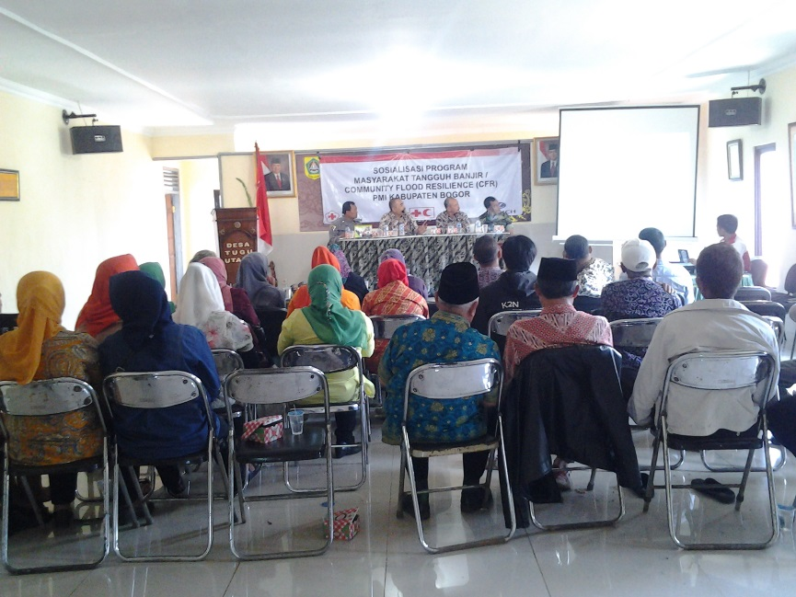
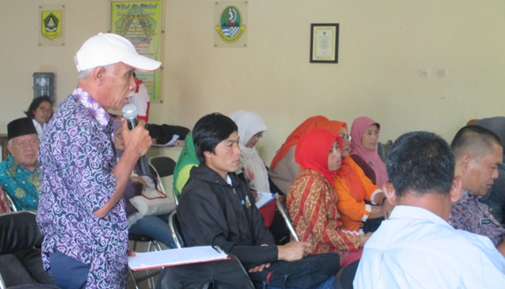
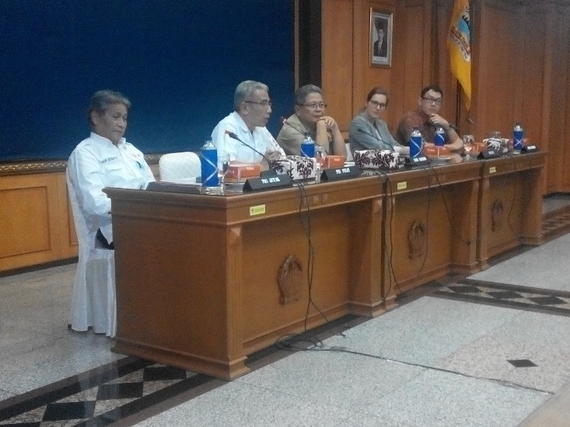
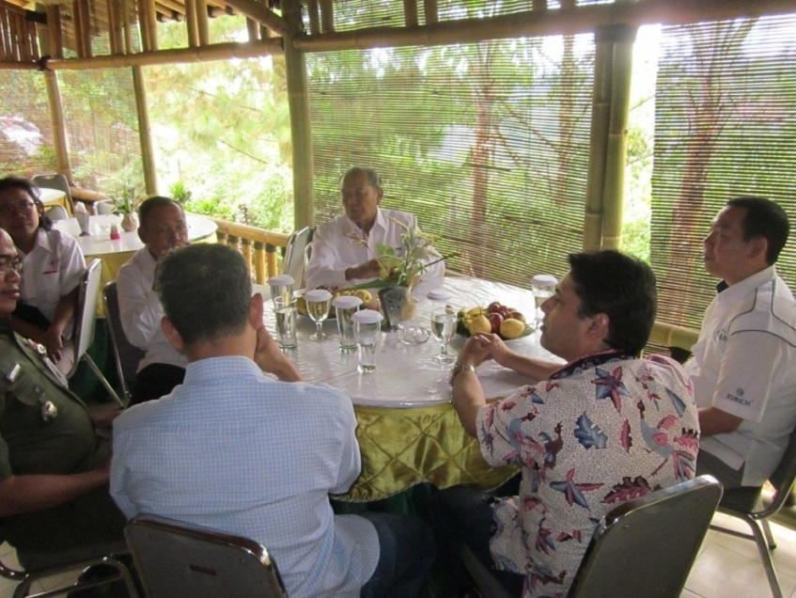
Achievements
Socialization and Advocacy of CFR Program

Slide 17
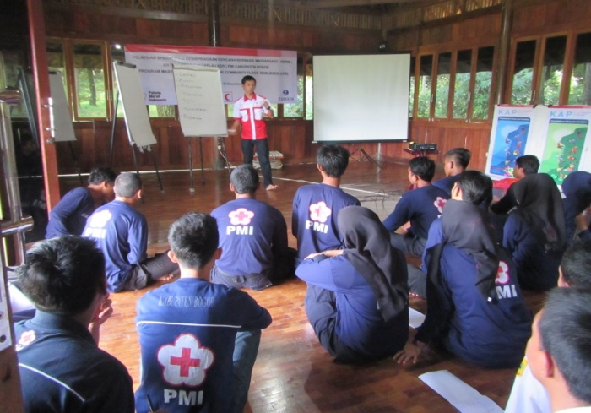
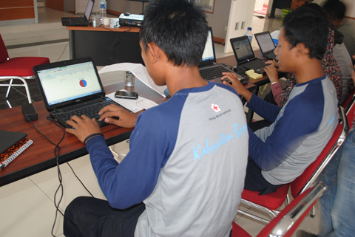
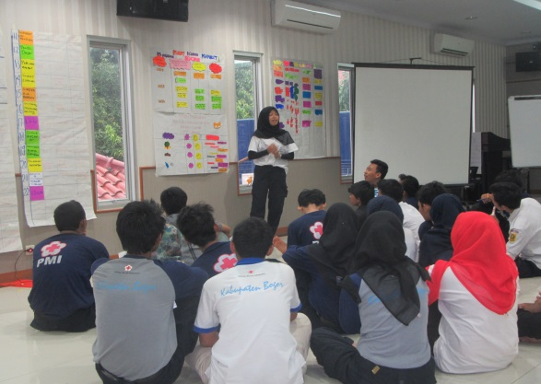
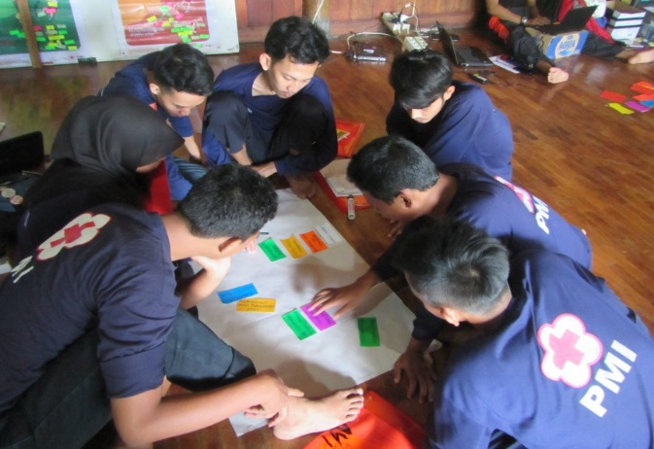
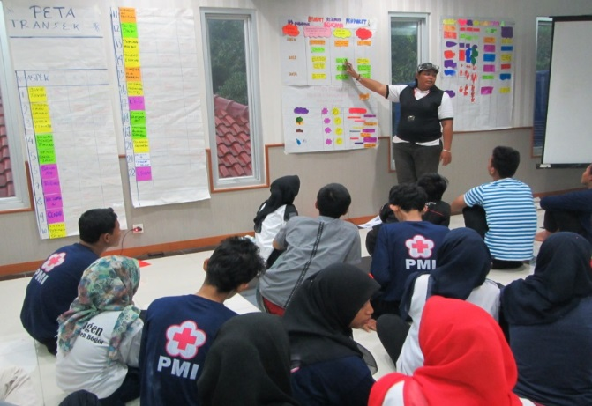
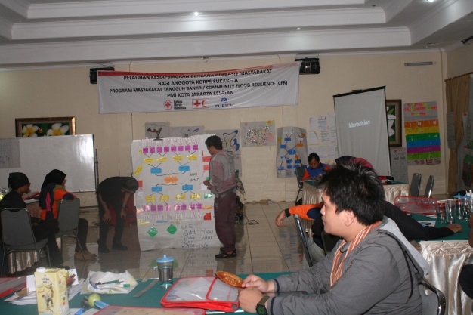
Achievements
KSR & SIBAT
Trainings & Orientation

Slide 18
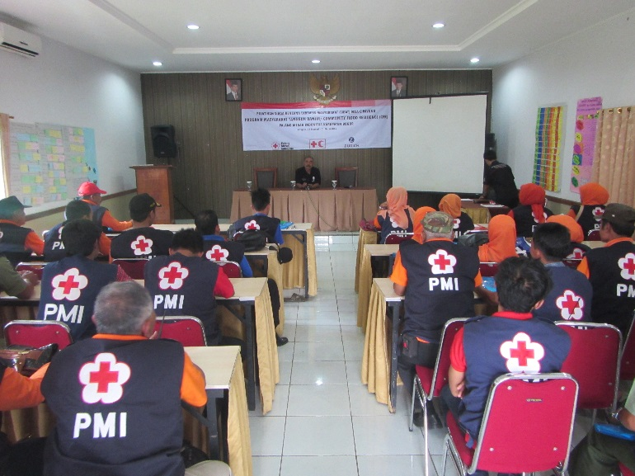
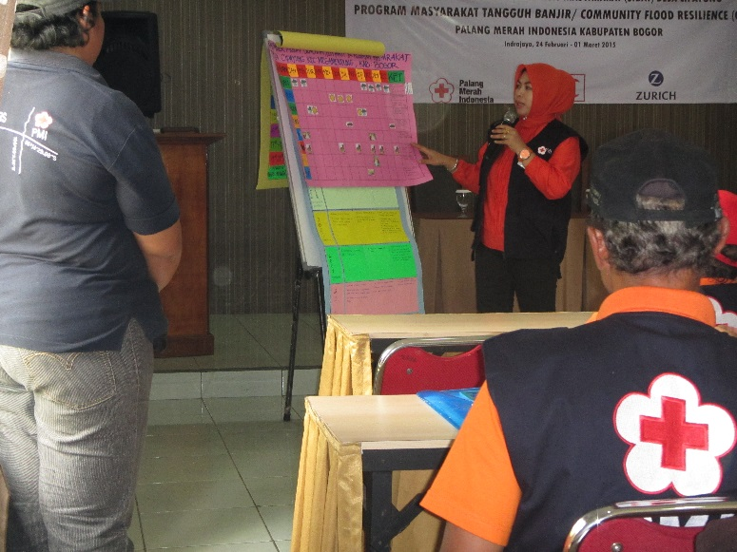
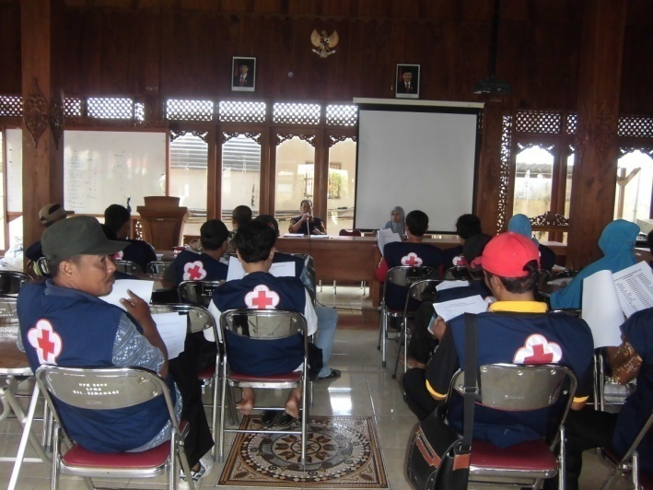
Achievements
Selection, Recruitment and Training for Community Based Action Team Member (CBAT)

Slide 19
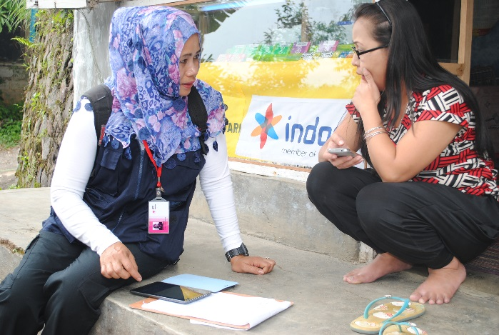
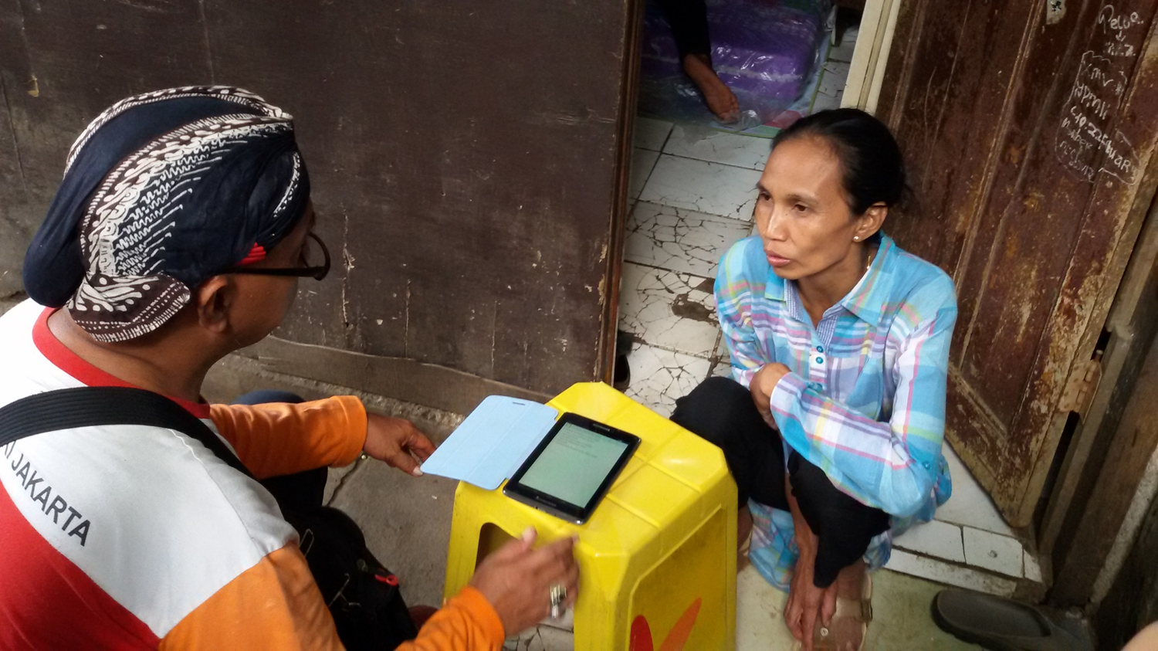
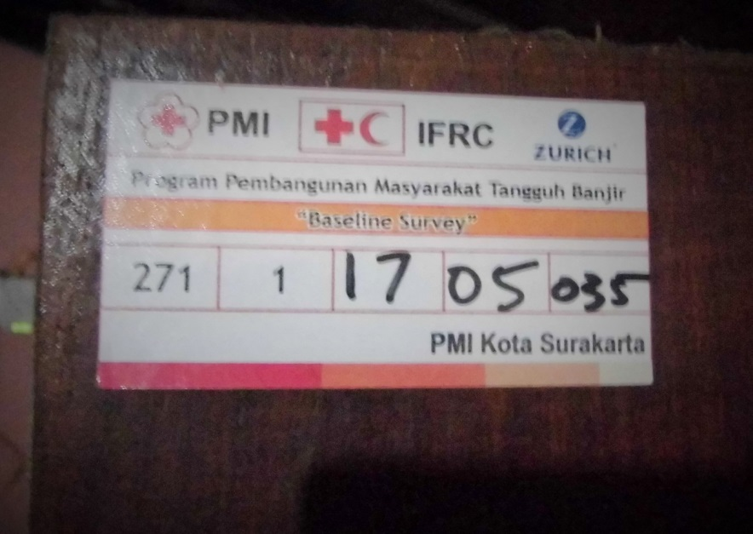
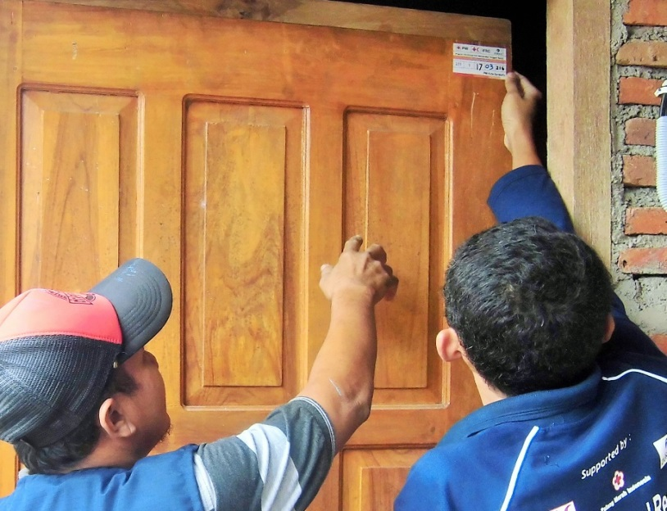
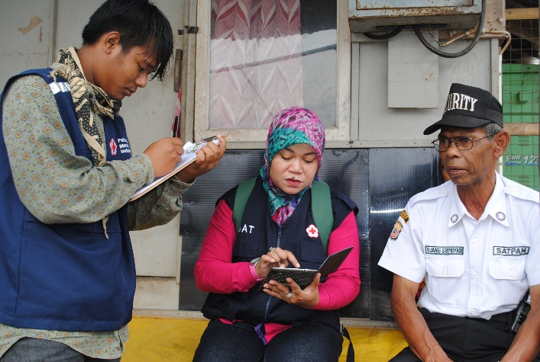
Achievements
KAP & Baseline Survey

Slide 20
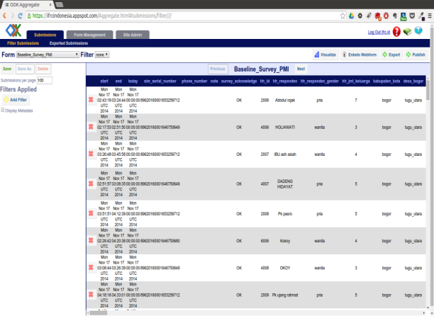
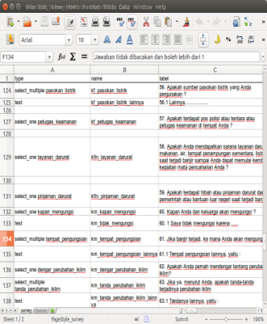
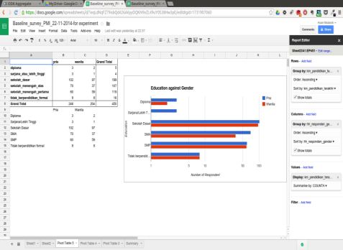
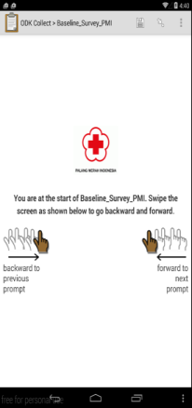
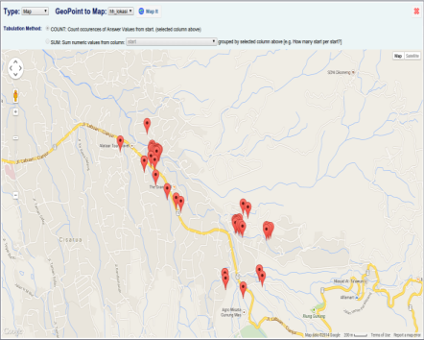
Illustration of ODK app for Baselines Survey
(ODK Aggregate/Google)
Disain Template Formulir
(Calc, Excel, Spreadsheet)
Download Formulir
Survey
Visualisasi hasil survey dan analisa lanjutan
Input data dari lapangan ke server
(Calc, Excel, Spreadsheet or ODK Aggregat)
(ODK Collect/Andorid Tablet)

Slide 21
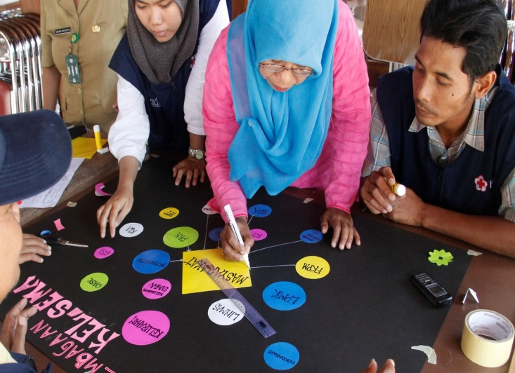
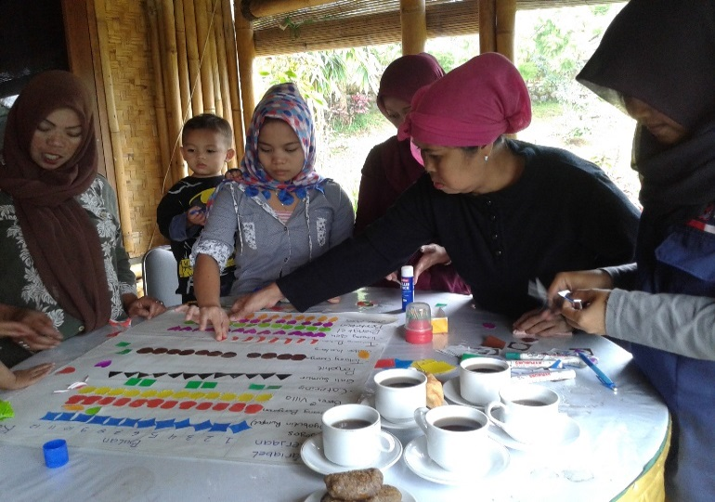
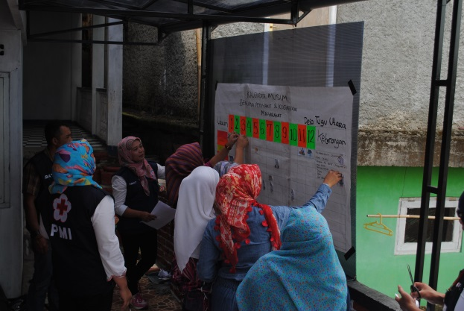
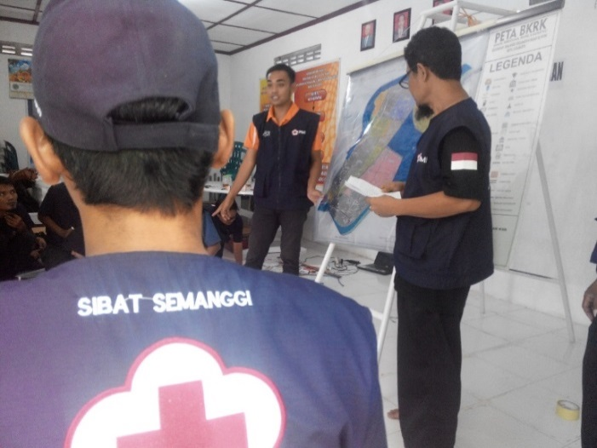
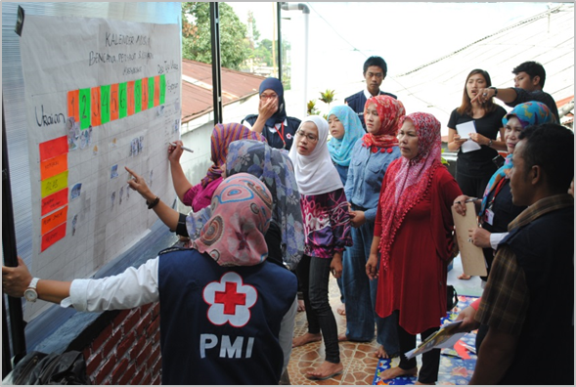
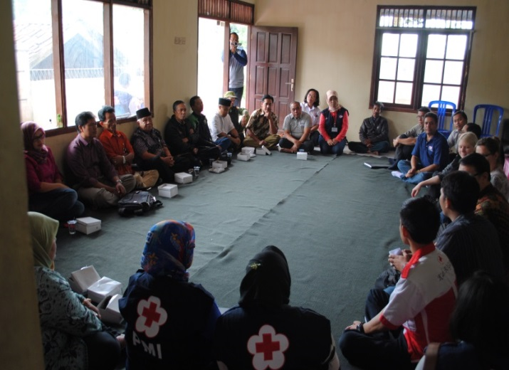
Achievements
VCA / PRA

Slide 22
Risk Mapping
Mapping use ODK App and linked into JOSM, QGIS and InaSAFE.
Retrieving data using the walking paper / paper field, form data and GPS.
JOSM as a data entry application, QGIS as application processing / analysis of data from the data in JOSM and Baseline data.
InaSAFE a plugin in QGIS to get an overview of the scenario or what actions can be taken during a disaster.

Slide 23
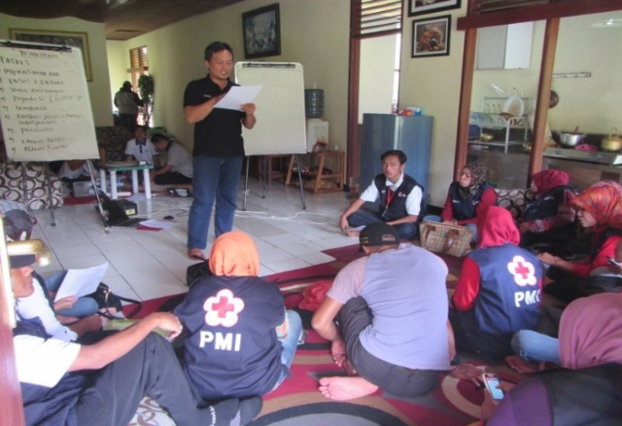
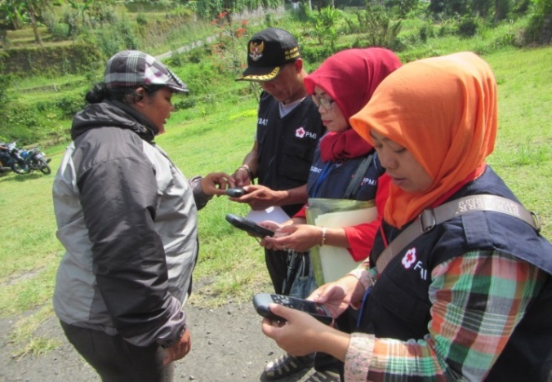
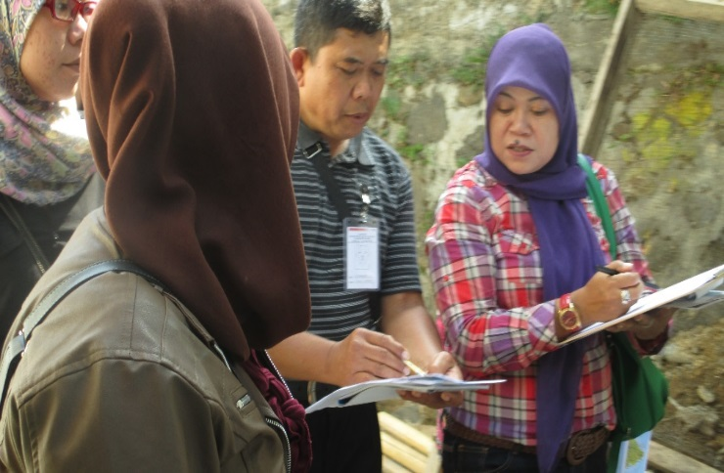
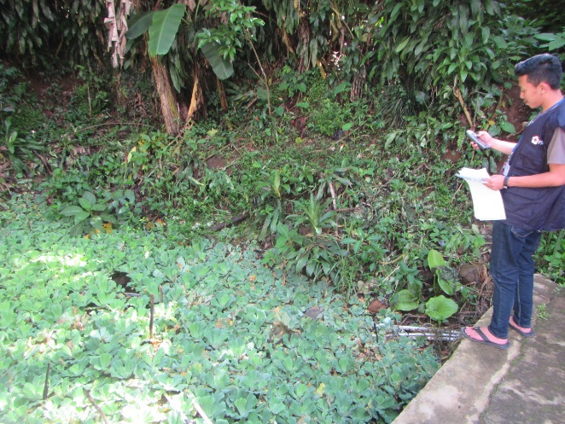
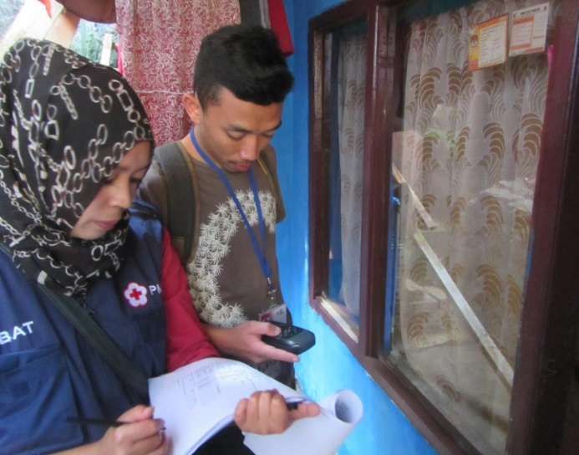

Achievements
Risk Mapping

Slide 24






Achievements
Risk Mapping

Slide 25






District/Area
NHQ/Province
Field Paper
ID Number|Register ID
GIS USER
Analisa Data
Decided the survey location
JOSM – Taging Data.Decided the location for survey
PIC NHQ– DM Div
Database Administrator – Unit IT
Analis – Danang Agud
Data Collector – Guthfan, Lala, Nuri, Menir, Kusumo
Tech Advisor – Agus Sugiharto
ODK – Load data
Map
Other USER
Management USER

Slide 26


Risk Map ready to used as RR plan tool.

Slide 27


Achievements
CFR Planning for Mitigation

Slide 28



Achievements
Support the utilization of Mobile Rapid Assessment Development and Hazard Application.
Train CFR SIBAT as key user of MRA and Hazard application
Notes:
Similar to other software GIS systems QGIS allows users to create maps with many layers using different map projections. Maps can be assembled in different formats and for different uses. QGIS allows maps to be composed of raster or vector layers. Typical for this kind of software the vector data is stored as either point, line, or polygon-feature. Different kinds of raster images are supported and the software can perform georeferencing of images.
QGIS runs on multiple operating systems including Mac OS X, Linux, UNIX, and Microsoft Windows. For Mac users, the advantage of QGIS over GRASS GIS is that it does not require the X11 windowing system in order to run, and the interface is much cleaner and faster. QGIS can also be used as a graphical user interface to GRASS. QGIS has a small file size compared to commercial GIS's and requires less RAM and processing power; hence it can be used on older hardware or running simultaneously with other applications where CPU power may be limited.^{[citation needed]}

Slide 29



Achievements
Other Activities Still Related on The Implementation of CFR Program
Outbond Top exercise
River Platform Forum

Slide 30



Achievements
Other Activities Still Related on The Implementation of CFR Program
Designed Draft For River Based Contingency Plan and SOP

Slide 31


Advocacy at all level

Slide 32



Advocacy at all level

Slide 33
What’s Next?
Design mitigation projects and implementation
Develop river based Contingency Plan at regional level
Established Radio Broadcasting for Community Resilience Promotion,
Developing and upgrading MRA 2.
Created a New Apps based on Android System for Flood Early Warning (working with Bandung Technology Institute).
Strengthen the National, Provincial and Local Platform and Road Map on Flood Management
Advocacy to National Government on implementation of Village Law for DRR financing in village level and also advocacy into Local Government to Release the Local Regulation (PERDES).
Mobilize the CBATs member into any other events
Simulation exercises, TTX or Drill based on the targeted rivers.
Flood Resilience promotion eg Produce video, Talkshow via National Television,

Slide 34
Constraints and Challenging
Open Data Kit, an android based survey application, is newly introduced into this program so needs more training to volunteers on this.
Developing innovating ideas and tools for flood risk reduction and community resilience.
Need more guidance and support from Zurich Insurance for the Risk Grading analysis.
Diversified communities with different and distinct characteristics (upstream, downstream, urban, rural, etc.).

Slide 35

Thank You

