Slide 1
Regional Health Meeting 28 – 29 October Bangkok

Slide 2
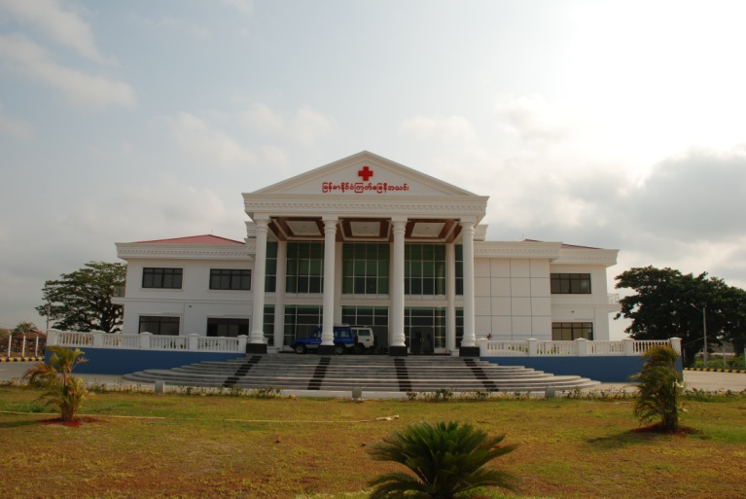
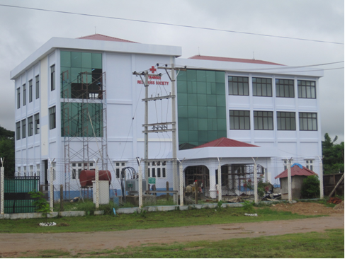
Health Projects
( 1 ) CBHFA ( 11 Tsp ) (HKRC, SRC, FRC)
( 2 ) CBHR ( 2 Tsp ) (Australian RC)
( 3 ) CBHR ( WASH ) ( 2 Tsp ) (Australian RC)
(4 ) CB (WASH ) ( 4 Tsp ) (IFRC)
( 5 ) Strengthening ERT (9 Reg.) (IFRC)
( 6 ) CB ( WASH ) ( 2 Tsp ) (French & Cana. RC)
( 7 ) CBHD – MNCH ( 4 Tsp ) (Consortium)
( 8 ) 3 MDG – MNCH ( 2 Tsp ) (Consortium)
( 9 ) CBHD – MNCH (1 Tsp )( EU , DRC, Austrian RC)
M R C S
( 10 ) CBHD – HIV ( 5 Tsp ) (DRC)
( 11 ) VNRBDP (9 State /R ) (IFRC)
( 12 ) PMCT - HIV (5 Tsp ) (UNICEF)
( 13 ) TB ( 15 Tsp ) ( WHO )
( 14 ) CB TB Prevention (1 Tsp ) ( MRCS)
( 15 ) Orthopedic Rehab. ( 5 S/R ) ( ICRC )
( 16 ) Malaria Prevention (10 Tsp) (UNOPS)
( 17 ) SRH (6 S/R ) ( UNFPA )
( 18 ) CB- CPP ( 6 Tsp) ( UNICEF )
IFRC & PNS

Slide 3
Health and Care Priorities
( a ) CBHD and Disease Prevention
( b ) VBDRP
( c ) FA & SS
( d ) H - ORC Rehabilitation
( e ) MNCH
( f ) Public Health Emergency and WASH

Slide 4
Key Achievements
( a ) Review & Revised strategic Plan
( b ) Pop. Reached ( 1,067,961 )
( c ) Well established PLHIV Self Help Group ( 3 + 17 ) Groups
( d ) New FA Post at the 115 miles Rest Camp ( RTA ) Open Feb. 2013
Accident (98), Injured (342), Referral (198), Dead bodies (48)
( e ) Support to Child Soldiers & Mine victims (64+3/ 100+25 ) 500 $/case
( f ) Gov. , Local Authority & Community ‘s trust
( g ) Community Based Bottom up Approach ( CBHFA )

Slide 5
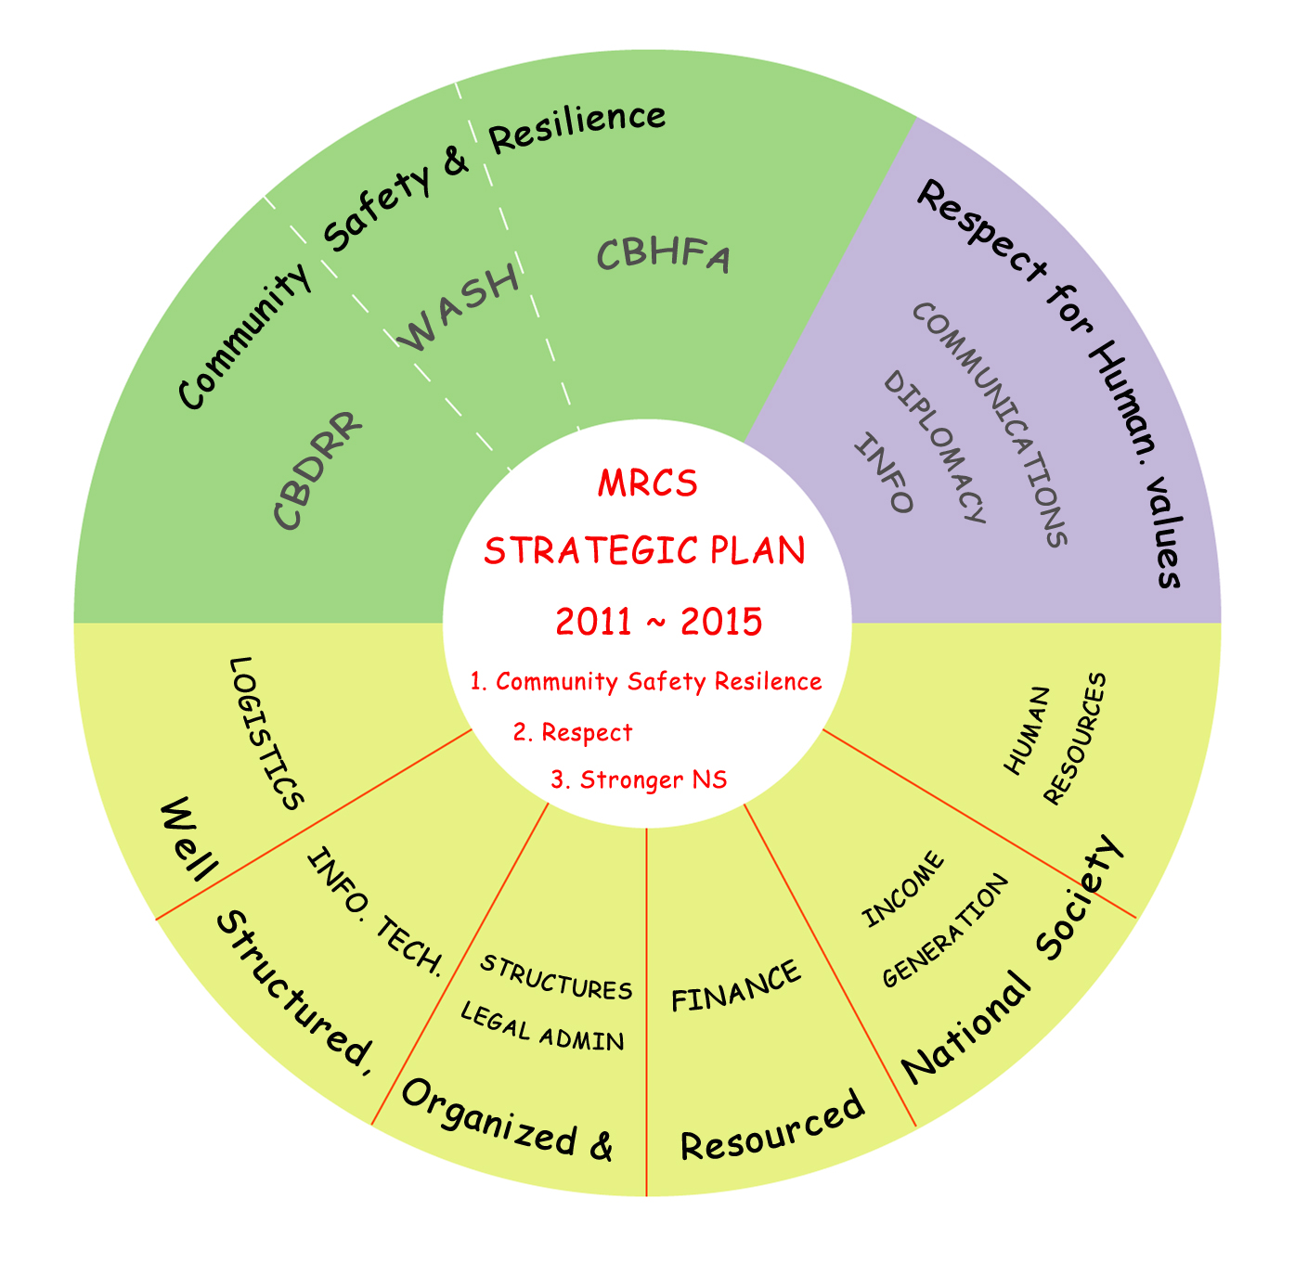
balance
operating
supporting
Sustainability ?

Slide 6
Key Challenges
( a ) Staff turn over ( NayPyiTaw – Salary )
( b ) Shortage of CBHFA Master Facilitators
( c ) PMER ( Staff & RCV Capacity building )
( d ) No. of active trainers ( FASS ) are very few ( Well
trained RCVs moved to other INGOs & NGOs )
(e ) Safety for Staff & RCVs

Slide 7
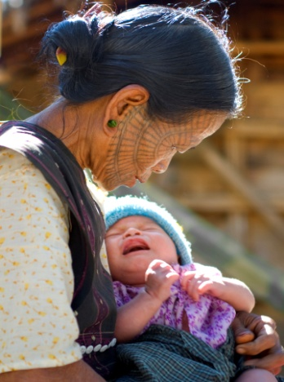
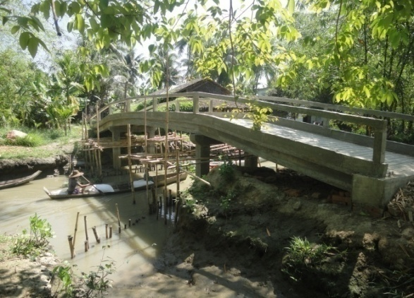
Future Direction
( a ) Common CB Approach
( b ) Inclusion of NCD, Disability, EPP & Violence prevention in CBHFA
( c ) CBHD Focused on MNCH
( d ) CB WASH Programme ( To establish strong WATSAN Unit )
( e ) To extend CBHFA Project, 2 Tsp per year to CBHFA non
implemented States & Regions
( f ) New FA Post at the Meiktila Rest Camp in the middle of NPT to
MDY
( g ) Commercial First Aid

Slide 8
Key Steps in CCB App.
Start Up
3 M / 1 M
Handover to community
Coordination with different divisions ,
Sensitization and advocacy
Training of Facilitators,
Organization of Committees
Branch Capacity Assessment
and Support
MRCS branch support to community
Community Initiatives and Ownership
Monitoring, Regular Meeting ,
Review , Evaluation
Start of Community Immersion
1 M
Reporting, Feedback, Lessons Learned, Conduct Endline survey and Evaluation
Initial community assessment, Identification of priority areas, Identification and Training of CVL, CV Promotion of humanitarian values
Community Initiatives
Resource Mobilization - 2 M mont Month
Baseline Survey and Community Need Assessment
3 M
Health Promotion, Prevention
Control of CD , NCDs ,
WatSan, DRR,
First Aid and Disability inclusion
Community Action Planning –
3 M
Discussion on assessment results with the community Draw plan of action

Slide 9
Water & Sanitation Unit, MRCS
WatSan/HP Manager
WASH Thematic Group
IFRC Technical and Managerial support
Emergency Structure
Wat / San Unit Structure
Project Coordinator and supported by FRC
WatSan ERT Coordinator
Hygiene Promotion Officer
WatSan officer
(Technical Support)
WatSan officer
(CBHFA)
Admin and Finance officer
HP Promotor
WatSan officer supported by ARC
WatSan ERE Officer
WatSan ERE Technician
4 Br. WASH Officers
Watsan officer supported by DRC
WatSan ERT Focal Person s- 6 states/region
Project officer By FRC
Red Cross / Community Vol. Leaders
Community Volunteers
Annual Appeal
DDA - external Technical Support
PNS Programmes

Slide 10
Support need from IFRC
( a ) CBHFA Master Facilitator including NCD Training
( b ) Standardization & harmonization of simple PMER Tools
( c ) CCA Training for Health
( d ) Emergency Health including PHiE Training
( e ) CSR Training
( f ) Donors for VBDRP , HIV Projects & New FA Posts ( RTA )

Slide 11
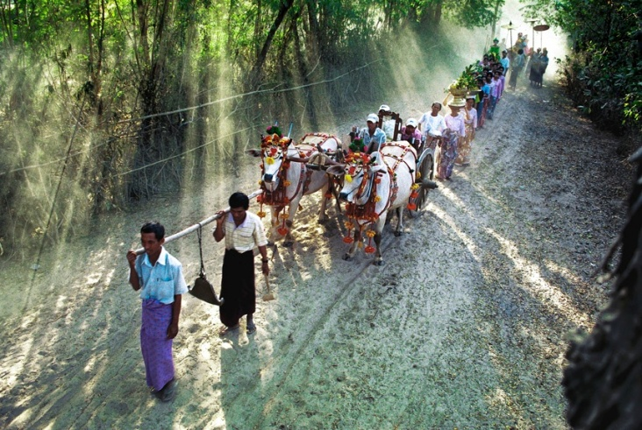
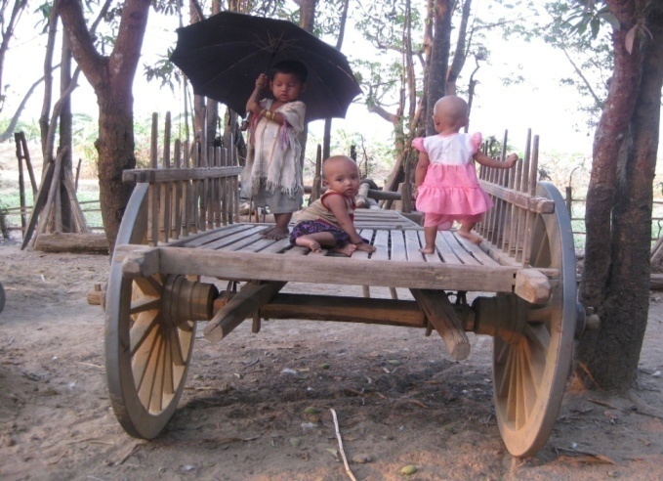
Travel on
a Road to Resilience
in
Southeast Asia……..
THANK YOU

