Slide 1
Indonesian Red Cross
Regional Health Meeting
Bangkok, 28-29 October 2013

Slide 2
Health and Care Priorities Indonesian Red Cross
Health in Emergency and Water Sanitation | Public Health | Social Services
Ambulance and First Aid Standardization Replenishment of Water sanitation Equipment Updating Preparedness and Contingency Plan for Epidemic Epidemic Response | CBHFA as entry point approach for community based program Adaptation Healthy lifestyle and Non Communicable Diseases workplace, Community based and school program) HIV AIDS prevention, anti stigma & discrimination | Psychosocial Support Program (PSP) Home based Care Social Services for most vulnerable people (people with disability, elderly, PLWHA)

Slide 3
Key Achievement 2013
Health Division | Drafted Strategic Planning for Health and Social Services 2014-2018
Health in Emergency sub div | Refresh training for77 First Aid Trainer, (12 Certified at National Level) Ambulance online survey capacity for all 33 province Sensitization Health Care in Danger in Headquarter & Papua, Draft HCiD with Ministry of Health, Develop Contingency Plan for Conflict integration with DM Sanitation and hygiene promotion training for 60 volunteers Clean Water Distribution during emergency: 7.593.075 liter for 143.959 Household in 22 District in 7 Province
Public Health Sub div | CBHFA: Reaching 33 villages, 60 district facilitator trained, 231 village committee and training for 760 village volunteers, providing 2.550 ceramic filter for household water treatment, Reaching 854.152 population Translation for Adaptation Healthy Lifestyle & NCD Module and toolkit HIV /AIDS: 30 Trained Core facilitator, Reach 150 Peer educator, 2.460 Peer in Bali. Reach 3000 student in East Jakarta trough Dance For Life HIV prevention program Pandemic Preparedness: 20 Facilitator Healthy market, Outreach 20 Healthy Market in 2 Province and 10 distirct
Social Services Sub div | Psychosocial Support: refresh training for 17 PSP trainer, specialization training for 19 people from province 80 Cataract surgery 239 Glasses distribution for student in West Java Home based care

Slide 4
Key Challenges
Bureaucracy (internal/ external)
Fund raising for sustainability
Integrated Planning, Implementation, monitoring and evaluation

Slide 5
Future Direction 2014 - 2015
Standardization of health and social services
Integrated planning (Health emergency, Public Health and Social Service)

Slide 6
Future Plan
Strategic Objectives
Enhance quality and scope of Red Cross Services through strengthened the service units at all PMI’s Level and Community Based program development
Strategic Objective (1)
Enhance the capacities and quality of PMI Health Services
Strategic Objective (2)
Enhance capacities and quality of PMI services for community based Health risk reduction
Strategic Objective (3)
Enhance the quality and scope of PMI Social Service to most vulnerable communities
Increasing the volunteer knowledge and skill
Activating First Aid Services Unit
Increasing Ambulance services
Develop Health Services team and Water Sanitation for disaster/ epidemic response.
Increasing the volunteer knowledge and skills in community based health program
Following and developing community based health program
Contributing in Government Public Health Program
Continuing cataract surgery and glasses program for vulnerable
Increasing Psychosocial support for disaster survivor and PMI volunteer
Increasing and developing Home Base Care

Slide 7
Future Plan
Expected Result
Role and Capacity of Health Response (in emergency and disaster), and the Specialization units in Headquarter/ Province/ District would be increased.
  PMI Province and District received the Policy/ SOP/ Guideline in health and social services
  Coordination meeting for health Network at all levels would be carried out regularly (Internal/external)
  PMI marketing Tools of Health and social services would be developed and printed
  PMI First Aid services at all levels would be available
The function of epidemic/ disaster equipment and tools would be increased as standard accountability.
  Availability of Risk Map and Update information about Outbreak/ Epidemic
  Adaptation Epidemic Control for Volunteer
  Setting Up the Coordination team on for outbreak/ epidemic response
  Availability of Standard equipment and PMER toolkit of PMI Health Services at all Level

Slide 8
Future Plan
Expected Result
Capacity and quality of PMI in Community Based Health Program would be increases
  Availability of PMI Staf and Volunteers were trained with specialization of community based training (CBHFA, HIV AIDS,etc)
  Implementation of Community based health program, and adaptation of Healthy Lifestyle and Non Communicable Diseases (NCD) in Work Place, Community Based Program and School Program
4. Social services for vulnerable communities would be Achieved. capai
  Implementation of cataract surgery for Vulnerable People
  Implementation of glasses distribution for Vulnerable People
  Implementation of Road Safety Campaign
  Availability of Integrated PMI ambulance services with local referral system

Slide 9
Support Needed from IFRC
(Country and Regional Delegation)
Technical Assistance, especially for:
  Role of RC on road safety campaign, (promotion, FA & Ambulance, etc?)
  Direction of global FA that can be used for developing the NS capacity on FA
  Developing the sanitation & HP intervention for disaster
  Piloting/ Roll-out New Module/ toolkit/ approach: NCD, ECV
Facilitating regional meeting/lesson learnt
(previously we have yearly psychosocial capacity building/networking activities, last meeting on 2008)
3. Technical regional training for National Societies Staff
4. More Simple Mechanism of Funding support for program priorities
Advocacy in country level (government, boardmember/ senior management) Example: support on people with disability, PLHIV, Personal Protective Equipment for staff and volunteer, etc)
Clear Direction - Integration on Community Safety and Resilience

Slide 10
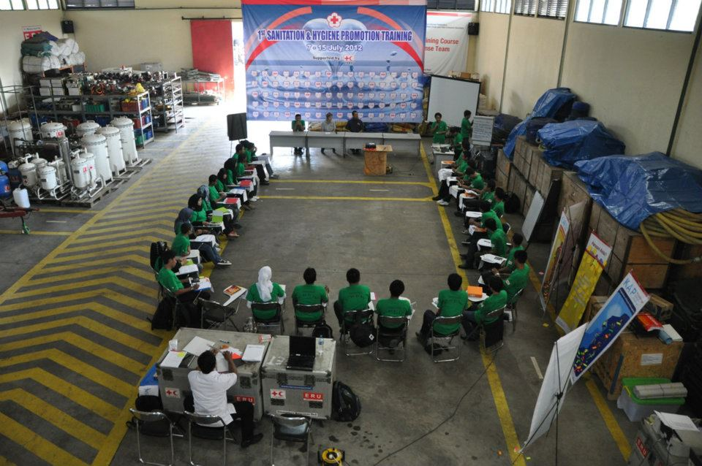
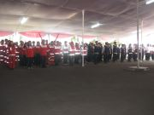
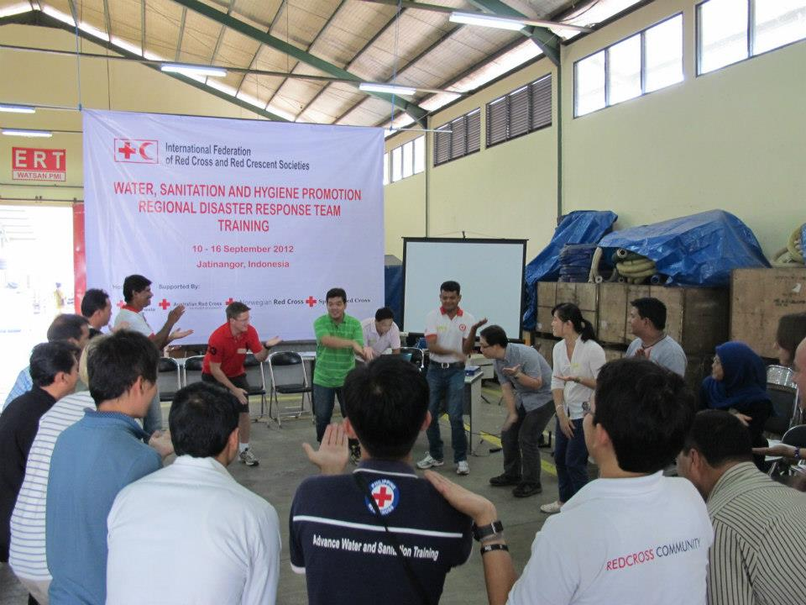
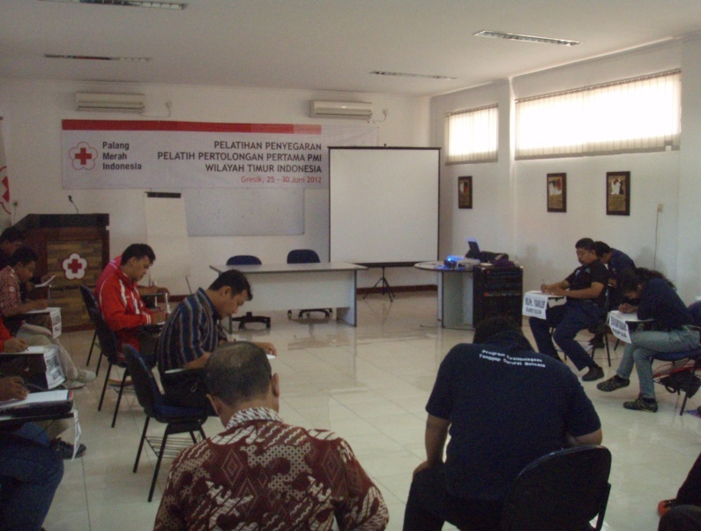
Emergency Health
Apel
Siaga Lebaran
Pelatihan Sanitasi Darurat
Pelatihan Penyegaran
Pelatih Pertolongan Pertama
RDRT
Watsan

Slide 11
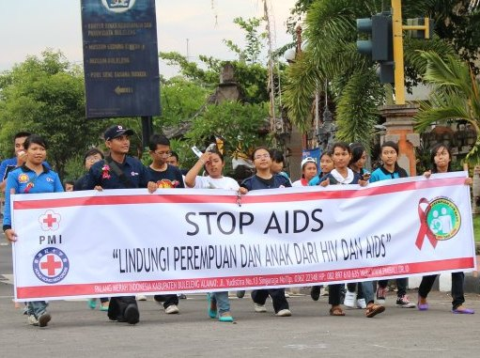
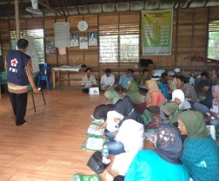
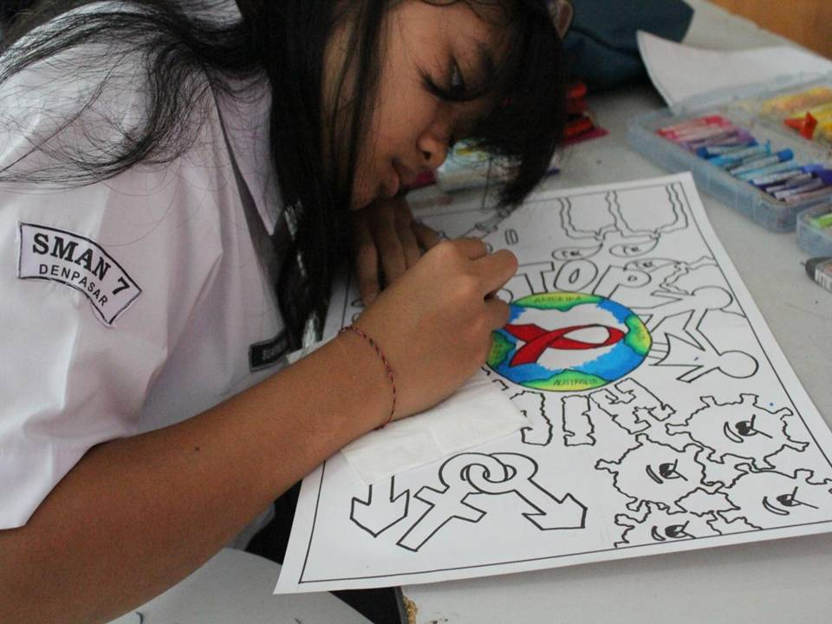
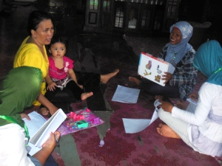
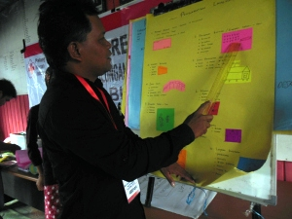
Public Health
HIV dan AIDS
Kesehatan &
Pertolongan Pertama
Berbasis
Masyarakat
dan
Kesiapsiagaan
Pandemi
Bersama
Relawan Desa

Slide 12
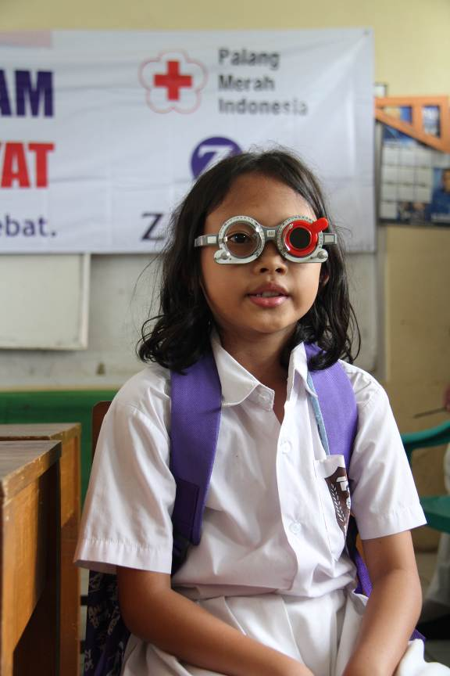
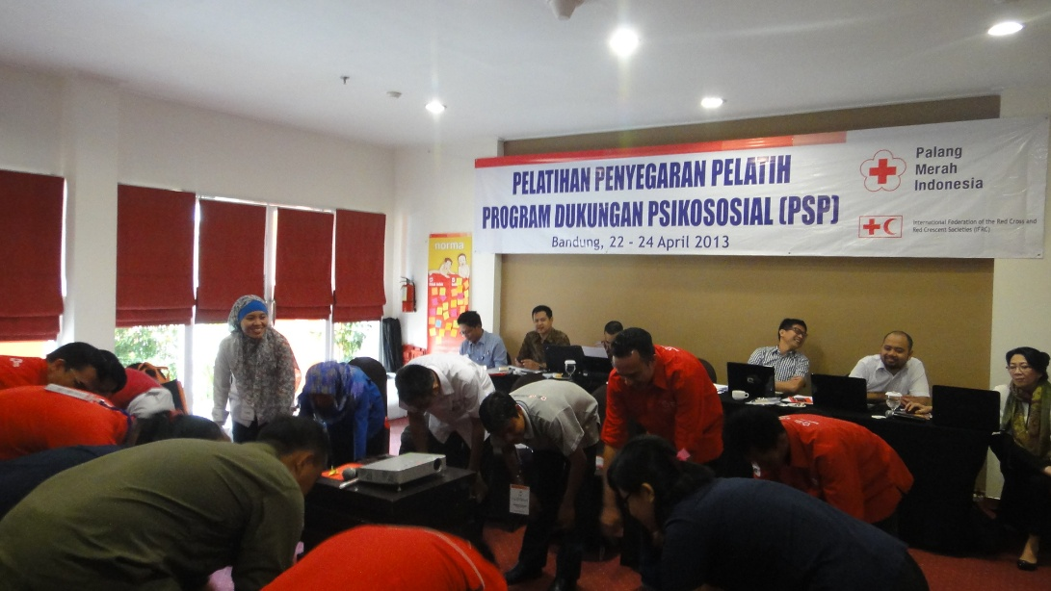
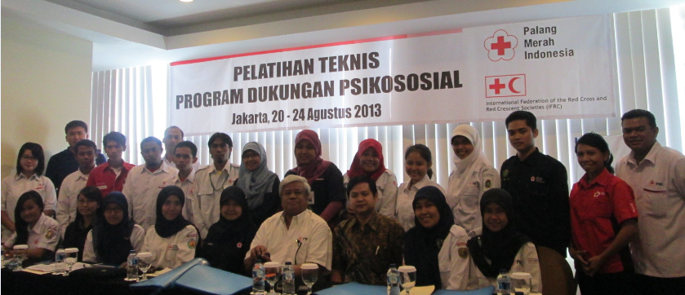
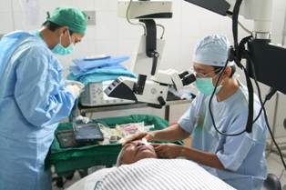
Social Services

Slide 13
Thank You

