Slide 1
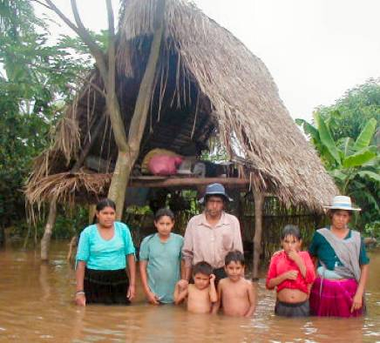
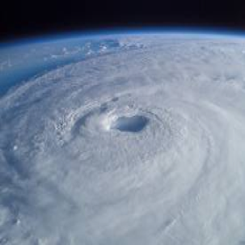
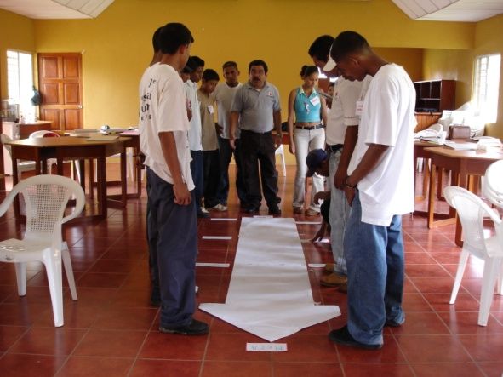
National Adaptation Plans (NAPs) and Nationally Determined Contributions (NDCs) of Governments and the Role of the Red Cross Red Crescent
Photo: Netherlands Red Cross
Photo: Nasa
Photo: Netherlands Red Cross
Notes:
The previsous modules introduced the scientific facts about climate change and some of its impacts.

Slide 2
National Adaptation
Programmes of Action (NAPAs)
Provide a process for LDCs to identify priority activities that respond to their urgent and immediate needs to adapt to CC – those for which further delay would increase vulnerability and/or costs at a later stage
Priorities are:
  Agriculture
  EWS

Slide 3
Focus of NAPAs
Focus on urgent and immediate needs – those for which further delay could increase vulnerability or lead to increased costs at a later stage.
NAPAs should use existing information; no new research is needed.
They must be action-oriented and country-driven and be flexible and based on national circumstances.
Finally, in order to effectively address urgent and immediate adaptation needs, NAPA documents should be presented in a simple format, easily understood both by policy-level decision-makers and by the public.

Slide 4
The NAPA Process
Synthesis of available information, participatory assessment of vulnerability to current climate variability and extreme events and of areas where risks would increase due to climate change, identification of key adaptation measures as well as criteria for prioritizing activities, and selection of a prioritized short list of activities.
Also includes short profiles of projects and/or activities intended to address urgent and immediate adaptation needs of LDC Parties.

Slide 5
NAPA | NAP
Simplified and direct channel of communication for information relating to the urgent and immediate adaptation needs of the LDCs. | NAPs will not simply duplicate the NAPAs priority list, but by having a longer-term, developmental outlook they will identify new priorities and respective prioritization.
Completing a NAPA made the LDCs eligible to apply for NAPA project funding under the GEF | Long-term planning under the NAPs cannot be understood as a stand alone activity: it has to be consistent and coherent with national development planning.
immediate response to urgent adaptation requirements | Will address long-term priorities for adaptation
While NAPAs were only conducted by LDCs | All developing countries are now invited to develop a NAP
Countries where a NAPA has already been developed will build on their experiences when developing their NAP. | Will facilitate the integration of climate change adaptation into relevant new and existing policies, programmes and activities → evelopment planning processes and strategies, within all relevant sectors and at different levels, as appropriate.

Slide 6
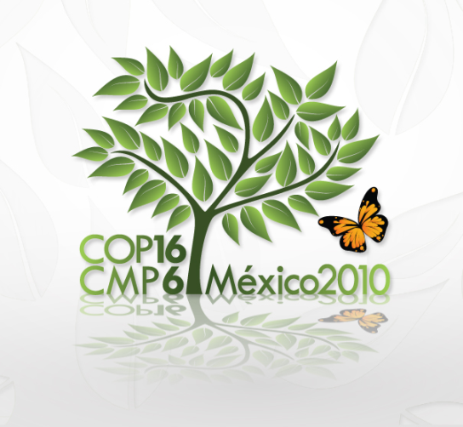
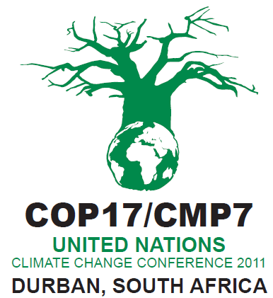
What is a National Adaptation plan (NAP)?
Concept first introduced at COP16 in Cancun in 2010. “Cancun adaptation framework”
COP17: Decision to develop NAPs. Mechanism to facilitate LDCs to receive financial support.
Who is doing What on Climate Change topic? –Work with govt’s, they are funds recipients.
NAPs build on the experiences of LDCs on the implementation of the NAPAs.
NAPs as a means of identifying medium to long term CCA needs and strategies to address the needs
Notes:
The 2011 COP17 in Durban agreed to develop National Adaptation Plans which would be a mechanism where least developed countries would then receive financial support subject to the outcomes of the negotiations but also have adaptation resources from other sources. In most countries it is often ministries dealing with the environment, natural resources or energy that take the lead on climate change. On the website of the UN Framework Convention on Climate Change (UNFCCC) you can find the contact information of the national focal points of the governments (the ministry where you can find out about the Climate Change adaptation planning of your government).
Government focal points on climate change should have a good picture of who is doing what in relation to climate change adaptation and may have produced documents on the topic in your country.

Slide 7
What is a National Adaptation Plan?
Medium- to long-term lists of priorities for climate change adaptation activities developed by the national government and closely aligned with its development objectives.
NAPs are intended to kick-start the planning for adaptation in developing countries and give an overall framework for the implementation strategy.
NAP process is a flexible process that builds on each country’s existing adaptation activities and helps integrate climate change into national decision-making.
Non LDCs are also invited to kick start NAP related processes and could also be eligible to funding of adaptation activities.
Notes:
The NAPs should be developed to enable LDCs build upon the experiences in preparing and implementation of the NAPAs. The NAPs are a means of identifying medium and long term climate change adaptation needs and there after strategies and programmes to address the required needs.
Generally, the NAP process is a flexible process that builds on each country’s existing adaptation activities and helps integrate climate change into national decision-making. The Parties to the UNFCCC established the NAP process in 2011 in Durban, outlining four flexible planning elements. Then, in 2012, a UNFCCC experts group developed a detailed set of NAP technical guidelines to assist developing countries, especially the least developed countries (LDCs), with adaptation planning.
The concept of NAPs was introduced through the Cancun Adaptation Framework (paragraphs 11-35) that was adopted during the 16th UNFCCC Conference of the Parties (COP) held in Cancun in 2010. The Cancun Adaptation Framework was a docu- ment agreed on internationally with the objective to “enhance action on adaptation, including through international coopera- tion and coherent consideration of matters relating to adapta- tion under the Convention.”1 Amongst the decisions that were adopted under the Cancun Adaptation Framework, included sup- port to Least Developed Countries (LDCs) in formulating and im- plementing NAPs. In addition, other developing countries were invited to conduct their long-term adaptation plans under the same modalities.

Slide 8
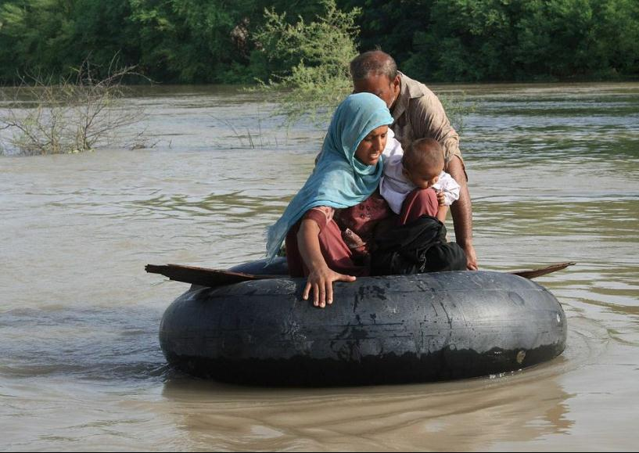
This is why we need NAPs……..
Notes:
In this slide, Facilitator should ask participants to try and give a justification on why they think NAPs are necessary before summarising it in the next slide.

Slide 9
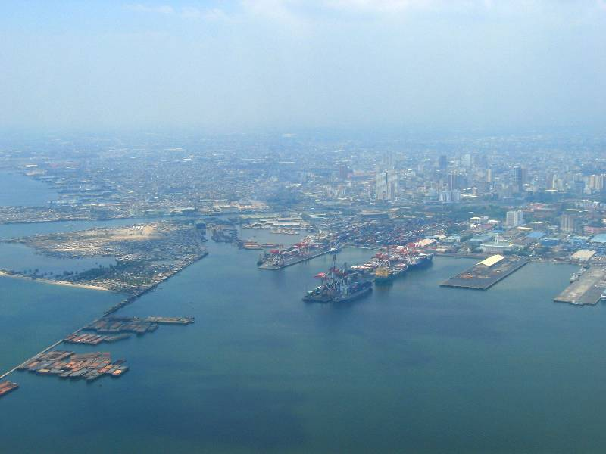
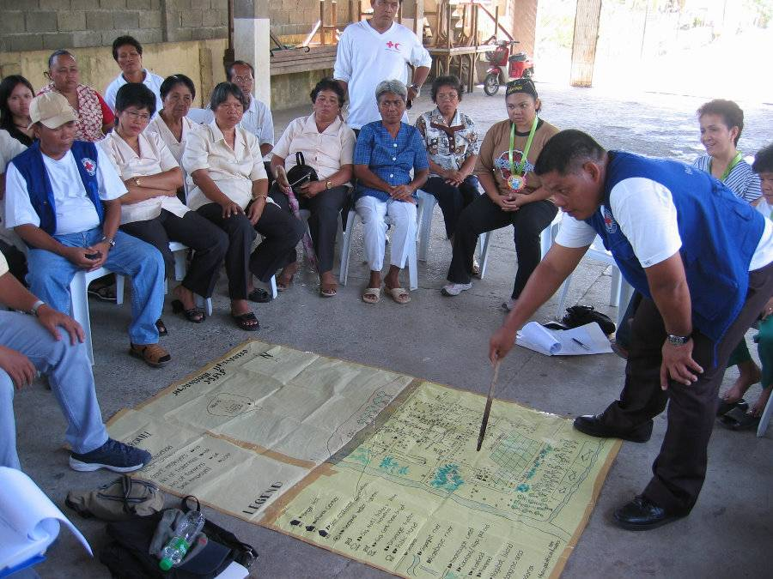
Why NAPs?
Most funding for climate change adaptation and mitigation, from both multilateral and bilateral donors, will increasingly be channeled through national governments and conditional to activities identified as priorities in the NAP.
Photos: Danish Red Cross
Notes:
9
Use Red Cross Red Crescent influence to advocate for adaptation funds, not only to cover the protection of infrastructure (too easy a default opportunity for political and administrative actors), but to make sure funding finds its way to vulnerable people and communities to help them adapt to new circumstances.
9

Slide 10
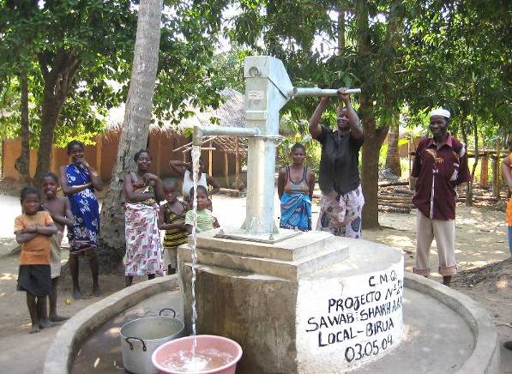
Why NAPs?
Influence Policy and Resource Allocation
The priorities identified in the NAP will determine where and what types of adaptation activities will take place in a given country and how adaptation finances will flow.
Photos: Danish Red Cross
Notes:
10
Use Red Cross Red Crescent influence to advocate for adaptation funds, not only to cover the protection of infrastructure (too easy a default opportunity for political and administrative actors), but to make sure funding finds its way to vulnerable people and communities to help them adapt to new circumstances.
10

Slide 11

The Paris Agreement
“Climate Action By All”

Slide 12
1st Commitment
Kyoto Protocol: 2008-2012
Entered into force in 2005; with 192 parties
2nd Commitment
Doha Amendment: 2013-2020
3rd Commitment
Paris Agreement: beyond 2020
Achieve a universal and legally binding agreement
on climate change beyond 2020
Notes:
In 2015, France was hosting and presiding the 21st Session of the Conference of the Parties to the United Nations Framework Convention on Climate Change (COP21/CMP11), otherwise known as “Paris 2015” from November 30th to December 11th. COP21 is a crucial conference, as it intended to achieve a new international agreement on the climate, applicable to all countries, with the aim of keeping global warming below 2°C. France was therefore playing a leading international role to ensure points of view converge and to facilitate the search for consensus by the United Nations, as well as within the European Union, which has a major role in climate negotiations.
The United Nations Framework Convention on Climate Change, or “UNFCCC”, was adopted during the Rio de Janeiro Earth Summit in 1992. It entered into force on 21 March 1994 and has been ratified by 196 States, which constitute the “Parties” to the Convention – its stakeholders.
This Framework Convention is a universal convention of principle, acknowledging the existence of anthropogenic (human-induced) climate change and giving industrialized countries the major part of responsibility for combating it.
The Conference of the Parties (COP), made up of all “States Parties”, is the Convention’s supreme decision-making body. It meets every year in a global session where decisions are made to meet goals for combating climate change. Decisions can only be made unanimously by the States Parties or by consensus. The COP held in Paris is the 21st, hence the name “COP21”.
The stakes are high: the aim is to reach, for the first time, a universal, legally binding agreement that will enable us to combat climate change effectively and boost the transition towards resilient, low-carbon societies and economies.
To achieve this, the future agreement must focus equally on mitigation - that is, efforts to reduce greenhouse gas emissions in order to limit global warming to below 2°C - and societies’ adaptation to existing climate changes. These efforts must take into account the needs and capacities of each country. The agreement will enter into force in 2020 and will need to be sustainable to enable long-term change.

Slide 13
The Paris Outcome
a legally-binding agreement between all countries
… and with a strong focus on climate action, beyond the negotiations, and not just by national governments
A VERY IMPORTANT STEP FORWARD…. but not perfect

Slide 14
Key Point #1: for all countries
The Paris agreement applies, for the first time, to all countries
Developed countries must continue to take the lead
Developing nations are encouraged to enhance their efforts

Slide 15
Key instrument: (I)NDCs:
“nationally determined contributions” that are set by countries individually
NDCs contain both mitigation and adaptation

Slide 16
Key Point #2: A strong long-term goal on emissions and global temperatures
….but insufficient concrete commitments
Agreement to keep the increase in global average temperature to well below 2⁰C (but with efforts to limit to 1.5⁰C)
Aim for GHG emissions to peak as soon as possible
In the long-term: towards zero (net) emissions

Slide 17
Impacts in practice….
2ºC= DANGER
Notes:
189 intended NDCs = 95% of global emissions = remarkable level of participation but put collective efforts only on a path to an approximately 3⁰C temperature increase

Slide 18
Key Point:
Mandatory Reviews
Each country must communicate Intended Nationally Determined Contributions (INDCs)
Progress towards the long-term goal will be tracked through a robust transparency framework (legally-binding)
A review every 5 years (from 2023)

Slide 19
(Intended)
Nationally Determined Contributions
INDCs are considered instrumental to increase the global ambition to reduce greenhouse gas emissions.
However, most countries also used their INDCs to also address other priorities and ambitions that are pertinent to national climate policy, notably regarding adaptation pledges, finance needs or fossil fuel subsidy reform.

Slide 20
Myanmar INDC
LDCs and SIDS
INDC submitted on 28.09.2015
Fossil Fuel Subsidy Reform NOT MENTIONED
Costs of mitigation (PARTIAL) COSTS NOT INDICATED
Costs of adaptation (PARTIAL) COSTS NOT INDICATED
Mitigation finance FULLY CONDITIONAL TO CONTRIBUTION
Adaptation finance PARTLY CONDITIONAL TO CONTRIBUTION
Historical responsibility NOT MENTIONED
Section on fairness SECTION ON FAIRNESS/EQUITY, ALSO
CONTEXTUALIZING EMISSIONS
Adaptation ADAPTATION ACTIONS INCLUDED
Loss and Damage LOSS AND DAMAGE MENTIONED IN INDC
Assessment and Review SECTION ON INDC TRACKING AND SELF- ASSESSMENT OF THE INDC IMPLEMENTATION
Size of INDC 18 PAGES

Slide 21
Myanmar INDC
Myanmar is determined to play its role in the global effort and to crystallise this will into our INDC.
Myanmar wishes to undertake a series of actions to demonstrate its commitment to climate change mitigation and highlight options for adaptation.
The development of the INDC is a nationally led process. Political guidance has
been sought from the highest institutional level within the Government of the Republic of theUnion of Myanmar.
The Ministry of Environmental Conservation and Forestry (MOECAF) has acted as INDC focal point, facilitating the inputs from other line ministries.
Myanmar presents its enhanced mitigation actions, policies, strategies and adaptive efforts on climate change, and wishes to contribute to making the Paris Conference agreement negotiation a success
This INDC is Myanmar’s opportunity to confirm its commitment to climate change mitigation, by pursuing the correct balance between socio-economic development and environmental sustainability.

Slide 22
Priorities for Adaptation and Emerging Issues
Short, medium and long-term priority actions by adopting the National Adaptation Programme of Action (NAPA).
Within these sectors, the NAPA establishes four priority level sectors:
  #1: resilience in the agriculture sector, developing early warning systems and forest preservation measures
  #2: public health protection and water resource management
  #3: coastal zone protection
  #4: energy and industry sectors, and biodiversity preservation

Slide 23
Priorities for Adaptation and Emerging Issues
Other needs:
  communicate and inform effectively at all levels (primary education, public opinion, policy makers),
  make fast-growing cities resilient
  pscale the achievements in the disaster risk reduction area need to be addressed.
Planning and prioritisation capacity is also developed under the
  Myanmar Action Plan on Disaster Risk Reduction (MAP-DRR, 2012)
  Disaster Management Law (2013)

Slide 24
Current and Planned Adaptation Efforts
Sectoral actions
Policy and legal instruments
Capacity building, education, awareness and communication
Monitoring of adaptation efforts

Slide 25
Key Point:
Strong Attention for Adaptation
Long-term goal on adaptation
Strong focus on stakeholder engagement
Explicit attention for the most vulnerable

Slide 26
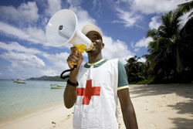
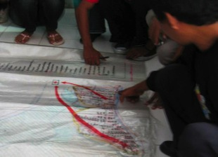
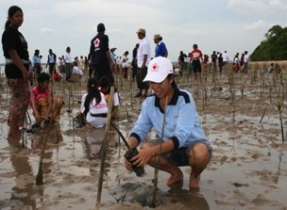
Much of what you already do, can set an example to your Government on adaptation in practice
Climate-Smart DRR = Adaptation

Slide 27
Engaging at the National Level
Check if NDC document is available for your country (opportunities for engagement / contribution)
Check with the government / climate change focal point if NAP or National Plan of Action on Climate Change is available for your country
Compare the NAP and NDC for your country and identify the areas where your NS can be engaged
Prepare a letter to the government urging them to sign the Paris agreement before 21 April

Slide 28
Engaging at the National Level
Arrange a meeting with government representatives to debrief on outcomes of COP21
Convene stakeholders meetings on the implementation of NDC, NAP and the Paris agreement
Investigate opportunities to sit on committees dedicated to climate change issues in your country
Engage in mainstreaming DRR and CC and access locally available funds for DRR, CCM and CCA work
Consistently follow up on the stakeholders meeting outcomes
Optional: use the IFRC Pledge on climate change to shape further agreements with your Government

Slide 29
Engaging at the
Sub-National/Local Level
                Identify the adaptation and risk reduction needs in the communities that you are working with (use the VCA findings or any other risk assessment results)
                Analyse how the NAP, NDC and the Paris agreement outcomes can be translated into local actions
                Meet with your local government authorities and discuss how these CCA measures could be incorporated into the local development planning
                Together with the local government authorities organize local or sub-national stakeholders meeting to create awareness about NDC, NAP and Paris agreement outcomes

Slide 30
Engaging at the
Sub-National/Local Level
                Discuss, agree and prepare a roadmap with the leadership of the local authorities on mainstreaming CCA and DRR into stakeholder’s area of work
                Together with the local government authorities and/ or with the other relevant stakeholders reach out to the vulnerable communities and sensitize them on NDC, NAP and Paris agreement outcomes, and give them guidance on the need for CCA and risk reduction implementation strategies
                In our community-based projects, make sure that your activities are climate-smart and risk informed
                Provide trainings and develop skills of your staff and volunteers on climate-smart programming and risk informed development

Slide 31
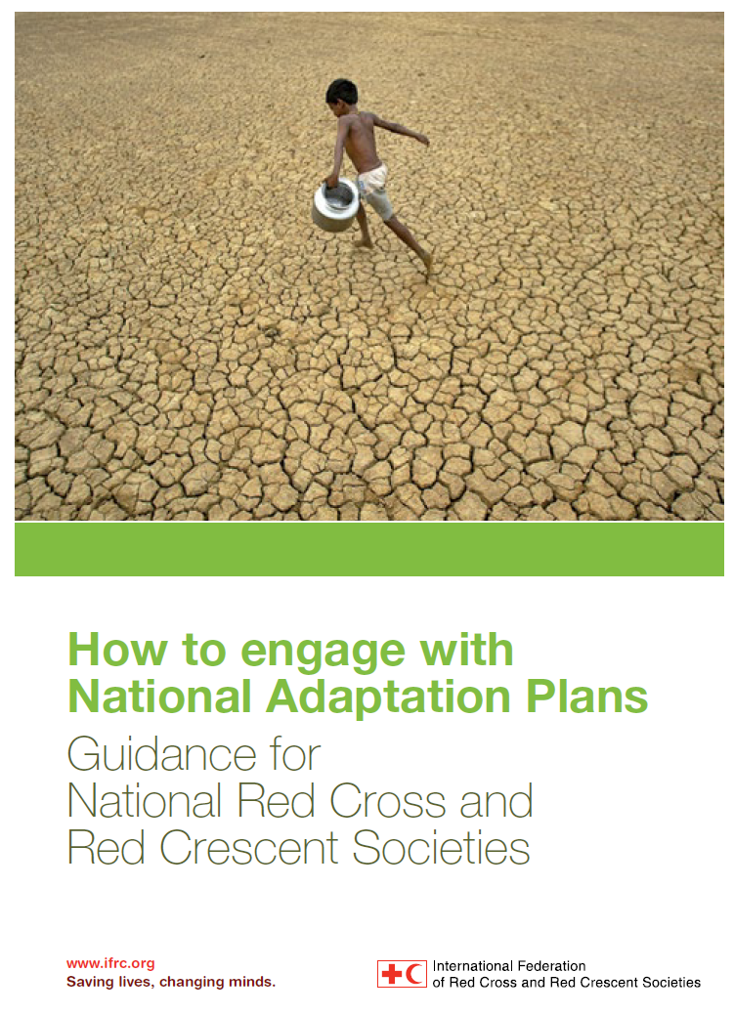
Strengthened capacity of national societies to engage with government in the national level adaptation planning processes (NAPs)
Notes:
Facilitator should explain to the participants a little bit about what Humanitarian Diplomacy(HD) means and how it Fits into the NAP project.
HD refers to all actions and strategies aimed at persuading decision makers and opinion leaders to act, at all times, in the interest of the vulnerable communities/people.
In the NAP project, we shall aim at exploring the opportunities that come with the auxiliary role of our National Societies in influencing the plans and policies that are made at national and sub national levels to reflect the local adaptation priorities.

Slide 32
How will NAPs look like?
Provide an initial analysis of the country, the expected impacts of climate change and a prioritization of medium- and long-term adaptation needs.
Be guided by “the best available science, and, as appropriate traditional and indigenous knowledge” (UNFCCC 2012a).
Built on experience from preparation and implementation of National Adaptation Programmes of Action (NAPA). These documents were developed by LDCs as short-term response to immediate and urgent adaptation needs.
Notes:
In all likelihood, the structure of the NAPs will be quite similar to that of the NAPA1 and will:
- contain a list of key priorities usually identified in terms of sectors such as agriculture, infrastructures, coastal zone protection or management of water resources.
- tend to focus on ‘hardware’ solutions (such as infrastructure) with less attention given to approaches related to capacity building of communities, education and disaster risk reduction.

Slide 33
……How will NAPs look like?
Contain a list of key priorities usually identified in terms of sectors such as agriculture, infrastructures, coastal zone protection or management of water resources
Tend to focus on ‘hardware’ solutions (such as infrastructure) with less attention given to approaches related to capacity building of communities, education and disaster risk reduction.
Notes:
Implications for National Red Cross and Red Crescent Societies:
- For countries where a NAPA has been produced, the National Society’s knowledge of it will put it in a better position to understand the NAP process.
National Red Cross and Red Crescent Societies’ input into the process is key, in particular given that through their work with communities they are able to witness on-going changes and to identify key issues for different sectors, such as health, water and sanitation, food security and strengthening of livelihoods. The analysis of the NAP will be more or less detailed depending on available country-specific information.
National Red Cross and Red Crescent Societies’ engagement with their respective governments is vital in ensuring that attention is not limited to ‘hardware’ solutions, but that an integrated approach to support adaptation to climate change is adopted, thus taking into account different measures needed to build capacity for resilience at the local level, ‘soft- ware solutions’.

Slide 34
Climate change needs humanitarian actors to:
What should Humanitarian actors such as the Red Cross do to promote adaptation?
Notes:
In this slide, the facilitator will make it more participatory to engage the participants in highlighting those actions required by humanitarian actors to respond to the climate change needs of the local communities.
Let participants respond while you write down on a flip chart and the next slide will be a summary of some of the actions that humanitarian actors could do.

Slide 35
Climate change needs humanitarian actors to:
Scale-up disaster preparedness and risk reduction
Position yourselves as key players in adaptation
Engage in country-level adaptation policy and implementation
Work with development, DRR, and environment actors
Ensure your activities address the risk of extreme weather
Contribute to long-term development
Be aware of relevant adaptation funding
Influence donors to fund humanitarian work from adaptation budgets
“The needs of the vulnerable are at the centre of national policies”
(Source: OCHA 2010)
Notes:
Disaster risk management has been recognized in the international climate negotiations as a core component of adaptation. There are actions that humanitarians can take to link with adaptation efforts at national and local levels. The information in this slide is taken from Potential new climate change adaptation funding sources for disaster preparedness activities – a 2010 OCHA background paper. It outlines that in the short term, humanitarians can:
 Scale-up disaster preparedness at all levels and help build the capacity of disaster-prone countries to adapt to the adverse humanitarian impact of climate change;
Position themselves as key players in the adaptation debate and framework, especially at the country level, where the majority of adaptation decisions will be made, as well as at the regional level;
Engage in country-level adaptation policy and programming, especially by promoting the inclusion of preparedness and by working closely with government counterparts and demonstrating the added value of humanitarian action in adaptation efforts so as to be considered as implementing partners of country-driven adaptation and preparedness processes;
Together with development, DRR, and environment actors, develop common approaches to adaptation financing to ensure appropriate scale and type of funding;
Ensure that preparedness and early-recovery activities address immediate and future extreme weather risks as well as contribute to longer-term development objectives as part of a single, integrated effort;
Be aware of relevant adaptation funding mechanisms and ensure that, as applicable, applications for preparedness funding are submitted;
Influence bilateral donors to earmark a sufficient proportion of their overall adaptation funding for humanitarian activities.

Slide 36
Our message to governments is closely related to what we already do
$28–67 billion per year by 2030
“People First”
Disaster management
Health and care
CLIMATE (CHANGE) RISKS
Water and sanitation
Food security
36
Notes:
Climate change risks cut across sectors and will have to be dealt with across sectors. This is not only challenging within the Red Cross Red Crescent Movement but for governments too. It is always smart in the Red Cross Red Crescent to start thinking about how to integrate the implications of climate change and climate risk management across different programmes and departments.
DRR is identified as a main element of climate change adaptation. This means there is huge overlap between what we consider to be climate change adaptation and DRR. Within the Red Cross Red Crescent we already have the experience to work in strengthening community resilience, with health, water and sanitation, as well as programmes on disaster preparedness and the mitigation of disasters. Therefore climate change adaptation is nothing new to us; only project design is slightly different.
If you have no practical example to show to your government, you can easily demonstrate experience from one of your neighboring National Societies that can help you to make the case.
36

Slide 37
Our Engagement as a National Society:
Advocate for mainstreaming climate risk assessments and adaptation measures in all relevant sectors; support greater coherence and mutual enforcement of national disaster risk reduction strategies and plans of action with the NAP
Be better positioned to mobilize resources for adaptation if their activities will be aligned with the priorities identified by the NAP
Highlight the work that Red Cross Red Crescent does on climate change and risk reduction and their experiences in building resilience at the local level.
Notes:
There is a significant risk that NAPs develop ‘stand-alone’ climate change adaptation projects, while climate related risks will have a potential impact on all climate sensitive sectors at all levels (local to national). By being at the table during the development of the NAP, the Red Cross Red Crescent can:
advocate for mainstreaming climate risk assessments and
adaptation measures in all relevant sectors; support greater coherence and mutual enforcement of national disaster risk reduction strategies and plans of action with the NAP
be better positioned to mobilize resources for adaptation if their activities will be aligned with the priorities identified by the NAP
highlight the work that Red Cross Red Crescent does on cli- mate change and risk reduction and their experiences in building resilience at the local level.
At international level, the International Federation of Red Cross and Red Crescent Societies (IFRC) can provide a consolidated re- port to the UNFCCC sharing information on activities carried out at national, regional and global levels.

Slide 38
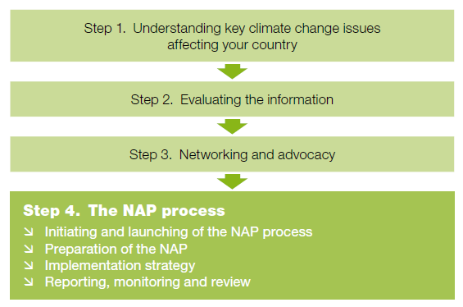
Engage in national CC planning
Notes:
38
Policy dialogue – advocacy or humanitarian diplomacy – is necessary as we believe many international commitments made by governments are not yet implemented nationally or locally, or in a way that builds the resilience of the most vulnerable people.
Ultimately, the Red Cross Red Crescent assisting in the implementation of, and accessing funding from, upcoming adaptation funds through national policy dialogues could be an outcome of advocacy efforts. We will therefore explain what is happening globally and how adaptation funds are being made available to governments.

Slide 39
Key point: Next Steps…
Ratification
by at least 55 countries
representing at least 55% of emissions
+
Action on the ground!

Slide 40
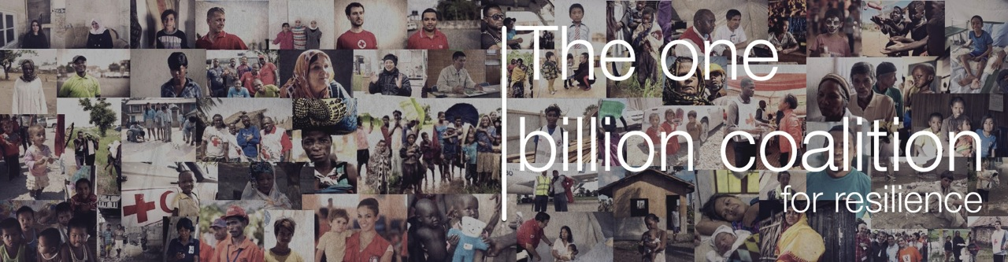
“We need to invest in their resilience, help them to adapt to the inevitable impacts of climate change, and forestall future crises by promoting ambitious emissions reductions.”

Slide 41
Our volunteers are standing on the front line and are witnessing how climate risks are disproportionately affecting the most vulnerable communities in in the world
Notes:
#1: testing to answer poll and to insert a comment in the text bar?
#2: Has your NS participated at COP? What was one major disappointment in this engagement and what was one major highlight?
#2: Has your NS actively discussed climate change issues with your Government throughout the years? If yes, what was the most exiting result?
#3: Do you think your NS will engage in the short term with your Government to engage on NDCs or NAPs?
#3: Has you NS seen the climate change pledge at the International Conference? Would you be willing to see if your leadership is willing to sign this pledge & discuss it with your Government?
#4:
#5: Has your NS in past 10 year been involved in climate change related programming/ resilience programming (with climate focus)? What has been your most successful experience with climate change related programming?
#6: Has your NS been involved in NAP dialogues? If not, Would you be interested in doing so?

