Slide 1
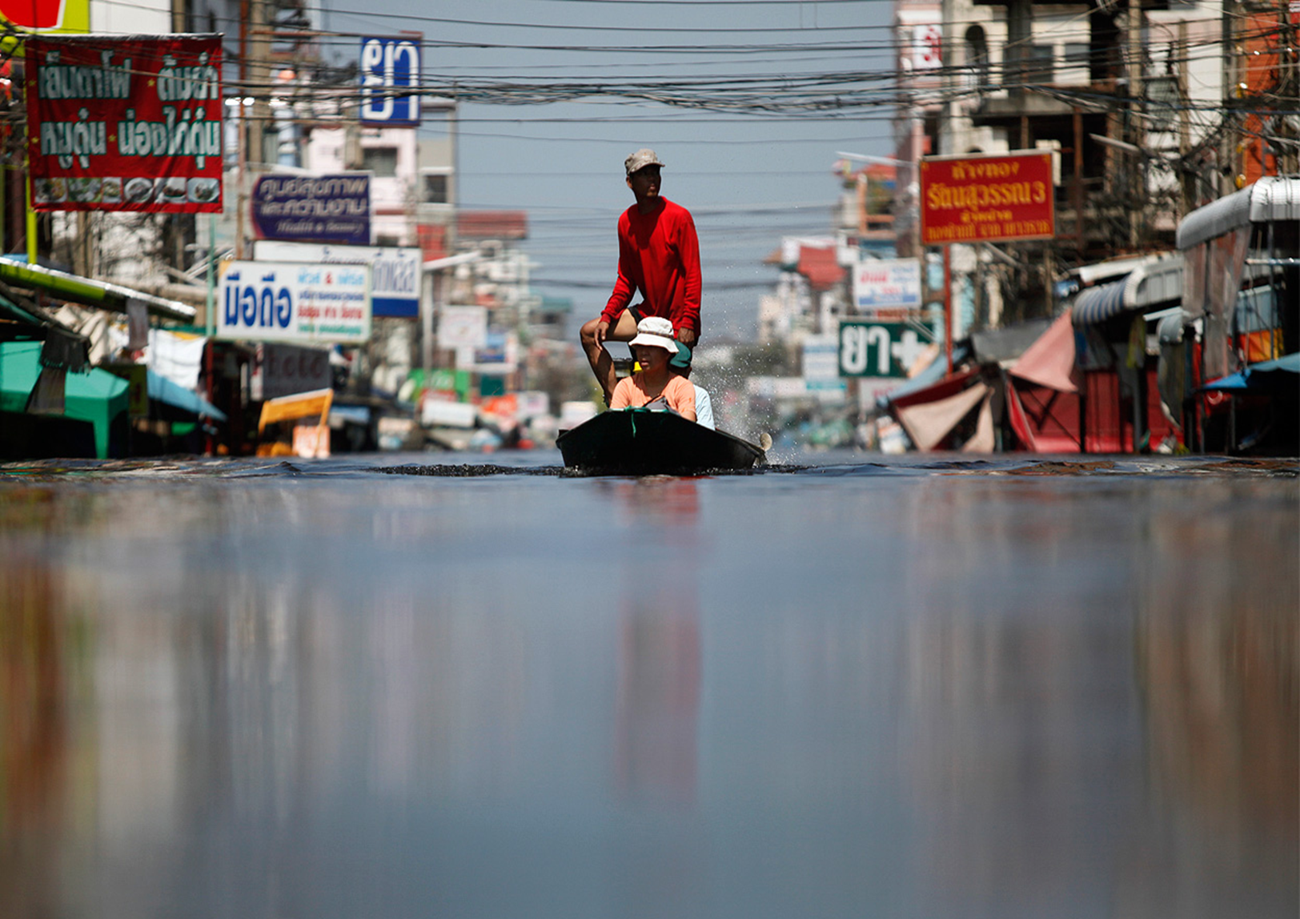
Disaster Law: An Asia Pacific Perspective
Introduction to Disaster Law – Part 1
ACE Programme 2015

Slide 2
Overview of the session: Part 1
Introduction to Disaster Law
What is IDRL? Background, tools, commitments
IDRL scenario exercise
Theme 1: IDRL
Part 2: Law and DRR, regional developments, Indonesia experience

Slide 3


What is disaster law?
Key
Disaster law

Slide 4

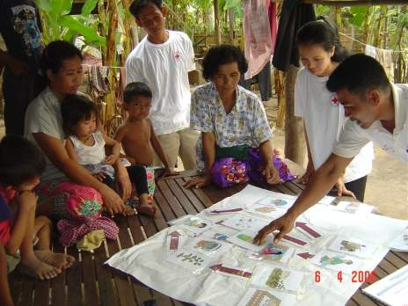
Disaster Law is…
The laws and regulations which:
address the roles and responsibilities to manage and respond to disasters
minimise impact of disasters
reduce disaster risks

Slide 5
Disaster Law themes
Law and Disaster Risk Reduction (Law and DRR)
International Disaster Response Law (IDRL)

Slide 6
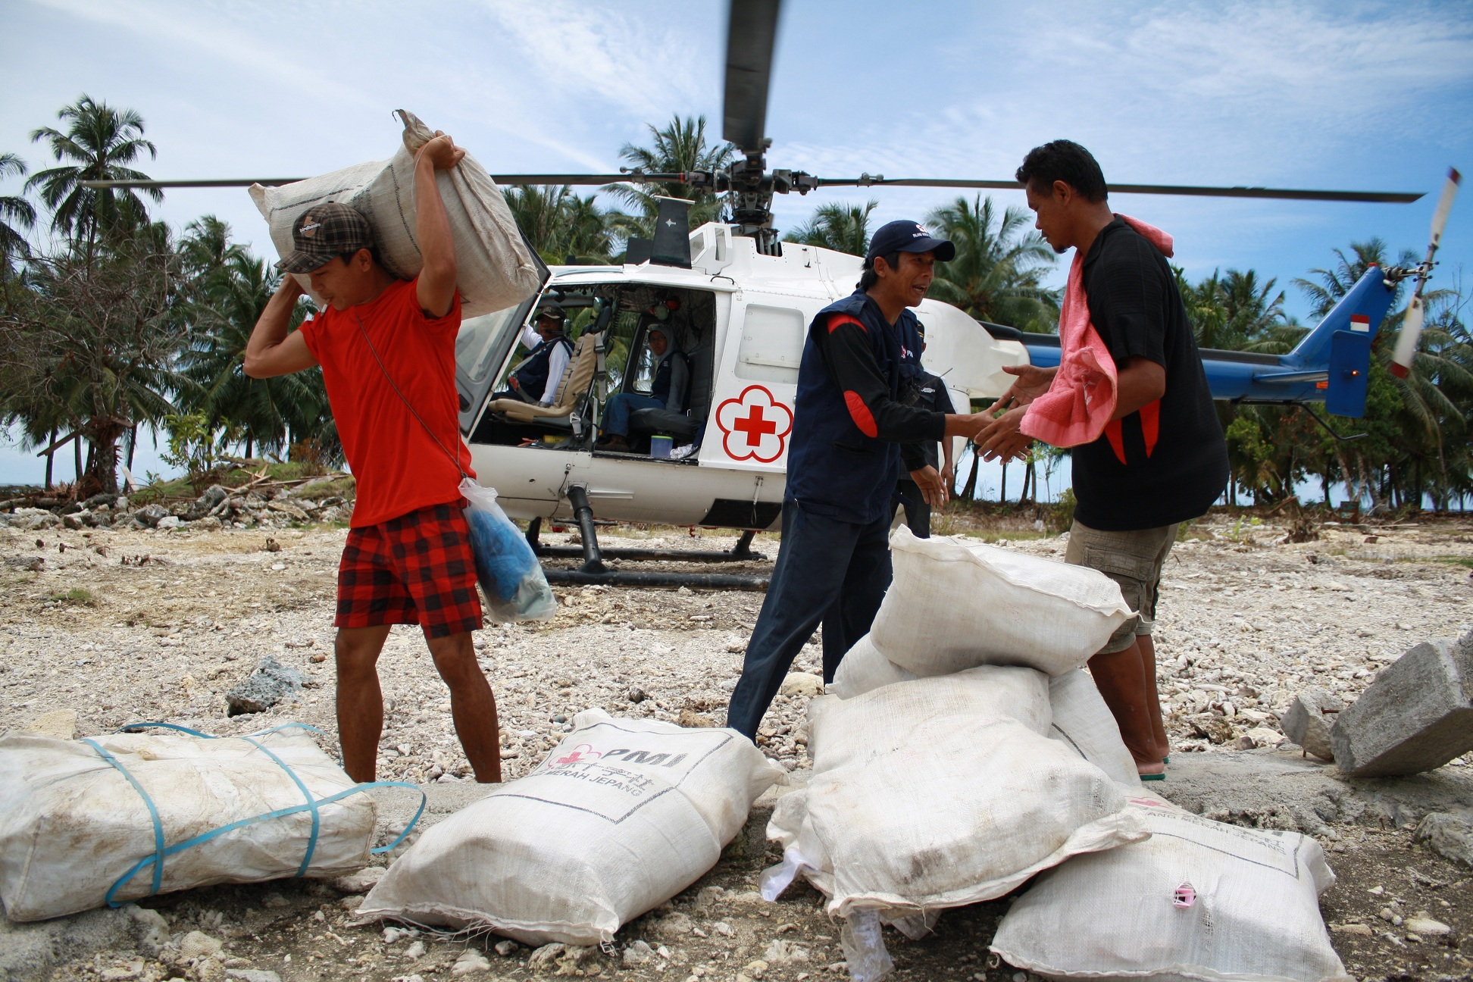
Theme 1: International Disaster Response Law (IDRL)
Theme 1: International Disaster Response Law (IDRL): the laws and regulations to handle incoming international assistance

Slide 7
True or False?
Disasters = chaos, confusion, there are no rules, law doesn’t apply.
Answer: False

Slide 8
True or False?
IDRL is international humanitarian law
Answer: False

Slide 9
True or False?
International humanitarian workers should abide by all national laws when working in disaster affected countries.
Answer: True

Slide 10
True or False?
International relief teams need the permission of the affected state to provide humanitarian assistance.
Answer: True

Slide 11
True or False?
After requesting international assistance, the affected state must allow foreign governments to bring in any type of aid.
Answer: False

Slide 12

Why legal preparedness for international disaster response?
More and different international responders
More frequent and larger natural disasters
Absence of laws and procedures to regulate an increasingly complex context

Slide 13
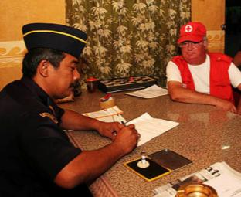

Research shows that a lack of legal preparedness hampers international relief
Barriers
  Initiation, visas, customs, radio use, taxes, professional qualifications, registration, transport, liability
Oversight gaps
  Inappropriate items, ignoring standards, poor coordination, corruption
Bottom line
  Aid is slower, more expensive, less effective, sometimes counter-productive

Slide 14
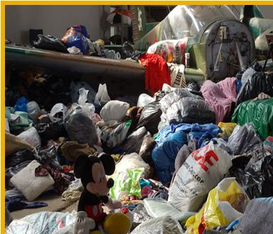
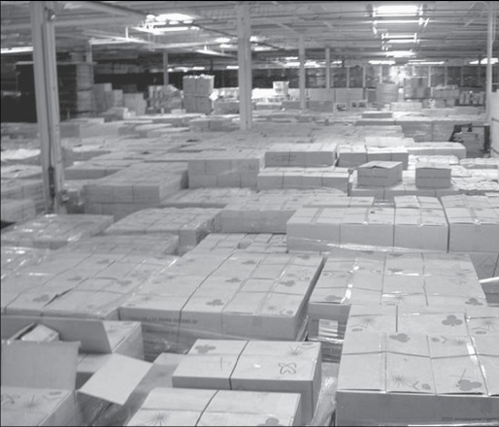

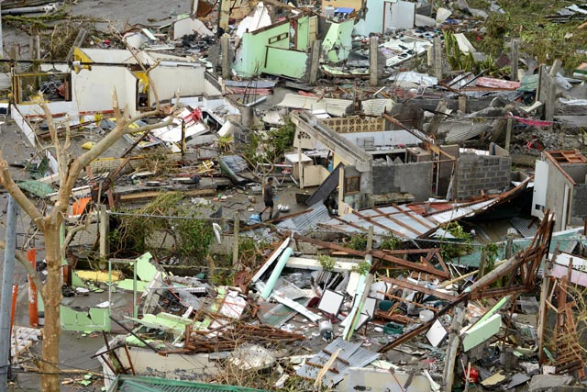
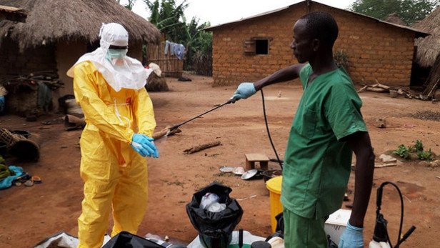
A few anecdotes…

Slide 15






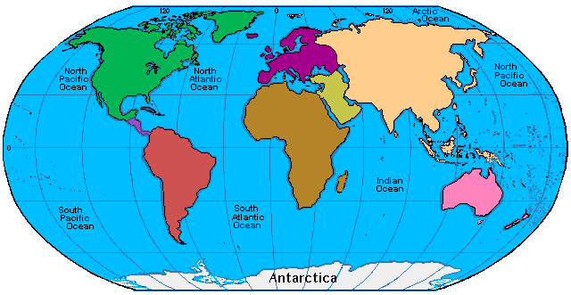
Global & Regional Institutions
RC /RC (Soft) Law
No Comprehensive Legal Regime
3
Soft Law
IHL, HRL and Refugee Law
Sectoral Law
Regional Law
Bilateral Agreements

Slide 16
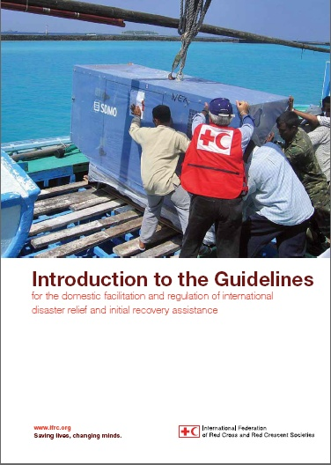
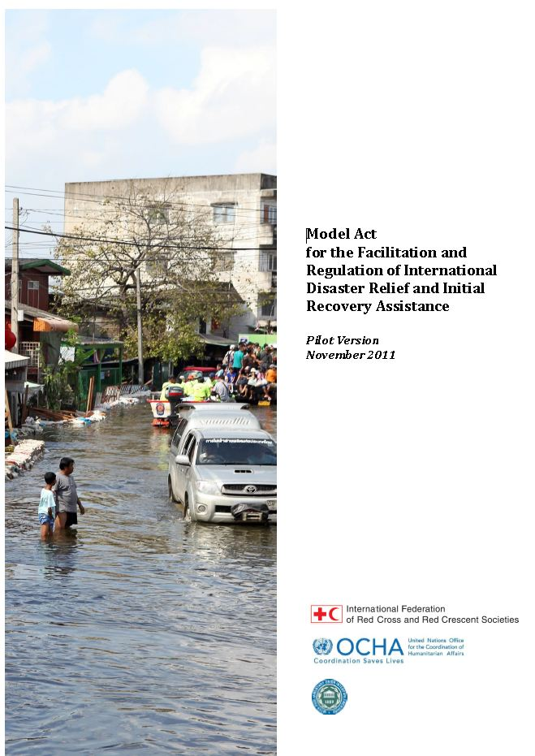
IFRC tools: IDRL Guidelines & Model Act
Draw upon existing international norms and best practice
Recommendations to governments on how to prepare domestic laws and procedures for international assistance
Requests for ‘legislative language’ to implement the Guidelines = Model Act
Translated into different languages

Slide 17
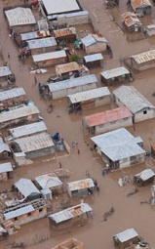
The core ideas of the IDRL Guidelines
Domestic actors have the primary role
International relief providers have responsibilities
International actors need certain legal facilities (e.g. expedited visa and customs processing, exemptions from taxes duties and fees, priority customs clearance)
Some legal facilities should be conditional upon compliance with humanitarian principles and national law

Slide 18
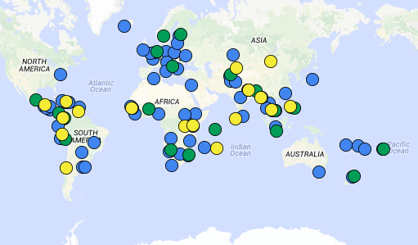
Progress to date: implementing the IDRL Guidelines at the national level
Key:
Blue: disaster law projects (50+)
Green: new laws/regulations adopted (18)
Yellow: new laws/regulations pending (17)

Slide 19
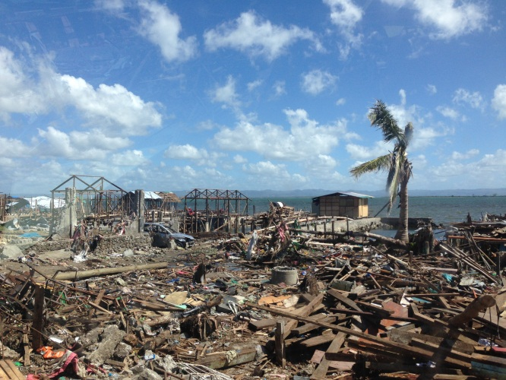
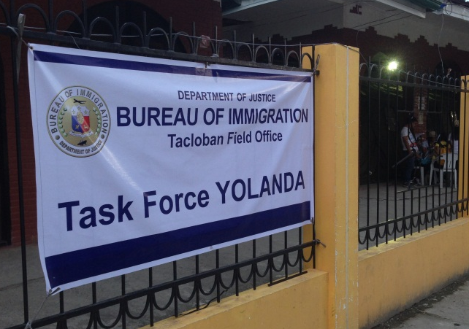
IDRL in action: The experience of the Philippines
Republic Act 10121 on National Disaster Risk Reduction and Management
‘Welcomed’ international support soon after Typhoon Haiyan / Yolanda
Established a “One-Stop-Shop” to expedite clearance of relief goods and equipment through customs
Established new immigration procedures and a Task Force
However, many different orders and guidelines – ad hoc response
A Bill now in Parliament based on the Model Act for international assistance

Slide 20
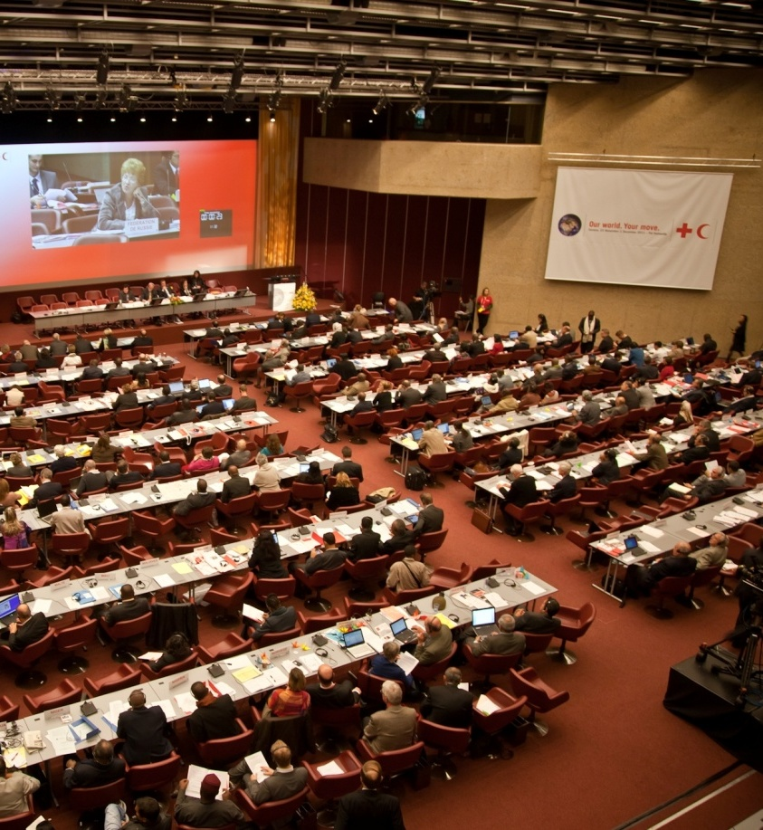
International Commitments
States adopted a resolution at the 31st International RCRC Conference in 2011 which:
  Reiterated the urgency to be prepared to facilitate international assistance
  Renewed its call on states to use the IDRL Guidelines to examine and strengthen their laws
  Called on regional and international organizations to use the IDRL Guidelines as well
  Issue will be raised again at 32nd IC in 2015

Slide 21
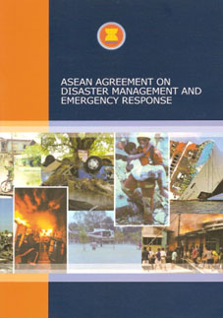
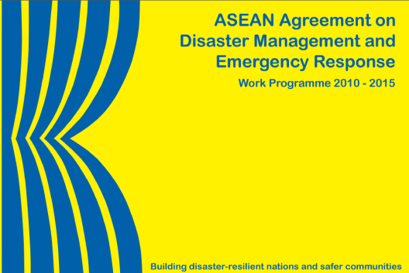
Regional Commitments
  AADMER Agreement: a binding agreement that provides a regional cooperation mechanism for disaster response
  Governments in SEA must take legislative measures to implement the AADMER e.g.:
        To provide assisting states with exemptions from taxation, duties and other charges of a similar nature, and facilitate entry and stay of personnel and equipment (art 14)
  AADMER work programme references the IDRL Guidelines as a key tool for developing national legal frameworks for international assistance

Slide 22

Why is IDRL important?
1. For governments:
  Sets out procedures, roles and responsibilities
  Controls the type of incoming assistance
  Regulates the actions of international actors
2. For International assisting actors:
  Facilitates response operations
  Provides ‘legal facilities’ to operate in country

Slide 23

Challenges
Law development is a long-term process: changes do not happen overnight!
Dissemination
Implementation
Are we seeing enough progress?

Slide 24
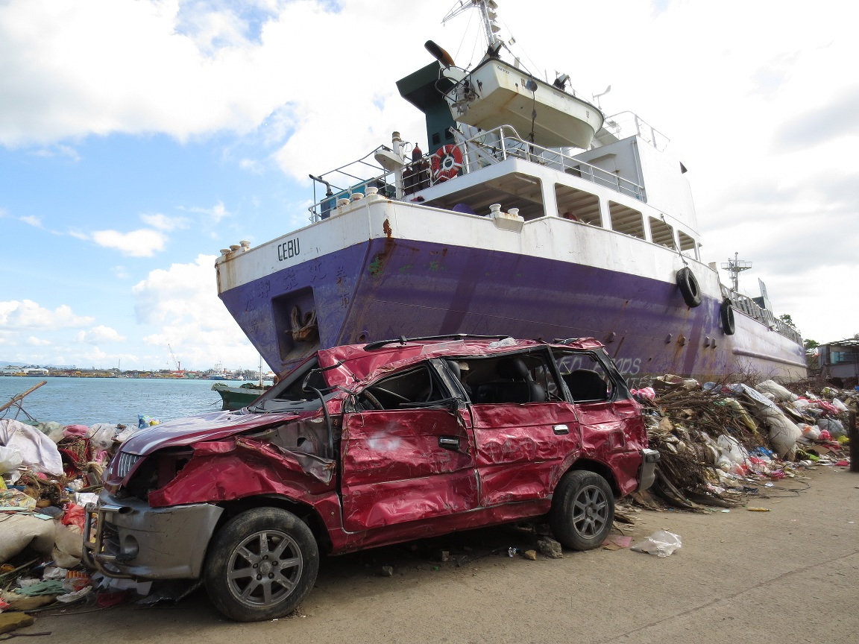
Legal preparedness is important….
…to provide the right aid, at the right time!

Slide 25

Questions? Comments?
Which IDRL issues have you come across in your experience?
Which challenges might be most relevant in your country context?
What procedures do you know of that are already in place in your country? e.g. DM law? customs laws? Immigration laws?

