Slide 1
Update on disaster law and the way forward
Lucia Cipullo, IFRC
Community Safety and Resilience Forum
Jakarta, August 2015

Slide 2
NS Commitment to Disaster Law - Phnom Penh declaration
A commitment by NS leaders to:
“Support the development of disaster law at national and regional levels, in partnership with governments, regional organizations and key humanitarian partners. [Acknowledging that] Strong legal frameworks benefit the wider humanitarian community and strengthen the resilience of vulnerable and disaster affected populations….we will continue to engage our governments and re-iterate our commitment and pledge to the upcoming 32nd International Conference in December 2015”

Slide 3
Scope of disaster law…
Disaster law
Gender and diversity
Health: first aid, health emergencies
IDRL (international disaster relief)
Disaster Risk Reduction and climate change
OD: Red Cross Law
Migration

Slide 4
CSR Survey: disaster law progress
DL engagement
7 of 8 NS engaged in DL processes
DL as a priority
Five NS said DL is a priority
Training / capacity building
7 NS would like more training
1 not sure
3 said it is not
1 said no

Slide 5
Recent developments at the country level
Cambodia: adopted new DM law, planning for launch and disseminations
Lao PDR: Disaster and climate change law workshop
Indonesia: soon commencing DRR law checklist project
Myanmar: recruiting researcher for IDRL project
Timor Leste: reviewing draft DM law
Notes:
Include Philippines – link to operational context

Slide 6
Recent developments at the country level
Philippines participating in ‘sunset review’ of DM law
Thailand: govt developing guideline on international assistance
Vietnam: exchange with DPRK on disaster law
Malaysia: working with HCT, priority to draft new law

Slide 7
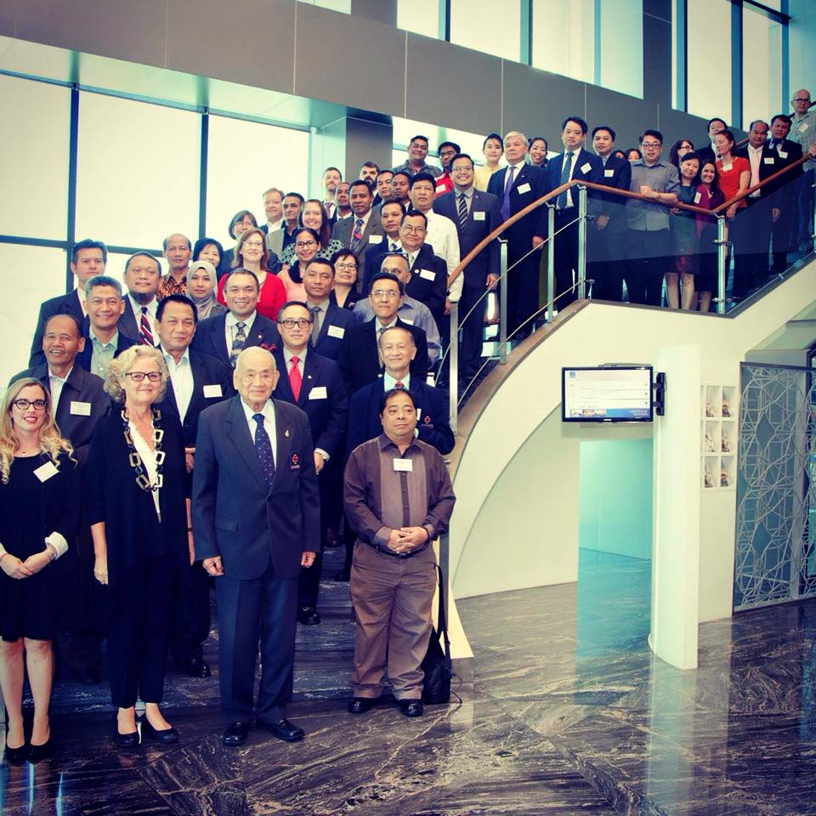
Recent developments: South East Asia Disaster Law Forum
June 10 – 11, 2015, Bangkok
Over 60 participants from National Societies, governments (Foreign affairs, NDMOs, parliamentarians), the UN, NGOs, donors (PNS, ECHO), ASEAN secretariat
Discuss DL developments at the national, regional and global levels.
First DL Forum for SEA in five years
Take stock and continue the momentum
Notes:
Or put on separate slides

Slide 8
Recommendations / outcomes from the DL Forum : National level
Commitment: participants committed to continue working on disaster law processes at the national level / identify opportunities to engage
Partnership: working with govt, UN, civil society, regional organizations
Process: disaster law takes time, does not happen overnight, long term/sustainable investment
Context: most countries active in DL, but different levels of progress
Learning and understanding: what’s it all about it? why do we need it? Need to continuing training, building mutual understanding and awareness for all stakeholders

Slide 9
Recommendations / outcomes from the DL Forum: Regional level
Raising the voice / profile of Southeast Asia on the international stage – DL can do this, many already looking to SEA
Disaster law as an avenue to engage with ASEAN Secretariat and AHA Centre – strategic, policy and operational levels
  Gather together at regional level to discuss developments e.g. DL forum, DL sessions at ASEAN events (e.g. ACDM in December – get DL on the radar!)
  DL is operational too! e.g. Nepal and Vanuatu deployments.
NS key actors in implementing AADMER as “AADMER advocates” and through new AADMER work programme (include DL tools)
Develop a regional platform / advisory group to share DL experiences, learning, challenges – idea approved by CSRF this week!

Slide 10


Recommendations / outcomes from the DL Forum: International level
DL forum discussed disaster law resolution themes
Agreed to support disaster law resolution at the 32nd International Conference of the Red Cross Red Crescent, Geneva 2015 (includes all NS, IFRC, ICRC and states from around the world)
NS committed to renew their disaster law pledge from 2011, explore pledges with govt.
Notes:
Include operational relevance

Slide 11
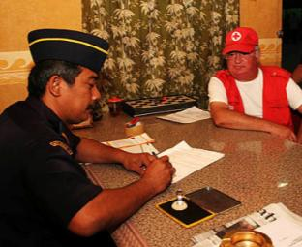
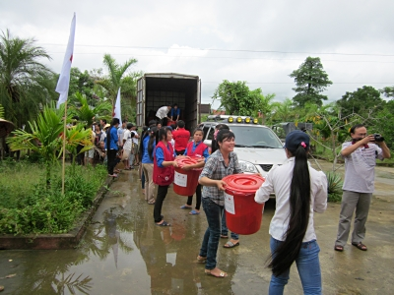

Disaster law resolution
Proposed elements of the disaster law resolution:
  Accelerating progress in the facilitation and regulation of international disaster response
  Strengthening laws for disaster risk reduction and using the Checklist on Law and DRR
  New theme: providing supportive legal frameworks for saving lives through first aid (together with Global First Aid Reference Centre) as a central part of disaster preparedness:
    Encouraging states to mandate first aid e.g. in schools
    Provide liability protections for FA providers
    Strengthen any legal frameworks related to FA
    Further research and consultations coming soon…what do health teams think of this?

Slide 12
Moving forward: the next few months will be critical!
Preparing for the 32nd IC: dialogue with governments
For information www.rcrcconference.org
Pledge database will soon be launched for pledging!
Draft pledge language/ideas to be share today!
Regional pledge | National pledge
Renewed commitment by NS to pursue disaster law work Joint pledge by all NS in SEA (following 2011 pledge) Can mention IDRL, DRR, regional DL platform/advisory group | Between NS and govt Strong foundation for country level work on DL Previous conference the NS and govts pledged separately – now encourage to pledge together

Slide 13
Planning for 2016 and beyond – what do you need?
Improve mutual understanding of disaster law for NS and govt:
  1. Begins with the NS – training staff and volunteers.
  2. Jointly training NS, govt, and other partners.
  3. Many NS already asked for this – Myanmar, Laos, etc. Who else?
Designate focal points and develop regional platform:
  Focal points suggested yesterday – who are our DL champions?
  Regional platform recommended during CSR discussions – to learn and share experience
  Need to develop ToR for regional platform / committee. Concept already developed (see handout).
Continue ‘business as usual’ but keep eyes open:
  Many projects, initiatives, disseminations already happening. Try to identify new opportunities to engage.
Keep your Leaders updated: your leaders need to know, and engage – for ownership and susbtainability! Inform and sensitize your leaders on all your great work!

Slide 14
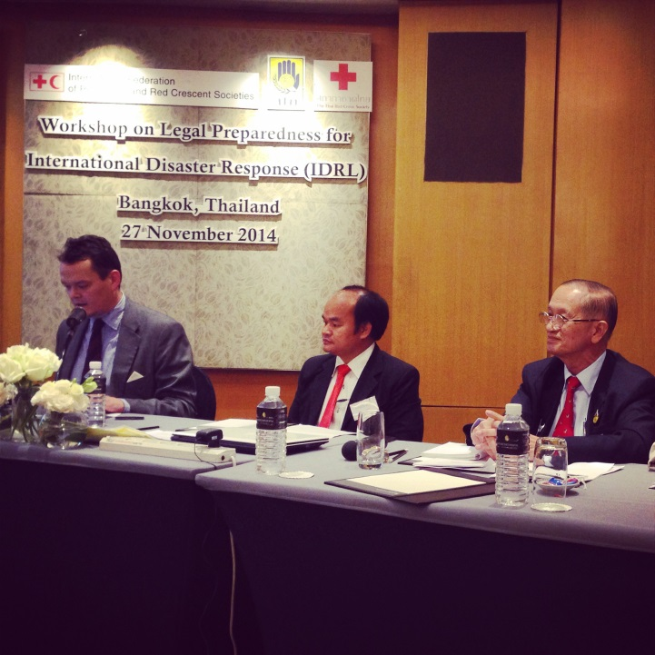
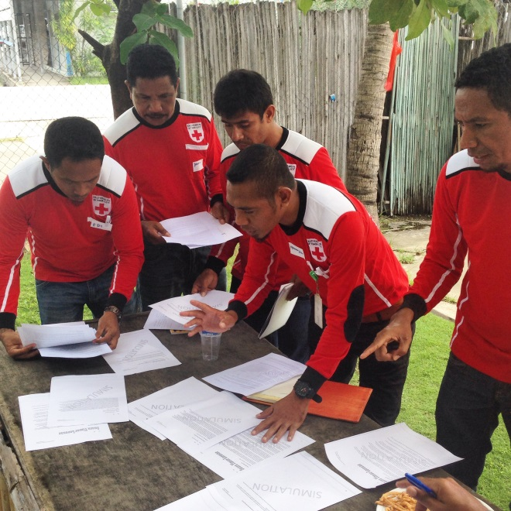
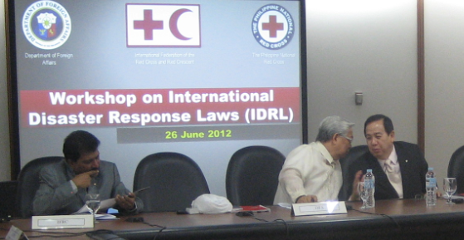
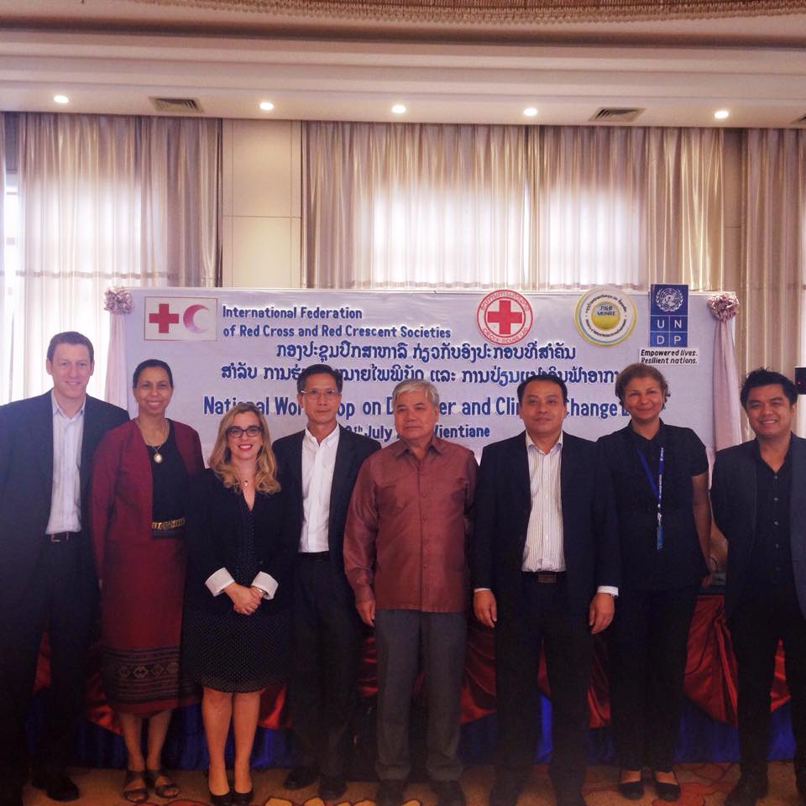
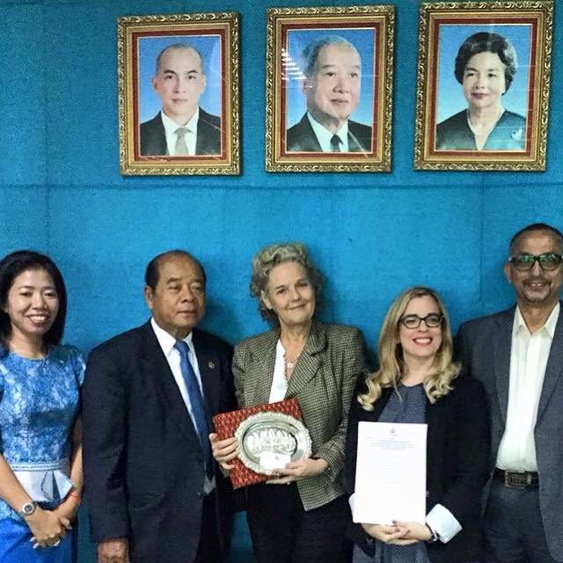
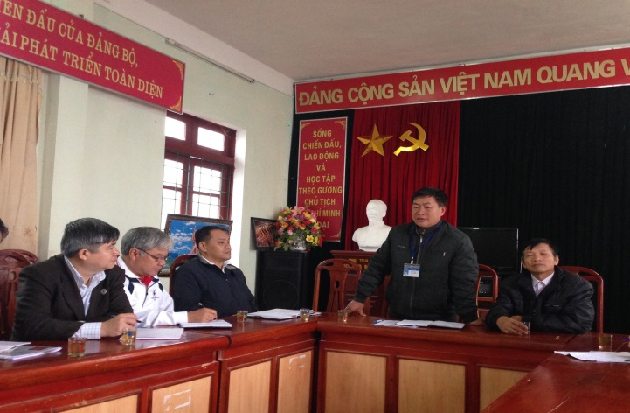
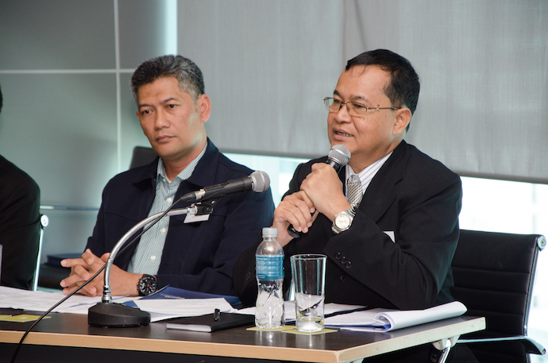
Southeast Asia: leaders in Disaster Law Let’s keep going!
Southeast Asia: leaders in disaster law let’s keep going!
Notes:
Add photos

Slide 15

Questions? Comments?

