Slide 1
Mainstreaming Gender and Diversity for Community Resilience Updates and Progress 2014-2015
Regional Community Safety and Resilience Forum
Jakarta, Indonesia
4-6 August 2015

Slide 2
Session objectives
The importance of gender and diversity for community resilience
An integrated and mainstreamed approach
Progress and plans from the region
SEA Regional Gender and Diversity Network and National Society Gender and Diversity Focal Points
Gender and Diversity for Resilience Toolkit
Training and Capacity Building – Regional Training
The way forward

Slide 3
Gender vs Sex
When we speak of ‘Gender’ we do not just mean women or girls
Gender refers to the social differences, rather than biological differences between men and women a
This relates to the attitudes, behaviors, roles and expectations put on men and women as a result of being male or female
Gender as an analytical tool
Notes:
Where as a person’s sex refers to the biological differences between men and women gender…..
Gender as a concept refers to the social differences between men and women and relate to the attitudes, behaviors, roles and expectations placed on men and women as a result of being male or female
Gender provides us with an analytical tool to understand better the needs and capacities of all groups in a community and ensure these are addressed

Slide 4
Diversity
Diversity refers to the acceptance and respect for the differences between people
Ethnic Origin
Health e.g.
Sexual Orientation
HIV Status
Diversity
Age
Religious affiliation
Socio-economic status
Nationality
Disability
Notes:
- Diversity refers to the acceptance and respect for the differences between people
- There are interactions between gender and aspects of diversity that can cause people and communities to be more or less resilience when it comes to disasters

Slide 5
Gender and Diversity for Community Resilience
Safer and resilient communities can only be achieved when everyone in the community is reached
This means understanding the needs and capacities in a community and addressing and harnessing these
Ensures that no one gets left behind
Therefore important to view gender and diversity as cross cutting issue of the pillars of DM and Health

Slide 6
Gender and Diversity…Building on what we are already doing
Addressing the needs of the most vulnerable is not new for National Societies
Disaster Management
Health
Community-based maternal & child health
Assisting people with HIV and outreach to vulnerable groups
Integrating gender approach in WASH activities
Assisting the elderly in their access to health services
First aid and PSP – specifically addressing needs of elderly, women, girls and PWD
Focus on gender and working with ethnic minorities for DRR
Development of policies and strategies for social inclusion / gender / disability
Tools e.g. VCA, risk mapping, baseline surveys are gender sensitive
Working with the elderly in disaster preparedness activities
Notes:
Addressing the needs of the most vulnerable is not new for National Societies. Here are only a few examples of the work National Societies are involved in and the ways gender and diversity needs are recognised and addressed.
…….
……
……

Slide 7
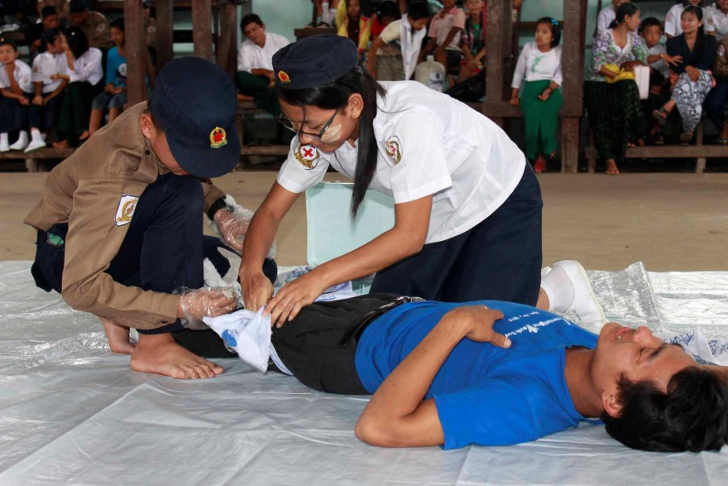
Gender and Diversity for Community Resilience
“The awareness of gender equality and diversity is important in providing humanitarian services towards the community, regardless of our local and international work. Gender inclusion, as well as other priorities should be taken into consideration,
to achieve a stronger and resilient society.”
Singapore Red Cross

Slide 8
A mainstreamed and integrated approach
Strategic
Shared
Systematic
Disaster Law
Migration
Violence prevention
Youth and volunteer networks
Notes:
In addition to Dm and Health, this past year work has been done to integrate gender and diversity into other areas of work.
Disaster law – to ensure the right aid gets to the right people including those most vulnerable groups
Engaging the youth in gender and diversity so that they can be agents for behavioral and attitude change and advocate for gender equality within their communities
Through migration – ensuring that vulnerable migrant populations are identified and that their specific needs and capacities are understood.
With all the work currently taking place what we need now is to ensure that our approach to g&d is more strategic, we need to ensure that G&D is systematically incorporated into all policies, programmes and tools so that more of the most vulnerable groups are reached and supported. And we need to ensure that we share better the work that we are doing, to exchange best practices and to document and communicate the work we do.

Slide 9
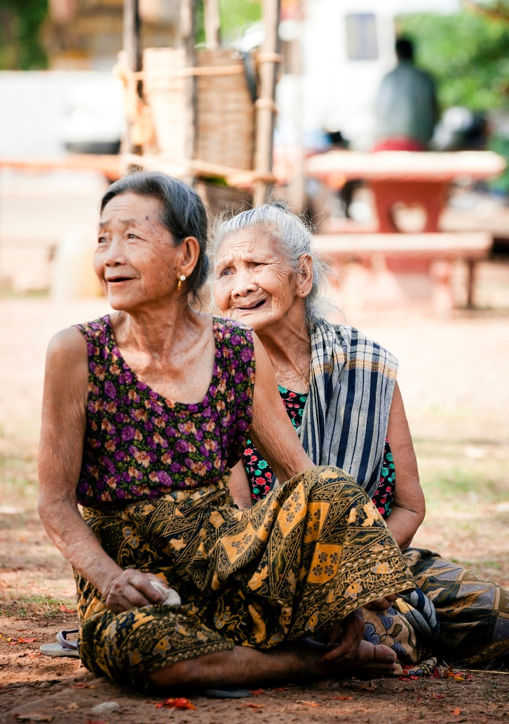
A mainstreamed and integrated approach
“In the Red Cross Volunteers policy, we are considering to recruit volunteers based on gender aspects eg: each village will recruit one man and one woman. For relief / emergency assistance the Red Cross is considering the most vulnerable groups which include gender and diversity in the beneficiaries list. eg: older people, women and children, OVC groups.”
Cambodian Red Cross

Slide 10
Scoping missions
Increase visibility and communication
NS Focal Point
Development of Policies and Strategies
Cambodia
Indonesia
Laos
Myanmar
Thailand
Viet Nam
Timor Leste
Increase strategic co-ordination
Tools and guidelines
Notes:
Scoping missions in seven countries in the region: Cambodia, Indonesia, Laos, Myanmar, Thailand, Vietnam and Timor Leste. This provided an opportunity to review in greater depth the legal frameworks in the country and external initiatives implemented by organisations or government authorities. This provided information on the areas of strengths within each National Society as well as areas identified for capacity building in the short and long term planning in this area
Some common recommendations:
The need to increase visibility and communication on G&D,
To have standard policies and strategies on G&D. Those that had policies and strategies already in place highlighted the need for more strategic co-ordination or support to integrate these across all programmes and to have practical tools and guidelines to support in doing this, increase internal awareness within NS.
Having a focal person for gender and diversity could enhance these areas relating to co-ordination and awareness raising.

Slide 11
Planning for 2015-16
Notes:
From this a collaborative planning process was undertaken for gender and diversity activities for 2015-2016.
This map highlights the activities being planned and currently undertaken by various national societies. Activities range from training and awareness raising, the review or development of policies and strategies, development of gender and diversity sensitive tools, research and impact analysis, workshops, and the identification of gender and diversity focal points or representatives within National Societies.

Slide 12
Regional Gender and Diversity Network
Nine Gender and Diversity Focal Points
First annual Southeast Asia Regional Gender and Diversity Network Forum
(November 2014)
TOR presented at the 12th Annual Southeast Asia RCRC Leadership Meeting
(February 2015)
Endorsement of the SEA Regional Gender and Diversity Network
(May-July 2015)
Identification of National Society Gender and Diversity Focal Points
(May – July 2015)
Notes:
First annual SEA Forum – Representatives from 7 National Societies. One of the recommendations was to have create a SEA Gender and diversity network comprising of a gender and diversity focal point in each NS. A draft TOR was drawn up and this was presented at the 12th Annual SEA RCRC Leadership meeting in February 2015
Between May and July National Societies have been endorsing the network and have been identifying gender and diversity focal points. There are currently 9 focal points who make up the network.

Slide 13
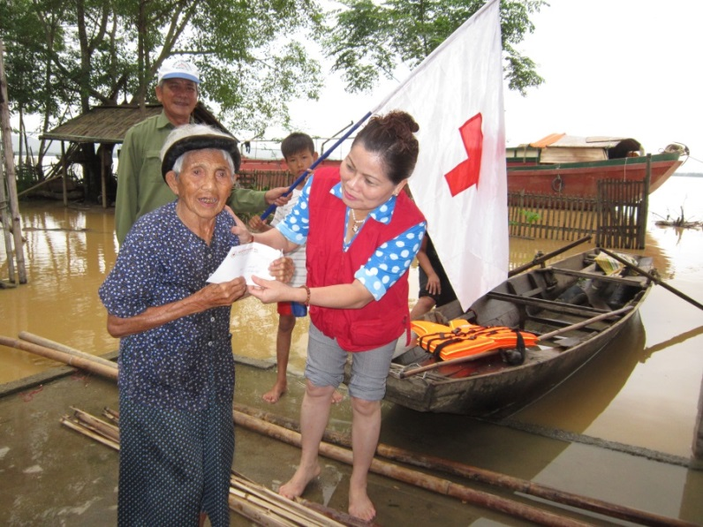
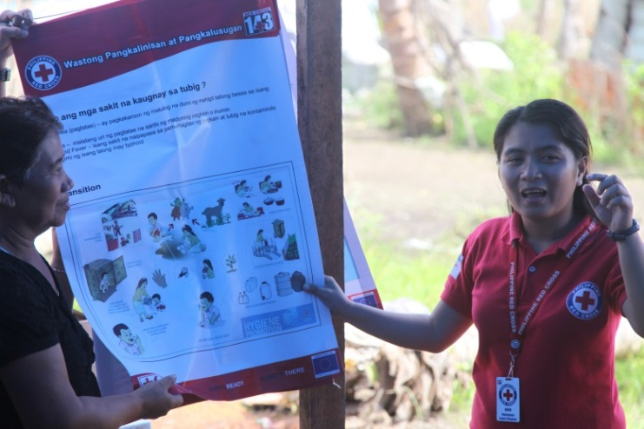
National Society Gender and Diversity Focal Points
To promote and assist in mainstreaming of gender and diversity
Provide technical assistance to National Society members on gender and diversity
Engage in peer-to-peer support
To actively participate in and contribute to the sustainability of the SEA Regional Gender and Diversity Network

Slide 14
Regional Gender and Diversity Network
Aims to…
Build stronger collaboration
Knowledge and capacity building
Encourage and enable peer-to-peer support
Co-ordinated regional approach
Promote the gender and diversity work of NSs
Enhance strategic direction
Currently 9 National Societies are involved in the network
Quarterly teleconferences – Next September 2015
Annual meetings – October 2015
Notes:
The SEA Regional Gender and Diversity Network will provide a platform that will ultimately strengthen and enhance the quality and effectiveness of National Societies existing and future programs in areas such as Disaster Management and Health, through better understanding and addressing the needs of the communities we work with.

Slide 15
Partnership and networks
Focal points to strengthen networks at a National level
Linkages with Government and external agencies: UN and EU, Civil Society Organisations.
Highlight national (Govt) and regional priorities (ASEAN, Mekong platforms) to understand the context and identify how National Societies can best contribute and add value
Strengthen collaboration within National Society – across units and at a branch level
Strong country-level networks will help strengthen and sustain active regional networks
Notes:
In addition to the regional level network, it is important four NSs, and in particular through the gender and diversity focal points to link with other gender and diversity networks e.g. governments, UN and EU agencies, Civil society organisations, that work on or have a specific focus on gender and diversity.
Further to work within the NS itself. Collaboration should be strengthened across units within the National Society, as well as at a branch level.
Focal points can work within the National Society to highlight national and regional priorities for G&D so that NSs can better understand their G&D activities in relation to the wider context and add value to within their environment.
These networks that form at a country level will help strengthen and sustain an active regional level network. This will also ensure that the network is based on the experience and priorities of each National society and that the regional network is owned collectively by National Societies with IFRC taking the role of a supporting role when required.

Slide 16
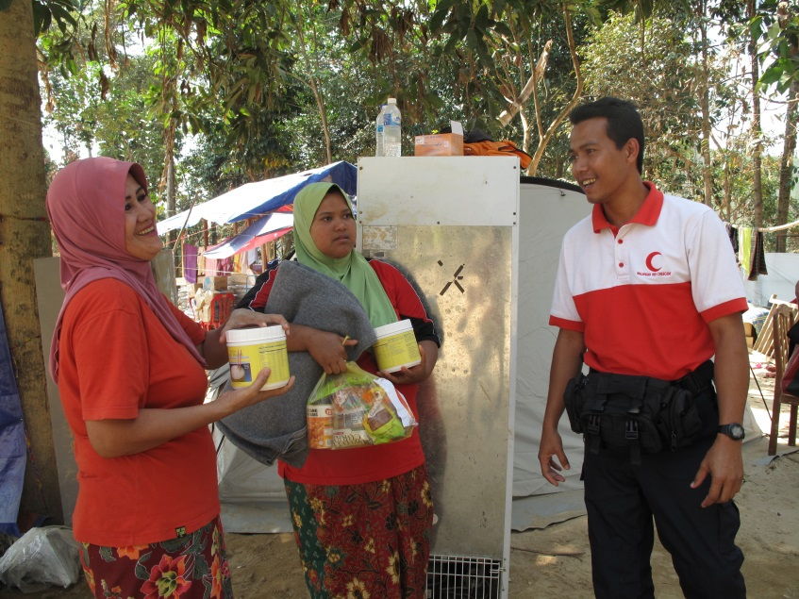
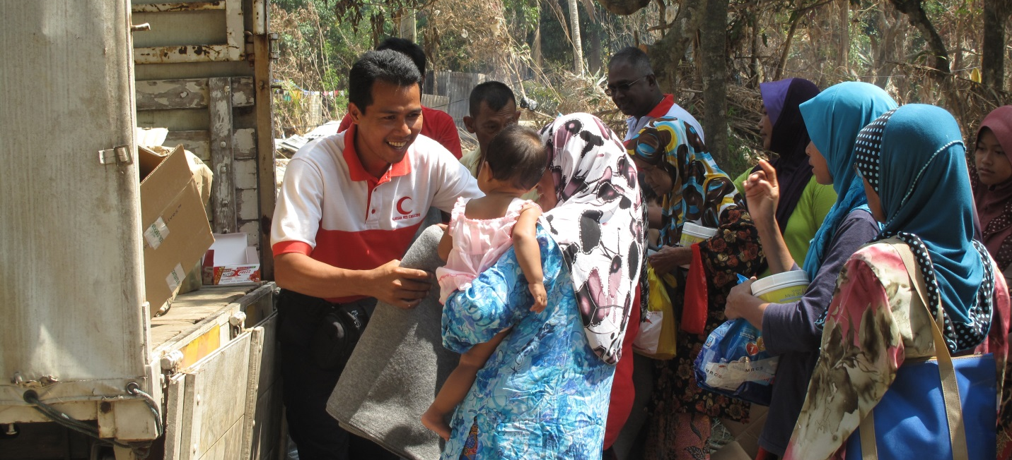
Regional Gender and Diversity Network
“Gender and diversity is about telling the stories of the people that MRCS reaches, and the impacts of our humanitarian work on Malaysian communities…we know that different people are affected differently by floods, and that people have distinct health needs – depending on their sex, age, and class – so we ensure that we meet all those needs through gender and diversity analysis. The gender and diversity network is helping us to improve the way we do this.” Malaysian Red Crescent Society

Slide 17
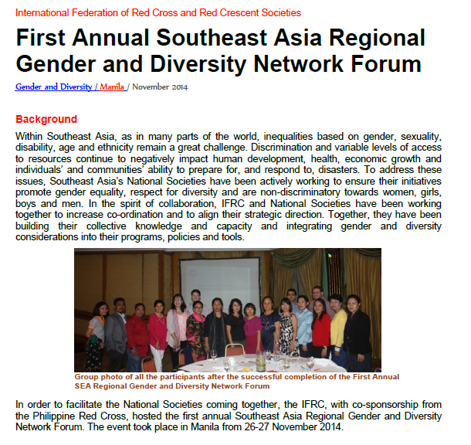
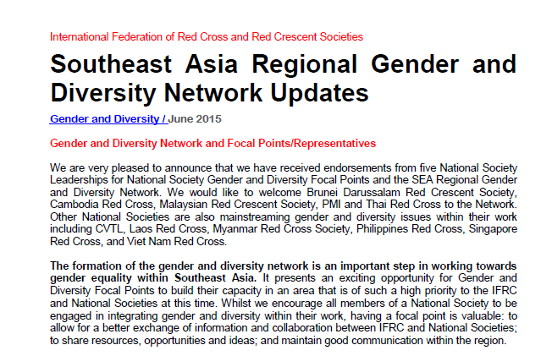
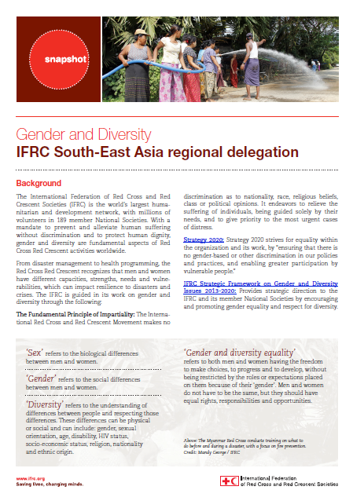
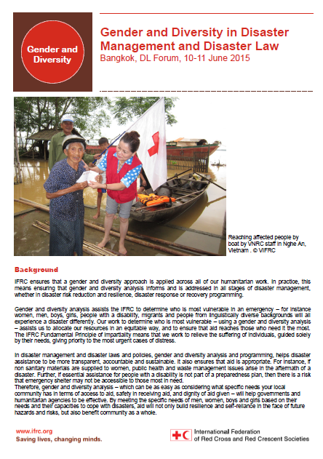
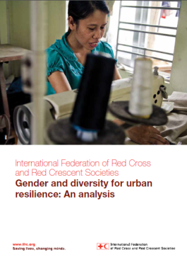
Communicating our work
Notes:
One of the advantages of having a network means that information will be better exchanged throughout the region including the challenges that are faced as well as good practices. This will be exchanged through the network teleconferences and the annual face to face meetings.
Over the past year we have developed a number of publications to both increase awareness of gender and diversity within a specific sector e.g. in urban resilience and well as publications highlighting the planned activities in the region and the ways we are mainstreaming gender and diversity intro migration, working with the youth and violence prevention activities.
We are also producing network updates which so far have highlighted the development of the network and some key events that have taken place. The next update will start to be produced following the teleconference in September where the chair of the network will take the lead in gathering updates from the region to highlight the great work being undertaken.

Slide 18
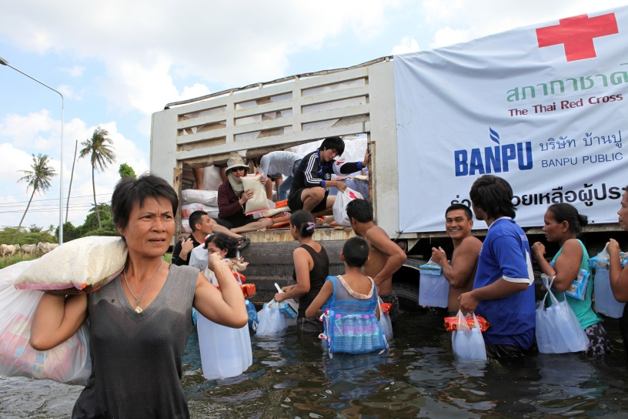
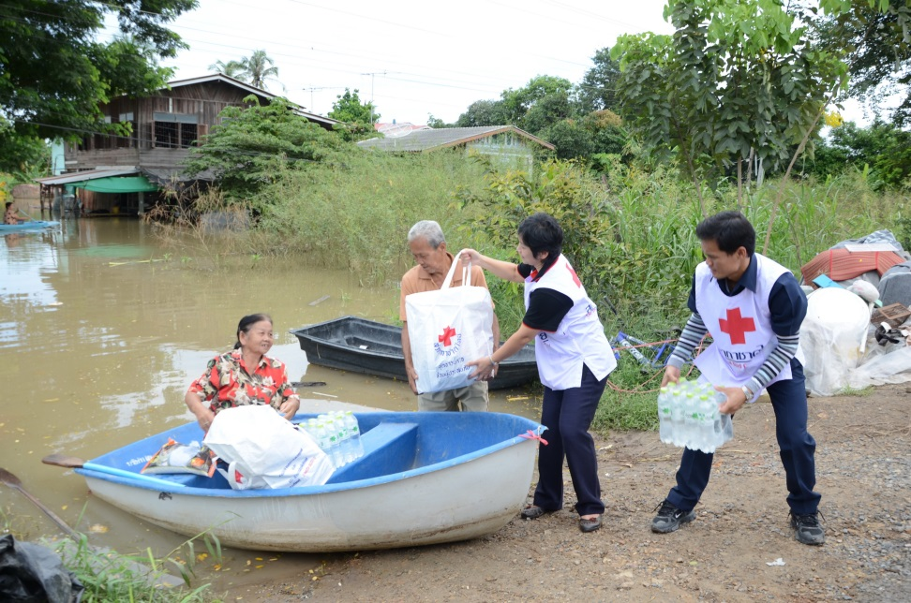
Regional Gender and Diversity Network
“Because the gender and diversity network supports NS, enhancing learning on related issues using minimal resources…It is very important to make the networks themselves sustainable, and participation in the larger networks of similar activities to enable wider exchange of knowledge and material resources.”
Thai Red Cross

Slide 19
Gender and Diversity for Resilience Toolkit
Burmese
Indonesia Bahasa
Khmer
Laotian
Malay
Tagalog
Tetum
Thai
Vietnamese
English
Comprehensive but selective set of resources
Tools for programming (DM, Health, WATSAN, Violence Prevention
Policies and strategies, self assessments, PMER, trainings and communications
Open source, free and hosted on SEARD’s online library
Summary information in nine regional languages
Request forms during gallery walk
Notes:
As reflected in the previous quote, one area that was highlighted regarding the practical application of integrating gender and diversity in general was the want for more easy access to gender and diversity-sensitive resources.

Slide 20
Training and capacity building
Gender and Diversity workshop – Manila November 2014
Climate Change Master Training – Phuket September 2014
Gender in Emergencies Training – Australia June 2015
MRCS gender and diversity workshop - November 2014
CVTL Gender and Diversity Awareness Training – August 2015
AHA Center ACE Programme – RCRC training. Gender and Diversity in DM
Notes:
It is important that the knowledge and capacity built up from these training in various national societies are harnessed through peer to peer learning and are able to translate through national societies so that one person’s training impacts the Society and region.

Slide 21
Gender and Diversity Regional TOT
Outcome 1
Increased awareness and knowledge of key concepts and issues related with gender and diversity and IFRC’s frameworks and approach
Outcome 2
Increased awareness of tools and resources to support the integration of gender and diversity within programmes
Outcome 3
Increased capacity in how to raise awareness and train others on gender and diversity concepts and their practical application,

Slide 22
The way forward… four key next steps
Technical working groups.
Priorities and recommendations for 2015-2016
Meet with your National Society Gender and Diversity Focal Point to discuss opportunities for integration
Document and communicate gender and diversity-related successes, achievements and lessons learned
View the tools and resources in the Gender and Diversity for Resilience Toolkit
Notes:
During the technical working group sessions tomorrow. It is important that in DM, Health and OD gender and diversity is integrated and mainstreamed within our priorities and plans for 2015-16 and that these are reflected in the regional road map and recommendations to the leaders.
Find out who your gender and diversity focal point, if you are not already aware and meet with them to discuss option and opportunities for integrating gender and diversity into the work you are already working on. This could also lead to ideas for future proposals or project planning
In October the resources for the gender and diversity for resilience toolkit will be online and available to download as they are, or to request for them to be translated in full or in part. Work with your gender and diversity focal point to see what resources you would like. There will be form tomorrow during the gallery walk where you can highlight resources of use so if we do not already have these in the toolkit I can look into sourcing them.
Finally document your gender and diversity achievements and share with your G&D focal point. These successes can then be shared through the teleconference and annual meetings and can be included in the G&D updates that will be circulated within the region.

Slide 23
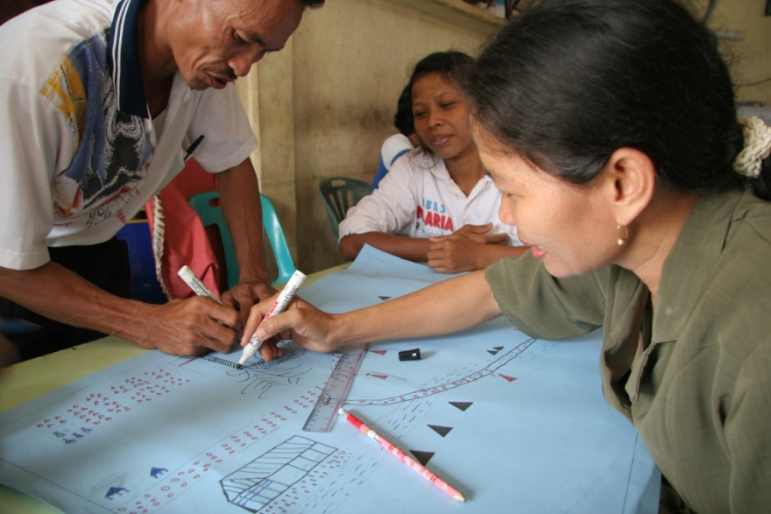
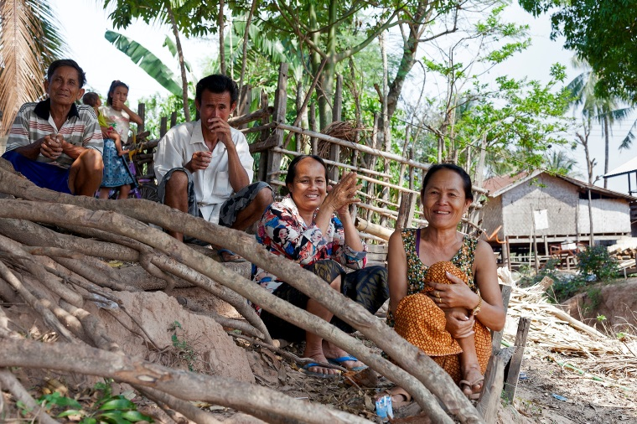
Terima kasih! Thank you!

