Slide 1
Gender mainstreaming
SEA Regional Gender and Diversity
Training of Trainers
5-8th October

Slide 2
Session learning objectives
(please included the results from your SMART objectives exercise)

Slide 3
What is gender mainstreaming?
“Gender mainstreaming is the process of assessing the implications for women and men of any planned action in all areas and at all levels.
It is an approach for making women’s and men’s concerns and experiences an integral part of the design, implementation, monitoring and evaluation of policies and programmes.
This is to ensure that women and men benefit equally and inequality is not worsened.”
Australian Red Cross, Organizational Assessment Tool

Slide 4
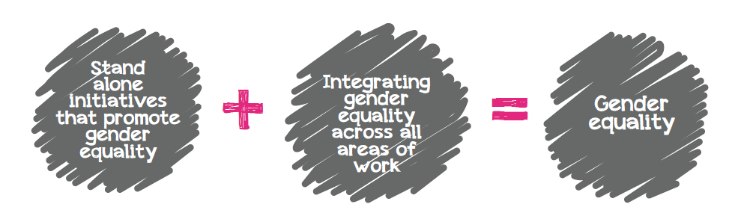
Stand alone + Integration
Gender equality will be most effectively achieved through stand-alone activities that promote gender equality AND by integrating gender throughout all areas of our work. (gender mainstreaming)
Graphic taken from: Think out loud. A practical guide to gender mainstreaming in community organisations. Alison Barclay & Kiri Dicker, 2014.

Slide 5
Gender Mainstreaming in programmes
It is important that we mainstream gender and diversity throughout all of our programmes including….
Health
DRR
Disaster response
Disaster recovery
Working with the youth
Disaster Law
Migration
WATSAN

Slide 6
Indonesia (PMI) – Integrated CBDRR after Tsunami
Indian Ocean Tsunami, 2004, 60-75% of fatalities were women
PMI mainstreamed gender throughout its Disaster Management activities.
Gender sensitive needs assessments ensured gender & diversity sensitive disaster action planning.
Gender-related needs, concerns and capacities from community
Equal male and female facilitators
Gender analysis on all areas: social, environment, economic issues
Outcome: Evacuation plans and routes were safer for women, children, the elderly and the disabled increasing overall community safety and resilience
Notes:
During the 2004 Indian Ocean tsunami, women accounted for 60-75 per cent of the total number of people killed.
After the tsunami PMI committed to mainstreaming gender throughout its operations and, with the American red cross developed an integrated CBDRR project to build the preparedness and response of communities.
As part of this project they conducted needs assessments.
Gender sensitive needs assessments ensured the development of gender & diversity sensitive disaster action planning.
Gender-related needs, concerns and capacities from community were collected
Equal male and female facilitators
Gender analysis on all areas: social, environment, economic issues
They used this information to influence their action planning.
During the planning, several communities proposed constructing a stairway as part of an evacuation route to a hill they had identified as a safe location in case of a flood or tsunami. After consulting with women during the gender review, the stairway was re-designed to include a handrail and to reduce the height of the steps in order to facilitate its use by women holding babies, the elderly, children and the disabled.
They also found out that the evacuation plans and meeting places suggested by some groups were not accessible to everyone mainly women, children and the elderly and they could not get there in the safe time – of 10 minutes. They then developed meeting places that everyone in the community could get to.
These gender sensitive approaches contributed to the overall increased community safety. Made sure the project addressed the needs and concerns of male and female community members and made them more accessible and user-friendly for women and children than they would otherwise have been.

Slide 7
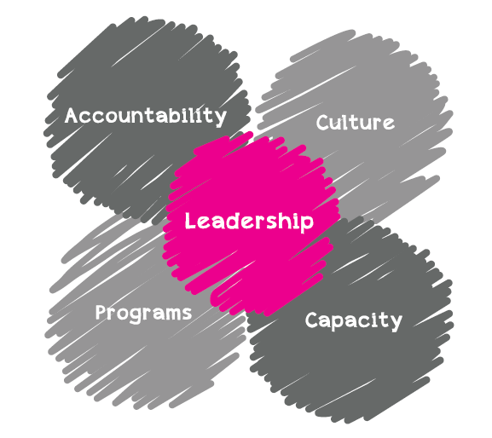
Steps to gender mainstreaming in your National Society
It is also important to mainstream gender within your National Society. This can involve:
Creating a checklist based around the key areas within the National Society
Making an honest assessment of areas where your National Society is performing well
Understanding areas where improvements can be made
Graphic taken from: Think out loud. A practical guide to gender mainstreaming in community organisations. Alison Barclay & Kiri Dicker, 2014.

Slide 8
Steps to gender mainstreaming in your National Society
After completing your National Society self assessment it is important to reflect on the results and as a team create an action plan moving forward!

Slide 9
Conclusion
(Please add your groups conclusion)

Slide 10
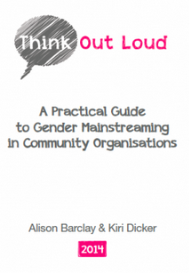
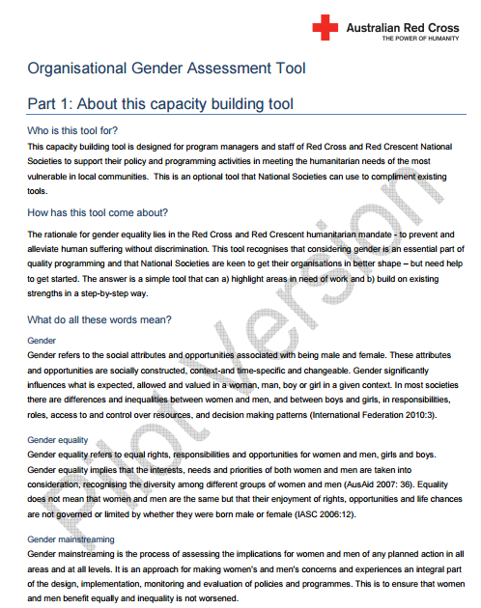
Gender and Diversity for Resilience Resource Library
For resources on gender and diversity sensitive assessments follow this link:
Link:
https://sites.google.com/site/drrtoolsinsoutheastasia/gender-and-diversity/gender-and-diversity-for-resilience-toolkit/national-society-assess

Slide 11

Any questions?

