Slide 1
Gender analysis
To inform sectoral and needs assessments
SEA Regional Gender and Diversity
Training of Trainers
5-8th October

Slide 2
Session learning objectives
By the end of the session, participants will have/be able to:
1. Define gender analysis and the reason why national societies need to do gender analysis
2. Identify at least two considerations when conducting gender analysis
3. To practice how to conduct gender sensitive need assessment and to use the gender analysis results to inform programming

Slide 3
Risks and vulnerabilities during disasters
Emergencies can impact anyone but not everyone will be affected in the same way
Even during peace-time, not everyone experiences daily life in the same way
As we have heard from the previous sessions, people with disabilities, the elderly, men and women all have different needs, during and after an emergency.

Slide 4
Risks and vulnerabilities during disasters
We know that roles and expectations are attributed to people because of aspects of their gender or diversity.
This can lead to people being more vulnerable or margenalised within society.
Vulnerabilities (physical, social, economic, or environmental) can become even more prevalent in times of disasters.

Slide 5
Gender inequality during disasters
Women, girls and boys are 14 times more likely to die during a disaster than are men
Asia Tsunami, 2004 +70% fatalities women
The death toll from the Bangladesh Cyclone (1991) was 5x higher for women than men. Part of the reason was that early warning information about the cyclone and the floods was transmitted by men to men in public spaces, rarely reaching women directly .
Notes:
Sources:
United Nations Development Programme, Gender and Disasters
http://www.undp.org/content/dam/undp/library/crisis%20prevention/disaster/7Disaster%20Risk%20Reduction%20-%20Gender.pdf
Gender and Disaster risk reduction (UNDP) Policy brief 3.
http://www.undp.org/content/dam/undp/library/gender/Gender%20and%20Environment/PB3-AP-Gender-and-disaster-risk-reduction.pdf

Slide 6
What is a gender analysis?
A gender analysis is:
a systematic approach to identifying and understanding the relationships of women and men within the family, economy and society…
…and how these relationships affect the distribution of resources, as well as the structures and rules that contribute to an unequal distribution of resources and power.
It involves consulting with a range of men and women from the community, including those in positions of authority, to get their different perspectives.
Notes:
Definition taken from A guide to gender sensitive disaster management (IFRC)

Slide 7
Why is a gender analysis essential?
A gender analysis:
Ensures that we know who is affected: e.g. women, men, boys, girls, older people, people with disabilities, pregnant women, ethnic minority groups, migrants, women who have survived sexual violence,
Ensures that we know how they are affected and
Ensures we understand the needs, capacities and vulnerabilities of these individuals and groups so we can respond appropriately.

Slide 8
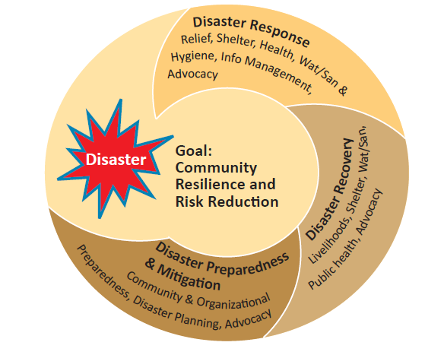
Gender-sensitive assessments
A gender analysis should inform all assessments at all stages of the disaster management cycle.
Preparing for emergencies (Hazard and risk assessments, VCAs)
Sectoral or needs assessment in the aftermath of an emergency
Sectoral or needs assessment to inform recovery planning

Slide 9
Myanmar Red Cross Society – Recovery after Cyclone Nargis
Cyclone = 61% of victims were women
Gender sensitive early recovery programme
Needs assessment teams
Participation of women in FGDs
Beneficiary selection – 33% female
Inclusion of people with disabilities, the elderly, FHH, widows, landless labourers, MHH
Equal wage
Outcome: Gender-sensitive needs assessment highlighted the need for child-care facilities ensuring economic development without discrimination
Notes:
The majority of the cyclone’s victims were women – with an average of 61% but with a much higher proportion in some villages.
The Myanmar Red Cross Society, with support from the IFRC, responded immediately as well as helping communities transition from relief to recovery stages.
They developed a recovery programme that would also build the capacity of communities for future disasters. One of the key areas of this programme was a Cash for Work programme. Which aimed to mainstream gender throughout.
Needs assessment: The team conducting the needs assessment consisted of both men and women in the team.
Women in the community were encouraged to participate in the assessment which included FGDs and interviews - This allowed them to find out that a particularly vulnerable group were landless female laborers who had difficulty finding employment post-disaster
When they planned the project:
Beneficiary selection was 33% female
They ensured inclusion of activities that women could take part in
Equal wage payment for both men and women
Wages were paid to the actual beneficiaries rather than family members – so women received money directly
They also ensured inclusion of people with disabilities, the elderly, single headed male and female households (including widows)
One of the most significant findings came just before implementation, in the final preparations. It became clear that female headed households, especially those with large families found it hard to balance work and family responsibilities. As a result of this MRSC set up facilitates so that women could bring their children to work.

Slide 10
Some considerations when conducting a gender analysis
What is the profile of the affected group? (i.e. number of households and household members disaggregated by sex and age; number of single male and female heads of household; number of pregnant and lactating women; and number (male/female) of unaccompanied children, older people, persons with disabilities, chronically ill, etc.)
Are there any other potentially vulnerable groups in the population such as ethnic minority groups, migrants, class or caste groups for example
Notes:
Sourced from Annex 1 of Minimum Standard Commitments to gender and diversity in emergency programming
https://www.ifrc.org/Global/Photos/Secretariat/201505/Gender%20Diversity%20MSCs%20Emergency%20Programming%20HR3.pdf

Slide 11
Some considerations when conducting a gender analysis
Are assessment and response teams gender-balanced? Are specific actions required to create permission and space for women and marginalised groups to participate in response teams? If so, what are these?
Are there mechanisms in place to ensure participant groups are representative and participatory. If there are social or cultural restrictions that prevent women from participating, are these being addressed?
Have males and females of all ages, including those from marginalised groups, been consulted and involved in assessments to determine their specific needs, priorities and concerns within the sector-specific programming as they relate to dignity, access, participation and safety?

Slide 12
Considerations when conducting a gender analysis
Understanding the daily routine of men and women; both for preparedness planning and also for participation in assessments
Understanding who are the key decision makers in the household/community?
What are the expected roles and responsibilities of males and females in the household and in the community for each sector e.g. division of labor/control of resources? in shelter construction, in the maintenance of water points, latrines and bathing areas, in the collection of water and fuel?)

Slide 13

Considerations when conducting a gender analysis
Never make assumptions, use a gender analysis to inform your understanding of a context, community and situation
Once you have conducted your gender analysis…Information must always be used to inform programme planning, monitoring and evaluation!

Slide 14
Conclusion
Gender analysis is important because it helps us to understand the needs, capacity, vulnerabilities of these individuals and groups so we can respond appropriately
Gender analysis should inform all assessment at all stages of the disaster management cycle.
Gender analysis should be integrated into all assessment tools (e.g. VCA, sectoral assessment tools)

Slide 15
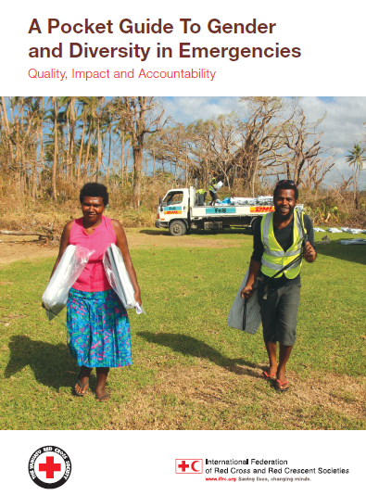
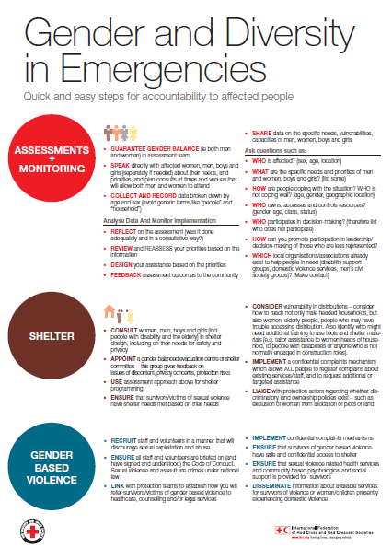
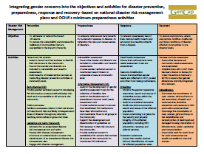
Gender and Diversity for Resilience Resource Library
For internal and external resources related to gender analysis and gender and diversity sensitive assessments follow this link:
Link:
https://sites.google.com/site/drrtoolsinsoutheastasia/gender-and-diversity/gender-and-diversity-for-resilience-toolkit/building-resilience/disaster-risk-reduction-drr---disaster-management-dm

Slide 16

Any questions?

