Slide 1
Dignity, Access, Participation and Safety of people with disabilities
SEA Regional Gender and Diversity
Training of Trainers
5-8th October

Slide 2
Session Learning Objectives
By the end of the session, participants will be able to:
Differentiate between impairment and disability
List four actions to take to support people with disabilities
To identify actions to do in order to promote the participation of people with disabilities in RC/RC programs and services.

Slide 3
Group Questions
What are the factors that prevent people with disabilities to benefit from or participate in our program?
What are the key messages to include in raising our RC personnel’s awareness on people with disabilities, related to your program?
What aspects can you think about to improve the accessibility of people with disabilities to your program?
What actions can you take to mainstream and include people with disabilities into your program?
Notes:
Adapted from Buscher, D. Humanitarian Practice Network (HPN), Humanitarian Exchange, No. 60, February 2014, Special Feature on Gender-based Violence in Emergencies, Preventing Gender-based Violence: Getting it Right.
And Council of Delegates of the International Red Cross and Red Crescent Movement Geneva, Switzerland 7 December 2015 Draft “0” Resolution on “Adoption of the Disability Inclusion Strategic Framework by the International Red Cross and Red Crescent Movement”
http://rcrcconference.org/wp-content/uploads/sites/3/2015/03/CoD15_disability_draft-0-resolution_20150916-EN.pdf

Slide 4
Conclusion
Impairment refers to physical, mental, intellectual and sensory challenges
Disability is an interaction of impairments and barriers that prevent an effective and full participation of people with impairment on an equal basis with others.
Participation, awareness raising, accessibility, and inclusion/mainstreaming are the four factors to meet the needs and interests of people with disabilities.
People with disabilities’ needs and contributions should be promoted in all RC/RC programs and services.

Slide 5
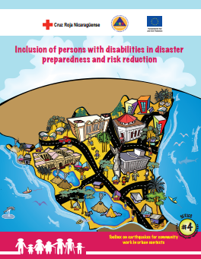
Gender and Diversity for Resilience Resource Library
For internal and external resources on inclusion of people with disabilities follow this link:
Link:
https://sites.google.com/site/drrtoolsinsoutheastasia/gender-and-diversity/gender-and-diversity-for-resilience-toolkit/building-resilience/disaster-risk-reduction-drr---disaster-management-dm

Slide 6
Any questions?

