Slide 1
Dignity, Access, Participation and Safety of the elderly
SEA Regional Gender and Diversity
Training of Trainers
5-8th October

Slide 2
Session learning objectives
(please included the results from your SMART objectives exercise)

Slide 3
Aging populations
In Southeast Asia, and globally there are a number of countries that have increasing aging populations.
We know that disasters impact people in different ways and they will have different needs during and after an emergency.
The elderly are one of the most vulnerable groups in disasters.

Slide 4
Aging inequalities during disasters
In the Japan earthquake and tsunami 2011
65% of casualties were over 60 years of age
As a result of the tsunami in Aceh, Indonesia
33.6% of victims were elderly (70+).
Notes:
References: (Who is vulnerable to Tsunami, UNESCAP)
Data from japan was taken from three of the divisions surveyed.

Slide 5
Vulnerability factors of the elderly during disasters
There are a number of factors that increase the vulnerability of the elderly to disasters:
Older people get weaker and slower and are more likely to have complications with their health
Older people may lack mobility, hearing, sight and are therefore would be more dependent on assistance
Elderly people with disabilities, can be even more prone to vulnerabilities (this highlights another interaction between aspects of diversity)

Slide 6
Vulnerability factors of the elderly during disasters
In rural areas, elderly members of the household may stay alone, while younger family members migrate to cities for work.
If a disaster strikes they may have to cope on their own and may have young members of the family to look after in addition to themselves.

Slide 7
Capacities of the elderly during disasters
Resourcefulness due to years of experience
Many may have lived through disasters before and understand the pattern of disasters
Experience of building up effective coping strategies or survival systems during and after disasters

Slide 8
Capacities of the elderly during disasters
Knowledge of traditional or alternative medicines, which can be vital to the development of the community
In some communities the elderly may have control over household assets and therefore play a key role in building back livelihoods
Elderly members of the community may be the main decision makers

Slide 9
What can we do?
Before a disaster, include the elderly in all disaster preparedness and disaster risk reduction activities e.g. mapping, analysis, planning, implementation and reporting
Encourage staff and volunteers to view older people in the community as having capacities and develop processes to harness and build on these capacities
After a disaster, ensure elderly people can access evacuation centers and that they can attend relief distribution points. It is important to make provisions to reduce barriers to this.

Slide 10
What can we do?
Understand the profile of the community to see whether elderly people are living alone or are looking after young children
Engage the elderly in recovery livelihoods programming. Adapt the programme to ensure their participation in order to further build their resilience
Ensure any data collected is disaggregated by age and if possible takes into account different elderly age brackets e.g. 60-69; 70-79; 80-89)

Slide 11
Conclusion
Please add your own groups conclusion

Slide 12
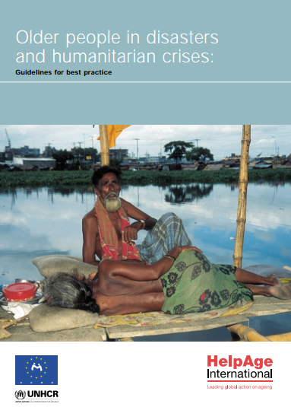
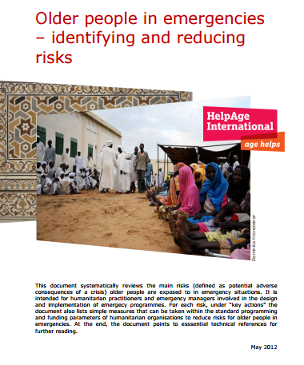
Gender and Diversity for Resilience Resource Library
For internal and external resources on inclusion of the elderly in DRR/DM follow this link:
Link:
https://sites.google.com/site/drrtoolsinsoutheastasia/gender-and-diversity/gender-and-diversity-for-resilience-toolkit/building-resilience/disaster-risk-reduction-drr---disaster-management-dm

Slide 13
Any questions?

