Slide 1
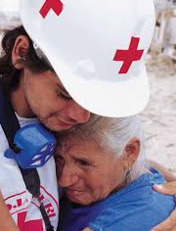
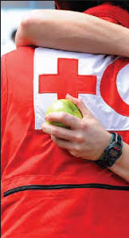
Violence Prevention
Gender and Diversity Training of Trainers
Bangkok, 6 October 2015

Slide 2
Key Messages
Violence is a global humanitarian catastrophe.
Violence is predictable, and preventable.
Organizations and Communities have an important responsibility to prevent and respond to violence.
Ten Steps tools can be used by organizations and communities to prevent and respond to violence.

Slide 3
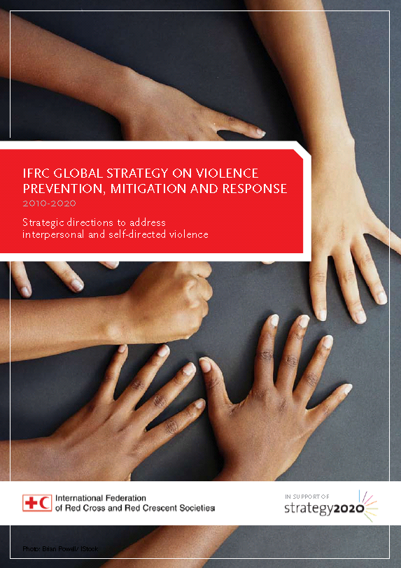
Strategic Framework
IFRC Strategy 2020
IFRC Strategy on Violence Prevention, Mitigation and Response
IFRC Violence Prevention Pledge
IFRC Gender Pledge
IFRC Gender and Diversity Strategy
Council of Delegates 2013

Slide 4
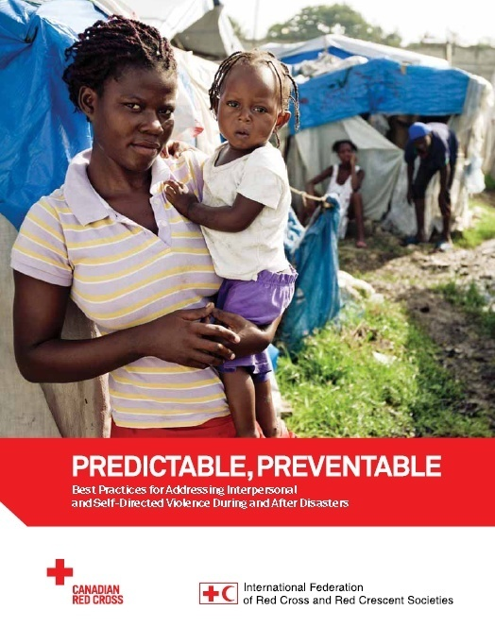

Slide 5
Categories, Types & Forms of Violence

Slide 6
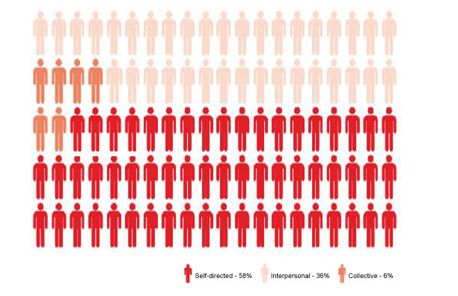
Global Deaths Each Day
4,200 deaths per day (1.6 million a year)
Source: WHO. (2013). WHO methods and data sources for global causes of death 2000–2011.

Slide 7
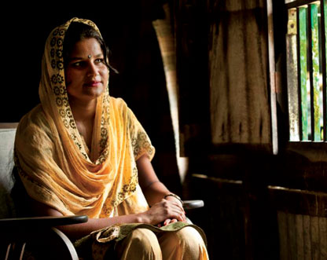
Definition of Violence
Violence between people is when one person uses his or her own power, in any setting, to cause harm physically, sexually or psychologically to a person or group of people.
Notes:
The slide is a summary or the following definition from the IFRC : violence is the use of force or power, either as an action or omission in any setting, threatened, perceived or actual against oneself, another person, a group, a community that either results in or has a high likelihood of resulting in death, physical injury, psychological or emotional harm, mal-development or deprivation.

Slide 8
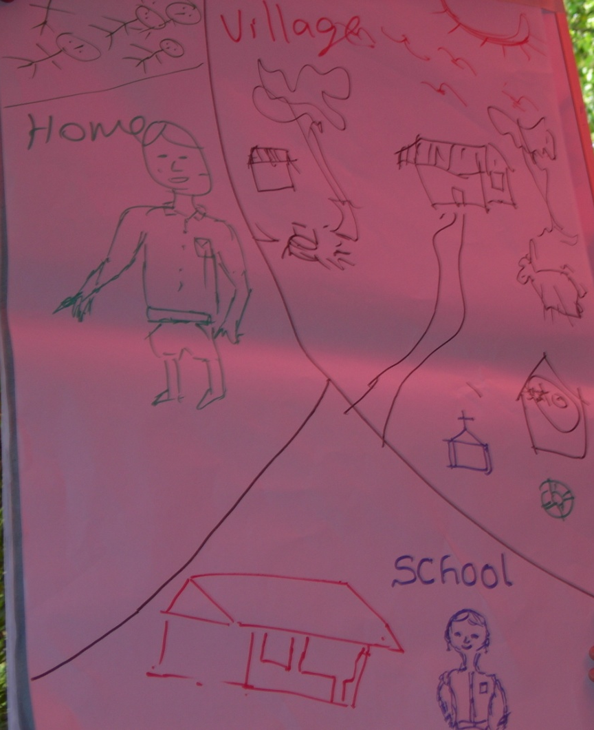
Settings
Homes/Shelters/Camps
Schools
Institutions
Workplaces
Communities
Online
Notes:
Jamaica
As of 2007, just over 6,000 children were living in residential care. As of 2009, over 400 children live in correctional institutions.

Slide 9
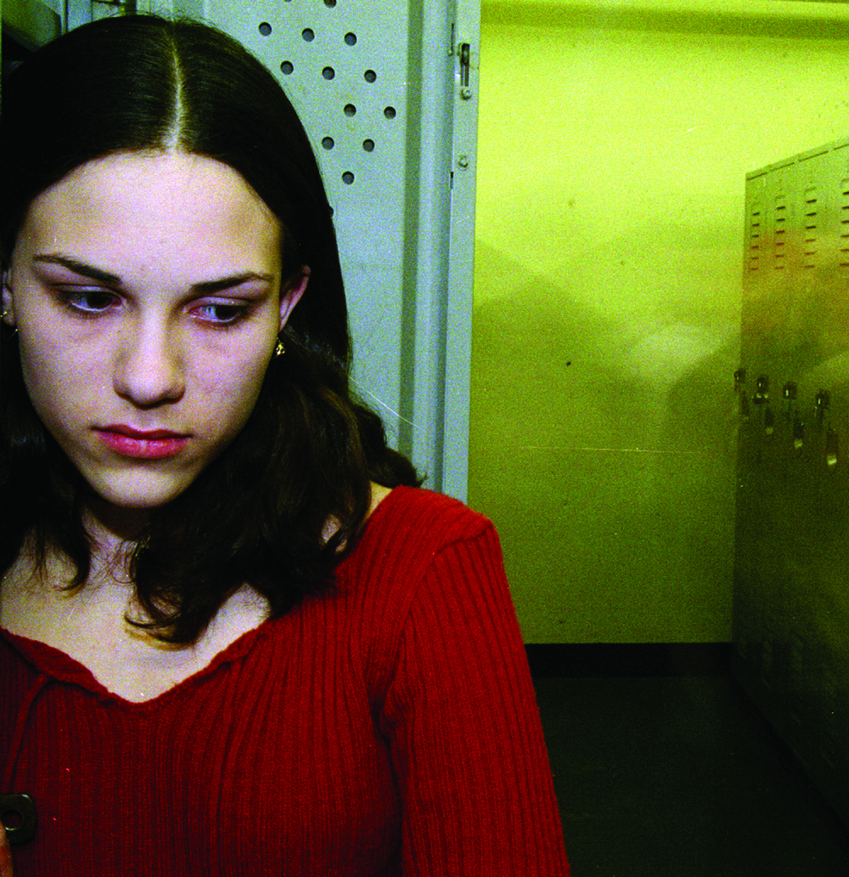
Forms of Violence
Physical
Emotional
Neglect/Deprivation
Sexual
Bullying & Harassment
Gender-Based Violence (GBV)
Self-Directed
Online

Slide 10
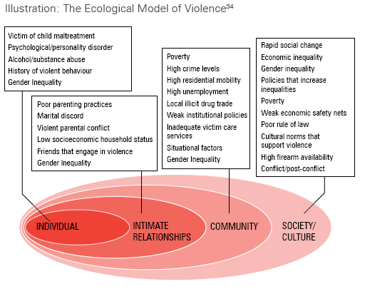
Root Causes of Violence
Notes:
- Individual child: physical size, trust adults, mental maturity; most vulnerable include separated children, orphans, children with disabilities, those already vulnerable due to gender, poverty, or anything that makes them “different”
- Family: high stress including in disasters, alcohol use (together these two factors often also lead to higher levels of domestic violence)
- Community: lack of effective support systems or community help; organizations without comprehensive prevention systems to protect children
Society/culture: where some people are treated as less important or as less entitled to rights, they are at risk of abuse and violence – men/women, adults/children, ability/disability, etc.
These same factors when reversed can become forces for protection. E.g. if a family copes with stress in a healthy way, it can become a source of safety for a child.

Slide 11
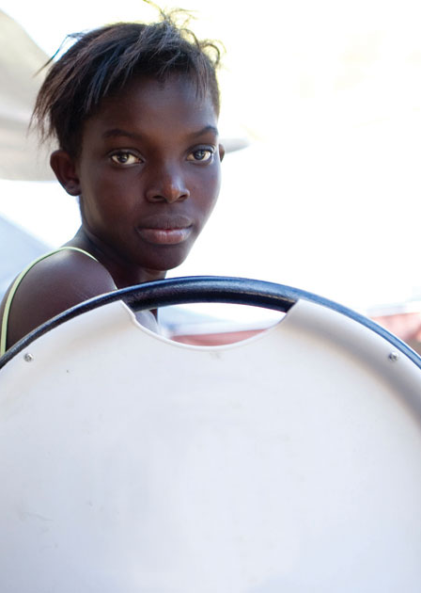
Impact
Human
Economic
Community Development

Slide 12
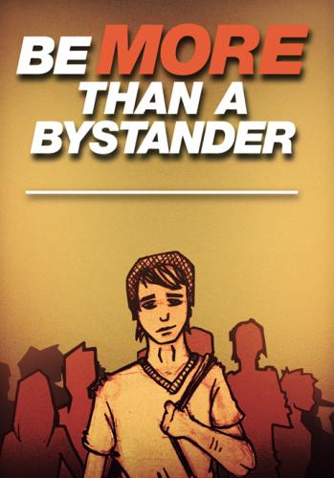
Who is involved in violent acts?
Person who is victimized/survivor
Person inflicting violence
Person who is the bystander

Slide 13
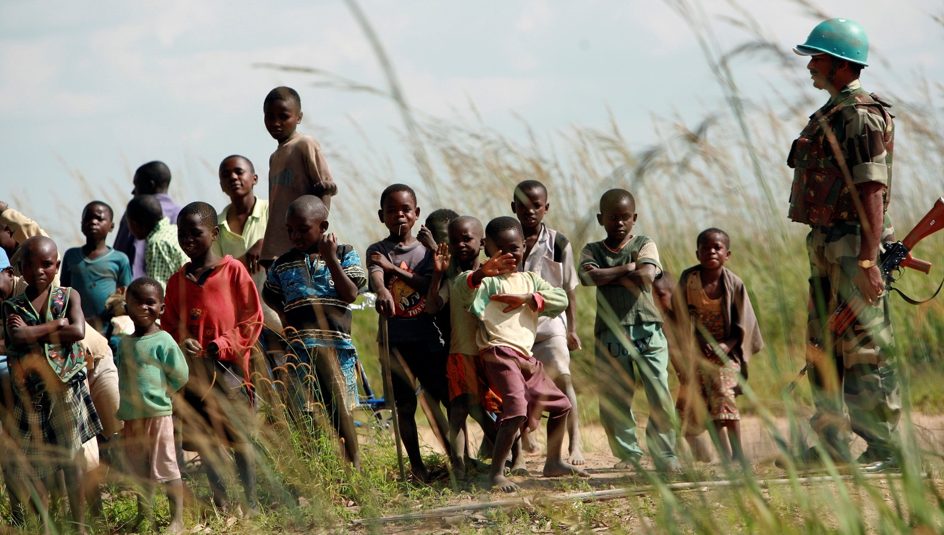
Power Relation
Where does our power come from?

Slide 14
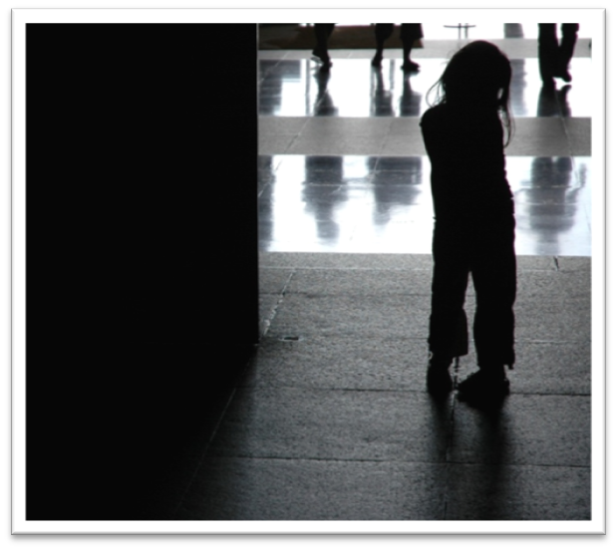
Vulnerable Populations
Children
Youth
Elderly People
Women
Men
Indigenous People
Xenophobic People
Persons with Disabilities
Marginalized Populations
During and After Disasters

Slide 15
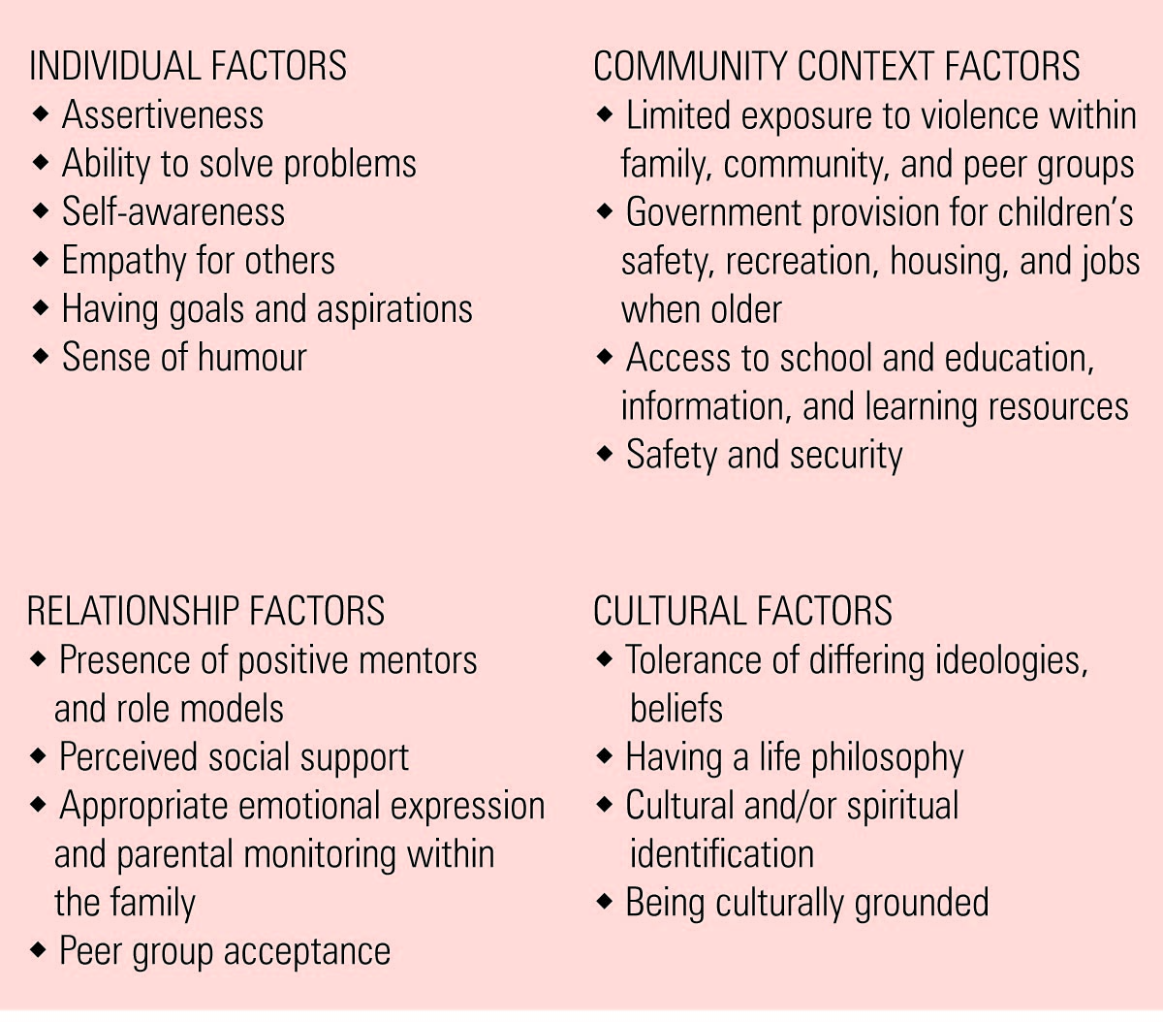
Resiliency/Protective Factors

Slide 16
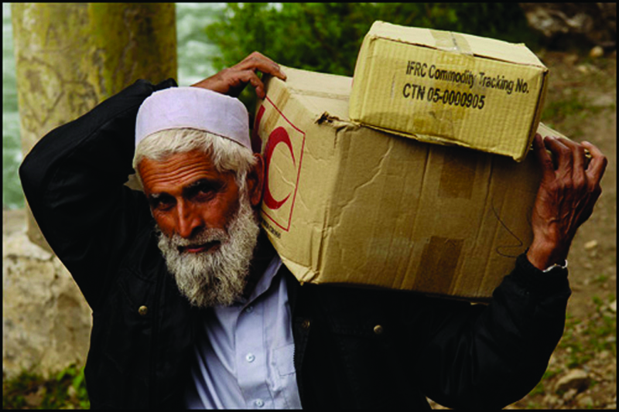
Protection Instruments
Disaster Standards:
SPHERE
IASC
International Instruments:
Children
Women
Persons with Disabilities
Indigenous Peoples
National Laws: Criminal Laws
Civil Laws
Regional/Provincial Legal Instruments
Notes:
Jamaica
Child Care and Protection Act: Every adult has one main duty under the Act.: to report if they know or suspect that a child is being abused or is in need of care and protection. This duty to report applies physical, sexual and emotional abuse:
Whether you are certain or only suspicious.
Whether the abuse has happened, is happening or is likely to happen.
1-888 – PROTECT
Convention on Rights of Child – ratified May 1991
Domestic Violence Act – amended 2004 "prohibits domestic violence and provides remedies including restraining orders and other noncustodial sentencing"
Guyana
Convention on Rights of Child – ratified Jan. 14, 1991
2009 – Child Care and Protection Agency launched; Subsequently three of five Children’s Bill; the Protection of Children’s Bill, the Status of the Children’s Bill and the Adoption of the Children’s Bill were passed. At present the Child Care and Development Bill and the Custody, Access, Maintenance and Contact Bill are before a Special Select Committee.

Slide 17
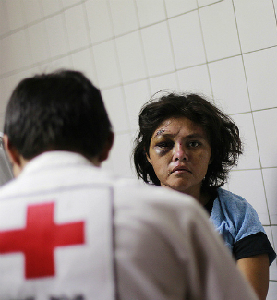
Barriers
Societal
Organizational
Individual

Slide 18
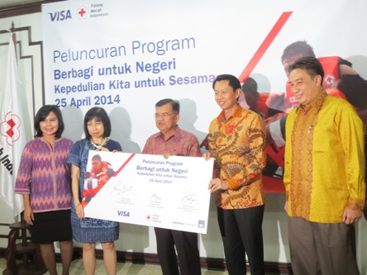
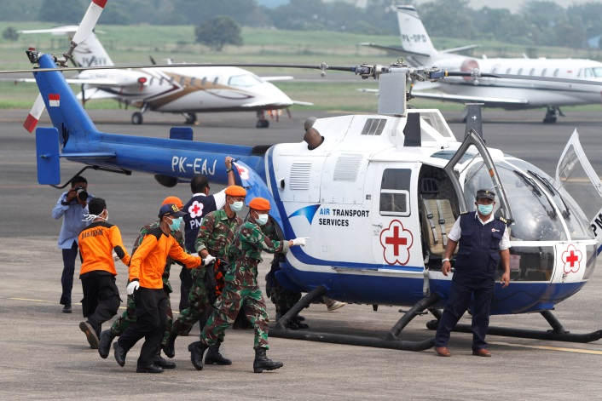
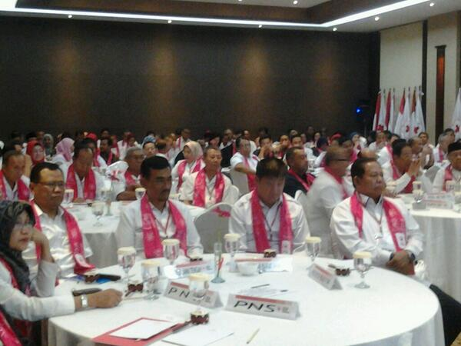
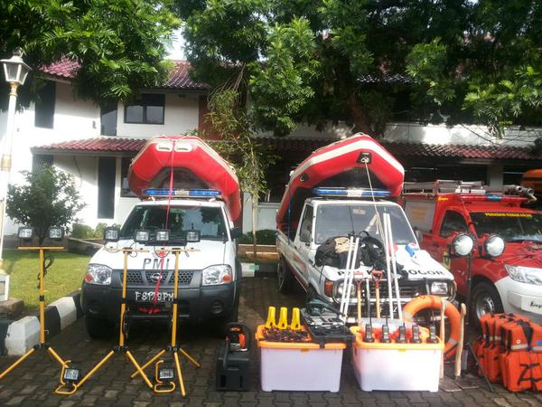
Consequences of Not Addressing Risks
Ethical
Human Rights
Image
Legal
Financial

Slide 19
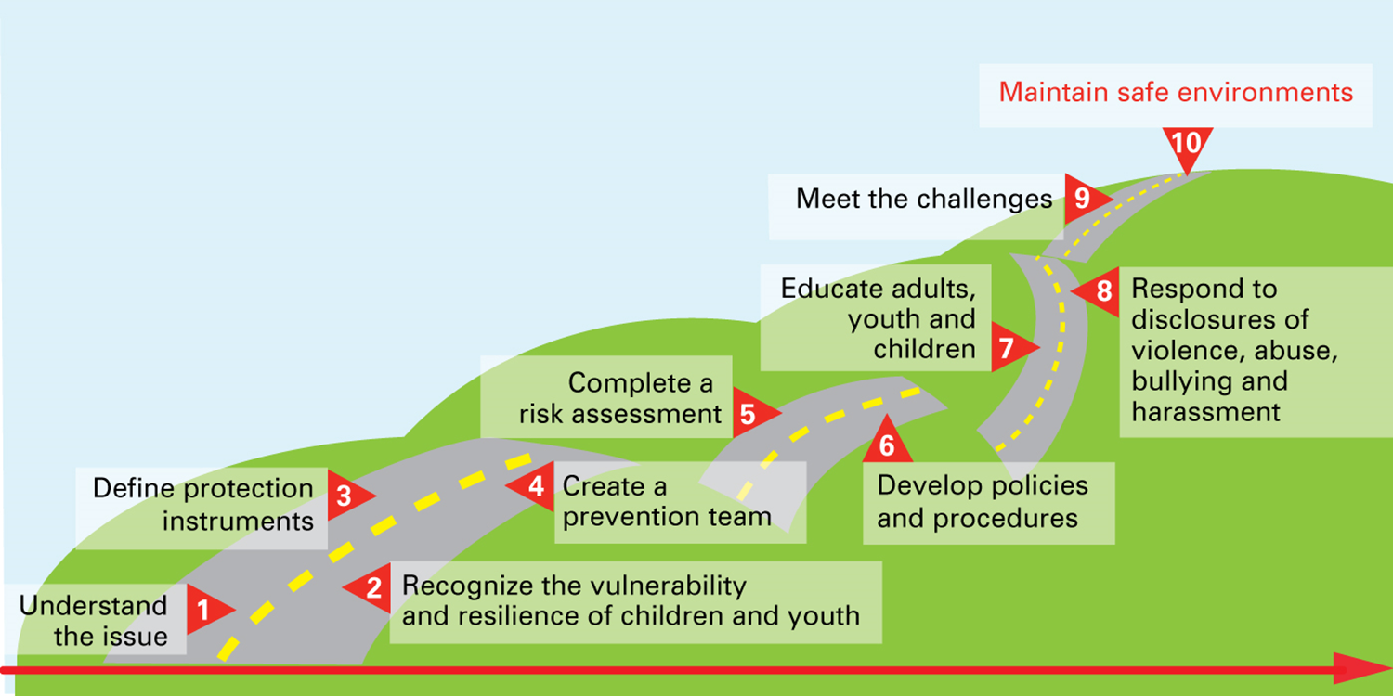
Ten Steps to Creating Safe Environments

Slide 20
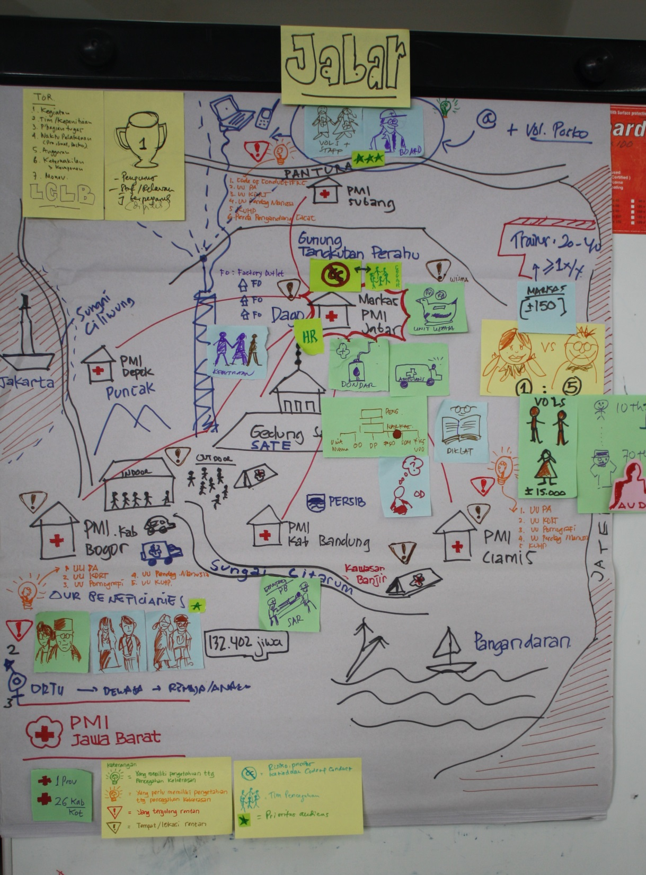
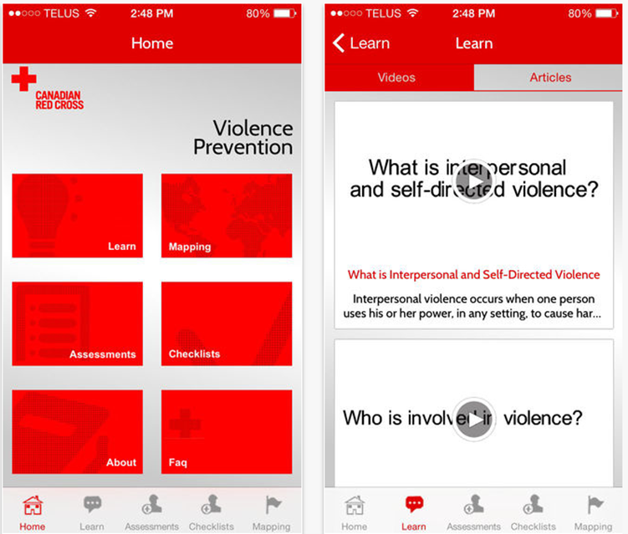
Mapping

Slide 21
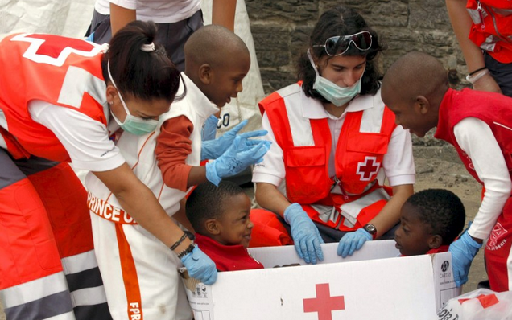
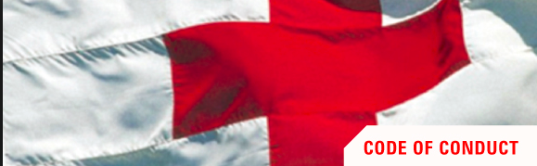
Priority Policies
Code of Conduct
Screening
Anti Harassment Policy
Child Protection Policy

Slide 22
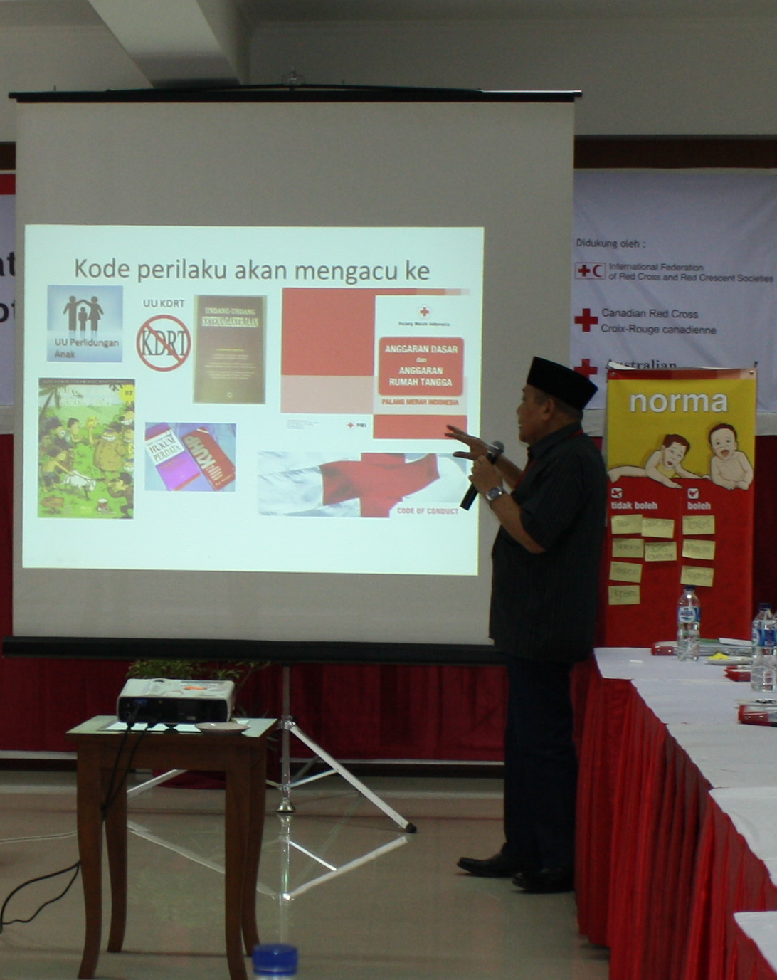
Code of Conduct – Key Inclusions
Rights and responsibilities of adults and children
Violence prevention
Definitions of violence
Prevention of discrimination
Appropriate behaviours including use of technology
Safe reporting line
Discipline process

Slide 23
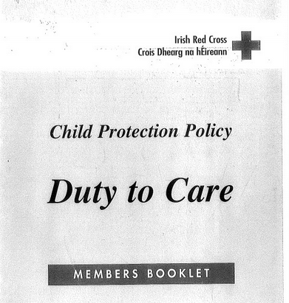
Child Protection Policy
Build awareness
Key Principles
Prevent all forms of violence and exploitation
Establish a reporting mechanism
Standard Behavior
Responsibilities and Review
Statutory Declaration

Slide 24
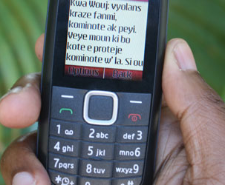
Organizational Reporting Systems
Confidential reporting systems
Investigative policies
Education of personnel and beneficiaries on reporting
Education of personnel on handling disclosures

Slide 25
PMI’s Pathway
Strategy
2020 Adopted
Violence Prevention Strategy Adopted
2012 – 3 Board Members Educated – Action Plan Developed
2013 – National Ten Steps – NHQ Divisions, 10 Provinces; VP Consortium Est.
2013 – National Volunteer Gathering – VP Introduction
2014 – PMI Child Protection Policy
2014 –TOT Ten Steps 10 Facilitators;
1 Province, 32 districts
2013 Key PMI Personnel Socialized
2015 –Integration into DM; CSE Case Studies
RCCV TWG Established
2015 –Disability Inclusion – 2 provinces, 17 Districts
Ten Steps Youth, 62 participants 31 districts
2015 –Code of Conduct; Safer Access Framework; DR Framework
2014 – Facilitators facilitating Ten Steps
3 Provinces, 35 districts

Slide 26
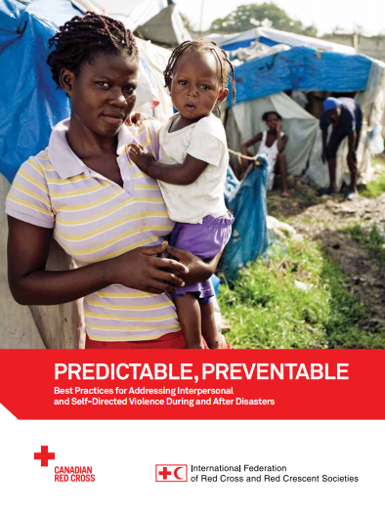
Gender and Diversity for Resilience Resource Library
For resources on violence prevention and gender-based violence visit this link:
Link:
https://sites.google.com/site/drrtoolsinsoutheastasia/gender-and-diversity/gender-and-diversity-for-resilience-toolkit/building-resilience/gender-based-violence

Slide 27
Key Messages
Violence is a global humanitarian catastrophe.
Violence is predictable, and preventable.
Organizations and Communities have an important responsibility to prevent and respond to violence.
Ten Steps tools can be used by organizations and communities to prevent and respond to violence.

