Slide 1
Applying a gender and diversity analysis to VCA
Introduction to Resilience Training
Thai Red Cross
9-12 November 2015

Slide 2
What we now know….
Disasters can impact anyone but not everyone will be affected in the same way
Even during non disaster periods, not everyone experiences daily life in the same way
….people with disabilities, the elderly, men, women boys and girls all have different needs, during and after an emergency.

Slide 3
What we now know…
VCA is a method of investigation into the risks that people face, their vulnerability to those risks and their capacity to cope with and recover from disasters.
We know that roles and expectations attributed to people because of aspects of their gender or diversity can lead to people being more vulnerable or margenalised within society.
Vulnerabilities (physical, social, economic, or environmental) can become even more prevalent in times of disasters.

Slide 4
Therefore it is important that we understand what these vulnerabilities are for each group
When we do a VCA it must be informed by a gender analysis. This ensures that we are inclusive and understand the risks, capacities and vulnerabilities of the whole community.

Slide 5
Gender & Diversity Analysis within VCA’s and assessments
Gender analysis examines relationships between females and males; their roles, responsibilities, access to and control of resources and constraints they face relative to each other.
Diversity analysis – examines the distinct reality of being a particular age/age group, disabled and other contextual factors (e.g. minority group, ethnicity, etc.)

Slide 6
Why is a gender and diversity analysis essential?
A gender and diversity analysis within a VCA:
Ensures that we know who is affected: e.g. women, men, boys, girls, older people, people with disabilities, pregnant women, ethnic minority groups, migrants, women who have survived sexual violence,
Ensures that we know how they are affected and
Ensures we understand the needs, capacities and vulnerabilities of these individuals and groups so we can respond appropriately.

Slide 7
Some considerations when conducting a gender and diversity analysis
What is the profile of the affected group? (i.e. number of households and household members disaggregated by sex and age; number of single male and female heads of household; number of pregnant and lactating women; and number (male/female) of unaccompanied children, older people, persons with disabilities, chronically ill, etc.)
Are there any other potentially vulnerable groups in the population such as ethnic minority groups, migrants, class or caste groups for example
Sex- and age-disaggregated data (SADD) – data broken out by sex and age (or age group)
Notes:
Sourced from Annex 1 of Minimum Standard Commitments to gender and diversity in emergency programming
https://www.ifrc.org/Global/Photos/Secretariat/201505/Gender%20Diversity%20MSCs%20Emergency%20Programming%20HR3.pdf

Slide 8
Some considerations when conducting a gender analysis
Are assessment teams gender-balanced? Are specific actions required to create permission and space for women and marginalised groups to participate in assessment teams? If so, what are these?
Are there mechanisms in place to ensure participant groups are representative and participatory. If there are social or cultural restrictions that prevent women from participating, are these being addressed?
Have males and females of all ages, including those from marginalised groups, been consulted and involved in assessments to determine their specific needs, priorities and concerns related to dignity, access, participation and safety?

Slide 9
Considerations when conducting a gender and diversity analysis
Understanding the daily routine of men and women, boys and girls; both for DRR plans but also for participation in VCAs
Understanding who are the key decision makers in the household/community?
What are the expected roles and responsibilities of males and females in the household and in the community for each sector e.g. division of labor/control of resources? Maintenance of water points, latrines and bathing areas, in the collection of water and fuel?)

Slide 10
Considerations when conducting a gender analysis
Never make assumptions, use a gender analysis to inform your understanding of a context, community and situation
Once you have conducted your gender analysis…Information must always be used to inform programme planning, monitoring and evaluation!

Slide 11
VCA tools used by Thai Red Cross
Structured and semi-structured interviews;
Focus group discussion;
Direct observation
Hazard mapping (perception)
Vulnerability mapping
Daily schedules – times of the day
Capacity/resource mapping;
Transect walk;
Seasonal calendar;
Historical profile (elderly);
Livelihood analysis
Institutional and social network analysis

Slide 12
Focus group discussions
Notes:
The importance of same sex facilitators and single sex FGDs

Slide 13
Resource mapping
Notes:
Examples of tools that incorporate both men and women’s responses…
Sourced from Integrating gender into community based disaster risk management: training manual (2010)
http://www.preventionweb.net/english/professional/trainings-events/edu-materials/v.php?id=14452

Slide 14
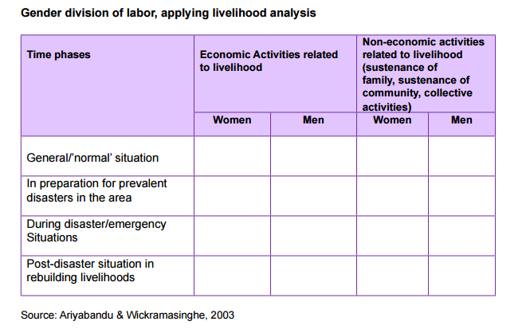

Slide 15
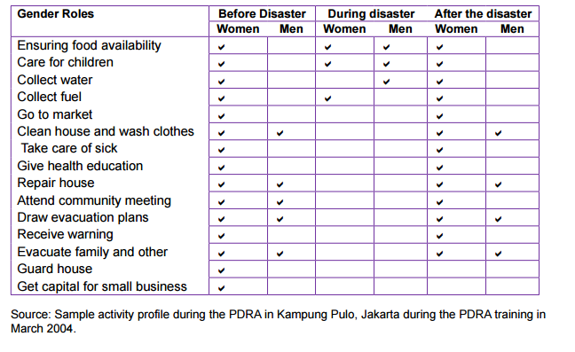
Notes:
This can be divided further to show the triple workload often encountered by women: productive work, reproductive work and community work

Slide 16
Daily schedule

Slide 17
Price of not including a gender and diversity analysis
We may not get all the information we need to reduce the risks of disasters for everyone in a community
We limit the effectiveness of our DRR or CBDRR programmes
Our programmes will not reach the most vulnerable
We may unintentionally cause greater harm to certain groups in a community by not understanding their vulnerability and capacities and the relationships with other members of the community.

Slide 18
Thank you!
Any questions?

