Slide 1
Seven Moves: Gender and Diversity in Emergency Programming
Southeast Asia Regional Gender and Diversity Training
Christina Haneef (IFRC) & Norwina Eclarinal (PRC)

Slide 2
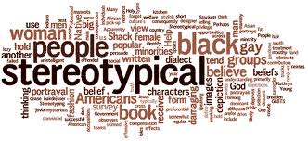
That’s just so typical!
A way of behaving, an attitude or a characteristic that would be considered typical for your sex/gender
Notes:
Overgeneralisation of the characteristics of one group of people. Often polarising in that it attributes +ve characteristics to one group and –ve attributes to another.

Slide 3
Objectives
To understand importance of mainstreaming gender and diversity in different sectors throughout programme cycle
Feel confident to articulate the reasons that we should implement gender- and diversity-sensitive programming and some practical ways to achieve it
Confident in the practical use of tools (IFRC Minimum Standard Commitments to Gender and Diversity) for reducing risks to disasters, conducting assessments, programming, and beneficiary selection

Slide 4
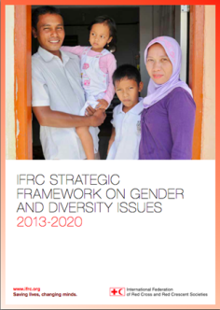
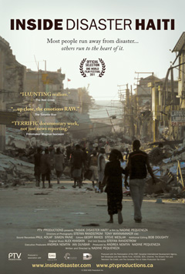
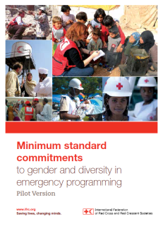
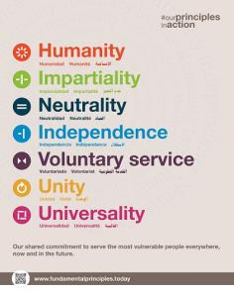
Agenda and Structure
Notes:
This training is structured around the following resources, and is based on the following priorities:
The IFRC Strategic Framework
The Fundamental Principles of the Red Cross Red Crescent
Case studies will include:
Mexican red cross and Haiti examples (because there is a great resource that is called Inside Disasters, which follows a Red Cross FACT Team)
The experiences of the group
You will learn to use this key PRACTICAL resource:
The IFRC Minimum Standard Commitments to Gender and Diversity in Emergency Programming

Slide 5
HUMANITY

Slide 6
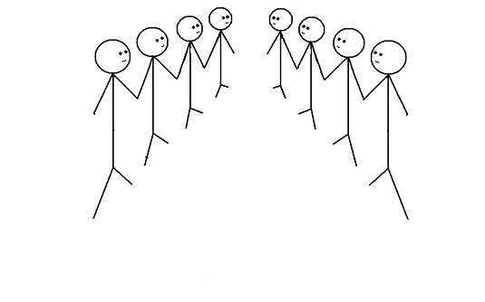
Group exercise
Speed debating

Slide 7
Discuss…
In disaster response we are so busy. Addressing gender and diversity must wait.
Notes:
This exercise if called SPEED DEBATING:
On this slide and the following slides you will find a series of ‘Black and White’ or ‘Blanket’ statements
You ask the group to stand in two lines facing each other, ensure that each person has a ‘partner’ in front of them (even numbers of people facing each other)
Then you will ask one side to take the ‘affirmative’ side of the statement; the other side argues that the statement is not true.
Give 3 minutes to debate each slide
Between slides, have a short debrief about the topic
KEY THEMES TO DRAW OUT:
It is not as simple as any of these statements
You often cannot view vulnerability only in terms of ‘gender’ or ‘diversity’ – you need to overlay them with each other

Slide 8
Discuss…
In disasters, women are the most vulnerable.

Slide 9
Discuss…
In a disaster response, we do not have the time or resources to understand and meet the distinct needs of people with disabilities

Slide 10
Discuss…
It makes no difference if we categorise an adolescent girl as an adult or a child?

Slide 11
Discuss…
As Red Cross Red Crescent we do not pay enough attention to the needs of older people during disasters
Notes:
This is a good exercise to get people to think about their own beliefs when it comes to gender and diversity
We have all grown up with some kind of bias and when we work in stressful situations it is important to know what we think and also what others may think
To understand ways in which gender and diversity influence decisions and policies

Slide 12
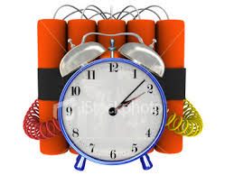
What do we hear about gender and diversity?
COMMON CHALLENGES
Too busy
No resources
Not a priority
I do not know how to do it
It is for someone else to do

Slide 13
Core Concepts
Sex | Gender
Biological differences | Social differences
Male, female | Masculine, feminine
Born male or female; difficult to change | We become masculine or feminine. Changes across the life-cycle, within and between cultures, traditions and beliefs
Binary opposites | Degrees of masculinity and femininity – society sets the bar on attitudes, behaviours etc.
Notes:
Male and female – binary opposites
Masculine and feminine – degrees of masculinity and femininity set against a bar set by society.
Feminine – girly-girl, princess, tomboy, butch, androgynous, bitch, whore, madonna
Masculine – hyper masculine, ‘a bit of a woman’, ‘a girl’s blouse’, ‘feminine’

Slide 14
Sex or Gender?
Females can get pregnant A higher percentage of American doctors are women, compared to Egypt Males have testicles, females have ovaries New Zealand was the first country in the world to give women the vote. | Males have deeper voices after puberty Women tend to do more of the housework than men Females breastfeed In some countries, women have to cover their heads when they go outside the house Women are the main care-givers (for children, aging parents, sick and disabled)
Notes:
•1893 New Zealand
•1902 Australia - Australian women, with the exception of aboriginal women. Aborigines, male and female, did not have the right to vote until 1962.
•1906 Finland
•1913 Norway
•1915 Denmark
•1917 Canada - Canadian women, except Canadian Indian women, won the vote in 1917. Canadian Indians, male and female, did not win the vote until 1960.
•1918 Austria, Germany, Poland, Russia
•1919 Netherlands
•1920 United States
•1921 Sweden
•1928 Britain, Ireland
•1931 Spain
•1934 Turkey
•1944 France
•1945 Italy
•1947 Argentina, Japan, Mexico, Pakistan
•1949 China
•1950 India
•1954 Colombia
•1957 Malaysia, Zimbabwe
•1962 Algeria
•1963 Iran, Morocco
•1964 Libya
•1967 Ecuador
•1971 Switzerland
•1972 Bangladesh
•1974 Jordan
•1976 Portugal
•1989 Namibia
•1990 Western Samoa
•1993 Kazakhstan, Moldova
•1994 South Africa
•2005 Kuwait
•2006 United Arab Emirates
•2011 Saudi Arabia – but can’t vote until 2015

Slide 15
Defining ‘gender’
Gender - a confusing and a contested term (not only women)
Gender as a concept refers to the social differences between men and women
Provides us a lens through which we can view and understand the attitudes, behaviors, roles and expectations put on men and women as a result of being male or female
Gender as an analytical tool
Gender (equality) as a strategy or an approach
Notes:
Gender provides us with an analytical framework to understand better the needs and capacities of all groups in a community and ensure these are addressed

Slide 16
Male and female/masculine and feminine?
Notes:
One dimensional – there’s a bit more to us than whether we are male or female, isn’t there?

Slide 17
Diversity
…The respect and acceptance of the differences between people

Slide 18
Sexual and Gender-based Violence (S/GBV)
An umbrella term for any harmful act that results in, or is likely to result in, physical, sexual or psychological harm or suffering to a person on the basis of their gender.
A result of gender inequality and abuse of power.
Includes but not limited to sexual violence, domestic violence, trafficking, forced/early marriage, forced prostitution, sexual exploitation and abuse and denial of resources, opportunities and services.

Slide 19
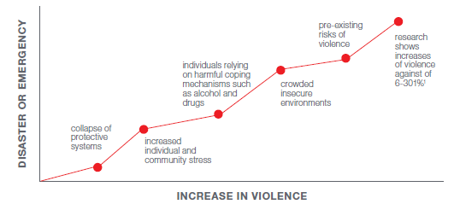
VIOLENCE INCREASES IN DISASTERS
Notes:
Violence must also be recognised as a cross cutting issue throughout DRR and DM activities. Violence can affect women, men, boys and girls, however women and girls and men who do not conform to society’s concepts of masculinity are usually more at risk of violence as a result of their gender (gender-based violence). Gender inequality is the root cause of vulnerabilities to violence.
Following a disaster, sexual, physical and gender-based violence (GBV) is known to increase, and this can happen for a number of reasons….

Slide 21
Quiz Time!

Slide 22
The Gender, Diversity and Gender-based Violence
Quiz
Notes:
Welcome!

Slide 23
Sex
How many female migrants are there in the world?
Is it 111 million, 4 million, 850,000 or 1 million?
111 million
Notes:
1. While approximately 50% of the world’s population is female, it is estimated that in most refugee populations, _____ are women and children. Is it 60%, 70%, 80% or 85%?
“80 percent of the world’s 51 million people displaced by conflict are women, children and youth.” (Women's Refugee Commission Fact Sheet 2013)
“Women and girls comprise about half of any refugee, internally displaced or stateless population.” (UNCHR)
“Refugee women and girls accounted for 48 per cent of the refugee population in
2012, a proportion that has remained constant over the past decade”
“Children below 18 years constituted 46 per cent of the refugee population in
2012. This was in line with 2011but higher than a few years ago.” (UNHCR Global Trends report 2012)
IFRC Feminisation of migration https://www.dropbox.com/s/d0bil0kfl3d9ff1/IFRC_Feminization_Migration.pdf?dl=0

Slide 24
Sex
Between 1990 and 2013, in Thailand, the number of female migrants has risen by _____%? Is it 150%, 20%, 652% or 33%?
652%
Notes:
1. While approximately 50% of the world’s population is female, it is estimated that in most refugee populations, _____ are women and children. Is it 60%, 70%, 80% or 85%?
“80 percent of the world’s 51 million people displaced by conflict are women, children and youth.” (Women's Refugee Commission Fact Sheet 2013)
“Women and girls comprise about half of any refugee, internally displaced or stateless population.” (UNCHR)
“Refugee women and girls accounted for 48 per cent of the refugee population in
2012, a proportion that has remained constant over the past decade”
“Children below 18 years constituted 46 per cent of the refugee population in
2012. This was in line with 2011but higher than a few years ago.” (UNHCR Global Trends report 2012)
IFRC Feminisation of migration https://www.dropbox.com/s/d0bil0kfl3d9ff1/IFRC_Feminization_Migration.pdf?dl=0

Slide 25
Age
% of world’s population aged between 0 and 14 years | 41 26 8 16 8 17
% of world’s population aged between 15 and 24 years
% of world’s population aged between 25 and 54 years
% of world’s population aged between 55 and 64 years
% of the world’s population over 65 years
% of the 232 million international migrants that are under 20 years of age

Slide 26
Age
% of world’s population aged between 0 and 14 years | 26%
% of world’s population aged between 15 and 24 years | 17%
% of world’s population aged between 25 and 54 years | 41%
% of world’s population aged between 55 and 64 years | 8%
% of world’s population aged over 65 years | 8%
% of the 232 million international migrants that are under 20 years of age | 16%
Notes:
World’s Age Structure 2015
0-14 years: 25.79% (male 956,360,171/female 893,629,520)
15-24 years: 16.61% (male 613,806,639/female 577,904,561)
25-54 years: 40.78% (male 1,478,739,525/female 1,447,244,791)
55-64 years: 8.51% (male 298,092,946/female 312,206,795)
65 years and over: 8.32% (male 265,453,689/female 331,172,947) (2014 est.)
Source: CIA https://www.cia.gov/library/publications/resources/the-world-factbook/geos/xx.html
There are some 33 million international migrants under the age of 20, who represent around 16 per cent of the total
migrant population (232 million)
Source: UNICEF 2013 http://www.unicef.org/socialpolicy/files/Population_Dynamics_and_Migration%281%29.pdf

Slide 27
Pregnancy
___% of women of reproductive age (i.e. 15 to 45 years), including refugees and IDPs, are pregnant at any given time.
20%
Notes:
Source: Cooperative for Assistance and Relief Everywhere Inc. (2002) Moving from Emergency Response to Comprehensive Reproductive Health Programs: A Modular Training Series.
Washington, DC: CARE.

Slide 28
Disability
Around % of the total world's population live with a disability | 12% 15% 90% 20%
% of the world's poorest people with some kind of disability
In countries with life expectancies over 70 years of age, people spend on average % of their life span living with disabilities.
% of children with disabilities in developing countries do not attend school

Slide 29
Disability
Around % of the total world's population live with a disability | 15%
% of the world's poorest people with some kind of disability | 20%
In countries with life expectancies over 70 years of age, people spend on average % of their life span living with disabilities. | 12%
% of children with disabilities in developing countries do not attend school | 90%
Notes:
1. 15% of the world's population, have some form of disability.
Source: WHO Disability and health Fact sheet N°352 Reviewed December 2014
2. 20% of the world's poorest people with some kind of disability
Source: UN Enable Factsheet on Persons with Disabilities
http://www.un.org/disabilities/default.asp?id=18
Original source World Bank, couldn’t find this!
3. In countries with life expectancies over 70 years, individuals spend on average about 8 years, or 11.5 per cent of their life span, living with disabilities.
Source: WHO / UN
http://www.un.org/disabilities/convention/facts.shtml
4. UNESCO estimates that 98% of children with disabilities in developing countries do not attend school, and that 99% of girls with disabilities are illiterate.
Source: United Nations (2007) From Exclusion to Equality: Realizing the rights of persons with disabilities
–Handbook for Parliamentarians on the Convention on the Rights of Persons with Disabilities and its Optional Protocol,

Slide 30
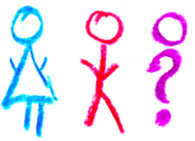
LGBTI
Being lesbian, gay, bisexual, transgender or intersex is illegal in how many countries? Is it 25, 47 or 76?
76 countries (or 78 depending ‘countries’)
Notes:
1. 76 countries retain laws that are used to criminalize people on the basis of sexual orientation or gender identity.
Source: “State-sponsored homophobia: a world survey of laws criminalising same-sex sexual acts between consenting adults”, International Lesbian, Gay, Bisexual, Transgender and Intersex Association (ILGA), Brussels, May 2011, p. 9
See the countries here http://76crimes.com/76-countries-where-homosexuality-is-illegal/
2. Five countries put people to death for their sexual orientation: Iran, Mauritania, Saudi Arabia, Sudan and Yemen [plus some parts of Nigeria and Somalia]
Source: ILGA 2010 Read more: http://deathpenaltynews.blogspot.com/2010/06/ilga-76-countries-ban-gay-sex-7-have.html#ixzz3e5E2Fper

Slide 31
Violence
There are 4,200 deaths per day (1.6 million a year).
What % of them are: : (58%, 36%, 6%)
Self-directed?
Interpersonal violence?
Collective violence (e.g. conflict)?
58%
36%
6%
Notes:
Of those killed by violence, 58% die by their own hand, 36% because of injuries inflicted by another person, and 6% as a direct result of war or some other form of collective violence.
Source: WHO updated January 2014
http://www.who.int/features/factfiles/violence/en/
The highest rates of suicide in the world are found in Eastern European countries. The lowest rates are found mainly in Latin America and a few countries in Asia. (WHO)
Within countries, suicide rates are frequently higher among indigenous groups – notable examples include the Aboriginal and Torres Strait Islander populations in Australia and the Inuit in Canada's arctic north. (WHO)
In general, suicide rates increase with age. Rates among people aged 60 and older are about three times the rates among people 15-29 years of age. The absolute numbers are, however, higher among those below 45 years
of age. (WHO)
Even though women are more prone to suicidal thoughts than men, rates of suicide are higher among men. On average, there are about three male suicides for every female one – though in parts of Asia, the ratio is much narrower. (WHO)

Slide 32
Violence
What % of women have reported experiencing physical violence by either an intimate and/or non intimate partner in their lifetime?
In Cambodia?
In Vietnam?
Is it 5%, 13%, 22%, 35% or 50%
Notes:
Source: http://www.endvawnow.org/uploads/browser/files/vawprevalence_matrix_june2013.pdf

Slide 33
Violence
What % of women have reported experiencing physical violence by either an intimate and/or non intimate partner in their lifetime?
In Cambodia? 22%
In Vietnam? 35%
Is it 5%, 13%, 22%, 35% or 50%
Notes:
Source: http://www.endvawnow.org/uploads/browser/files/vawprevalence_matrix_june2013.pdf

Slide 34
Violence
How often does an adolescent girl die as a result of violence in the world? Is it every 30, 20 or 10 minutes?
Every 10 minutes
Notes:
1. What % of the 4.5 million people forced into sexual exploitation are women and girls? 98%
Source: UN Women Facts and Figures on Violence Against Women and Girls
http://www.unwomen.org/en/what-we-do/ending-violence-against-women/facts-and-figures
2. Every 10 minutes, somewhere in the world, an adolescent girl dies as a result of violence
Source: UNICEF 2014
http://www.unicef.org/publications/files/A_Statistical_Snapshot_of_Violence_Against_Adolescent_Girls.pdf

Slide 35
Violence
What % of women age 15-49 reported experiencing sexual violence in non-disaster times in the Philippines
6%
3%
10%
2%
Notes:
1. What % of the 4.5 million people forced into sexual exploitation are women and girls? 98%
Source: UN Women Facts and Figures on Violence Against Women and Girls
http://www.unwomen.org/en/what-we-do/ending-violence-against-women/facts-and-figures
2. Every 10 minutes, somewhere in the world, an adolescent girl dies as a result of violence
Source: UNICEF 2014
http://www.unicef.org/publications/files/A_Statistical_Snapshot_of_Violence_Against_Adolescent_Girls.pdf
3. Philippines National demographic and health survey (NDHS) 2013

Slide 36
Violence
What % of women age 15-49 reported experiencing sexual violence in non-disaster times in the Philippines
6%
Notes:
1. What % of the 4.5 million people forced into sexual exploitation are women and girls? 98%
Source: UN Women Facts and Figures on Violence Against Women and Girls
http://www.unwomen.org/en/what-we-do/ending-violence-against-women/facts-and-figures
2. Every 10 minutes, somewhere in the world, an adolescent girl dies as a result of violence
Source: UNICEF 2014
http://www.unicef.org/publications/files/A_Statistical_Snapshot_of_Violence_Against_Adolescent_Girls.pdf
3. Philippines National demographic and health survey (NDHS) 2013

Slide 37
Violence
How many countries only recognise female victims of rape? 42, 62 or 82
62
Notes:
Retrieved from: INTO THE MAINSTREAM: ADDRESSING SEXUAL VIOLENCE AGAINST MEN AND BOYS IN CONFLICT
A briefing paper prepared for the workshop held at the Overseas Development
Institute, London, 14 May 2014
Dr Chris Dolan (funded by Plan, Refugee Law Project, War Child)
http://www.plan-uk.org/assets/Documents/pdf/26374/Into-the-Mainstream
This survey, relying on web-searches to locate the relevant penal codes or equivalent legislation, reviewed 189 codes. Legislation for 4 countries could not be found.
Legal regimes were placed in four categories, and combined with population statistics from the World Bank. This was combined with current characterisations of countries at conflict, sourced from the International Institute of Security Studies database. (Doan C and Luedke A, forthcoming)

Slide 38
Notes:
Impartiality – what do you see here?

Slide 39
Why it matters in our approach to disasters?
Women, girls and boys are 14 times more likely to die during a disaster than are men
Indian Ocean Tsunami, 2004 +80% fatalities women
Japan earthquake 65% of casualties 60+
Cyclone Nargis, 2008 61% deaths women
Accountability
Do no harm
Quality
Address vulnerability
Cost effective
Fundamental Principles
Notes:
So we know now we can analyse what already exist and here are some reasons why it is so important: These are some examples of WHY it matters to analyse WHAT ALREADY EXIST
Disasters and emergencies are not gender-neutral Neither are the programmes and services that aim to address them
Evidence:
More than 70% of those that died in the 2004 Asia Tsunami were women (it was 80+% females in some areas affected by the Tsunami)
News Article: http://www.theguardian.com/society/2005/mar/26/internationalaidanddevelopment.indianoceantsunamidecember2004
Oxfam Report: Women and the Tsunami http://www.preventionweb.net/files/1502_bn050326tsunamiwomen.pdf
In three of the affected areas of the 2011 Japan earthquake/ tsunami, 65% of casualties were over the age of 60
Cyclone Nargis, 2008, World Bank http://siteresources.worldbank.org/INTEAPREGTOPSOCDEV/Resources/12680GNEAPDisaster.pdf

Slide 40
IMPARTIALITY

Slide 41
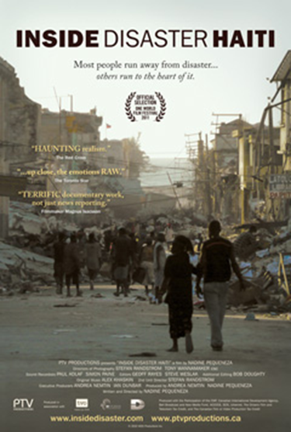
Impartiality, non-discrimination
The scene of a (mega) disaster
Inside disaster Haiti - trailer
“Everything needs to be done at once but we just can’t”
Jean-Pierre Taschereau, IFRC Team Leader
What challenges do you see in integrating gender and diversity in disaster response?
Notes:
In the next section we are going to look at relevant skills: both internal and external, for doing a good and rapid vulnerability analysis
Show films:
Trailer of Inside Disaster: https://www.youtube.com/results?search_query=inside+disaster+haiti
Show the film about how difficult it is to given aid quickly based on vulnerability critera
https://www.youtube.com/watch?v=FCDFUT5HZQI

Slide 42
Prioritisation
Due to funding limitations, not always possible to reach everyone.
Need to target and prioritise most vulnerable.
Develop beneficiary selection and prioritisation criteria in consultation with affected community.
Ensure transparency and communication – safety and security of staff

Slide 43
Beneficiary Registration
Basis for planning programmes
If you’re not counted, then your needs don’t count
Population’s assistance and protection needs
Individual registration – especially protection needs
Where individual registration not feasible, ensure individual registration of persons with specific needs.

Slide 44
Needs Assessments – Gender & Diversity Analysis
Who is affected? Why and how are they affected? What are their distinct needs, protection concerns and priorities?
Sex- and age-disaggregated data (SADD) – data broken out by sex and age (or age group)
Gender analysis examines relationships between females and males; their roles, responsibilities, access to and control of resources and constraints they face relative to each other.
Diversity analysis – examines the distinct reality of being a particular age/age group, disabled and other contextual factors (e.g. minority group, ethnicity, etc.)

Slide 45
Needs Assessments – Gender & Diversity Analysis
Challenges in collecting and analysing SADD
No harmonised way to collect SADD
Different people in chain of collection, analysis and design
If collected, who does the analysis? (Who has capacity?)
If collected and analysed, who feeds/how is this fed into project design?
0-5 |  | 6-17 |  | 18-59 |  | 60+
F | M | F | M | F | M | F | M
2 | 4 | 6 | 3 | 25 | 44 | 2 | 4
5 | 6 | 14 | 19 | 0 | 0 | 0 | 0
Notes:
DFID standards of SADD but we can also adjust to meet our own programmatic needs
Must be supplemented with additional questions e.g. understanding the needs of adolescents

Slide 46
Needs Assessments – Gender & Diversity Analysis
Price of not including a gender and diversity analysis
We limit the effectiveness of humanitarian operations
Humanitarian operations do not reach the most vulnerable
Potential to deepen pre-crisis inequalities
We do not meet donor requirements

Slide 47
Equal Access: Considering our teams
Team composition doing assessments is important, we risk not allowing people to truly tell us about their needs
We also need to consider practical ways in emergencies to transform our teams to meet needs – simple measures e.g wrist bands, local knowledge, and leveraging all capacities in the community
Notes:
This film shows how important it is to be:
Inclusive in our teams
Consider local knowledge, vulnerability and who is missing out
Use simple measures such as wrist bands, and outreach to deliver aid to the most vulnerable
Tabasco floods (2007, Mexico): https://www.youtube.com/watch?v=3d-Yu8Dh1LY

Slide 48
Exercise: Registration, Selection Criteria and Needs Assessments
Following extreme flooding in Malaysia, many people have been displaced and informal settlements are forming.
It is now 1 week after the floods
Some quick multisector assessments and distributions have been carried out and shelter was identified as a need, as was safe and dignified health care
Your role is to establish a beneficiary desk and identify who in the community has protection risks and specific needs
Comment on your team composition.
What information is missing in the table?
Who would you ask and what would you ask for GD needs assessment?
What are challenges in collecting each piece of information?

Slide 49
INDEPENDENCE

Slide 50
IFRC’s approach
The IFRC’s gender and diversity work is not a separate or new component
It is rooted in its humanitarian mandate to prevent and alleviate human suffering without discrimination and to protect human dignity.
The RCRC recognizes that women and men have different capacities, strengths, needs and vulnerabilities which can impact their resilience to disasters

Slide 51
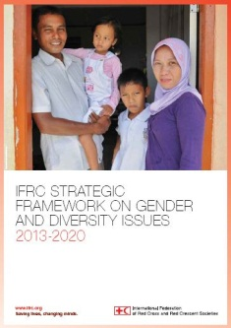
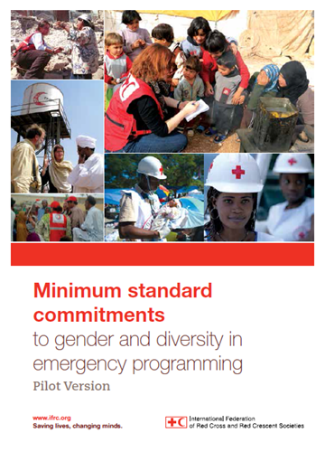
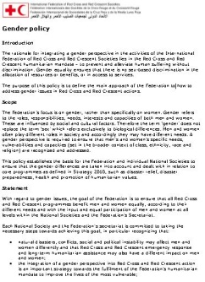
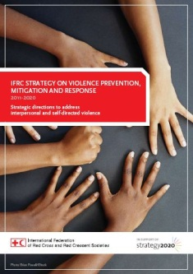
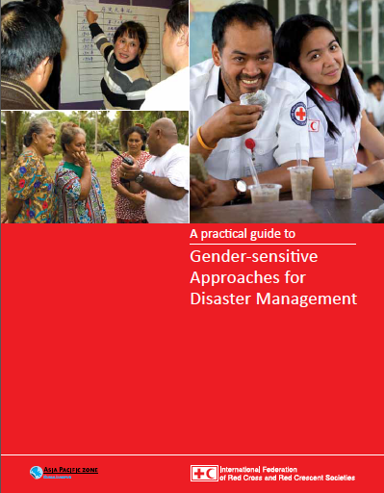
Organisational Policies and Tools

Slide 52
Organisational Commitments

Slide 53
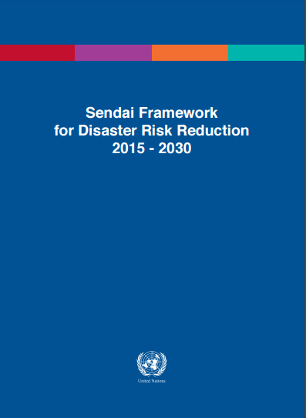
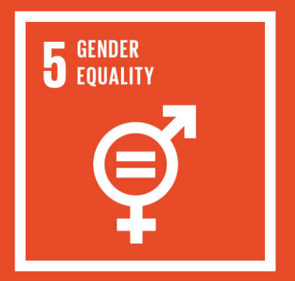
Guiding commitments
Sexual and gender-based violence: joint action on prevention and response (IFRC-ICRC)
Strategic framework on disability inclusion

Slide 54
SGBV: Joint action on prevention and response
Call to look at existing research and to continue research to enable guidance and tools to be developed for preventing and responding to disasters
Call upon states to look at their laws, plans and procedures to asses if they adequately prevent and respond to SGBV
Call upon states to engage community members in particular women, in decision making about DRR
Ensure appropriate efforts to integrate GBV into DRR and response activities

Slide 55
Exercise
THE WHY OF GENDER AND DIVERSITY IN EMERGENCIES
What are some of the key reasons for including a gender and diversity analysis in emergencies?
How would you advocate for this within your work?

Slide 56
Gender and Diversity Advocacy
The National Disaster Management Authority has instructed all humanitarian organisations to deliver assistance to male headed households (only), stating that men will provide for everyone in the community. You have been invited to discuss their plan. Articulate your concerns and advocate for an alternate arrangement.
A Government Donor is questioning the Programme Plan of Action. Justify to the donor why you have a budget line on gender and diversity in your plan, and what you will spend it on.
The Operations Manager is very busy. You note that the Emergency Plan of Action does not contain gender or diversity focused activities or beneficiary analysis. Convince him to include these.

Slide 57
Gender and Diversity Advocacy
National Society Secretary General: has recently taken the post for the National Society. You as the gender and diversity focal point have a briefing with the SG to sensitise him on gender and diversity. You have heard this is not one of his priorities. Your task is to convince him that it should be a key priority in all programmes to benefit the National Society
You are developing a proposal with an external agency for a WASH programme. The agency would like to exclude a particular marginalised group who they have experienced issues with in previous projects. Without including this group you will not reach the most vulnerable in the community. Convince him to include these.

