Slide 1
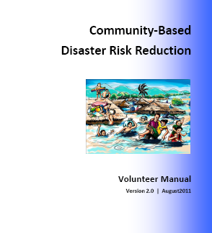
RCRC/DIPECHO partnerships in South East Asia
Lao PDR experience (2008-2011)
RCRC/DIPECHO Coordination Meeting
Bangkok – August 09, 2013

Slide 2
FRC-LRC / DIPECHO collaboration in Lao PDR
Background, framework and direct outcomes
2004 IFRC/LRC: First Pilot HVCA tool and CBDP methodology applied in on village, then extending to some others
2008-2011 DIPECHO FRC/LRC projects (two rounds): Incubator for CBDRR development and scaling-up in-country, with four main legacies:
CBDRR methodology extensively tested, improved and documented from (H)VCA to mitigation measures
Capacity built for many Disaster Management Committee members (from village to district and province) over Khammouane province
LRC CBDRR handbook as a reference for all main practitioners in-country (HPA, OXFAM SB, CARE, PLAN…)
RCRC identified as a key player in DRR, leading to many multiplier effects (see slides further)

Slide 3
RCRC interaction records with FRC/LRC DIPECHO funding in Lao PDR (extracts only)
IFRC initial HVCA methodology and guidelines
IFRC technical contribution to CBDRR handbook v 2.0 update
IFRC participation to CBDRR trainer skills evaluation in Khammouane
IFRC use of FRC/LRC DIPECHO target villages for regional field exercise
Luxemburg Red Cross additional emergency response equipment for some FRC/LRC DIPECHO target villages

Slide 4
FRC-LRC / DIPECHO collaboration in Lao PDR
Multiplier effects (extracts only)
LRC capacity and profile raised to better fulfill their mandate in Disaster Management as per GoL policy
LRC/FRC spreading CBDRR nationwide (into more than 300 villages to date; UNICEF, UNDP, PLAN, CARITAS…)
Luxemburg Red Cross additional LRC emergency response capacity building project in Khammouane province
FRC CBDRR integration into other Food Security / Heatlh / Rehabilitation projects; Resilience and LRRD approaches) (development of additional methodologies and training modules)

Slide 5
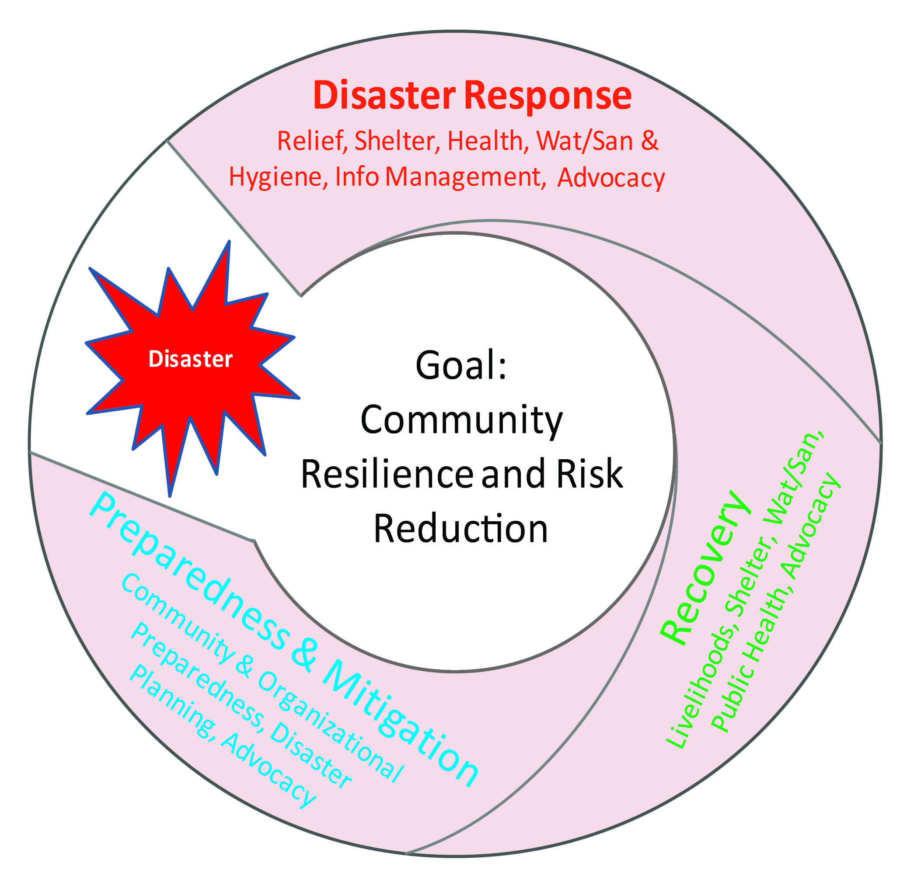
Focus multiplier effect: Community Resilience process
Target area and beneficiary selection processes
(Scoping/Mapping/RRA)

Vulnerability & Capacity Assessment (VCA)
Community Empowerment
Village profile
Historical disaster profile
Community mapping
Seasonal calendar
Social and institutional network analysis
Livelihood analysis
Community Disaster Risk Reduction Planning
Applied in:
ECHO projects
EuropeAid projects
Disaster Preparedness and Mitigation
Disaster Response
Community Safer Development Solutions Programming

Slide 6
Focus multiplier effect: Toolbox for capacity building
French Red Cross / Lao Red - as of August 2013
 | Thematic / Tool | Support / Methodology
Community-Based Risk Mitigation | VCA toolkit | Handbook / Curriculum
 | Village DRR plan | Handbook / Curriculum
 | Structural mitigation measures | Plans / Drawing
 | CCA general awareness | IEC material
Community-Based Disaster Preparedness | VDPU setting up | Handbook / Curriculum / Equipment kit
 | Household readiness auto-evalution | Forms
 | SOP (VDPU-DDMC) and contingency plan | Curriculum / Forms
 | Simulation exercice | Scenario / Forms
 | Flood appropriate behaviors awareness | IEC material
 | School schildren sensitization | IEC material
Community-Based Disaster Response | Damages and needs assessment (DANA) | Curriculum / Forms
 | Search and Rescue | Curriculum / Equipment kit
 | First Aid | Curriculum / Equipment kit
 | Water born desases prevention | Curriculum / Leaflet
 | Psychological First Aid | Leaflet
Community-Based Safer Development Solutions | Water and sanitation | PHAST/CLTS
 | Health and nutrition | CBHFA/LANN
 | Food security and livelihoods | SWSF/VHHG

Slide 7
FRC-LRC / DIPECHO collaboration in Lao PDR
Conclusions
Lessons
RCRC is a legitimate key player on DRR in Lao PDR that brings some comparative advantage and solid assets to DIPECHO programming
Shortcomings
CBDRR methodology not completed yet (third DIPECHO proposal unsuccessful)
DRR National platform not achieved yet (reluctance from some stakeholders)
Most effective and efficient use of both FRC and IFRC resources and skills could be achieved (with more prior consultation for programming and then systematic coordination / task sharing)
Ways forward
Adoption of best practices and standardization of tools
Develop additional innovative tools where gaps are noticed
Increase number of available Master Trainers in CBDRR
Open more window opportunities for putting DRR issues on debate

Slide 8
FRC-LRC / DIPECHO collaboration in Lao PDR
Suggestions
What we need now, it is a fresh support from DIPECHO to enable FRC/LRC/RCRC trigger a new major DRR development in Lao PDR, thus enabling another leap forward for the whole community of DRR practitioners in the country.
In that respect, the FRC is glad to formulate some suggestions as follow (not exhaustive):
Set up a National DRR platform (or similar)
Finalize CBDRR methodology with additional components
Adapt CBDRR methodology and subsequent handbook for upland areas
Edit and complement FRC/LRC resilience toolkit (curriculum and tools)
CCA pilot project phase 1 (out of X) for documentation and capitalization

Slide 9
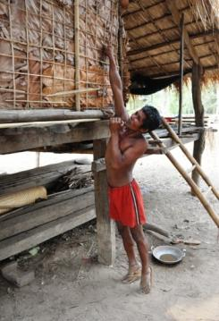
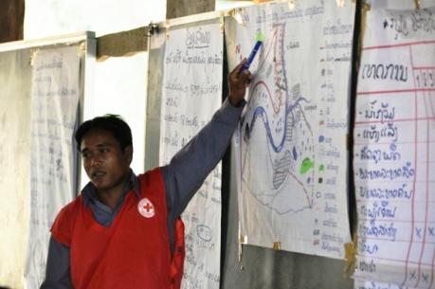
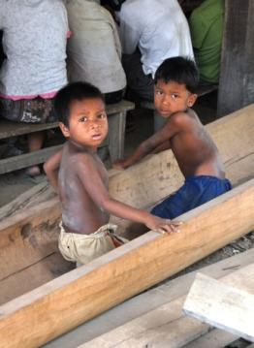
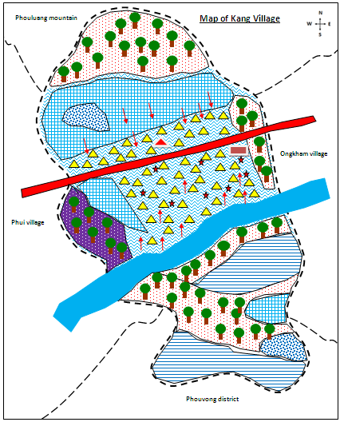
Keep moving forward, together !

