Slide 1
Recovery Programming: building back better and enhancing resilience
ACE Training
PMI training Centre Meeting
Semarang, Indonesia
28 April 2015

Slide 2
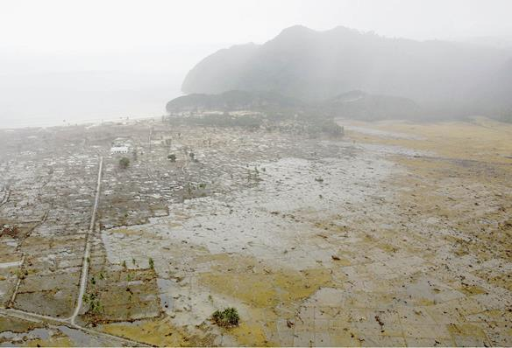

Slide 3
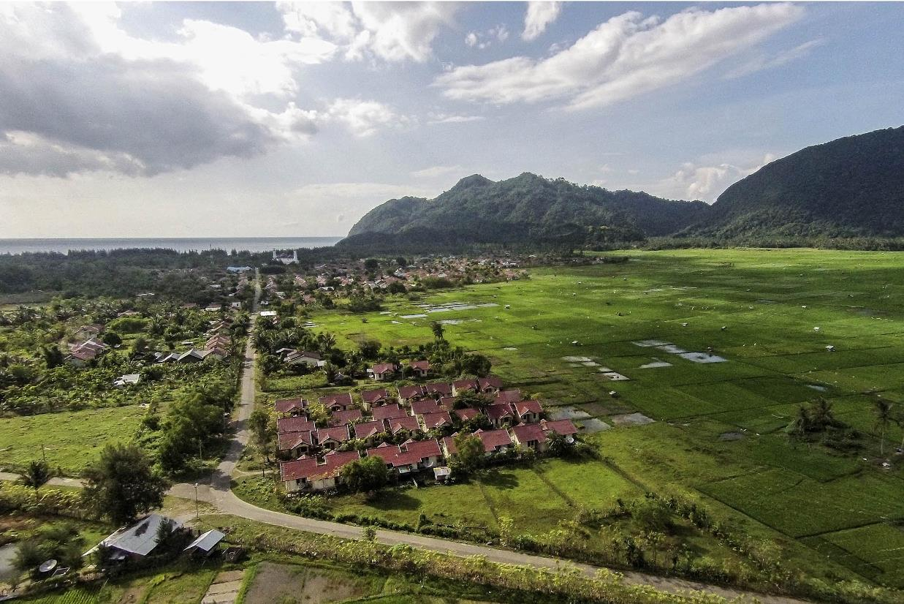

Slide 4
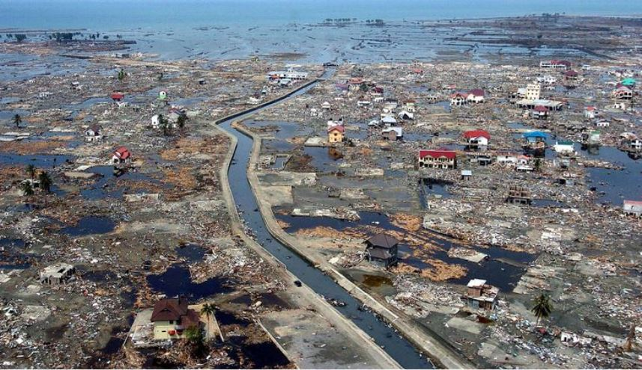

Slide 5
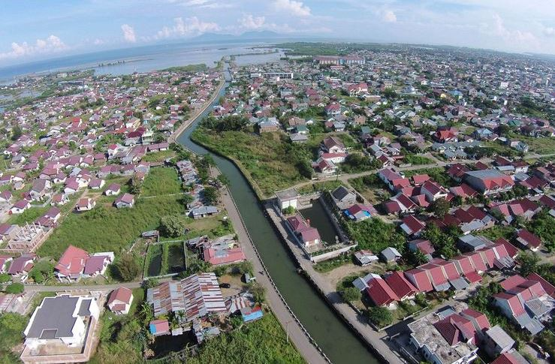

Slide 6
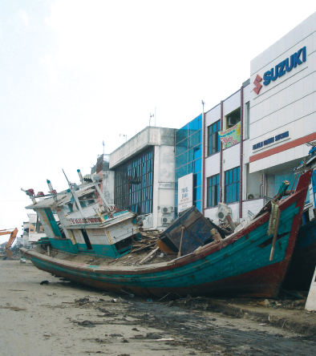
Purpose of this session:
Know the concepts and key strategic issues of recovery.
Highlight recovery examples from Indonesia and discuss other examples in the South East Asia.
Present tools for developing operational strategies and designing recovery interventions.

Slide 7
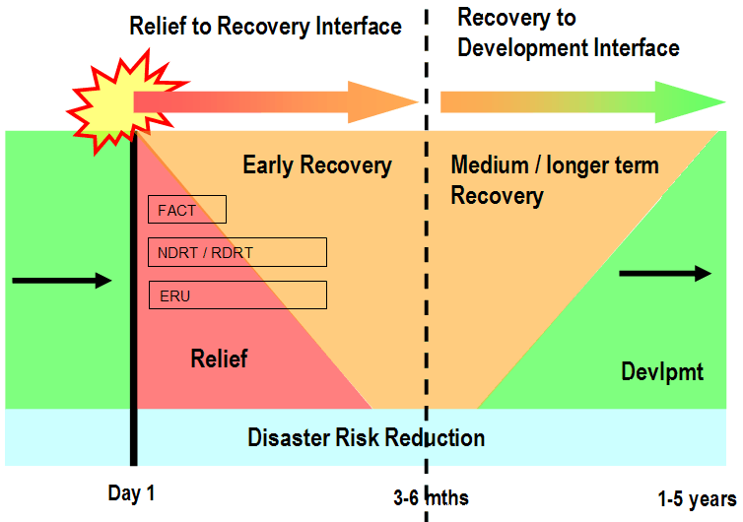
Notes:
To recap on recovery as part of a disaster response:
Relief and early recovery start together and are inseparable.
The global tools (FACT, RDRT, ERUs) span both relief and early recovery roles
Disaster risk reduction is an objective of all our DM activities
Preparedness for response should include preparedness for recovery – a solid baseline understanding of the conditions and issues within vulnerable communities will enable timely and effective disaster relief and recovery programming.
The timelines on the diagram above are indicative – timelines always change according to each disaster context
The development of communities is disrupted by disasters and basic relief and recovery needs have to be met before developmental activities can resume.
Relief and recovery are “anchored” to a disaster event – development programming is not
For large disaster response operations - relief and early recovery activities are often funded through emergency appeals and implemented in a multilateral approach by the Federation and the host NS. Medium and longer term recovery programming is often funded by PNS and implemented through a bilateral approach by PNS and the host NS.

Slide 8
A definition of early recovery:
Early recovery is the process of people’s lives returning to normal in the immediate aftermath of a disaster. It involves providing assistance to people in the earliest stages of disaster response in conjunction with the provision of relief, improving the effects of the relief and providing the basis for longer-term recovery.
Early recovery enables people to participate more readily in longer-term recovery activities
IFRC recovery programming guidance 2012
Notes:
For slow onset situations: For people whose pre disaster situation was critical, early recovery seeks to assist them over the peak of the crisis within a longer term menu of programme activities to build more resilient lives that are better than their pre disaster situation.
Early recovery is an approach that takes place alongside relief, (whereas recovery is more medium term and links rehabilitation to development) improving the quality of the relief as well as preparing for the next stage of the recovery process through assessment, planning and implementation of activities. Early recovery activities can:
Strengthen the quality and impact of relief
Prepare the ground for longer term recovery
Improve people’s capacity to cope early on by responding to their wishes and priorities
Support programmes determined by people’s priorities.

Slide 9
A definition of recovery
Recovery in the context of disaster response, is a process that results in people’s lives returning to normal in a way that they will be more resilient to future disasters.
The extent to which people can recover after a disaster depends on the situation beforehand and how robust or resilient their resources are to withstand the effects of the disaster. For some, recovery will be relatively quick; for others it may take years.
IFRC recovery programming guidance 2012
Notes:
For slow onset situations: For people whose pre disaster situation was critical, early recovery seeks to assist them over the peak of the crisis within a longer term menu of programme activities to build more resilient lives that are better than their pre disaster situation.
Early recovery is an approach that takes place alongside relief, (whereas recovery is more medium term and links rehabilitation to development) improving the quality of the relief as well as preparing for the next stage of the recovery process through assessment, planning and implementation of activities. Early recovery activities can:
Strengthen the quality and impact of relief
Prepare the ground for longer term recovery
Improve people’s capacity to cope early on by responding to their wishes and priorities
Support programmes determined by people’s priorities.

Slide 10
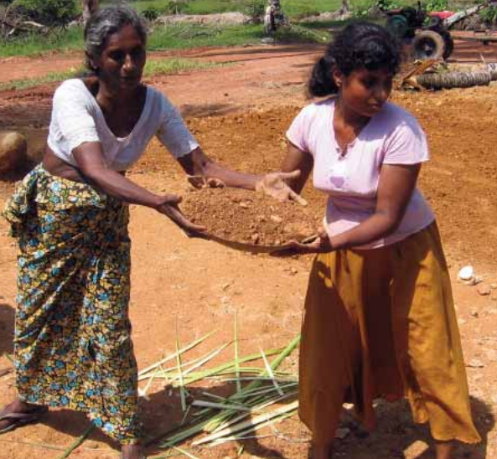
REMEMBER……..
Individuals, communities and institutions begin to recover immediately after a disaster, relying on their own skills, experience and resources.

Slide 11
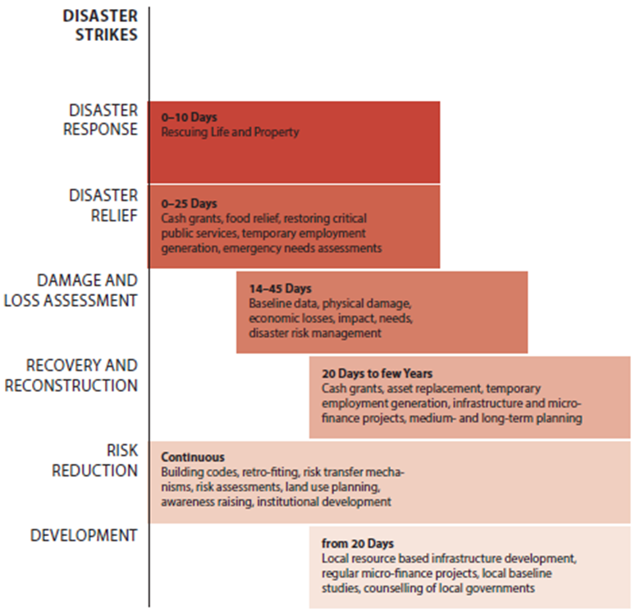
‘Recovery programming’ is what external agencies do with the aim of supporting people as they recover from disasters.
At its best: early recovery and recovery are based on good community-based programming principles and practices that may link to longer-term development.
GTLL Disaster Recovery Tool Kit

Slide 12
Examples of Recovery activities
Early recovery immediate support
  cash for work to remove the rubble
  materials for immediate shelter repair
  agricultural inputs to restart livelihoods
  protect remaining assets, avoid further loss
  providing psychological first aid to community members
Recovery in the midterm
  reconstruction (houses, schools, health clinics, water supply systems)
  further strengthen livelihoods
  Restoring family links

Slide 13
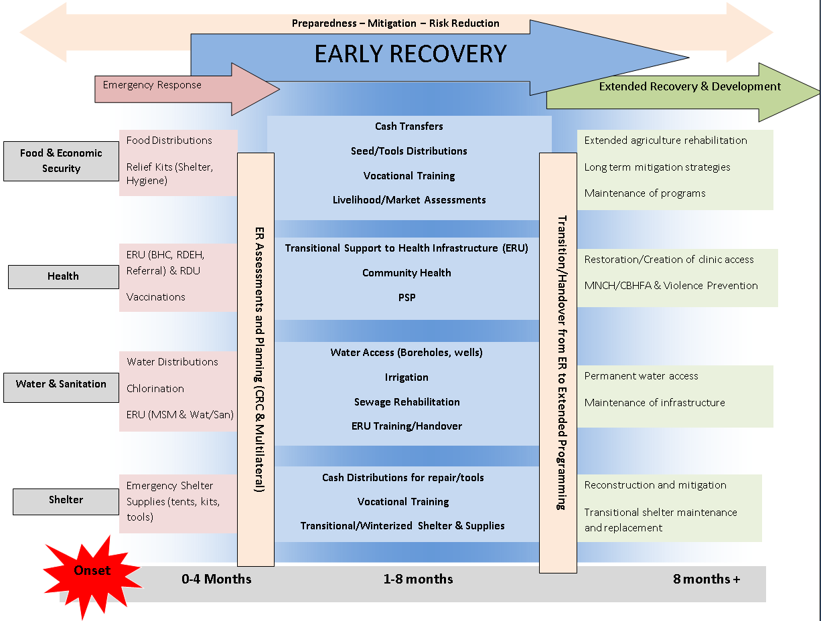

Notes:
This diagram illustrates the three phases often referred to: the initial emergency or relief response, early recovery and the extended recovery period which is conditions allow, will lead back into the longer term development.
Participants will usually be familiar with the types of interventions in the three phases outlined in the diagram. Emphasis that;
The Federation is trying to strengthen its early recovery programming so that immediate post disaster assistance supports the recovery efforts of the disaster affected population immediately. Examples include:
Providing flexible (unconditional) cash transfers to allow people to meet their immediate needs
Restore access to functioning health services
Provide agricultural inputs to allow households to quickly restart and restore their livelihoods etc…

Slide 14
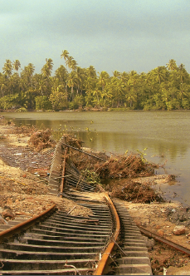
In your table groups:
What factors determine the extent and speed people can recover?
When does early recovery happen?
List as many recovery responses as you can in 10 seconds.
List 5 ‘ways of working’ for recovery programming.

Slide 15
IFRC recovery “ways of working”
Participation of disaster-affected women, men, girls and boys, who have a right to determine their own future.
Inclusive participation with equal involvement of members of the community regardless of age, sex, ethnicity & wealth.
Being accountable to the affected communities, ensuring that affected populations can influence and participate in decision making concerning the operation.
Doing no harm either socially, economically or environmentally.
Being timely and starting early to support and complement relief activities whenever possible.

Slide 16
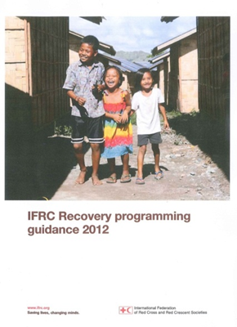
Strengthening recovery programming:
To build recovery thinking and approaches into disaster preparedness and response
IFRC Recovery Guidance 2012 focuses on:
applying key recovery principles and strategic issues
assessment and response option analysis
community participation
building resilience and applying the ‘Do No Harm’ approach
a multi-sector integrated approach & strong coordination
use of innovative approaches (inc CTP and market support)
Notes:
Hand out copies of Recovery Guidance

Slide 17
Sinabung Volcano: Voucher distribution
Mount Sinabung volcano on Sumatra Island triggered the displacement of 28,715 people from 33 villages by January 14.
In March it was decided to support the returning evacuees with necessary tools to clean up ash, repair roofs and work farm lands through a cash transfer pilot project.

Slide 18
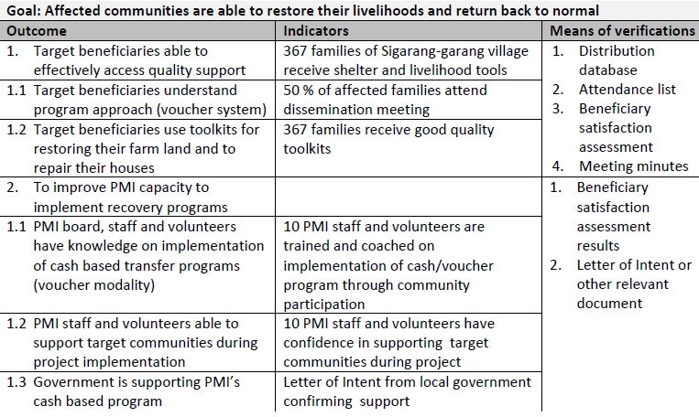

Slide 19
Practical Innovation
Target area and beneficiary selection
Adaptation of barcode-reading software
Market survey
Field training and simulation
Socialization
Voucher distribution and scanning
Administration, finance and traders

Slide 20

Video

