Slide 1
Disaster Law: An Asia Pacific Perspective
Regional Disaster Law Forum
South East Asia
10 – 11 June, 2015
Bangkok, Thailand

Slide 2
Agenda – Day One
Introduction: Disaster Law, themes and tools
Looking towards the 32nd International Conference of RCRC
Disaster Law at the National level
Developments in Southeast Asia
Disaster law at the Regional level

Slide 3
Agenda – Day Two
Disaster Law at the Global Level: International commitments
DRR Law and climate change
Gender & diversity; GBV in emergencies
Focus on IDRL
Moving forward: Recommendations from the DL Forum

Slide 4
Objectives of the Disaster Law Forum
National:
- Discuss progress at country level
- Share experiences, challenges
-Identify what more can be done
Regional:
- Identify how the RCRC can engage with ASEAN on disaster law
- Discuss the idea of a regional disaster law advisory group
International:
- Highlight key international commitments
- Discuss disaster law themes/ resolution coming before the RCRC International Conference
- Plan for a new regional pledge

Slide 5
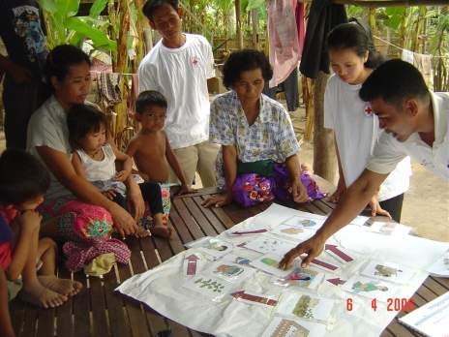
Disaster Law is…
The laws and regulations which:
address the roles and responsibilities to manage and respond to disasters
minimise impact of disasters
reduce disaster risks

Slide 6
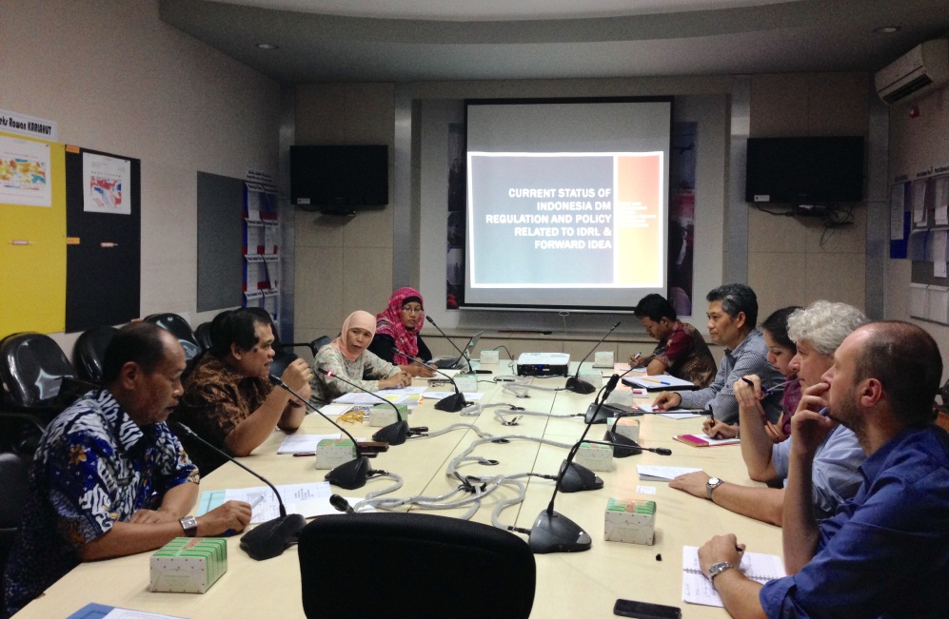
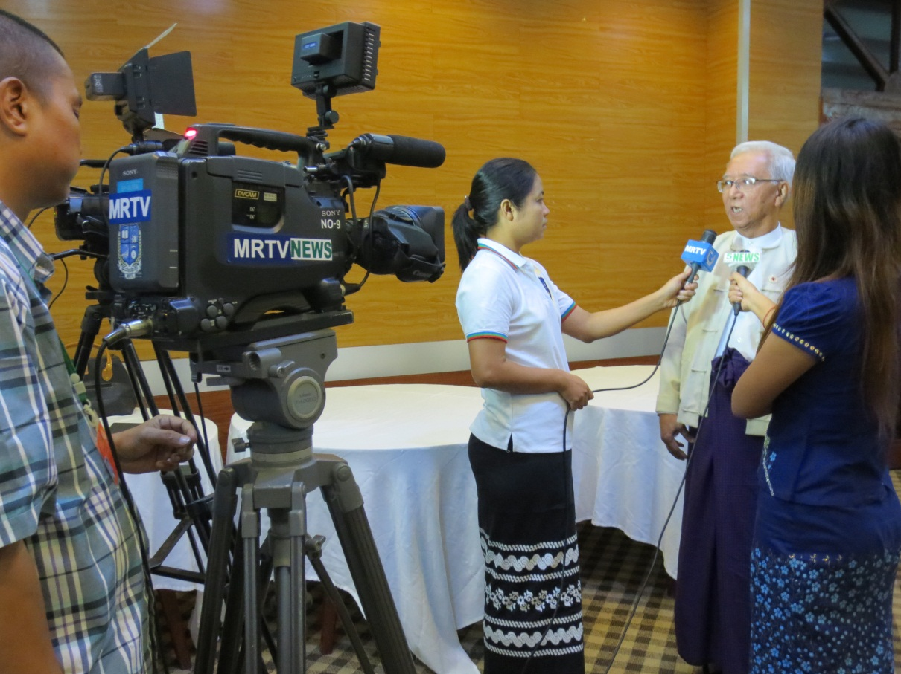
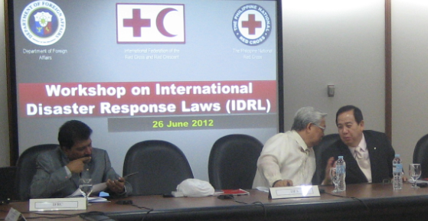
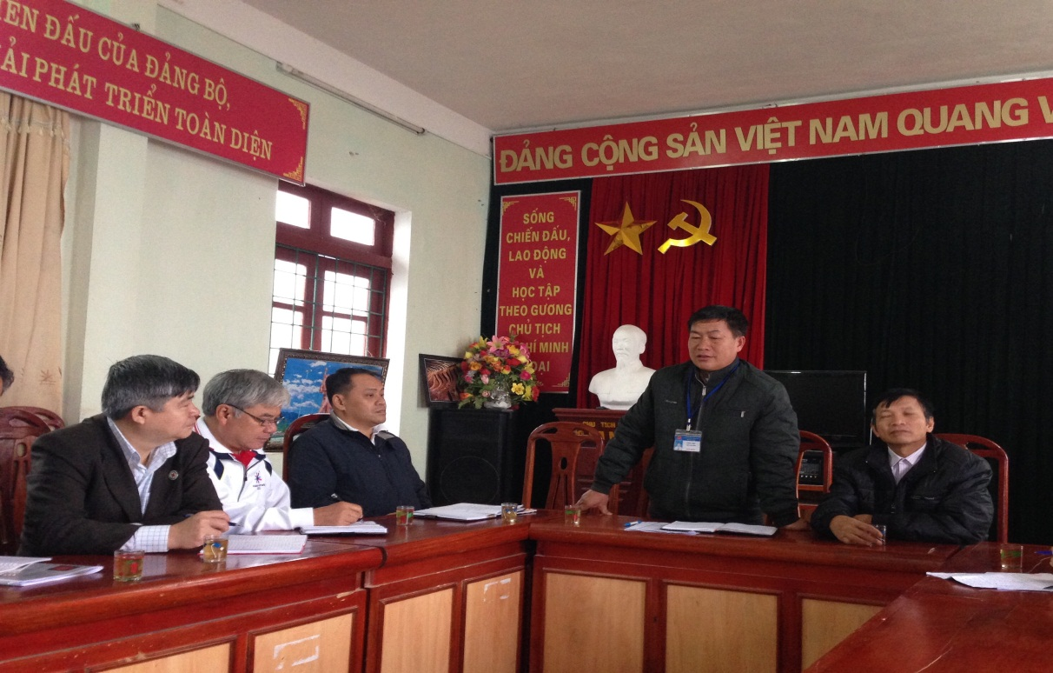
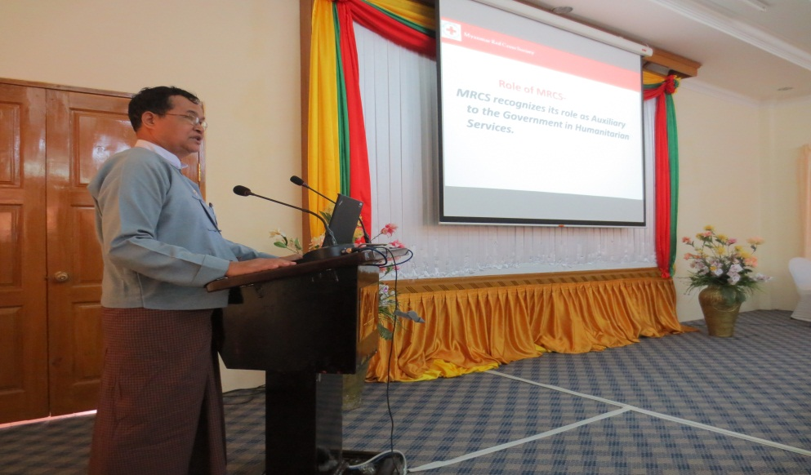
Southeast Asia: making great progress in disaster law

Slide 7
Why disaster law?
As governments, national societies and humanitarian partners in one of the world’s most disaster prone regions – we need these laws as a foundation for our work in disaster management, risk reduction as response.
For National Societies: this is an opportunity to profile your National Society and represent the community voice in national law and policy making processes
For governments: NS/IFRC can provide technical advice to help develop your national disaster laws; NS as the bridge between community and national level; wide networks to disseminate and help implement national and local laws & procedures.
Building partnerships with and strengthening regional organizations through disaster law work

Slide 8
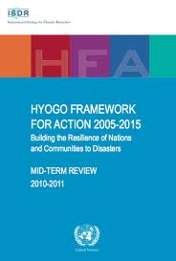
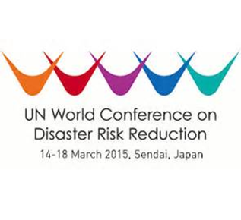
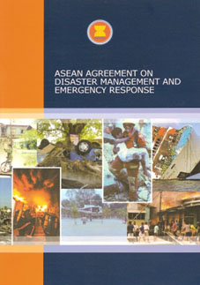
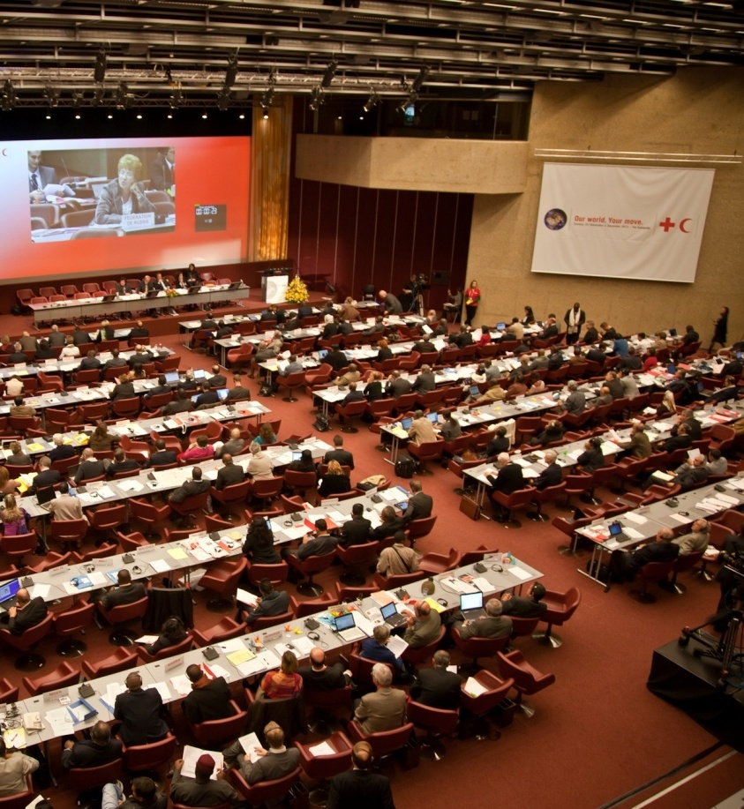
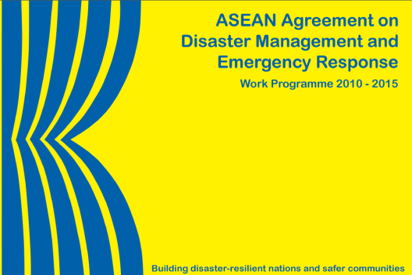
International and regional mandates

Slide 9
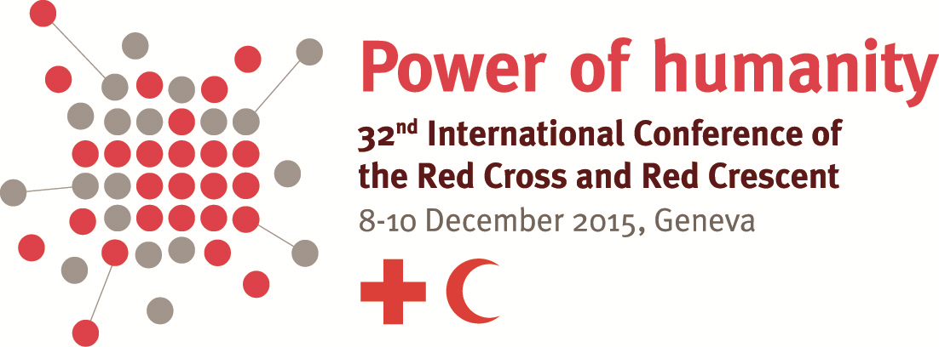
32nd International Conference of the Red Cross and Red Crescent
December 2015

Slide 10
32nd International Conference
Power of Humanity:
the Fundamental Principles in action
Preventing and Responding to Violence
Safety and Access
Risk Reduction and Resilience
IHL Compliance and Detention
Gender Based Violence
Health Care in Danger
Safety of Volunteers and Staff
Disaster Laws
Urban Risk and Climate Change

Slide 11
Conference Outcomes:
Pledges
Resolutions on the core topics

Slide 12
Key disaster law themes
Law and Disaster Risk Reduction (Law and DRR)
International Disaster Response Law (IDRL)

Slide 13
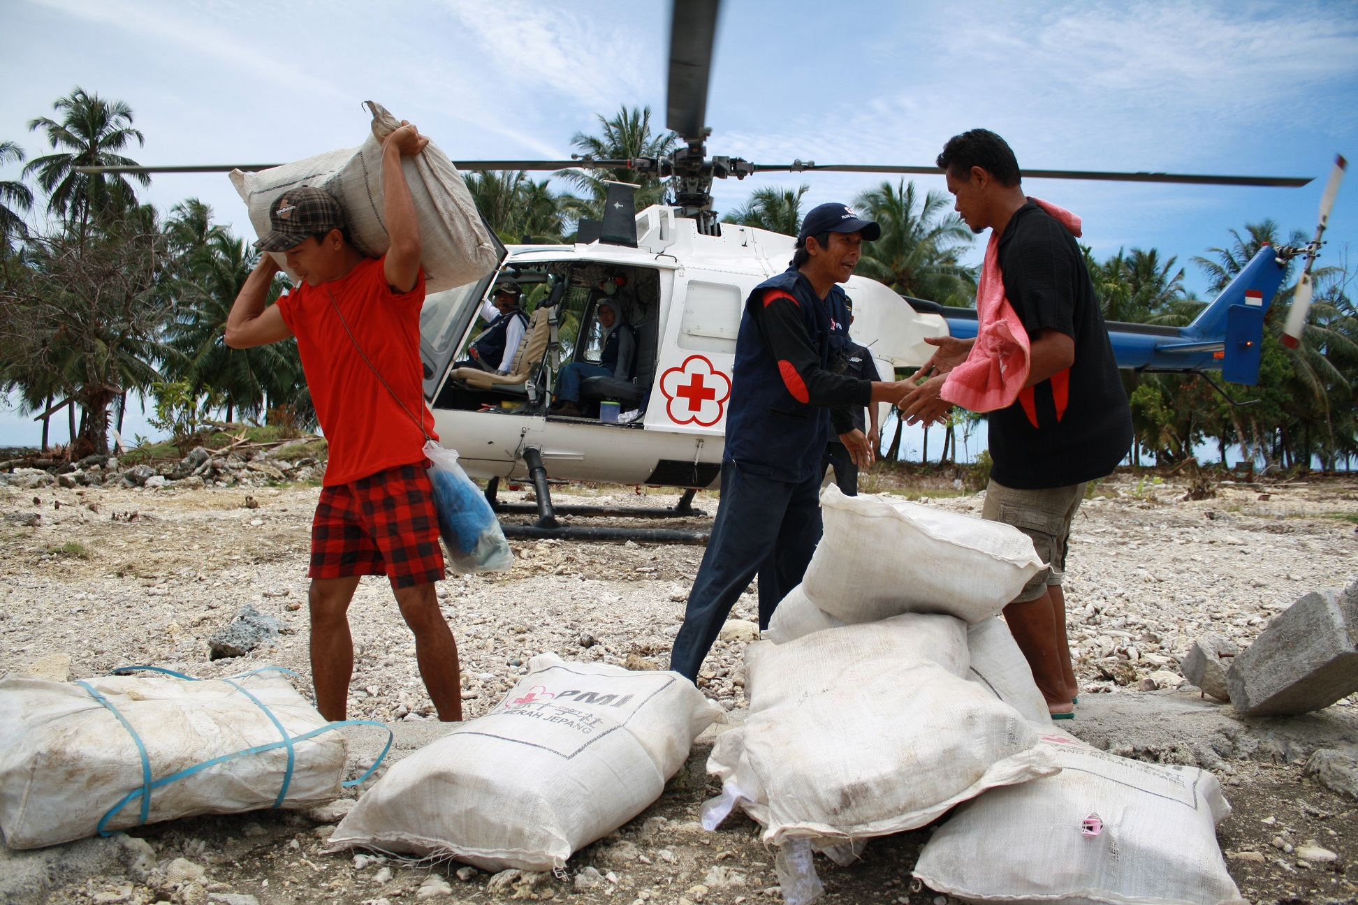
Theme 1: International Disaster Response Law (IDRL)
Theme 1: International Disaster Response Law (IDRL): the laws and regulations to handle incoming international assistance

Slide 14
Why legal preparedness for international disaster response?
More and different international responders
More frequent and larger natural disasters
Absence of laws and procedures to regulate an increasingly complex context

Slide 15
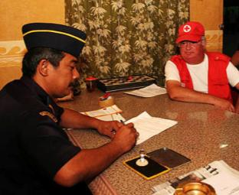
Research shows that a lack of legal preparedness hampers international relief
Barriers
Initiation, visas, customs, radio use, taxes, professional qualifications, registration, transport, liability
Oversight gaps
Inappropriate items, ignoring standards, poor coordination, corruption
Bottom line
Aid is slower, more expensive, less effective, sometimes counter-productive

Slide 16
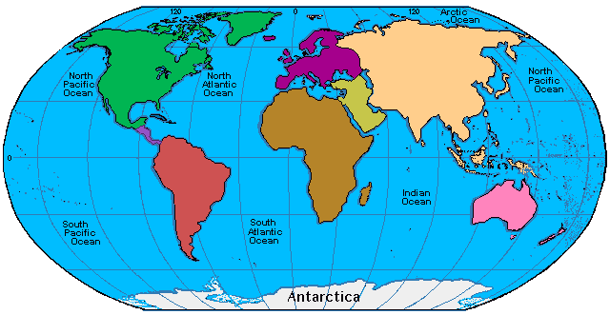
Global & Regional Institutions
RC /RC (Soft) Law
No Comprehensive Legal Regime
3
Soft Law
IHL, HRL and Refugee Law
Sectoral Law
Regional Law
Bilateral Agreements

Slide 17
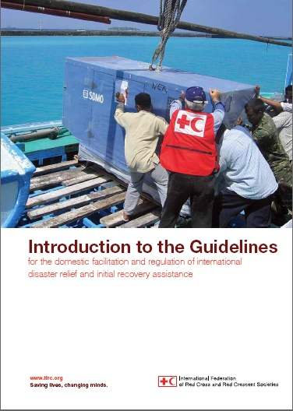
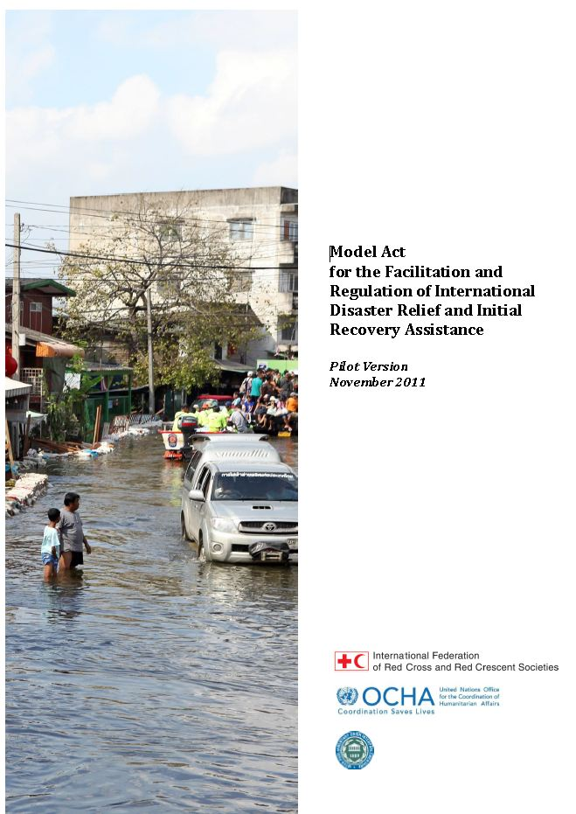
IFRC tools: IDRL Guidelines & Model Act
Draw upon existing international norms and best practice
Recommendations to governments on how to prepare domestic laws and procedures for international assistance
Requests for ‘legislative language’ to implement the Guidelines = Model Act
Translated into different languages

Slide 18
Why is IDRL important?
1. For governments:
Sets out procedures, roles and responsibilities
Controls the type of incoming assistance
Regulates the actions of international actors
2. For International assisting actors:
Facilitates response operations
Provides ‘legal facilities’ to operate in country

Slide 19
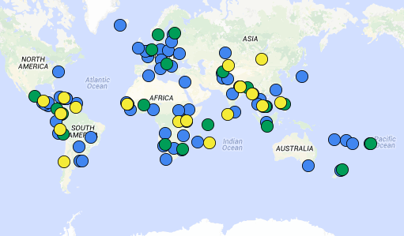
Progress to date: implementing the IDRL Guidelines at the national level worldwide
Key:
Blue: disaster law projects (50+)
Green: new laws/regulations adopted (18)
Yellow: new laws/regulations pending (17)

Slide 20
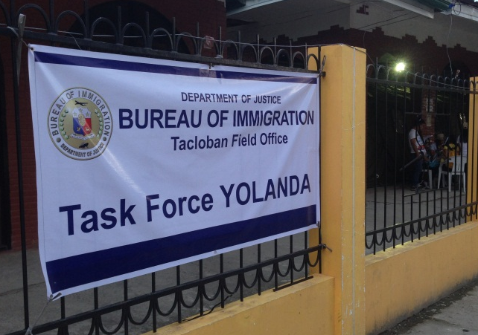
IDRL in action: The experience of the Philippines
Republic Act 10121 on National Disaster Risk Reduction and Management
‘Welcomed’ international support soon after Typhoon Haiyan / Yolanda
Established a “One-Stop-Shop” to expedite clearance of relief goods and equipment through customs; Established new immigration procedures and a Task Force
However, many different orders and guidelines – ad hoc response
Now the Philippines is reviewing its disaster management law: this is an opportunity to promote these tools and improve the law

Slide 21
True or False?
Disasters = chaos, confusion, there are no rules, law doesn’t apply.
Answer: False
International relief teams need the permission of the affected state to provide humanitarian assistance.
Answer: True

Slide 22
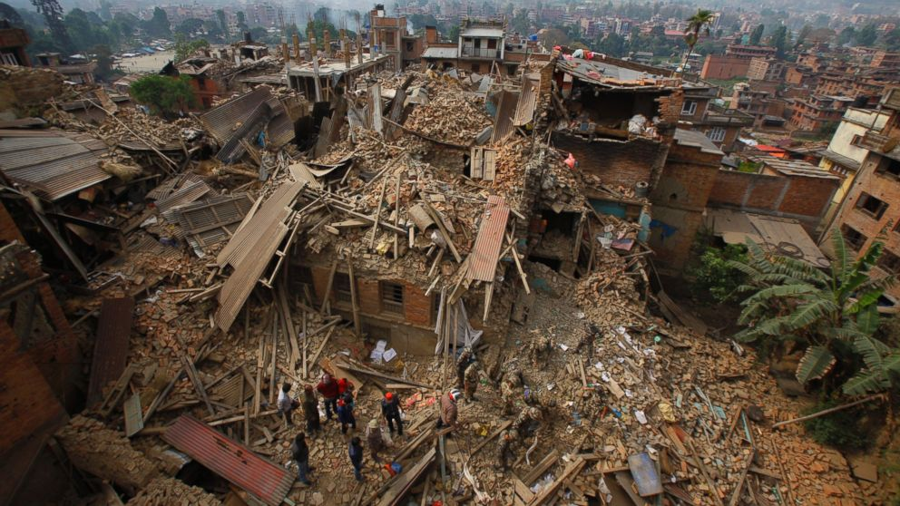
Theme 2: Law and Disaster Risk Reduction (DRR)

Slide 23
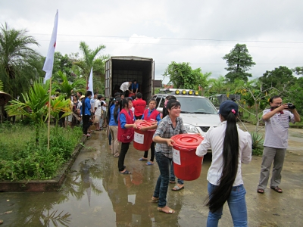
Why law and DRR? Experience highlights the importance of legal frameworks for DRR
Vietnam:
Seen the benefits of having strong laws / regulations for DRR in terms of saving lives.
Legislation on early warning, the establishment of dykes, drains (prevent flooding) and safe shelters and community awareness activities = a substantial reduction in lives lost from flooding and storms.
The flood level in the Mekong Delta in 2011 was similar to 2000 BUT the number of deaths from floods dropped from 600 down to 60.

Slide 24
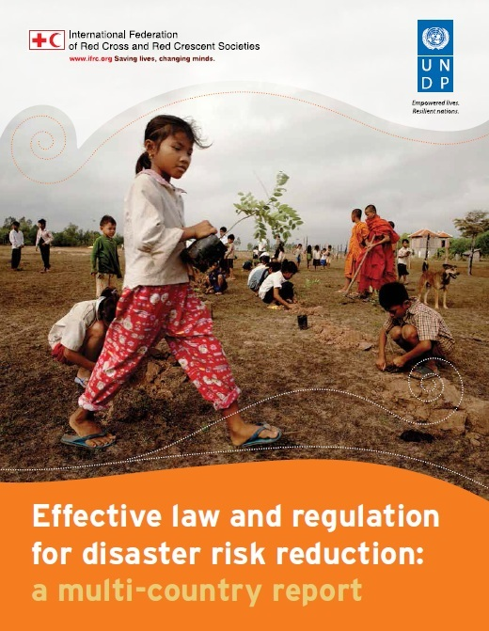
What has IFRC been doing to address this? Multi-Country Report
IFRC and UNDP launched a global study in 2014 looking at 31 countries:
Examples of good practice legal provisions
What helps or hinders implementation
Recommendations for reviewing or drafting laws
Aim to support legislators, public administrators and development practitioners to prepare and implement legal frameworks for DRR

Slide 25
Findings: Role of Disaster Risk Management laws
DRM law
DRR as a priority in law and policies
Support DRR education and awareness
Provide budget allocation for DRR
Define roles and responsibilities at different levels

Slide 26
Findings: sectoral laws are equally important!
Building codes
Land Use planning
Environment
Development approvals
Climate change adaptation
Mainstreaming DRR

Slide 27
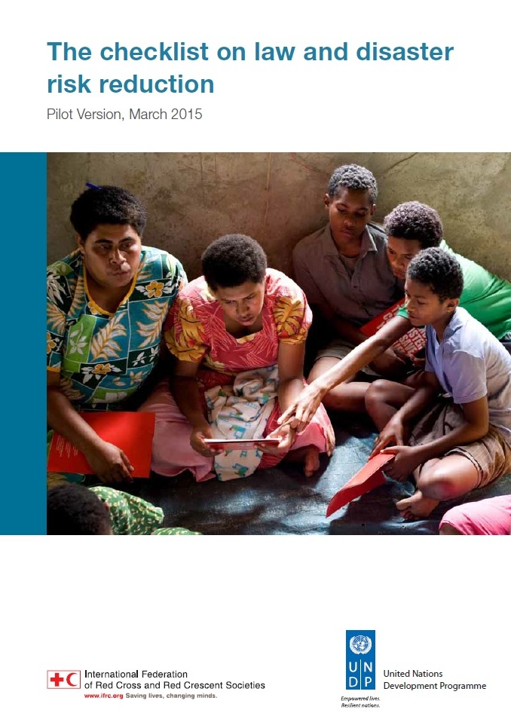
How to strengthen laws on DRR: The Checklist
A succinct and easy to use tool to support the strengthening of legal frameworks for DRR by:
Drawing on key findings of the multi-country study
To help guide a review and revision process of laws and regulations for DRR
For use by lawmakers, NDMOs, RCRC Societies, other DRR advocates
Handbook being drafted to guide implementation of the checklist

Slide 28
True or False?
If you have a good disaster management law, your legal framework for DRR is complete
Answer: False

Slide 29
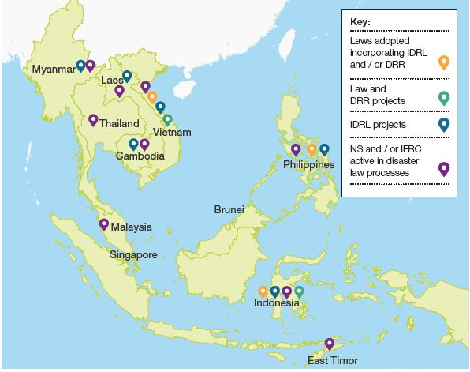
Why DL?

Slide 30
Key points to remember on Disaster Law themes!
DRR and Law (prevention):
disaster management laws are important: BUT other sectoral laws are equally as important for risk reduction
Effective laws and regulations serve as a foundation for building community resilience and making people safer
IDRL (response):
laws and regulations for international assistance means disaster-affected people get the right aid at the right time
Gives government control over type of assistance but also give humanitarian responders the access they need
IDRL is something NS can support that benefits govts, the RCRC the international humanitarian community and vulnerable people.

Slide 31
Disaster law is a cross-cutting area of work
Disaster law
OD: Red Cross Law
Disaster Management: DRR, preparedness, response
Health: legal preparedness for health emergencies, first aid legislation
Gender and diversity

Slide 32
Questions? Comments?

