Slide 1
Assessing climate risks at community level and mainstreaming adaptation into community activities

Slide 2
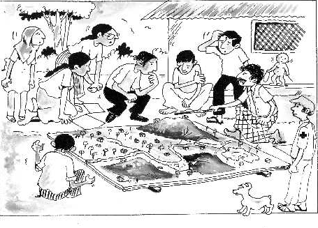
Key objectives of this session
Provide guidance how to integrate into the existing community level risk assessment process and tools, information on the additional risks and vulnerabilities linked to climate change when carrying out a community assessment/VCA. (Participants are expected to have knowledge about VCA.)
Develop a climate smart community action plan.
Notes:
Vulnerability and Capacity Assessment (VCA) is a participatory method that allows National Societies to work with communities to assess people’s vulnerabilities and build their capacities

Slide 3
Vulnerability Capacity and Assessment (VCA)
Vulnerability and capacity assessment (VCA) was developed to
enable National Societies to help communities understand the
hazards that affect them and take appropriate measures to minimize their potential impact. These measures are based on communities own skills, knowledge and initiatives – thereby preventing these hazards turning into disasters.

Slide 4
Vulnerability Capacity and Assessment (VCA)
IFRC has been at the forefront in working with communities to increase their resilience to hazards. Our vulnerability and capacity assessment (VCA) is a process of participatory investigation designed to assess, analyze and address major risks affecting communities in a timely manner. It aims to determine the level of people’s vulnerability to those risks, and their capacity to cope and recover from them. VCA has been one of the prominent methodologies used by the IFRC and its member National Societies since the 1990s.

Slide 5
Vulnerability Capacity and Assessment (VCA)
VCA is an investigation that uses various participatory tools in order to understand the level of people’s exposure to (and capacity to resist) natural hazards at the grass-roots level
It is an integral part of disaster preparedness and can contribute to the creation of community based disaster preparedness programmes at the rural and urban grass-roots level.
As part of the process, it allows the people to identify and
understand the risk they consider should have priority, even if these are not the natural hazards

Slide 6
What VCA is?..............
It is a tool which enables local priorities to be identified and leads to the design of actions that contribute to disaster reduction
as well as the design and development of programmes in each of the International Federation’s priority areas that are mutually supportive and responsive to the needs identified by people at the grass-roots level.

Slide 7
Why integrate climate change into community assessments?
To ensure that additional risks (already changed and future risks) caused by a changing climate will be included in risk reduction strategies determined based on people´s priorities.
A well-managed VCA can detect these changes that are already occurring and having an impact on people´s lives.
Outcome underscores need for partnerships.
Highlights synergies and opportunities for resource mobilization.
Multi-purpose approach NOT only assessment (Awareness, Advocacy and Action).
Photo: Danish Red Cross
Notes:
This session provides an overview of why we might need to consider climate change in the community-based tools we use in Red Cross Red Crescent.
It also outlines aspects that can be considered before, during and after a community-based process, as well as points to keep in mind.

Slide 8
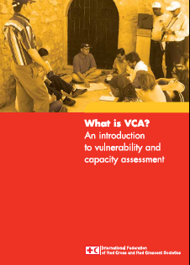
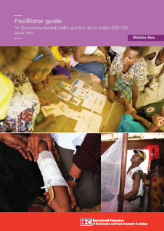
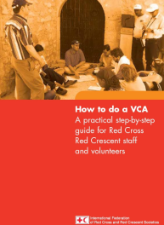
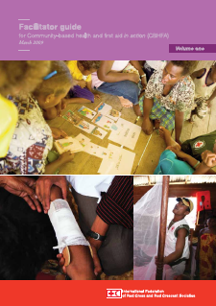
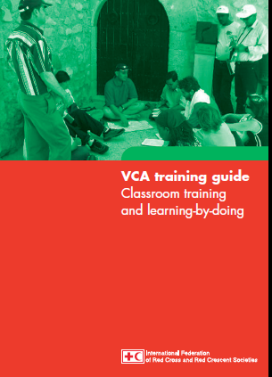
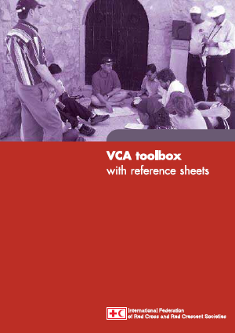
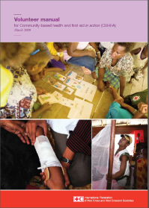
HOW?
Starting point…
Notes:
These are the main community assessment tools in the Movement – in CBHFA it is “module 3” in the manual.
VCAs is therefore a key methodology to assess the changes in hazards and risks, and the damaging effects of climate trends on livelihoods and health. VCA therefore becomes a means for assessing the likely changing hazards, the level of vulnerability, and the means for a community to engage in adaptation measures. VCA is used as a means of engaging with people to deal with the priorities that the communities have identified. It is not pre-determined to be focused on DRR, nor on climate change. It is designed to respond to problems the people want to work on. Most of these are likely to be existing problems that the RCRC already addresses and the issue is what needs to be done differently and additionally to deal with changes and increased vulnerabilities due to climate change.
Climate change can be thought of as a “magnifier” or “intensifier” of many existing problems such as environmental degradation, desertification, species extinction, food insecurity, health risks. It will challenge the RCRC in most areas of its work, and so the move to more integrated programmes should help to deal with climate change. For example, a water and sanitation (WatSan) projects that is done in isolation may not work properly unless it is “climate proofed” and fits in with other community needs, so that it is not just designed for existing conditions, but can cope with changes in climate that may exceed its design. In the same way, DRR preparations will be undermined if they do not take account of more intense risks, so for example a house-raising project may need to increase the height of the plinths.

Slide 9

Considering climate change in VCA/CBHFA tools
Ex1: Which tools to use to assess also climate risks?
Notes:
You can usually address locally experienced changes in weather without necessarily introducing the concept of climate change, which can cause some confusion.
This is a list of common tools and methods used in the VCA/CBHFA process. Note:
You could get participants to list this for you rather than presenting it.
Or you could get them to reflect on this list and indicate which ones are used more frequently or whether there are some missing.
Now you can do the exercise VCA/CBHFA tools and climate change.

Slide 10
12 tools to consider…
Review of secondary sources;
Structured and semi-structured interviews;
Focus group discussion;
Direct observation
Hazard mapping,
Vulnerability mapping
Capacity/resource mapping;
Transect walk;
Seasonal calendar;
Historical profile;
Livelihood analysis
Institutional and social network analysis

Slide 11
Ex1: Which tools to use to assess also climate risk?
Mark the tools with color stickers:
RED – not useful for collecting information relevant to climate change
ORANGE – can be useful
GREEN – very useful for collecting information on climate change and changing risks

Slide 12
In groups, answer the following questions:
1. What is the information relevant to climate change that can be collected per tool?
2. What are the uses of this information?
Each group focuses on three tools:
Group 1: hazard mapping, historical profile, FGD
Group 2: vulnerability mapping, secondary data, interviews
Group 3: capacity mapping, direct observation, livelihood analysis
Group 4: seasonal calendar, transect walk, institutional and social network analysis

Slide 13
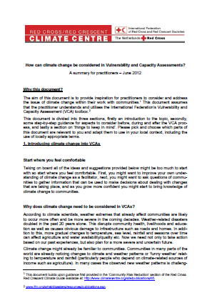
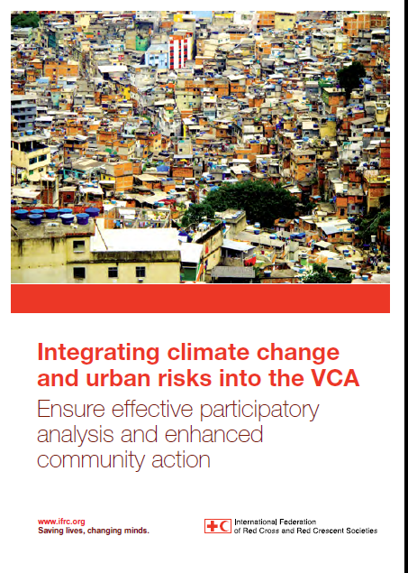
Which tools need changes? (Ex2)

Slide 14
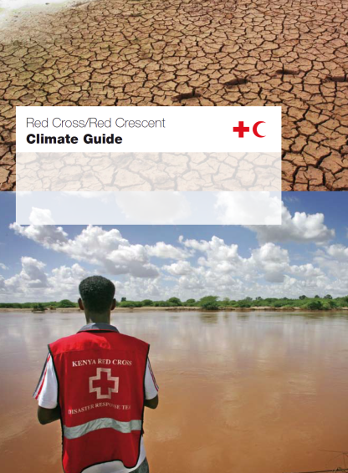
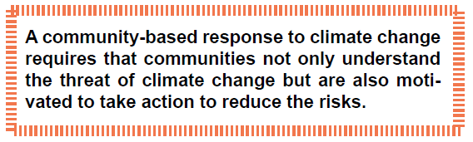
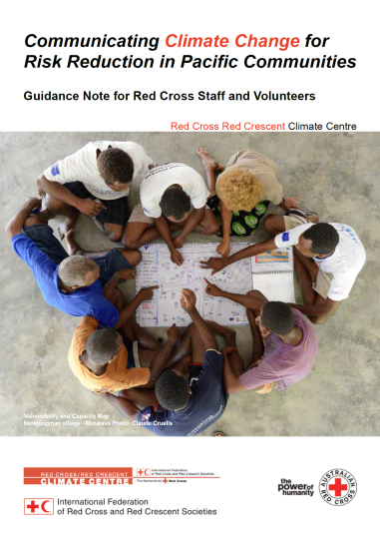
Communicating climate change for risk reduction action during VCA
Be careful but creative when you discuss changes with the community. Be prepared to discuss a range of issues, especially if the community asks.

Slide 15
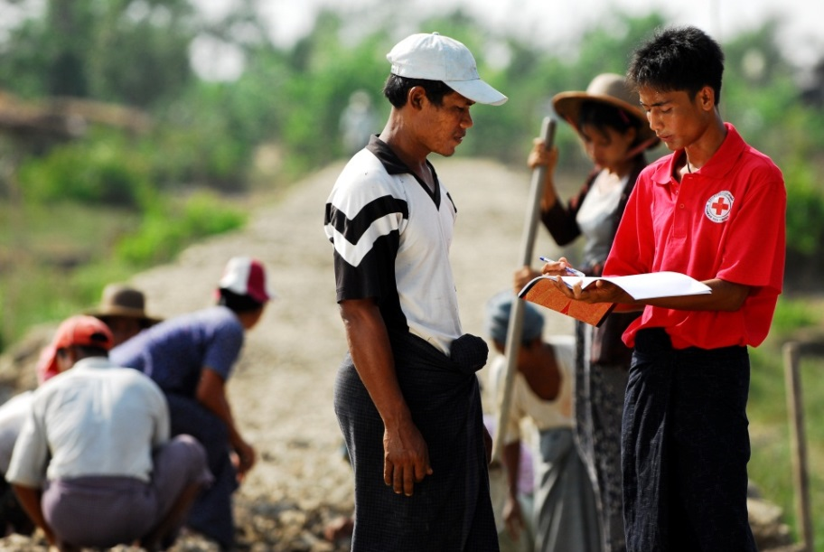
Discuss changes with the community (1)
In the facilitation, use information provided from elders and others to reflect the community’s experience with climate and weather, and how they already affect lives and livelihoods.
Discuss what they think are causing any changes.
How did they deal with past events?
What if the events became more intense and frequent? What can the community do to prepare?
The answers can help in adjusting the community risk reduction plan to become more climate-smart.
Notes:
To communicate climate change with communities, practitioners can facilitate the VCA/CBHFA process and incorporate concerns for increased weather variability in the programmes – without actually using the term climate change. But as they gain more confidence, they may introduce the concept of climate change.
Be creative: they could brainstorm ideas for this at this stage, by getting youth volunteers to put on a drama, for example. Through careful training, facilitators must feel confident in explaining the concept of climate change and relating it to the community’s context. It’s important not to over-emphasise climate change; remember that there are many risks that a community faces. It is better to incorporate climate change messages alongside others that are being taken to communities. In areas where water availability is an issue, for example, information on the drying trends can illustrate why improving water conservation is important.
Practitioners can consider contacting environmental NGOs or departments who may have experience on discussing climate change with communities.
Talking about climate change with communities can seem daunting, but it doesn’t have to involve explaining complicated concepts. The best approach is to begin discussions about climate change based on participants’ experience – how local weather impacts upon their day to day lives and affects their livelihoods. These can be drawn out during the VCA/CBHFA process. If you find that people notice changes are taking place and would like to know why, then you could present more information about the causes of climate change.

Slide 16
Discuss changes with the community (2)
Start discussing many causes of change in the community and then highlight where climate may be (or may not be) linked.
Sometimes local knowledge, such as traditional ways to predict weather or seasons doesn´t work that well anymore. Respectfully introduce other sources of information like seasonal forecasts.
If it is useful to discuss longer term implications of climate change, focus on climate change projections within a generation or one´s own life.
Link climate and weather information and longer term projections with risk reduction actions.

Slide 17
Discuss changes with the community (3)
Think about if, how and when to introduce the concept of climate change.
It is difficult to communicate climate change without relying on science based messages.

Slide 18
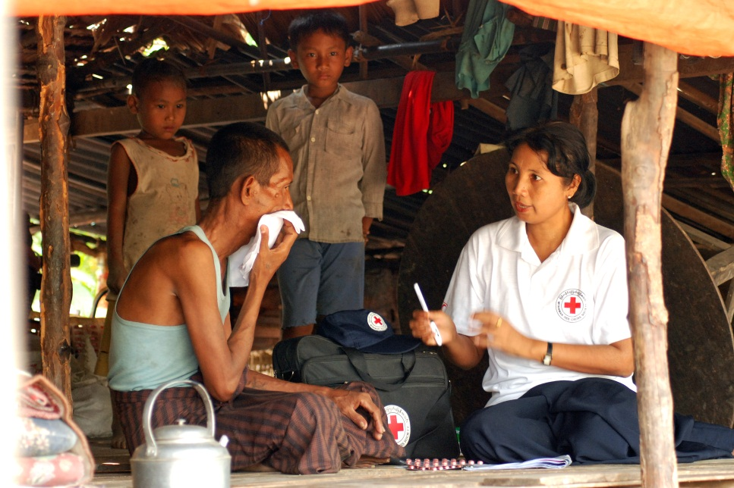
Remember
NOT to prompt the people to talk about climate change in the first place
NOT assume that climate change has affected the community
NOT over-reliant on memory as evidence
NOT all changes that people observed are a sign of climate change

Slide 19

General concept of risk and its analysis
Risk is a combination and interaction of Hazard, Vulnerability and exposure which can be represented by three sides of a triangle
Vulnerability
Hazard
Vulnerability
Hazard
If any one of these sides reduces, the risk reduces
RISK
RISK
Vulnerability
Hazard
If any one of these sides increases, the risk increases
Risk
Exposure
Exposure
Exposure
If we can eliminate one side there is no risk
Notes:
Hazard: A dangerous phenomenon, substance, human activity or condition that may cause loss of life, injury or other health impacts, property damage, loss of livelihoods and services, social and economic disruption, or environmental damage.
Risk: The combination of the probability of an event and its negative consequences
Exposure: People, property, systems, or other elements present in hazard zones that are thereby subject to potential losses.
Vulnerability: The conditions determined by physical, social, economic, environmental and political factors or processes, which increase risk and susceptibility of people to the impact of hazards.
Capacity: The combination of all the strengths, attributes and resources available within a community, society or organization that can be used to achieve agreed goals.

Slide 20
A matrix to help the risk analysis
Hazard/threats | Impacts/Risks | Elements at risk | Vulnerability | Capacity
Risk Prioritization
Problem Identification
Problem Tree Analyses
Objective Tree Analysis
Community Action Plan
Notes:
An example from the Solomon Islands.
20

Slide 21
A matrix to help the analysis
Changes observed by the community | Possible reasons for changes
 | Evidence based on scientific information | Other factors that may explain changes observed by communities
Example 1. Sea eroding the coastline | Sea level rising 8 mm per year in XX island | Some sand mining along coastline
Example 2. Getting hotter in the summer | Temperature rising
Example 3. Flooding more often | Meteorological office reports that no change in extreme rainfall events | Logging present upstream, probably affecting flow
Notes:
21

Slide 22
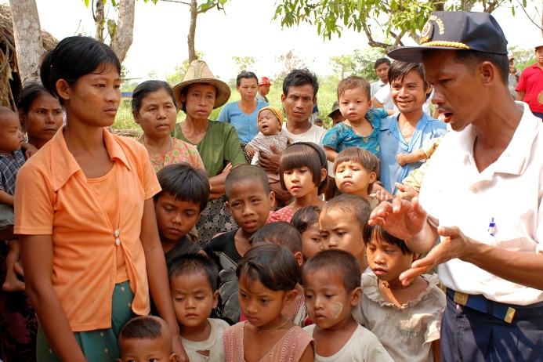
Key messages
Local knowledge vs. Scientific information
Multi-sector assessment & analysis -> NOT a separate assessment for climate change
CHANGES vs. Existing
Capacity building of field staff/volunteers and local stakeholders is vital
Awareness/Advocacy during & after Assessment
Photo: Danish Red Cross
Notes:
Information gathered in the VCA/CBHFA on changes that communities are noticing and strategies they come up with in community risk reduction plans can be very useful tools for making recommendations in advocacy to government agencies.
As the climate changes, the Red Cross Red Crescent will need to exchange methods for dealing with it at the community level both within and outside the Movement.

