Slide 1
Health in a Changing Climate

Slide 2
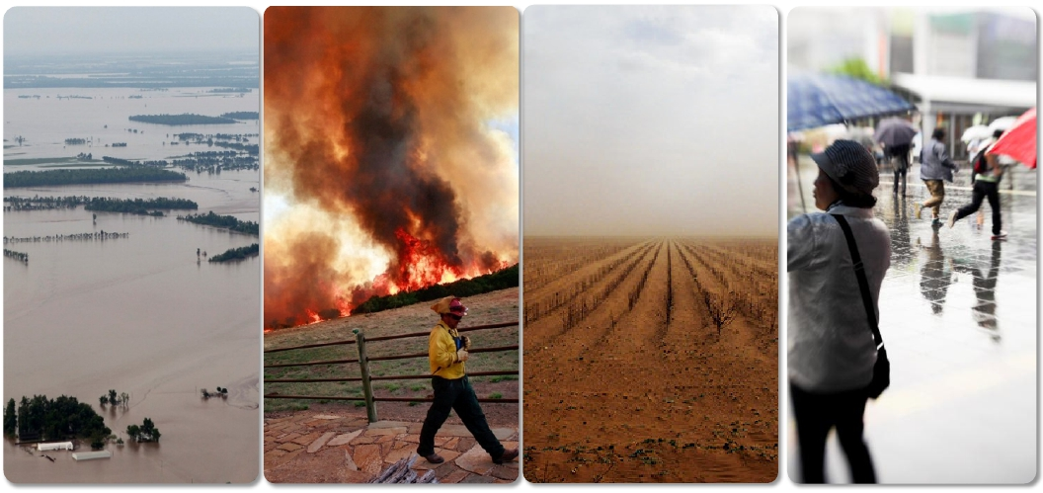
Global Climate is changing

Slide 3
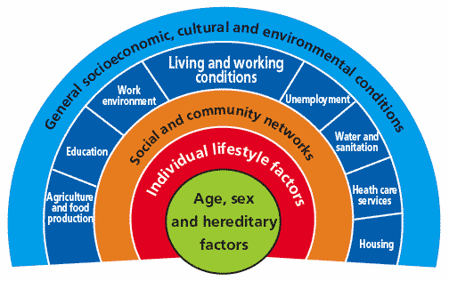
Determinants of health
Person’s individual characteristics and behaviors
Physical environment
Social and economic environment
Source: www.who.int/hia/evidence/doh/en/
Notes:
Many factors combine together to affect the health of individuals and communities. The context of people’s lives determine their health, and so blaming individuals for poor health or crediting them for good health is inappropriate.
For details: www.who.int/hia/evidence/doh/en/

Slide 4
Climate Change: Health Impact
Vector-borne Diseases
Water-borne Diseases
Temperature related illness
Effects of food & water shortages
Injuries
Extreme weather events shifting to new locations
CLIMATE CHANGE
Increase in frequency and/ or Severity of extreme weather events

Slide 5
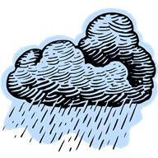

Water
Both extremes can have health effects
Too much
Too little

Slide 6
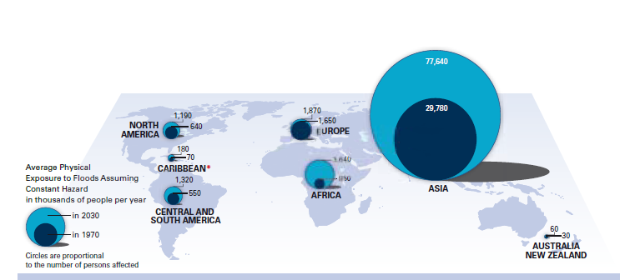
Flooding: Projection
Notes:
The projected increase in the number of people (in thousands) exposed to floods in 2030 compared to those in 1970

Slide 7
Flooding - Too much water
increasing cases of drowning and other physical trauma;
increasing risks of water- and vector-borne infectious diseases;
increasing mental health effects associated with emergency situations;
disrupting health systems, facilities and services, leaving communities without access to health care when they are needed most; and
damaging basic infrastructure such as food and water supplies and safe shelter
Notes:
Heavy rainfall, even without flooding, may increase rates of diarrhoeal disease as latrines or sewage systems overflow and in areas with poor sanitation. Increases in soil run-off may contaminate water sources. With heavy precipitation events expected to become more common, rates of diarrhoeal diseases may increase and it is likely that the most vulnerable populations will suffer the greatest burden.
many vectorborne diseases such as malaria and dengue are sensitive to temperature and rainfall. The vector itself, or the pathogen (virus, bacteria) replication rates can be sensitive to temperature. Changes in precipitation patterns can alter the number of breeding sites available or the way people store water – again creating breeding sites.
Dengue and malaria: more breedind site, people more exposed

Slide 8
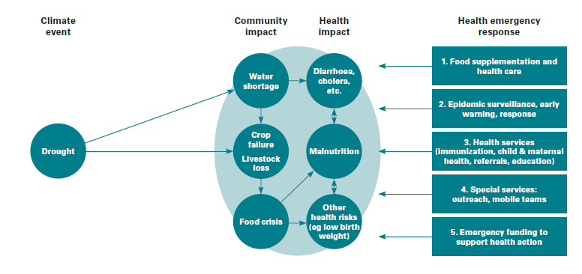
Drought – Too Little
Notes:
Water scarcity on the other hand is also likely to have consequences for public health. A lack of availability of water for personal hygiene and washing of food may lead to an increase in diarrhoeal disease and other diseases such as skin and eye diseases associated with poor hygiene.

Slide 9
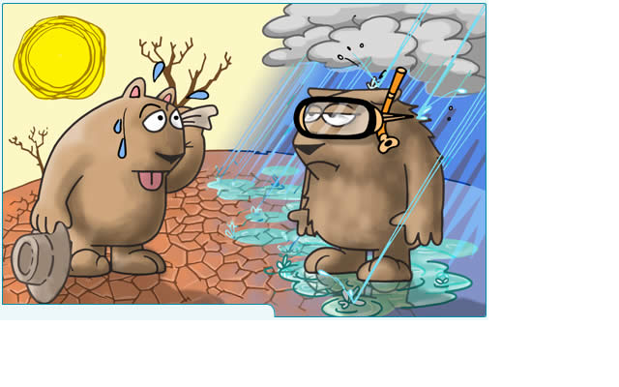
Water: Too much and Too Less

Slide 10
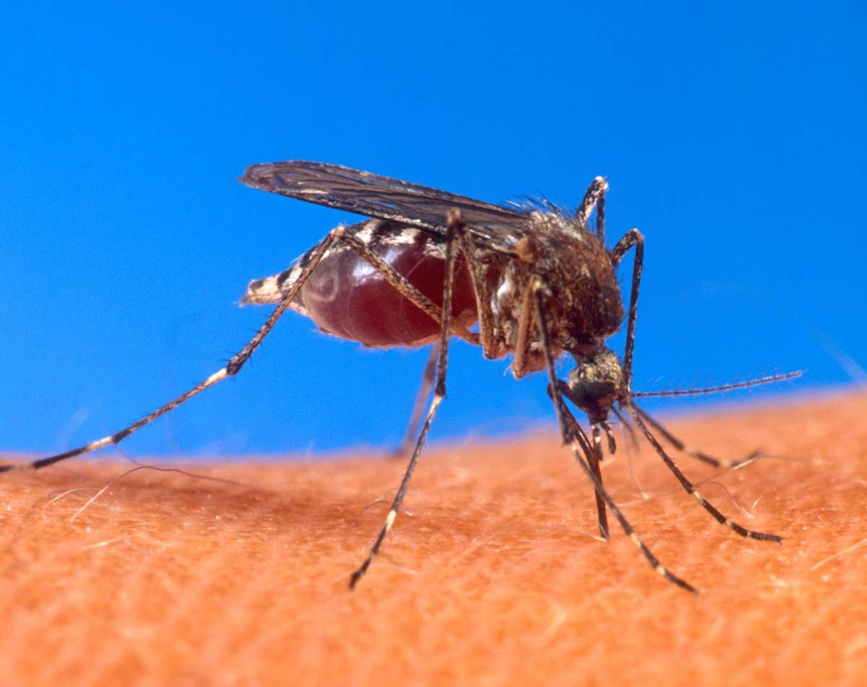
Vector - borne diseases
Dengue Fever
Malaria
Notes:
Infections caused by pathogens that are transmitted by insect vectors are strongly affected by climatic conditions such as temperature, rainfall and humidity. These diseases include some of the most important current killers: malaria, dengue fever and yellow fever. Climate change may change the temporal and spatial patterns of many vector borne diseases.
Climate variables – rainfall, humidity and temperature – are fundamental to the propagation of the mosquito vector and to parasite dynamics. Rainfall produces mosquito-breeding sites, humidity increases mosquito survival and temperature affects parasite development rates.

Slide 11
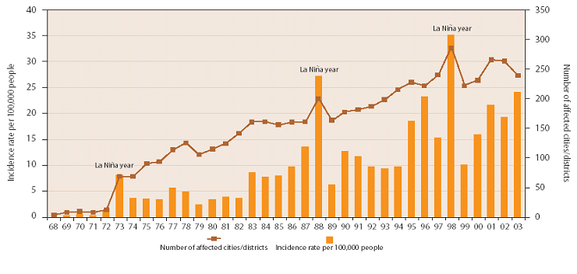
Dengue pattern relation to 'La Niña’
Notes:
In Indonesia, the rate of dengue is gradually increasing, but with marked peaks in years where there is a 'La Niña' which brings unusual wet conditions to most of the country (see about La Nina above). This can be predicted with high confidence months in advance – the 'early warning – and Red Cross could take 'early action' to combat disease outbreaks by mobilising volunteers in timely and comprehensive dengue awareness efforts in likely risk zones. The trained health volunteers would largely do what they would normally do in their communities, but the HQ and Branches could alert and train them and organise earlier and more intense community campaigns. Incidence of dengue and the number of affected cities and districts, Indonesia 1968-2003 (source: Indonesia Department of Health)

Slide 12
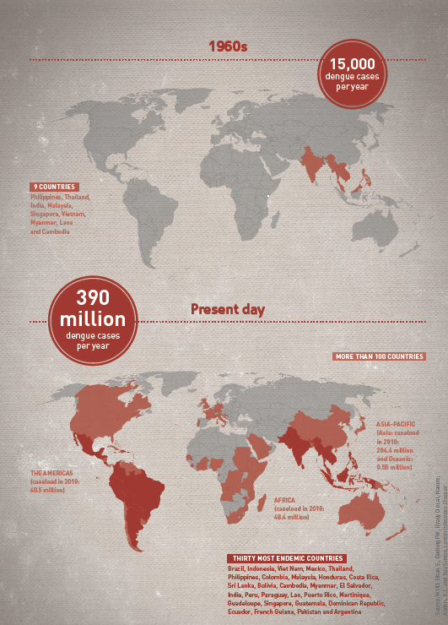
Dengue

Slide 13
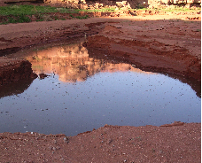

Rain, temperature and humidity
Rain
Increase breeding sites for mosquitoes
Humidity
Mosquito survival
Temperature
Parasite development rates
Notes:
Increased levels of rainfall or flooding means that water collects in stagnant pools which provides conditions for mosquito breeding and therefore the risk of spreading dengue fever.
Low rainfall can also increase infection rates as people store more water at home and these containers provide breeding sites.

Slide 14
Biological Amplification
A mere half degree centigrade increase in temperature can bring about a 30 – 100% increase in mosquito abundance.
Highlands with low temperature are no longer safe against mosquito borne disease.

Slide 15

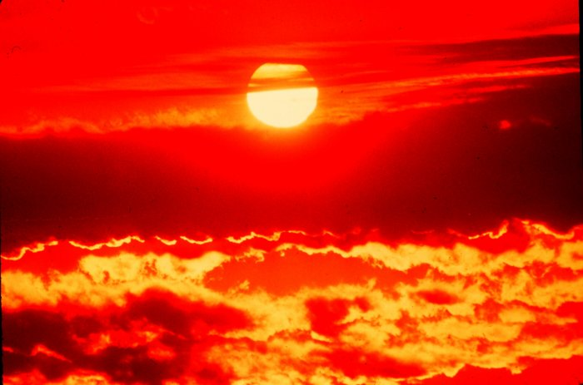
Heat waves
Vulnerable people:
Elderly people, infants,people with other diseases (heart, respiratory)
Manual Labors
Notes:
Climate change is expected to increase average temperatures as well as the number and intensity of heatwaves. Heatwaves are associated with increased mortality in the short term, especially among populations who are not adapted to extremely hot weather.
The extreme heat adds an additional stress to vulnerable elderly people and to those who already have weak heart, brain and lung conditions. Heat stress can rapidly become life threatening, especially among those with limited access to immediate medical attention. People with severe heat stroke symptoms have little time to seek emergency treatment.

Slide 16
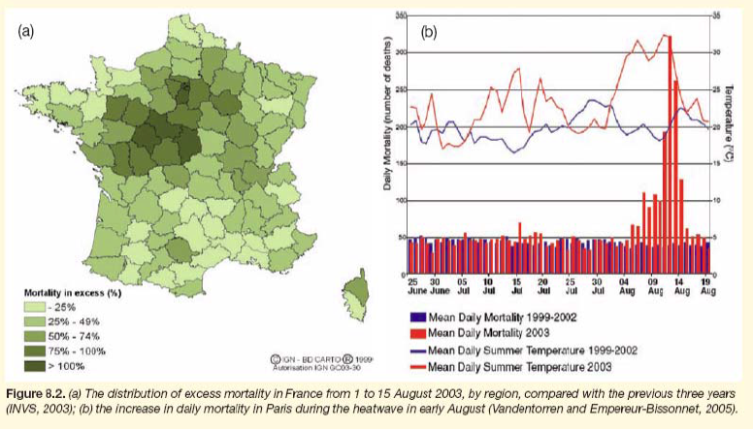
Heat wave – Europe 2003
Notes:
Peer reviewed analysis places the European death toll at 70,000, in France alone almost 15,000

Slide 17
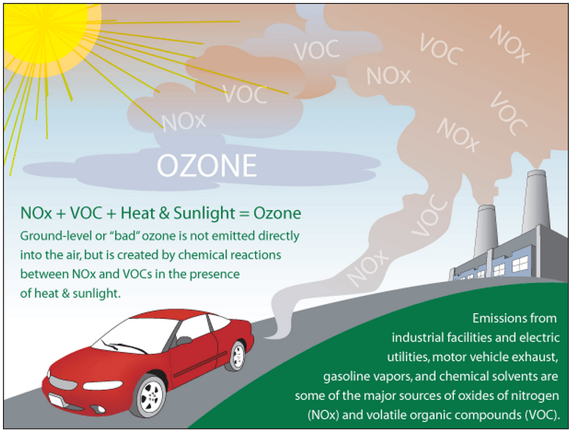
Air Quality
Notes:
The formation of many air-pollutants is determined in part by climate factors such as temperature and humidity. Climate change may therefore influence pollutant concentrations, which in turn may affect health as air pollution is related to cardio-respiratory health.
Exposure to high levels of ground-level ozone, for example, which is formed from the exhaust of transport vehicles, industrial emissions, increases the risk of exacerbations of respiratory diseases such as chronic obstructive airways disease and asthma, leading to hospital admissions or increased mortality.
“Peak ambient O3 concentrations are typically observed in summer months, when higher temperatures and increased sunlight enhance O3 formation and also lead to increased emissions of biogenic and fugitive anthropogenic hydrocarbons, important precursors of O3 formation. Above 90°F (32°C), a strong positive association has been found between temperature and ground-level O3 production (Patz 2000). Numerous epidemiology studies have reported associations between O3 and hospital admissions or emergency visits for respiratory conditions, diminished lung function, and a variety of other health outcomes(Kinney 1999; Koken et al. 2003). A relatively recent but growing body of literature also has documented acute effects on mortality in large cities, in many cases while controlling for particulate matter and other pollutants (Dominici et al. 2003; Hoek et al. 1997; Moolgavkar et al. 1995; Thurston and Ito 2001; Vedal et al. 2003).” – Knowlton et al 2004

Slide 18
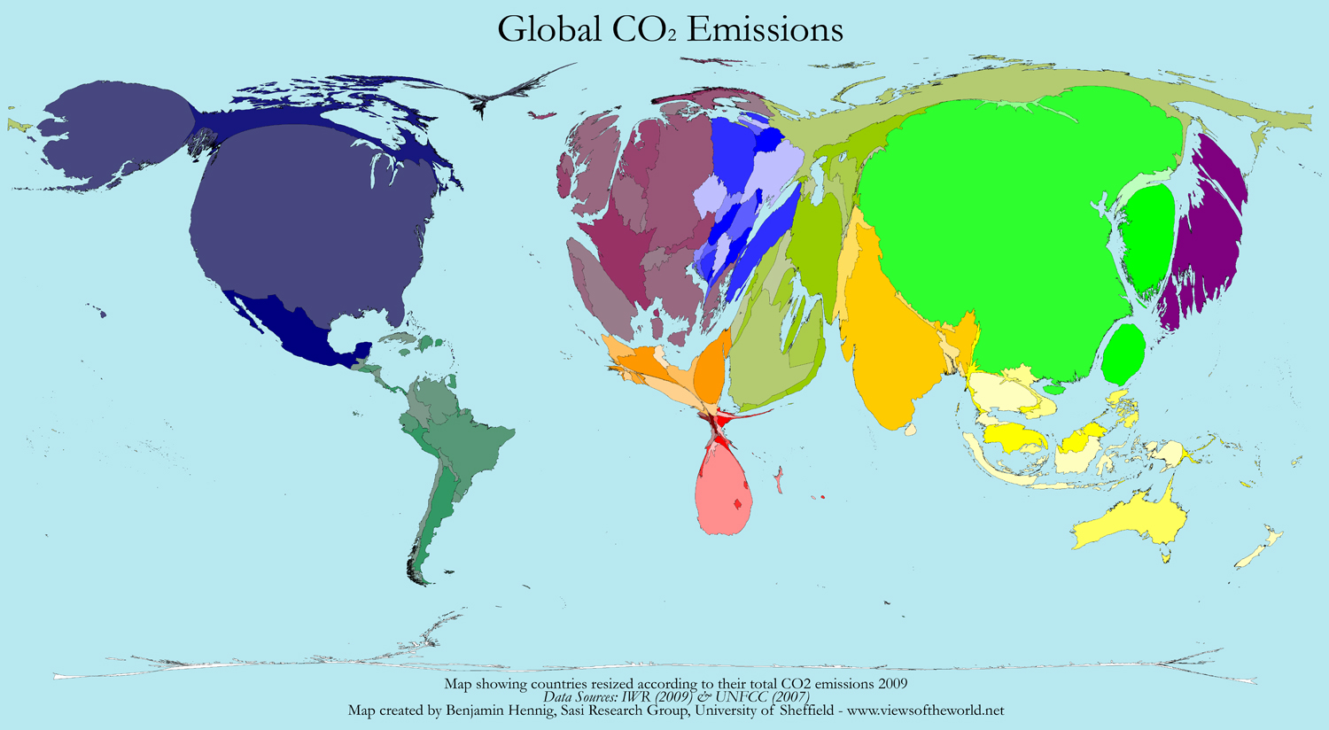

Slide 19
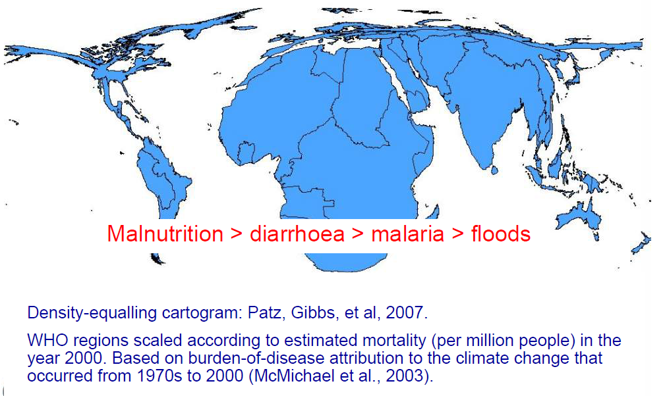
Cartogram: Selected health impact of climate change

Slide 20
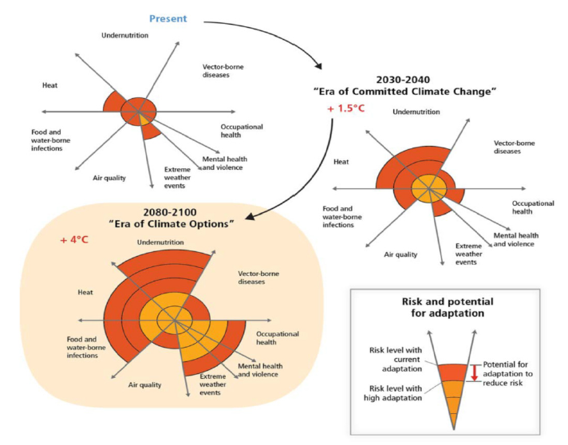
Notes:
Qualitative assessment of the health impacts from climate change, with and without adaptation measures. The width of the slices gives an indication of the attributable burden for each health impact, and
the dark orange area indicates the proportion that could be avoided through strong adaptation measures. Assessments are shown for the period 2030–2040, for which human actions have effectively committed the
world to warming of approximately 1.5ฐC above preindustrial levels; and the period 2080–2100, in which vigorous mitigation efforts could potentially avoid part of the 4ฐC temperature increase that would otherwise be expected from current emissions trends

Slide 21
EARLY WARNING EARLY ACTION
For health effects?
Focus surveillance efforts at areas predicted to be at particularly high risk for changing patterns of disease
  Vector-borne diseases (malaria, dengue, etc)
  There are not yet early warning systems for everything, everywhere
Notes:
Early warning, early action means making use of climate and weather information before a health emergency strikes and act sooner than you would do without this information.
We often have some information ahead in time of the upcoming disaster event such as flooding, tropical storms and heatwaves, and that information can be interpreted and used to prepare the emergency operation better.
Disease surveillance is an epidemiological practice by which the spread of disease is monitored in order to establish patterns of progression.
So in the ‘Early Warning, Early Action’ approach we make full use of climate information – and we act in a way that prepares us better as a whole, but also with a more strategic approach to health emergency response.

Slide 22
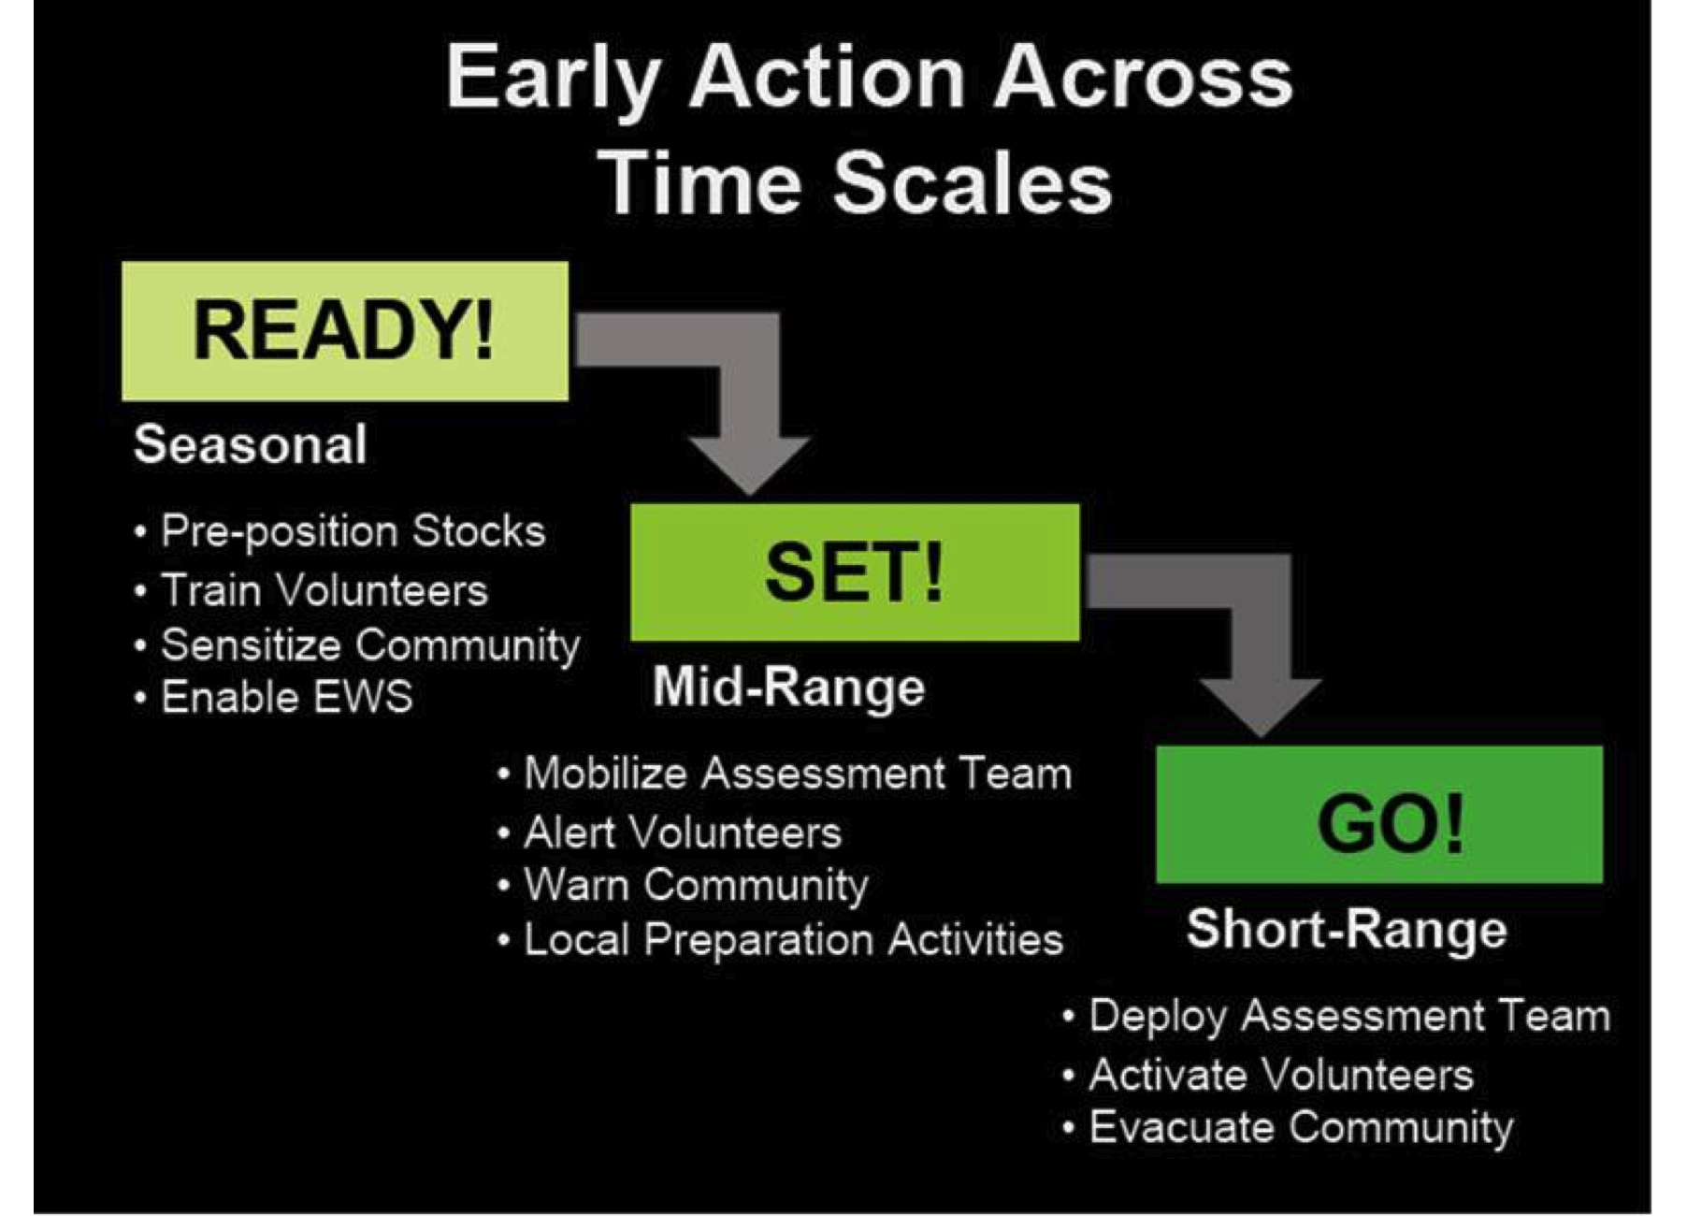
Notes:
The 2008 actions of the West and Central Africa Zone (WCAZ) provide a model for the Movement to improve and scale-up the use of climate information, allowing translation of early warnings into early action for better disaster management and response. Some of the great ways the WCAZ utilized seasonal forecasts for life saving early action include:
Employing “no-regrets” strategies to focus and plan for probable (but not certain) events.
Monitoring forecasts on multiple time-scales, to reduce uncertainty in longer-term outlooks.
Consulting multiple sources of forecast information for greater scientific consensus, including ACMAD (African Centre of Meteorological Application for Development)
Utilizing tools that combined the seasonal precipitation forecast with hydrology for flood risk mapping (important since a precipitation forecast is not a flood forecast).
Holding a meeting with key stakeholders to develop preparedness strategies.
Issuing the first-ever Preliminary Emergency Appeal, and initiating changes that now make funds from the Disaster Response Emergency Fund (DREF) available for preparedness activities.

Slide 23
Summary
Increase of climate sensitive diseases
(Shift of) high temperatures & vectors
Same problems - changing patterns/frequency/places
Proper adaptation measure can reduce the burden of disease
Combine detection/surveillance, baseline resilience and use of climate information to promote health resilience

Slide 24
Emergency Health Unit
can I help you…..

