Slide 1
Climate Change Mitigation

Slide 2
Content of the module
Global Climate Change Mitigation (CCM) challenge and
relevance to RCRC 25 min
IFRC’s position on CCM 10 min
Community CCM activities and benefits 60 min
Greening of organization / carbon foot print 25 min

Slide 3
Section 1 (25 min)
Global climate change mitigation challenge, sources of human-induced greenhouse gas (GHG) emissions, options for mitigating climate change
  IPCC WGIII: Climate change 2014: Mitigation of Climate Change (Video)
  De-brief of the video with key messages and relevance to the Red Cross and Red Crescent
Notes:
Common resource

Slide 4

Climate change is a global
common problem.
Notes:
What does this mean in the context of climate change mitigation?
Effective mitigation will not be achieved if individual agents advance their own interests independently.
Climate change has the characteristics of a collective action problem at the global scale, because most greenhouse
gases (GHGs) accumulate over time and mix globally, and emissions by any agent (e.g., individual, community, company,
country) affect other agents.
The key challenge of the global commons is the design of governance structures and management systems capable of addressing the complexity of multiple public and private interests, subject to often unpredictable changes, ranging from the local to the global level. As with global public goods, management of the global commons requires pluralistic legal entities, usually international and supranational, public and private, structured to match the diversity of interests and the type of resource to be managed, and stringent enough with adequate incentives to ensure compliance. Such management systems are necessary to avoid, at the global level, the classic tragedy of the commons, in which common resources become overexploited

Slide 5

Notes:
http://www.cisl.cam.ac.uk/Resources/Climate-and-Energy/Videos.aspx
https://www.youtube.com/watch?v=gDcGz1iVm6U (this video is recommended)
Put subtitles on.

Slide 6
Climate Change Mitigation – video debrief
List two to three key messages from the video
How are these key messages relevant to the Red Cross Red Crescent?
Notes:
Effective mitigation will not be achieved if individual agents advance their own interests independently.
Climate change has the characteristics of a collective action problem at the global scale, because most greenhouse
gases (GHGs) accumulate over time and mix globally, and emissions by any agent (e.g., individual, community, company,
country) affect other agents.

Slide 7
Key messages – Move away from BAU (Business As Usual)
Climate policy intersects with other societal goals creating the possibility of co-benefits or adverse side-effects.
Delaying mitigation efforts beyond those in place today through 2030 is estimated to substantially increase the difficulty of the transition to low longer-term emissions levels and narrow the range of options consistent with maintaining temperature change below 2º C relative to pre-industrial levels (high confidence).
Decarbonizing (i.e. reducing the carbon intensity of) electricity generation is a key component of cost effective mitigation strategies in achieving low-stabilization levels.
Reducing energy demand through efficiency enhancements and behavioral changes are a key mitigation strategy.
Notes:
Mitigation and adaptation can positively or negatively influence the achievement of other societal goals, such as those related to human health, food security, biodiversity, local environmental quality, energy access, livelihoods, and equitable sustainable development.

Slide 8
Relevance of CCM for the RCRC
Low Carbon Climate Resilient Development
Common but
Differentiated Responsibility
Climate Finance
Limits to Adaptation
Synergies
Co-benefits
Notes:
Issues of equity, justice, and fairness arise with respect to mitigation and adaptation. Countries’ past and future
contributions to the accumulation of GHGs in the atmosphere are different, and countries also face varying challenges
and circumstances, and have different capacities to address mitigation and adaptation. The evidence suggests that outcomes
seen as equitable can lead to more effective cooperation
The preamble of the UNFCCC acknowledges "that the global nature of climate change calls for the widest possible cooperation by all countries and their participation in an effective and appropriate international response, in accordance with their common but differentiated responsibilities and respective capabilities and their social and economic conditions". Article 3(1) of the Convention adds the leadership role that developed countries should take, and after reaffirming the principle of common but differentiated responsibility, it states that "the developed country Parties should take the lead in combating climate change and the adverse effects thereof.“
Co-benefits: health, social benefit, environmental benefits, energy security,…
Synergies/Trade-offs: Energy vs food security, Plant/tree suitability vs water availability
In Bangladesh, for example, waste-to-compost projects contribute to mitigation through reducing methane emissions;
to adaptation through soil improvement in drought-prone areas; and to sustainable development through the
preservation of ecosystem services

Slide 9
Section 2 (70 min)
Strategy 2020, IFRC Plan of Action:
Presentation (10 min)
Community and RCRC CCM activities & benefits:
Discussion/Exercise (60 min)

Slide 10
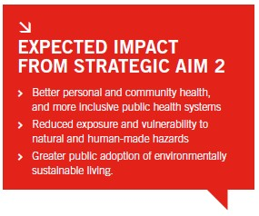

Strategy 2020 – contribution to CCM
Advocacy & social mobilization
Sustainable community development
Optimize communities’ carbon footprint
Use energy more efficiently
Reduce the impact on the environment
Exemplify through the way we conduct our own business

Slide 11
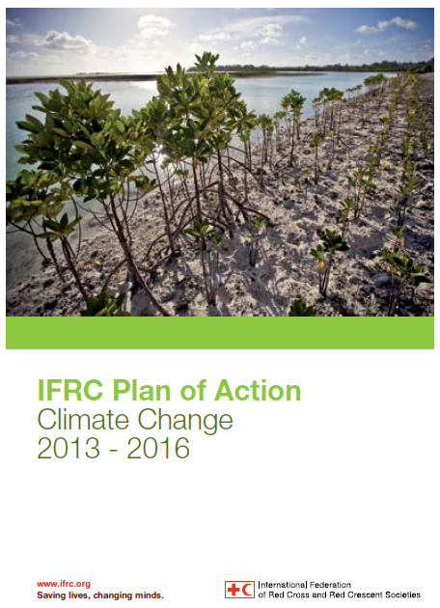
IFRC Plan of Action on
Climate Change
Key objectives and activities for scaling-up work on climate change;
IFRC key priorities for building community resilience to climate change;
Overall framework to increase coordination and knowledge sharing.

Slide 12
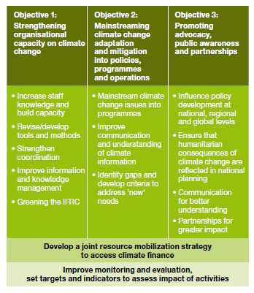
IFRC Plan of Action on
Climate Change
Contribute to low carbon climate
resilient development pathways, NAMAs,etc.
Develop guidance & training materials for CCM
Advocate for more ambitious targets in light of adaptation limits
Identify and claim CCM benefits from existing activities - mapping
Private sector financing,
carbon standards, etc.
Carbon footprints, green response, etc.
Learn and benefit from experiences in result-based financing
e.g. carbon market
Tap into dominant CCM in climate finance

Slide 13
Community and RCRC CCM activities and benefits – group exercise (40 min)
Discuss and come up with a list of existing CCM activities (energy efficiency, renewable energy, waste management, etc.) in the communities where you have worked and the benefits from these activities using the given format on a flip chart;

Slide 14
Community and RCRC CCM activities and benefits – group exercise (40 min)
Review and de-brief with groups (with slides and flip charts):
  what are the community benefits / co-benefits of these activities?
  how emission reductions materialize?
  is this already a RCRC programme activity? Could it be a community action supported by the RCRC?
  what are the challenges encountered in implementation / partnerships?

Slide 15
Energy efficiency in the field
Notes:
CFL compact fluorescent lamp

Slide 16
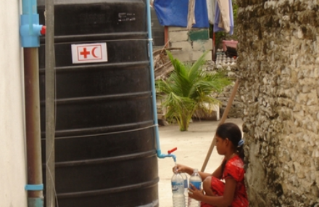
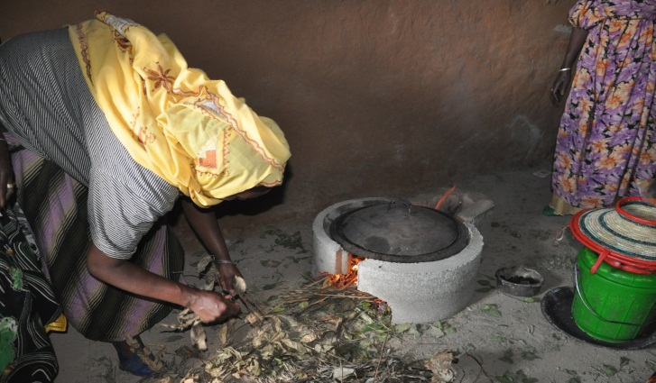
Energy efficiency in the field
Improved cook stoves, improved ignition techniques
Water conservation, e.g. drip irrigation, rain harvesting
Safe water provision, e.g. water filters
Insulated blankets (shelter)
Advanced lighting, e.g. CFLs
Etc.
Rain water harvesting (Maldives)
Improved stoves (Ethiopia)
Notes:
CFL compact fluorescent lamp

Slide 17
Renewable energy in the field

Slide 18
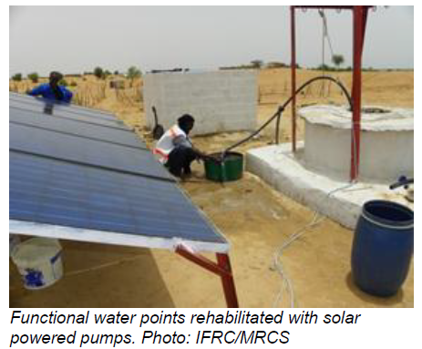
Renewable energy in the field
On-site power gen, e.g. PV, micro-hydro, micro-wind
Solar pumping, inc. safe water provision
Solar stoves
Solar lighting
Solar hot water
Etc.

Slide 19
Waste management in the field
Notes:
In Bangladesh, for example, waste-to-compost projects contribute to mitigation through reducing methane emissions;
to adaptation through soil improvement in drought-prone areas; and to sustainable development through the
preservation of ecosystem services (Ayers and Huq, 2009

Slide 20
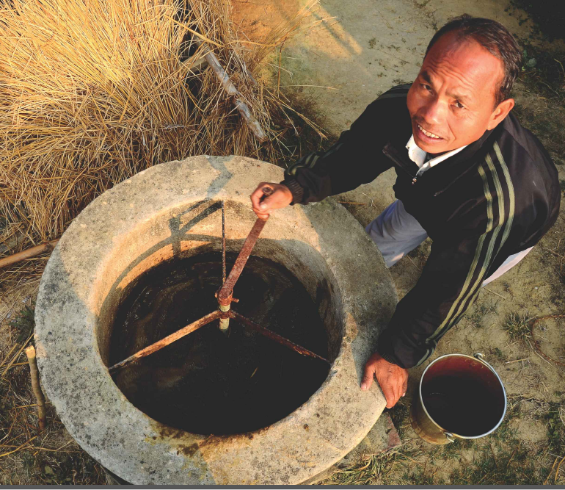
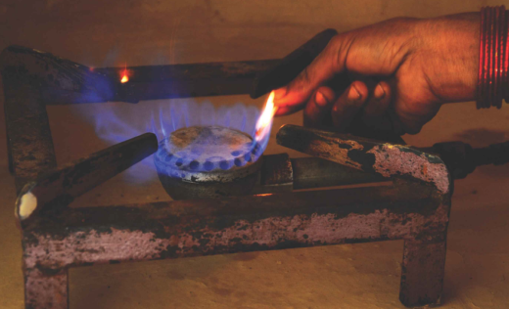
Waste management in the field
Composting
Biodigesters – biogas for cooking, lighting
Biomass briquettes
Recycling
Etc.
Source: WWF Nepal Biogas programme
Notes:
In Bangladesh, for example, waste-to-compost projects contribute to mitigation through reducing methane emissions;
to adaptation through soil improvement in drought-prone areas; and to sustainable development through the
preservation of ecosystem services (Ayers and Huq, 2009

Slide 21
Land use management in the field
Notes:
Land management and forestry activities contribute to ecosystem-based mitigation, for example through the reduction of emissions from
deforestation and forest degradation, and adaptation, for example through the conservation of hydrological services
provided to people facing water problems, as well as renewable energy (see several cases of ecosystem-based
adaptation in Pramova et al., 2012). However, tradeoffs are also possible, for example if ecosystem management for
mitigation purposes reduces the livelihood opportunities and the adaptive capacity of local people (Locatelli et al.,
2011). The scale of these examples is often local, however, and longer-term success of these pathways will depend
on the broader context of mitigation and facilitation of adaptation options (Metz et al., 2002).
However, tradeoffs are also possible, for example if ecosystem management for mitigation purposes reduces the livelihood opportunities and the adaptive capacity of local people.

Slide 22
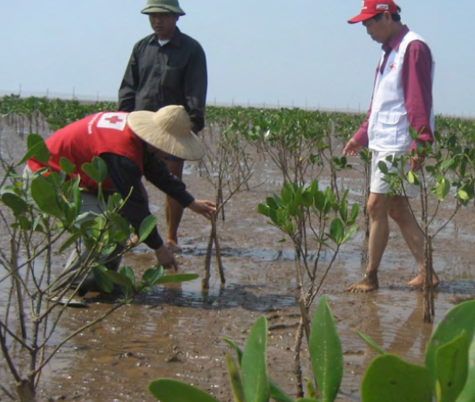
Land use management in the field
Afforestation/ Reforestation
Agroforestry
Forest management, e.g. fire prevention
Organic agriculture
REDD
Etc.
Source: Vietnam RC Mangrove Programme
Notes:
Land management and forestry activities contribute to ecosystem-based mitigation, for example through the reduction of emissions from
deforestation and forest degradation, and adaptation, for example through the conservation of hydrological services
provided to people facing water problems, as well as renewable energy (see several cases of ecosystem-based
adaptation in Pramova et al., 2012). However, tradeoffs are also possible, for example if ecosystem management for
mitigation purposes reduces the livelihood opportunities and the adaptive capacity of local people (Locatelli et al.,
2011). The scale of these examples is often local, however, and longer-term success of these pathways will depend
on the broader context of mitigation and facilitation of adaptation options (Metz et al., 2002).
However, tradeoffs are also possible, for example if ecosystem management for mitigation purposes reduces the livelihood opportunities and the adaptive capacity of local people.

Slide 23
‘Climate Change – Take Action Now’ (Youth)
Plant trees, organize a tree-planting event and invite local officials
Use public transportation more often and encourage others to do so too;
Make solar cookers, use them in public place and cook local specialty;
Buy products made or grown locally rather than shipped/flown from far away;
Learn how to grow your own food and help others to learn as well;
Refrain from getting a new mobile phone every year;
Persuade family and community members to save energy in the home;
Organize a play for your local community, acting out the devastating effects of climate change and the actions individuals can take to reduce harm to the environment.
Work in school with students to develop & implement an energy-saving plan.

Slide 24
Key messages
Globally – climate change adaptation is not enough.
The cost of CCM for the sake of CCM is too high for the most vulnerable.
Red Cross Red Crescent is already doing CCM for different reasons.
  Community Risk Reduction and Sustainable Development ´co-benefits´ are the key!
Tap into the CCM finance.

Slide 25
Section 3 (25 min)
Carbon & environmental footprints 5 min
Brainstorming + presentation 20 min
Individual carbon footprint:
Test at home how big is yours!

Slide 26

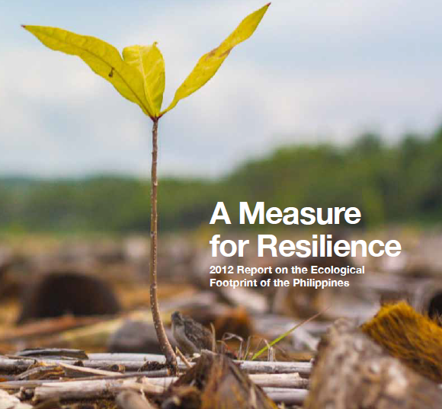
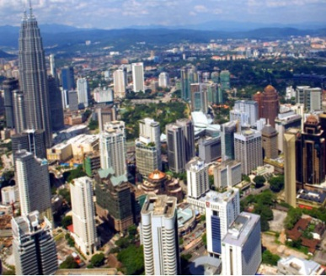
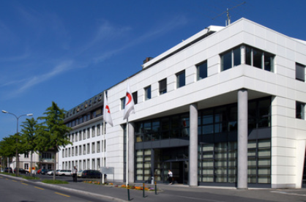

Carbon & environmental footprints
Scope:
  World
  Country
  City
  Organization, Firm
  Individual
Notes:
An individual's, nation's, or organization's carbon footprint (release CO2) can be measured by undertaking a GHG emissions assessment or other calculative activities also called as carbon accounting.
Once the size of a carbon footprint is known, a strategy can be devised to reduce it, e.g. by technological developments, better process and product management, green procurement, logistics, carbon capture, consumption strategies, carbon offsetting and others.

Slide 27
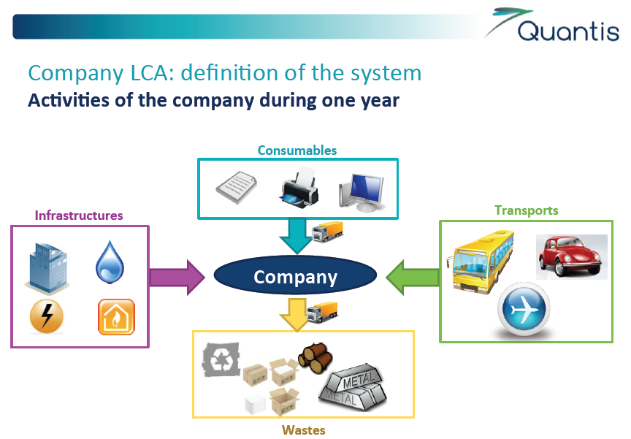
Design a PoA for your NS to how to assess and reduce carbon footprint

Slide 28
Institutional carbon & environmental footprints
Greening the organization for…”greater public adoption of environmentally sustainable living”
´Walk the talk´ in similar manner e.g. as in CCA
Learning process for GHG emission assessment
Cost savings (energy efficiency)
Staff and volunteer satisfaction
…
Notes:
´Walk the talk´- Be a good example, Be a credible actor

Slide 29
Group discussion: start with institutional carbon footprint
Form groups to focus on institutional carbon footprint;
Each group to:
  Think whether your NS should assess and reduce its carbon footprint and why;
  Come up with a list of possible priority actions to take to reduce the carbon footprint of your NS;
  Briefly present the outcome of the brainstorming.
  Use the innocent ´measuring carbon across our entire supply chain´ as your inspiration!

Slide 30
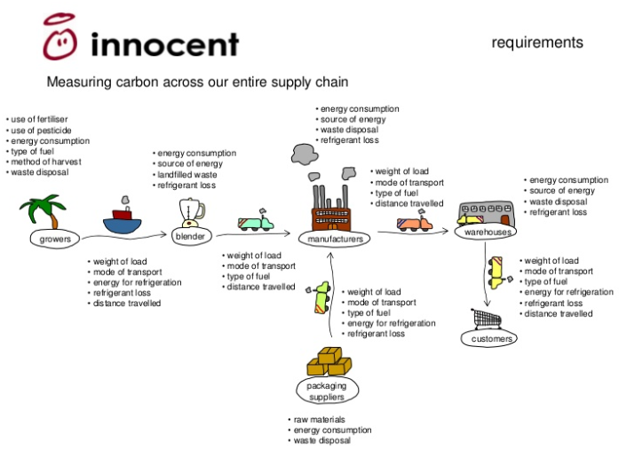
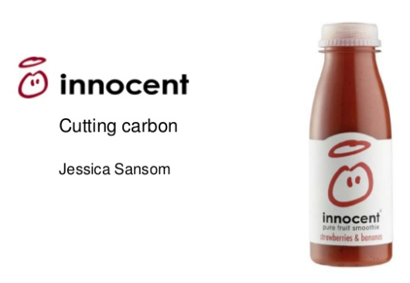

Slide 31
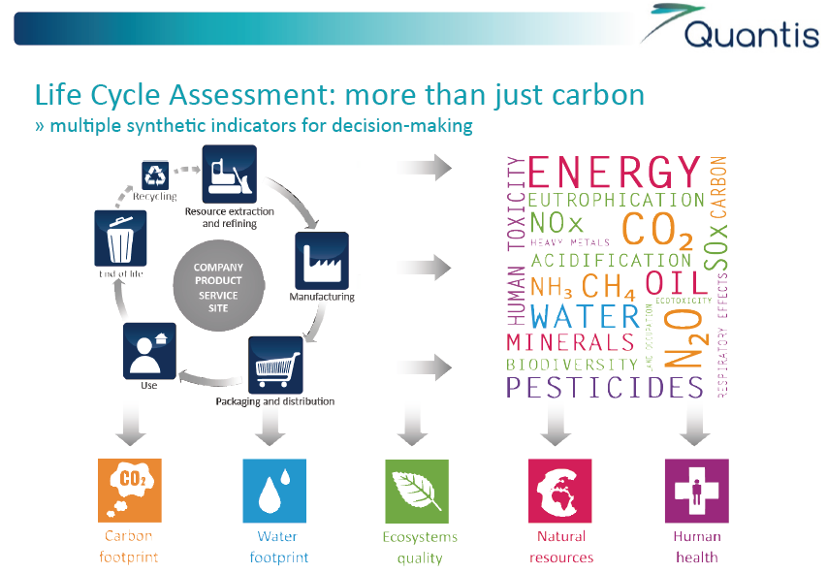

Slide 32
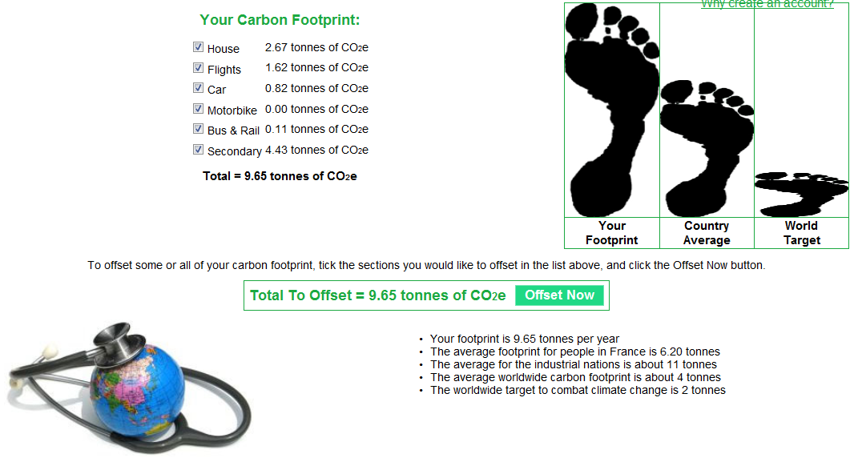
Individual carbon footprint
http://www.carbonfootprint.com/calculator.aspx
Notes:
Take home test!

