Slide 1
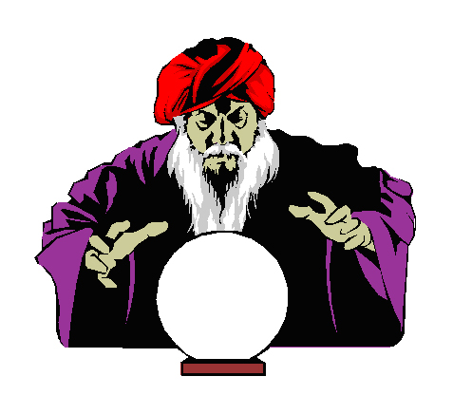

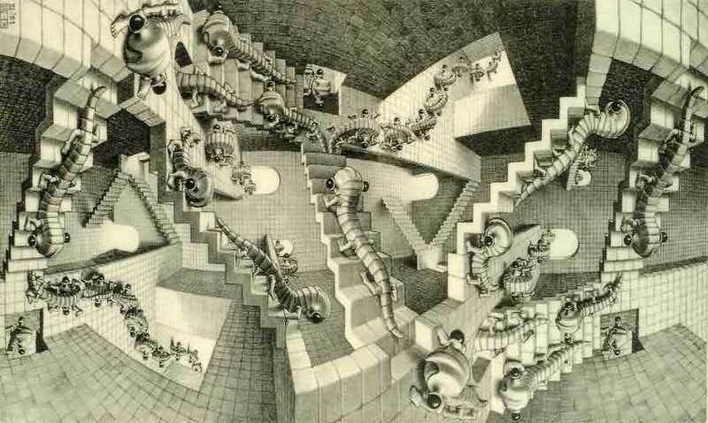
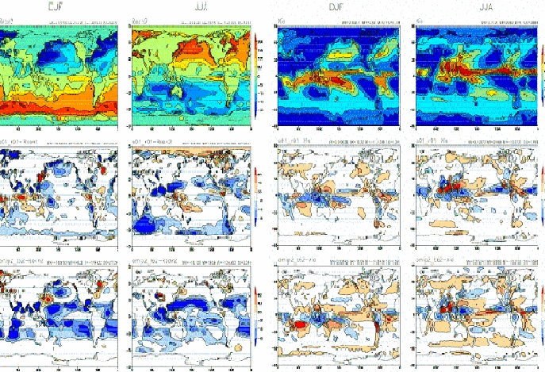
Paying for Predictions
A game on information, decisions and consequences
PARTICIPATORY!
(EXPECT CONFUSION)
  by Pablo Suarez
Red Cross / Red Crescent Climate Centre
Notes:
Clicks:
Start by introducing the Red Cross Red Crescent Movement
Wouldn’t it be great if the Movement had a crystal ball and could know in advance if a disaster was going to happen?
?
Actually, it is currently possible to have early warning of climate-related disasters! Scientists can make predictions about many things, including rainfall, up to months ahead, that can actually help us make decisions about how to prepare for potential disasters. However, if you show a Red Cross employee this map, you might as well be showing them
This!
We have developed games to help explain this, but expect confusion.

Slide 2
Ground Rules
1. Game = simplified representation of reality (No questioning of game rules)
2. Decisions are individual (But consultation with team is encouraged)
3. You win or lose beans (Beans cannot be shared - Start with 10)
Notes:
Explain that each group of 3 is a region, each person is a local branch. (Use consistent language throughout)
Beans represent the money/resources of your Red Cross Red Crescent Branch.

Slide 3
Winners & Losers
Losers: Need more beans than you have?
you have a humanitarian crisis! (receive a red stone each time)
Winner: Most beans
Winning Team: Fewest “humanitarian crises” (red stones)
If a tie, team with most total beans
Notes:
You have a “humanitarian crisis” if you cannot pay what is necessary; you receive a red stone. Note that players who run out of beans do not die; don’t refer to death as a penalty – games that playfully invoke death are unacceptable to humanitarian workers who have seen it first hand.
Show prizes here.

Slide 4
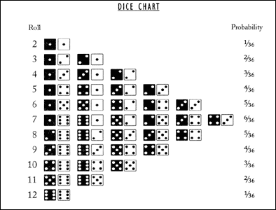
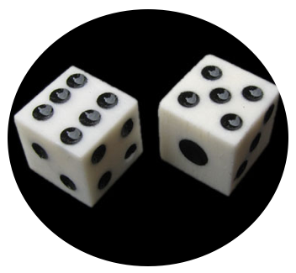

Local Climate in Regional Context
Local
Flood if 10+
(~16% chance)
Regional
2
3
4
5
6
7
8
9
10
11
12
Notes:
In this game, each Red Cross/Crescent region is vulnerable to floods.
How do you get a flood? You roll the die.
Click 1: There is one die for the region, and one die for the local. If the sum is >10, there will be a flood!
How often do you think it will flood?
Click 2: Here are all the possible combinations of the die.
Click 3: According to probability, it will flood about 16% of the time.
Now, ask everyone to roll the dive. Ask who got a flood? Make sure people get the concept.

Slide 5
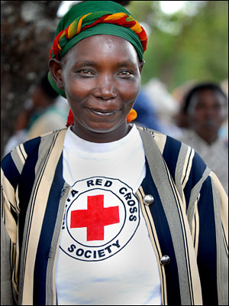
YOU
(RED CROSS WORKER)
Stand up for Flood Preparedness:
Pay 1 bean before rains
Early Action
Stay sitting (doing non-disaster tasks):
Pay nothing
Wait & See
Notes:
You are a Red Cross Red Crescent Worker.
If you are worried about flooding, is there anything you can do about it before the flood happens?
Click 1: Yes. You can prepare for a flood, but this will cost you 1 bean. You can only prepare for flood before the rainy season, so you will need to stand up before the dice is rolled.
Click 2: If you don’t want to prepare for the flood, you don’t have to pay anything, and you stay sitting down.

Slide 6
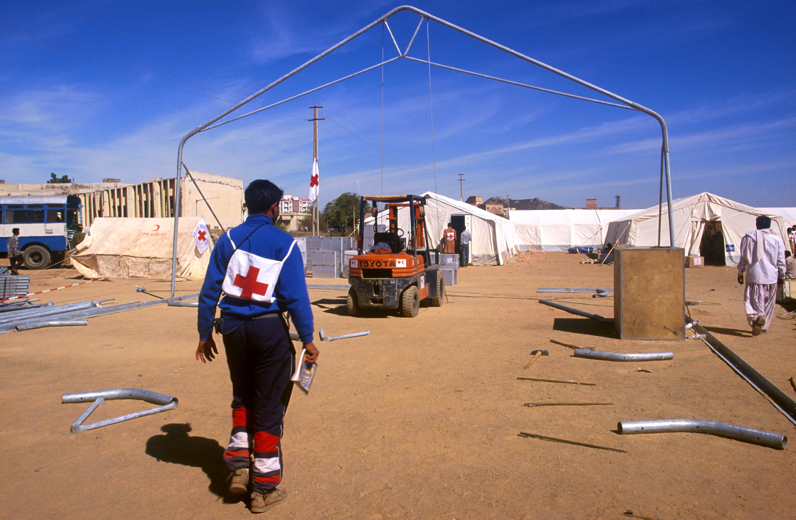
Notes:
This is a slide showing preparation for disaster – prepositioning tents?

Slide 7
No problem
No disaster ?
: No problem
: Pay 4
Early Action
Flood ?
Wait & See
Not enough beans to pay? Crisis!
Notes:
If there is a crisis, the player receives a red stone.

Slide 8
LET’S
PLAY!
PLAY!
Two practice rounds
Notes:
After the first roll, ask everyone to look and see what has happened. Find an example of people who acted in vain (wasted donor money!), prepared for a flood that actually happened (was a hero!), and didn’t act but there was a flood (had to pay a lot of beans). Ask each person what happened to them so others can see.
Then, ask everyone, who would like to know what was under the cup before they had to decide whether to invest in preparedness? Everyone will say yes.

Slide 9
Bid For A Regional Forecast
Half of the teams will have info about likely rains
The bid:
1. Put as many beans in the bowl as you want to invest
2. By end of countdown, bring bowl to front
Highest bidders: Team can see regional die before decision, throughout game (receives transparent cup). Facilitator keeps beans
Other teams: Recover your beans

Slide 10
A. Your Team: _______________________
B. Contribute to the Forecast bid: ______ beans
C. Did your team win the forecast bid? Yes / No
Note: Maybe manuscript for Nature CC
Notes:
Ask to fill out sheet.

Slide 11
Bid For Disaster Risk Reduction
One team will reduce impact of future extremes
Bid:
1. Put as many beans in the bowl as you want to invest
2. By end of countdown, bring bowl to front
Highest bidder: Facilitator keeps beans.
: If and then , pay only 2 beans
Other teams: Recover your beans
Flood
Wait & See

Slide 12
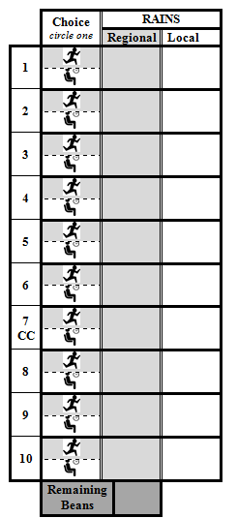
Contribute to the Forecast bid: ____ beans
Did your team win the forecast bid? Yes / No
Contribute to the DRR bid: ___ beans
Did your team win the DRR bead? Yes / No
Notes:
Now play the game.

