Slide 1


Climate Change Training
Basic science and facts of climate change – past, present and future
www.ifrc.org
Saving lives, changing minds.

Slide 2
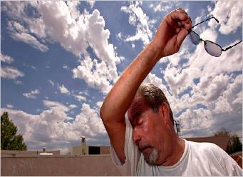
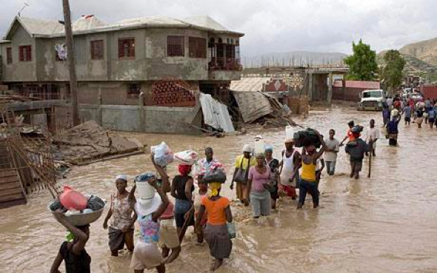
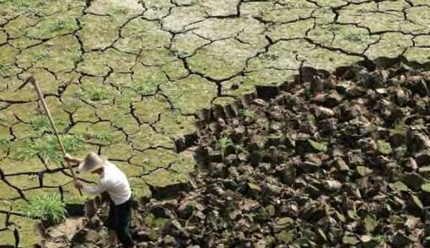
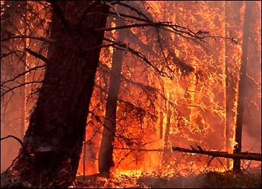
Climate Change
Notes:
Ask the participants why the Red Cross should be worried about climate change.
Take a few answers (likely to involve things such as drought, floods, etc.), and then explain: climate change is likely to cause humanitarian impacts around the world, and click through to have these worrying pictures appear.
2

Slide 3
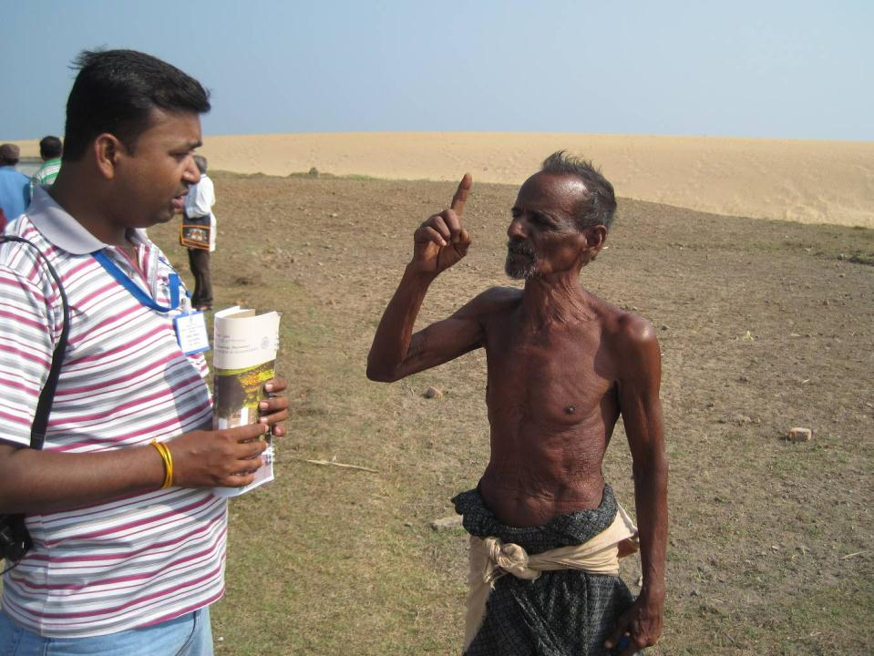
”More and worse floods”
”Rains no longer normal – difficult to know when to plant”
”Our paddy fields get eaten away by the sea”
”... so our children have to move away”
Notes:
What the people are telling us – including the sense of long-term needs for adapting

Slide 4
Weather or climate?
Weather: Short Timescales
“hours, days”
Climate: Long Timescales
“average over the past 30 years”
Will I need an umbrella today?
Is it raining? What is the weather?
I’m going to Nairobi in May – is that normally the rainy season there? What is the climate?
Notes:
Before we go on let us clarify the difference between weather and climate:
(ASK the participants to describe how they perceive the difference)
Then wrap up:
climate is what usually happens in a location (i.e.: it usually rains in May),
weather is what happens on any given day (i.e.: it is not raining on May 10).
Here, we are talking about changes to the climate system, which means changes to what is usual for a location.
Therefore, if the climate of a location is expected to get warmer, it means that location will be warmer on average, but we can’t predict how the weather will turn out on any given day.
An easy way to remember the difference: “Climate is what you expect, weather is what you get.”
4

Slide 5
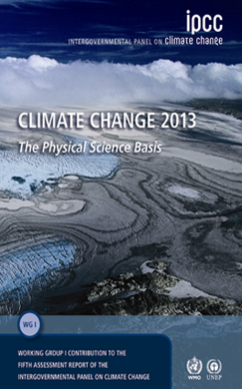
IPCC – the ‘key reference’ on climate change
Main findings
Climate change is already happening
It is mostly caused by man
It will continue
The rate of change is alarming
Extreme weather is getting more frequent
It is urgent to stop further warming
IPCC Fifth Assessment Report, 2013
Notes:
5
5
The IPCC is the Intergovernmental Panel on Climate Change, the leading international body for the assessment of climate change, established by the United Nations Environment Programme and the World Meteorological Organization in 1988. Thousands of scientists worldwide contribute to it and their highly detailed reports are accompanied by a “Summary for Policymakers” (SPM), approved line-by-line at formal UN meetings and endorsed by all governments. The SPM then becomes the agreed scientific basis for international negotiations about climate change and is used for national policy-making on climate by many countries.
The latest report – launched in September 2013 – added considerable strength to the previous (2007) report, which was already an eye-opener to the larger public. Its statements were clear and alarming: climate change is now unequivocal, it is bound to continue at an alarming rate unless substantial measures are taken to reduce greenhouse gas emissions and it already is and will continue to bring the world more extreme weather events.
Find the full report – and shorter summaries especially for the Red Cross Red Crescent – on www.climatecentre.org/AR5
and further background on the IPCC at www.ipcc.ch or www.climatechange2013.org

Slide 6
Three Questions
Q1.
WHY IS IT GETTING WARMER?
Q2.
WHAT DOES IT MEAN?
Q3.
WHAT DOES CC MEAN FOR THE HUMANITARIAN SECTOR

Slide 7
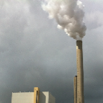
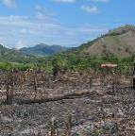
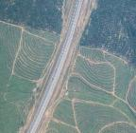
First Question: Why is it getting warmer?
Answer: The rapid global warming of the past 100 years is caused mostly by human activity, mainly:
Burning fossil fuels (e.g. coal, oil, natural gas) at unprecedented rates, sending “greenhouse gases” into the atmosphere
Widespread deforestation (trees contain a lot of carbon, and when burnt CO₂ is released )
Changing agricultural and land-use practices (agriculture releases other GHGs, CH₄ and NO₂)
Notes:
Historical records show that our climate has always varied naturally over time, for instance due to changes in the intensity of the Sun’s energy reaching the earth, volcanic eruptions, and natural changes in greenhouse gas (GHG) concentrations. However, the rather rapid warming in recent decades cannot be attributed only to natural causes. Scientific consensus now tells us that human activities are very likely to blame.
CO2 is the most important GHG - some other greenhouse gases are methane, nitrous oxide, water vapor.
7

Slide 8
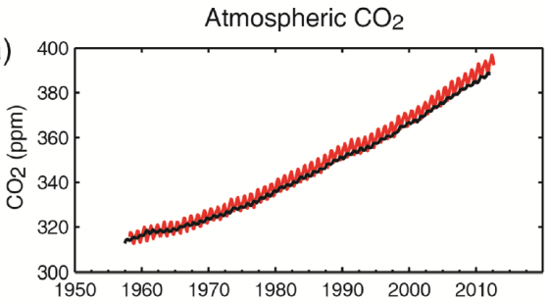
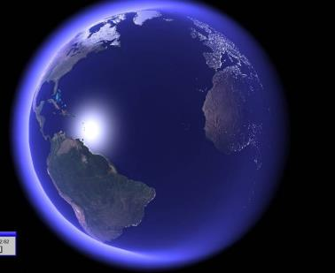
First question: Why is it getting warmer?
Greenhouse gases are acting as a blanket around the earth
Notes:
Short answer: Greenhouse gases act as a blanket over the earth, keeping it warmer. Human activities (as mentioned on the previous page) are adding greenhouse gases to the atmosphere, making it warmer and warmer.
Technical explanation
The greenhouse effect is actually part of a natural process: the sun warms up the earth, the earth radiates the heat back into the atmosphere through thermal radiation. This heat is absorbed by greenhouse gases in the atmosphere, and is re-radiated in all directions. This “blanket” of greenhouse gases that prevents the heat from escaping right away causes the temperature to be higher than what it would be without greenhouse gases in our atmosphere (which is a good think, because without our atmosphere it would be very cold on earth).
However, the human activities mentioned on the previous slide are now rapidly adding additional greenhouse gases to the atmosphere, as can be seen on this graph the 2013 IPCC report. It shows the annual variation (red) concentration of CO2 in the atmosphere measured at one station in Hawaii. In 2013 the concentration for the first time in at least 800 000 years exceeded the 400 parts per million mark on the graph (not shown). This rapid rise in greenhouse gases is resulting in a rising global temperature: climate change.
Further background information
In 2013 IPCC concluded that:
“Human influence on the climate system is clear. It is extremely likely (>95%) that human influence has been the dominant cause of the observed warming since the mid-20th century”
“The atmospheric concentrations of.. [greenhouse gases] .. have increased to levels unprecedented in at least the last 800,000 years. CO2 concentrations have increased by 40% since pre-industrial times, primarily from fossil fuel emissions and secondarily from net land use change emissions.”
“Continued emissions of greenhouse gases will cause further warming and changes in … the climate system”
8

Slide 9
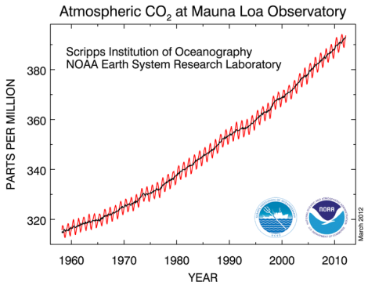
Does anyone know how many ppm of CO₂ we have in the atmosphere today?
Today CO₂ is higher than it’s been for hundreds of thousands of years
http://400.350.org/
400 ppm
That’s 120 ppm higher than the max for 800,000+ yrs
… and the difference between an ice age and a warm period is just 100 ppm
Notes:
Source: http://www.esrl.noaa.gov/gmd/ccgg/trends/
As of February 2012
Abhishek: I just updated the figures: in May the 400 ppm limit was exceeded ☹

Slide 10






Second Question: Along with the GHG the earth is getting warmer – what does that mean?
Rising temperatures, heat waves
Sea level rise
Scientists very sure
Melting ice
Ocean acidification
Changing rainfall patterns
Less clear, and regional differences
Changes in extreme events
Notes:
Walk through an overview of the expected changes, using the points below. Explain that the rest of the presentation will cover impacts on human society in more detail.
It is a fact that Greenhouse Gas concentrations is increasing, but the effects following from that have different levels of “certainty”:
1) Rising temperatures – with heat waves:
We know that at the “global scale” (i.e. for most land areas with sufficient data)
It is very likely that there has been an overall DECREASE in the number of cold days and nights.
It is very likely that there’s been an overall INCREASE in the number of warm days and nights.
In the future, for most land areas, this trend is expected to continue.
Sea surface temperatures are also rising; “minimum” temperature extremes have risen.
Heat waves are expected to become more frequent and more intense.
Source: http://www.climatechange2013.org/images/uploads/WGIAR5_WGI-12Doc2b_FinalDraft_Chapter02.pdf
2) Sea level rise
-Ocean thermal expansion and glacier melting have been the dominant contributors to 20th century global mean sea level rise.
-Thermal expansion: ocean temperatures have been increasing, water expands as it warms → sea level rise
-Glacier melting: land based ice that melts and flows into the ocean, increasing mass of water in the ocean → sea level rise.
-Higher sea levels put coastal cities at risk from flooding, more intense storm surges, and coastal erosion.
-Higher sea levels also increase risks for salt-water contamination of farmland and freshwater sources.
Source: http://www.climatechange2013.org/images/uploads/WGIAR5_WGI-12Doc2b_FinalDraft_Chapter13.pdf; http://www.ipcc.ch/publications_and_data/ar4/wg1/en/faq-5-1.html
3) Melting ice (sea ice and glaciers)
Sea ice = frozen sea water that floats on the ocean’s surface
Glaciers = dense ice exceeding a surface area of 0.1 km² constantly moving under its own gravity. Example: Greenland ice sheet
- Rising temperatures have caused glaciers and sea ice (espcially around the North Pole) to melt faster than many scientific projections
- Melting ice has implications for sea level rise and ocean chemistry.
Source: http://www.climatechange2013.org/images/uploads/WGIAR5_WGI-12Doc2b_FinalDraft_Chapter13.pdf
4) Ocean acidification – and its effects
-The ocean has absorbed more CO2 as emissions have risen, this increases the pH of the water and has serious implications for marine life. Biodiversity is under pressure due to increasingly inhospitable environmental conditions (e.g., coral bleaching because of acidifying oceans).
Source: http://www.climatechange2013.org/images/uploads/WGIAR5_WGI-12Doc2b_FinalDraft_Chapter03.pdf
5) Changing rainfall patterns
Data limitations make it difficult to say with certainty what the rainfall trends will be in all regions of the globe
BUT, on average, places that have currently have heavy precipitation can expect to see the intensity of rainfall events increase, places that are dry can expect less frequent rainfall (but more intense rain when it falls).
Or in other words: “The wet get wetter and the dry get drier”; this means drought becomes more frequent in many places around the world.
Sources: http://www.gfdl.noaa.gov/cms-filesystem-action/user_files/kd/pdf/gfdlhighlight_vol1n5.pdf; http://www.ipcc.ch/news_and_events/docs/ar5/ar5_wg1_headlines.pdf
6) Changes in extreme events
-Heat waves and droughts have become more frequent, and in some places, more intense.
-It is difficult to measure the frequency and intensity of floods, but generally there has been an increasing trend.
-Climate change is expected in increase the frequency of high-intensity tropical storms. -Very difficult to identify trends with tornados, dust storms, hail, and other severe local events because data reliability is low and current climate models don’t simulate these phenomenon. BUT, risks are expected to increase with demographic and land use changes increase people’s exposure to these events.
Sources: (http://ipcc-wg2.gov/SREX/images/uploads/SREX-SPMbrochure_FINAL.pdf) (http://www.nature.com/nclimate/journal/v2/n3/full/nclimate1357.html) (http://www.ipcc.ch/publications_and_data/ar4/wg1/en/ch3s3-8-4-2.html) (http://www.ipcc.ch/pdf/special-reports/srex/SREX_Full_Report.pdf)
(explain that this presentation will go through these points in more detail)
“Melting ice” picture: http://www.flickr.com/photos/worldresourcesinstitute/3525024219/ ; Photo by Linda Shaffer, World Resources Institute, 2009.
“Other changes” picture (bleached coral): http://www.flickr.com/photos/worldresourcesinstitute/5476510553/ ; Photo by Mark Spalding, World Resources Institute, 2011.
10

Slide 11
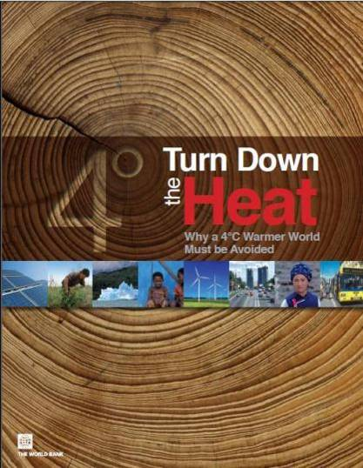
Scientist warnings are clear:
We should avoid more than a 2°Celsius temperature rise in the coming century
A 2012 World Bank report summarizes the potential effects of a 4°warmer world: it’s urgent to limit GHG emissions
The more we limit GHG emissions now, the less need for adaption to a future wilder weather
Notes:
From World Bank Report, Turn Down the Heat: why a 4 degree warmer world must be avoided –
Despite the global community’s best intentions to keep global warming below a 2°C increase above pre-industrial climate, higher levels of warming are increasingly likely.
Scientists agree that countries’ current United Nations Framework Convention on Climate Change emission pledges and commitments would most likely result in 3.5 to 4°C warming. And the longer those pledges remain unmet, the more likely a 4°C world becomes.
Facilitator tip 1: consider to delete this slide and replace this with the ‘Tipping point’ exercise in this module.
Facilitator tip 2: consider running the 2:30 minute movie clip: “World Could Be 4 Degrees Hotter By End of This Century” available at http://www.youtube.com/watch?v=CQbOlI0YQNs
The vast majority of scientists believe that the average global temperature rise must be limited to 2°C in order to avoid catastrophic climate change.
Many people believe a rise of 2 degrees C is a tipping point for disastrous and irreversible impacts, like the melting of the arctic ice, Greenland ice sheet, and melting of permafrost (which would even trigger methane bubbles under the ice to be released into the atmosphere, exacerbating the level of greenhouse gasses in the atmosphere).
Even if greenhouse gasses are reduced substantially world wide, some scientists state we still have a 50% chance of reaching 2 degrees rise.
11

Slide 12
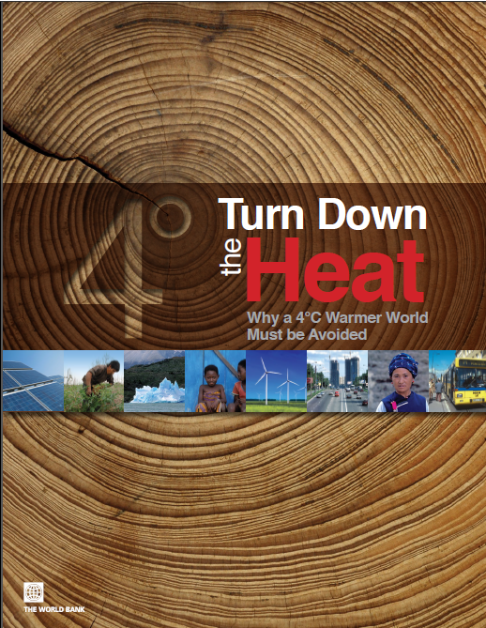
Notes:
Show “World Could Be 4 Degrees Hotter By End of This Century.mp4” by World Bank

Slide 13
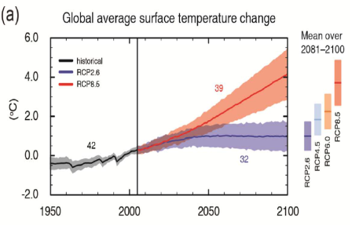
Warming will continue, but how much is our choice
In the next few decades, temperatures will continue to rise, even if we almost completely stop emissions of GHGs today (blue line)
This is because GHGs, especially CO₂, stay in the atmosphere for a long time
Therefore, we have further climate change “in the pipeline” because of the emissions already in the atmosphere
Notes:
As you can see from the chart, both the best case (Blue line) and worst case (Red line) scenarios show temperature increases.
Temperatures are bound to rise even if we stop emissions immediately!
Climate change will still continue for centuries due to the time scales associated with climate processes and feedbacks.
This means we are bound to at least 30 more years of temperature increase (and other climate change impacts); so, we have to prepare!
IPCC 2013 concluded: “Most aspects of climate change will persist for many centuries even if emissions of CO2 are stopped. This represents a substantial multi-century climate change commitment created by past, present and future emissions of CO2”
Blue line and uncertainty zone (RCP2.6) = rapid stop for further CO2 emissions into the atmosphere (virtually impossible)
Red Line and uncertainty zone (RCP8.5) = continued very high greenhouse gas emissions
Even if we stop emitting CO2 immediately (which we won't!) climate change will still
Facilitator note: Intermediate options are marked to the right of the graph only
13

Slide 14
Warming will continue, but how much is our choice
But if, and only if, we cut the global amount of GHG emissions quickly, we may avoid escalating warming in the second half of this century (the red line)
If we act now to reduce global emissions, it is still possible to keep changes within a “manageable range” for our children
Notes:
As you can see from the chart, both the best case (Blue line) and worst case (Red line) scenarios show temperature increases.
Temperatures are bound to rise even if we stop emissions immediately!
Climate change will still continue for centuries due to the time scales associated with climate processes and feedbacks.
This means we are bound to at least 30 more years of temperature increase (and other climate change impacts); so, we have to prepare!
IPCC 2013 concluded: “Most aspects of climate change will persist for many centuries even if emissions of CO2 are stopped. This represents a substantial multi-century climate change commitment created by past, present and future emissions of CO2”
Blue line and uncertainty zone (RCP2.6) = rapid stop for further CO2 emissions into the atmosphere (virtually impossible)
Red Line and uncertainty zone (RCP8.5) = continued very high greenhouse gas emissions
Even if we stop emitting CO2 immediately (which we won't!) climate change will still
Facilitator note: Intermediate options are marked to the right of the graph only
14

Slide 15
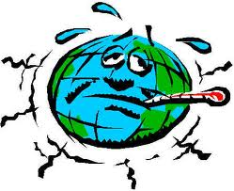
When the ocean, land and air get warmer, things change in the climate system…
… temperature is not all that’s changing…

Slide 16
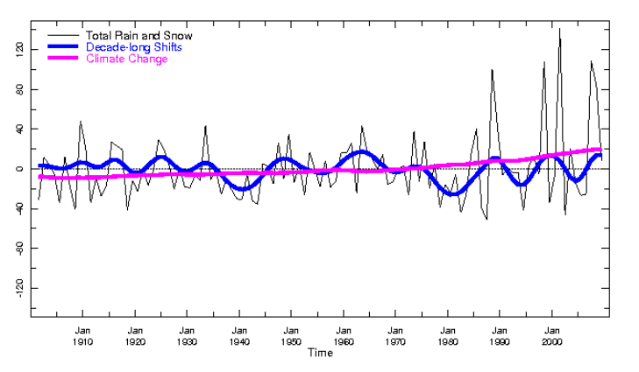
Climate variability and change
New record highs
Long term average
Notes:
So again in brief: the most immediate effect of climate change in relation to humanitarian work is not the gradual shift in temperature or rainfall, but that we encounter new records highs (and lows) that exceeds our experience and expectations – so there are “more surprises”.
This graph shows annual rainfall in Sri Lanka/extreme southern India in the monsoon months (from IFRC-IRI MapRoom)

Slide 17
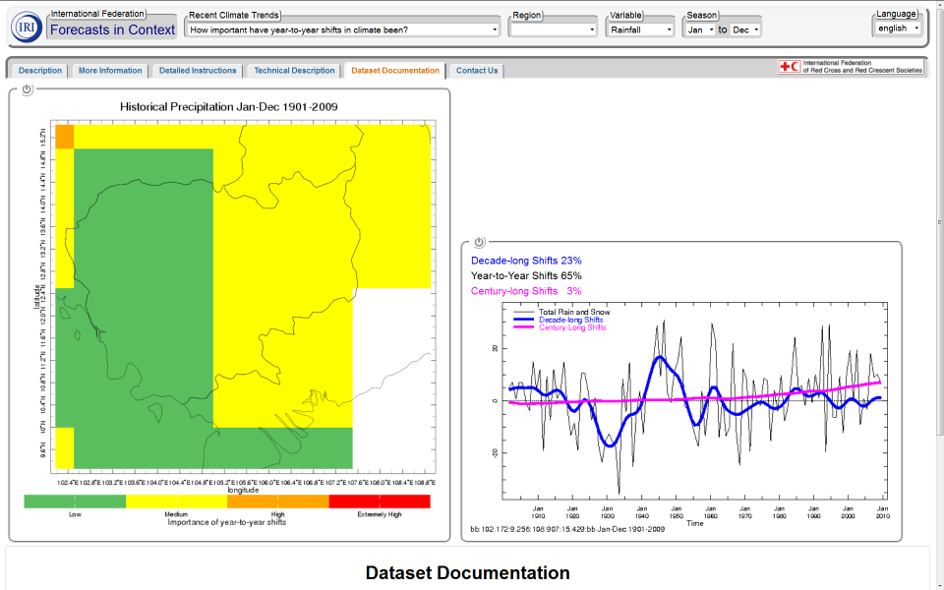
Notes:
And a zoom-in on Cambodia

Slide 18
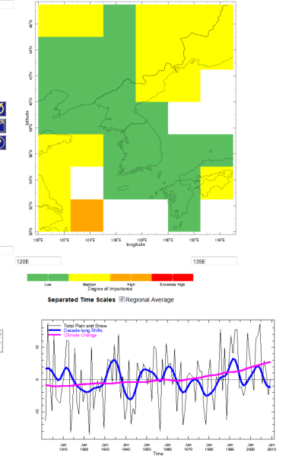

Slide 19
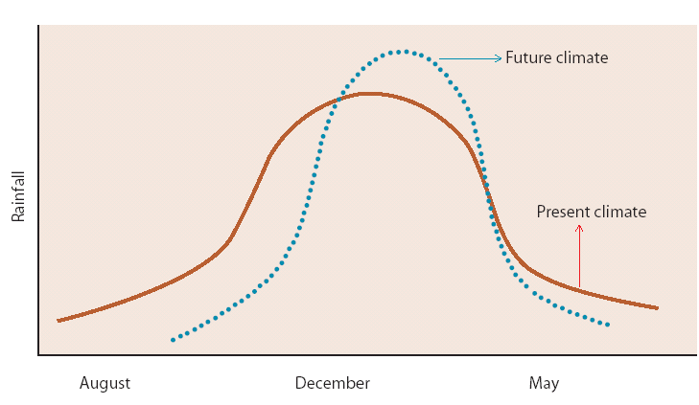
Shift in season and intensity
Sumatra & Java - compared to 1961-90:
Onset of the wet season is now 10 - 20 days later
Onset of the dry season is now 10 - 60 days earlier
Based on Naylor et al. 2007
Notes:
19
19
An example form Indonesia on shifting seasonal rainfall patterns
An example from Indonesia shows how climate change may alter the seasonality of rainfall patterns (and agricultural seasons with it): rainy season starts later and become shorter, but with more intense precipitation (see chart).

Slide 20
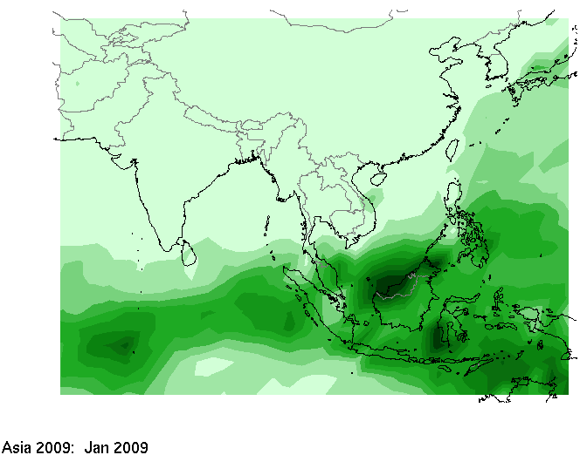
Huge annual variability is normal
Notes:
20
20
The animation (produced via from IRI home page) shows rainfall patterns in Asia over 2009, showing the immense complexity in actual rainfall. It also gives an impression of the challenges scientists have in providing precise forecasts, and of course the forecast precision becomes weaker the further into the future we are trying to forecast.
You who live here recognizes the seasonal pattern, and you may also be aware of great variations between years – as we'll see next
Source: IRI

Slide 21
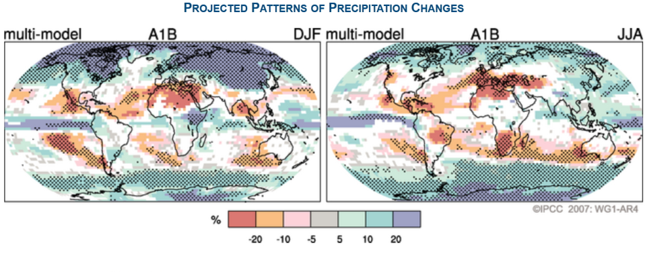
Climate change projections: general – NOT zoom in
Rough regional forecasts – will not be much better
Act on that basis
Notes:
Downscaling the long-term projections to small regions (i.e. ”zooming in” on a province or small country) cannot be done reliably; beware of some websites that allows you to zoom in and show estimates of temperature or rainfall for small areas.
Do not wait for information becoming available for your specific area – act upon the information already available.

Slide 22


Climate change projections: Asia
Increased riverine, coastal and urban flooding leading to widespread damage to infrastructure, livelihoods and settlements (M)
Increased risk of heat-related mortality (H)
Increased risk of drought-related water and food shortage causing malnutrition (H)
Source: IPCC, 2007
Climate Training Kit. Module 1A Science and Impacts – South Africa
22
Notes:
Source: IPCC 2007, WG1, Chapter 11
22

Slide 23
Some things are certain:
… in addition to sea level rise – what more?
Notes:
certain things:
higher average temperatures
melting ice/glaciers
SLR
Acidification (by CO2)

Slide 24
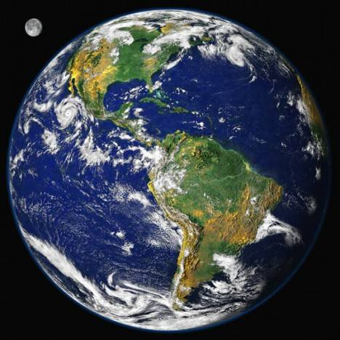
One thing is for sure:
the future will be different from the past
Photo: NASA
Notes:
24
24
Photo: Hurricane Irene, photo by NASA

Slide 25
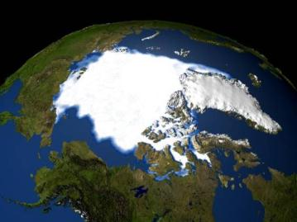
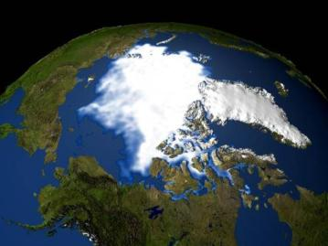
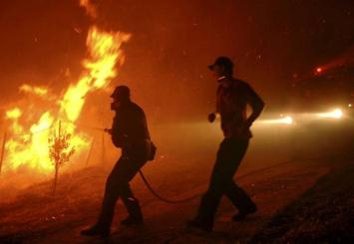
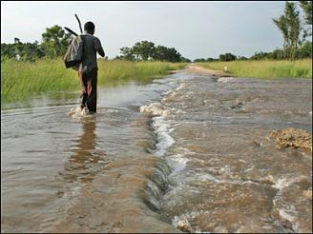
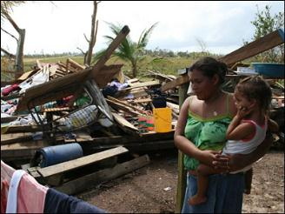
More certainty about climate change
More uncertainty about its manifestations
Notes:
Moreover the debate about the causes of global warming has further delayed engagement of the public and non environmental organisations like the Red Cross. Why should we radically change our course? Global warming and sealevel rise does not affect our work. There are no vulnerable people living on the melting Northpole. Why should we act when the evidence is still speculation?

Slide 26
Something’s changing - are you prepared?
Notes:
26
26
Show RC movie: “Red Cross Voices on our changing climate.mp4”

Slide 27
Third Question: What does climate change mean for the humanitarian sector?
Trends we have observed…
Weather related disasters doubled over the past 2 decades
Increase in small- and medium-scale disasters
Notes:
27
UNISDR has noted that the number of weather related disasters has increased over the past two decades.
The number of small and medium scale disasters has increased → people experience these events more often.

Slide 28
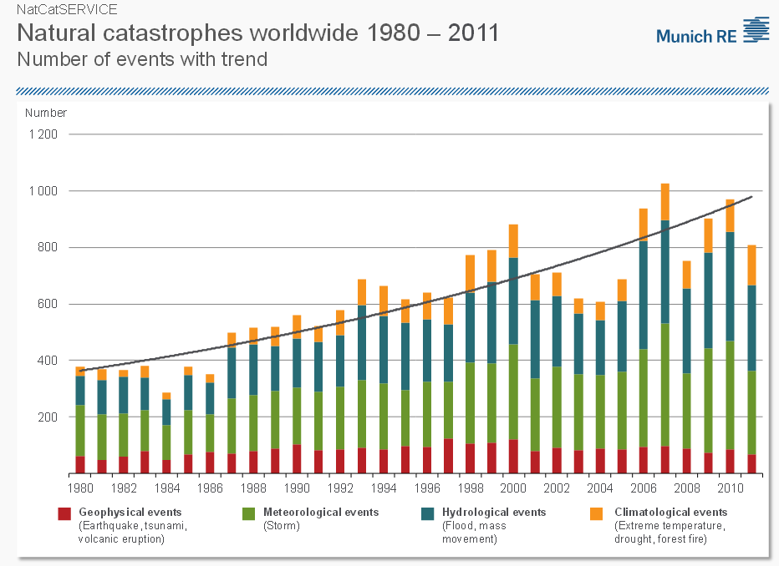
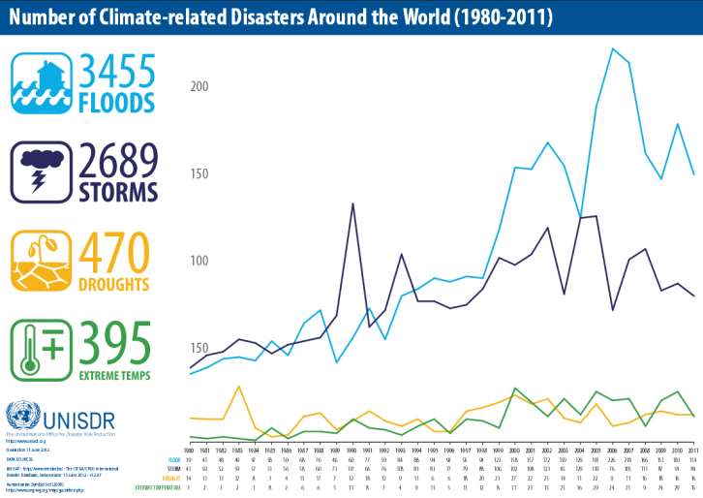
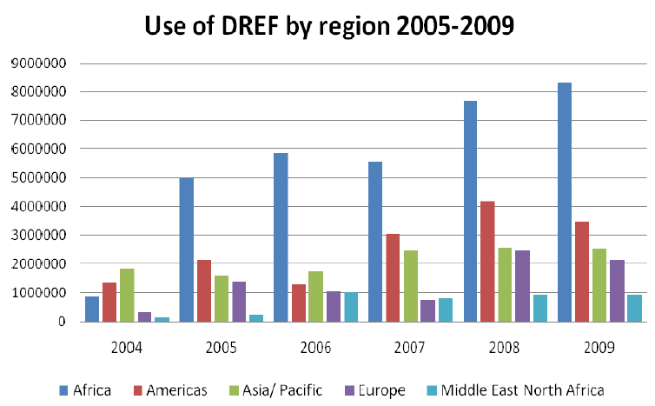

Observed Changes in Disaster Patterns
Weather related disasters doubled over the past 2 decades
Increase small- and medium-scale disasters
More surprises/uncertainties
Notes:
28

Slide 29





IMPACTS
CLIMATE
SOCIOECONOMIC
PROCESSES
Vulnerability
Natural
Variability
Socioeconomic
Pathways
Hazards
RISK
Adaptation and Mitigation Actions
Anthropogenic
Climate Change
Governance
Exposure
EMISSIONS
and Land-use Change

Slide 30
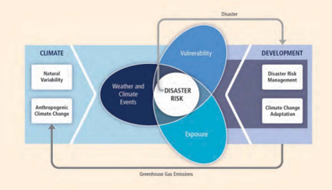
Risks = Hazards x Vulnerability x Exposure
The number of hazards is increasing
More people are exposed to extreme events
The vulnerability of people and assets is increasing
= Risks are increasing
Notes:
30
By reducing vulnerability and limiting exposure, disaster risk can be reduced.
Disaster risk management and climate change adaptation should be integrated into development to help improve resiliency to climate change impacts.
From IPCC SREX: http://www.ipcc.ch/pdf/special-reports/srex/SREX_Full_Report.pdf

Slide 31
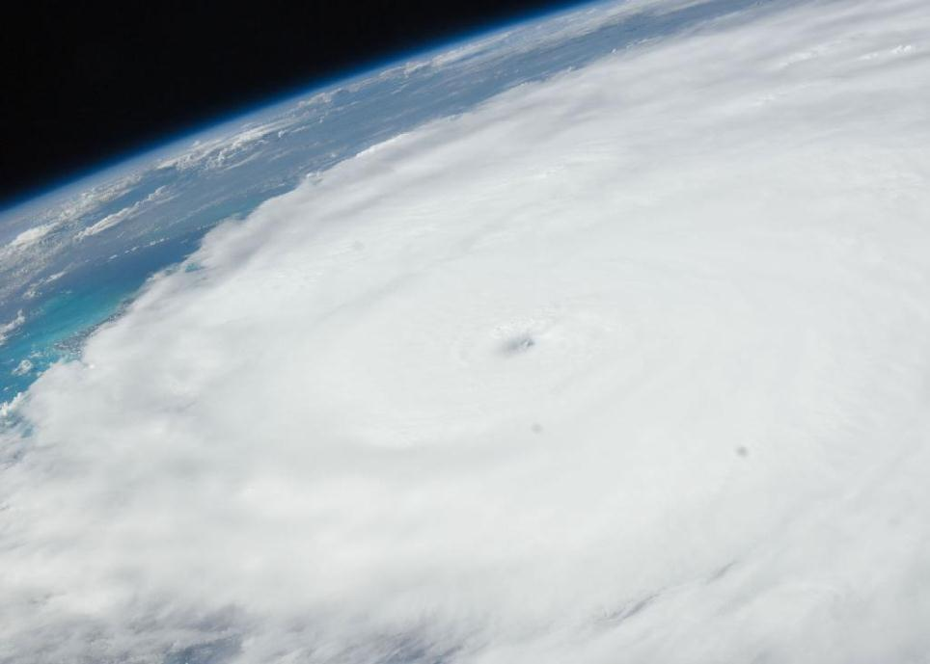
A range of effects
Changes in frequency and/or intensity of hazards
Changes in geographical / seasonal extent of hazards
Climate trends (temperature, rainfall, sea level rise) impacting livelihoods etc.
Trends becoming shocks – lack of knowledge to cope
IFRC
Notes:
31
Increases in the number of high sea level events are being recorded. Sea level rise causes stress for people living in coastal areas all around the world and is exacerbated by phenomenon such as storm surges and king tides.
Furthermore it’s a threat to water resources because of the salination of ground water after inundations. It obviously has consequences for food security as well because of salt-water intrusion into soils and also because inundations lead to destruction of land and crops.
The impacts of sea level rise can be exacerbated by environmental degradation and poor urban planning such as sand mining, dense coastal living, or the location of critical infrastructure along the coast.

Slide 32
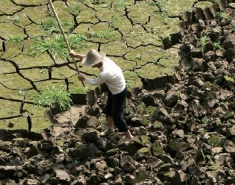
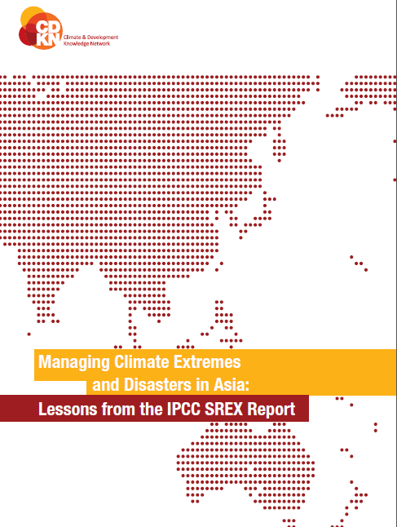
Special report on
extreme events and disasters, a summary for policy makers
IPCC Summary for Policy makers, 2011
Key messages:
Disaster risk increases (regardless of climate change)
Extreme events are more frequent and more intense, due to climate change
Stronger emphasis on anticipation and risk reduction needed
Better information available
32
Notes:
The IPCC SREX report itself will be launched in February 2012, but the summary for policy makers already reveals some key messages which the report will bring forth.
The special focus of this report is the relation between climate change and extreme weather events and its impacts.
There are many more key messages in this report, but we have selected just a few important ones for Red Cross/ Red Crescent work.
1. Exposure to disasters is rising, regardless whether climate change (think of population growth, man made hazards, etc)
2. Extreme events are more frequent and more intense, due to climate change
3. A new balance needs to be struck between measures to reduce risk and effectively prepare for and manage disaster impact in a changing climate. This balance will require a stronger emphasis on anticipation and risk reduction.
4. There is better information on what is expected in terms of changes in extremes in various regions and sub‐regions, rather than just globally; though for some regions and some extremes uncertainty remains high. Climate extremes are essentially becoming more unpredictable.
32

Slide 33
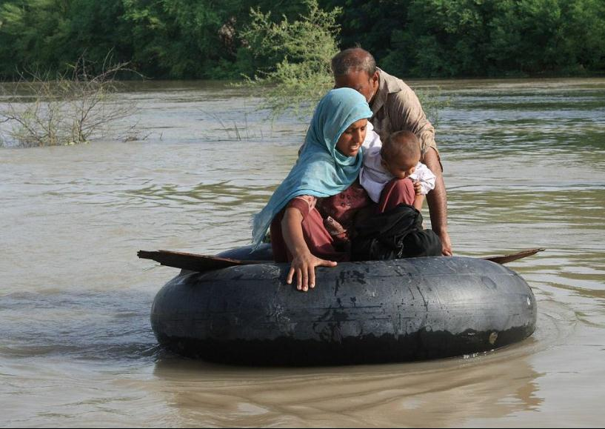
Potential impact: Floods
Difficult to measure the frequency and intensity of floods, but generally there has been an increasing trend
Changes in rainfall patterns and precipitation intensity could put more people at risk from flooding
Photo: IFRC, Pakistan floods 2010,
Notes:
It is difficult to measure the frequency and intensity of floods, but generally there has been an increasing trend.
Floods depend on a number of different factors (land use, water management, flood policies, etc.) so measurement can be difficult.
Climate is never the only factor that can increase risk of flooding. Floods can of course also be strongly affected by other factors, such as rapid and unplanned urbanization, population growth and poor natural resource management.
BUT, changes in rainfall patterns and precipitation intensity could put more people at risk from flooding.
http://www.ipcc.ch/pdf/special-reports/srex/SREX_Full_Report.pdf

Slide 34
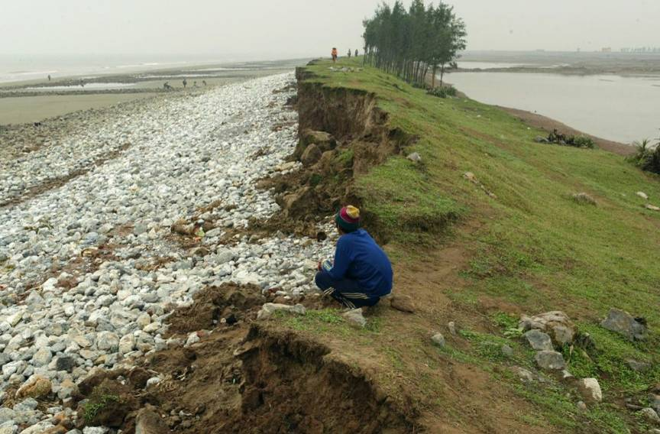
Potential impact: Coastal erosion, coastal flooding and salt water intrusion
Photo: IFRC, Viet Nam coastal dike damages
Notes:
The risk of coastal flooding is also increasing due to the rising average sea levels, and this can be exacerbated by changing patterns of storms or extreme rainfall events.
Climate is never the only factor that can increase risk of flooding. Floods can of course also be strongly affected by other factors, such as rapid and unplanned urbanization, population growth and poor natural resource management.
34

Slide 35
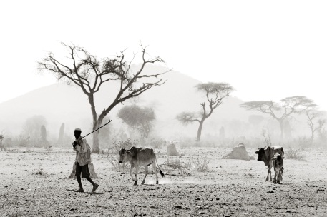
Potential impact: Drought
Photo: Jacob Dall
Notes:
Drought frequency and duration has increased, this trend is generally expected to continue (with the exception of some of the far northern and far southern latitudes, where droughts may decrease).
Droughts have important implications for for global food production.
http://www.ipcc.ch/pdf/special-reports/srex/SREX_Full_Report.pdf
35

Slide 36
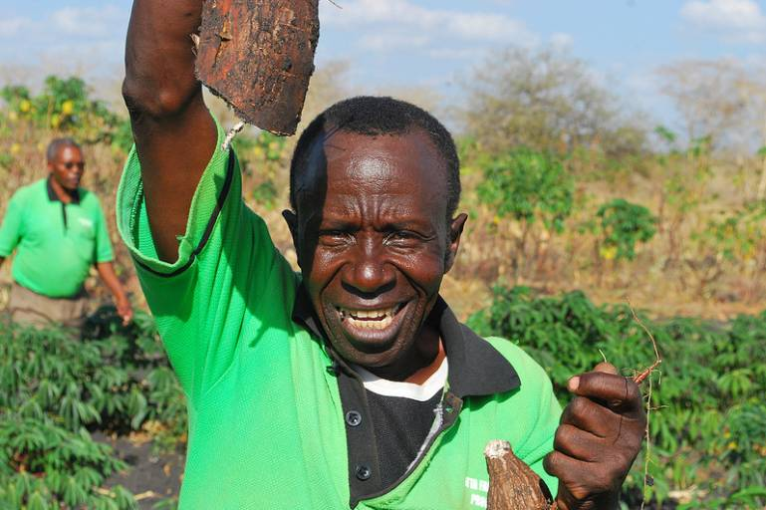
Possible impact: increasing food insecurity
(Photo: Tamara Leigh/IFRC-Climate Centre)
Notes:
Linked to increasing likelihood of drought in major food producing areas (for instance: China, southern Europe and the Mediterranean region, central Europe, central North America, Central America and Mexico); agricultural yields may decline due to climate change.
More people will be at risk from food insecurity if yields decrease and food prices increases.
http://www.ipcc.ch/pdf/special-reports/srex/SREX_Full_Report.pdf
36

Slide 37
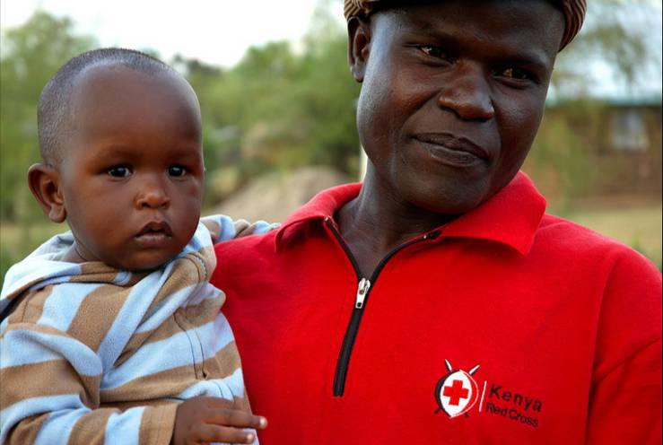
Possible impact: Changing disease patterns
(Photo: Nancy Okwengu/IFRC-Climate Centre)
Notes:
Climate change can lead to a shifting of vector borne (=insect/animal carried) diseases such as malaria, dengue, west Nile virus, lyme, schistosomiasis.
The insects/animals that carry these viruses could shift to new territories and survive in more places where they never occurred before because of the changes in temperatures and humidity patterns around the world.
Changes to rainfall can increase risk of waterborne diseases, malaria, dengue, diarrheal disease, cholera, depending on the region.
The picture: Kenya, Nyando province is vulnerable to endemic malaria, devastating floods and diarrheal disease. Silas Liech, a Kenya Red Cross Society volunteer assists and carries 8-month-old Daren Onunga, recovering from diarrhea.
(Photo: Nancy Okwengu/IFRC-Climate Centre)
37

Slide 38
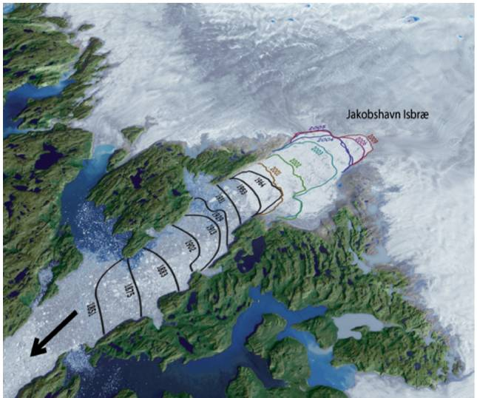
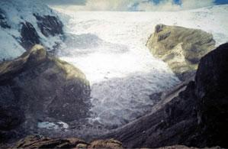
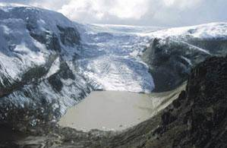
Potential impact: Melting ice
1978
2002
Source: NASA – UNDP
Source: Barnett et al. (2005)
Notes:
Since the mid 19th century, most glaciers have retreated (melted) and the speed of melting has been higher than ever before in history. Mostly in the Arctic Ocean and along the Antarctic Peninsula, there are clear decreases in the extent and seasonal duration of sea ice.
The melting of ice on land will contribute to rising sea levels. The pictures shows how fast the front of the worlds most production glacier (in Greenland) has retreated the last 150 years – and how it got faster in recent years (the arrow shows the direction of ice flow from the glacier to the ocean) (data: NASA 2009 – from UNDP Climate Change Science Compendium 2009)
Melting of glaciers can also affect steady fresh water flows / supplies: Countries such as Peru – and much of South Asia (south of Himalaya) are completely dependent on water supplies offered by glaciers.
A constant melt during the dry season is of utmost importance for continued water supply. Glaciers are then usually ‘recharged’ with more snowfall during the wet season. If the rate of melting is greater than the rate of replenishment, the glaciers will eventually disappear, having long term implications for water security (e.g. 1,5 billion people depend on Himalaya-fed rivers).
Glacial melt can also cause a glacial lake outburst flood, which is a type of outburst flood that occurs when a dam consisting of glacier ice containing a glacial lake fails.
38

Slide 39
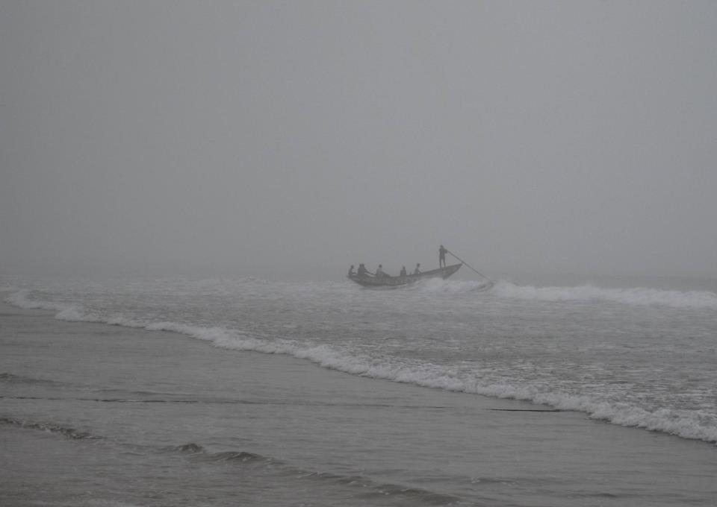
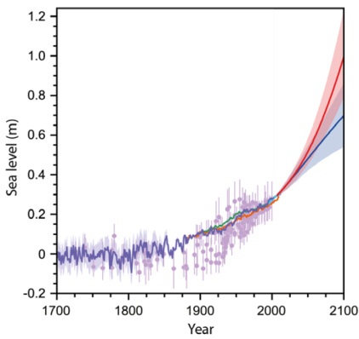
Potential impacts: Oceanic changes
Sea levels are rising – at a faster rate
Sea level rise
NOW
Notes:
Sea levels are rising due to two factors:
as the ocean gets warmer, the water expands, and
ice on land melts (i.e. the glaciers, including the ice caps in Greenland and Antarctica, melts and water flows into the ocean)
The graph is from IPCC 2013 – showing showing historical records of sea levels, and projected sea level rise for the future if we
stop GHG emissions now (dark blue line),
or continue emitting large amounts og GHG (red line)

Slide 40
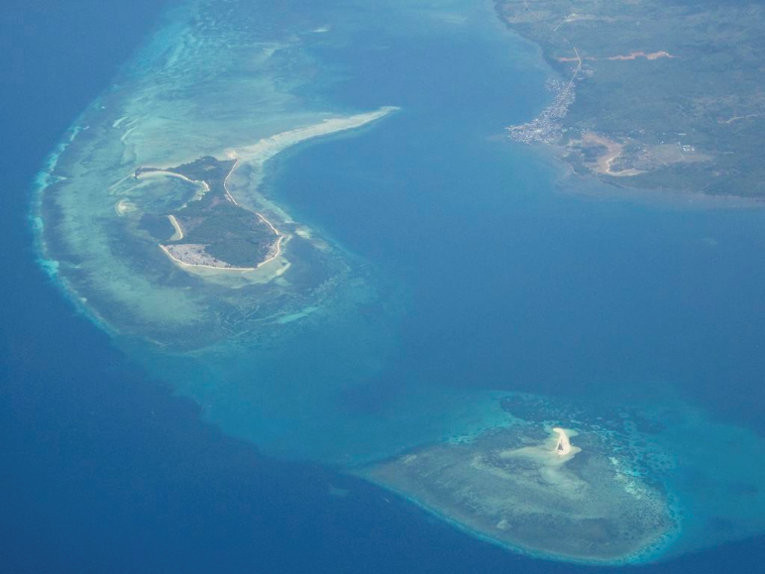
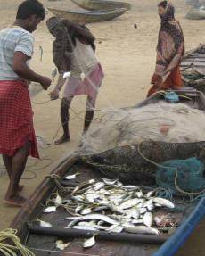
Potential impacts: Oceanic changes
Large scale degradation and/or loss of coastal and marine ecosystems
the oceans are becoming more acidic
sea surface temperatures are increasing
... and fish stocks decline, eroding livelihoods for millions of people
Ocean acidification damages coral reefs – reducing their coastal protection effects
Notes:
The acidity of the ocean is increasing as a direct result of the increasing concentration of the amount of greenhouse gases (especially CO2) in the atmosphere.
The oceans absorb the CO2, which makes them more acidic. More acid water harms many ocean ecosystems such as coral reefs.
The degradation to coral reefs can be harmful for human habitations nearby, which used to use the coral reefs as protection from storms. Also, many costal populations depend on animals and plants living in these reefs for their livelihoods (fishing), and their food security is at risk if the reefs are destroyed.
40

Slide 41
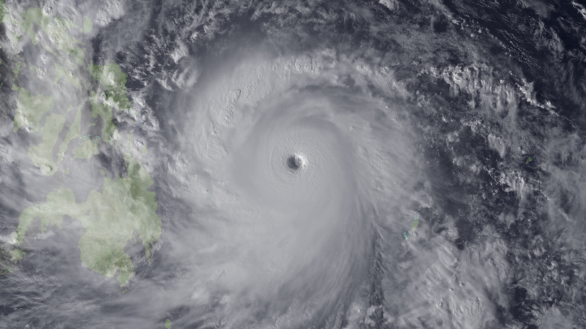
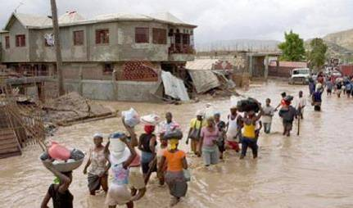
Potential impact: tropical cyclones impacts
Possibly an increase in the intensity of tropical cyclone activity (hurricanes/typhoons), coupled with higher storm surges due to sea level rise
→ economic/human losses are expected to increase
IFRC
Source: NOAA
Notes:
41
Cyclones are affected by climate change, especially by the increase in ocean temperatures and changes in winds patterns.
Globally scientists expect that there will be less or a similar number of cyclones, although this might vary around the world. The worrying thing is that when they do form, they may on average be more intense in terms of rainfall and wind speed – exemplified by typhoon “Haiyan” (photo) that hit the Philippines in November 2013. It should be noted that research on trends in tropical cyclones is ongoing, and there is low confidence in current projections.
However, the storm surges that often accompany cyclones are likely to become more damaging, simply because of the higher sea levels
In addition, losses (assets and human life) are expected to increase because of greater exposure to storms → demographic trends indicate that coastlines are becoming more populated.
http://www.ipcc.ch/pdf/special-reports/srex/SREX_Full_Report.pdf
http://www.climate2013.org/images/uploads/WGI_AR5_SPM_brochure.pdf

Slide 42
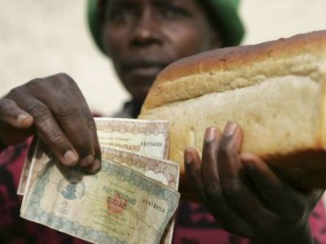
Climate change fingerprint in complex crises
increased demand
failed harvests
less land for agriculture (a.o. urbanisation)
biofuels
distorded markets (ban on exports)
price speculations
Climate
change
related

Slide 43


Humanitarian concern
Will vulnerable people worldwide have a voice in geoengineering decisions?
Will there be extra funding for humanitarian work in a geoengineered future?
Notes:
For humanitarians the prospects of geo-engineering raises two important questions:
* Will vulnerable people worldwide have a voice in geo-engineering decisions?
* Will there be extra funding for humanitarian work in a geo-engineered future?
In addition, if these technological fixes should be implemented, but suddenly gets damaged or discontinued, the globe will rapidly heat up – so it is definitely not a “sustainable solution” even for those of us who may have temporary benefits from the Geo-engineering.
The only sustainable element inlcuded in the graph above (previous slide) is the afforestation & reforestation (which is normally not considered geoengineering) – which is already, along with forest conservation and better lland management, a key aspect of existing plans for helping minimise GHG concentrations in the atmosphere
The Red Cross Red Crescent must be aware of these emerging challenges to vulnerable people and the humanitarian sector – and consider this topic for Humanitarian Diplomacy
Read more in this article http://geoengineeringourclimate.files.wordpress.com/2013/08/suarez-et-al-2013-ge-and-the-humanitarian-challenge-click-for-download.pdf

Slide 44
Key Messages
Climate Change is already happening and will continue to affect us especially the most vulnerable groups
Rate of change is alarming and mostly caused by men
CC brings another layer of risk
R = Hazard x Vulnerability x Exposure
We already see a lot of observed changes in disaster patterns
Urgent action is a must
We need to make choices under periods of uncertainty
www.ifrc.org
Saving lives, changing minds.

Slide 45
From IFRC President Konoe issued at the release of the IPCC AR5 WGII
This is the strong confirmation that risks have
been rising in recent decades
The second message emerging from the report is more positive –
Immense capacities exist to addressing risks – capacities that can be even more effective when applied with greater awareness and investment ahead of potential problems
The third message of the report is about our choices for the future –
Past greenhouse gas emissions have already committed us to rising risks for several decades to come. This report shows that we can largely handle those now-inevitable changes. For the second half of the century, however, we face a bigger choice – one that needs to be made now.

Slide 46

Thank you!
Further information
ipcc.ch
climatecentre.org
ifrc.org
Notes:
Note: Maybe provide a deeper link into ifrc.org to most relevant parts of that giant?

