Slide 1
CRUZ VERMELHA de TIMOR-LESTE
Youth School safety ( YSS)

Slide 2
Introduction
CVTL youth department was established in 2008. The activity such as road safety, tobacco and drug use campaign, life skill and youth healthy training and risk mitigation activity. During implementation found that students are more interest to involve in these such activities and to be as member of youth red cross.
As lesson learnt from that, youth department established youth School program in 2013 to engage more students and young people in humanitarian action.
A part of that, youth integrated into community based project (ICBRR) to empower youth in risk reduction activities

Slide 3
Objective
Engaged young people as leader, volunteer and beneficiary able to actively contribute to humanitarian activities in their communities

Slide 4
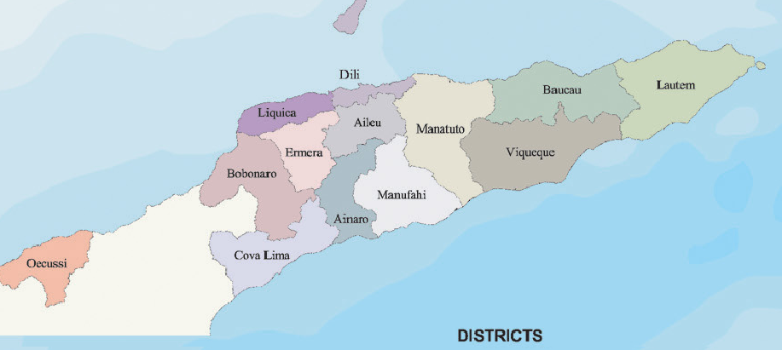
YSP intervention area
Ì
Ì
Ì
Ì
Ì
Ì
Ì
Ì
Ì
Ì
Ì
Ì
Ì
Ì
Branch & community
JCV Program

Slide 5
Component of Youth school program
First aid
DRR
Healthy youth
health and hygiene promotion
Communication and Dissemination

Slide 6
Progress achievement
Developed youth school module (in collaboration with MoE, SSoYS, MoH) and facilitated by PMI
Established youth school program
Pilot YSP in 2 districts (Oecusse and Dili) and now has expanded to 4 districts (Bobonaro, Ainaro, Baucau, Liquiça)
International, branch and school youth camp
MOU with Ministry of Education (youth school program as extra curricular) is in progress

Slide 7
Cont…
Assessment in school target ICBRR
Established Hand washing tippy-tap in school target
Hand washing campaign and hygiene promotion
Risk mitigation activities (tree planting)
Disaster Simulation

Slide 8
YSP target area
District | School area
Dili | Ensino Sekundáriu 4 de Setembru Unamet Dili Ensino Sekundáriu Publiku 28 de Novembru Becora
Oecusse | Ensino Sekundáriu No. 02 Baqui Ensino Báziku Sentral 1 de Maio palaban Ensino Pre-sekundáriu Catolica St. Antonio santa rosa
Baucau | Ensino Sekundáriu No. 1 Villa Nova
Ainaro | Ensino Basico Filial 1 2 Ciclo Horai kiik
Liquiça | Ensino Basico central Liquica
Bobonaro | Essnsino Sekundáriu No. 2 Malibaka

Slide 9
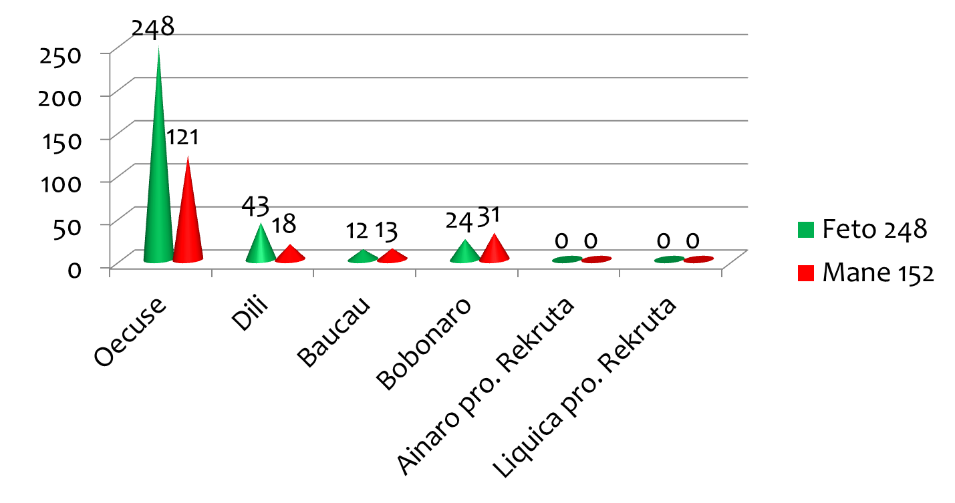
Benifisiaries
Total :400

Slide 10
Challenges
Lack of awareness of community while Youth red cross conduct activities
Not all school have extra curricular program
Funding limited and not permanent (gov.)

Slide 11
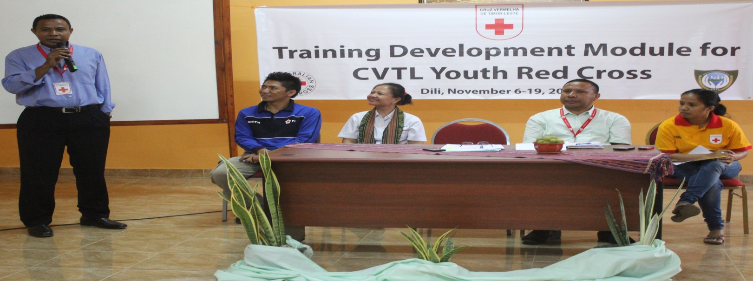
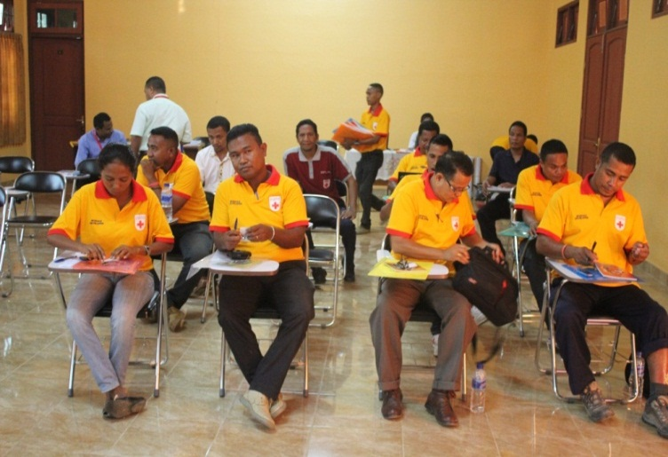
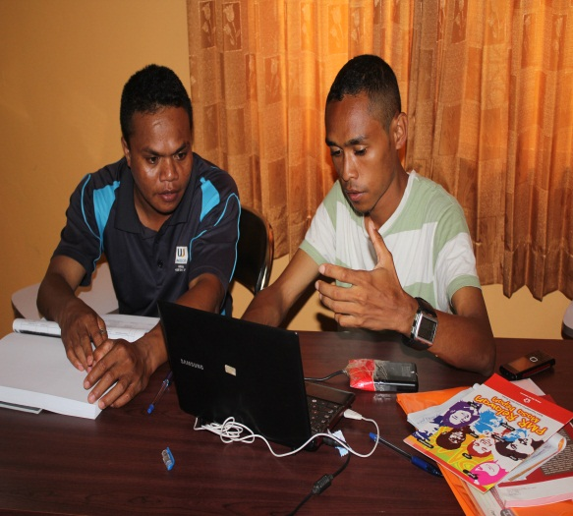
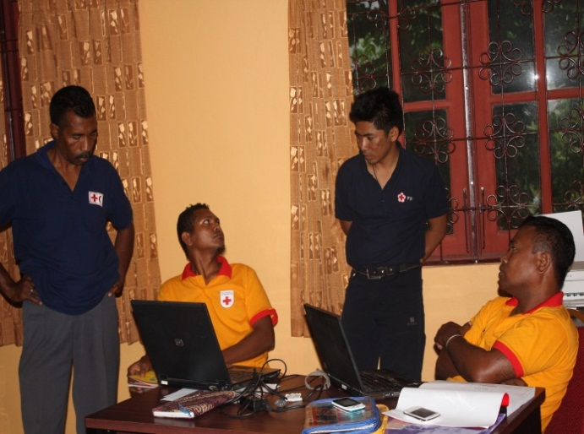
Activity picture

Slide 12
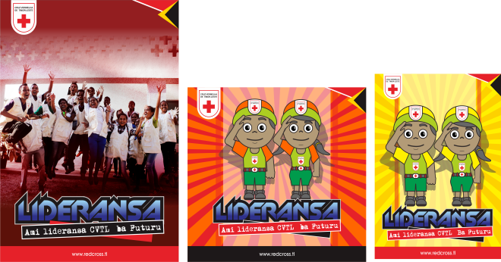
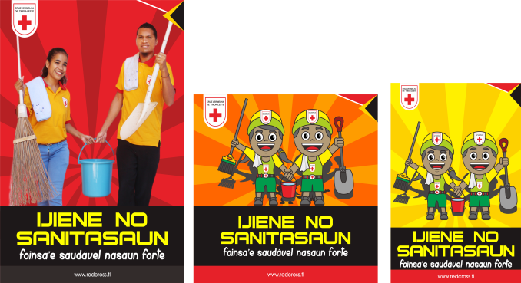
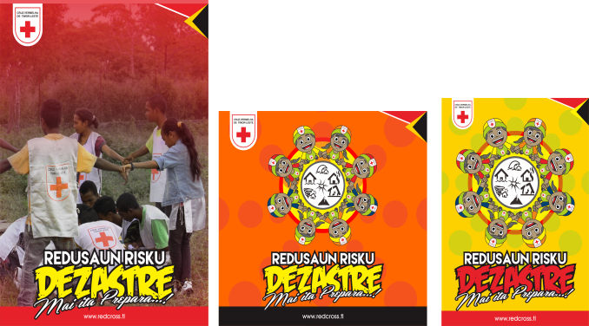
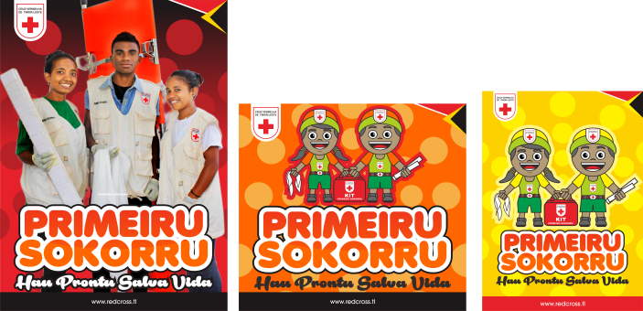
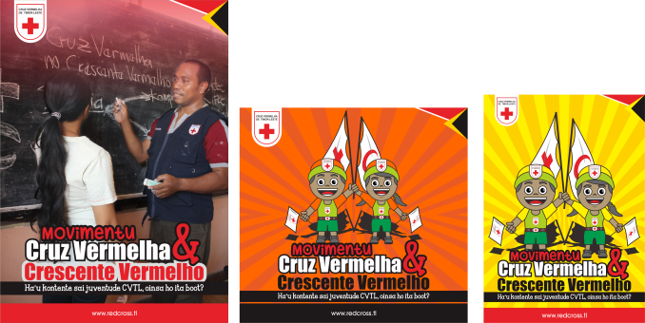

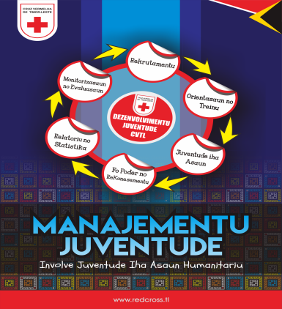
YSP MODULES

Slide 13
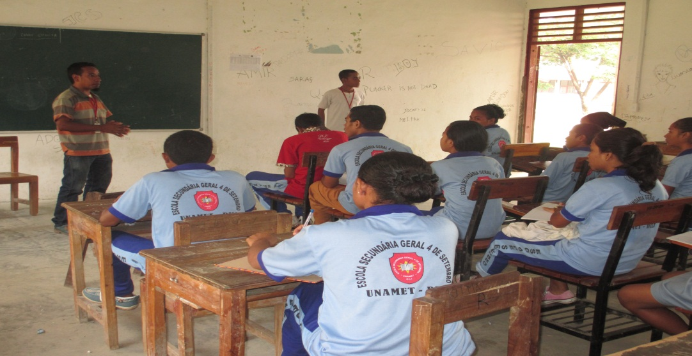
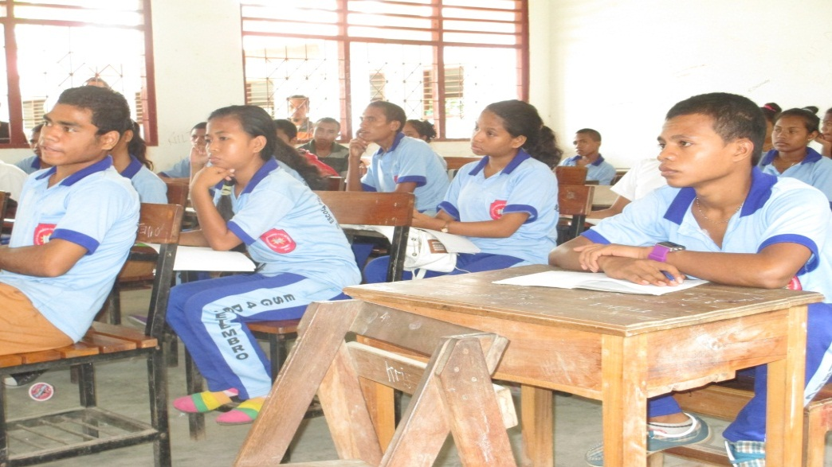
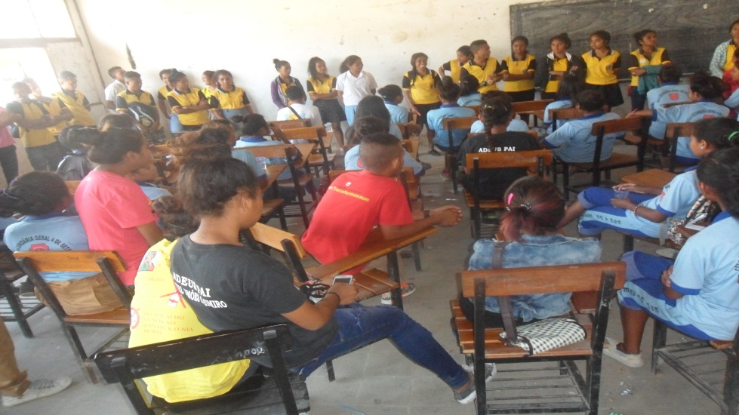
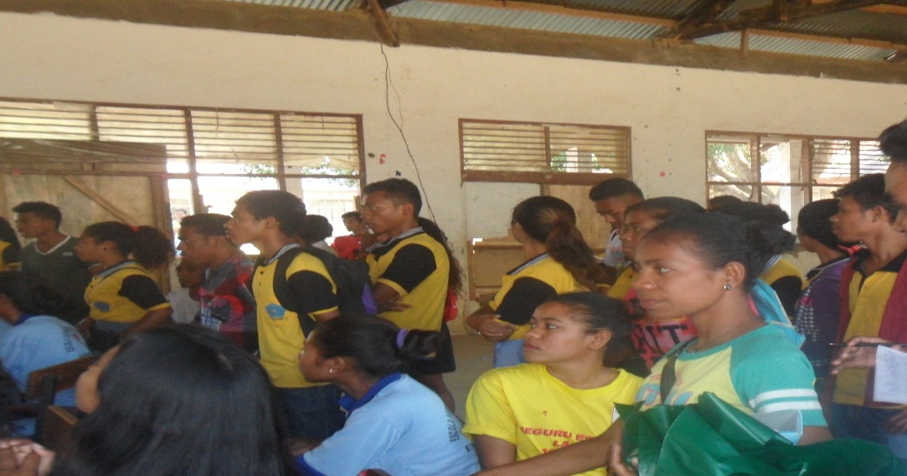
School activities

Slide 14
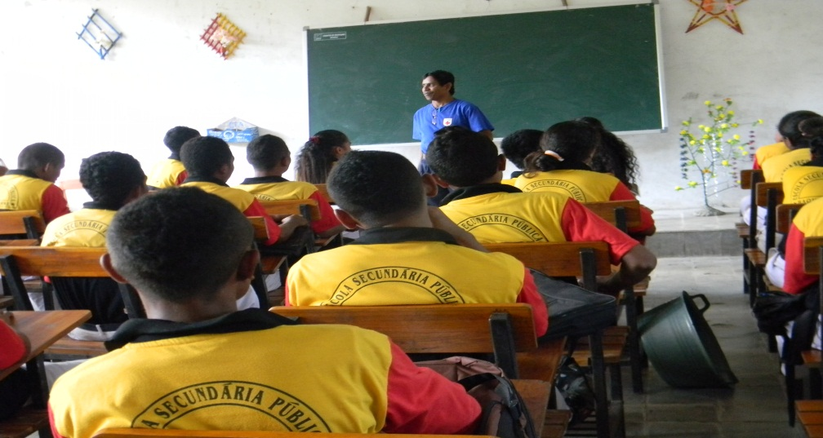
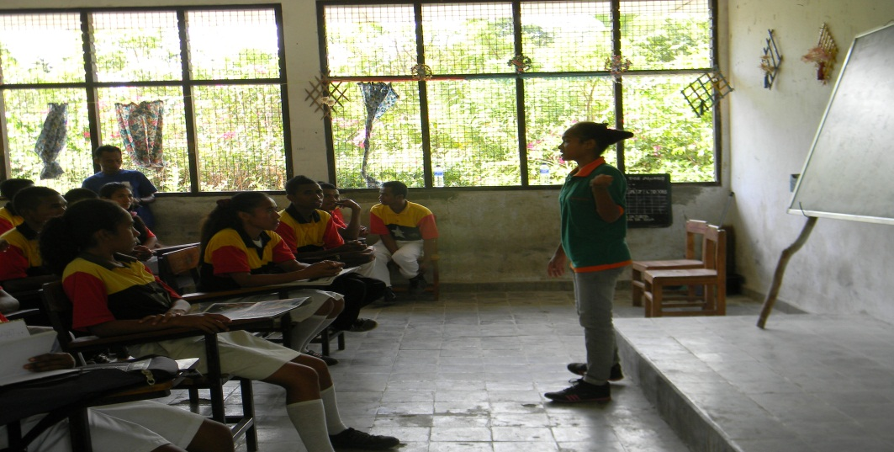
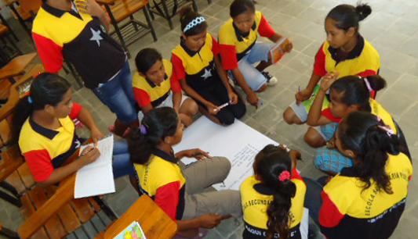
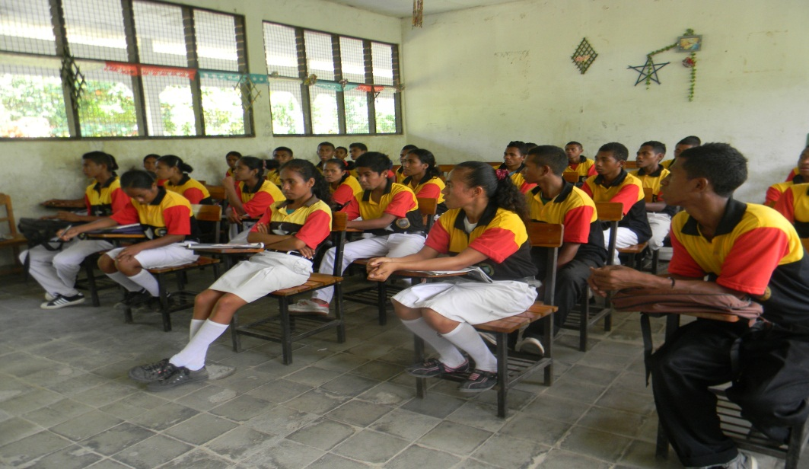

Slide 15
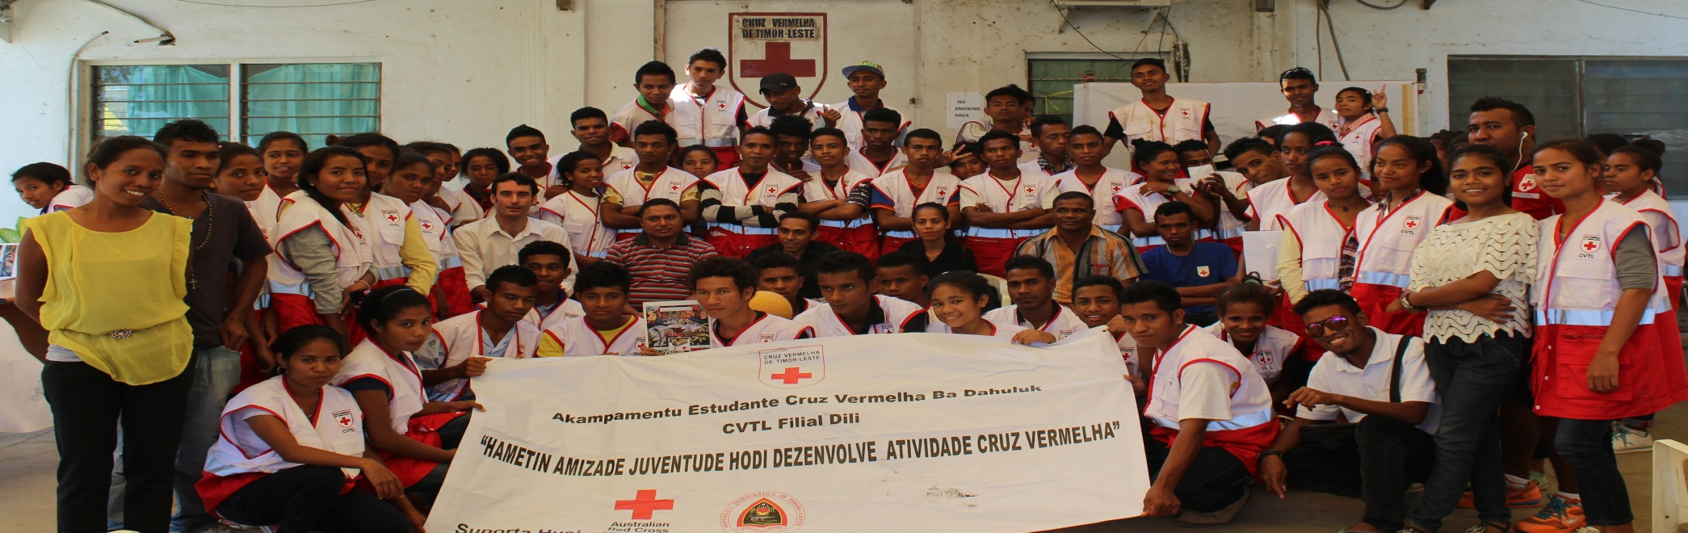
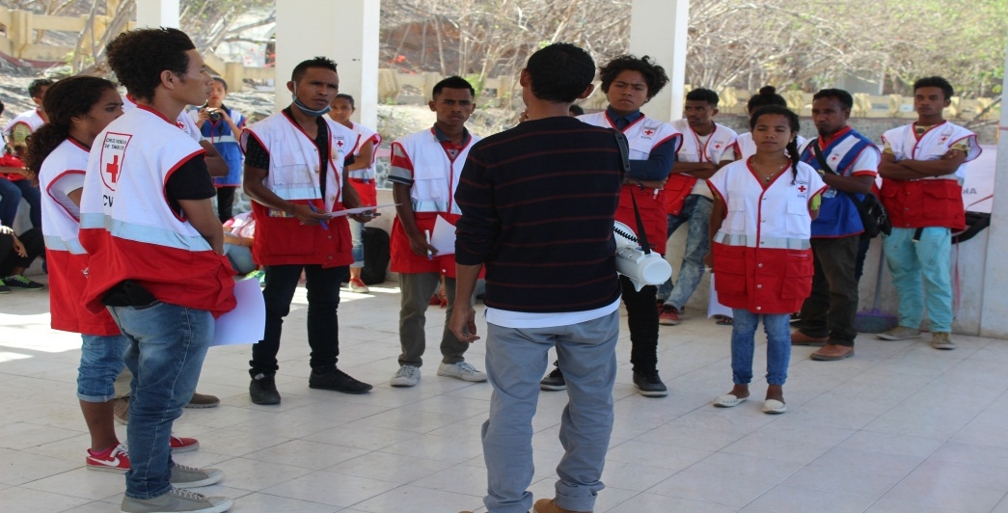
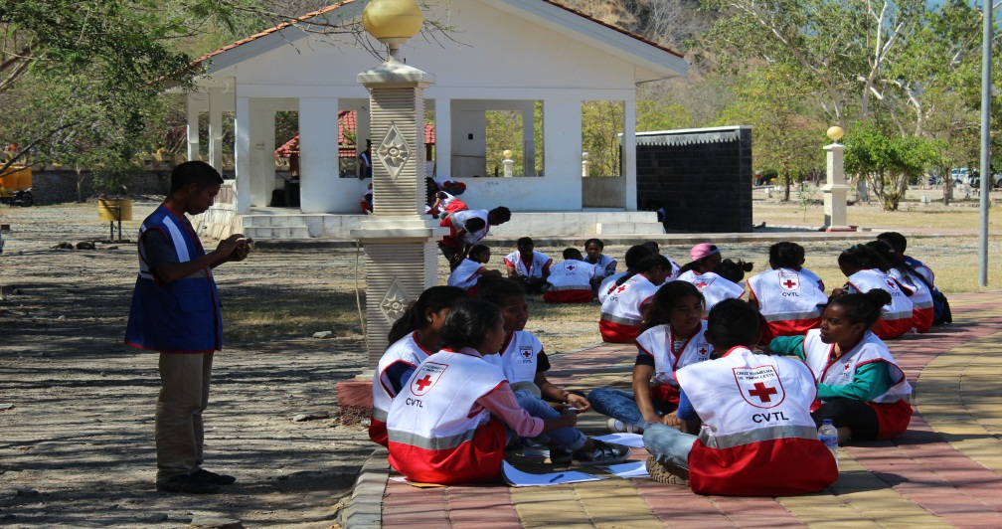
School youth camp

Slide 16
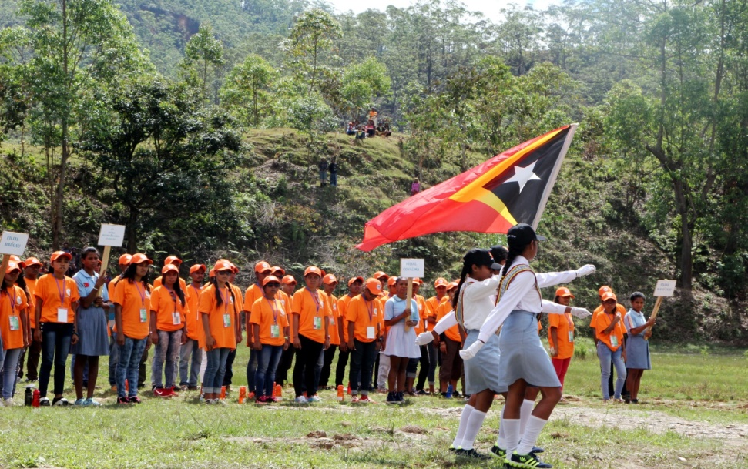
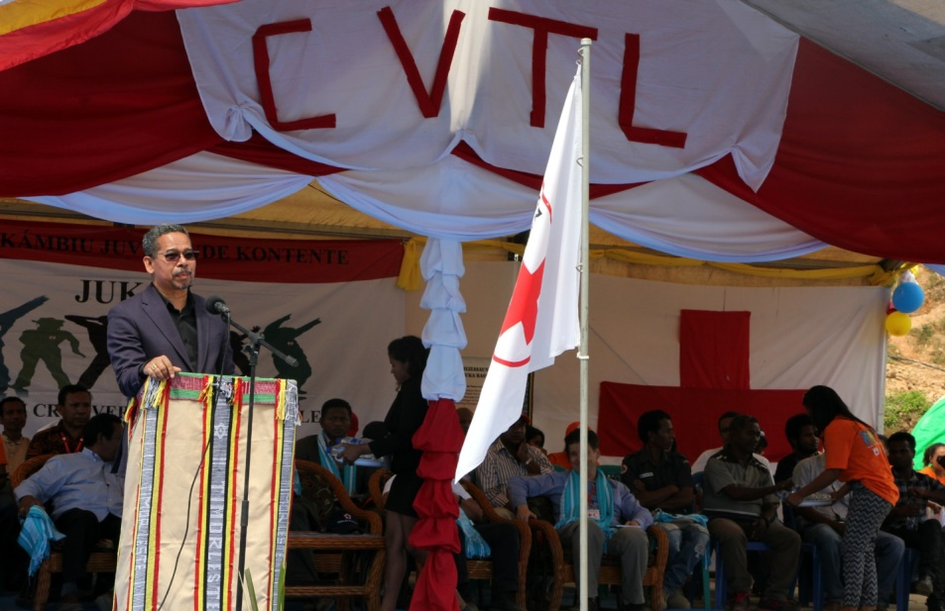
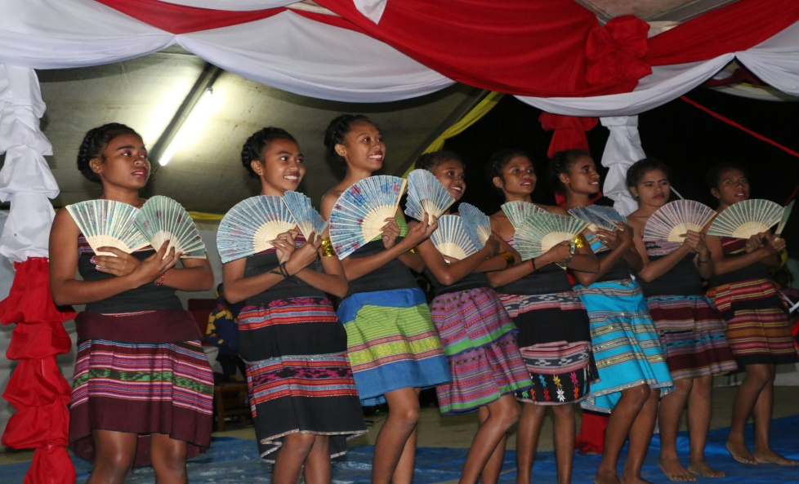
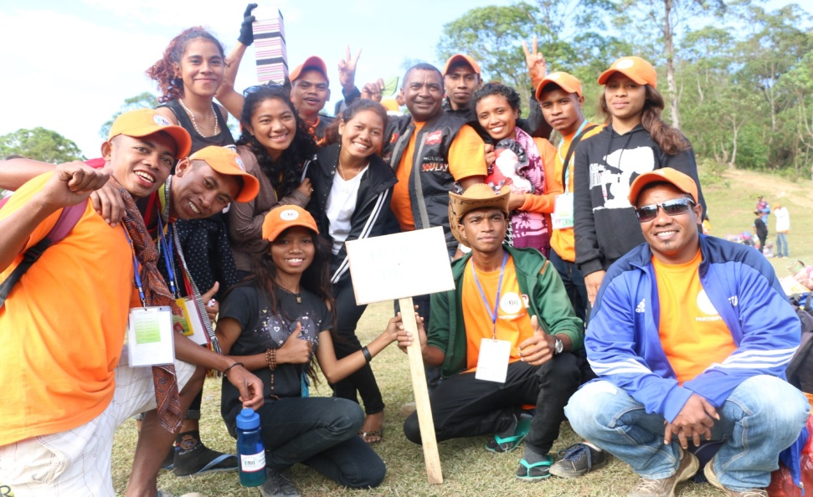
Youth camp (Jukon)

Slide 17
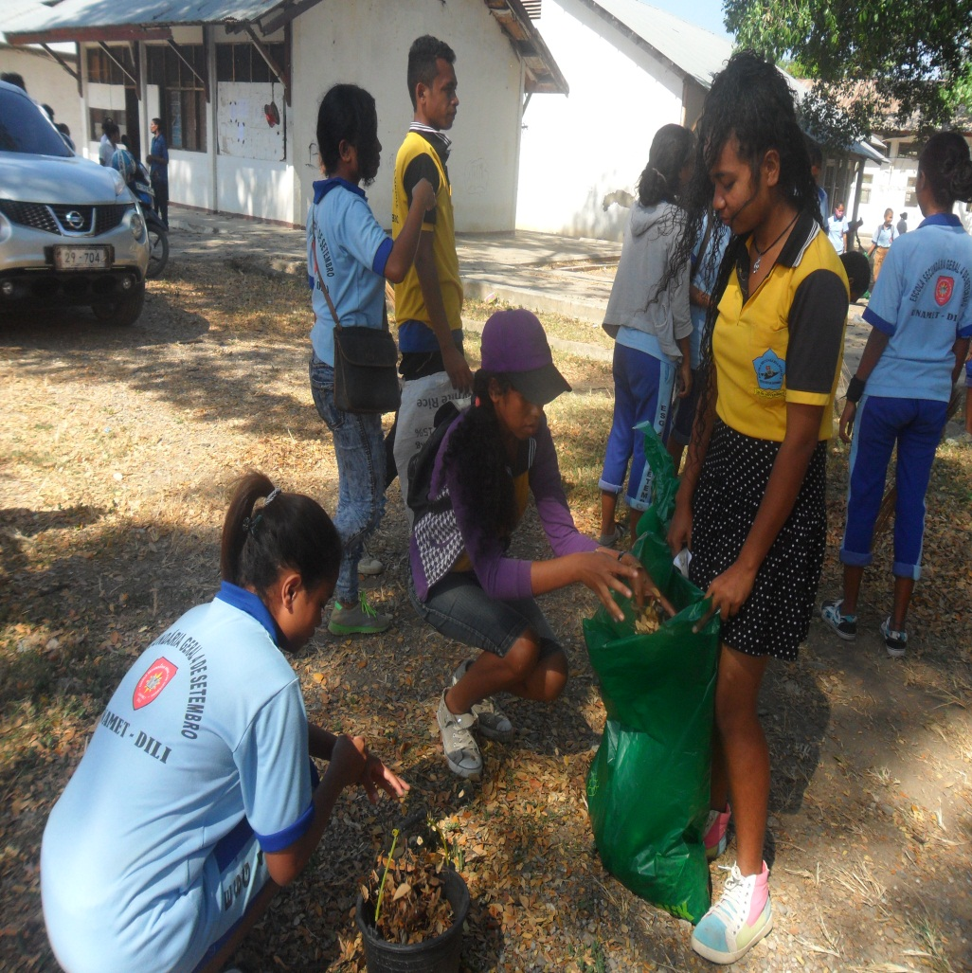
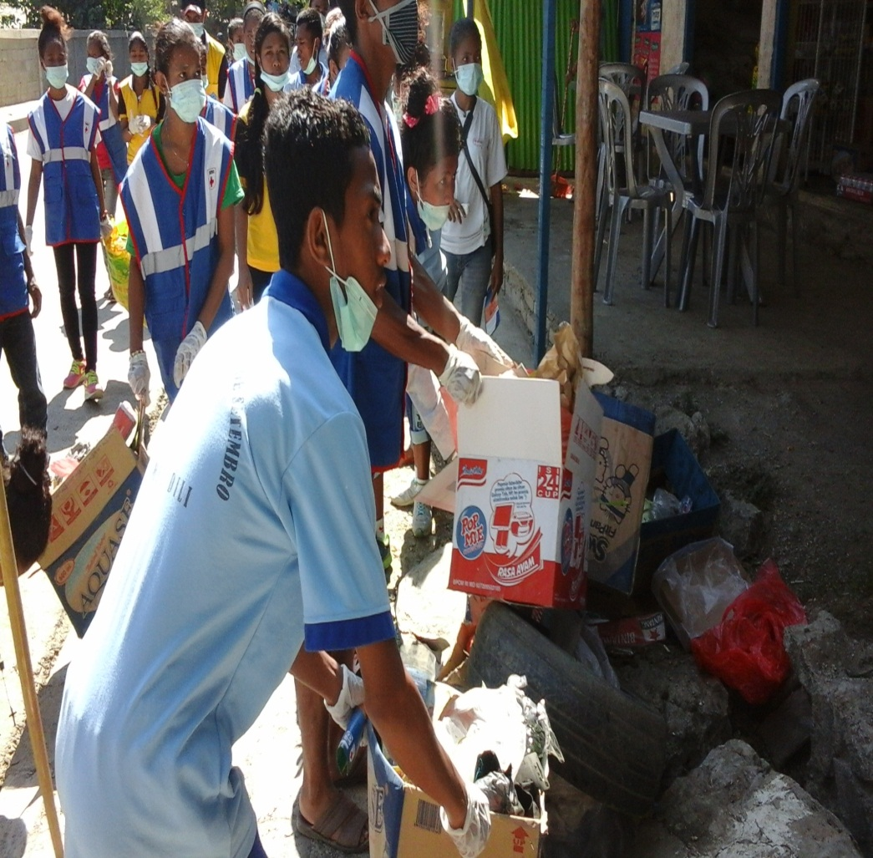
Youth in action

Slide 18
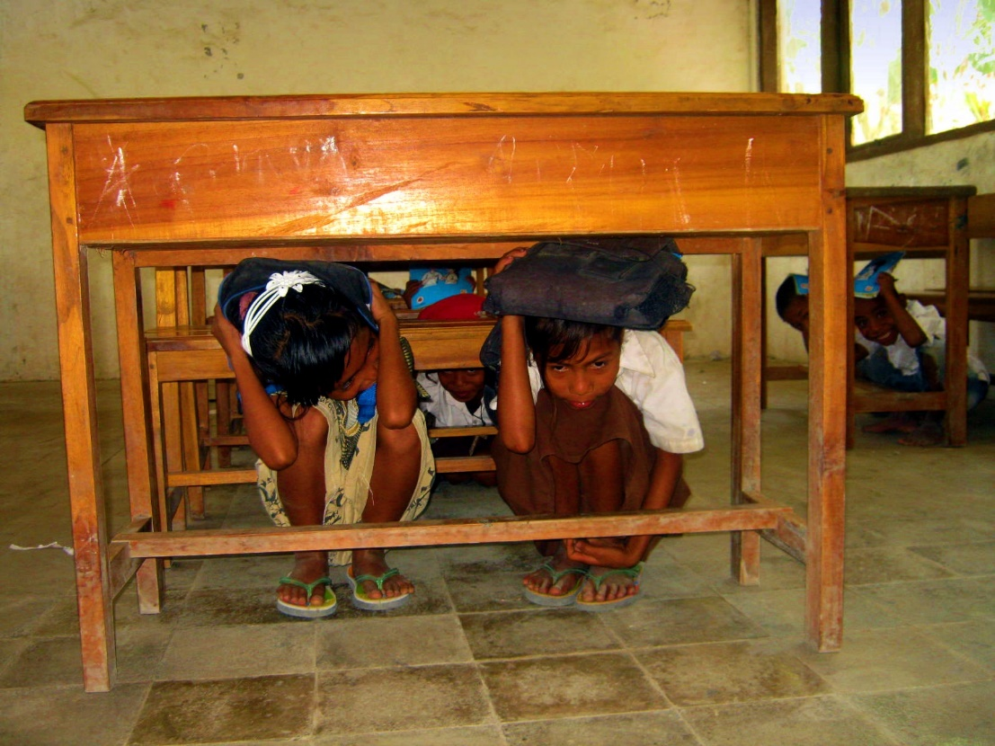
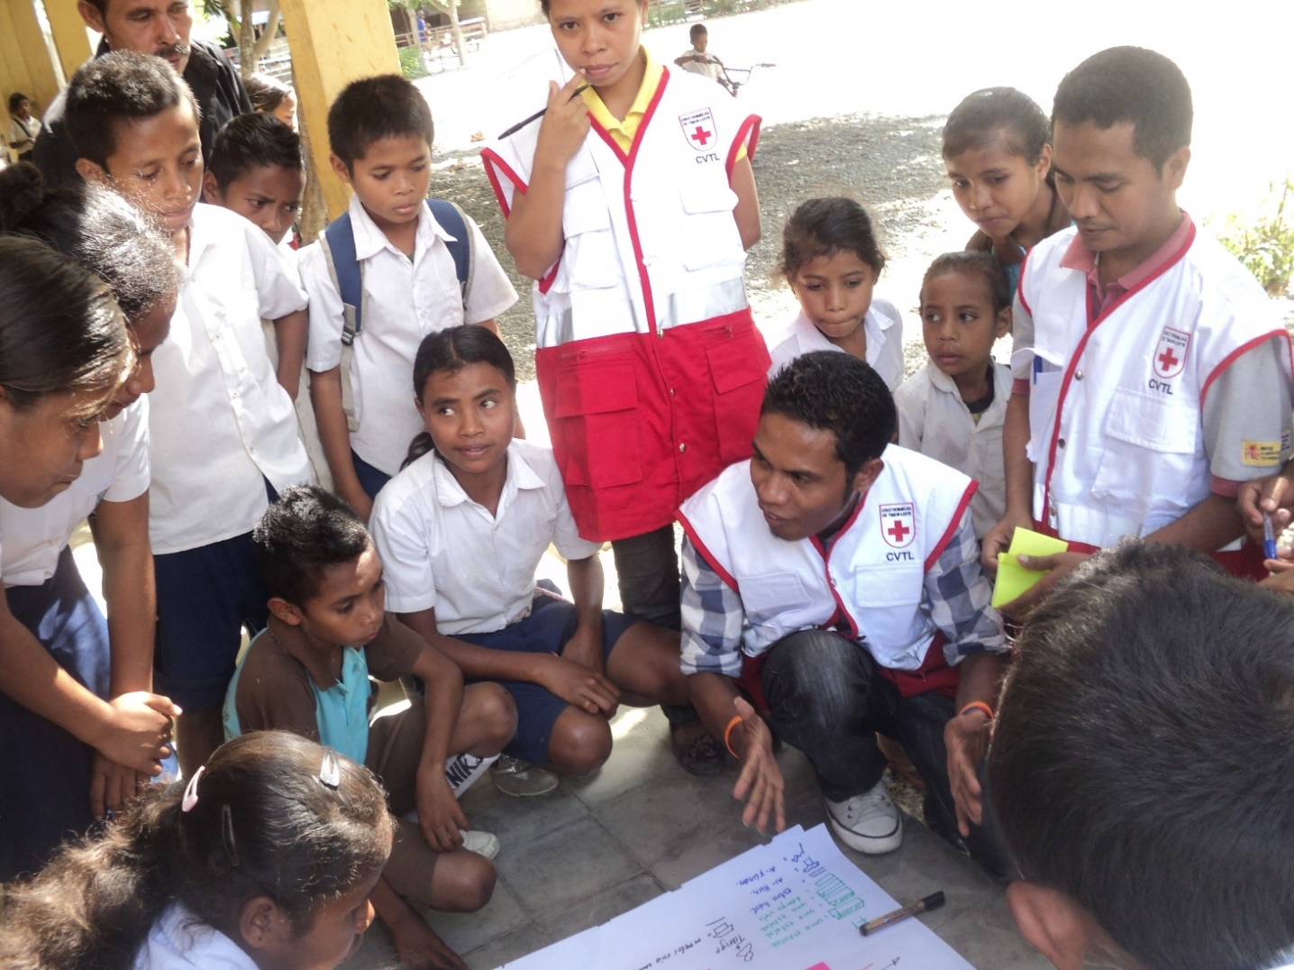
Education Information & Simulation

Slide 19
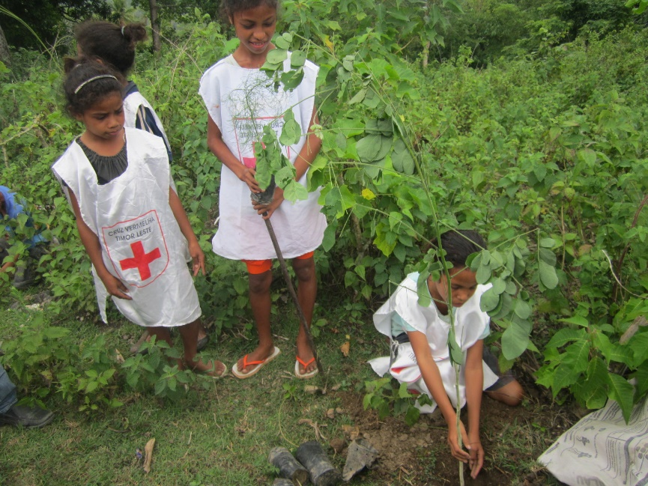
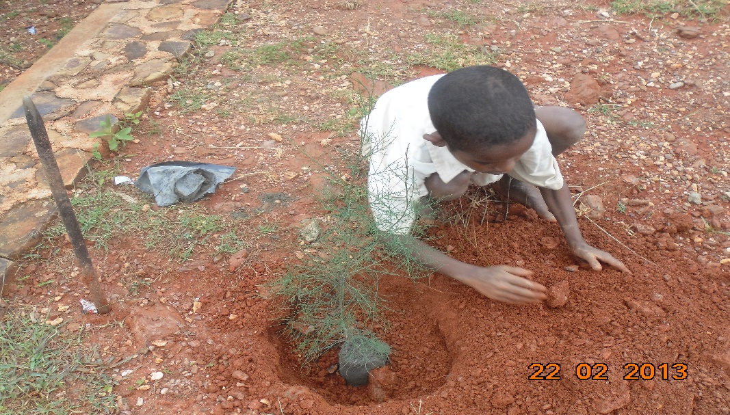
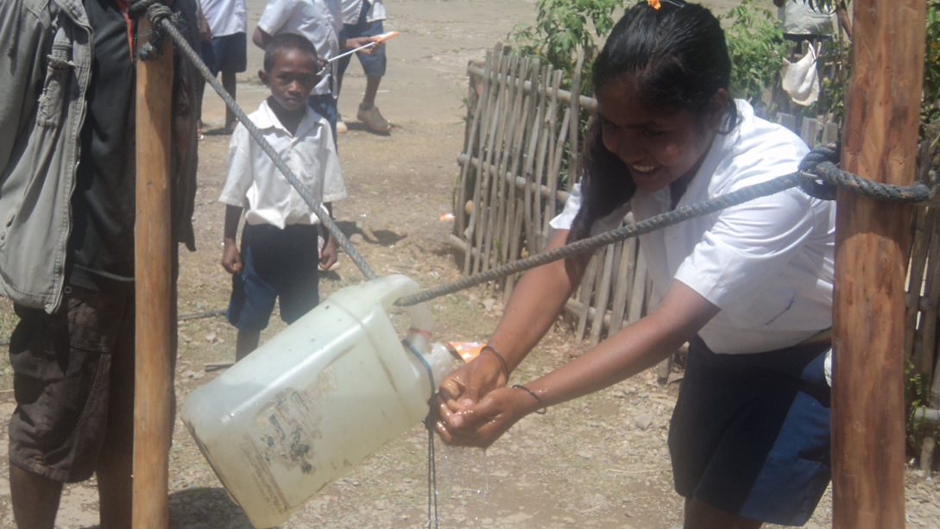
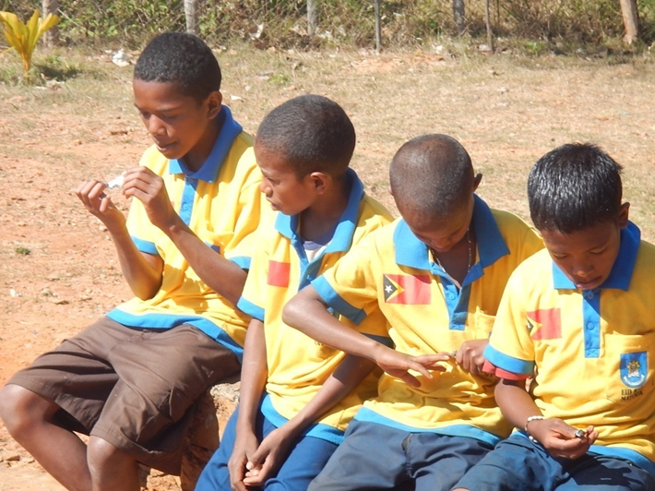
Risk Reduction activities

Slide 20
OBRIGADU/A WA’IN

