Slide 1
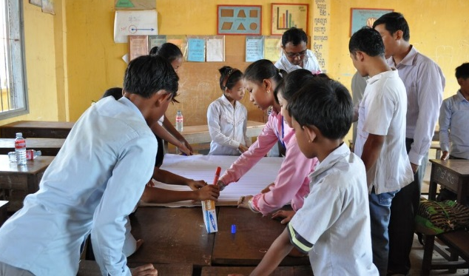
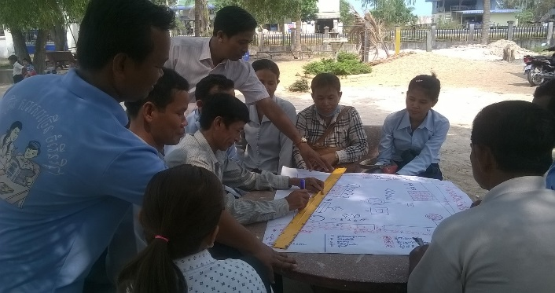
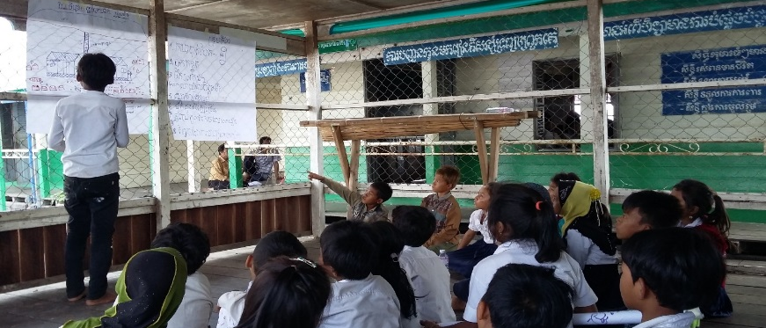
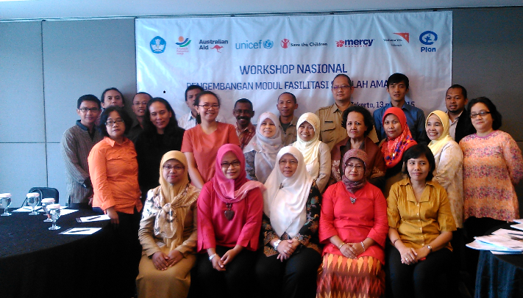
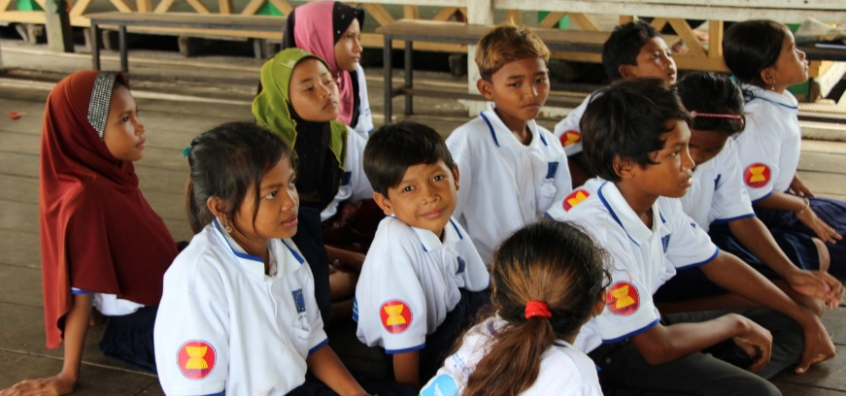
ASEAN Safe Schools Initiative

Slide 2
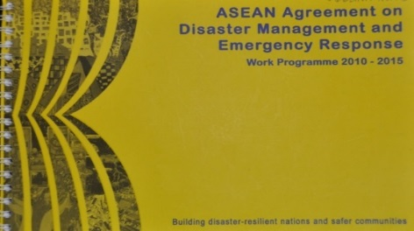
Background
ASEAN Agreement on Disaster Management and Emergency Response (AADMER)
Legally binding regional disaster risk reduction framework for ASEAN
Enacted in 2009
AADMER Work Programme 2010-2015
Roadmap to put the AADMER into action

Slide 3
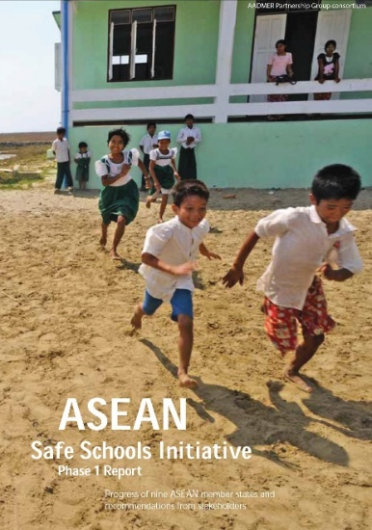
ASEAN Safe Schools Initiative
Supporting AADMER Work Programme 2010-2015: “Disaster Safety of Educational Facilities” and “Integrating DRR into curriculum”
2013
2014
2015
Establishment PMT
Launch of ASSI Phase 2
Endorsed by ASEAN Committee on Disaster Management (ACDM)
Program design and consortium formation
Progress report from nine ASEAN member States

Slide 4
ASEAN Safe Schools Initiative - 2016
ASSI as a sub-regional initiative on school safety in ASEAN region – in alignment w/ APCSS & GADRRES.
Creates a space in the SEA to discuss and share technical resources, policy development and practices to minimise the impacts of disasters to children’s education
Promotes and advocates CSSF in ASEAN and coordinates and collaborates with players on school safety in ASEAN
Contributes to achievement of school safety at regional and global levels (SFDRR: Priority 3 & SDGs)
AADMER Work Programme 2016-2020 (PP2: BUILD SAFELY
ASEAN Education Sector Strategic 5-Year Work Plan 2016-2020
A Partnership between ASEAN Member States & CSO to promote a comprehensive approach to school safety.

Slide 5
ASSI focus in 201-2015: ECHO and DFAT-funded
Principal objective:
Children in ASEAN are more resilient to disasters and have a safe and secure learning environment
Specific objective:
Improved technical and institutional capacity of ASEAN Member States on safe school programming through inter-agency collaboration and the use of the ASEAN framework, guidelines, and tools for safe school
Result 1:
Regional collaboration on the development of school safety across ASEAN MSs is strengthened with prioritised tools and approaches in place by the end of the project
Result 2:
Policies, tools, and technical capacity are in place and being utilised through inter-agency collaboration to promote safe schools at the country and school levels
Result 3:
Increase in advocacy and learning initiatives on school safety across Ministries of Education, National Disaster Management Organisations, and other stakeholders in ASEAN Member States

Slide 6
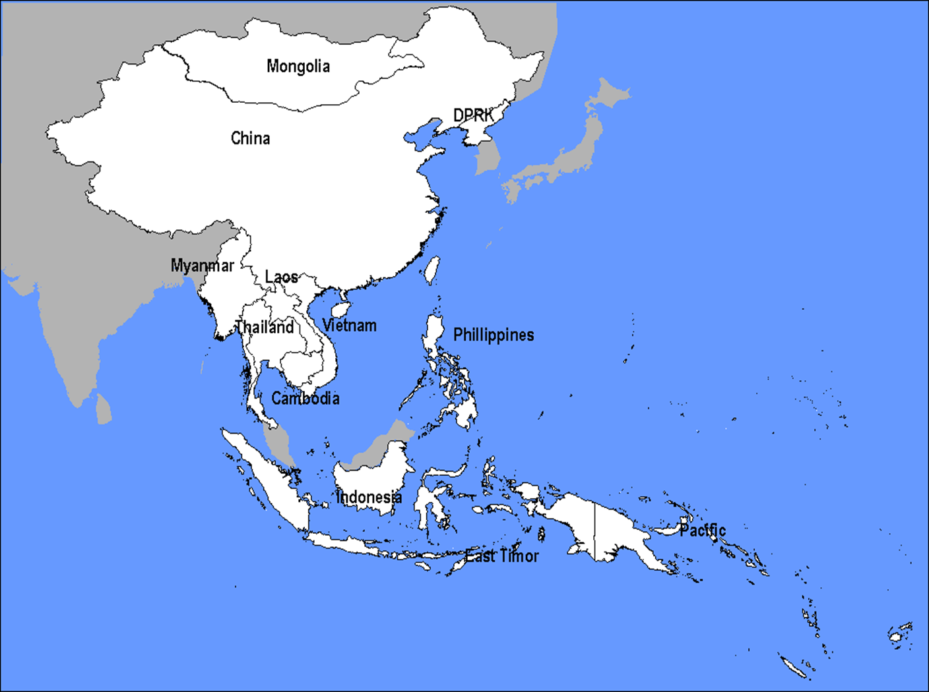
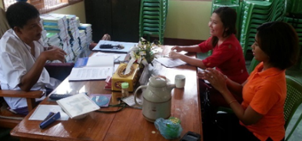
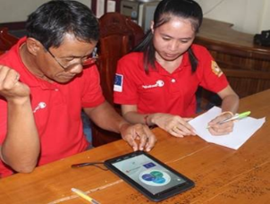
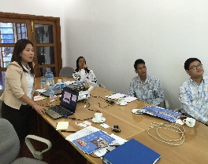
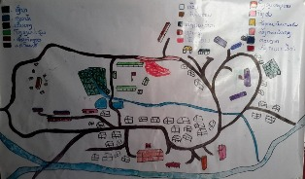
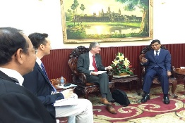
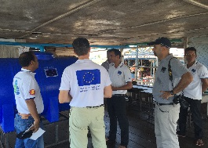
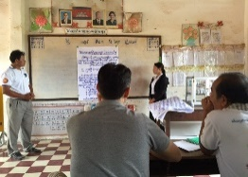
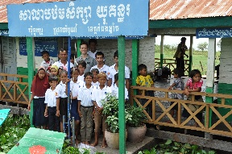
ASEAN Safe Schools Initiative
At National Level
Myanmar (ECHO): Yangon township and Rakhine state
Laos (ECHO):Bolikhamxay
Cambodia (ECHO): Kampong Chhnang and Pursat
Indonesia (DFAT)
Location: 2 urban schools in Jakarta:

Slide 7
Opportunities and Priorities: ASSI Now & Future
AADMER WP 2016-2020 in concurrence with the newly adopted SFDRR (new Working Group on Knowledge and Innovation Management).
Joint endorsement of the ASEAN Common Framework for CSS by the Education and DM sectors.
Strengthening of knowledge and good practices exchange mechanism among AMSs (ASSI KM/COM)
Strengthening ASEAN capacity on SS and development of pool of trained SS experts/practitioners

Slide 8
Opportunities & Priorities: ASSI Now & Future
AADMER WP 2016-2020 aims to strengthen national ownership by encouraging the national level initiatives.
Compilation and standardising school safety tools and resources in country (SDRM guideline and existing national tool kits)
Strengthening of inter-agency coordination
Providing technical support in the development or enhancement of SS database and information system in AMSs
ASEAN Vision 2025: institutionalization and communication, partnership and innovation, and finance-resource mobilization
ASSI engagement of private sectors and other relevant sectors including Youth sector, development & planning sector, budget and finance sector and media
Strengthening resources mobilization with the leadership of the ASEAN Member States

Slide 9
Thank you!

