Slide 1
Asia Pacific Coalition for School Safety
(APCSS)
  Regional Lessons Learnt Workshop on School Safety Initiative
  and School-Based Disaster Risk Reduction
15-16 September 2016, Bangkok, Thailand

Slide 2
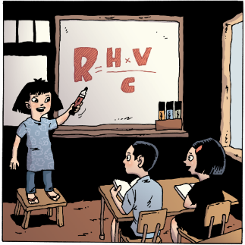
Why is Safe Schools important in SouthEast Asia?
  80% of disaster deaths happen in Asia
  70% of pupils are enrolled in schools that are in high seismic risk zones and hundreds of millions more face regular flood, landslide, extreme wind and fire hazards
  Children are disproportionally affected by disasters, but also strong agents for resilience
  14,500 schools were fully or partially damaged in disasters in SEA over the last 5 years
  Schools are powerful venues for resilience building
  Lack of regulatory framework and budgetary commitment in SEA countries

Slide 3
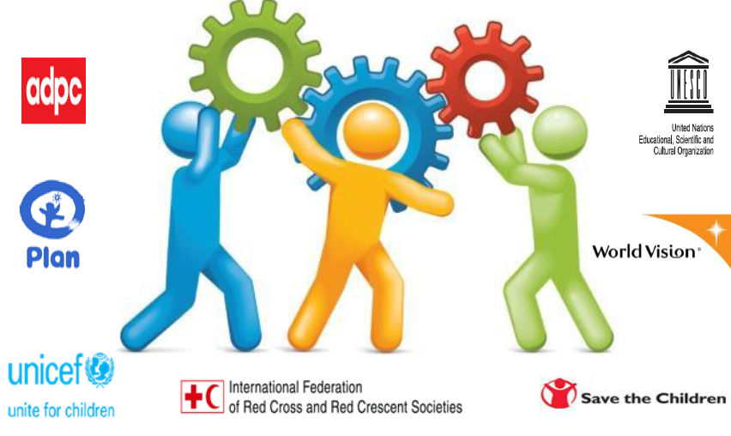
APCSS – Regional Collaboration

Slide 4
Asia Pacific Coalition on Safe Schools (APCSS) – A Regional Collaboration
The coalition was established on 19th Sep 2012
The members of APCSS are Plan International, Save the Children, World Vision, UNICEF, UNESCO, IFRC, ADPC and UNISDR
Plan is a secretariat of (APCSS).
APCSS is to create a space at the regional level for discussion and sharing of technical resources, good practices/lesson learns and model policies on Safe Schools to minimize the impacts of disasters to children’s education and to coordinate and promote advocacy for Comprehensive School Safety.
Regional branch of Global Alliance for Disaster Risk Reduction and Resilience in the Education Sector (GADRRRES)

Slide 5
Asia Pacific Coalition on Safe Schools (APCSS) – A Regional Collaboration
The coalition was established on 19th Sep 2012
The members of APCSS are Plan International, Save the Children, World Vision, UNICEF, UNESCO, IFRC, ADPC and UNISDR
Plan is a secretariat of (APCSS).
APCSS is to create a space at the regional level for discussion and sharing of technical resources, good practices/lesson learns and model policies on Safe Schools to minimize the impacts of disasters to children’s education and to coordinate and promote advocacy for Comprehensive School Safety.
Regional branch of Global Alliance for Disaster Risk Reduction and Resilience in the Education Sector (GADRRRES)
5

Slide 6
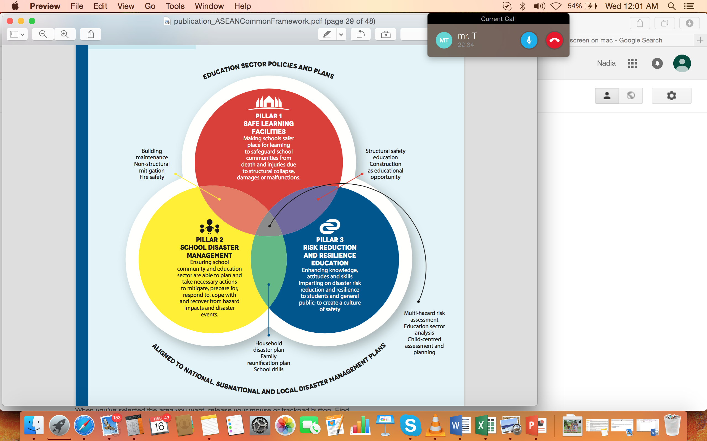
The ASEAN Common Framework For Comprehensive School Safety

Slide 7
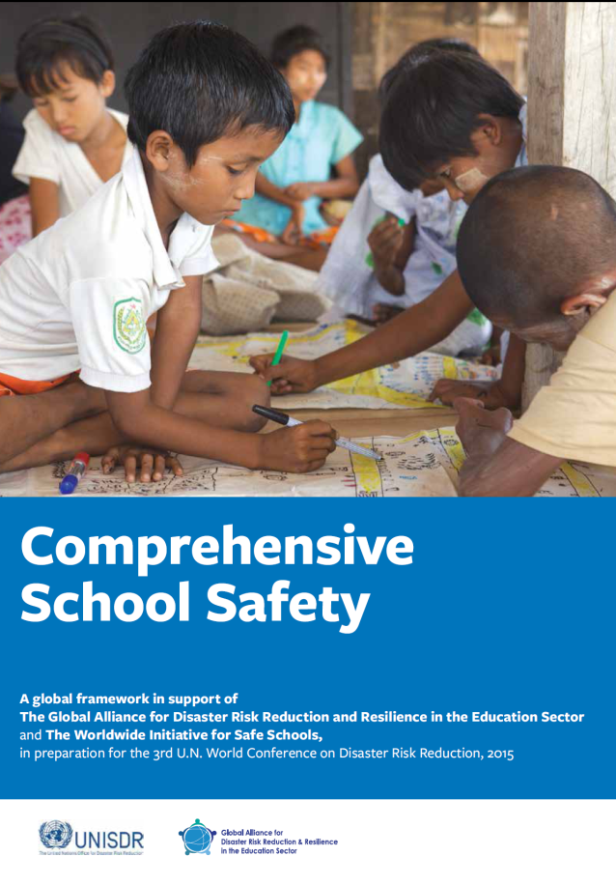
APCSS - Objectives
Promote comprehensive school safety – advocacy at regional and sub-regional and country levels.
Coordinate and collaborate with players on school safety
Develop and share technical resources, good practices, policies and lessons learned – knowledge management

Slide 8
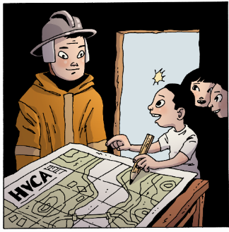
On-going coordination by APCSS
Asian Ministerial Conference on Disaster Risk Reduction 2016 (2-5 Nov. 2016, India):
  Thematic session: Promoting educational continuity and resilience of children and community through increasing child-focused Comprehensive School Safety in different contexts and innovative educational solutions.
      Collaborators: APCSS, All India Disaster Mitigation Institute (AIDMI), and the International Institute of Earthquake Engineering and Seismology (IIEES)
  Technical Session 3: Investing in DRR for resilience.
      Theme: Increasing public & private sector investment in disaster risk prevention and reduction that strengthens economic, social, health and cultural resilience.
      Collaborators: Thailand Ministry of Health; Federation of Indian Chambers of Commerce and Industry FICCI; Malaysian Industry-Government Group for High Technology (MIGHT); Asia Pacific Coalition for Safe Schools (APCSS); the Centre for Asia Pacific Partnership

Slide 9
Questions?

Slide 10
Every child
is a powerful
agent of change
Thank you!

