Slide 1
Communicating in Disaster
AHA Centre Executive (ACE) Programme 2015
Semarang, 29 April 2015

Slide 2
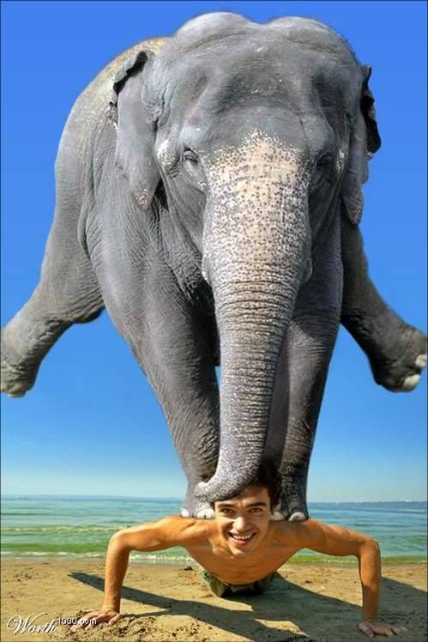

Slide 3
Objectives
Identify the challenges of communicating in disasters
The value of communication
Look at the disaster life cycle
Practical advices

Slide 4
Ongoing vs disaster communications
Long-term (non-crisis)
Story generated by the Red Cross
Information, images and spokespeople already prepared
Information unlikely to change
Red Cross chooses best timing for story
Story tailored to media outlets
Short-term (disaster)
Story is external (flood, cyclone, earthquake etc)
Urgent need for information, images, spokespeople
Information changes rapidly and must be updated constantly
Very short window of opportunity
Many media need the same thing at the same time

Slide 5
Ongoing vs disaster communications
Long-term
Red Cross the only agency speaking
Adequate preparation time
More time spent on choosing the right time to pitch the story
More time for choosing good subjects for interviews
Short-term
Many agencies compete for media space and will give comment if Red Cross doesn’t
Little time for preparation – so, advanced preparation is critical
24-hour news cycle means deadlines are constant
Near enough might have to be good enough

Slide 6
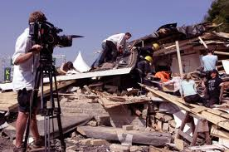
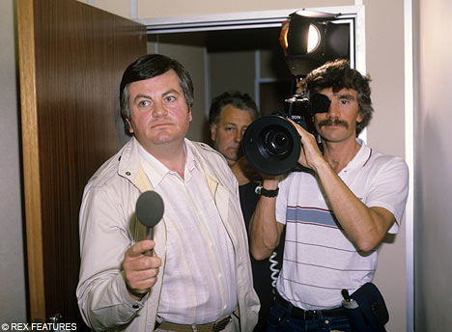
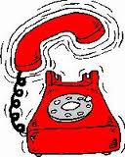
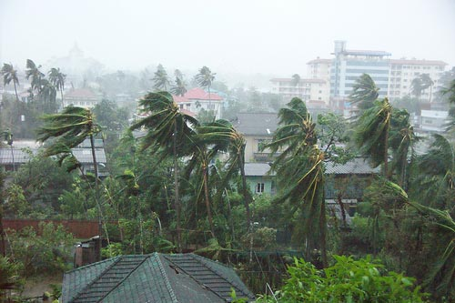
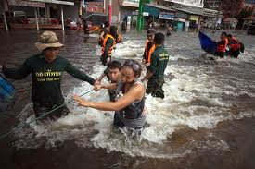
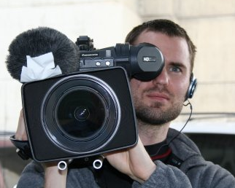
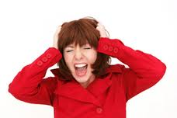
Threat or opportunity?
Notes:
When an emergency strikes….a lot of things start to happen. The phone starts ringing and then cameramen and journalists start to show up and want information. You might be more concerned about the victims of the disaster but the media is very demanding. And, they don’t really go away…

Slide 7










I’m too busy to do media
Notes:
However, if you are too busy to get around to the media side of things, there are many other “players” who will be making sure the media are looked after and are getting their messages out there.

Slide 8
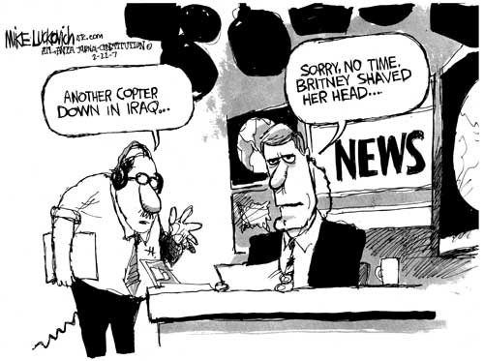
An emergency is an opportunity
Notes:
The competition for media space is fierce. So, at the time of a disaster, is the best time to capitalise on the media attention that is coming your way. If you miss the opportunity, it might not come around again for quite some time. That’s why we’re here today – to help you to capture this opportunity.

Slide 9

Sharing experiences
In your groups, spend 10 minutes discussing the most recent disaster you have worked on
In terms of communications:
What are some of the unique challenges you faced?
Were you able to overcome these challenges?
What did you learn from the process which might be useful to share with the room?
Have a member of your group provide a 3-minute verbal summary on behalf of your group to the floor.
Notes:
The purpose of this exercise is to share the expertise and experiences of those in the room, so that the less experienced can benefit from the more experienced.
40 minutes – Facilitator to ask questions of each summary – and to also pick up on common problems, issues that arise during emergencies.

Slide 10
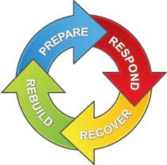
Life cycle of an emergency
Disaster
Response
Recovery
Rebuild
Prepare
DISASTER

Slide 11
Life cycle of media coverage of an emergency
Onset of the emergency – What happened?
Very high demand for info and stories from the field
Rescue and relief race – What next?
Highly dramatic ‘life or death’ stories in first few days
Aftermath – What is being done about it?
Within a week or sooner, attention shifts to new issues, including initial analysis of Red Cross actions
Report card – How did we do?
Fresh stories focus on questions surrounding aid efforts
Prospects for recovery – When will things go back to normal?
Stories about longer-term prospects for recovery

Slide 12
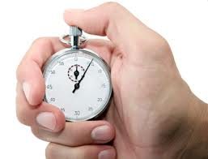
Timing
Once a disaster strikes, there is a very short period of time to work with the media
Estimated four-day period
Communications vital now
Media loses interest quickly
Red Cross must be highly visible
Issuing statements after media moves on not effective

Slide 13
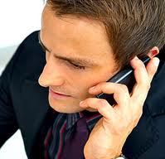
Timing
Do not wait for the media to contact you
Nominate and prepare a spokesperson
Source information from the field (stories, images, people for interviews)
Develop key messages
Write media releases based on key messages
Call journalists daily with updates, especially photographs and offer to take into the field
Do not call them if you have nothing to offer

Slide 14
RC Communicators as journalists
During emergencies, Red Cross Communicators are essentially working as journalists or “Journalist Facilitators” – except they are “reporting” from the point of view of the Red Cross
Travel to the field
Interview disaster victims
Take photographs or video footage
Gather information from a variety of sources… AND
Provide this in a filtered form to the media
Notes:
So, it’s good to refresh those skills

Slide 15
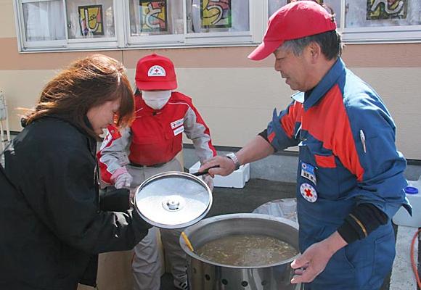
The process for developing stories
Before writing a story, we have a basic idea of what it’s about, but need more information
Interview RC personnel
Find good interviewees in the field
At the same time, seek permission from survivors to be interviewed (again) by a journalist
Notes:
We’ve already looked at what makes a story interesting from our own point of view and we’ve look at what journalists are looking for a news story. So, now we need to distill that information and create stories that will be picked up by the media. So, let’s quickly look at the step-by-step process.
*We will review the process of seeking “good” interview subjects tomorrow

Slide 16
The power of new media
Social media platform → Facebook, Twitter, Youtube
How Red Cross Red Crescent reach more public support using the platforms
Understanding characteristics of each platform
Good practices, lessons learned from emergencies from different countries in different disasters

Slide 17
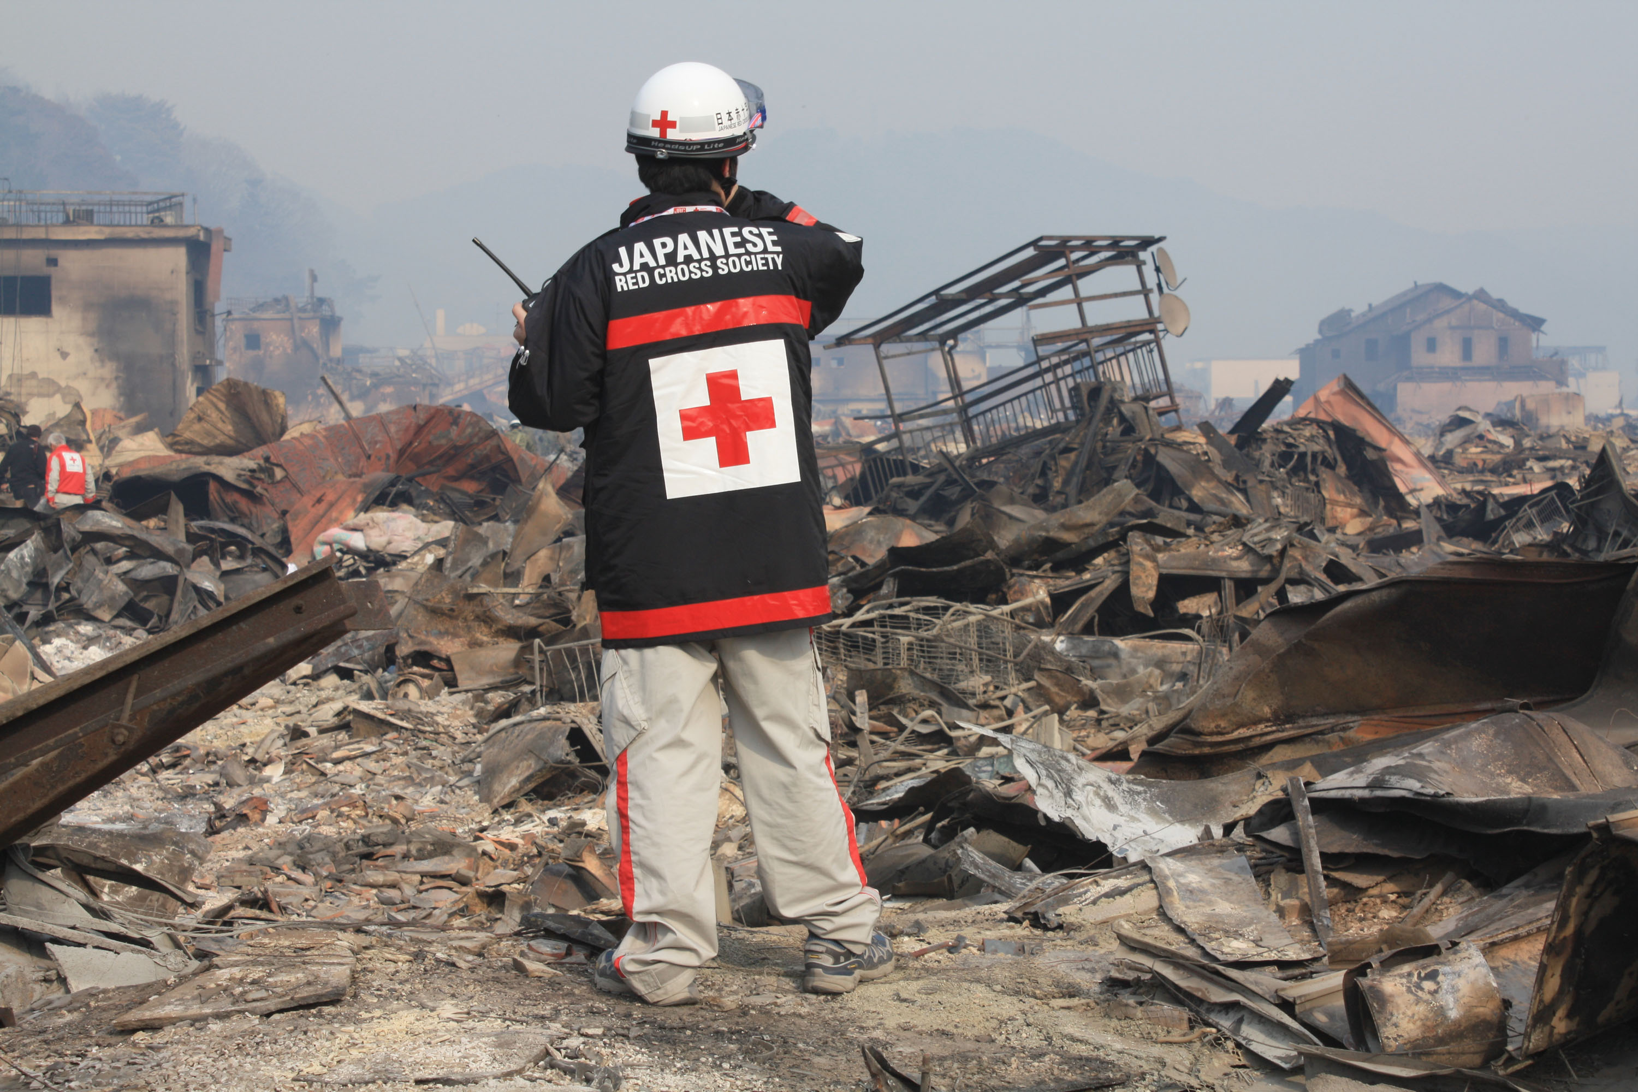

Slide 18
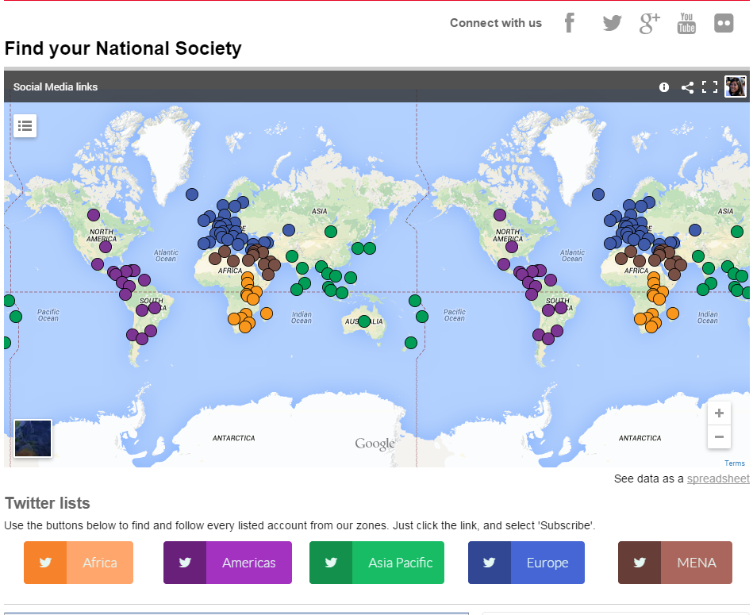

Slide 19
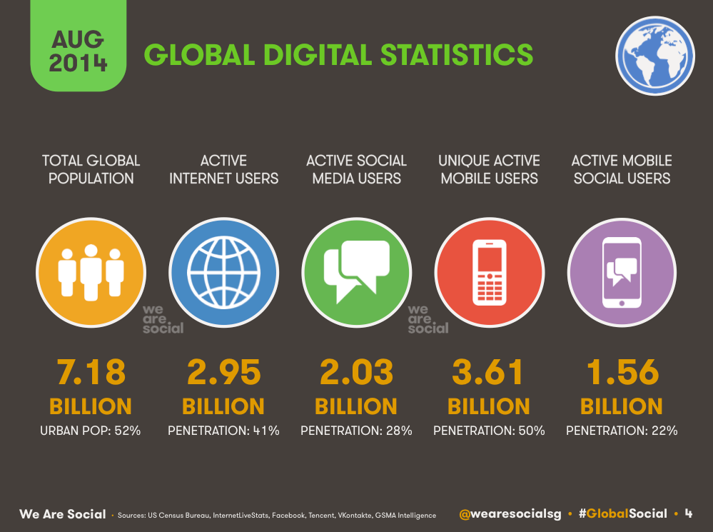

Slide 20
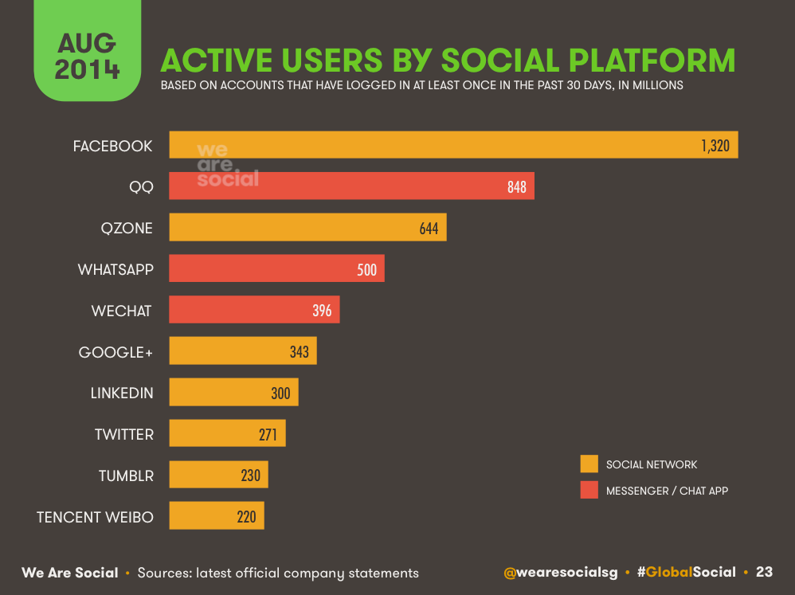

Slide 21
In a disaster social media is about ..
trying to help people directly
improving your awareness of what is happening
enabling the affected people help themselves.

Slide 22
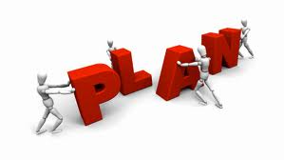
Planning for emergency communications
Having a strong plan in place is vital for emergency communications
The plan should be developed by communications staff in conjunction with DM staff
The planning process can also reveal areas where training is required

Slide 23
Planning for emergency communications
The plan should at least cover:
Agreed roles and emergency roster (possibly including volunteers)
Tasks, timing and who is responsible
Primary and secondary spokespeople (and their languages)
Approvals process for media materials
Contact information
Once a plan has been developed, it must be communicated to all relevant people so that it will be useful during the emergency

Slide 24
RCRC communications and Govt
RCRC and its auxiliary role to the Government
HOW to synergy:
Cooperation and resource sharing
Join work – training, capacity building
…??

Slide 25

Planning for emergency communications
Brainstorm in groups for 15-20 minutes on what major activities should be included in your emergency communications plans
Write the ideas on flipcharts
One person will present the ideas, then we will try to determine any gaps
Notes:
Give the handout on disaster planning to help this exercise.
The purpose of this exercise is to trigger the thought process on planning ahead for communicating during an emergency.

Slide 26
Activities during disaster (response – recovery)
Interview
Field trip
Producing IEC materials
Humanitarian Diplomacy
…

Slide 27
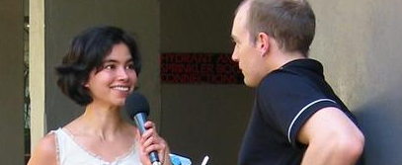
Interviews
Are a conversation between you and a person who has newsworthy information
Approach is important – you want the person to feel relaxed
Show empathy to the interviewee
Usually, the first few questions asked are just to help the person relax
Notes:
What is an interview? t’s likely only a small part of the interview will be used

Slide 28
Open questions and accuracy
Ask “open” questions
The ideal first question is something like:
“What actually happened?” or
“Could you tell me about..?”
Listen and make sure you understand what the person is saying
You might have to ask more questions to check what has been said
Notes:
Ask “open” questions which encourage the person to speak, rather than questions where the answer is yes or no.
For example, you might ask:
"Did you say you had 12 cows but now you only have two?”

Slide 29
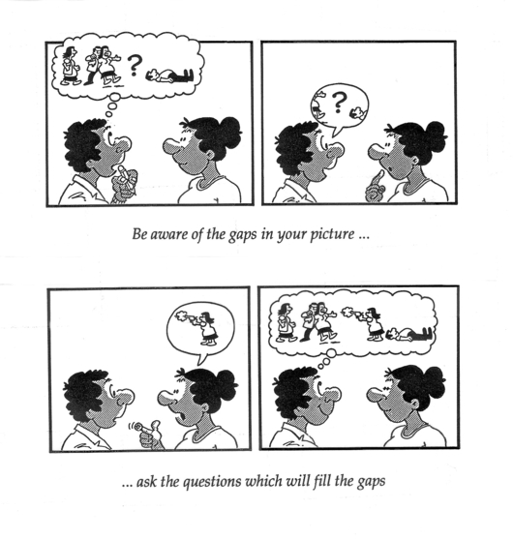
Visualising
As you are hear the information, you need to add it to the picture you have in your mind.
Notes:
Source: www.thenewsmanual.net/index.htm

Slide 30
Who? What? Where? When? Why? and How?
Can you now visualise the whole story? Could you answer any question about this story if it was put to you - Who? What? Where? When? and especially Why? and How?
If there are gaps in your understanding, it means you lack information. Your next question should be to fill in this gap.

Slide 31
Ask again and listen
Sometimes a person’s reply does not answer the question. Ask again – or ask the question in another way.
Listening is very important
Final question:
"Is there anything else I should know?“
Record interviews and take notes for accuracy
Check spellings of names of people and places
Exchange contact details
Notes:
Again, listening is very important – asking questions based on what the person has told you should uncover all of the elements you need for your piece

Slide 32

Role play
Interviewing beneficiaries
Split into pairs
People who played journalists yesterday will now play beneficiaries who have suffered losses in a disaster
Movement communicators must interview the beneficiaries in a sensitive way to extract all of the information they can from them
Notes:
Hand out two role plays of beneficiaries.
The purpose of this exercise is to force RC communicators to practice interviewing a beneficiary who has been traumatised and is not very co-operative in giving information. The communicator needs to show empathy and also persistence in order to extract information in a sensitive manner.

Slide 33

Different places for content
When sourcing material through interviews, be aware of the different audiences you will be communicating with:
1. Content for RC online, FB etc
2. Content for external media
3. Strong interview subjects for both
Notes:
We have this expression in English called Wearing Three Hats…which means thinking about things from different points of view at the same time. So, there are three roles you are playing here. One is as content creator for the Red Cross vehicles, one is as a content creator to send out to external media – and the third is as a “talent scout” for the external media.

Slide 34
Preparing for a media interview
EXERCISE: Q and As [Questions and Answers]
This is a simple but effective way to prepare yourself or your spokesperson for interviews.
Use the scenario we worked on for our key messages. Try to imagine the types of questions a journalist might ask you and then develop your responses.
Q
&
A
Notes:
The purpose of this exercise is to try to anticipate all of the questions that might come up during an interview and then develop responses to them, so that the interview subject is well prepared for all questions – especially worst case scenario questions.
I usually try to think of every question possible when I am preparing in this way.
Can we have two people at the front as scribes to write down the questions – now we will go around and get a question from each table until we feel we have exhausted all of the questions.
Now, reviewing the questions, are there any that will give us some difficulty in answering? We do not need to develop answers for the straight-forward ones, but can look at the touchy ones and we can park those and then have a quick look at how to respond to those now.

Slide 35
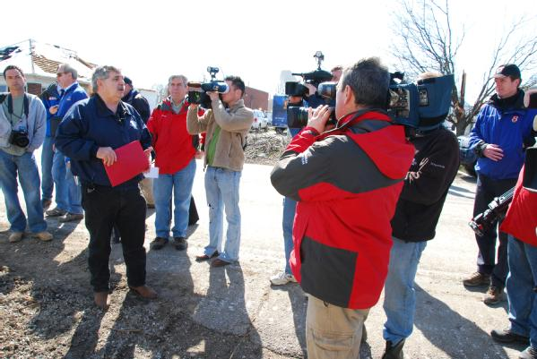
Field trips

Slide 36
Preparation is crucial
Three things to remember when preparing for field trips:
Red Cross/Crescent key messages
What does the journalist need?
Advanced preparation

Slide 37
Key messages
Key message 1
Situation/problem
What RC knows
Key message 2
Activity
What RC is doing
Key message 3
Call to action
What RC needs
Who
What
Why
Where
When
How
Notes:
There can be more than 3 key messages but depending on what type of media you are speaking with, you might not get the time to elaborate further. An exception is a long radio interview, where you can definitely speak more fully on a situation. TV interviews are normally very short – say a 10 second grab. Messaging should be people-based – it’s about the people.
Key messages can also give some context if there has been a previous disaster – for instance – two years ago Red Cross completed work on a $$ relief effort after Cyclone Nargus which left 60,000 dead and 250,000 homeless etc etc

Slide 38
Field trips
Key messages
What do you want the journalist to see?
If the key message is “The situation is severe and there is not enough support.” Show the severity of the situation.
A journalist (especially for TV) needs a lot of elements to make a story. It’s not enough to just take them to a Red Cross distribution point.

Slide 39
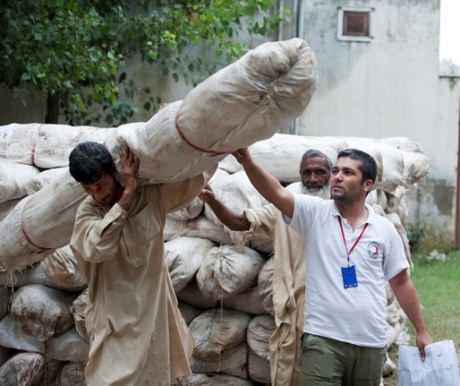
Field trip basics
You at least need to organise for media:
To show the Red Cross in action
People to be interviewed
The damage to the area
Note: This can also be a time for you to take photos and report

Slide 40
Field trips – Dos and Don’ts
Do go the day before to check access and to make sure that there are going to be interesting pictures.
NEVER tell beneficiaries what to say, BUT…
Check beneficiaries are happy with the help they are receiving and seek their permission to speak with journalists and have photos taken.
Give journalists clear information about travel times – you do not want them to miss their deadline because they are stuck in the field.

Slide 41
After media attention has shifted
Update media contact lists
Contact journalists with news about arrival of new supplies, handover of new housing, other stories relating to the relief effort
Continue updating information on web and social media
Consider an event to thank volunteers
Keep in touch with journalists by feeding them regular stories

