Slide 1
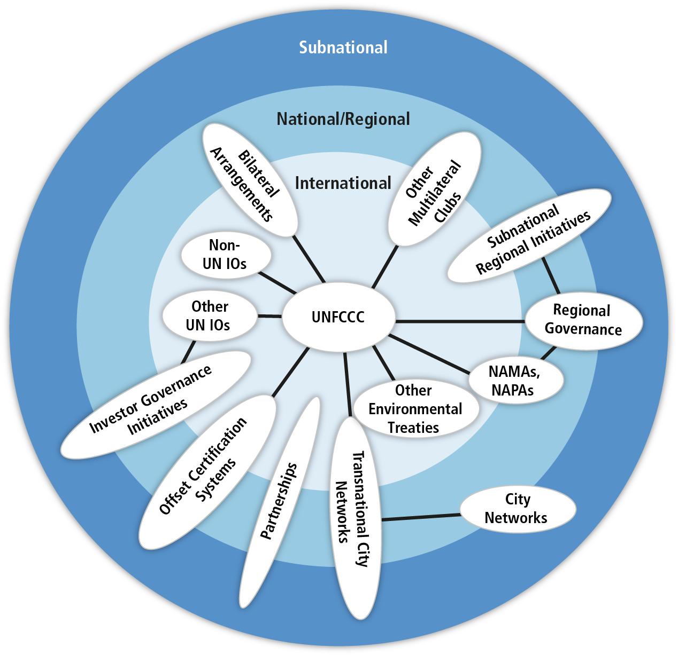
Climate Change and Finance
Global
Regional/National
Subnational
Notes:
1. Climate change mitigation (and adaptation) is a global common problem that requires international cooperation across scales, including for financing.
2. The costs of adaptation in developing countries are significant.
3. At a time when current resources are already stretched, National Red Cross and Red Crescent Societies have expressed the need to gain better understanding of how to access existing climate funds that will enable them to mainstream climate change in their programmes.

Slide 2
Content of the module
Setting the scene
Climate finance architecture: global, bilateral and national channels/funds
CCA finance vs CCM finance
Climate Funds
Few examples
Gender responsive climate finance
Co-benefits of CCA (or climate-smart DRR)
Key messages
Notes:
Total climate finance includes all financial flows whose expected effect is to reduce net greenhouse
emissions and/or to enhance resilience to the impacts of climate variability and the projected
climate change. This covers private and public funds, domestic and international flows, expenditures
for mitigation and adaptation, and adaptation to current climate variability as well as future climate
change.

Slide 3
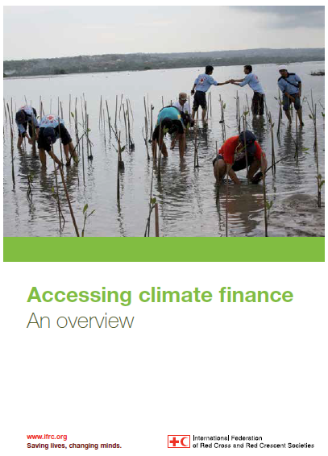
Setting the scene: Accessing climate finance
Contents:
Overview of the climate finance architecture;
Basic information on climate funds and how to access climate funds;
Tips to bear in mind when writing a funding proposal;
IFRC climate finance guide is being updated
Notes:
Several multilateral and bilateral funds exist, most of them are not directly accessible to RC.
Funding for adaptation mainly from public sources through government
Many international sources are conditional to the content of NAP/government climate change strategy
Public sector funding is not distributed directly to end-users, but channelled through government agencies or development banks. Many international funds are only available through governments or UN development agencies.
Most of funding goes through private sector, only limited sources of climate finance can be thought of traditional aid.
Most funding is directed to mitigation. Mitigation-adaptation together is seen to support sustainable development
This document aims at providing National Red Cross and Red Crescent Societies with an overview of some dedicated funding sources for climate change. The guide also provides some basic information on how to access these funds.

Slide 4
Global climate finance architecture – COMPLEX AND EVOLVING
Notes:
Source: Climate Finance update December 2015
Myanmar INDC document: Myanmar calls on the international community to continue supporting the development of capacities to achieve self-sustained adaptation as soon as is practically possible. A major obstacle continues to be access and availability of technologies. This is particularly true, for instance in the area of climate data analysis and short to long term forecast, i.e. lack of advanced computing facilities to enable accurate warning and information and scenarios.
Myanmar is budgeting for adaptive actions in all sectors with the national budget. However, the scale of the adaptation effort, considering the current level of capacities, and the trend of worsening changes in climate, means major support and investment is required. Investments, both from the Private and Public International Cooperation will be oriented for capacity building and technology development and transfer.

Slide 5
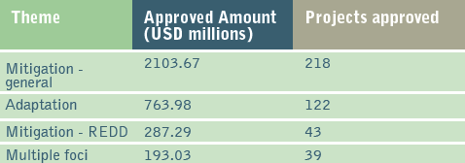
What is
funded in
Asia Pacific?
Since 2003, in AP
63% of funds to CCM
23% of funds to CCA
52% CCM projects
29% CCA projects
Notes:
Total USD 3347.97 / 422 projects,

Slide 6
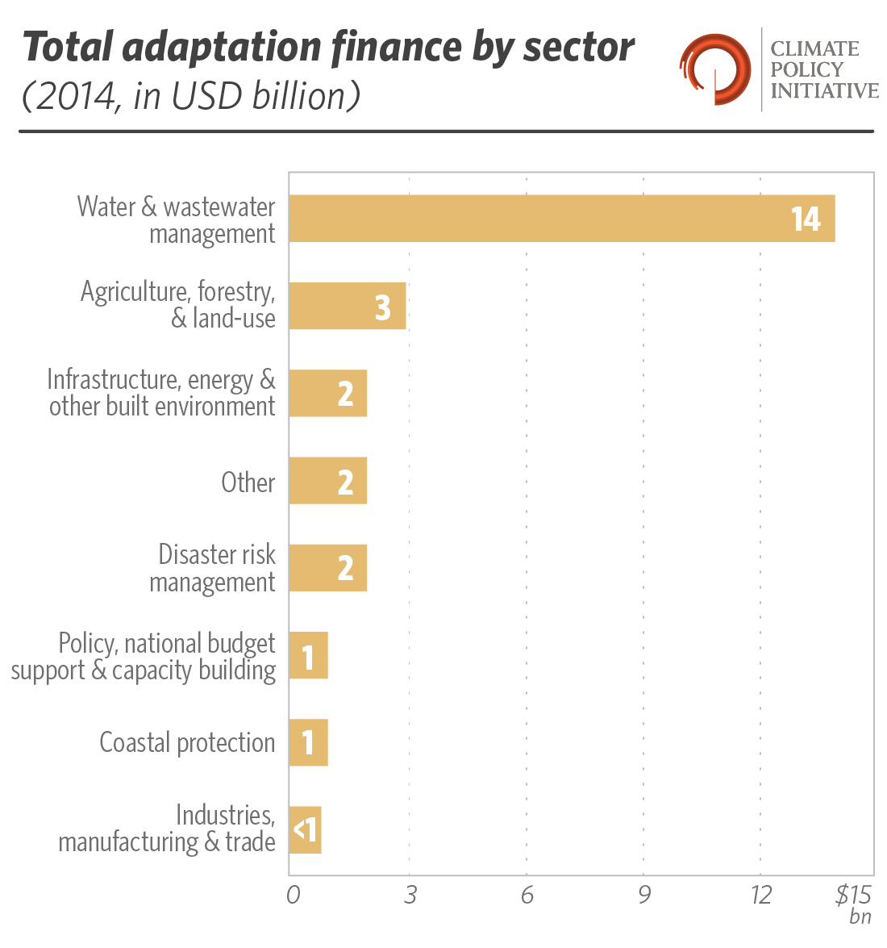
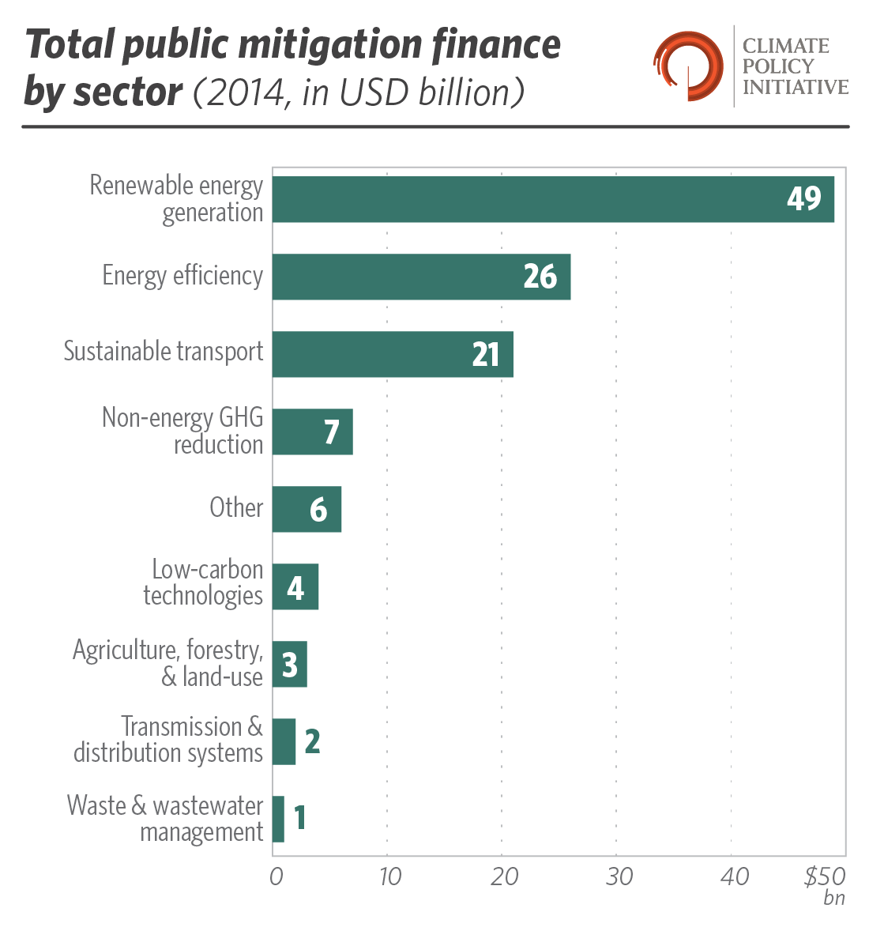
Finance for CCA vs CCM sectors
In Asian countries classified as LDCs:
Over 80% of the funding approved for Asian LDCs has been for adaptation projects, primarily through the Pilot Program for Climate Resilience (PPCR) and the Least Developed Countries Fund (LDCF) until 2015.
A large portion of these have taken a multi-sectoral approach to increasing resilience, while projects focusing on disaster risk reduction and agriculture have received over USD 100 million.
Notes:
Source: Climate Policy Initiative, 2015

Slide 7
Majority of adaptation funds went into infrastructure in 2015
Influence what is being funded so that climate finance is used in a way that supports the most vulnerable people to build their resilience.

Slide 8
Climate Funds: Green Climate Fund (GCF)
Newest fund, hosted by Republic of Korea – fully operational in 2015 – 8 projects approved before COP21 in Paris. Expected to be a major channel of climate funds in the future.
GCF allocation will balance funding for mitigation and adaptation measures (50-50%), and support for the urgent needs of Least Developed Countries (LDCs), Small Island Developing States (SIDS) and African countries and for local private sector actors.
Implementation through accredited agencies/partners. IFRC is currently going through the accreditation process that has proven to be a lengthy one.
GCF is the 1st multilateral fund to include a gender-responsive approach starting from its design phase.
Notes:
Climate Funds Update: Green Climate Fund. December 2015.
Significant share of funding to adaptation. And a significant share of the adaptation funding for LDCs, SIDS and African countries.

Slide 9
Key Principles and Action for Gender-Responsive Climate Financing / GCF
Gender equality as a guiding principle and cross-cutting mandate;
Gender-responsive funding guidelines;
People-centred approach, paying particular attention to community-based actions, in which women are over-represented, including as owners of MSMEs;
Gender criteria for objectives, results frameworks and evaluation of funding options, incl. gender analysis, gender budget, indicators measuring contribution to gender equality objectives, as well as systematic collection of sex-disaggregated data;
Special efforts to seek meaningful input and participation of women as key stakeholders throughout the funding cycle;
Regular audit of gender impacts of funding allocations, community feedback mechanisms, etc.
Notes:
Source: Climate Funds Update. Gender and Climate Finance. December 2015.
Gender equitable – women and men due largely to their gender roles and respective rights (or lack thereof) have differing vulnerabilities to climate change as well as differentiated capabilities to mitigate emissions, adapt to and cope with climate change impacts. These differences need to be taken into account by creating gender-responsive climate financing mechanisms and fund disbursement guidelines and criteria that support gender equality and women’s empowerment in order to increase the effectiveness and efficiency of climate financing; such a link has been proved for gender-responsive development finance.

Slide 10
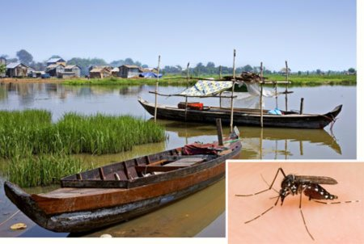
Climate funds: Cambodia Climate Change Alliance (CCCA) Trust Fund
Strengthened capacity for Climate Change Adaptation in Health: Integrated Response to Climate Sensitive Vector Borne Diseases in Cambodia
Trend: National Calls for Proposals with possibility for local organizations to receive small-scale grants (USD 50-100,000), and technical assistance.
For projects to be eligible for funding, they must respond to national priorities that are articulated in existing Government documents such as the NSDP, NAPA, etc.
Notes:
Source: CamClimate website.

Slide 11
Key messages from IFRC publication:
Need to strengthen collaboration with national governments
Develop innovative partnerships with private sector – funding, knowledge, technology
Seek synergies between adaptation and mitigation
Notes:
Source: IFRC 2013. Accessing climate finance – An overview.
Several multilateral and bilateral funds exist, most of them are not directly accessible to RCRC.
Funding for adaptation still mainly from public sources through government
Many international sources are conditional to the content of NAP/government climate change strategy
-Public sector funding is not distributed directly to end-users, but channelled through government agencies or development banks. Many international funds are only available through governments or UN development agencies.
-Most of funding goes through private sector, only limited sources of climate finance can be thought of traditional aid.
-Most funding is directed to mitigation. Mitigation-adaptation together is seen to support sustainable development

Slide 12
Key messages
Influence what is being funded so that climate finance is used in a way that supports the most vulnerable people to build their resilience;
Climate finance opportunities exist – Red Cross can enhance the opportunities to access funding through improved profiling/reporting on what we do, through partnerships and close engagement with relevant governmental agencies;
Explore the potential for funding our core business ‘community resilience’ through climate change funds focusing on DRR/CCA and co-benefits;

Slide 13
Brainstorming exercise
CCA & co-benefits
Exercise background: A Call for CCA project ideas was opened by the National Climate Change Grant Facility. RC is planning to submit a Letter of Interest, including a summary of key information.
1. Choose the most appropriate/interesting thematic focus area (of Green Climate Fund) for Red Cross, e.g. a) Ecosystem and ecosystem services, b) Health, food and water security, c) Livelihoods of people and communities, d) Infrastructure and built environment;
2. Please prepare 3 bullet points:
Please explain in short (5-10 words) the climate change problem(s) the RC project idea is aiming to address;
Please list who would be the possible RC partners?
Please list what would be the main co-benefits (e.g. CCM or environmental) of the Red Cross CCA (climate-smart DRR) activities (refer to the discussions on the overlapping circles exercise)?

