Slide 1
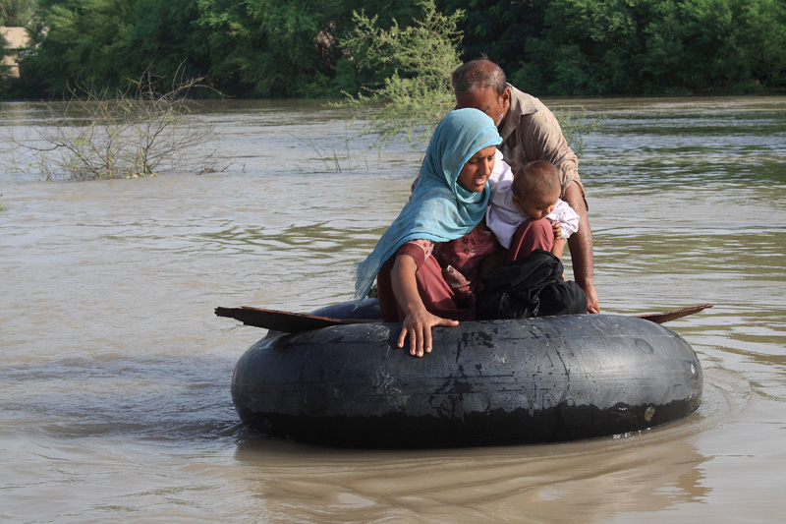
Frequently used terminologies and definitions
Notes:
This week we are not here to tinker with the definition as there is a global working group on that and we can separately feed into that process (Terhi, Susil and Nelson are well connected to that group)
- at the end of the day resilience is the goal and it's far more about mindset and approach than our structures - it's about our people (ie in NS as well!) who want to make an integrated difference in people's lives at local levels and can forget their egos and protective approaches to budgets and skill sets and make them available for collective impact
- it's about donor education and advocacy if we find others only willing to resource silo approaches
- that's why our agenda starts again at exploring what inspiring experiences we have found at community level to try and emulate them elsewhere, and then to reflect on how the way we work helps or hinders those examples of excellence we have come across and need to better celebrate at community levels where people have been working on their resilience for hundreds of years!
- But first - - My presentation will focus on current discussions on the concept of resilience and the discussions around putting the concept of resilience in to practice.

Slide 2
Rules
Five teams – each identifies a ‘speaker’
A question is displayed…
.. teams need to check whether the answer is correct
Teams with correct answer get 1 point
Bonus 1 Point if team can translate the terminologies into volunteers/community language

Slide 3
Ready?!

Slide 4
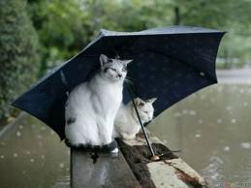
Weather
Is the set of meteorological conditions – wind, rain, snow, sunshine, temperature, etc – at a particular time and place.

Slide 5
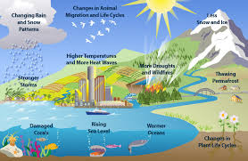
Climate
The climate of an area is its local weather conditions — such as temperature, precipitation (rainfall, snow, etc.), humidity, sunshine, cloudiness, wind, and air pressure. It is the weather averaged over a long period of time (normally 30 years), taking account of the average conditions as well as the variability of these conditions. Some people say "climate is what you expect, and weather is what you get".

Slide 6
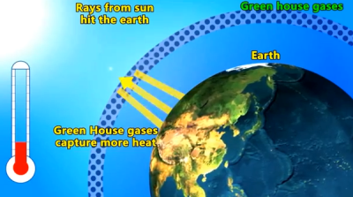
Greenhouse Gas (GHG)
Naturally occurring and human-made gases that trap infrared radiation as it is reflected from the earth’s surface, trapping heat and keeping the earth warm. The six main GHGs whose emissions are human-caused are carbon dioxide (CO2), methane (CH4), nitrous oxide (N2O), hydrofluorocarbons (HFCs), perfluorocarbons (PFCs), and sulphur hexafluoride (SF6).

Slide 7
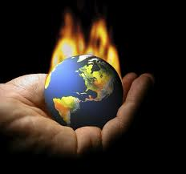
Global Warming
The progressive rise of the earth’s surface temperature thought to be caused by the enhanced greenhouse effect. Global warming may be responsible for changes in global climate patterns.

Slide 8
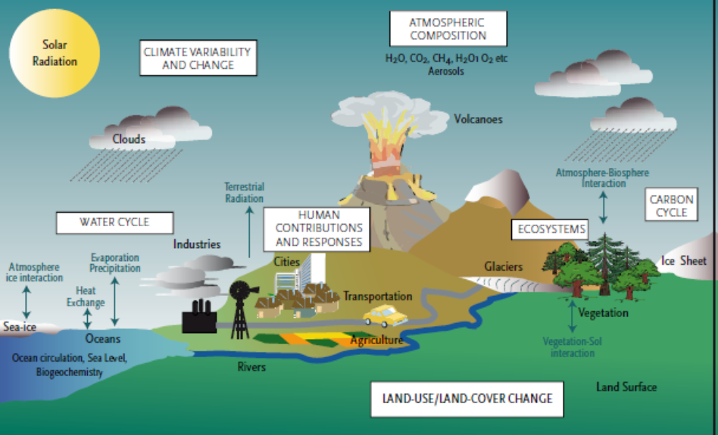
Climate Change
A significant change in measures of climate (such as temperature, precipitation, or wind) lasting for an extended period (decades or longer). Climate change can result from both natural changes (such as changes in the sun’s intensity or oceanic circulation) and human activities. Today we tend to use the term for changes in the climate that are induced by human activities that alter the gaseous composition of the atmosphere due to the release of greenhouse gases, in particular CO₂ (such as fossil fuel burning or deforestation).

Slide 9
Question
Which of the following greenhouse gases has the biggest impact on climate change?
Water vapour
Methane
Carbon dioxide
Ozone

Slide 10
Answer : Carbon Dioxide
Water vapour is the most prolific greenhouse gas, but its levels are reasonably constant. Methane and ozone are much more potent greenhouse gases than carbon dioxide, but they’re present in smaller quantities. Burning of fossil fuels – carbon, oil, petroleum – has seen carbon dioxide levels in the atmosphere increase from 280 parts per million 200 years ago to 430 parts per million today.

Slide 11
Question
Explain what is the difference amongst:
Weather – Climate – Climate Change

Slide 12
Can the terms ‘global warming’ and ‘climate change’ be used interchangeably?
Question
Yes, they refer to processes closely related, and people understand what you’re referring to when you use either of them
No, these are completely separate processes and should not be confused

Slide 13
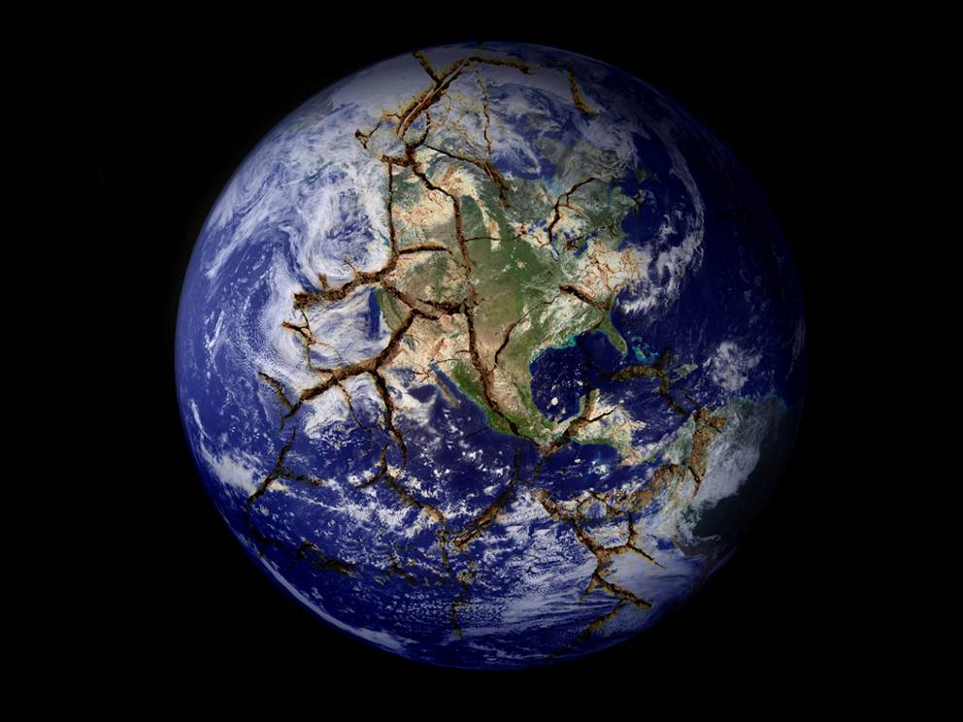
The answer is Yes!
When the ocean, land and air get warmer (global warming), things change in the climate system (climate change)…
Notes:
Answer: Yes
Explanation:
These terms are often used interchangeably.
Global warming was commonly used in the 80’s to talk about how human activities, such as the burning of fossil fuels and deforestation, were increasing the heat-trapping gases in the atmosphere that have been causing the planet to warm.
But scientists have learned that raising the temperature of the atmosphere, oceans and land will also result in large scale climatic changes, such as changes in rainfall patterns.
Both global warming and climate change are happening, and it is okay to use either term, though ‘climate change’ refers more comprehensively to the changes occurring due to increased greenhouse gases in the atmosphere.
http://www.climatecentral.org/library/faqs/what_is_the_difference_between_global_warming_and_climate_change
On a warmer planet, interactions between the ocean and atmosphere change. For example: warmer ocean temperatures supply more energy to tropical cyclones as they move across the ocean, strengthening them. At warmer temperatures evaporation increases, as does the ability of the atmosphere to hold more water vapour. Thus we can expect longer/more intense dry periods, and heavier more intense rainfall when it occurs. Scientists call this increased rainfall variability. We can also expect that some areas will generally become drier while others become wetter overall.

Slide 14
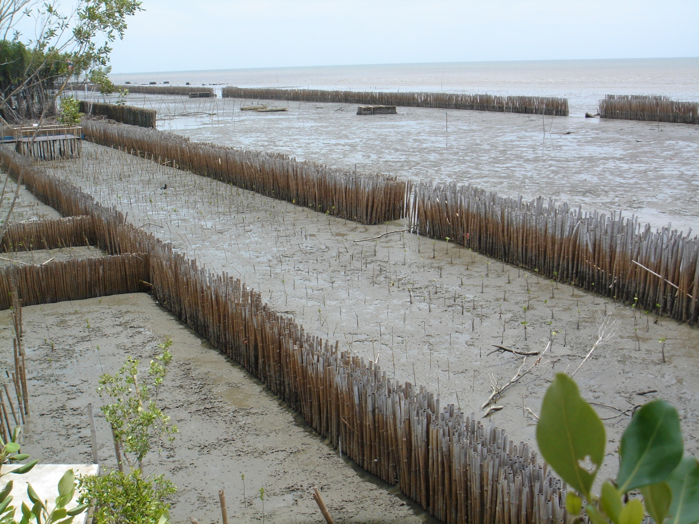
Climate Change Adaptation
"Adjustment in natural or human systems in response to actual or expected climatic stimuli or their effects, which moderate harm or exploit beneficial opportunities." The definition recognizes that humans can adjust to past ("actual") climate change and its impacts, or prepare for projected future ("expected") climate change and its impacts. Adaptation can include changes in behaviour, technology, institutions, policies, and other aspects of human systems. (IPCC Definition)

Slide 15
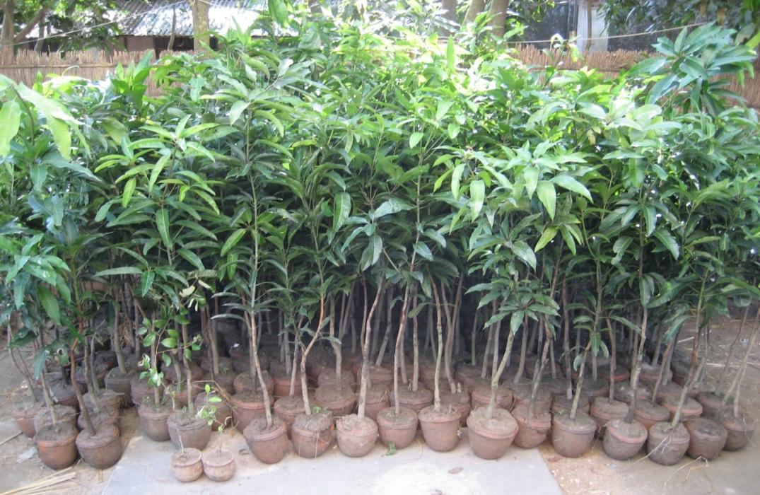
Climate Change Mitigation
Actions that reduce the sources of greenhouse gases, or enhance carbon sinks. Examples include using fossil fuels more efficiently for industrial processes or electricity generation, switching from oil to natural gas as a heating fuel, improving the insulation of buildings, and expanding forests and other sinks to remove greater amounts of carbon dioxide from the atmosphere. (UNFCCC)

Slide 16
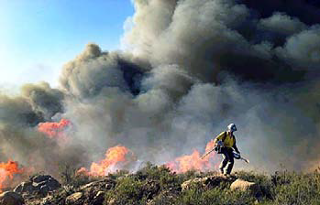
Hazard
A dangerous phenomenon, substance, human activity or condition that may cause loss of life, injury or other health impacts, property damage, loss of livelihoods and services, social and economic disruption, or environmental damage.

Slide 17
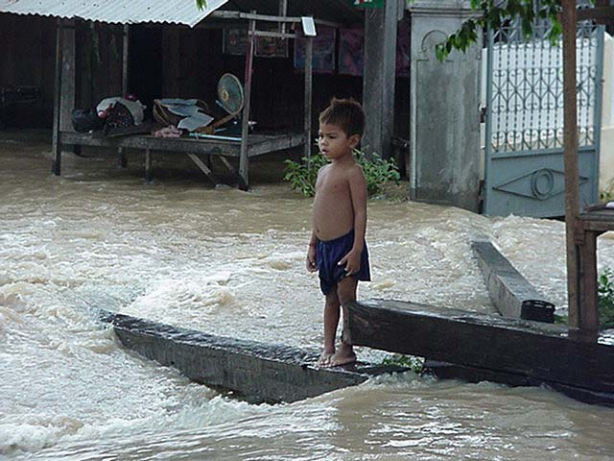
Exposure
People, property, systems, or other elements present in hazard zones that are thereby subject to potential losses.

Slide 18
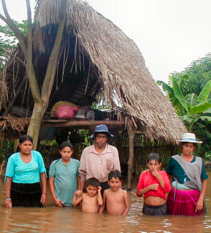
Vulnerability
The conditions determined by physical, social, economic, environmental and political factors or processes, which increase risk and susceptibility of people to the impact of hazards.
Notes:
The question that must always be asked is: “Vulnerable to what specific hazard or what specific shock?” For example, people living in coastal zones are vulnerable to seasonal storms, flooding and rising sea level. (Official IFRC definition) Climate change can cause changes in the environmental conditions that determine the risk of people to the impact of hazards and is therefore an important factor for vulnerability.

Slide 19
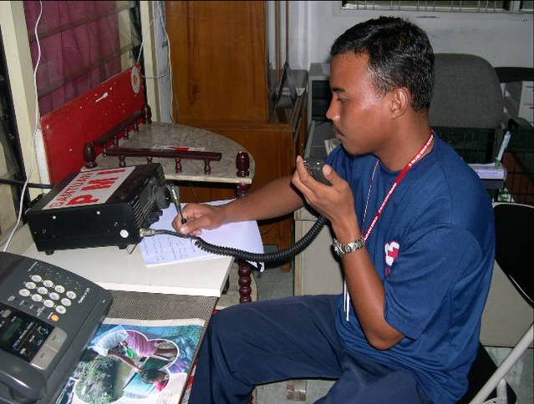
Capacity
The combination of all the strengths, attributes and resources available within a community, society or organization that can be used to achieve agreed goals.

Slide 20
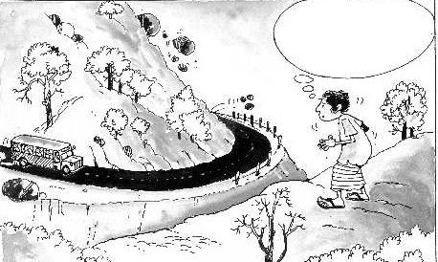
Risk
The combination of the probability of an event and its negative consequences

Slide 21
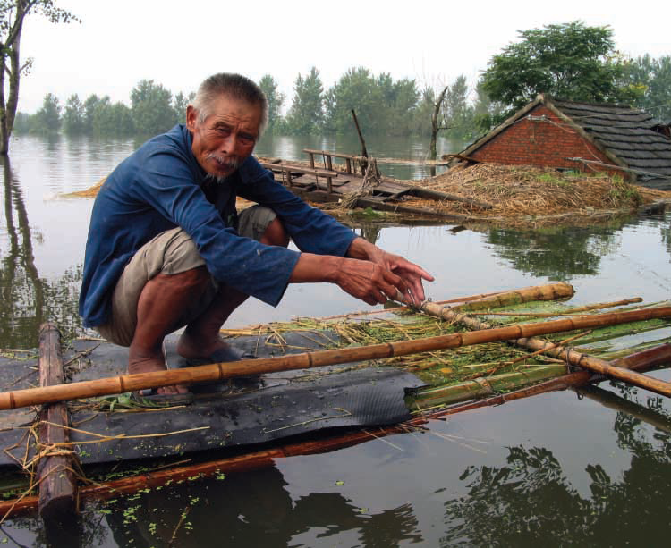
Climate Risks
The probability of harmful consequences or expected loss (e.g., death, injury, loss of livelihoods, reduced economic productivity, environmental damage) resulting from interactions between climate hazards, exposure to these hazards and vulnerable conditions (Adapted from United Nations International Strategy for Disaster Reduction [UNISDR], 2009).

Slide 22
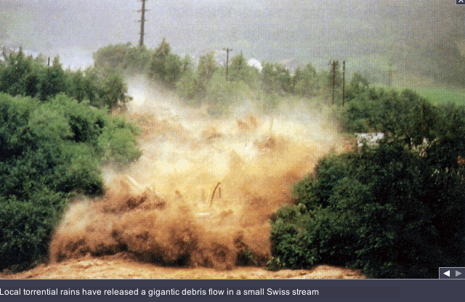
Disaster Risk
The potential disaster losses, in lives, health status, livelihoods, assets and services, which could occur to a particular community or a society over some specified future time period.

Slide 23
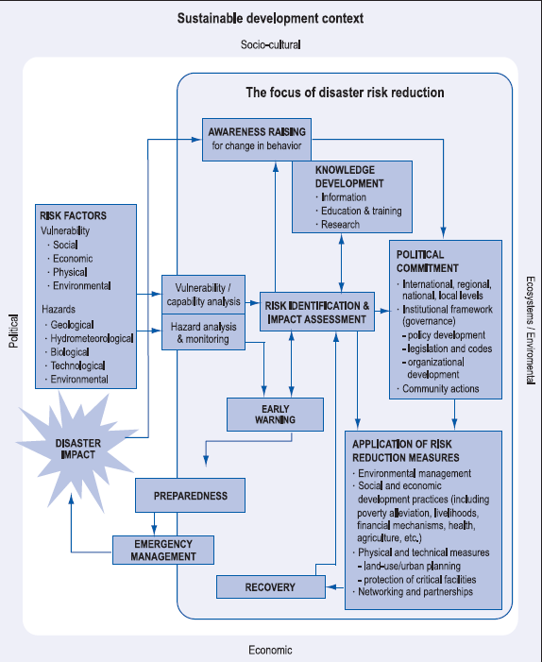
Disaster Risk Reduction
The concept and practice of reducing disaster risks through systematic efforts to analyse and manage the causal factors of disasters, including through reduced exposure to hazards, lessened vulnerability of people and property, wise management of land and the environment, and improved preparedness for adverse events.

Slide 24
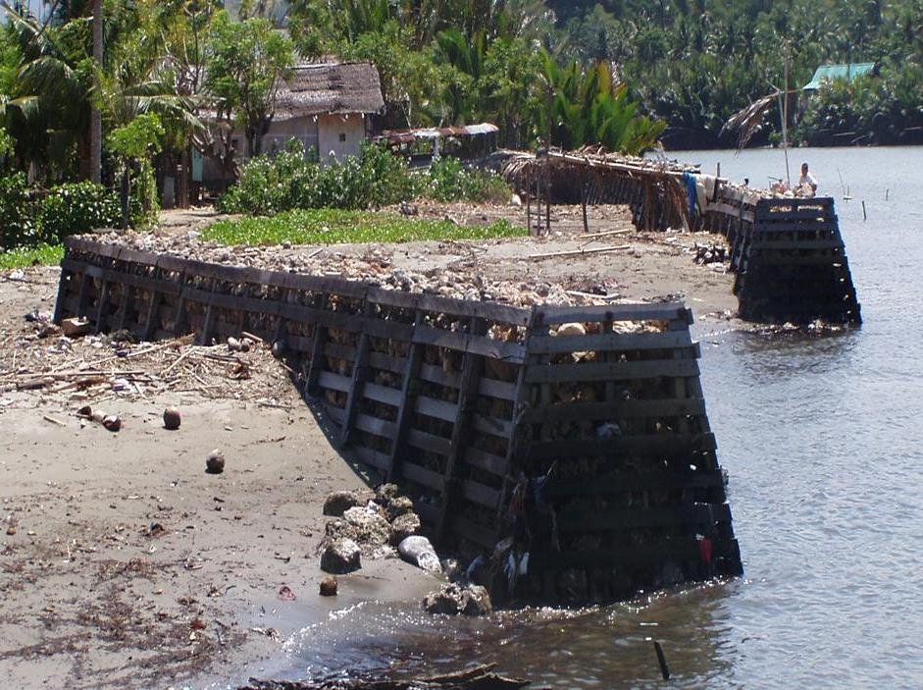
Disaster Mitigation
The lessening or limitation of the adverse impacts of hazards and related disasters.

Slide 25
Question
What is the difference between:
Disaster Mitigation and Climate Mitigation

Slide 26
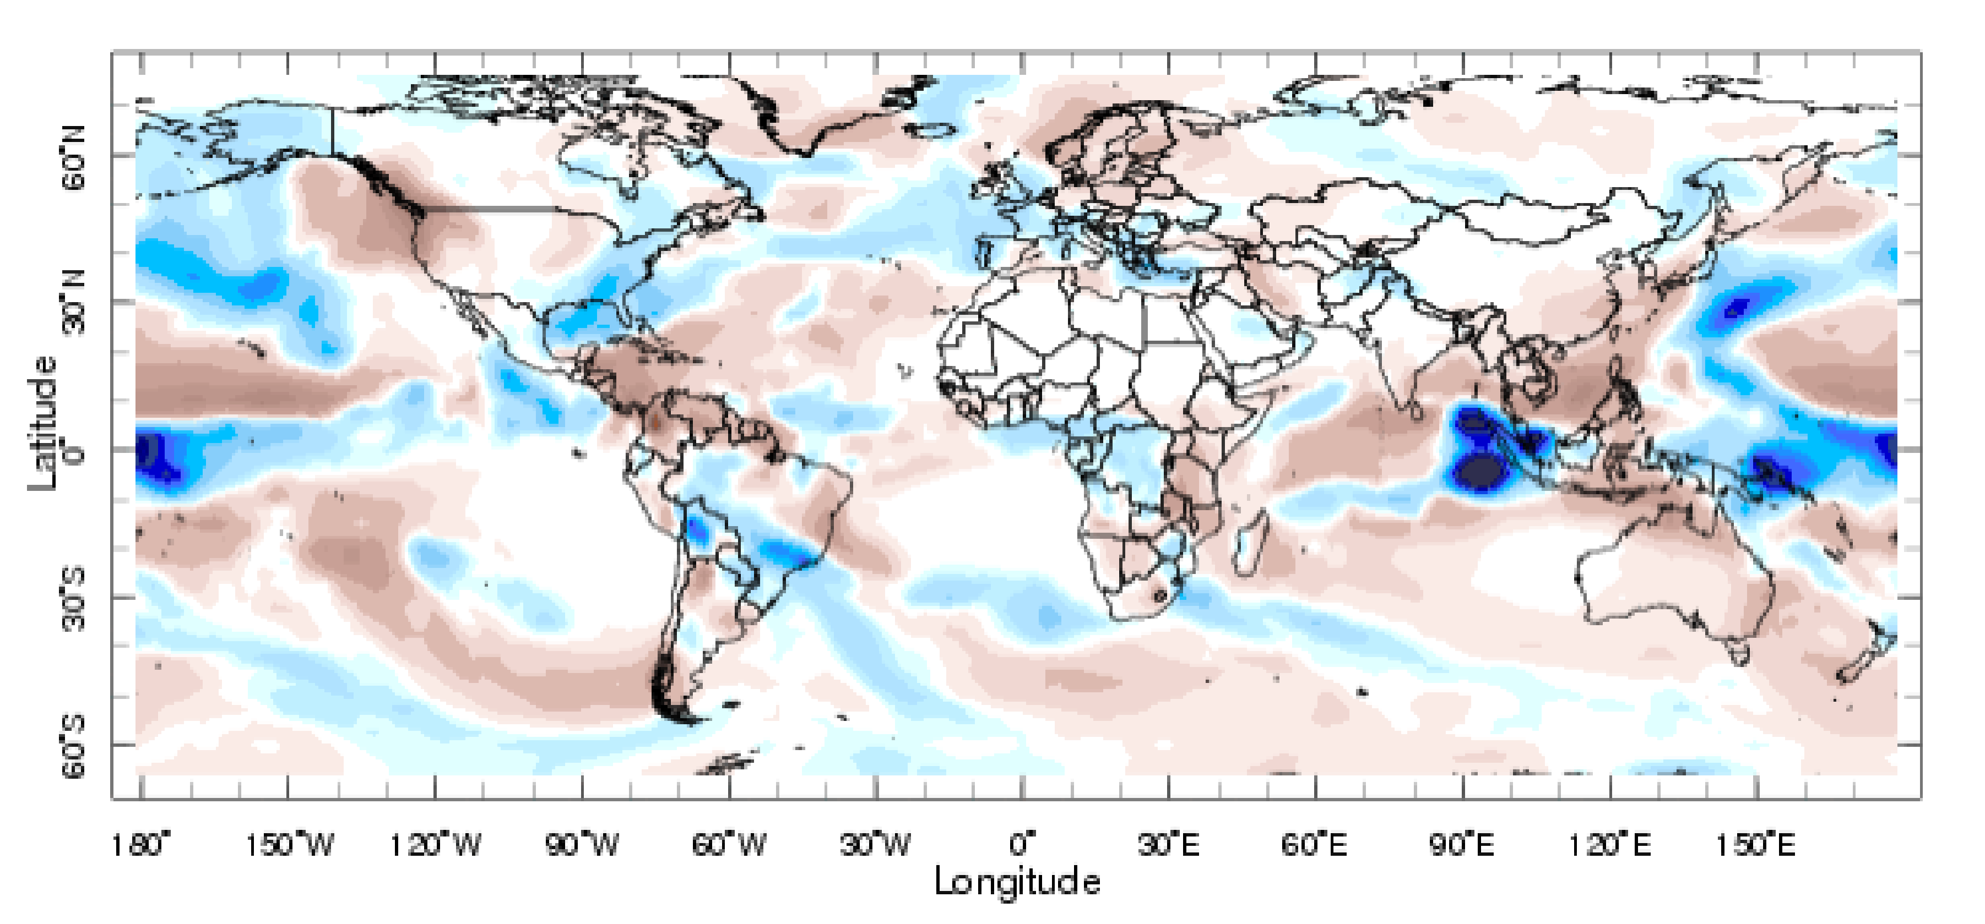
Forecast
Definite statement or statistical estimate of the likely occurrence of a future event or conditions for a specific area.

Slide 27
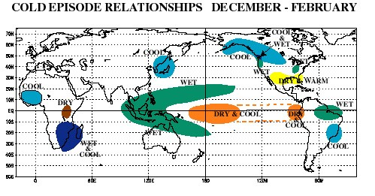
El Niño and La Niña (the Southern Oscillation)
A complex interaction of the tropical Pacific Ocean and the global atmosphere that results in irregularly occurring episodes of changed ocean and weather patterns in many parts of the world, often with significant impacts over many months, such as altered marine habitats, rainfall changes, floods, droughts, and changes in storm patterns.

Slide 28
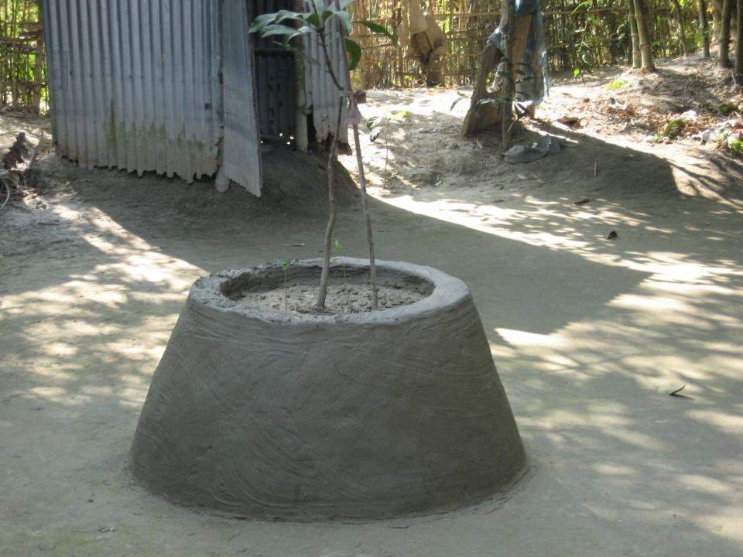
Climate Proofing
Modification of existing and future projects so that they are resilient to impacts from climate change and/or do not contribute to increased vulnerability of the projects goals (Klein et al., 2007)

Slide 29
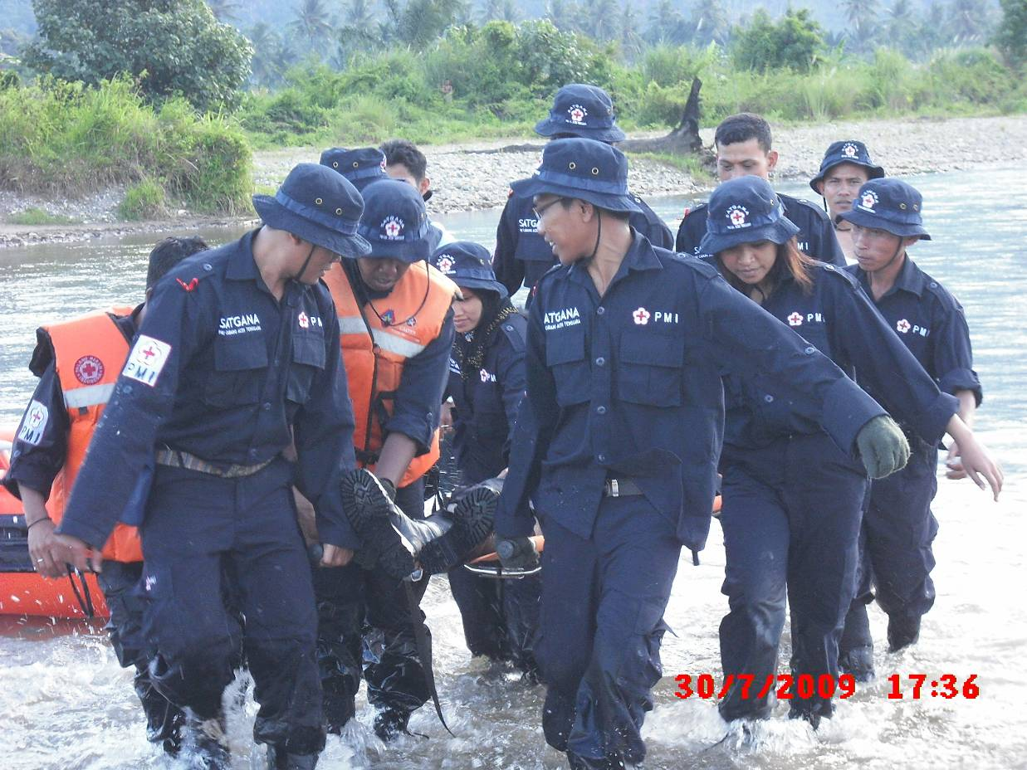
Adaptive Capacity
The ability of a system to adjust to climate change (including climate variability and extremes) to moderate potential damages, to take advantage of opportunities, or the consequences.

Slide 30
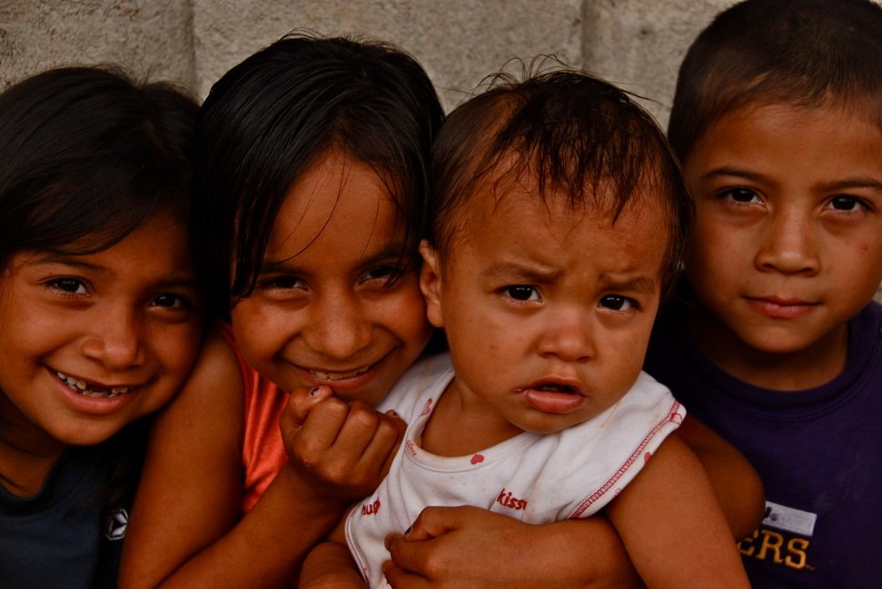
Epidemic
Refers to an increase, often sudden, in the number of cases of a disease above what is normally expected in that population in that area.

Slide 31
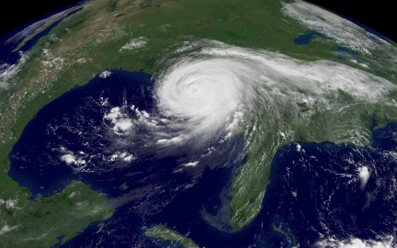
Vulnerability to Climate Change
The degree to which a system is susceptible to, or unable to cope with, adverse effects of climate change, including climate variability and extremes

Slide 32
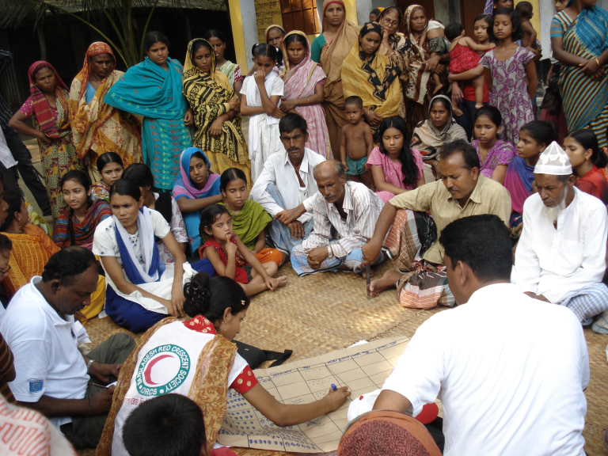
Risk Assessment
A methodology to determine the nature and extent of risk by analysing potential hazards and evaluating existing conditions of vulnerability that together could potentially harm exposed people, property, services, livelihoods and the environment on which they depend.

Slide 33
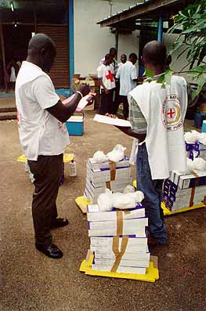
Preparedness
The knowledge and capacities developed by governments, professional response and recovery organizations, communities and individuals to effectively anticipate, respond to, and recover from, the impacts of likely, imminent or current hazard events or conditions.

Slide 34
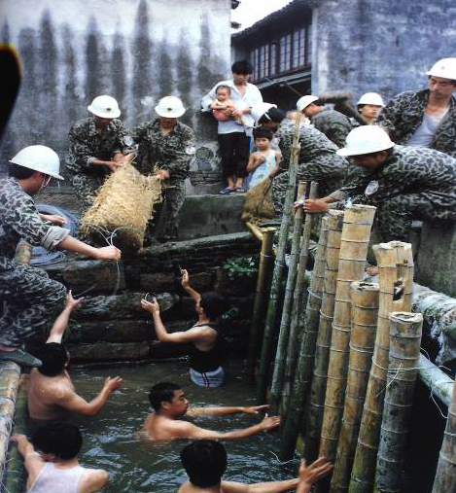
Coping Capacity
The ability of people, organizations and systems, using available skills and resources, to face and manage adverse conditions, emergencies or disasters

Slide 35
Environmental Impact Assessment
Process by which the environmental consequences of a proposed project or programme are evaluated, undertaken as an integral part of planning and decision making processes with a view to limiting or reducing the adverse impacts of the project or programme.

Slide 36
Early Warning System
The set of capacities needed to generate and disseminate timely and meaningful warning information to enable individuals, communities and organizations threatened by a hazard to prepare and to act appropriately and in sufficient time to reduce the possibility of harm or loss.

Slide 37
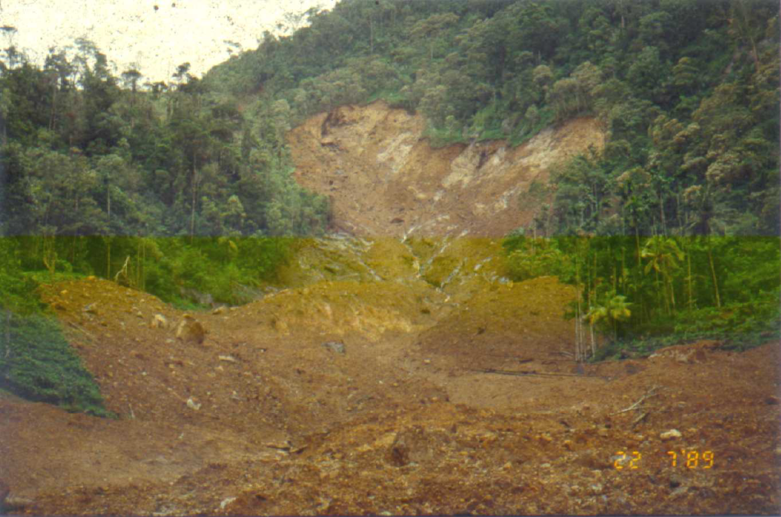
Environmental Degradation
The reduction of the capacity of the environment to meet social and ecological objectives and needs.

Slide 38
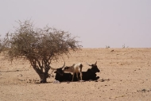
Climate Hazards
A potentially damaging hydro-meteorological event or phenomenon; they can be events that have an identifiable onset and termination, such as a storm, flood or drought, as well as more permanent changes, such as shift from one climatic state to another (United Nations Development Programme [UNDP], 2005).

Slide 39
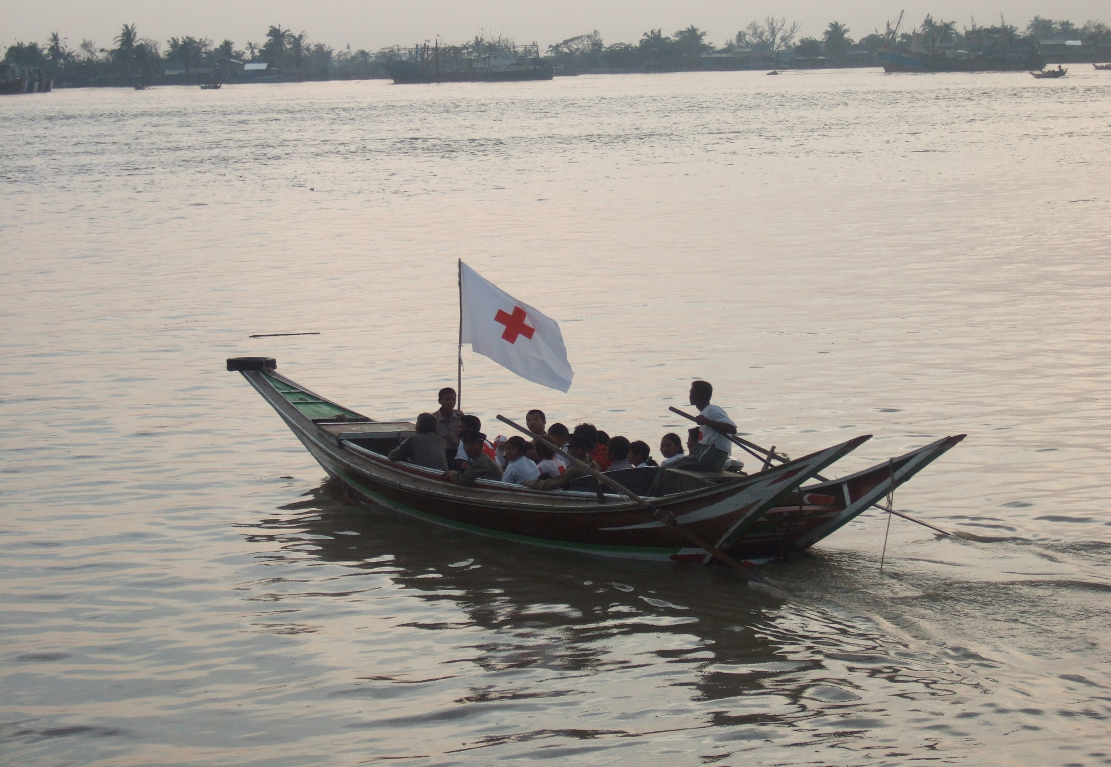
Climate Variability
Variations (ups and downs) in climatic conditions from long-term means on time scales beyond that of individual weather events. Variability may result from natural internal processes within the climate system (internal variability) or to variations in natural or anthropogenic external forcing (external variability) (Adapted from IPCC, 2001).

Slide 40
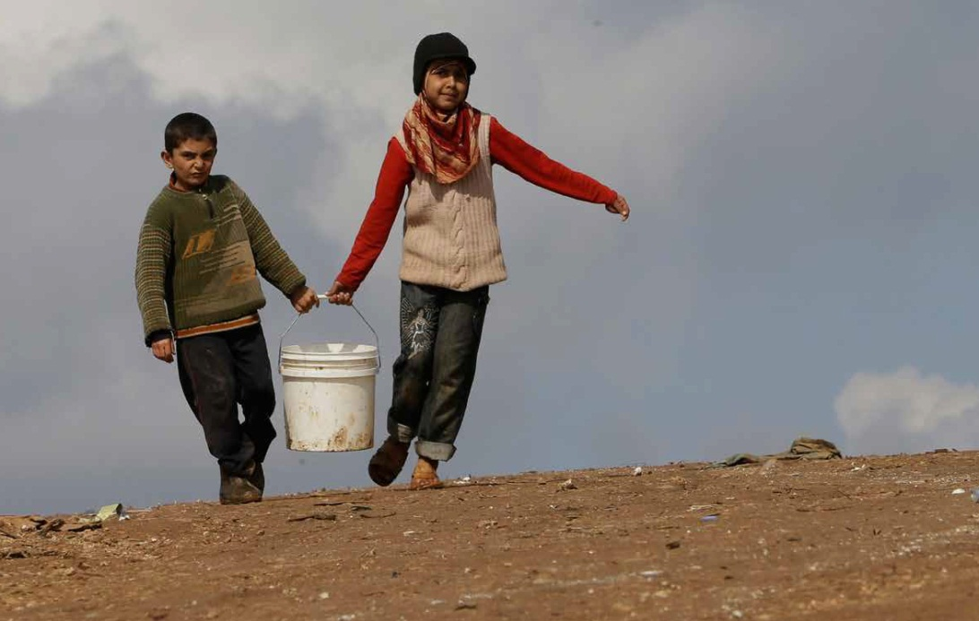
Climate Impacts
The effects of climate hazards and climate change on natural and human systems (Adapted from IPCC, 2012).

Slide 41
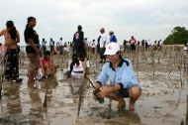
Climate Risk Management
The systematic approach and practice of using climate information in development decision-making to minimize potential harm or losses associated with climate variability and change (Adapted from UNISDR, 2009

Slide 42
Challenge Question (5 Points)
Identify other terminologies which are considered to be important to be added
Explain why they are important based on the National Societies, DRR and CCA Context

Slide 43
Let’s tally the points…
1 | 2 | 3 | 4 | 5
Team
Points

