Slide 1
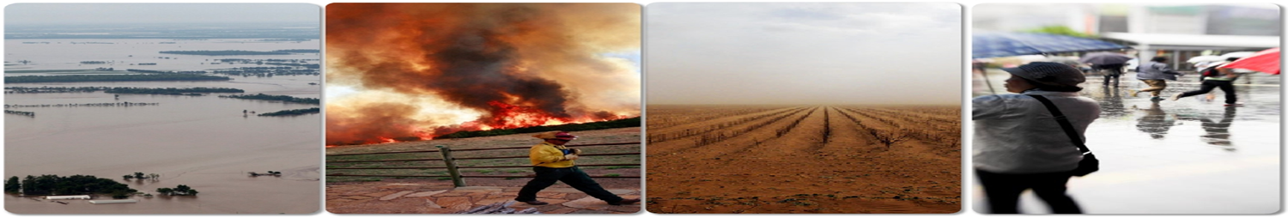
Health and Climate Change

Slide 2
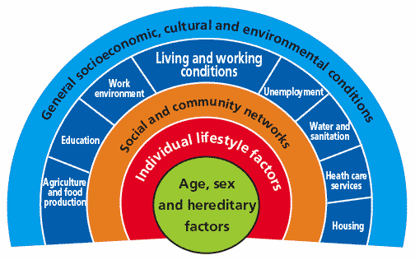
Determinants of health
Person’s individual characteristics and behaviors
Physical environment
Social and economic environment
Source: www.who.int/hia/evidence/doh/en/
Notes:
Many factors combine together to affect the health of individuals and communities. The context of people’s lives determine their health, and so blaming individuals for poor health or crediting them for good health is inappropriate.
For details: www.who.int/hia/evidence/doh/en/

Slide 3
Potential impacts of climate change
  Extreme weather events
    Temperature
    Storms / floods
  Drinking water supply issue & water borne disease
  Drought
  Food production and security
  Food born diseases
  Vector-borne diseases
  Poor Air quality
  Social impacts
Source: www.who.int/hia/evidence/doh/en/
Notes:
Many factors combine together to affect the health of individuals and communities. The context of people’s lives determine their health, and so blaming individuals for poor health or crediting them for good health is inappropriate.
For details: www.who.int/hia/evidence/doh/en/

Slide 4
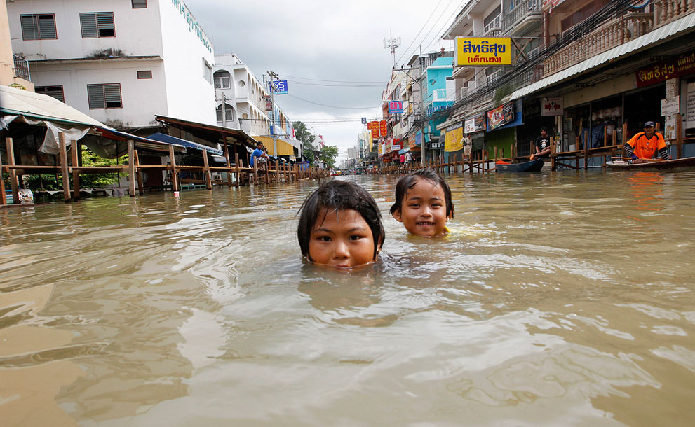
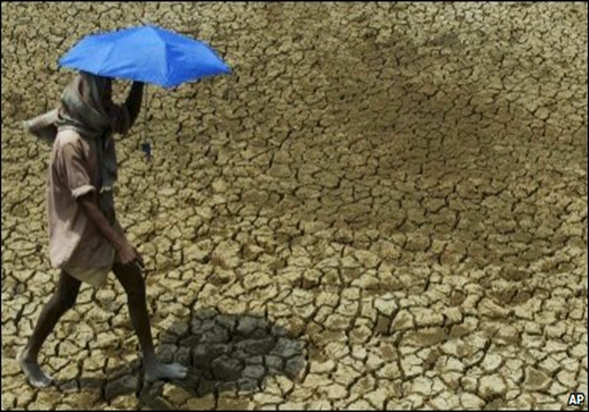
Water
Both extremes can have health effects
Too much
Too little

Slide 5
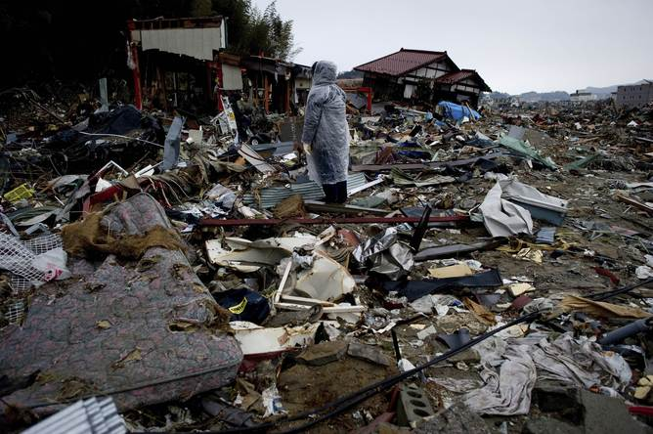
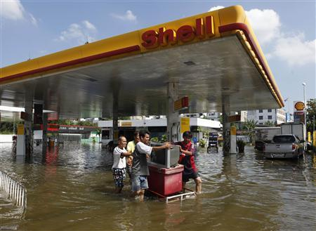
Health Impacts of Floods
Immediate deaths and injuries
Non-specific increases in mortality
Infectious diseases – leptospirosis, hepatitis, diarrhoeal, respiratory, and vector-borne diseases
Exposure to toxic substances
Mental health effects
Increased demands on health systems & damage water supply system
Destruction of food product & storage food
Loss of properties
Notes:
As indicated on this slide, the effects of flooding extends beyond immediate deaths and injuries

Slide 6
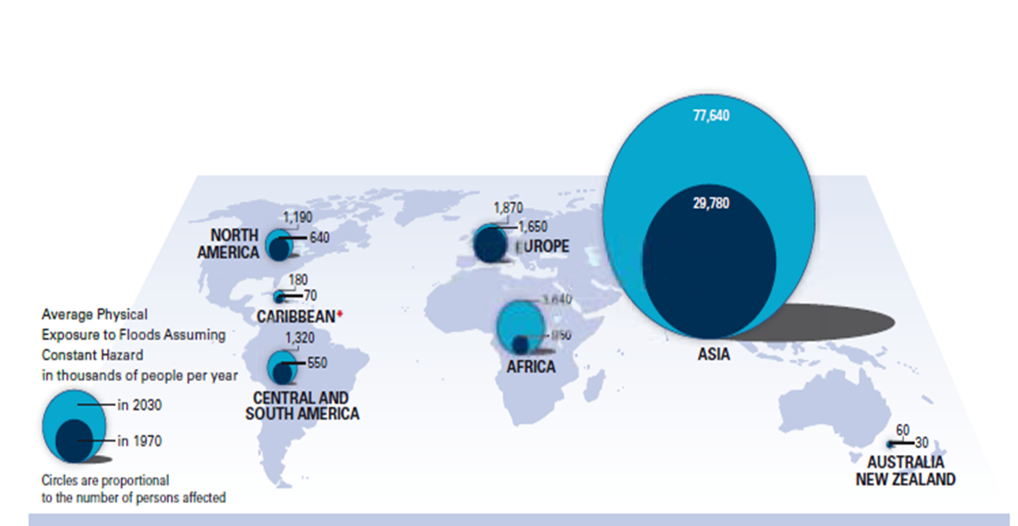
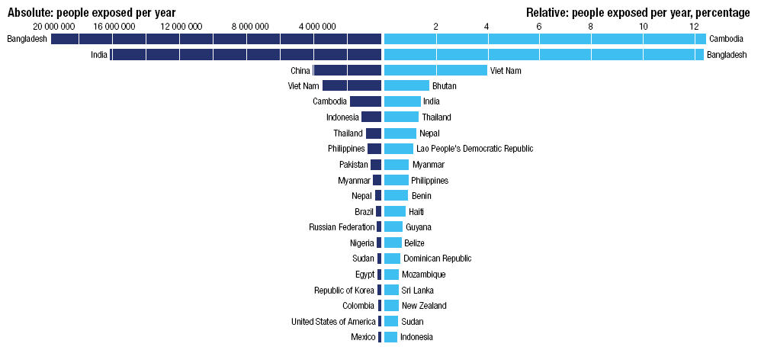
Storms / Flooding
Flooding is heavily concentrated in Asia
From: Environment Solutions: www.environmentsolutions.dk

Slide 7
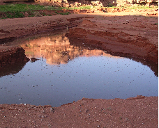
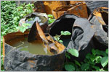
Rain, temperature and humidity
Rain
Increase breeding sites for mosquitoes
Humidity
Mosquito survival
Temperature
Parasite development rates

Slide 8
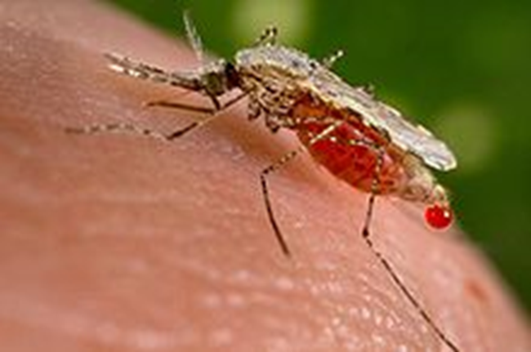
Vector - borne diseases
Dengue Fever

Slide 9
Biological Amplification
A mere half degree centigrade increase in temperature can bring about a 30 – 100% increase in mosquito abundance.

Slide 10
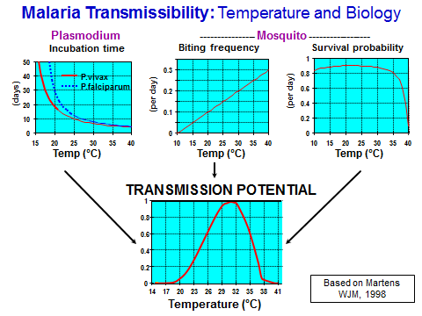

Slide 11
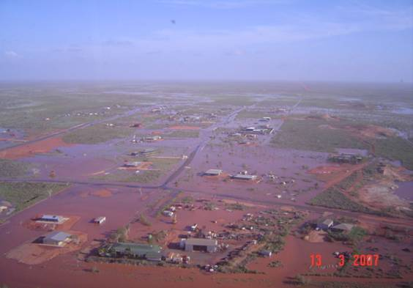
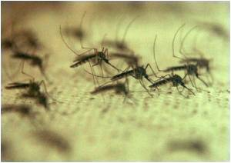
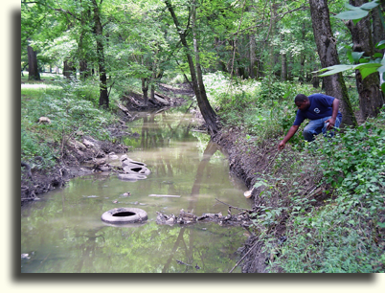
Mosquito-borne-disease: Environmental Changes
Distribution of vectors will change arising from:
Increasing temperature
Changing rainfall:
  Increase or decrease
  Seasonality
Cyclones, flooding
Rising sea levels
Extreme tides
Loss of coastal margins.

Slide 12
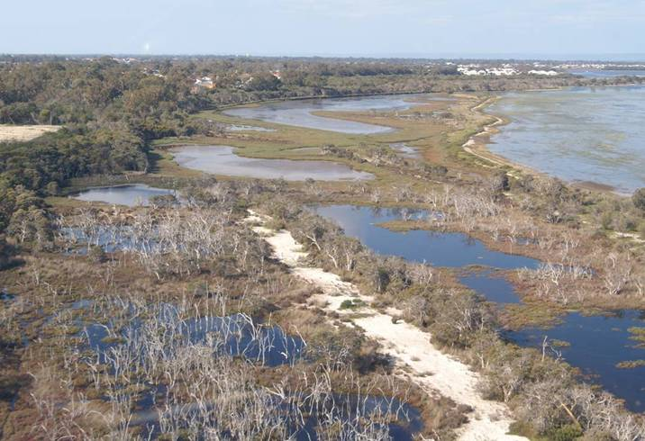
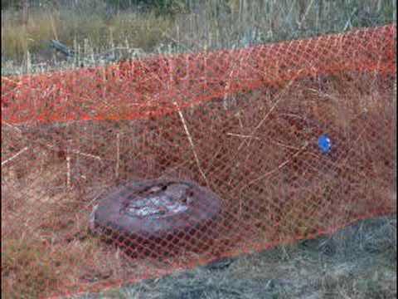
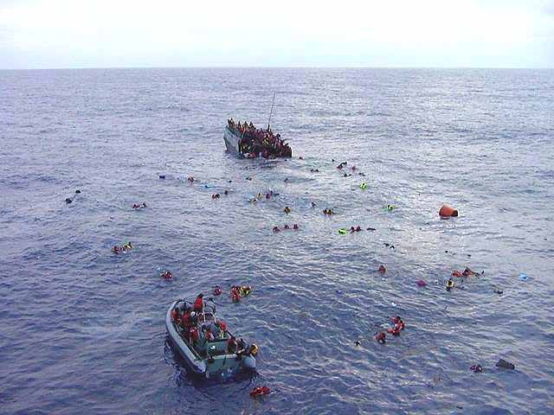
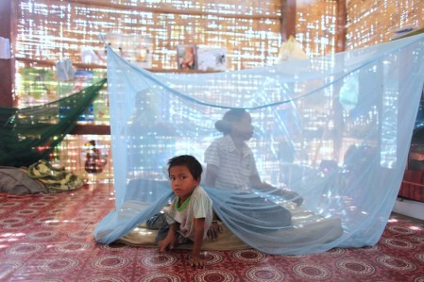
Mosquito-borne-disease: Human Factors
Location of population:
  Geographic location
Urban environment:
  Peri-domestic breeding
Mobility of population
  Arrival of infected people
    International
    Interstate
    Intrastate
Living standards:
  Insect screens, air conditioning

Slide 13
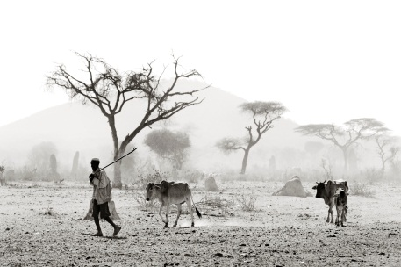
Potential impact: Drought

Slide 14
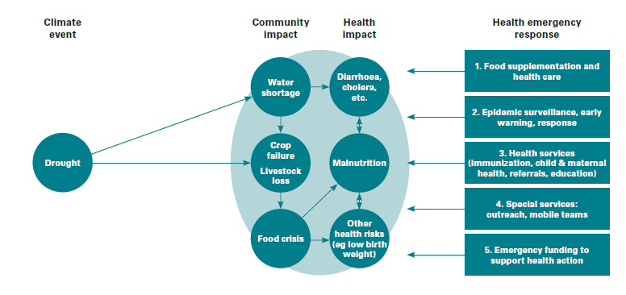
Drought

Slide 15
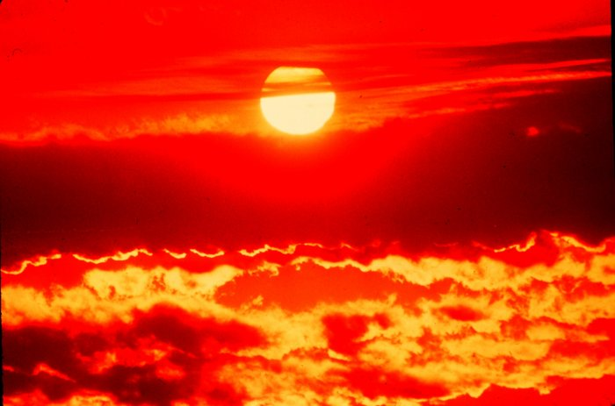
Heat waves
Vulnerable people:
Elderly people, infants , people with other chronic
diseases ( heart, respiratory, cancer)
Manual Labors

Slide 16
Impacts to Health from Increased Temperatures
Direct impacts to health:
  Heat cramps – muscular pains and spasms
  Heat exhaustion – body fluids are lost through heavy sweating
  Heat stroke – is life threatening.
Indirect impacts:
  Includes impacts on ecosystems, water, food, disease-carrying vectors, lifestyle, community resilience.

Slide 17
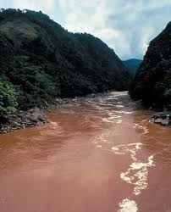
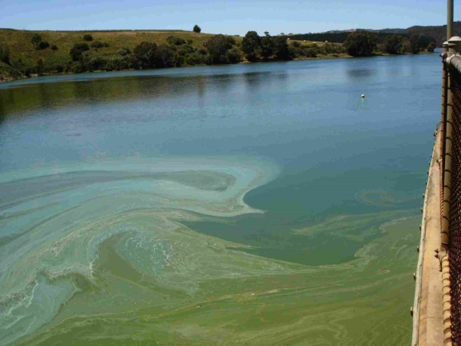
Drinking Water Supply
Reduction in flows to dams and groundwater aquifers
Increased evaporation from surface water storages
Salt water intrusion into coastal aquifers
Acidification of susceptible inland aquifers
Increased risk from the:
  Concentration of chemical contaminants
  Formation of toxic algal bloom

Slide 18
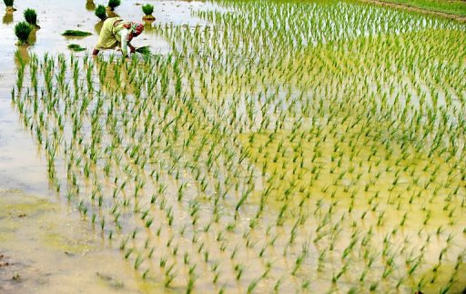
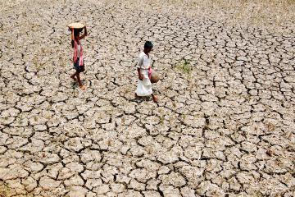
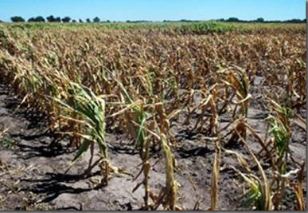
Food Production: Land
Land based agriculture:
Food production, loss of soil fertility, erosion and salinization:
  Changes in crop yields and protein levels (+/-)
  Effects on feed intakes and animal reproduction
  Changes to pests, weeds and diseases
  Changes to use of agrochemicals
Dietary and nutritional changes

Slide 19
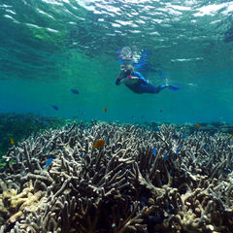
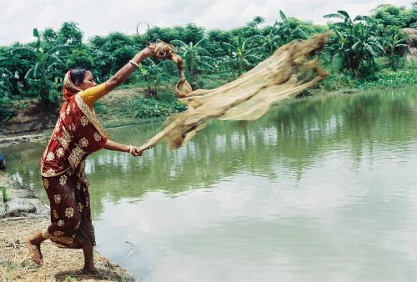
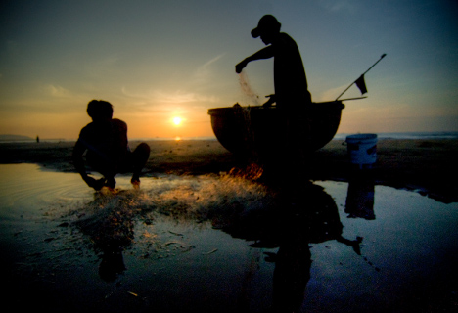
Food Production: Fisheries
Oceanic and coastal fisheries:
A change in coastal circulation patterns
can affect:
  Nutrient supply
  Coastal erosion
  Ocean acidity
  Decline in productivity.

Slide 20

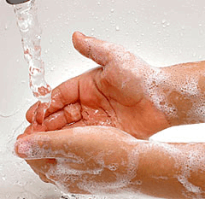
Food Safety
Food borne disease may cause food poisoning:
  May increase the proliferation of bacterial pathogens including eg . Salmonella.
  May increase mycotoxins and alfatoxins in seafood.

Slide 21
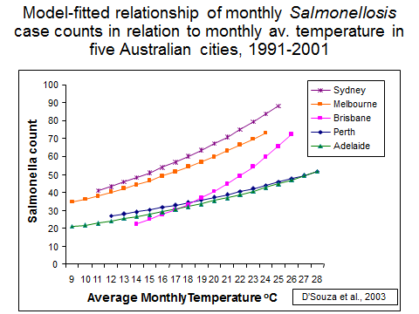

Slide 22
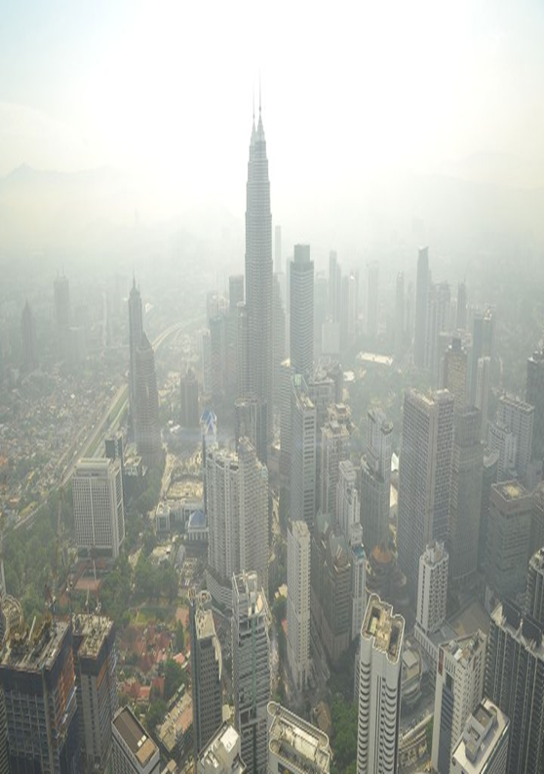
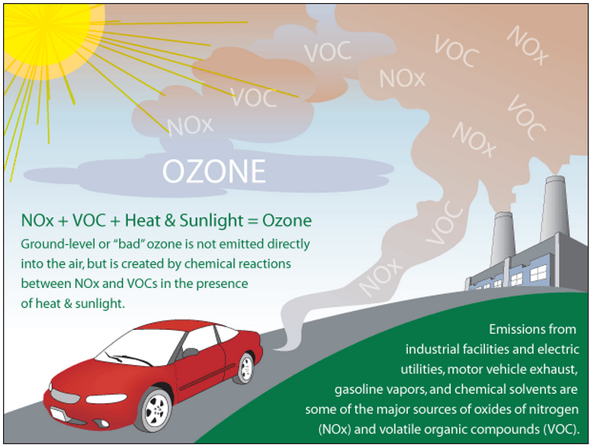
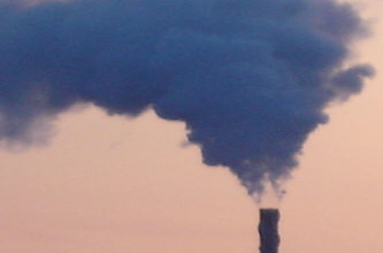
Air Quality
Notes:
The formation of many air-pollutants is determined in part by climate factors such as temperature and humidity. Climate change may therefore influence pollutant concentrations, which in turn may affect health as air pollution is related to cardio-respiratory health.
Exposure to high levels of ground-level ozone, for example, which is formed from the exhaust of transport vehicles, industrial emissions, increases the risk of exacerbations of respiratory diseases such as chronic obstructive airways disease and asthma, leading to hospital admissions or increased mortality.
“Peak ambient O3 concentrations are typically observed in summer months, when higher temperatures and increased sunlight enhance O3 formation and also lead to increased emissions of biogenic and fugitive anthropogenic hydrocarbons, important precursors of O3 formation. Above 90°F (32°C), a strong positive association has been found between temperature and ground-level O3 production (Patz 2000). Numerous epidemiology studies have reported associations between O3 and hospital admissions or emergency visits for respiratory conditions, diminished lung function, and a variety of other health outcomes(Kinney 1999; Koken et al. 2003). A relatively recent but growing body of literature also has documented acute effects on mortality in large cities, in many cases while controlling for particulate matter and other pollutants (Dominici et al. 2003; Hoek et al. 1997; Moolgavkar et al. 1995; Thurston and Ito 2001; Vedal et al. 2003).” – Knowlton et al 2004

Slide 23
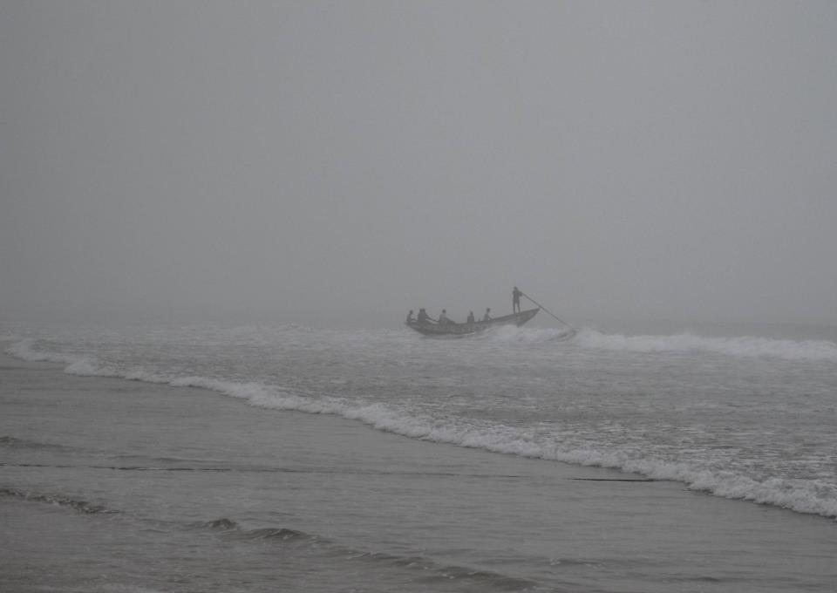
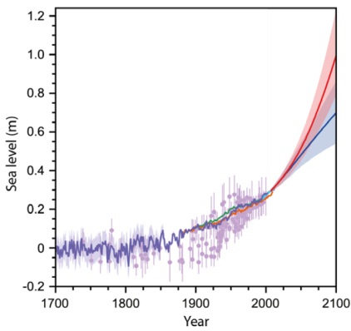
Potential impacts: Oceanic changes
Sea levels are rising – at a faster rate
Sea level rise
NOW

Slide 24
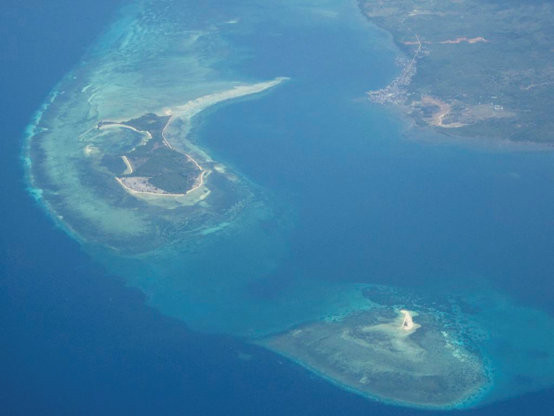
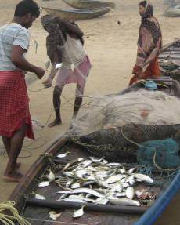
Potential impacts: Oceanic changes
Large scale degradation and/or
loss of coastal and
marine ecosystems
the oceans are becoming more acidic
sea surface temperatures are increasing
... and fish stocks decline, eroding livelihoods for millions of people
Ocean acidification damages coral reefs – reducing their coastal protection effects

Slide 25
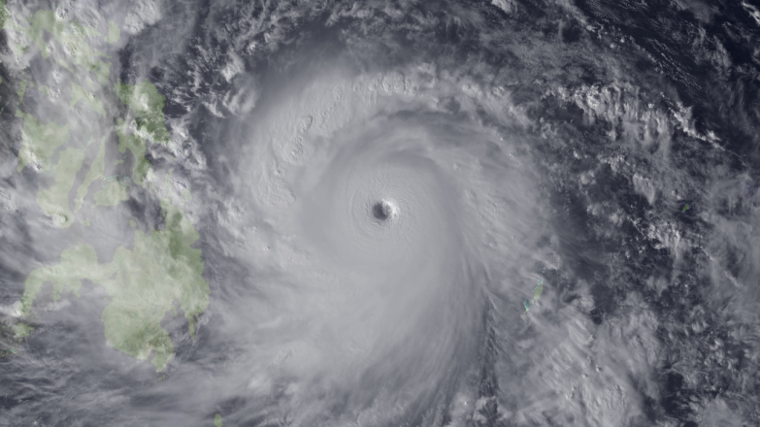
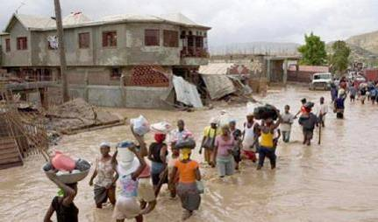
Potential impact: tropical cyclones impacts
IFRC
Source: NOAA

Slide 26
POTENTIAL HEALTH IMPACTS OF EXTREME EVENTS
Impact type | Health impact | Potential impact pathway
Direct Impacts to Humans | Fatigue , injuries Heat stress | • Direct physical injuries from extreme events. • Direct temperature related effects from heatwaves.
Natural Environment
Water borne | Gastro-intestinal diseases Diarrhoea, vomiting | • Run-off events from heavy rainfall – risk of contamination by disease pathogens such as Cryptosporidium spp. • Contamination from wildlife and stock deaths in drought, bushfires.
water supply | water stress | • Effect on quantity and quality of water to reservoirs - increase sediment, nutrient and debris flow. • Changes to land cover–change in runoff patterns.
Vector borne | Dengue , Malaria | • Extreme events will impact on the complex ecological cycles of the diseases, as well as our ability to respond. Direction of impacts likely to be positive and negative. • Changes to climate may allow exotic diseases and vectors to establish.

Slide 27
Impact type | Health impact | Potential impact pathway
Food borne | Food poisoning | • High temperatures may increase proliferation of bacterial pathogens including Salmonella, Campylobacter and Listeria spp. • Heavy rainfall events – increased risk of Cryptosporidiosis. • Temperature increase may cause increase in mycotoxins and aflatoxins.
Food production | Changes to diet | • All extreme events particularly in relation to reduced water from rainfall, destroy or damage a wide range of crops and livestock – changes in cost and availability of food.
Air quality | Respiratory effects Asthma Allergic reactions | • Bushfires – increase air pollutants. • Droughts/wind – increase dust. • Heat events – increase smog. • Links between high temperature and ground ozone levels.
Biodiversity | Very difficult to determine. Impacts on ecological goods and services | • wide range of potential impacts on biodiversity, particularly drought and bushfires.
Other | Chemical exposure | • Damage to chemical pipelines, storage. • Drought increases concentration of soil and water contaminants.

Slide 28
Impact type | Health impact | Potential impact pathway
Built environment
Infrastructure and essential services | Physical injuries Reduced access to health care, food, water Exposure to chemicals, fires, explosions, micro-organisms | • Damaged infrastructure/buildings. • Damaged transport systems, energy, water, wastewater, communication. • Off-shore petroleum platforms, pipelines (chemical, gas, water), storage facilities. • Inability to meet increased demand for energy, water, health services. • Breakdown of equipment/computers/ machinery – impact on all services.
Social environment
Dislocation | Psychological stress of loss of home, community | • Damage to property, homes. • Repeated events – permanent dislocation is possible.
Mental health | Traumatic stress conditions | • Experience of extreme event.
Community | Reduction in sense of community Loss of goods and services | • Negative impacts particularly from repeated extreme events and gradual nature of drought.
Lifestyle / behavioural | Increase in crime, involving aggression Increase in accidents – workplace | • Heat waves – hot nights – sleep deprivation. • Times of crisis such as drought and floods – physical health often neglected.

Slide 29
Impact type | Health impact | Potential impact pathway
Economic | Stress from loss of income and loss of assets. Reduction of goods and services Inability to insure assets | • wide range of economic pathways. Loss of income from damage to crops, property, infrastructure such as transport. • Increased cost of insurance, food. • Cost of rebuilding. • Higher maintenance and construction costs with more extreme weather.

Slide 30
Climate Change & Health Impact
Health System Conditions
Social Conditions (upstream determinants of health
Environmental Conditions
Direct Exposures
Indirect Exposures
(Changes in food quality, disease vectors, ecosystem changes)
Health Impacts
Climate Change
Changes in Social Disruption

Slide 31
Climate Change and Health
Health effects
Temperature-related illness and death
Extreme weather- related health effects
Air pollution-related health effects
Water and food-borne diseases
Vector-borne and rodent- borne diseases
Effects of food and water shortages
Effects of population displacement
CLIMATE
CHANGE

Slide 32
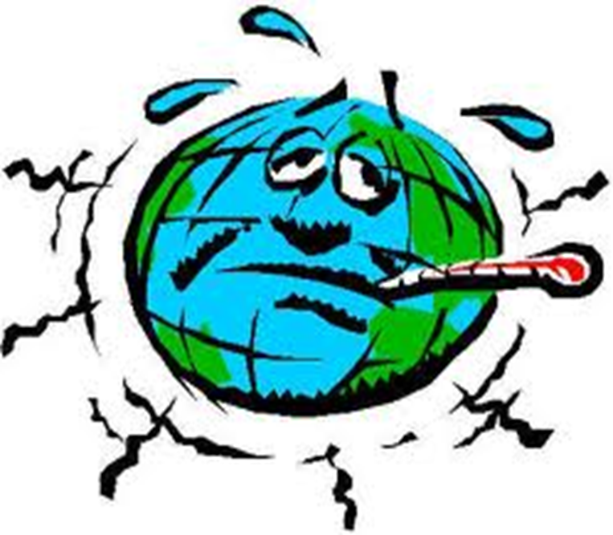
Global Warming

Slide 33
EARLY WARNING EARLY ACTION
For health effects?
Focus surveillance efforts at areas predicted to be at particularly high risk for changing patterns of disease
  Vector-borne diseases ( malaria, dengue )
  Water – borne diseases ( Diarrhoea )
Notes:
Early warning, early action means making use of climate and weather information before a health emergency strikes and act sooner than you would do without this information.
We often have some information ahead in time of the upcoming disaster event such as flooding, tropical storms and heatwaves, and that information can be interpreted and used to prepare the emergency operation better.
Disease surveillance is an epidemiological practice by which the spread of disease is monitored in order to establish patterns of progression.
So in the ‘Early Warning, Early Action’ approach we make full use of climate information – and we act in a way that prepares us better as a whole, but also with a more strategic approach to health emergency response.

Slide 34
Notes:
The 2008 actions of the West and Central Africa Zone (WCAZ) provide a model for the Movement to improve and scale-up the use of climate information, allowing translation of early warnings into early action for better disaster management and response. Some of the great ways the WCAZ utilized seasonal forecasts for life saving early action include:
Employing “no-regrets” strategies to focus and plan for probable (but not certain) events.
Monitoring forecasts on multiple time-scales, to reduce uncertainty in longer-term outlooks.
Consulting multiple sources of forecast information for greater scientific consensus, including ACMAD (African Centre of Meteorological Application for Development)
Utilizing tools that combined the seasonal precipitation forecast with hydrology for flood risk mapping (important since a precipitation forecast is not a flood forecast).
Holding a meeting with key stakeholders to develop preparedness strategies.
Issuing the first-ever Preliminary Emergency Appeal, and initiating changes that now make funds from the Disaster Response Emergency Fund (DREF) available for preparedness activities.

Slide 35
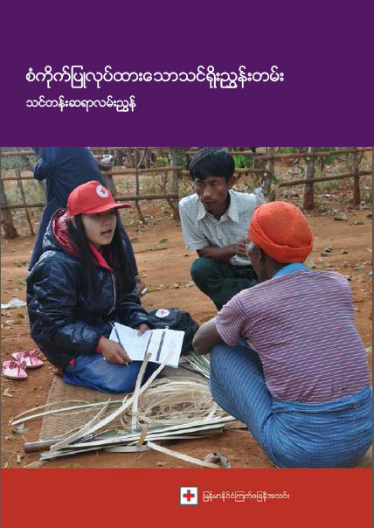
Epidemic Control for Volunteers
Toolkit
- and -
Training
Manual

Slide 36
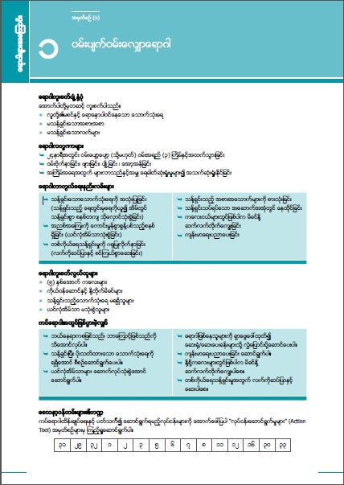
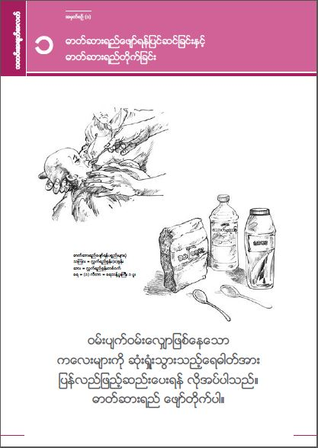
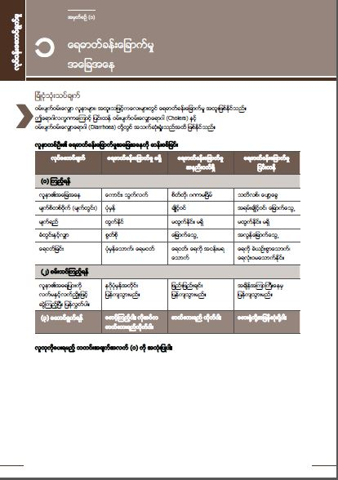

Epidemic control
tools for volunteers
13 disease tools
35 actions tools
25 community message
tools
1 ECV facilitator Guide
4 modules (Manual)
  1. Introduction to epidemics
  2. Principles of epidemic control
  3. Actions in epidemic control
  4. Using the epidemic control toolkit

Slide 37
How to use ???

Slide 38

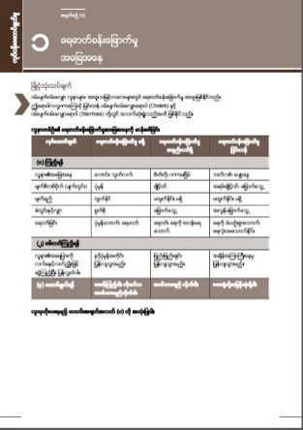
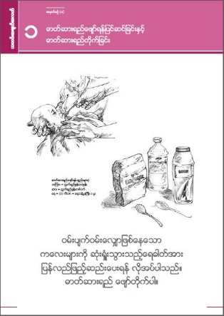
When to use ?????
Preparedness Phase
Alert Phase
Epidemic Control Cycle
Community Action Plan
Evaluation Phase
Epidemic Phase

Slide 39
Preparedness Phase
Community Assessment
Develop Community Action Plan
Collection of resources
Training and Awareness Session in Community
Health Promotion and Health Education
Define Communication Channel

Slide 40
Alert Phase
Epidemic Assessment
Develop detail Plan of Action
Conduct refresher course for volunteer
Collection of resources
Active Surveillance and new case detection
Inform to health authorities and local authorities
Coordination with community, local authorities and health authorities
Health Promotion and Health education

Slide 41
Response Phase
Health Promotion
Prevention of spreading
Case Management and referral
Psycho-social support to community and volunteers
Coordinate with local and health authorities

Slide 42
Evaluation Phase
Health Promotion
Follow up people in community f0r new case
Evaluate the action during the epidemic
Lesson Learnt
Planning for the next time

Slide 43
Two Major Areas
1. Mitigation
2. Adaptation

Slide 44
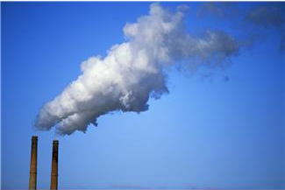
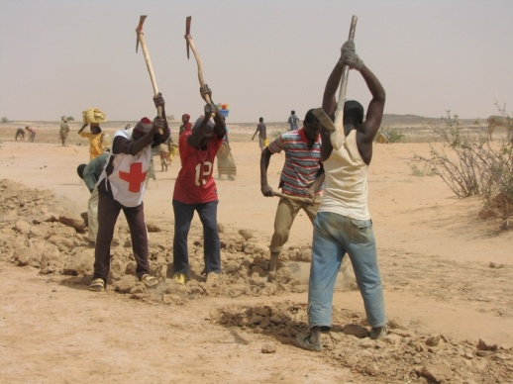
‘ Mitigation ’ and ‘ Adaptation ’
Mitigation:
Tackling the causes of climate change
Adaptation:
Adjusting and preparing for change
Photo: IFRC
Main focus for
humanitarian work
Strategy 2020
“We also contribute to mitigating the progression of climate change
through advocacy and social mobilization to promote sustainable community development that optimizes communities’ carbon footprints”
Strategy 2020
“Our climate change adaptation work is through scaling up disaster risk reduction measures and strengthening traditional methods of coping with disasters that are relevant in particular environmental contexts”

Slide 45
Health impact pathway – opportunities for adaptation
Flood zones , flood prevention and mitigation
Improve design of waste water systems to reduce risk of overflow
Extreme Rainfall
Flooding
Overflow of waste water
Reduce contact with flood water. Evacuation/physical barriers education
Human contact with flood water
Medical treatment
Gastro-intestinal illness

Slide 46
Health Targets of Sendai Frame Work By 2030
Substantially reduce
(1) Disaster mortality
(2) The number of affected people
(3) Direct disaster economic loss
(4) Disaster damage ( infrastructure , basic health
services and health & educational facilities)

Slide 47
We have to do ,
Enhance DRR and Resilience of health system
Capacity Building for preparedness and response
Strengthening design and implementation of inclusive policy
Partnership and the Role of Stakeholder and Disaster
preparedness

Slide 48
The Red Cross / Red Crescent commitments
Raise awareness on climate change
Provide humanitarian assistance
Improve capacity to respond
Decrease vulnerability of communities most strongly
affected
Integrate climate risk management into policies and plans
Mobilize human and financial resources, giving priority to actions for the most vulnerable

Slide 49

THANK YOU

