Slide 1
Putting communities at the center of advocacy Regional Resilience Workshop, February 2015

Slide 2
What is beneficiary communication?
Provision of information
and
dialogue & giving a voice
and
connectivity
Action and analysis

Slide 3
Why beneficiary communication?
Relevance and effectiveness
Aid/services targeted according to needs &inclusive of vulnerable groups
Transparency and accountability
Providing accurate, timely and accessible information enables communities to make informed decisions
Detection of errors, fraud, mismanagement of aid, abuse
Trust and security
Open dialogue is a mark of respect and builds trust and acceptance of programmes among communities
Empowerment and sustainability
Participation and engagement in decision-making empowers communities and recognises them as experts and advocates
Programmes can be more responsive by making necessary improvements or adjustments based on feedback
Provides a sense of ownership over projects, creating continuity and longer lasting impact
This can improve safety of staff operating in insecure environments
Notes:
Relevance/effectiveness - Aid is targeted according to needs, and inclusive of vulnerable groups (Improves targeting of humanitarian and development programmes by ensuring that goods and services are relevant to people’s needs, and take into account the interests of vulnerable groups)
Transparency - Providing clear, accurate, timely and accessible information to enable beneficiaries to make informed decisions about if, how and when to engage with the organization – Also detection of errors, fraud, mismanagement of aid, abuse, etc
Feedback/responsiveness - Feedback allows programmes to be responsive - integrating beneficiary feedback into the decision-making process of programmes can make way for improvements/adjustments
Trust - Open dialogue builds trust and acceptance of programmes among communities
Security - Improving operational security of staff in insecure environments eg Ebola
Empowerment - Participation and engagement in decision making processes empowers communities, by giving them a voice that enables them to advocate their own interests on issues related and play a greater role in their recovery – This also recognises and respects beneficiaries as experts and not helpless victims
Sustainability - Contribute to empowerment of communities and feeling of ownership of processes and results - long-lasting impact that goes beyond the immediate objectives of projects and continuity of projects after aid workers leave
Accountability – Accountable and answerable to beneficiaries, staff, partners, donors

Slide 4
Links between BC and advocacy?
So that people can make decisions about things that affect them
Listening
Provision of information
and
dialogue & giving a voice
and
connectivity
Empowerment through connectivity
So that people can advocate for their own needs
RESILIENT COMMUNITIES
Strong participation = sustainability
Action and analysis

Slide 5
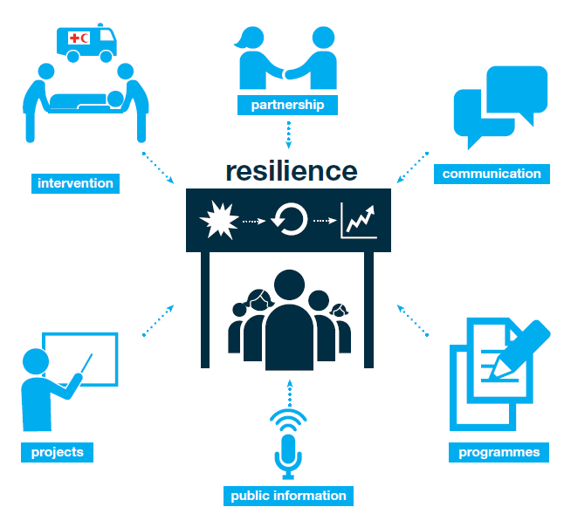
Notes:
These are all elements necessary for resilient communities

Slide 6
Links to RCRC community-based programmes
RCRC helps communities identify needs & vulnerabilities
Needs larger than RCRC capacity
RCRC enables communities to advocate for their needs
Empowerment and sustainability

Slide 7
The role of Red Cross Red Crescent in supporting community-led advocacy
Convening & connecting power
Unique position of NS as auxiliaries to governments
Global footprint in local communities
Responsibility - to influence decision makers to act for vulnerable people AND to take action to allow vulnerable people to do this for themselves

Slide 8
Supporting communities to be better connected and better organised – How?
Advocacy component in RCRC community-based programmes
Connecting with local authorities – e.g. via village development committees or other local government structures
Support community to use government structures to do advocacy: e.g. village committees
Facilitate local coalitions and bridge local-to-municipal-to-local
Help share community action plans
Platform for peer-to-peer cross learning and sharing
Public messaging and advocacy to government and other partners

Slide 9
Enablers?
Strong participatory foundation of programmes
Accountable programming & beneficiary communication mainstreamed
Integrating advocacy in programme design: e.g. self-organising DIY model; training community committees...

Slide 10
Building skills for community advocacy
Strategy development
Documenting evidence
Key messages
Technical skills
Notes:
Aside from acting as a connector, we can also provide skills to help
Develop strategies: what do you want to say and who to say it to? We have to be really strategic – as we’ve heard lots about so far.
understand the issue
who are the stakeholders
who to target
what channels to use
will public of private be more effective?
Providing or supporting to document evidence of:
what works
cost effectiveness
Providing key messages – e.g. on the power of prevention – sharper stronger messages
Technical skills
Hard skills: Using technology, using the media: radio, TV, film, photography, social media
Social media is a great means for capturing community voice
Soft skills: communication, facilitation, negotiating skills

Slide 11
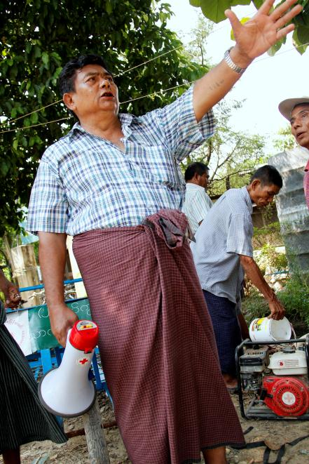
Myanmar Urban DRR programme
Notes:
MRCS supported construction of culvert for DRR based on community action plans
Recognizing the benefit of this intervention, the ward disaster risk reduction committee shared their risk reduction plan to local government for further support.
Government constructed 85 small culverts that cover the whole ward.
MRCS provided technical support but the community moved it forward with their clear plan of action and commitment towards of risk reduction.

Slide 12
RC Youth and Volunteers in the 6th Asian Ministerial Conference on DRR

Slide 13
Kenya Red Cross and WHS
Notes:
Local to international level
As a result of the advocacy work done by communities themselves with our support, Judith, one of the Kenya RC youth volunteer from Nairobi slum, has been invited to provide a speech at the opening of the regional consultation together with Valerie Amos and head of states, and her key recommendations have been included in the final report from that consultation.

Slide 14
Questions for discussion
What are you already doing in your countries to support community-level advocacy?
What communications channels do you use or support communities to use?
What are the opportunities to do this better?
How can we better undertake community level engagement - including local authorities - in disaster law? :
E.g. Awareness raising / IEC activities about laws and regulations that affect them
Consultations on what local authorities/communities want to see in their DM laws

