Slide 1

Towards an ASEAN Comprehensive School Safety Framework
Outcome of Country Consultations and Background Work

Slide 2
Technical Assistance to the ASEAN Safe School Initiative Phase 2

Slide 3

Technical Assistance to the ASSI Phase 2
To contribute to the achievement of the objectives of ASSI Phase 2 – Outcome 1, UNISDR in consultation with ASec and ASSI partners, engaged the Asian Disaster Preparedness Center (ADPC) to provide technical assistance for:
building a consensus to assist in the development and adoption of an ASEAN common framework for safe schools, and
development of a set of indicators to measure progress in building safe schools in the region.
While ADPC implemented the background review and country consultations, UNISDR provided overall management of the assignment. The ASEC, APG and the ASSI partners provided technical inputs and coordination in the countries.

Slide 4
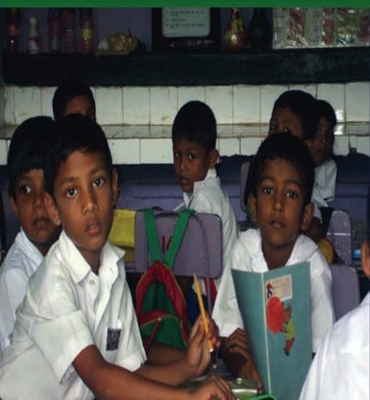
TA Objectives and Deliverables
Deliverable 1. Compendium of existing national policies, guidelines, standards and indicators on Safe School (taking the AADMER Work Programme and the Comprehensive School Safety Framework as reference)
Deliverable 2. Introduce the Comprehensive School Safety Framework and consult with ASEAN Member States and Stakeholders on its adoption and/or adaption to serve as ASEAN common framework for safe schools
Deliverable 3. Draft set of indicators to monitor the implementation of school safety in the ASEAN region ready for review by Ministry of Education, NDMOs and other relevant stakeholders in the ASEAN.

Slide 5
Deliverable 1: Development of a compendium
Gathered and reviewed about 60 existing national policies, guidelines, frameworks, practices and other initiatives on school safety (2004-present) in the ten (10) ASEAN Member States
The compendium includes:
(1) description or summary of the material, and
(2) brief discussion on the relevance or significance of the material on the three pillars of the CSS and how it contributes in the enhancement of school safety in the country or region.
Compendium is a live document, data collection and analysis is continuous
Additional data gathering will be conducted for Singapore, Malaysia and Brunei Darussalam

Slide 6

Deliverable 1: Development of a Compendium
The review and analysis of the documents were framed on the existing inter-agency Comprehensive School Safety (CSS) Framework (2012) and previous works done in the region by the ASEAN, SEAMEO, ADPC, and other development partners.
The trends and patterns on the school safety-related practices in the region were extracted from the review, including the identification of strengths, limitations and gaps.
The review indicate that albeit in varying levels of progress, ASEAN Member states has a significant number of initiatives on building school safety which can be categorized in the following themes: (1) safe school facilities, (2) School disaster management, and (3) inclusion of DRR/CCA in formal education systems and training
Notes:
The results of the desktop review of existing policies, guidelines and other strategies to promote the integration of DRR in the education sector in several countries in the ASEAN region generally dwelled around the three basic themes of school safety interventions, namely: (1) building safe learning facilities, (2) development of school disaster management plans and preparedness, (3) integration of disaster risk reduction and climate change topics into the formal school curriculum.
A. Safe Learning Facilities
Most of the reviewed policies and other initiatives to promote school safety have shown that ASEAN countries give primary importance in building safe learning facilities. These initiatives are commonly backed up by adopted policies and building codes of the respective countries.
Challenges: Despite these concrete initiatives for developing guidelines and policies for safe school construction undertaken in the ASEAN region, challenges in the actual implementation and monitoring of the compliance of the guidelines exist. Trainings and awareness building on DRR among local masons, engineers, architects, and building managers should be widely implemented and sustained to ensure compliance of safe school construction.
B. School Disaster Management
A relatively common practice among all the ASEAN countries is to readily establish disaster management plans for schools and learning facilities. Countries such as Cambodia, Indonesia, Myanmar, Philippines, Thailand and Singapore have developed national manuals and guidelines for schools in establishing their disaster management plans and committees. Most of these guidelines also provide strategies for preparedness, awareness-building and management of emergencies. Indonesia’s Sekolah Siaga Bencana: A Framework on School-Based Disaster Preparedness (2011) even pushed further to include components of a wider community education on DRR and resource mobilization.
Based on the reviewed documents of school safety initiatives in ASEAN, the development and implementation of school disaster management plan usually always accompany the safe school construction interventions. The establishment of school disaster management is used as a strategy to sustain and substantiate interventions related to school construction.
C. DRR/CC into School Curriculum
In the recent years, because of the recognition of the massive impact of disasters in the education sector and the acknowledgement of education as a powerful tool for risk reduction, there has been a move among the Southeast Asian Countries to incorporate DRR and CCA topics into their formal school curriculums to build awareness among the young.
In Cambodia, mainstreaming and integrating DRR activities and topics in the school curriculum at the primary and secondary level have been ongoing since 2008.
In the Philippines, with the guidance of the Department of Education (DepEd), DRR and CCA topics were incorporated in the elementary and secondary school (First and Second Year) curriculums. Higher-level educational institutions in the country are also putting up certificate courses and full degrees on Disaster Risk Management. At the same time, the Philippine NDMO is also currently in the process of establishing the National Disaster Risk Reduction and Management Training Institute.
Like the Philippines, Lao PDR is also successful in incorporating DRR into the primary and secondary school curriculums. Master degrees and certificate courses on DRR have also been made available in higher educational institutions in the country.
Brunei Darussalam, Indonesia, Malaysia, Thailand and Viet Nam have also been providing workshops and trainings for teachers and educators to aid and capacitate them in incorporating DRR/CCA into school curriculums.
An integrated ASEAN guideline on Mainstreaming DRR in the School Curriculum entitled, “Disaster Resilience Starts with the Young” have also been published in March 2011 by the ASEAN Secretariat. This guideline showcases case studies and lessons learned on mainstreaming DRR into the education sector, shared by different member states during the ASEAN Knowledge Sharing Workshop on Mainstreaming DRR in Education.
“Nothing the above, we can determine that there was a significant aim to to be comprehensive in building school safety among the ASEAN Members since the early 2000.”

Slide 7
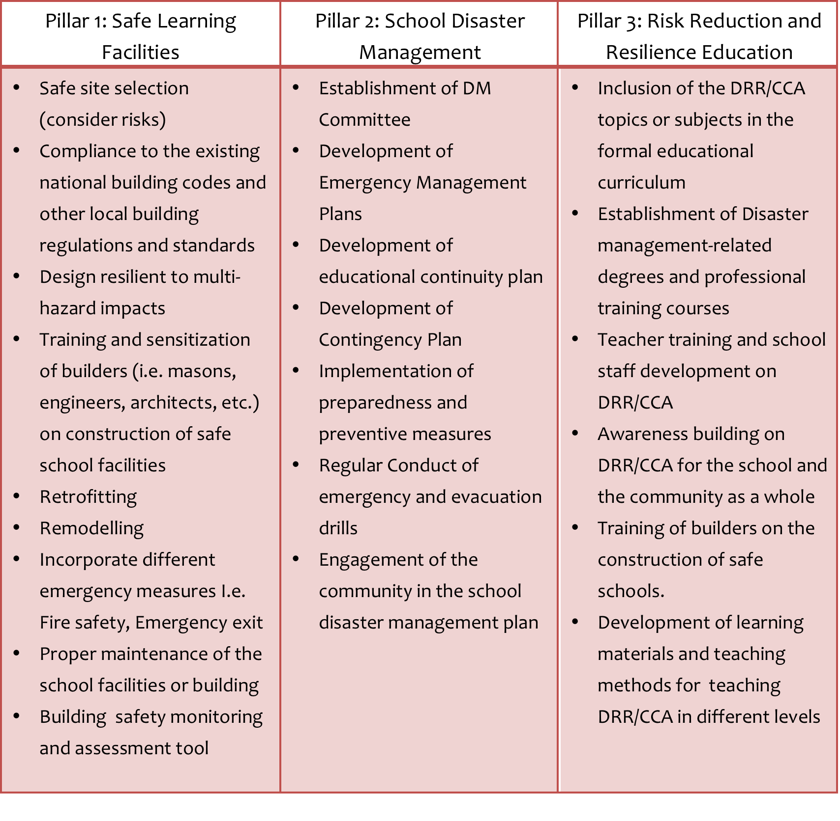
Delivery 1: Development of a Compendium
Policy Intervention Programme/Project
Notes:
Given the trends and patterns on the school safety practices and interventions in the ASEAN region that mainly fall into three major themes or pillars of the Comprehensive School Safety (CSS) Framework, the ASEAN member states can easily adapt the CSS framework into the specific context of the region. The following are some aspects or components for each of the Safe School pillar that can be considered for the ASEAN common framework for Safe School:
Several aspects or components of each pillar are interlinked and may overlap. For example, the training of builders (i.e. masons, architects, engineers) on the construction of safe schools can both be under the Pillar 1: Safe Learning Facilities and Pillar 3: Risk Reduction and Resilience Education.
During the country consultations, stakeholders have also validated the significant progress achieved by the ASEAN countries in promoting school safety from the policy intervention aspect to the program/project level initiatives. In order for the intervention to be more effective and sustainable, there should be a push from both the policy level and the project level aspects. A strong legislation or policy can support a robust implementation of a programme/project. At the same time, a substantial programme/project can boost and enhance an existing policy intervention.
Up-scaling actions in a more comprehensive and coherent way was also deemed necessary to make interventions more unified and encourage linkages, collaboration and cooperation.
As the trends on the initiatives for safe schools in the region resonates the three pillar of the CSSF, countries that were consulted relatively welcome the adoption or adaptation of the framework for the region with emphasis on the regional and country contexts.

Slide 8
Deliverable 2: Recommendations for consideration in setting up a common framework for Safe School in SEA
Ensure the institutionalization of DRR/CCA in the education sector for each ASEAN Member States
Strengthen legislation and policies related to building school safety
Encourage documentation of school safety practices and sharing of experiences among the nations
Identify framework goals and objectives that can be generally aligned to national priorities and strategies as well as to international/global interventions (i.e. Hyogo Framework for Action on DRR, Millennium Development Goals 2015, etc.)
Notes:
Given the manifested increasing impact of disasters to the education sector in the Southeast Asian Region, and the recognized potential of Education as an effective strategy for disaster risk reduction, it is essential that disaster risk reduction should be mainstreamed in the education and school system through the promotion of school safety.
At the same time, as a region with one vision and goal to build resilient nations, it is important that collaboration and cooperation in disaster risk reduction among the ASEAN Member States should be deepened. In order to encourage linkages and collaboration among nations, unified efforts particularly in school safety should be in placed through the adaptation of a comprehensive regional school framework. This framework can be developed using existing school safety models and the trends of the current initiatives undertaken by the ASEAN nations.
The comprehensive school safety framework and indicators, when put in place, will significantly articulate one ‘language’ for a common framework for the education sector within the ASEAN context. This will also substantially guide national goals, actions and practices on the basis of the regional framework and regionally recognized standard.
To effectively set up the common school safety framework, the following recommendations can be considered:
Ensure the institutionalization of DRR/CCA in the education sector for each ASEAN Member States
Encourage documentation of school safety practices and sharing of experiences among the nations
Identify framework goals and objectives that can be generally aligned to national priorities and strategies as well as to international/global interventions (i.e. Hyogo Framework for Action on DRR, Millennium Development Goals 2015, etc.)

Slide 9
Deliverable 3: Development of Indicators for measuring progress on SS
Initial set of indicators to monitor the progress of ASEAN countries on school safety was developed through previous discussions with partners and literature review
Consultation meetings were organized to present the initial set of indicators in three ASEAN countries – Indonesia, Thailand, Cambodia, Viet Nam, and Lao PDR (January to July 2014)
Key stakeholders in the education sector in each of the countries including the Ministry of Education, local and international organizations, as well as the APG members, the ASEAN Secretariat, UNISDR and other UN agencies doing related work on the education sector (i.e. UNICEF, UNESCO, UN-OCHA etc.)

Slide 10
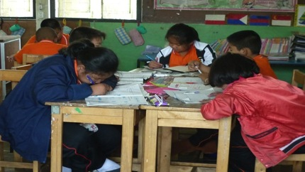
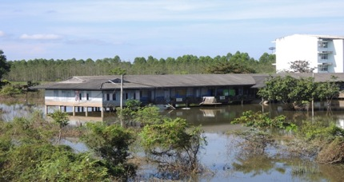
Need for Safe Schools Indicators
To assist in operationalizing a Common Framework for Safe Schools in ASEAN
To track progress of school safety’s building blocks & geographical spread, avoid weak link and for trend analysis
To assist the Working Group Chair/Lead Shepherd (Thailand, Viet Nam and Lao PDR ) and ASEAN Secretariat in M&E of School Safety as committed in the AADMER WP 2010-2015
Source: ADPC
AFP News

Slide 11
Proposed indicator for monitoring School Safety implementation
Indicators to track progress of the school safety are at two phases, namely
Impact/Outcome phase, and
Activity/Input phase
Uses following principle/approach:
SMART (Specific, Measurable, Attainable, Relevant and Time bound)
Tracks progress of the implementation of all key building blocks of school safety (input) as well as outcome/impact
It engages stakeholders at both levels: National and sub-national level and School level
Flexible
AFP News

Slide 12
Proposed indicator for monitoring School Safety implementation
To track national and ASEAN region progress towards achieving the goals of a comprehensive school safety
To protect learners and education workers from death, injury, nd harm in schools (indicators 2 & 3)
To plan for educational continuity in the face of expected hazards (indicator 4 & 5)
To safeguard education sector investments (Indicator 1)
To strengthen climate-smart disaster resilience through education (Indicator 6)
AFP News
Notes:
In identifying indicators, the following goals were identified for a comprehensive school safety framework.

Slide 13
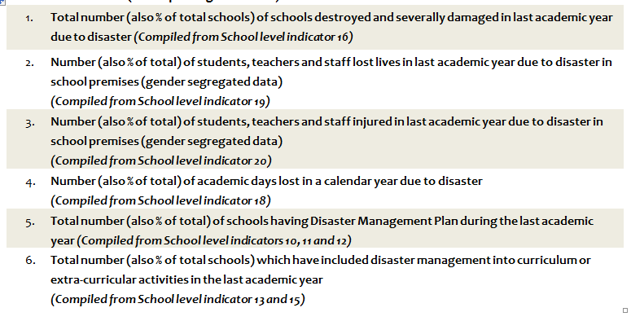
Proposed indicator for monitoring School Safety implementation
National Level Indicators (for Reporting to ASEAN)
AFP News
Notes:
To provide a better perspective in the monitoring and tracking process, indicators can be categorized into (1) the National/Regional Level and the (2) School Level. The National level indicators (Table 1) will be used for reporting to the ASEAN Region and to gauge how a member state is at par with its neighbors in the region.

Slide 14
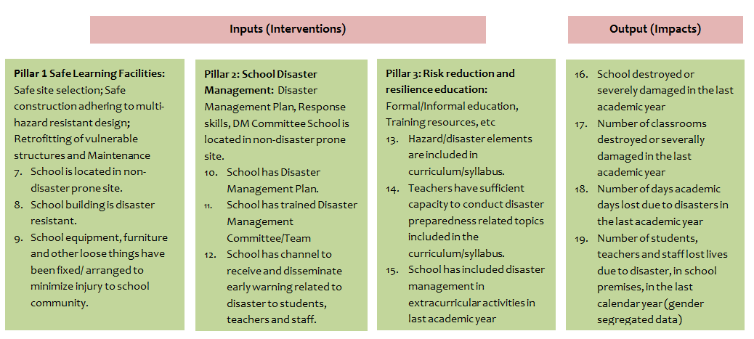
School level Indicators
Remark: Upon endorsement of SSF and monitoring indicators, questionnaire could be developed to illicit the information required which could be further adapted to fit specific country context and requirements.
AFP News
Notes:
The School level (Table 2) set of indicators on the other hand, is a more detailed set to monitor school level initiatives. This set of indicators, is further classified into input indicators (interventions) and the output indicators (impacts). At the same time, following the major themes to which the school safety interventions within the ASEAN region fall, indicators to track the progress on safe school may be developed in the following categories: (1) Safe Learning Facilities (2) School Disaster Management, and (3) Risk Reduction and Resilience Education.
These school level indicators can also be used to provide data for the national/regional level indicators. For example, compiled data gathered for the school level indicator 16 (No. of School destroyed or severely damaged in the last academic year) can be used as a data for the National/Regional level indicator 1 (Total number of schools destroyed and severely damaged in last academic year due to disaster).

Slide 15
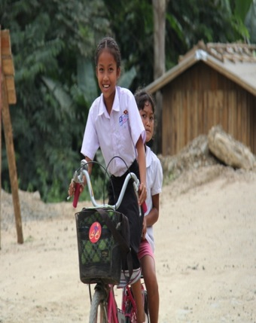
Recommendations for effective monitoring of Safe School initiatives in ASEAN Member States
Existing national data collection systems (national and school level) should be fully utilized to ease school data collection
Ensure the incorporation of disaster damage and loss data of the education sector in the comprehensive national disaster loss database system
Review existing database (number of schools, number of school damages in disaster in an academic year, inventory of school facilities, number of student/teachers and staff, etc.) maintained by different bodies or agencies to avoid discrepancy of data.
Evaluation and monitoring process should be designed to minimize efforts of merging DRR indicators into the existing systems for the annual school monitoring and education sector performance.
Notes:
Setting up indicators to monitor the progress of school safety initiatives can assist in the operationalization of the common framework for school safety in the ASEAN Region. It can also track progress of school safety’s building blocks and geographical spread for trend analysis and to avoid weak links. Lastly, indicators can also assist practitioners in gauging future actions to address gaps or to sustain effective measures.
Apart from identifying indicators, the following are several key recommendations for monitoring the progress on school safety initiatives of the ASEAN Nations:
Existing national data collection systems (national and school level) should be fully utilized to ease school data collection
Ensure the incorporation of disaster damage and loss data of the education sector in the comprehensive national disaster loss database system
Review existing database (number of schools, number of school damages in disaster in an academic year, inventory of school facilities, number of student/teachers and staff, etc.) maintained by different bodies or agencies to avoid discrepancy of data.
Evaluation and monitoring process should be designed to minimize efforts of merging DRR indicators into the existing systems for the annual school monitoring and education sector performance.

Slide 16
THANK YOU
FOR YOUR ATTENTION

