Slide 1
Disaster Law at the Regional Level:
Engaging with ASEAN

Slide 2


Slide 3
    ASEAN Community Building
If the ASEAN Community were a house:
ASEAN:
A People-oriented Community
    ASEAN
    Political-Security
    Community
    (APSC)
    ASEAN
    Economic
    Community
    (AEC)
    ASEAN
    Socio-Cultural
    Community
    (ASCC)
Narrowing the Development Gap (NDG)

Slide 4
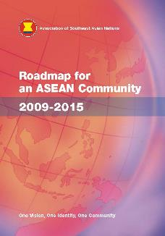
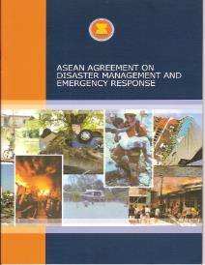


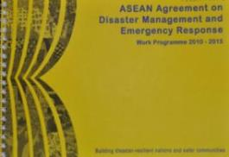
“Rules-based” ASEAN

Slide 5
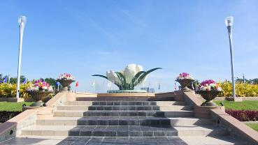
DETERMINED to share a bold and forward-looking future for ASEAN which will enhance and strengthen the ASEAN Community and enable the realisation of a politically cohesive, economically, integrated, socially responsible, and a truly people-oriented, people-centred and rules-based ASEAN
Nay Pyi Taw Declaration on the ASEAN Community’s
Post-2015 Vision
Nay Pyi Taw, 12 November 2014

Slide 6
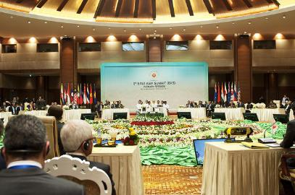
Establish a whole-of-nation (government, communities, individuals and the private sector including civil society and non-government organisations) resilience-based approach to enhance the capacity of States to reduce risk, prepare for, respond to, and recover from, natural disasters
East Asia Summit Statement on Rapid Disaster Response
Nay Pyi Taw, 17 November 2014

Slide 7

Kuala Lumpur Declaration on a People-Centred, People-Oriented ASEAN
Kuala Lumpur, 27 April 2015
Continue establishing a people-oriented, people-centred and rules-based ASEAN Community where all people, stakeholders and sectors of society can contribute to and enjoy the benefits from more integrated and connected Community encompassing enhanced cooperation in the political-security, economic, and socio-cultural pillars for sustainable, equitable and inclusive development.

Slide 8
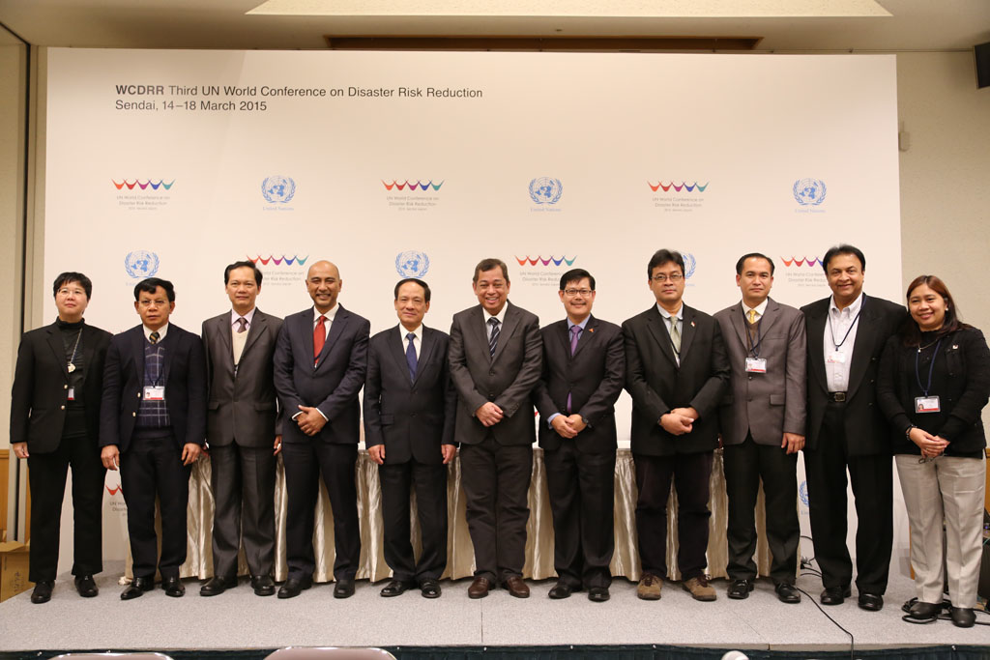
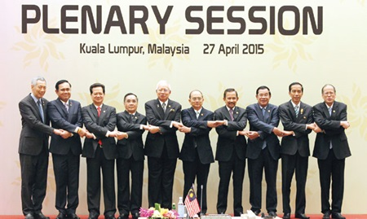
DECLARATION ON RESILIENCE, ADOPTED BY THE ASEAN LEADERS AT THE ASEAN SUMMIT IN APRIL 2015
The “ASEAN Declaration on Institutionalising the Resilience of ASEAN and its Communities and Peoples to Disasters and Climate Change” aims to develop a cross-pillar and cross-sectoral resilience building in the context of disaster risk management, climate change adaptation and sustainable development.
The Declaration was endorsed by the Informal ASEAN Ministerial Meeting on Disaster Management (AMMDM) one day before the World Conference in Sendai started, and adopted by the ASEAN Leaders at the 26th ASEAN Summit on 27 April 2015 in KL, Malaysia
Informal AMMDM, March 2015, Sendai
26th ASEAN Summit, April 2015, KL
ASEAN is Resilient as One
Notes:
Recognising that the region is at high risk to natural and human-induced disasters, ASEAN has laid down a policy framework that mandates the programmatic pursuance of disaster management and risk reduction initiatives at regional and national levels. The ASEAN Agreement on Disaster Management and Emergency Response or AADMER was ratified by all ten Member States and entered into force on 24 December 2009. It has two objectives: (a) reduction of disaster losses, and (b) enhanced regional cooperation in responding to disasters. AADMER is a legally-binding instrument, binding all the ten countries, serving as a common platform in responding to disasters within ASEAN. The Agreement establishes the ASEAN Coordinating Centre for Humanitarian Assistance (AHA Centre), as the operational coordination body and engine of AADMER.

Slide 9
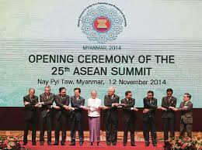
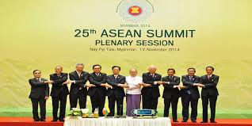
“ONE ASEAN, ONE RESPONSE”,
TO BE LAUNCHED AT THE 27th ASEAN SUMMIT IN NOVEMBER 2015
We noted with satisfaction the outcomes of the 2nd ASEAN Ministerial Meeting on Disaster Management (AMMDM) convened in Bandar Seri Begawan on 16 October 2014, including the adoption of the strategy "One ASEAN, One Response: ASEAN Responding to Disasters as One". This Strategy, which will be launched in 2015, will ensure ASEAN to respond effectively and efficiently to regional disasters.
We encouraged the promotion of synergy and coordination among the relevant internal ASEAN mechanisms related to humanitarian assistance and disaster relief, using AADMER as the regional policy backbone and common platform.
We welcomed the progress made by the Joint Task Force to Promote Synergy on HADR, which under the chairmanship of the (ACDM held two meetings in Bandar Seri Begawan in May and October 2014, with the participation of the representatives from SOM, ADSOM, SOMHD, SOMSWD and other relevant ASEAN sectoral bodies”
25TH ASEAN Summit
November 2014, Myanmar
Notes:
Recognising that the region is at high risk to natural and human-induced disasters, ASEAN has laid down a policy framework that mandates the programmatic pursuance of disaster management and risk reduction initiatives at regional and national levels. The ASEAN Agreement on Disaster Management and Emergency Response or AADMER was ratified by all ten Member States and entered into force on 24 December 2009. It has two objectives: (a) reduction of disaster losses, and (b) enhanced regional cooperation in responding to disasters. AADMER is a legally-binding instrument, binding all the ten countries, serving as a common platform in responding to disasters within ASEAN. The Agreement establishes the ASEAN Coordinating Centre for Humanitarian Assistance (AHA Centre), as the operational coordination body and engine of AADMER.

Slide 10
ASCC Blueprint Post-2015
Engages and benefits the people (Good governance)* A committed, participative and socially-responsible community through an accountable and inclusive mechanism for the benefit of all ASEAN peoples, upheld by the principles of good governance
Inclusive | Sustainable | Resilient | Dynamic
An inclusive community that promotes high quality of life, equitable access and opportunity for all and promotes and protects human rights of women, children, the elderly, persons with disabilities, migrant workers, and other vulnerable and marginalised groups | A sustainable community that promotes social development and environmental protection through effective mechanisms to meet the current and future needs of the people | A resilient community with enhanced capacity and capability to adapt and respond to social and economic vulnerabilities, disasters, climate change as well as emerging threats, and challenges | A dynamic and harmonious community that is aware and proud of its identity, culture, and heritage with the strengthened ability to innovate and proactively contribute to the global community
*Endorsed by the ASCC Council, March 2015

Slide 11
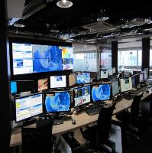
NOTIFICATION OF DISASTER
The AHA Centre to analyse the initial report and notify other Party/Entity of the disaster
he AHA Centre to analyse each Siituation Report and immediately notify the other Party /Entity of the significant developments (a) periodically or (b) by 10:00 am (Jakarta time)
Joint Assessment of required Assistance
The AHA Centre to facilitate mobilisation of ERAT
The AHA Centre to receive updates on any plans and findings of joint assessment
The AHA Centre to receive copy of the Contractual Agreement for Assistance
REQUEST FOR ASSISTANCE
The AHA Centre to forward the request to other Party/Entity
The AHA Centre will explore other possible assistance
AHA
Centre
MOBILISATION OF ASSETS AND CAPACITIES
The AHA Centre to facilitate the processing of exemption for provision of assistance and facilities, transit of personnel and equipment
AHA
Centre
OFFER OF ASSISTANCE
The AHA Centre to forward the offer to the receiving Party
DEMOBILISATION OF ASSISTANCE AND REPORTING
The AHA Centre to receive and update of this development
The AHA Centre to be received within 2 weeks of departure from the affected country
DISASTER SITUATION UPDATE
The AHA Centre to receive report within 24 to 48 hours of arrival of assistance at disaster site
One ASEAN, One Response
Connecting ASEAN for Disaster Readiness

Slide 12
Development of the post-2015 AADMER work programme
ASEAN Declarations and Statements on disaster management
Elements of the Post-2015 AADMER Work Programme
Contextual Analysis
Characteristics and Strategies
Action Plans
Implementation Mechanisms
Resources
Communication
Monitoring and Evaluation
ASEAN Community Vision 2025
Successor AADMER Work Programme
M&E of the AADMER Work Programme 2010-2015
Assessment of the 21 Concept Notes
Strategic “think-pieces”

Slide 13
Development of the post-2015 AADMER work programme
M&E of AWP 2010-2015 (on-going)
AADMER Post-2015 Visioning Workshop (August 2015)
Adoption by 27th ACDM, December 2015, Cambodia

Slide 14
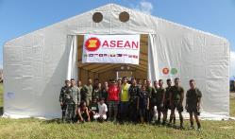
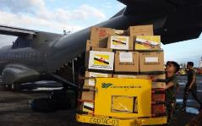
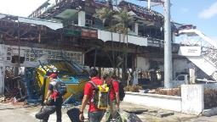

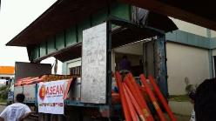
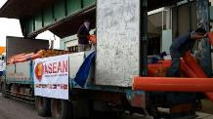

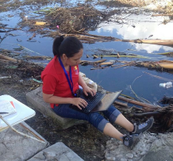
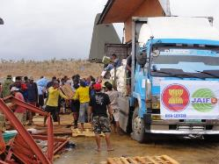
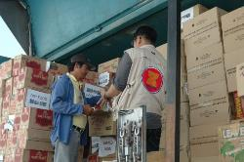
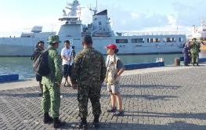
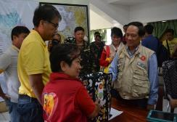
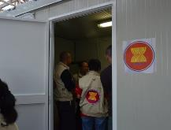
THANK YOU

Slide 15
Question 1
How can cooperation between ASEAN and National Societies be enhanced through disaster law initiatives? (e.g. research? training? technical support to member states to develop/implement their national DM laws and procedures?)

Slide 16
Question 2
What are some priorities for action in the next five years, and how can this be reflected in the new AADMER work programme?

Slide 17
Question 3
How can regional cooperation on disaster law raise the profile of Southeast Asia at the global level e.g. National Societies and member states working together to implement the Sendai Framework for DRR?

