Slide 1
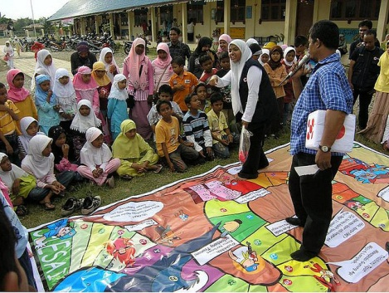
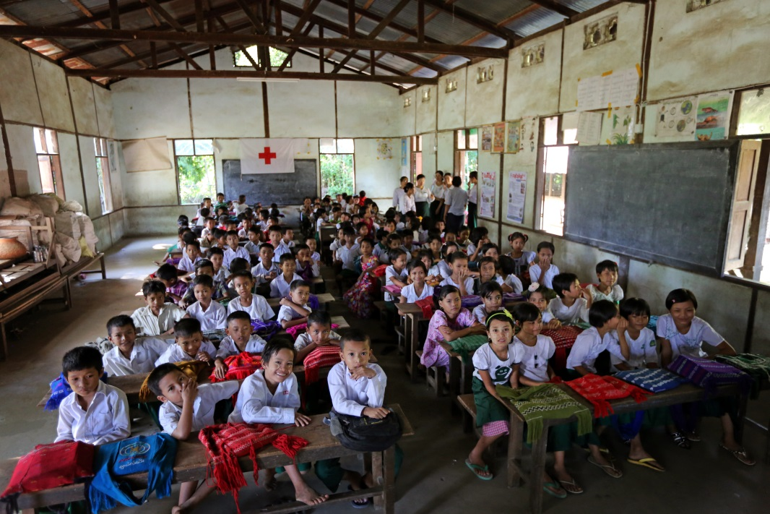
Red Cross / Red Crescent engagement in School Safety in Southeast Asia

Slide 2
The ASEAN Common Framework For Comprehensive School Safety

Slide 3
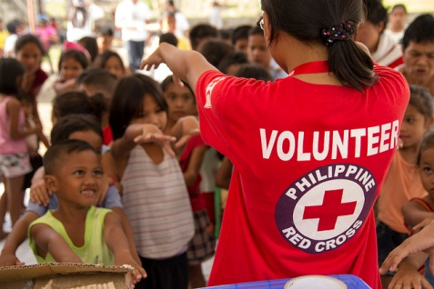
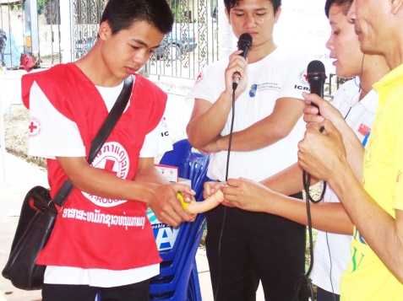
Presence in Southeast Asia
11 RC/RC National Societies in South-East Asia (incl. Timor Leste) with country wide networks
1 Million Volunteers and 4 million Youths
Auxiliaries to national governments (cooperation with NDMOs and Education authorities)
From local to global: the IFRC Secretariat is supporting and representing National Societies

Slide 4
Challenges…
School safety activities are often based on short-term projects
They often focus on a specific sector (DM, DRR health, first aid, WatSan, Road Safety, youths development…) and are not integrated
Knowledge about policies and tools is often not systematically shared.
Data about the interventions is not available in a single report

Slide 5
Why the need for a mapping of our initiatives?
To enhance knowledge and information sharing within and among National Societies
To profile the work of National Societies in School Safety
To support technical advocacy towards our partners (ASEAN, governments, NGOs, UN agencies…), influencing policies and tools and mobilizing new resources
To be accountable to governments and partners about our contribution to their frameworks and plans

Slide 6
Proposed output
For each NS, a concise document (max 10 pages) to present key information about the NS engagement in school safety to date (policies, guidelines, key statistics, good practices, recommendations, etc.
Based on the request from NS, the documents will be translated in national languages as well.

Slide 7
Proposed steps
1 | Preparation and launch of the research | July-September 2016
2 | Data collection in the countries | October – December 2016
3 | Data analysis | January-February 2017
4 | Reporting / translation, graphic design / printing | March – June 2017

Slide 8
A proposition: SEAYN to lead the process
An opportunity for youth leaders and departments managing youths to engage in a dialogue with other departments of NSs (DM, Health, etc.) on school safety
Role of SEAYN would be to coordinate the research part, with a focus on data collection within National Societies
With support and guidance from IFRC (tools development, data analysis, reporting, etc.)

Slide 9
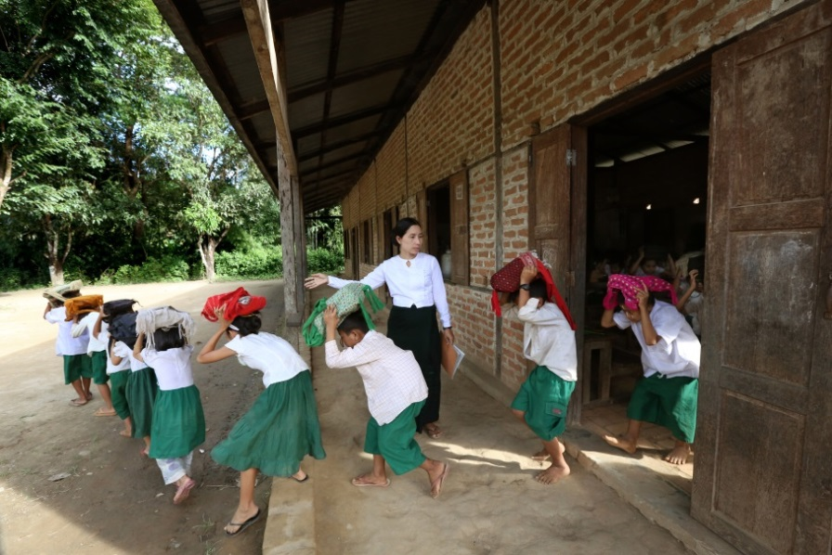
THANK YOU and Any Questions?

