Slide 1
Youth Situation in Asia Pacific

Slide 2
Active Volunteers among RCRC National Societies
17 million volunteers, are the backbone of the RCRC services
IFRC Global Youth Consultation report (2011)
IFRC Global Review on Volunteering (2015)
Notes:
Following the previous slide, this slide shows the overall numbers of the Active Volunteers (globally)
Highest numbers: Indonesia and Iran.
The Indonesian Red Cross Society and the Red Crescent Society of the Islamic Republic of Iran declared to have more than 500,000 active volunteers.

Slide 3
Youth Engagement Youth among Active Volunteers
In Asia Pacific,
70% of the active volunteers, are Youth
IFRC Global Youth Consultation report (2011)
Notes:
Amount of Youth in the active volunteers of each National Society
Young people (in this survey defined as 35 years old or younger) seem to represent a large part of the global active volunteer base. Around 54% of National Societies declared to have more than half of its volunteer base comprised of youth.
When comparing the percentage of youth volunteers with the total number of volunteers in these National Societies, it can be seen that the total percentage of youth in general is somewhere between 36 to 47 %.
It seems that great representation of youth (over 70% of active volunteers) can be seen in National Societies of all sizes. The same thing applies for those National Societies that have less than 30% youth among its volunteers. Thus, it seems that the size of the National Society has no clear connection with the amount of youth involved in its services and activities.
The amount of National Societies with a large number of youth volunteers is fairly similar in all the areas except for Asia Pacific, where among the National Societies that answered the survey as much as 31% declared to have more than 70% of their volunteers youth.
The small amounts of youth (less than 30%) seem to be more usual in the Americas and Europe & Central Asia zone, the latter reaching as high as 32% of National Societies having less than 30% youth volunteers.
Based on the the gender balance among volunteers is nearly the same as in the previous consultation done in 2005-2007.
The current global gender balance is an average of 55% female and 45% male while in the Global Youth consultation 2005-07 the ratio was 54% female, 46% male. However there are more National Societies that have majority of women than those that have more men. Only 14 National Societies replied that the balance is somewhat even. Whether this balance is the same among young volunteers remains unknown.

Slide 4
Youth Volunteering among Southeast Asia National Societies
Approximately 3.9 million youth volunteer aged 12 to 29 are registered under our Southeast Asia Red Cross and Red Crescent National Societies

Slide 5
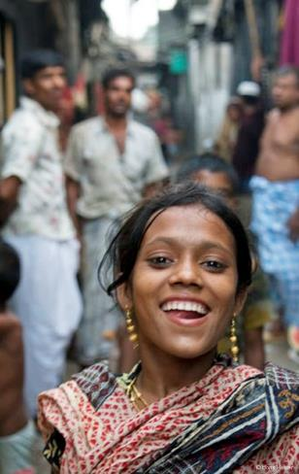
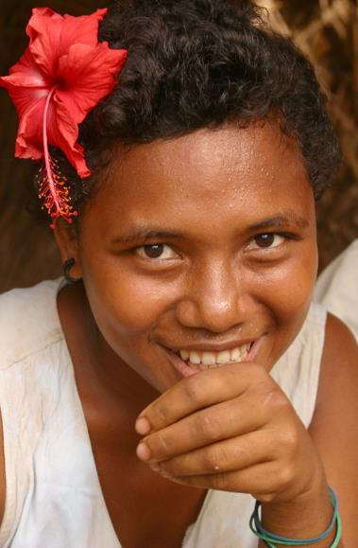
A largely urban environment
CEE/CIS
65%
South-East Asia
46%
East Asia
53%
South34%
Oceania 19%
Source: UNICEF 2014 State of the World’s Children. NY: UNICEF.
Notes:
Young people are the drivers of several historic trends across the region. Among others, they form the majority of rural to urban migration. Since the year 2000 nearly two-thirds of demographic expansion of all urban areas in the world has taken place in Asia and the Pacific. Many of these urban residents are and will be young. According to projections, by 2030 as many as 60 per cent of all urban dwellers globally will be under the age of 18.
Much of this has been rapid and unstructured, leading to a rise in informal settlements and slums, where youth often have limited access to basic services and employment opportunities and are at increased risk of poverty.
Source of projections: State of Urban Youth Report, UN-Habitat, 2013

Slide 6
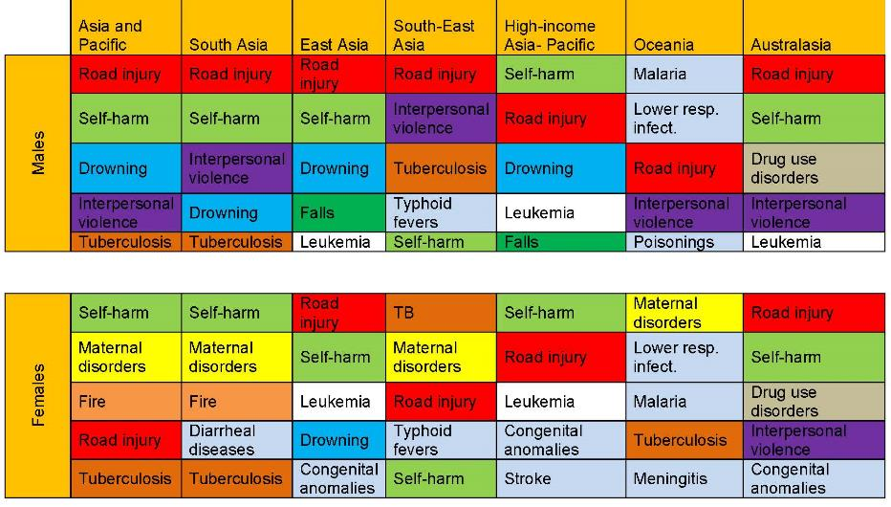
Around 900,000 youth 15-24 die annually from preventable causes in Asia and Pacific
Top 5 causes of death
Source: UNFPA, from Institute for Health Metrics and Evaluation (IHME). 2014 Mortality Visualization. Seattle, WA: IHME
Notes:
Asia and the Pacific nearly 900,000 youth aged 15-24 die from preventable causes annually, including road accidents, self-harm and pregnancy-related causes. Additionally, lifestyle habits that often start in adolescence – such as tobacco and alcohol use, poor nutrition and lack of exercise– contribute to ill health later in adulthood.
The top causes of death in the region for young males are road accidents and self-harm; for females, they are self-harm and maternal causes (pregnancy and child birth). There is considerable subregional variation, however, especially for young females. Maternal disorders are a prominent cause of death in South Asia, South-East Asia and Oceania but are not a significant cause of death in higher-income subregions.
Suicide is yet another important factor in youth mortality, particularly at ages 15-19. It is the leading cause of death for 15-24-year-old females with one of every 6 deaths among adolescent females in South-East Asia is due to suicide. Overall, young men have higher suicide rates than young women, with suicide being the second leading cause for males 15-24 years old in Asia and the Pacific.
Suicide data from: Shah and Ahman 2012 Reproductive health Matters 2012 – 2008 estimates

Slide 7
Ensure inclusive and equitable quality education
and promote lifelong learning opportunities for all.
Notes:
Also, here is the situation of Education in our region

Slide 8
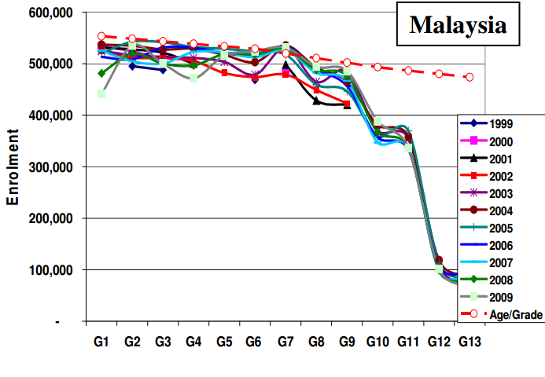
Notes:
As you can see from the following slides, formal education and its drop-off is a continuous serious challenge in Asia Pacific.
This phenomenon is seen across all countries regardless its development stage.
Thus it is a serious question, when we talk about Youth-led approaches, is it only in the Formal educations (in school)? Or how are we also looking into informal Peer-to-peer approaches, thus we are enabled to reach out to the unseen Youth out of formal educations.
<More statistics>
1. Education
Although significant achievements have been made during the last decade, gender inequalities in education continue to exist.
Overall, in South and South-West Asian countries, 8 girls for every 10 boys are enrolled in secondary education, while 3 women for every 4 men are enrolled in tertiary education, representing lower female to male enrolment ratios than any other sub-region.
A large number of youth remain out-of-school due to urban/rural disparities, socioeconomic inequality and continuing exclusion of children with disabilities.
Many young people face obstacles transitioning from school to work, as education and training systems often do not match modern labour market demands. The mismatch creates a sub-population of discouraged and excluded youth that are outside the educational system and are also unemployed.
Youth who are “not in education, employment or training” (NEET) rate increases among young women and girls. This group of young people needs particular attention since they are more prone to entering a vicious circle of poverty and exclusion.
2. Employment
While unemployment in Asia and the Pacific is lower than in any other region, too many young people in the region are likely to end up in vulnerable jobs or out-of-school because of absent unemployment benefits and other support measures
Long-term unemployment is another challenge, and several countries in the region report that over 50% of youth have been unemployed for more than a year.
Youth who are working are often still in a precarious position, with low wages, poor working conditions and a lack of social protection and more likely to be working poor.
Young women continue to be underrepresented in the labour market, though subregional discrepancies prevail. Young women’s labour force participation in South and South-West Asia is only 23%, less than half the rate for young men.
In search of better living conditions, some young people choose to migrate; youth migrants make up about 1/4 of the total Asian migrant stock. Many are undocumented and some are trafficked, including for sex work.

Slide 9
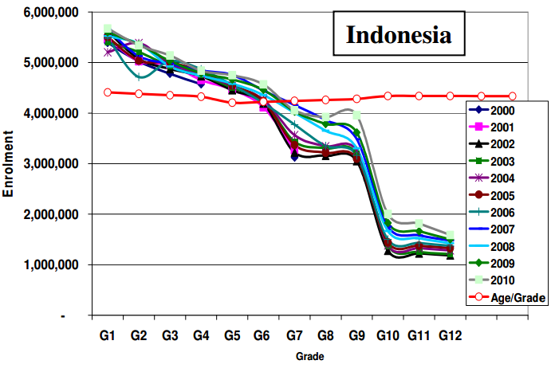

Slide 11
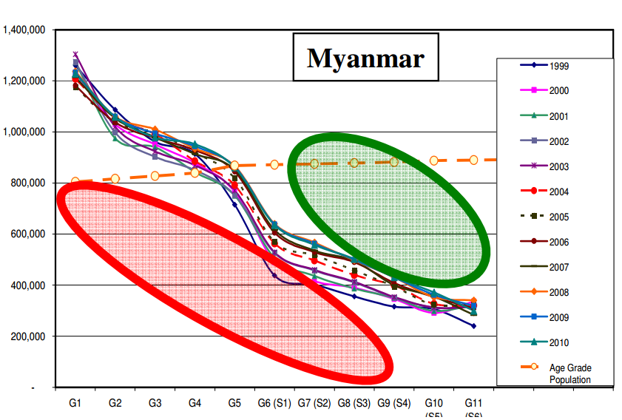

Slide 12
IFRC Plan and Budget 2016-2020
Key target Areas of Focus are:
Strategy for Implementation are:
Disaster Risk Reduction
Shelter
Livelihoods
Health
WASH
Social Inclusion
Culture of Non-violence and Peace
Migration
Strengthen National Societies
Ensure effective international disaster management
Influence others as leading strategic partners
Ensure a strong IFRC
Notes:
Join the HELP community and you will find interesting and exciting initiatives (programmes, projects, activities, materials, videos) on humanitarian issues for strategic and operational work as a volunteer or stuff member. You are welcome to use the HELP as a knowledge bank and to see if you would like to implement projects within your country and community on a first step.
On a next step you are encouraged to choose a relevant HE initiatives and to start to collaborating with volunteer and staff colleagues to connect on peer to peer level practicing project based learning
Please also upload and submit your projects and activities you developed with your students to share it on the community with others who might be interested to collaborate
On the HELP community you will be able to provide certificates and awards (badges) for your students to reward (life and career) skills and (humanitarian) competencies they accomplished by working on HE initiatives

Slide 13
Youth Commission
Global
Gouvernance
Management
Regional
Regional
Regional
Regional
Youth Network
National level
National level
National level
Gouvernance
Management
Gouvernance
Management
Gouvernance
Management
National
Youth Network
Youth Policy/Strategy
Age-specific needs
Peer Effect
Peer Effect
Age-specific needs
Local Community level
Individual Training
School based RC
V
V
V
V
V
M
M
V
M
M
V
M
M
M
M
M
M
V
Notes:
Following these Global Policies and Strategies, when it comes to the action of the “Youth Development” initiative, it could simply seen in 4 areas based on different levels of the cycle of the movement.
Youth Network
Youth Policy Development
School based/ Junior Red Cross activities
Individual Capacity Training

Slide 14
Regional and Global updates

Slide 15
Regional / Global Events
AMCDRR @ India (2-5 November 2016)
Humanitarian Education Learning Forum @ Hong Kong (8-13 November 2016)
Statutory Meeting @ Turkey (November-December 2017)
Model IFRC General Assembly @ TBC (Summer 2017)

Slide 16
Regional Plans and Highlights (2016 Q3-2017)
YABC Resource pool development (IFRC-Youth Networks)
Youth Engagement Self-Assessment tool development (Youth Commission/ East Asia Youth Network)
Case-Study development (IFRC)
Ensuring coherence in School Based-RCRC approaches (Value Based Education/ Skills based Education)
Evidence based Research (eg. Supporting country situation analysis and linking NS Youth Development plans)
National Youth Structure development and its connection with Regional (Sub-regional) Youth Networks.
Youth Network development (Youth Commission/ IFRC)
Technical package development for Youth enagement in AoF (IFRC)
Mid-term review of AP Regional Conference (IFRC)

Slide 17
Volunteering solution bank
Notes:
Lab-hub is our concept of working to identify cooperation methods and working together for solutions identifying on Volunteering.
Currently, we have a Volunteering Solution Bank which contains a series of case studies and documents that showcase the work of our RCRC National Society volunteers in various parts of the world - See more at: http://www.ifrc.org/en/what-we-do/volunteers/volunteering-solutions-bank/#sthash.Cd1f9VSb.dpuf
Further more, we are looking forward to form lab-hubs in the following area and would be very much looking forward to collaborate with ASEAN Youth sections to together identify the solutions for enhancing and enriching Youth volunteering cultures across the ASEAN nations;
A wide level of volunteer work is associated to communities of people who enjoy common interest and those communities of volunteers may contribute to the work of the orgarinsations and expanding the reach out to new and different networks of society and promoting in such a way new forms of social inclusion. We need to consider as well that today’s volunteers prefer to stay for shorter periods. They want more from their volunteering experience e.g. training, enhancing employability, lifeskills etc. New volunteers also want greater control over their experience and a platform to develop their own ideas and initiatives, focusing more on meaning, independence and impact. Co-development is the trend rather than slotting in volunteers into pre-designed services.
SUGGESTED AREAS FOR THE Forming of Lab-hubs:
Virtual volunteers
Virtual volunteers in emergencies and virtual volunteers in the development phase. In times of disasters, virtual volunteers can provide first-hand information of the consequence of a disaster, but this group will require what kind of information is useful for us. At the same time, these kind of volunteers can become reference points in communities where our reach capacity is limited. In development times, these volunteers can disseminate in their communities prevention message from the Red Cross, provide virtual homecare support for elderly communities or people with disabilities, even provide psychological support for people in need.
Volunteers with disabilities
Exploring a group of volunteers with disabilities should offer an excellent opportunity for social inclusion and expanding services of the orgiarnisations.
National Societies which could be potential “knowledge centers “ or “innovation hubs” could be:
Senior Volunteers
Engaging seniors for volunteering brings benefits to the individual, to the National Society, and to the most vulnerable in the communities. Aside from promoting social inclusion, the National Society is providing the platform for this often excluded group, who at their old age are still capable and willing to contribute to the society but have little or no opportunities for such. The Senior Volunteer programme can target peer to peer dynamics and contribute to develop a methodology. Seniors have years of wisdom and could contribute to inter-generational initiatives, especially coaching and mentoring.
Professional volunteers
Professional volunteers refer to individuals that have certain level of expertise and are capable to offer a couple of hours during the week or a month or year, to support the NS in special needs they may have.
Corporate Volunteers
Corporate Volunteering enables corporate partners to build a sustainable partnership with communities and make a positive social impact in their community. Through the Red Cross and Red Crescent, a variety of opportunities may be offered to corporate volunteers to get involved in community-based projects or support development initiatives for the national society. Skilled and talented workforce of a corporate may volunteer for a period of time to support an NS in a specific area of the organization.
Socio-cultural community groups
There are different groups of volunteers in the countries which offer national societies the opportunity to engage with new generations of volunteering work and also of communities of people associated with specific causes: The environmentalists, the hip hop, the sporty, the trekking, the motorbikes, the technology communities, etc. Explore those communities of volunteers and their work will help the NS to expand their knowledge and attract different group of volunteers that can offer an added value to the organization.
DURING DISASTERS, TRANSITIONING VOLUNTEERS INTO STAFF
For many national societies a significant challenge remains around transitioning volunteers between paid and unpaid roles. Recent experiences highlight how in some instances volunteers who received additional paid contributions during emergency times, despite being expected to work like paid staff, retained the status of volunteers. This affected the pride they felt in their new roles. For those volunteers who receive payment over a longer period of time, the concept of returning to pure unpaid voluntarism was sometimes a challenging adjustment to make. As a general rule, when volunteers are paid at least equal to the minimum wage law of the country, they should be transitioned into NS staff under proper HR procedures.
DIASPORA/MIGRANT VOLUNTEERING
Diasporas from south to north continues to rise. In Asia Pacific, the affluent mega-cities and urban areas contain migrants from countries such as Bangladesh, Nepal, Philippines, Myanmar, Vietnam, Pakistan amongst others. Singapore for example has 2.3 million migrants (out of a total population of 6 million) and there are vibrant, structured communities from countries ranging from Malaysia, Thailand, Indonesia and the Philippines to the Indian sub-continent. Malaysia as well has a large Nepali, Bangladeshi, Myanmar and Pakistani communities. While there are migrants who have reaped great benefits from moving to another country, a significant number are frustrated by a sense of exclusion, limited options, even abuse and loneliness.
NSs could serve as bridges across the diasporas, encouraging diaspora members to get involve in the Red Cross Red Crescent activities. NSs can explore the opportunities presented by the diverse migrants, especially in peer support mechanisms nuanced by cultural understanding and common language. NSs however must understand who the diaspora or internal migrants are, how they operate and in what way they wish to engage.
TRANSFORMING YOUTH MEMBERS INTO ACTIVE VOLUNTEERS
Majority of NSs in Asia pacific have school Red Cross program: junior, senior and university/college Red cross Youths. There are two challenges: first, to effectively harness the potentials of these young people as they move up the educational ladder by mobilizing them with appropriate youth led activities of the NS; and, second, retaining them as volunteers when they move out of the educational system. The proportion of youth members disappearing from the roster of NS volunteers and members after their educational programs are huge. The experiences of young people in RCRC volunteering seems to determine whether they stay or go out of the organization. Having a functional database such as RMS supports movement of youth volunteers, endorsing them one branch to another. Having regular graduation ceremonies for Red Cross Youth and recognizing their performance will encourage young people to continue to link with the organization. Lastly, youth unemployment is a concern globally. Engaging youth and transforming them into volunteers with exposure to trainings and experiences that enhances their competencies and life skills improves their employability.

Slide 18
Case-studies
Notes:
From the hashtag, you can also see some further voices and ideas related to this title which individuals have been posting.
#RC21C is planned to be used during the 5th Asia Pacific Communication Forum where “Social Media” had identified to be its theme.

Slide 19
Value of Volunteers Youth stories
Case-study collection on Youth-led initiatives and its value it brings to the beneficiaries, communities and young volunteers themselves.
Planned to be served as a advocacy material for NSs, youth leaders, and Youth Networks
So far stories are developed by;
Pakistan
Mongolia
China
Philippine
Bangladesh
Kenya

Slide 20
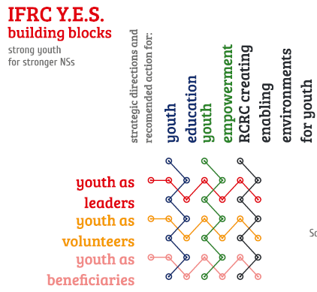
Young Humanitarians in Action!
Case-study collection on Youth-led initiatives and step by step approaches on “How” the initiative was organised.
To be captured in the 9 YES boxes as to serve for reference for NS to implement YES

Slide 21
Volunteer solution bank and Lab-hub concept
Virtual volunteers
Volunteers with disabilities
Senior Volunteers
Professional volunteers
Migrant volunteer
Professional Volunteering
Corporate Volunteers
Socio-cultural community groups
During Disasters, Transitioning Volunteers to staff and exiting plan
Diaspora Volunteering
Transforming Youth Members into active volunteers
Youth Engagement
Volunteering solution bank

Slide 22
Online Portals
Notes:
From the hashtag, you can also see some further voices and ideas related to this title which individuals have been posting.
#RC21C is planned to be used during the 5th Asia Pacific Communication Forum where “Social Media” had identified to be its theme.

Slide 23
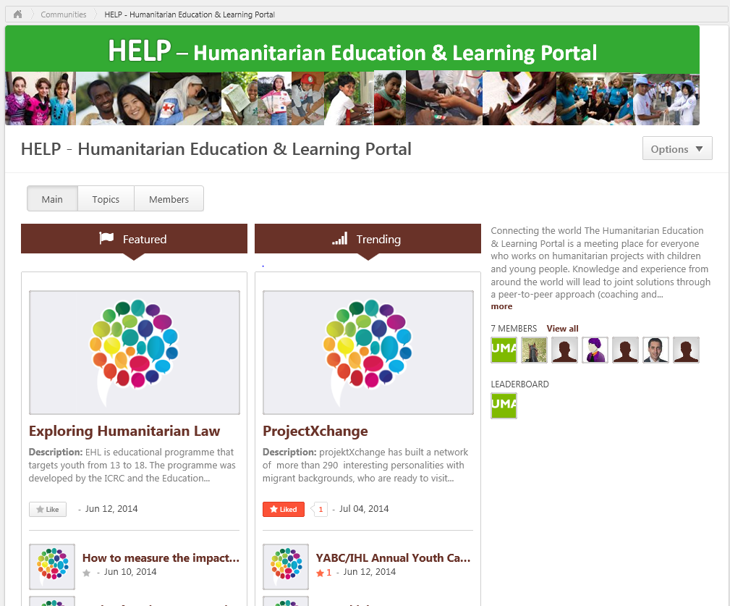
Notes:
How to used the Portal:
I arrive on the HELP Welcome page. On this page I can …
Find and read the HELP-Welcome message + all about HELP
Watch the HE video “Reach out – share – inspire” in 4 different RCRC languages
Submit a full HE-initiative (programme, project, activity) by using the HE initiative online template – for download through the link on the HELP Welcome page
Download the empty HE-initiative form
Complete the HE-initiative template, print and scan it
Attach the HE-initiative (pdf-scan) template when submitting and “posting” the HE-initiative on the HELP Community by “creating a file”
All HE-initiatives from already submitted by National Societies can be uploaded directly to the “HELP Community” and taken from the Excel or word doc which will be provided by us (no need to fill in the form again)
We will try to improve the online submission on HE-initiatives
Click on “Join the HELP Community” and follow the steps as advised later in this flow chart

Slide 24
Mid-term review of AP Regional Conference outcome
Notes:
From the hashtag, you can also see some further voices and ideas related to this title which individuals have been posting.
#RC21C is planned to be used during the 5th Asia Pacific Communication Forum where “Social Media” had identified to be its theme.

Slide 25
Beijing Youth Commitments 2014
Beijing Youth Commitments 2014
9 commitments | 5 Calls
Contributing to the HD efforts of the NS | NS to effectively participate and represent Youth in the Regional Youth Network (YN)
Innovative use of Social Media and communication technologies
Taking lead in developing/revising Youth policies and Y.E.S. | Regional YN’s action plan to be implemented
Designing “Youth-led and NS owned” projects in all programmes, especially in the DRR and Safe Schools Framework | Youth Development to be implemented in IFRC’s technical department’s operational plans
Creating global toolkit on Youth | Youth Commission’s zone-level work plan to be implemented
Participating in the IFRC global processes (eg. Constitutional review, S2020 review)
 | Continuous organization of Youth Summit prior to Reg Conf and Youth leaders to be participating their NS’s delegation in the Reg Conf
Preparing, participating and following up regional/international meetings with NS
Organizing Youth Summit prior to Reg Conf
Contributing to implement the “Beijing call for Innovation”
Notes:
The Asian Pacific Youth Summit had become a milestone to arise the discussion on “How Youth are working as ‘Young Humanitarians’ in every single corner of the RCRC services”.
As we look into the existing tools, the AP region has its own Regional Youth Network. APYN contributed the youth development in the region over the last 4 years, yet they have faced many challenges and some of the key functions were time to time facing difficulty in delivered as it was initially planned.
Through this youth Summit, youth delegates discussed and agree on the function of the Youth Networks--- to restructure the youth network in to a bottom-up structure: in other words to recognize and respect the NS’s needs and bring those needs and expectation to a global decision making.
Therefore, the strong focus had been on “identifying the NS challenge in terms of Youth Development”, “Identifying the NSs challenge in service delivery” and “identifying a regional connection in those challenges”, so that these discussions and identified challenges and connections could simply transit into an Plan of Action for each Sub-regional Youth Networks.
Following these identification, from Dec 2014-Feb 2015, action plans for each Sub-regional Youth Network (South Asia, Southeast Asia, Pacific, East Asia) have been in progress of its development.
These 4 PoA will then be collected and APYN as a cross over and zonal Network will further strengthen its 4 function pillars (Resource Centre/Communication Channel/Think Thank/Advocacy Platform) to support these 4 PoA and become a relevant platform for all 37 NS in Asia Pacific.
This final Action Plan of APYN shall be finalised in April 25-28th 2015, during the APYN Steering Committee/Coordination Committee member’s meeting.
So far, Afghanistan RC and Bangladesh RC Youth Leaders are one of the 9 SC/CC members of APYN.
Along with such development of the Action Plans of each Youth Network, a concrete outcome was stated at the closing of the Youth Summit.
This statement “Beijing Youth Commitments 2014” is consisted of 9 commitments from the Youth who see themselves as “Young Humanitarians” who are in the frontline of the RCRC services. These 9 statements were made so that the Youth commit themselves to do better and strengthen its RCRC service and its NS.
Also, to allow such commitments to be formed smoothly and also to allow their Youth Network Action Plans to be implemented, they also made 5 calls to the NS and the IFRC secretariats.
When looking into all these statements, it is clear that when we talk about “Youth Development”, its outcome and impact is always in line with the “Better RCRC services”. Therefore paradoxical it is important to include Youth into all programme forming, all RCRC related discussions, all decision makings, as only then the 2 connection of “Youth Development” and “Better RCRC services” make an impact together.
Also, once again recalling the previous slides, in Asia Pacific, Youth consist 70% (in average) of the Active Volunteers.
Having youth, as those in the frontline of the services and in close connection with the community, into the discussion and decision making, NS will be making itself relevant to the real needs of the community.
Following are the details of what the Beijing Youth Commitments are staining:
9 Commitments from the Youth
1. Contributing to the humanitarian diplomacy efforts of our National Societies for respect of the emblem and the safety and security of volunteers and their safer-access to vulnerable people.
2. Championing the innovative use of social media and communications technologies to increase the effectiveness of our services and how we manage and share knowledge.
3. Taking a lead in our National Societies’ efforts in developing and / or revising national Youth Policies and Youth Engagement Strategies, while being informed by approaches applied in our sister National Societies.
4. Designing “Youth-led and National Society-owned” projects across all programmes and services of our National Societies, especially in the Disaster Risk Reduction and Safe Schools Framework.
5. Participating in development of the Global Toolkit for Youth Leadership and creation of Youth-led governance structures to foster youth participation in decision-making of our National Societies.
6. Participating in the IFRC global processes such as the Constitutional review, Strategy 2020 review, and the Fundamental Principles consultation to voice and elevate our regional needs.
7. Effectively preparing, participating, and following-up regional and international meetings through active engagement with our National Society leadership and peers.
8. Working with National Societies to continue organising Youth meetings prior to our Regional Conferences as a means to enhance and develop the role of young humanitarians as equal contributors towards shaping strategic direction of our humanitarian efforts in the Asia Pacific and Middle East.
9. Following-up and contributing to the implementation of commitments endorsed by the Asia Pacific Regional Conference.
5 calls to NS/IFRC
Effective participation of National Society youth representatives in the Regional Youth Networks,
2. Technical and expert support for the implementation of the Regional Youth Networks’ Action plans to be provided through the IFRC Secretariat structures,
3. Integration of Youth development into IFRC Secretariat’s technical departments’ operational plans at all levels to be ensured by the IFRC Secretariat structures,
4. Technical and expert support for the implementation of the zone-level priorities of the IFRC Youth Commission work-plan to be provided through the IFRC Secretariat structures, and lastly,
5. Continuous organisation of Youth Summits prior to Statutory Regional Conferences and inclusion of youth leaders into National Societies’ delegations at Regional Conferences.

Slide 26
Thank you
© International Federation of Red Cross and Red Crescent Societies, Geneva, 2014.
Add any information to copyrighted materials here.
Any part of this presentation may be cited, copied, translated into other languages or adapted to meet local needs without prior permission from the International Federation of Red Cross and Red Crescent Societies, provided that the source is clearly stated. Requests for commercial reproduction should be directed to the IFRC Secretariat at secretariat@ifrc.org
All photos used in this presentation are copyright of the IFRC unless otherwise indicated.
This presentation was written and developed by Naomi Akamatsu and produced in April 2015.
This presentation and relevant resources are available on FedNet at fednet.ifrc.org

