Slide 1
Overview of Red Cross Red Crescent in South-East Asia
Anne E. Leclerc
IFRC Head of Regional Delegation

Slide 2
Expectations
1. Each participant writes 2 expectations on different post-it (3mn)
2. In each table, share about your expectations as a group (5mn)
3. Each group shares in plenary the most important expectations (5mn)

Slide 3
Learning objectives
To learn about principles, strategies, programming, approaches and tools of Red Cross Red Crescent, in particular in the context of South-East Asia
To share among participants and with facilitators about good practices of collaboration between RCRC, governments and ASEAN

Slide 4
Agenda
 | Morning | Afternoon
Monday 27 | Introduction to the Red Cross and Red Crescent Movement | Disaster preparedness and response
Tuesday 28 | From recovery to resilience | Inclusive approach
Wednesday29 | Disaster Law | Communications and Advocacy
Thursday 30 | Field visit in Solo | Field visit in Klaten
Friday 1 | Field visit in Yogyakarta | Field visit in Yogyakarta
Saturday 2 | Debriefing session | Back to Jakarta

Slide 5
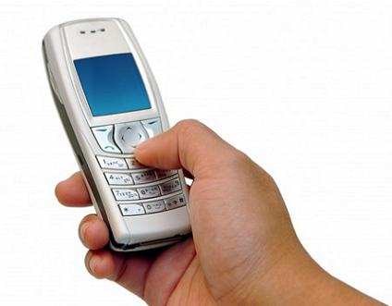
Rules for this week
Participate and voice our ideas – and let others to do the same
Respectfully listen when others presenting…
Attend all sessions - & on time!
Others ….?

Slide 6
Logistics / security

Slide 7
Pre-test and self-assessment
How much do you know about Red Cross / Red Crescent?

