Slide 1
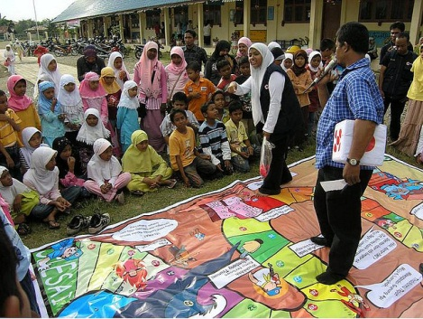
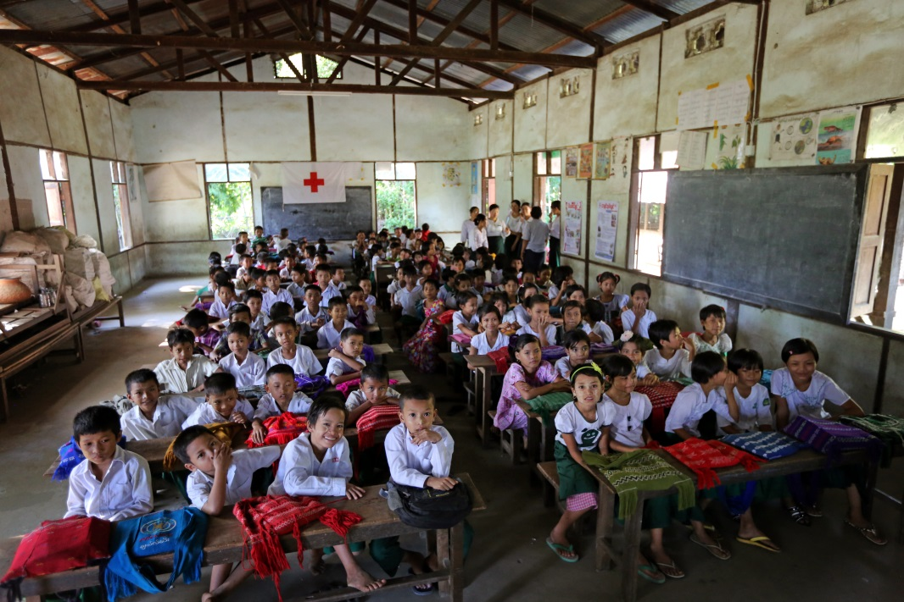
Red Cross / Red Crescent engagement in School Safety
a focus on Southeast Asia

Slide 2
Presentation outline
Our engagement within global and regional networks
IFRC supporting National Societies in school Safety
National Societies working in schools around the region
Key messages

Slide 3
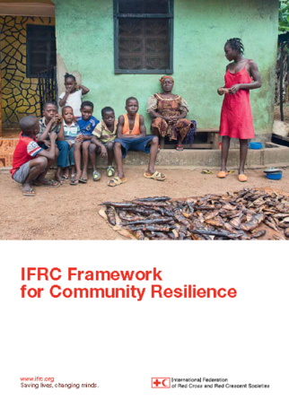
Global and Regional Commitments
Global
Regional
ASEAN Safe School Initiative (ASSI)
Notes:
At Global level
1/ IFRC is one of the members of The Global Alliance for Disaster Risk Reduction and Resilience in the Education Sector (GADRRRES)
The main purposes of GADRRRES are to strengthen global coordination, increase knowledge, and advocate on risk reduction education and safety in the education sector. The work of the Global Alliance ultimately contributes to a global culture of safety and resilience through education and knowledge. The GADRRRES adopted also the CSS framework and supports the Worldwide School Safety initiative among governments promoted by UNISDR.
2/ IFRC launched its One Billion Coalition for Resilience (1BC) in Sendai to promote partnerships towards more resilient communities (including schools). This is now being rolled out in regions and countries.
At regional level
- IFRC is part of the Asia-Pacific Coalition on School Safety (APCSS) and supports its strategic plan with joint advocacy initiatives as well as an effort to better harmonize our actions at regional level.
- IFRC was also involved in key steps of the ASEAN Safe School Initiative (ASSI) , such as the consultation processes around the ASEAN framework on school safety and the 1st ASEAN conference on School Safety in 2015.

Slide 4
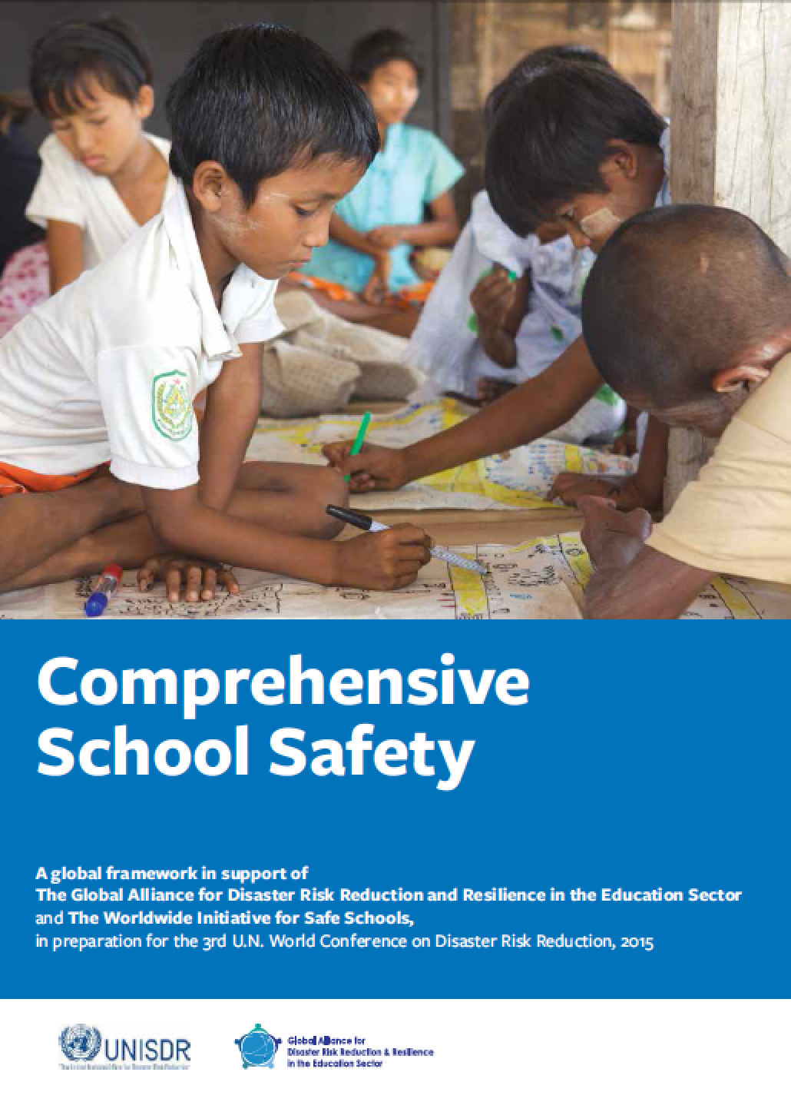
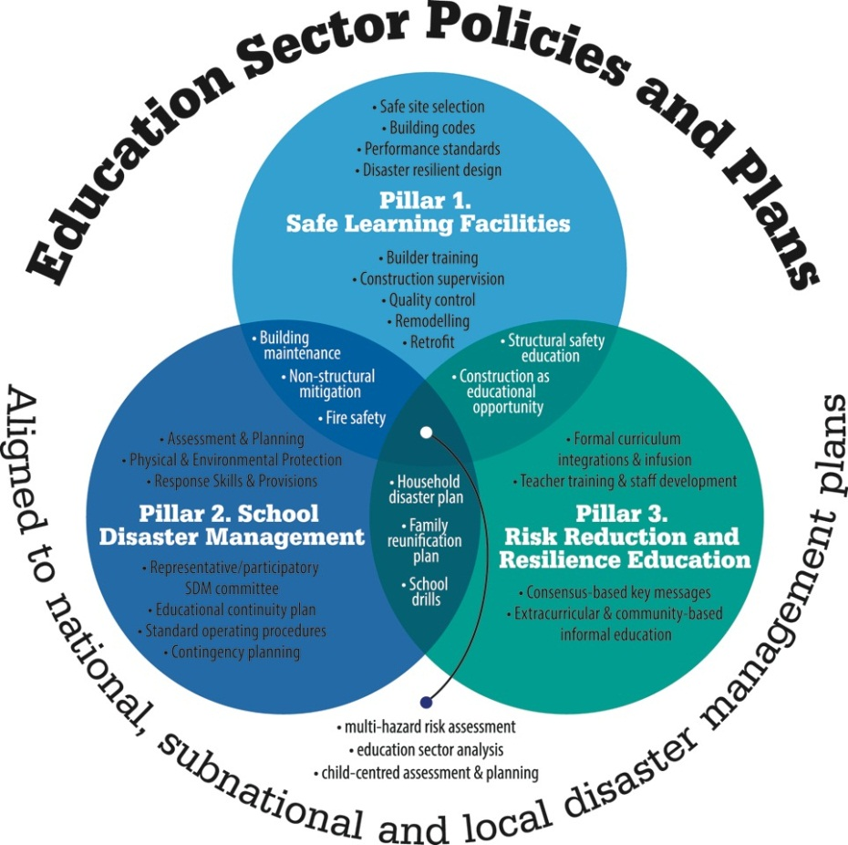
Notes:
Option slide – most probably already presented by previous speakers

Slide 5
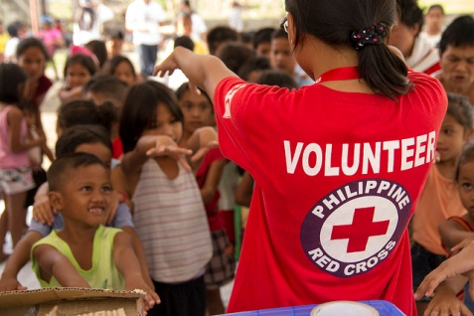
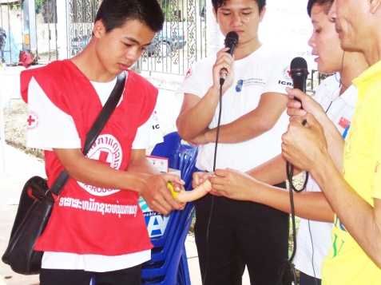
Presence in Southeast Asia
11 RC/RC National Societies in South-East Asia (incl. Timor Leste) with country wide networks
1 Million Volunteers and 4 million Youths
Auxiliaries to national governments (cooperation with NDMOs and Education authorities)
From local to global: the IFRC Secretariat is supporting and representing National Societies

Slide 6
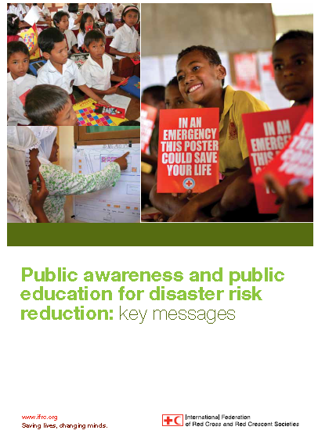
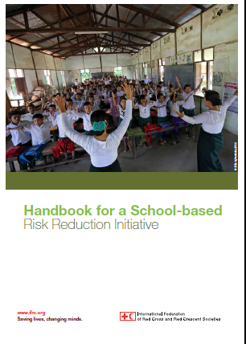
Support to our network and to partners
Public Awareness and Public Education (PAPE) for DRR: guide and key messages (2011). Ongoing adaptation by various stakeholders.
Handbook for school-based risk reduction initiatives (2015)
Piloting of a “Youth in School Safety” toolkit in September 2016
Systematic knowledge management: gathering tools in our online library (link on the last slide)
Initial discussions for a comprehensive mapping of school-based initiatives by National Societies across Southeast Asia
Notes:
These are key resources developed in recent years to support our network of National Societies.
The PAPE toolkit is a global partnerships with several organizations such as Save the Children
The handbook (2015) compiles tools and experiences from our region and provides guidance to NSs on how to maximize existing relationships with national authorities
The Youth in School Safety toolkit is an effort to bridge the gap between youth-led initiatives in schools and DRR/health project approaches
The planned mapping would feed into the ASSI mapping being initiated (will be presented by Nadia on day 2)

Slide 7
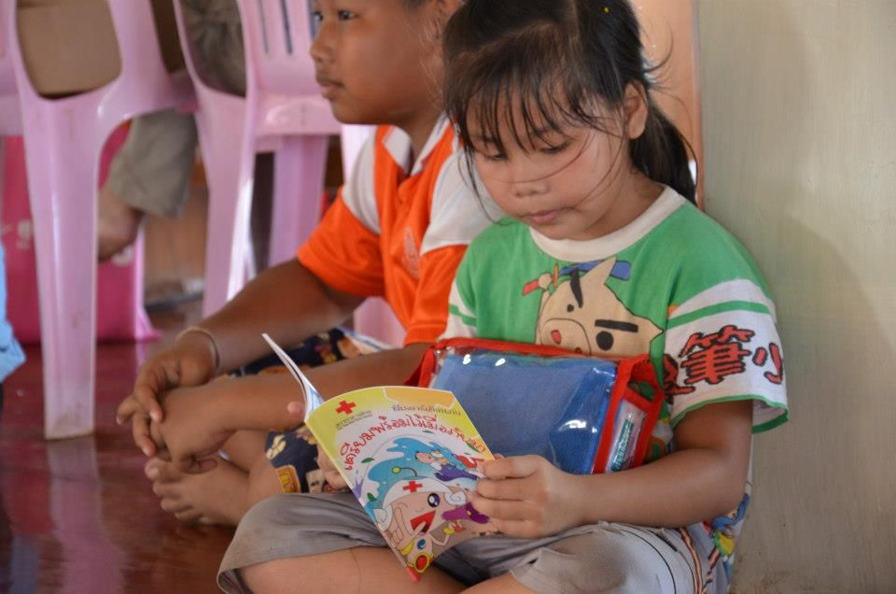
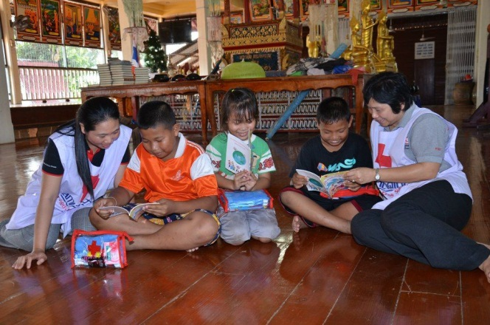
Engagements in school safety at national level
Throughout ASEAN countries, National Societies engage in schools in various ways (youth clubs, campaigning, DRR projects, hygiene promotion, etc.)
There are existing cooperation mechanisms with governments (NDMO, health, education, etc.)
Youths and volunteers have a potential to scale up such initiatives

Slide 8
Challenges…
School safety activities are often based on short-term projects
They often focus on a specific sector (DM, DRR health, first aid, WatSan, Road Safety, youths development…) and are often not integrated
Knowledge about policies and tools is often not systematically shared.
Data about the interventions is not available in a single report

Slide 9
Key messages
Build more systematic and formal partnerships with governments and other key stakeholders in each country
Contribute to harmonization of tools, models, frameworks as the key for long term systematic approach to building resilience in education
Actively engage on joint actions (National Societies – governments – partners) in schools
Enhance the documentation of the Red Cross Red Crescent contribution to school safety in ASEAN

Slide 10
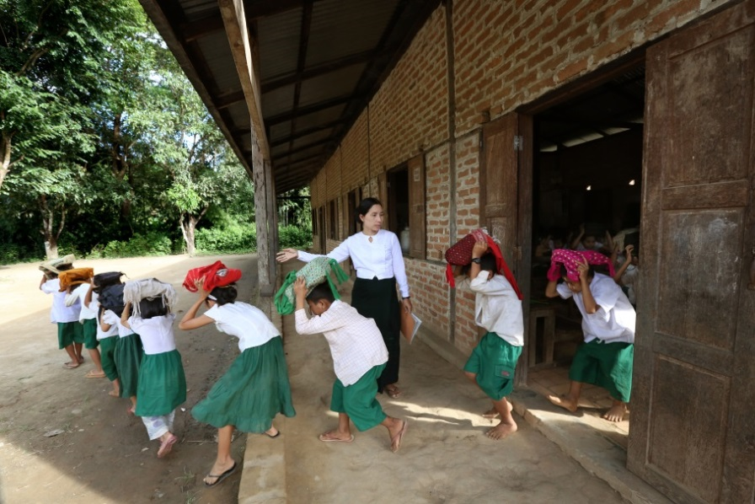
Thank you!
For more information visit:
Public website:
www.ifrc.org
Online library:
https://sites.google.com/site/drrtoolsinsoutheastasia/

