Slide 1
Strengthening Movement Cooperation and Coordination - SMCC
The scope of the work was to focus on improving the coordination of the Movement’s collective operational Preparedness and Response to Large-scale Emergencies.
A large-scale emergency is defined as a situation of Disaster, Armed Conflict or Crisis requiring a Movement-wide response.

Slide 2
SMCC
Movement Cooperation and Coordination

Slide 3
Movement Consultation through four Reference Groups
Strengthening leadership and coordination roles
Scaling up the Movement’s operational preparedness, response and recovery work through coordinated and aligned operational plans, tools and mechanisms
Promoting coherent and well-coordinated internal and external communications
Exploring new Movement-wide resource-mobilization approaches.

Slide 4
Movement wide Resource Mobilization
Internal and external coordination
Scale up coordinated and aligned
Strong Leadership & Coordination Roles
24 hrs
48 hrs
72 hrs
7 Days
30 Days
90 Days
1 year

Slide 5
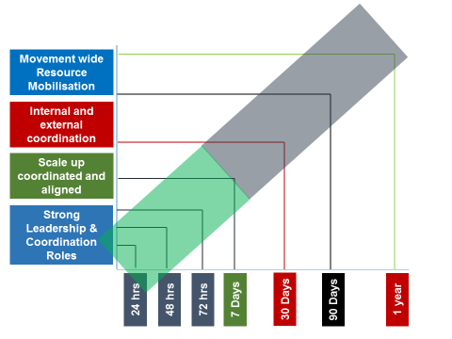
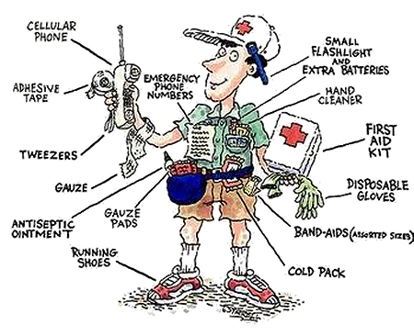
National
Regional
Global

Slide 6
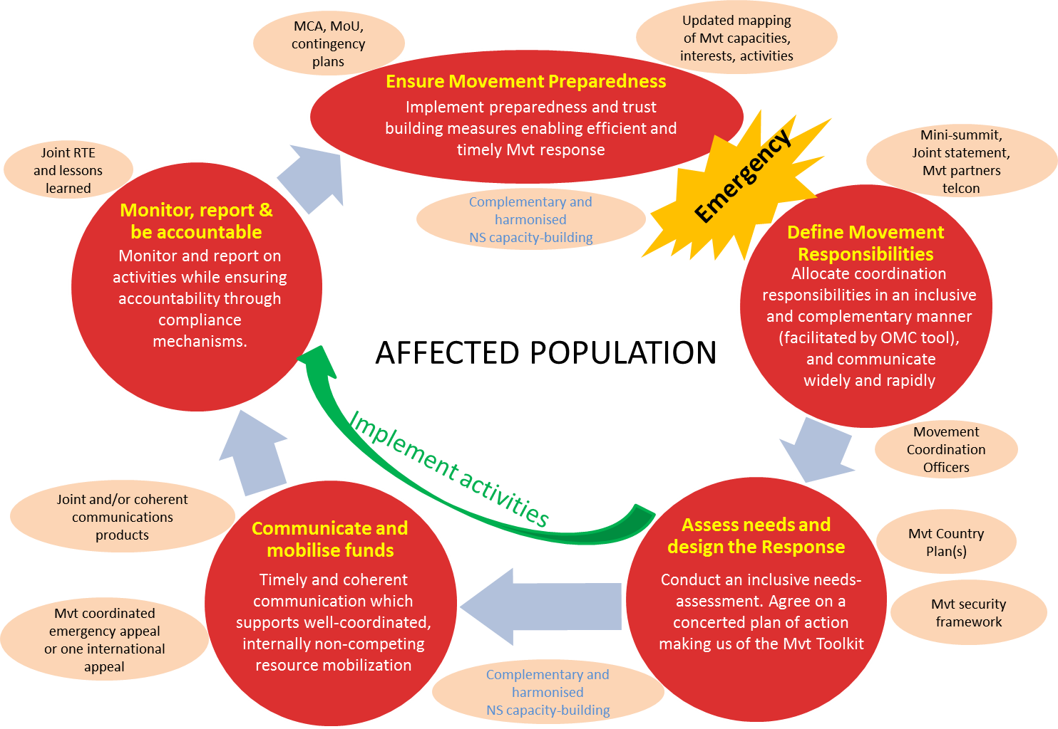
The Response Cycle

Slide 7
Expected results 2017 ……
Report back to the Council of Delegates
(End of 2017)
Demonstrate progress
(Success in response, preparedness enhanced, piloted tools, etc.)

Slide 8
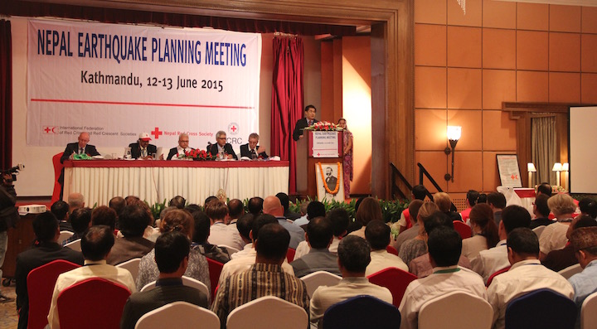
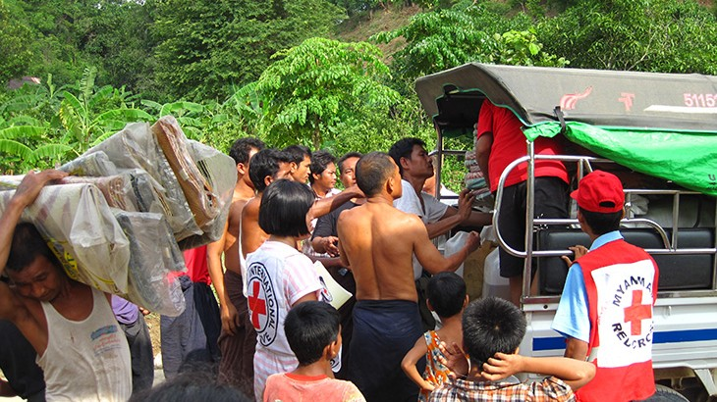
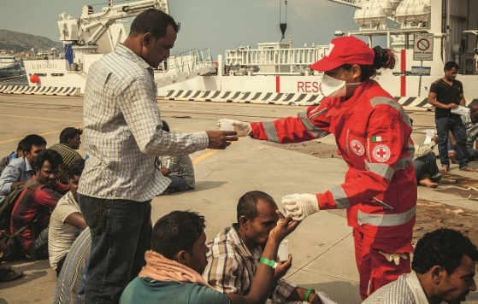
Some Milestones….
Nepal Earthquake
(Seen as Movement response)
Myanmar Floods
(Complementary action in support of NS)
Migrant Crisis
(Complementary / Coherent approach)

Slide 9
“Front Door”
Fundamental Principals
Legal Base
Auxiliary Role
Principles and Rules for HA
Local
National
Regional
Global
ONE
Plan
Action
Voice
Movement
“Go to Partner”

