Slide 1
South East Asia Youth Network
Review 2015-2016
Successes and Challenges

Slide 2
1. Seayn

Slide 3
Coordination Team (2015-2016)
Chair Malaysian RC
Co chair, APYN SC member
Deputy Chair Philippines Red Cross (2)
Officer Singapore Red Cross (2)

Slide 4
SEAYN
To enhance NS service delivery by improving communication, mobilizing the resources for youth development through regional youth actions in the aspirations for positive change.
Purpose/Goal
5 Key functions; OPD Opportunity; explore for national youth programmes , peer to peer support and election of their leaders, Coordination team . Project; develop and implement and even regional joint project. Platform; to information knowledge, data best practices Dissemination; global agenda and SEA youth network Discussion; issues and concerns of youth jointly
Function

Slide 5
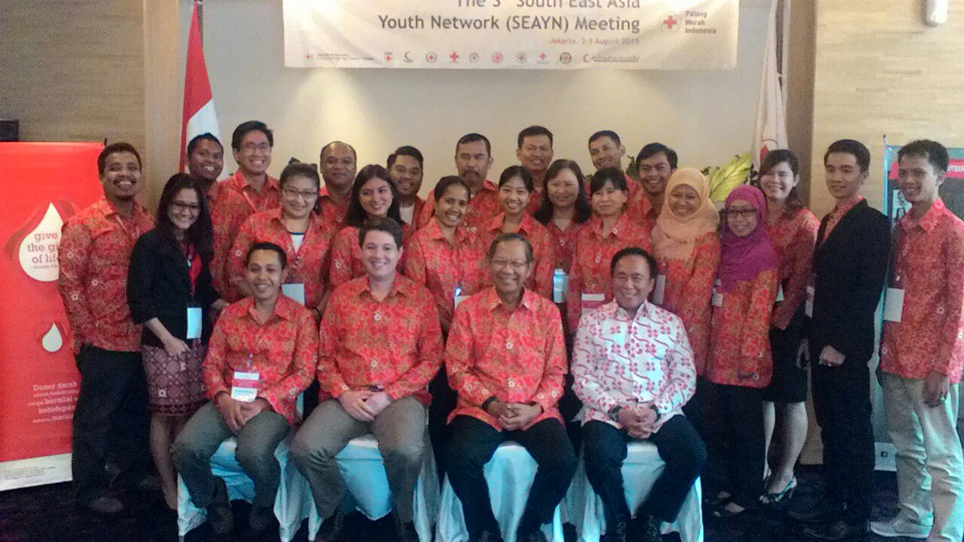
3rd SEAYN meeting in Jakarta Indonesia (August 2-3)

Slide 6
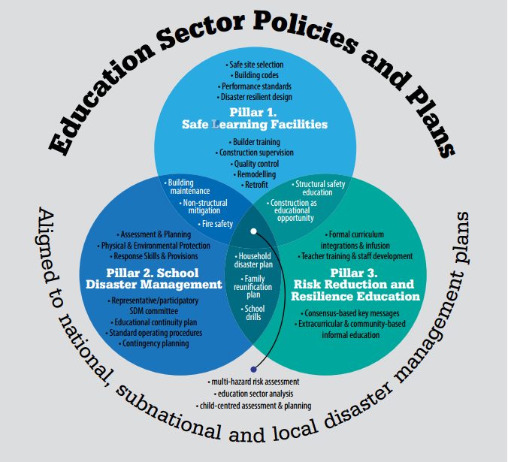
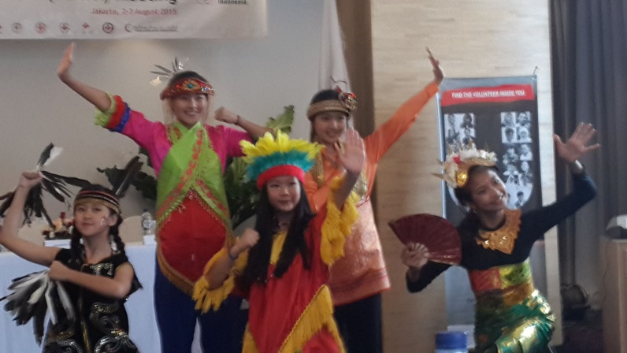
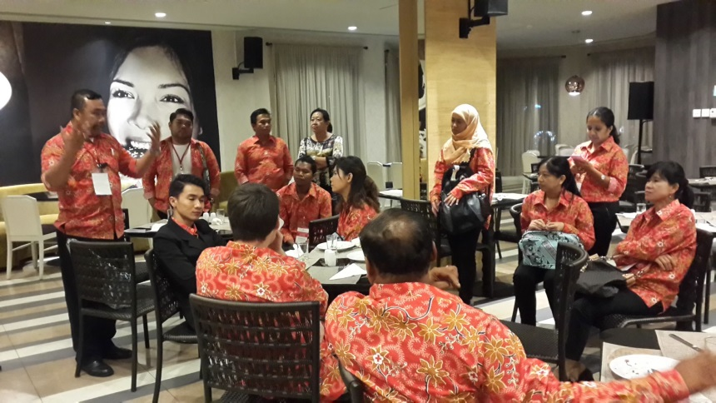
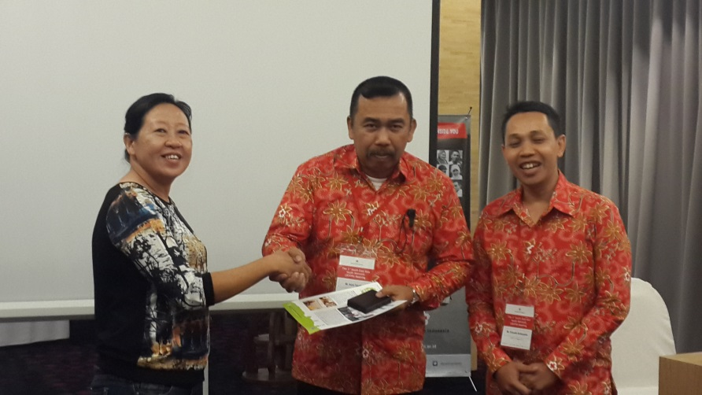
Youth in SS DRR

Slide 7
2015-2016 Regional Action Plan
1. Advocacy of SEAYN; Development of SEAYN Case study with good practices of NS
Indicators: 6NS; PMI, Myanmar, VNRC, SRC, BDRC, CRC(TBC)
2. Youth champion on Social media including IT initiative and in humanitarian action and promotion of RC learning platform
Indicators: 11 NS establish of national webpage/facebook, increase No of learning platform users
3. School Safety (SBDRR- child friendly) tool incorporated into existing programme /continued in ALL NSs and strengthened
Indicators: 6NS; MalRC, PMI (review), SRC, CVTL(review), BDRC, MyRC(Discussion)
4. Youth Empowerment Programme initiatives
Indicators: YABC (8NS; MalRC, PMI, CVTL, VNRC, BDRC, SRC,MyRC,TRC)
Leadership Programmes(6NS; MyRC, PMI,MalRC, SRC,VNRC, BDRC)
Non-Violence Peace Programme (5NS; PMI, CVTL, TRC,MyRC, BDRC)
5. Peer support and youth exchange facilitation thru webinar, events, conferences, networking, capacity building for members for the development of Youth and Volunteers
Indicators: MalRC - annual meeting, 11 invitation to national events, deployment of members to some trainings thru support of IFRC

Slide 8
SEAYN Action Plan Implementation 2016
No | Action plan | Indicators | NSs in PLAN | NSs completed action | Remarks
1 | Case study | 5NS | PMI, Myanmar, VNRC, SRC, BDRC, CRC | CRC, MalRC
2 | Facebook opening | 11NS |  |  | Not reporting
3 | School Safety Tool | 11NS | ALL | ALL | YSS Training in Malaysia
4.1 | YABC | 7NS | MalRC, PMI, CVTL, VNRC, SRC,TRC, PRC | VNRC, SRC, PRC | Planning for Lao, MalRC, CVTL, PMI
4.2 | Leadership | 7NS | MyRC, PMI,MalRC, SRC,VNRC, BDRC, PRC | PRC, PMI | Planning for MyRC, SRC, BDRC
4.3 | NVP | 5NS | PMI, CVTL, TRC,MyRC, BDRC, PRC | PMI
5 | RCY Event for SEAYN | 11NS | MalRC | MalRC

Slide 9
Success
Coordination and Cooperation
Active support from members to network.
Frequency is raised to join the online meetings and Chair and CT ownership is increased.
Meeting minutes shared in timely manner.
2. Recognition by Other Sectors and Management
Sharing funds for the SEAYN Action from DM, IFRC, Donors
Engagement of SEAYN Chair to events, listened to voice of youths

Slide 10
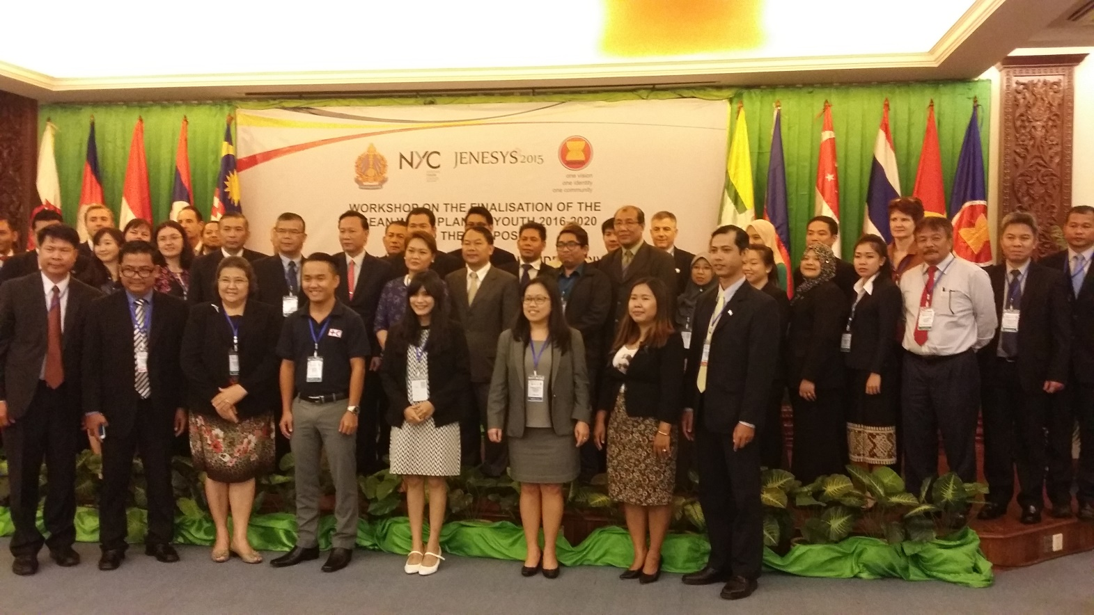
ASEAN Youth Development Index
Workshop on the finalisation of the ASEAN work plan on youth 2016 – 2020
14-15 March 2016

Slide 11
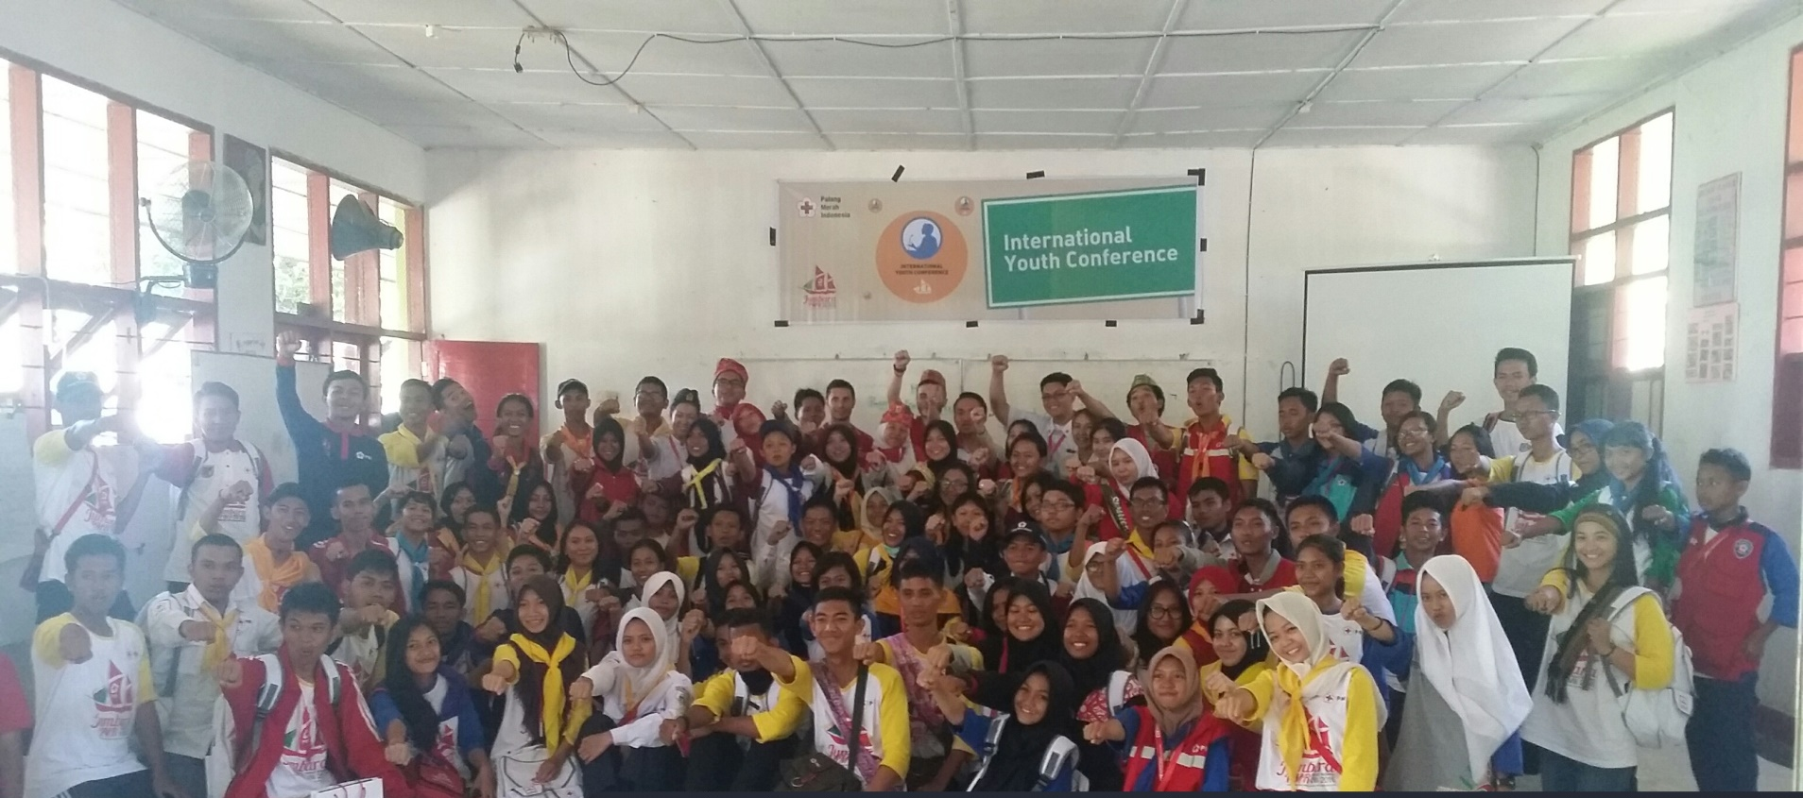
International Youth Conference
Jumbara, Pangkep Indonesia
25 – 31 July 2016
Italy Red Cross
Cambodia Red Cross
Thailand Red Cross
Myanmar Red Cross

Slide 12
Challenges
Reporting to SEAYN was not carried on regular basis. information update is limited and not captured thru Newsletter, FB
Advocacy is limited to leadership (case study, SEAYN Page)
CT engagement was not regular
Members leave and replacement
NS FB and National Youth Network Establishment was not implemented

Slide 13
Your ideas/suggestions tomorrow for the Working system.

Slide 14
Thank You Very Much

