Slide 1
July 2016
ONE BILLION COALITION
FOR RESILIENCE in AP
Notes:
IFRC-convened initiative as a contribution to the SDGs, Sendai and Paris Agreement.
A partnership platform and joint strategic planning tool.
No formal, unified platform has been established to formally register partners. However, in addition to the 10 National Societies having signed the 1BC pledge, the 1 BC has served as a framework for engagement with ASEAN, Bangladesh and Mongolian governments as well as GRAB, Prudence Foundation and Visa. A more robust framework for collaboration and partner engagement will need to guide intensified guidance and support to NS rollout and potential regional initiatives in Q3 and Q4, in correlation with common, global registration platform. The aim remains to have registered at least 15 partners by the end of the year.

Slide 2
ASIA PACIFIC HUMANITARIAN LANDSCAPE
icon
800 million vulnerable people in AP, one in five live with less than US$1.25 a day
icon
60% of the world hungry people live in Asia Pacific
icon
98,6 million people affected by disasters (2015)
icon
41% of the population in AP have no access to sanitation, 8% have no access to safe drinking water,
icon
One billion people could be displaced by climate change by 2050
Notes:
Speaking points
Critical initial step: What are critical vulnerabilities, risks and humanitarian trends at country or regional levels
Regionally:
Although gains have been made, one in five people in developing regions still live on less than $1.25 a day, and there are millions more who make little more than this daily amount, plus many people risk slipping back into poverty.
Around 100 million are affected by natural disasters every year and numbers are likely to grow as extreme weather events become more severe.
Conflicts are becoming more brutal, forcing more people from their homes. The number of people forcibly displaced at the end of 2015, over 65 million, was the highest ever recorded
Every dollar (USD) spent on preparedness saves seven dollars in emergency response. Failing to act early to mitigate preventable and predictable crises (like food, health and migration crises), and failing to adequately invest in reducing the risk of natural hazards like floods, earthquakes and tropical storms, costs millions of dollars.
Short-term shocks, even in the absence of a disaster, can have long-term consequences that reverse development gains.
The statistics say it all and, as we know, disasters and emergencies are becoming more frequent, and conflicts more complex.
Organizisations and programming within organizations are silo-ed.
Even integrated programming does not go far enough to bring together organizations working on similar issues or with similar communities.
The aid and development sector must change the way it works to be more collaborative and more proactive.

Slide 3
GLOBAL OUTPUTS: FIVE INTERCONNECTED PLATFORMS
Web-based platform for digital ecosystems
CSO partnership platform
Business continuity & employee engagement platform
1BC
Operations platform
Advocacy platform
Notes:
Talking points:
There will be many different tools evolve over time, as partners join the 1BC, bringing new resources and services, and as we respond to the needs of communities and coalition members.
But we are going to begin with these. Specifically, this is where has competence and can add value immediately to kick-start activities and coalition building, resulting in benefits on the ground.
Web based ecosystem of services
Offer a set of progressive opportunities for online and offline engagement of individuals, organizations, and communities on risk assessment and resilience-building via the web, mobile devices, and social media:
one billion users by 2025
Training in life skills, info, peer support, menu of solutions
Shared space for partners
Apps to assess risks and strengthen resilience
Business continuity & employee engagement platform
Offer a scalable and adaptable suite of business continuity tools and services, developed and source in partnership with committed stakeholders and subject matter experts for use globally by Red Cross and Red Crescent (RC/RC) National Societies (NS) and partner organizations
500,000 SME able to accelerate recovery time, forge more resilient supply chains, promote stronger linkages to government support and greater coverage of potential losses through insurance.
CSO partnership platform
Provide a publicly accessible platform that maps out and nurtures 1BC coalition members down to the community level
The CSO platform will help the 1BC to harness the potential of community-level organizations by increasing their visibility, transparency, accountability and capacity, ultimately leading to more effective partnerships at the local level.
The CSO platform will provide valuable insight into the organizational ecosystem and contribute to increasing accountability towards communities.
Advocacy platform
To influence decision makers and opinion leaders to create or change policies, legislation or practice that promotes resilience
Iterative process designed to guide implementation through: 1) Knowledge management and communication, 2) Policy analysis, 3) Strategic partnerships 4) capacity development, Policy and 5) engagement
Operations platform
Millions of partners are connected and working with communities to address priority risks and design local solutions to build resilience
190 NS, 160000 branches and partners working in communities to map out risks and vulnerability, implement resilience-building programmes, collect data for decision making and measure impact.

Slide 4
Enhance partnerships with local and national institutions
To engage xx people and xx organizations to overcome
Conflict
Risks
Vulnerabilities
Hunger
Crisis
Disease
so they can have safer, healthier and more resilient communities that are more
Prepared
Healthy
Knowledgeable
Organized
Connected
with better access to
Infrastructure
Services
Economic opportunities
Natural assets

Slide 5
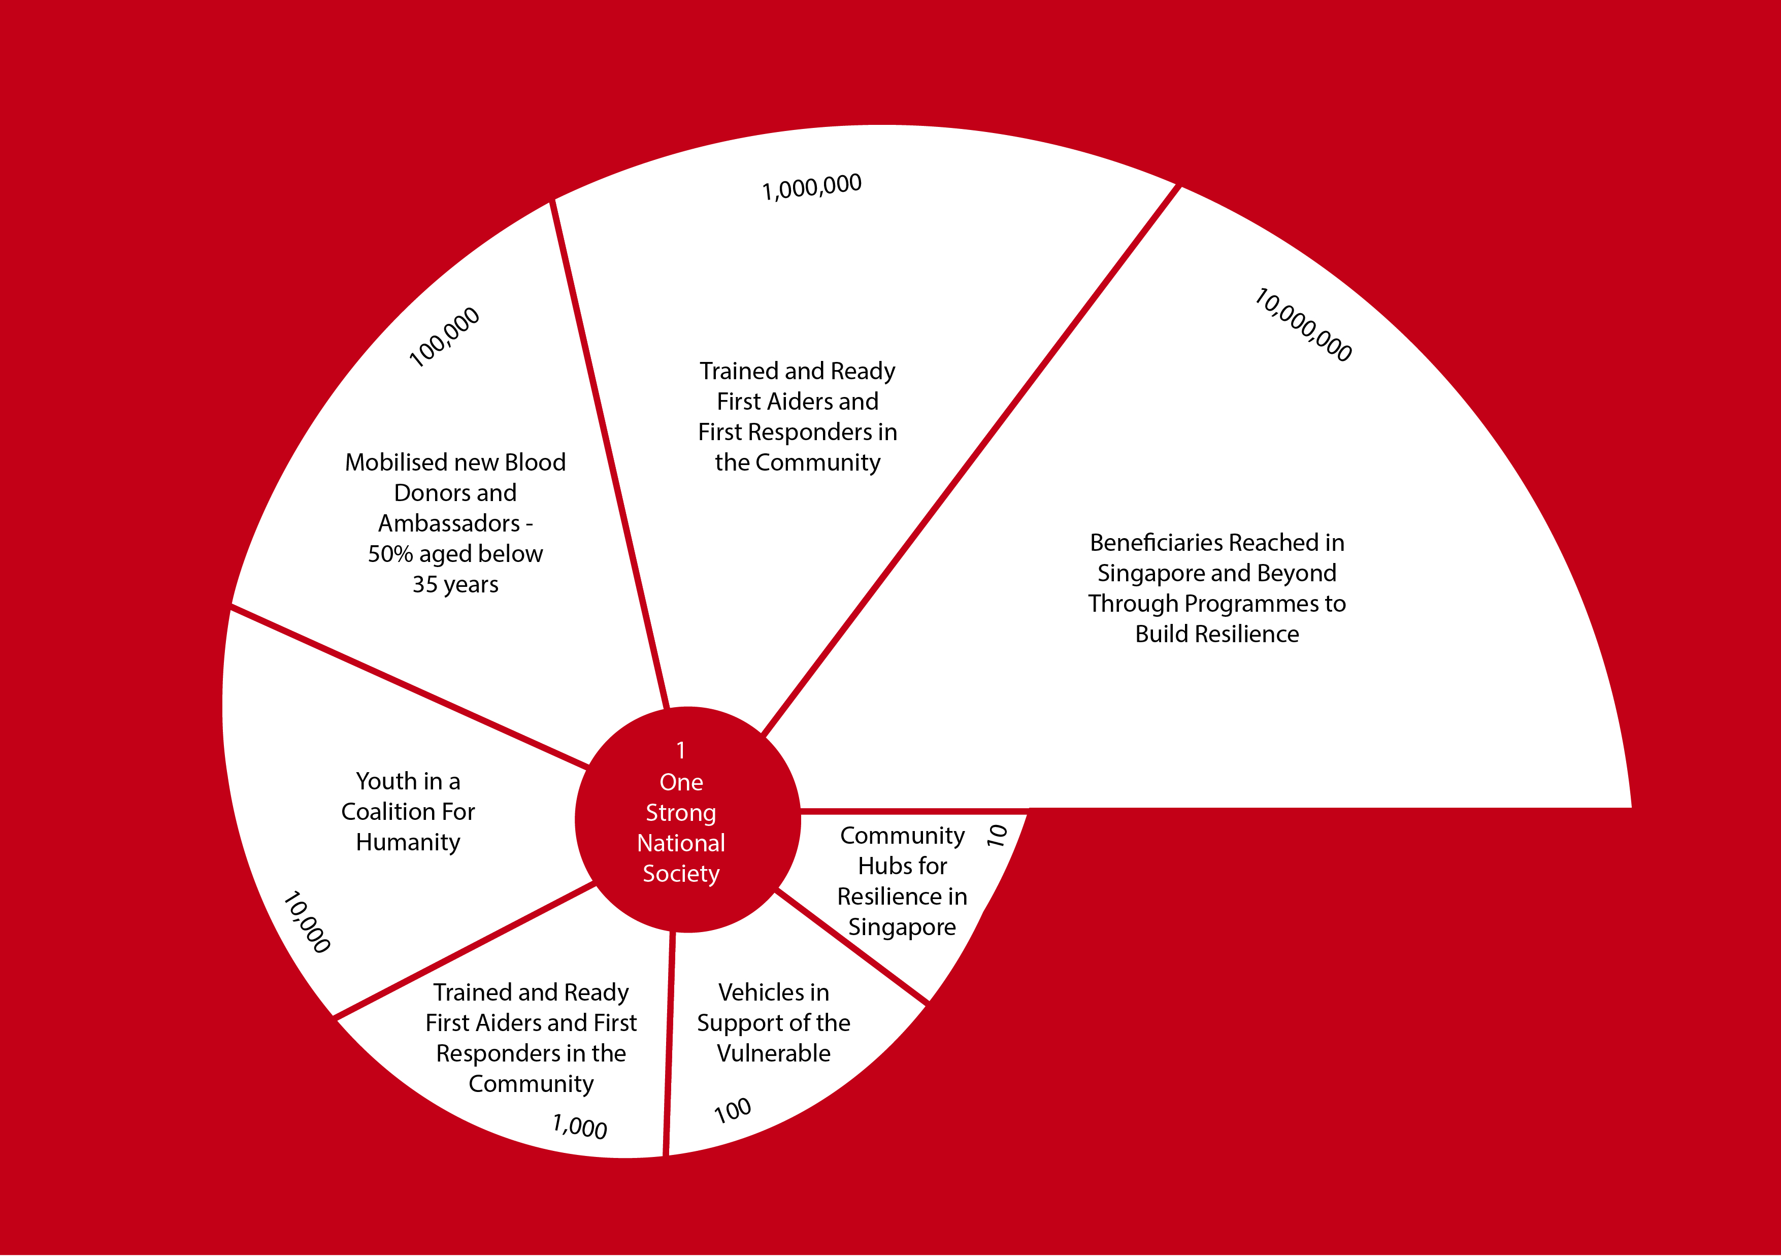
SINGAPORE RED CROSS’ APPROACH
Notes:
How Singapore RC ‘conceptualize’ the implementation of the 1BC as a driver of its strategic plan and based on high level measurable, nation-wide outcomes commensurate with Singapore’s population and including international programming

Slide 6
Nation-wide ambition / targets
Based on vulnerability analysis
Goal: XX million people enabled to be safer, healthier and more resilient across the country by 2025
Targets (examples) included in NS strategic plan:
- Number/percentage of people trained in first aid, road safety, disaster preparedness by 2025
- Number of schools reached by 2025
- Number of small businesses made disaster resilient by 2025
- Number of people supported in DRR, health, access to water by 2025
……
Notes:
From diverse:

Slide 7
Leverage existing regional initiatives
AP Reference Centre on DRR and Community Resilience – Korea/ Asia Pacific
Regional resilience initiative - ASEAN countries
Partnership for resilience – India, Indonesia, Philippines
Coastal cities project – Indonesia, Vanuatu
AMCDRR thematic event and commitment
Notes:
Talking points:
Reference Centre on DRR and Community Resilience
Partnership for resilience – India, Indonesia, Philippines with a focus on advocacy and climate change (Coalition of host NS, CSOs, Netherlands RC, Climate Centre, Netherlands-based NGOs.
Regional initiative for resilience – ASEA countries with a focus on advocacy (initiated by Canadian RC/Canadian Govt
Coastal cities project – Indonesia, VanuatuThe Global Disaster Preparedness Center (GDPC) in collaboration with the IFRC and American Red Cross has received an award from USAID/OFDA to design and test a set of tools and services to assist NS
and their partners to create effective city coalitions on community resilience, targeting climate smart resilience and coastal risk reduction.
AMCDRR thematic event and commitment – Thematic event on 1BC and invitation of governments to join eh 1BC

Slide 8
WHAT DOES SUCCES LOOK LIKE BY 2020?
30 National Societies and 15 governments have joined and/or launched the 1BC in their respective country
10,000 partners (public institutions, schools, corporates, academics, CSOs…) have joined and engaged in the 1BC
2 million volunteers trained in community-based early warning, disaster preparedness and response and recovery
200 million people supported through resilience-building activities (disaster risk reduction, water/sanitation, livelihoods, shelter, social inclusion)
500 million people equipped with live-saving/life-protecting skills
Notes:
Talking points:
In 2014, the collective of IFRC and NSs was mobilising 9 million volunteers through 120,000 local branches and reaching 77 million people with disaster response and longer-term programmes activities.

