Slide 1



March 14-18, 2015 www.wcdrr.org
Cambodia 25-27 February 2015

Slide 2

WCDRR Objectives
a) To complete assessment and review of the implementation of the Hyogo Framework of Action (HFA).
b) To consider the experience gained through the regional and national strategies/institutions and plans for disaster risk reduction and their recommendations as well as relevant regional agreements under the implementation of the HFA.
c) To adopt a post-2015 framework for disaster risk reduction.
d) To identify modalities of cooperation based on commitments to implement a post-2015 framework for disaster risk reduction (HFA2).
e) To determine modalities for periodic review of the implementation of HFA2.
Cambodia 25-27 February 2015
Notes:
HFA is the global framework guiding DRR. All governments of the region have committed to it and it is widely used as a reference for laws, policies and programs related to DRR.
National Societies are contributing to the HFA through their DRR and Health initiatives, although their action is not always well captured in Government reporting mechanisms.
Recently, Myanmar and Thailand drafted their HFA contribution report. PMI is now starting and SEARD stands ready to support other NSs interested. In fact, PMI already did a report (“Light Up”) back in 2008 which helped their positioning with government authorities at the time.

Slide 3
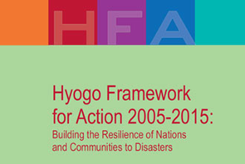
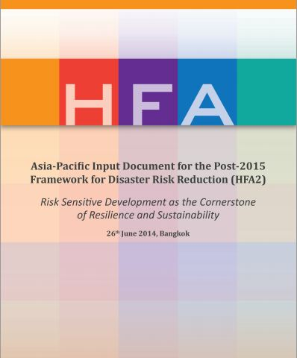

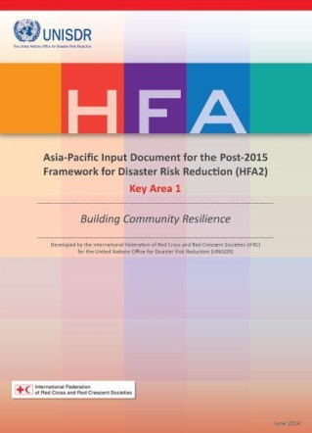
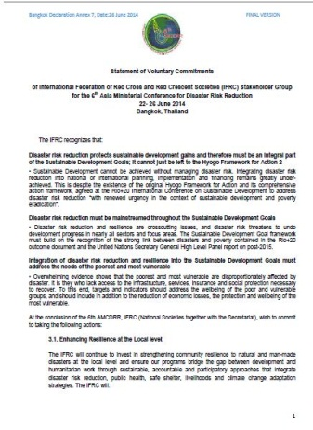
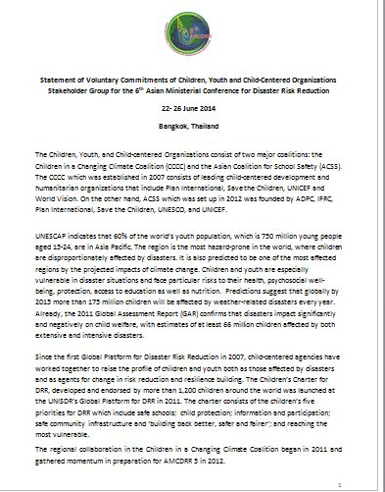
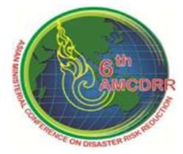

Cambodia 25-27 February 2015
Notes:
As an active member of the UNISDR system and with the firm commitment to improving the lives of vulnerable people by reducing vulnerability and disaster risks, the IFRC has actively contributed to the key international DRR initiatives and to the implementation of the HFA.
IMAGES SOURCE: Indira’s PP presentation from Regional Resilience Workshop (Bangkok, Feb 3-5)

Slide 4
Red Cross Red Crescent Objectives
Ensure the key documents of the WCDRR including HFA2 are strengthened by the experience of the RCRC and increase their focus on the situation of the most vulnerable;
b) Create an enabling environment for the RCRC work for DRR and resilience;
c) Promote the RCRC work for DRR and resilience towards governments and international community;
d) Build partnerships and strengthen relationships, with different stakeholders.
Cambodia 25-27 February 2015
Notes:
The WCDRR will be an important event for the IFRC to contribute to the adoption of the HFA2 and reiterate its commitment to DRR and resilience strengthening. It will impact on national policies and plans of the governments (and ASEAN) in the next 15 years, which is why National Societies should be part of it (as a key contributor to the resilience agenda) and should use the momentum to reinforce their partnership with their government counterparts, after Sendai.
Here are some possible Humanitarian Diplomacy objectives for the event:
National Societies can play a role in supporting their governments to establish / strengthen national platforms or any other form of coordination mechanism among actors working on resilience. This is at the heart of HFA.
National Societies can play a role in promoting the voices of the most vulnerable to inform national-level policy processes and decision-making in general. This has proved to be successful through the Disaster Law programme which is gaining momentum in our region.
The new IFRC Community Resilience Framework (Nov 2014) provides guidance to NSs in terms of integrated approach for community resilience. It is about integrating DRR within development work, at community level, through the youth and volunteers networks and in interaction with local and national governments.
Partnerships remain key to enhance community resilience, and conferences such as Sendai can be a good opportunity to explore new ways of engagement and collaborations.

Slide 5
Our regional contribution
Attendance of representatives from National Societies in SE Asia. IFRC is supporting travel costs (32 000 CHF)
Contribution of financial support (10 000 CHF) to the ‘Road to Sendai’ campaign
Promotion of the work of SE Asia National Societies via Road to Sendai story submissions (20+ stories gathered from Indonesia, Philippine, Timor-Leste, Myanmar, Cambodia, Laos, and Viet Nam Red Cross so far)
Regional social media plan promoting the efforts of National Societies to build resilience to disaster
Cambodia 25-27 February 2015
Notes:
Road to Sendai Story Submissions: Among the stories are ones such as building livelihoods in Timor-Leste, training women firefighters in Myanmar, preparing for climate change in Viet Nam, and the resilience and solidarity of Thai communities and disaster response authorities in the face of Thailand's 2011 floods.
Attending from the region:
*NB There is one youth attending from the Cambodia RC (Ms. Hang Pisey), funded by the Finnish RC
Also one Youth Delegate from Thai Red Cross (Mr Withtawat Suntawan) – self funded.
* IFRC is also partially funding the NDMC Cambodia representative, HE Ma Norith
Philippines RC
Mr. Richard Gordon - Chairman
Indonesia RC
Mr. Arifin Muhammad Hadi
Chair of Regional DM Working group and Head of DM of PMI
AND
Mr. Sumarsono
The board member in charge of Disaster Management
Lao RC
Mr.Thongphachanh Sonnasinh - Vice President
Myanmar RC
Prof. Dr. Tha Hla Shwe - President
Philippines RC
Ms. Gwendolyn Pang - Secretary General
Viet Nam
Mr Chau Minh Dang - Dy. Secretary General and Director of International department
Red Cross of Timor Leste
Jose Pereira da Conceicao - President
Thai Red Cross
Dr. Amnat Barlee - Chair of Regional CSR Forum and Director of Director of Relief and Community Health Bureau
Philippines RC
RODERIC SALVE - Manager, DM service

Slide 6
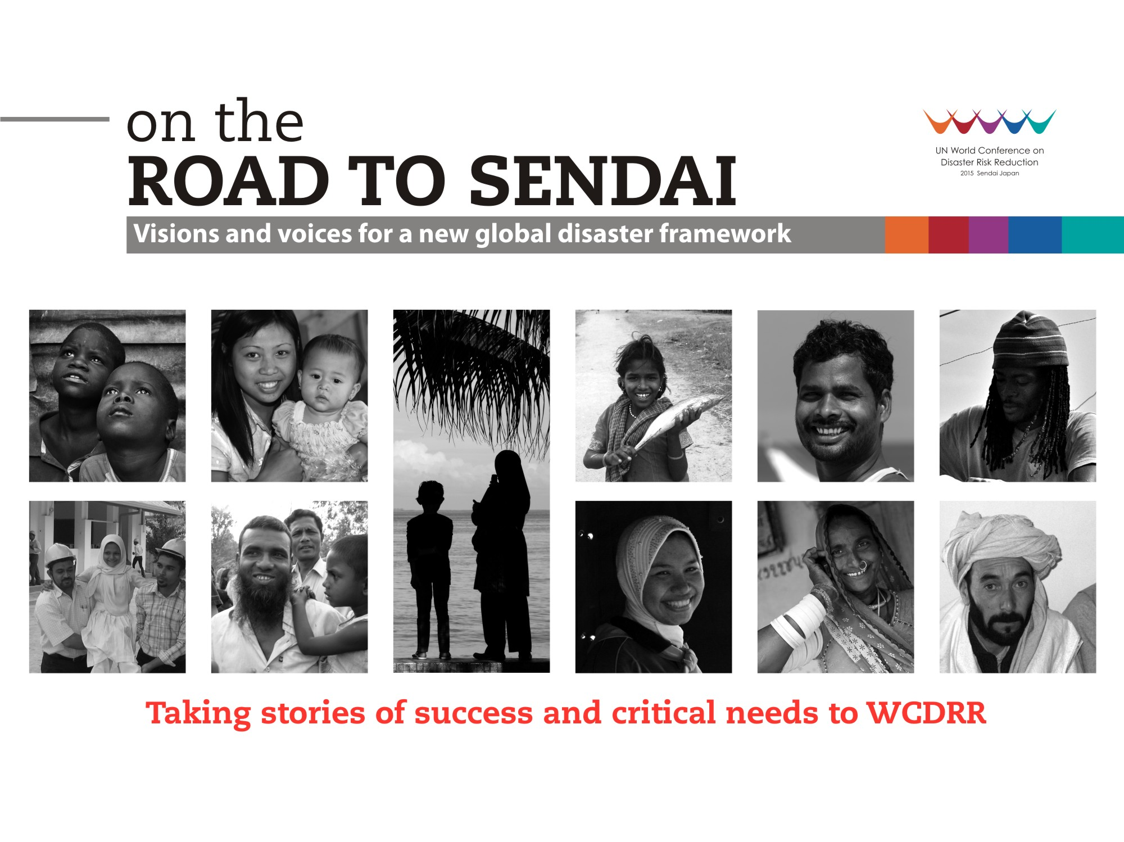
Notes:
Road to Sendai is a global, online citizen-connect campaign; taking community voices to world leaders. It attempts to amplify the local successes and critical needs of people on disaster risk reduction. The campaign is the product of a collaboration of partners including IFRC, UNISDR, AusAid, Plan International, Asian Disaster Reduction and Response Network (ADRRN), Global Network For Disaster Reduction (GNDR) and others.
Stories being compiled (not new stories, just “repackaging” of existing documents, with quotes from beneficiaries…):
- PMI in cooperation with American Red Cross: Community ownership in the flow of water
PMI in cooperation with Danish Red Cross and DIPECHO: Planting Mitigation, Harvesting Coffee
Cambodian Red Cross, Swedish Red Cross, IFRC, Australian Red Cross, Global Road Safety Partnership: Youth Volunteers Champion Road Safety
Myanmar Red Cross Society: The impact of disaster risk reduction field sessions in Myanmar
Indonesian Red Cross and American Red Cross: Debunking Myths, Preventing Malaria
Lao Red Cross: working in partnership with people living with HIV
Myanmar Red Cross Society: Reaching out to the new generation
PMI: Building A Fortress of Mutual Assistance against Disaster
Philippine Red Cross: Typhoon Bopha: How Communication can Save Lives
Viet Nam Red Cross, IFRC, American Red Cross, German Red Cross and Netherlands Red Cross: Viet Nam: Cash transfer programming in emergencies
Malaysian RC: Practice Makes Perfect
Singapore RC: When First Aid Training Becomes Personal
PMI: Avian Influenza Awareness Campaign
PMI "Begins with Me" - Integrating DRR into School Education
PMI Transitional Shelter - Bamboo Houses PMI Integrating Women into Community-Based Risk Reduction Projects in Indonesia'
Myanmar RC: Reducing risks and mobilising government support in Myanmar
Myanmar RC: Women firefighters help build safer communities
Myanmar RC: Classroom learning empowers students and community in Yangon
Thai Red Cross: Resilience and solidarity in the face of Thailand's 2011 floods
Timor-Leste Red Cross (CVTL): Recovery and risk reduction through livelihood support in Timor-Leste
Viet Nam Red Cross: Preparing for climate change in Viet Nam
Viet Nam Red Cross: Mangrove plantation in Viet Nam: measuring impact and cost benefit

Slide 7
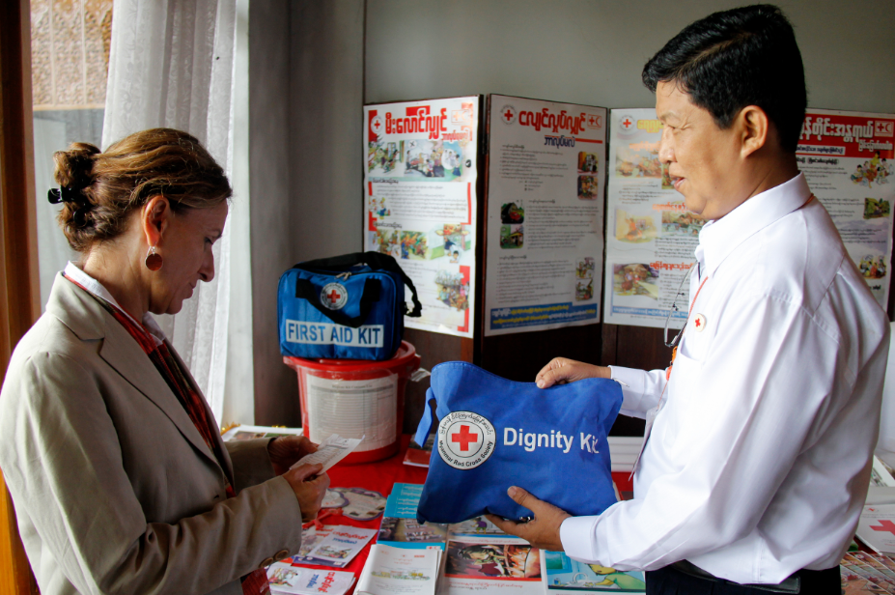
Notes:
Myanmar Red Cross International Day for Disaster Reduction, October 2015

Slide 8
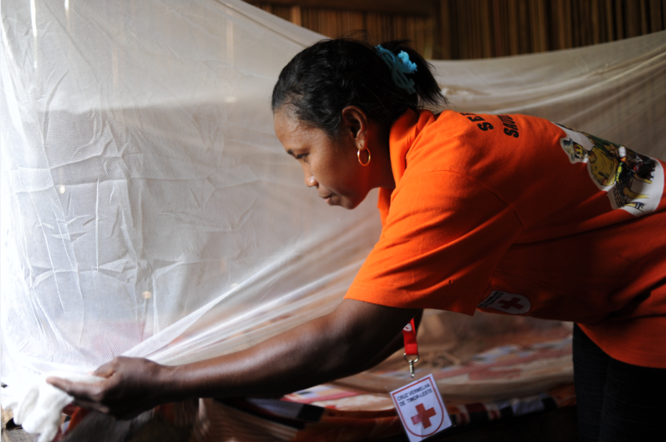
Notes:
Distributing mosquito nets as part of dengue campaign – CVTL, Timor-leste

Slide 9
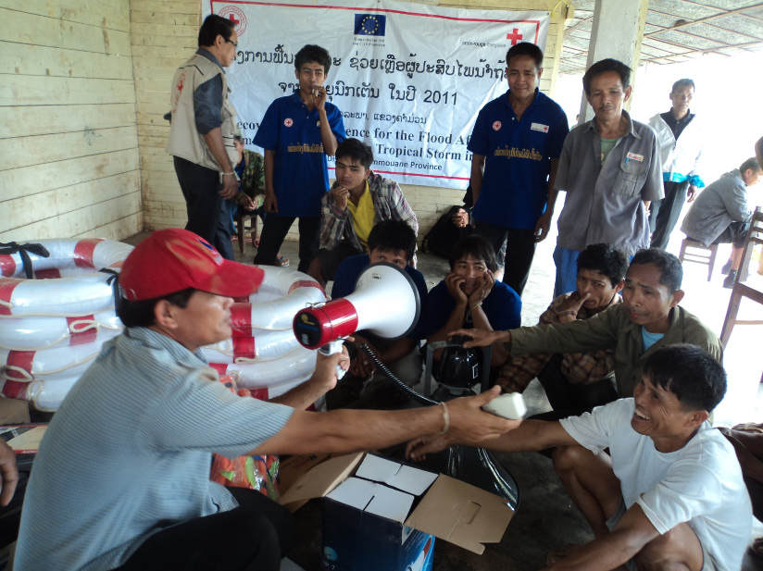
Notes:
Early warning kit distributed to community by Cambodia RC

Slide 10
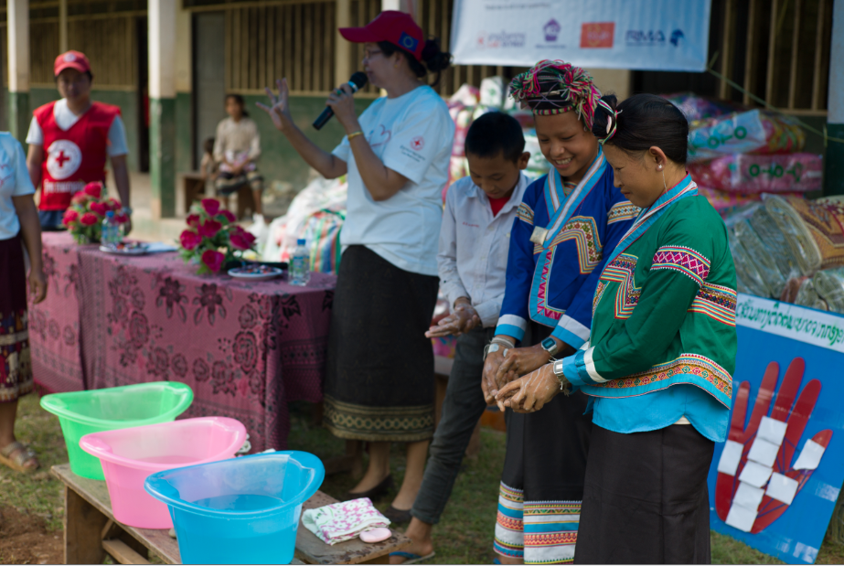
Notes:
Laos Red Cross – As part of ‘Warm for Winter’ campaign late last year (2014) – distributed donated clothing and also took the opportunity to do a hand wasking/sanitation training with communities

Slide 11
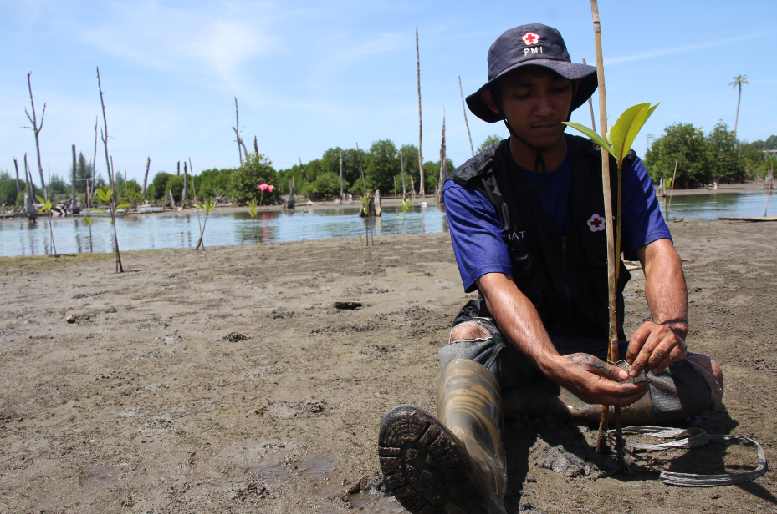
Notes:
Planting mangroves in Indonesia. Mangrove forests provide essential functions and services to coastal communities.
These include acting as carbon sinks (mitigating the effects of climate change), providing nutrients for marine life, and enhancing protection
to coastal communities from associated storm surges and erosion

Slide 12
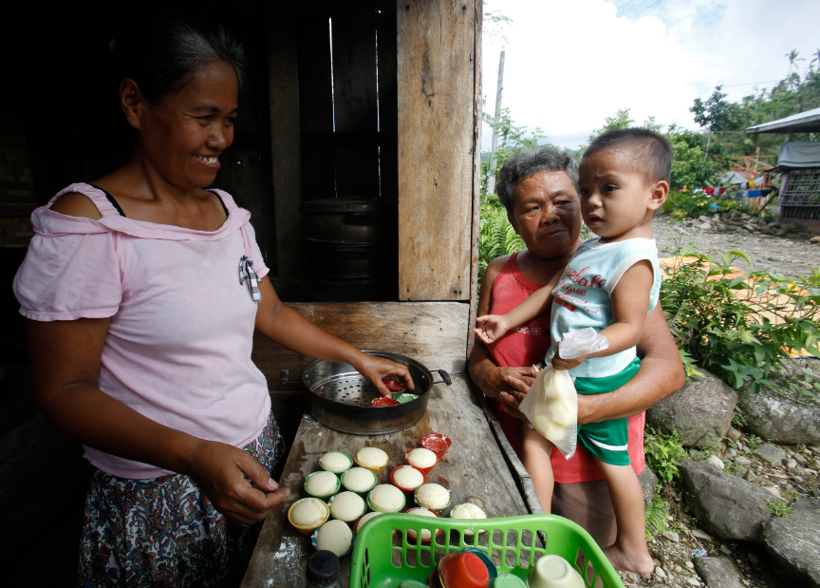
Notes:
PRC is helping build livelihoods post Typhoon Haiyan in the Philippines. Here Maria Redubla Liorarda serves cakes at the bakery she set up using money from the PRC livelihoods programme.

Slide 13
How you, the National Societies, can engage
Mobilise your National Society to contribute to the online conversation (on Facebook and Twitter) in the lead up to - and during - March 14-18 – using the hashtag #WCDRR
Involve staff, volunteers and beneficiaries – update them and encourage them to share their thoughts on building resilience via social media
Use the opportunity to meet with your counterparts in government. Share your plans on building resilience.
Organise a meeting with your heads of unit to share what is happening in Sendai and how the Movement is contributing
AFTER SENDAI: Connect with your NDMO to host a debriefing meeting, with in-country partner to discuss the way forward
Cambodia 25-27 February 2015
Notes:
There will be some youths events during Sendai and our youth network can continue promoting resilience after the conference. This also links to the ongoing discussion around School Safety and increasing the involvement of youths and volunteers in community-based programming for resilience (CBDRR, CBHA, etc.).
The “Road to Sendai” campaign will also potentially hold debriefing events in selected countries. APZ is the focal point and will keep us informed.

Slide 14

Communications
Kate Roux, Regional Communications & Advocacy Manager, SE Asia Delegation
  Email katherine.roux@ifrc.org | Skype katebundraroux1 | Twitter @katherineroux
Kate Jean Smith, Events and Publications Officer, SE Asia Delegation
Email katejean.smith@ifrc.org | Skype kate.jean.smith | Twitter @K_jean_
Resilience
(including questions re. gender and diversity, youth, DRR, health)
Indira Kulenovic, Resilience Coordinator, DM Unit, Asia Pacific Zone
  Email Indira.kulenovic@ifrc.org | Skype kulenovicindira | Mob:+66 81 846 7927
Sanjeev Kafley, Head of Community Safety & Resilience Unit, SE Asia Delegation
Email sanjeev.kafley@ifrc.org | Skype sanjeevkafley | Mob.+66 844277428
Cambodia 25-27 February 2015

Slide 15



Slide 16
Thank you

