Slide 1





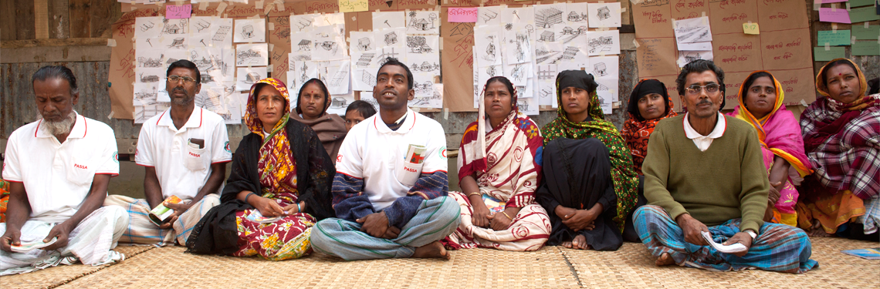
Billion Coalition for Resilience
Notes:
A network of 189 National Societies and 60,000 branches
Bringing tools and approaches for community resilience to a global scale

Slide 2
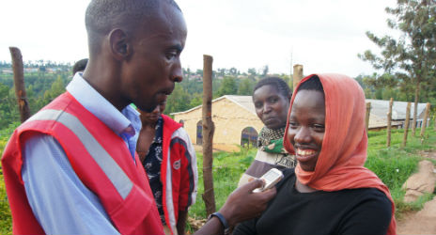
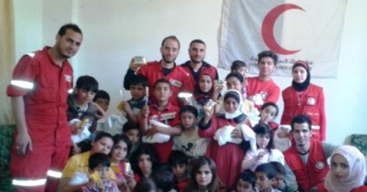
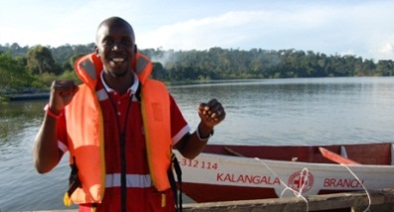
Billion Coalition for Resilience
By 2025 Billion People are taking active steps towards enhancing community resilience.
Notes:
What is the goal?

Slide 3
Billion Coalition for Resilience
overall campaign that focuses on building individual, household and community resilience
call to action with multiple opportunities for others to engage and support efforts
united effort linked to & building upon other campaigns (100 Resilient Cities challenge, ‘Making Cities Resilient’ campaign)
organizing model through a coalition building approach
Notes:
Currently, there is a number of resilience initiatives being driven by external partners including UNISDR’s ‘Making Cities Resilient’ campaign, the Rockefeller Foundation’s 100 Resilient Cities and the UN-Habitat’s World Urban Campaign. However, there has been little to no focus on the role of communities and households in these initiatives, and key engagement has been centralized on national actors and at the local government level.

Slide 4
A contextualized and tailored approach in communities
Billion Coalition for Resilience
Communities to decide on a variety of resilience building activities that suit local needs:
Expanding first aid and preparedness trainings
Access to health, water and sanitation, and shelter
Strengthening of early warning systems
School safety and education
Support to income generating activities
Road safety and education
Reforestation and environmental education
Others…
Notes:
Cognizant that the resilience needs of communities vary greatly from place to place, the campaign intentionally strays away from prescribing a one-size fits all approach towards programming and resilience building activities.

Slide 5





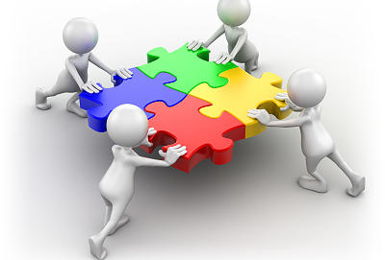
Components to Support Efforts
Households
Institution
Neighborhood/ Community
City / District
National
Global
(Graphic adapted from World Development Report 2014)
Notes:
Key components

Slide 6



  Engagement opportunities at different levels
Global
Invite partners from organizational and corporate networks
Refine and share global messaging
Develop easy-to-use toolkits and menu of options
Create financing mechanisms to spur innovation
Prioritize at-risk areas of country
Align initiative with national platforms for DRR
Notes:
What are the opportunities for involvement?

Slide 7






  Engagement opportunities at different levels
Engage local (neighbourhood level) stakeholders
Create local resilience action plans
Learn new safety and health preparedness skills
Create family disaster plan or business continuity plan
Help family, neighbours, and friends to prepare
Engage existing campaigns
Build a local coalition of partners for resilience
City- and district-wide risk assessment
Design local solutions
Create a local campaign

Slide 8

Billion Coalition for Resilience
GPDRR Briefing
Phase 1 – 3 months
Continue co-creation and consultation, Sendai soft Launch, Continue research to validate the 1-billion target and goals / Partnership development / Finalize strategy
Phase 2 – 6 months
Membership consultation, Partner engagement / coalition building / Baseline and operational planning/developing and piloting tools/methodologies
Phase 3 – 9 months
Engagement and peer-sharing platforms established, communications and marketing materials distributed, high level pledges at international conferences, and campaign launch at International Conference

Slide 9
Q & A
(please feel free to address to Mohammed Mukhier, CPRR, Geneva)
Thank You

