Slide 1
Framework for Development Update
SEA Leaders Meeting
March 25-27, 2013
Luang Prabang, Laos

Slide 2
Global OCAC Update – MRCS Pilot 2012
2011
Ethiopia | Macedonia
Georgia | Mali
Guinea Bissau | Niger
Guinea Conakry | Senegal
Ireland | Togo
Italy | Tunisia
Lithuania | Turkmenistan
2012
Belarus | Kyrgyzstan
Benin | Myanmar
Burkina Faso | Nigeria
Burundi | Peru
Chile | Poland
China (National & 8 branch assessments) | Romania
Colombia | Russia (3 branch assessments)
Costa Rica | Slovenia
Fiji | Tajikistan
Guatemala | Ukraine
Kazakhstan | Uzbekistan
2013
Iraq | Zambia
Qatar
Future assessments
Afghanistan | Bolivia
Bangladesh | Gambia
Belize | Mozambique
Notes:
Vietnam RC, Philippines RC and Timor RC have all indicated interest for next round
Vietnam RC, Philippines RC, and Timor Lest have all indicated interest in OCAC. Needs confirmation.

Slide 3
Lessons from OCAC pilots
Almost ALL NSs identify organisational deficits and request support!

Slide 4
Anomalies or systemic weaknesses?
PMER CAPACITY
FINANCIAL RESOURCE MOBILISATION
Income diversification and stability
Revenue generation
Unrestricted reserves
Donor mobilisation
RM capacities
SECURITY AND SAFETY MANAGEMENT
LACK OF A CLEAR IDENTITY AND INSTITUTIONAL MEMORY
EXTERNAL COMMUNICATIONS
RISK MANAGEMENT
Integrity framework
Reputational risk management
Insurance
HUMAN RESOURCES MANAGEMENT
Staff satisfaction
Staff development

Slide 5
Framework for Strengthening NSs
OCAC
Myanmar RC was the first NS to pilot OCAC. Self assessment finalized and Myanmar RC evaluating next steps to support identified weaknesses
PRC, VNRC and CVTL have indicated interest in OCAC / this needs follow-up and confirmation with Geneva Team
Currently no SEA countries on Geneva confirmed list for 2013 OCAC
CRC and PMI want to wait and observe

Slide 6
Framework for Strengthening NSs
Fed-wide Databank & Reporting
Slow progress in this area due to:
Poor internet connection (CVTL)
Need for more clarification (Myanmar RC)
Challenge of data collection (PMI)
Activity delayed while HR system gets ready (VNRC)

Slide 7
Framework for Strengthening NSs
Learning and Knowledge Sharing Network
8,305 users from Asia Pacific
30,880 users globally
AP is 60% of population / but only 26% of users from APZ
Need to facilitate more usage which requires local language and better connectivity

Slide 8
Framework for Strengthening NSs
Bridging the Digital Divide
Steady progress by Myanmar RC, CRC, CVTL, PRC and VNRC
VNRC noted their good progress was based on strong commitment from Leadership

Slide 9
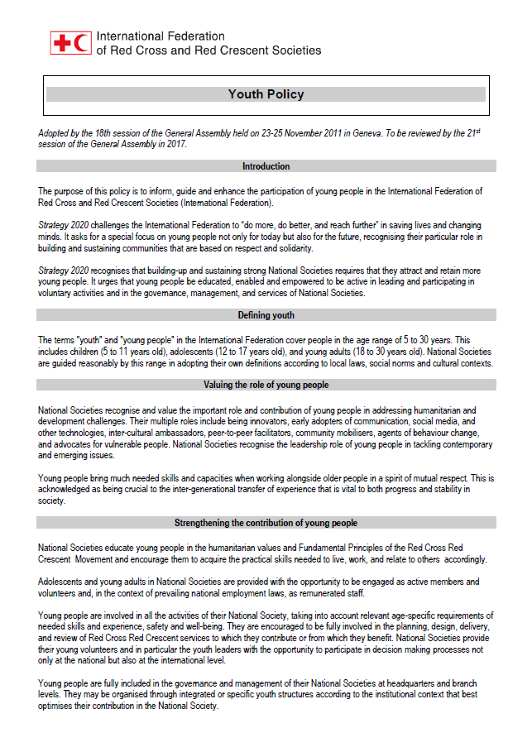
Youth development in RCRC
IFRC Youth Policy adopted in 2011
2013 plans:
→ Youth Strategy to suggest “how”
based on “what” described in the
Youth Policy
→ Guidelines on Youth Networking
to strengthen youth networks
Notes:
IFRC Youth Policy was adopted in the General Assembly 2011. Youth Commission as part of IFRC Governance and a key to develop further youth action has been working to develop Youth Strategy to suggest “how to realize the vision of Youth Policy” and Guidelines on youth networking to encourage Youth Networks.
Youth Strategy
While the Youth Policy describe “what” to achieve, Youth Strategy will suggest “how to implement and realize the Policy and its vision”. The draft is developed based on the inputs given by youths from 78 NSs and external organizations during the Global Youth Conference last year (Vienna, Dec 2012). The consultation with NSs and youth networks will start in April 2013 and the draft will be finalized and presented during the General Assembly in this November.
Guidelines on Youth Networking
Youth Network is one of key for youth development – “networks established by young people themselves are an invaluable contribution to sharing knowledge and innovation across the RCRC Movement. Therefore the Youth Policy encourages NSs to actively encourage and support youth representatives to participate in these networks aimed at promoting youth leadership and exchange of concrete ideas , innovations and activities”. Guidelines document is currently developed and will be presented in the General Assembly this year.
Asia Pacific Youth Network (APYN)
In Asia Pacific, there are APYN and some sub-regional networks linked to APYN. Established in 2010, the APYN gradually develop itself to function as “Advocacy Platform, Resource Centre, Communication Channel and Think Tank”. It also provides an excellent link to the global Youth Commission linking regional, zonal and global.
Notes:
By adopting the IFRC Youth Policy at the General Assembly 2011 the National Societies proclaimed value of the important role and contribution of children, adolescents, and young adults and thus committed to scale up their efforts to increase youth engagement as a key driver in the development of our National Societies and our Movement.
The last IFRC Youth Policy 1995 was acutally “Youth Policy and Strategy”. The 2011 Policy has “Strategy” as a separate document

Slide 10
Youth Strategy – 2013
April
Consultations with NSs and RCRC Youth networks
June
Review Strategy, upon receiving inputs from Youth Commission Meeting
Jul –Oct
Dissemination and promotion of Youth Policy and Youth Strategy final drafts
Nov.
Youth Strategy presented to General Assembly
Regional Action Plan to be developed based on Youth Strategy at the Global RCRC Youth Conference
Notes:
April will be an important month to provide the inputs to the Youth Strategy. APYN also plans to play a role in this by organizing a webinar to widely share the contents and request for inputs.
The strategy will then reviewed with the feedback from all the zones by Youth Commission, then the final version will be disseminated and promoted.
November will be another big month, due to the Global RC RC Youth Conference and Statutory Meetings 2013 which will take place in Sydney, Australia. The IFRC Youth Strategy will be presented to the General Assembly. The Global Youth Conference 2013, hosted by Australian RC and organized adjacent to the General Assembly, will be an opportunity for youth to take the Youth Strategy forward to make it into action to further youth action in NS.

Slide 11
NSs Statutory Compliances : Article 35 of IFRC constitution
Income declaration is required from each NS once in Two years in a prescribed format.
Next Income declaration from each SEA NS is due in May 2013. This declaration will be used to calculate 2014& 2015 contribution. Mary Rankin will send request to each NS next Month.
The latest financial statements to accompany the Income declaration preferably audited.
Income declaration statement to be signed by the Chief Executive of the NS.
Income Declaration and Financial Statements to be sent to mary.rankin@ifrc.org.

Slide 12
Statutory contribution for 2013 due in Feb 2013 ( in CHF)
NS | 2013 Contribution | Year Declared | AFS | Audited | Remarks
Brunei | 6,339 | None | None | NA | Excluding arrears CHF 46,183
Cambodia | Paid | None | None | NA
Indonesia | 89,432 | 2009 | 30.09.2009 | Yes
Lao | 2,146 | None | None | NA
Malaysia | 53,233 | None | None | NA
Myanmar | 2,546 | None | 31.03.2010 | Yes
Philippines | 105,158 | 2010 | 31.12.2010 | Yes
Singapore | Paid | 2009 | 31.12.2009 | Yes
Thailand | Paid | 2010 | None | NA
East Timor | 1,000 | 2010 | 31.12.2010 | Yes
Vietnam | 8,773 | 2010 | 31.12.2010 | Yes

Slide 13
Questions …

