Slide 1
International Humanitarian Law (IHL) and International Disaster Response Law, Rules and
(IDRL)
Anne LeClerc and Sandra Moretti

Slide 2
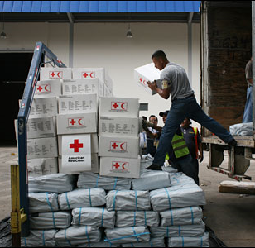
Overview of the presentation
Overview of IHL
Overview of IDRL
Main differences
Common considerations
Role of NS for each area of law

Slide 3
What
is IHL?
INTERNATIONAL HUMANITARIAN LAW
International humanitarian law is a part of public international law
Also known as the "law of armed conflict" or the "law of war"
IHL is set out in treaty form (eg 1949 Geneva Conventions and their Protocols), but additional rules existing in customary international law have been published by the ICRC
Rules which apply only in armed conflict, even if they create obligations in peacetime (eg drafting legislation)

Slide 4
Purpose
of IHL
Limits in armed conflict
LIMIT the suffering caused by armed conflict
How does IHL do this?
PROTECTS persons who are not, or no longer, participating in conflict and certain places and objects;
RESTRICTS the means and methods of warfare used by parties to the conflict.

Slide 5
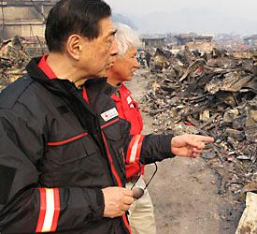
Overview: International Disaster Response Laws, Rules and Principles (IDRL)
Laws and regulations that govern the provision of international assistance in non-conflict disasters.
Has been a focus of IFRC and NS’ since 2001
Six years of research demonstrated that a lack of legal preparedness hampers international relief
Found that international law on topic exists, but it is dispersed and there are many gaps
Notes:
The IFRC and National Societies have been researching and consulting on the regulatory frameworks and problems in international disaster relief since 2001. After dozens of case studies, a global survey of governments and the humanitarian sector, and a series of regional forums, they published their findings in a comprehensive study published in 2007.
This study found that alack of legal preparedness was leading to technical barriers to the entry of relief, such as with regard to visas, customs duties and clearance, taxation, registration, transport permissions and the like. For example, following the Indian Ocean tsunami, vital relief – in the form of tents, food and blankets – was still sitting in hundreds of containers awaiting customs clearance over a year after it was needed. The imposition of taxes can also be extremely costly and result in delays, for example, when Oxfam tried to import 25 vehicles for its relief work, it was charged over $1 million.
At the same time, the absence of adequate procedures for oversight of international relief was allowing for poor quality and coordination in relief efforts and a lack of respect for the role of domestic actors. E.g the tsunami of misguided will after the Indian Ocean tsunami.
The bottom line was unnecessary delays and costs in bringing critical aid to those in need and a reduced quality of the aid that did arrive.
Our research found that while there are many international instruments on this topic, the international law is dispersed and fragmented. For example, a convention or treaty may only relate to one aspect of disaster response – like telecommunications or civil aviation (sectoral law). As such, there are still many gaps in the international law related to international disaster response.

Slide 6
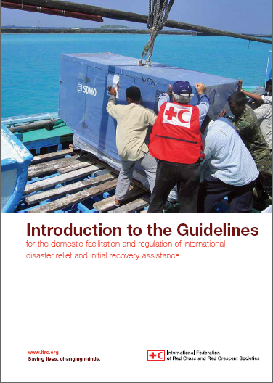
The IDRL Guidelines
IDRL Guidelines adopted by consensus by the 30th International Conference in 2007
Compile existing international norms and best practice
Recommendations to governments on how to prepare domestic laws and procedures for international assistance
Not a binding treaty
Notes:
In response to the findings of our research, In 2007 the 30th International Conference adopted by consensus a new set of “Guidelines for the domestic facilitation and regulation of international disaster relief and initial recovery assistance” (also known as the IDRL Guidelines). They are the product of years of study and consultations with over 140 governments, 140 Red Cross and Red Crescent National Societies, and 40 international organizations and non-governmental organizations.
The IDRL Guidelines are non-binding. They are global in scope. They are relevant for both state and non-state actors, for all sectors of response, and for all types of disasters except armed conflicts. They serve as recommendations to governments on how to prepare their domestic legal frameworks for international disaster assistance in order to avoid the most common problems and facilitate the swift delivery of relief and initial recovery assistance to those affected.
They compile existing norms and best practice to propose a package of minimum legal facilities that assisting states and humanitarian organizations need to provide relief (such as visas and work permits and preferential customs clearance and duty exemption) The IDRL Guidelines also recommend that any package of facilities be conditioned on eligibility requirements set by the receiving/affected state, as well as on adherence to minimum humanitarian standards.

Slide 7
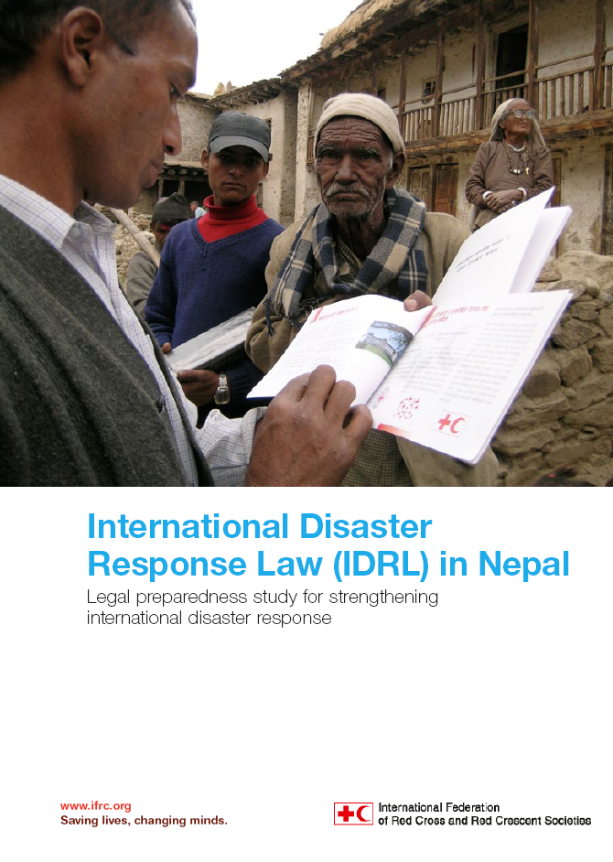
Implementation of the IDRL Guidelines
Growing interest in IDRL Guidelines
20 technical assistance projects (inc Cambodia, Vietnam and Laos)
New domestic laws or rules in 9 countries, draft legislation pending in 12 others
UN and regional resolutions (e.g ASEAN)
New tools
Model Act on International Disaster Assistance
Disaster law training
Work remaining
More states need to take up the issue
Notes:
To support governments in making use of the IDRL Guidelines, the IFRC and National Societies have provided technical assistance to governments to examine their national laws on international disaster relief. Projects have been undertaken here in SEA in Cambodia, Vietnam, Laos and more recently in Indonesia.
Since their adoption, 9 states have reported adopting new or updated laws, regulations or procedures consistent with the recommendations of the IDRL Guidelines. They are Finland, Indonesia, the Netherlands, New Zealand, Norway, Panama, Philippines, Peru and the United States. A dozen more are currently considering draft legislation or rules, for example in Cambodia.
The IDRL Guidelines have also proved a useful consensus-building instrument at the international and regional levels. They have been recognized in no fewer than 6 UN General Assembly resolutions, and referenced in numerous declarations and statements by regional organizations, including ASEAN. The IDRL Guidelines were utilise in the development of the ASEAN Agreement on Disaster Management and Emergency Response (AADMER) and its standard operating procedures
At the 31st International Conference, the pilot version of a new “Model Act on the Facilitation and Regulation of International Disaster Relief and Initial Recovery Assistance” was launched. Developed jointly by the IFRC, UNOCHA and the Inter Parliamentary Union, with support from legal experts from around the world, the Model Act is designed as a starting point for lawmakers interested in implementing the recommendations of the IDRL Guidelines into domestic law. The final version will be launched at the IPU Assembly at the end of March this year.
The IFRC has also developed a series of training opportunities, including a disaster law short course for governmental officials and an online training module available for free online in five languages. Nevertheless, it is plain that much work remains to be done.

Slide 8

IHL and IDRL: Common Considerations
Both address legal barriers in providing humanitarian assistance:
  Administrative bottlenecks
  Visas for international relief personnel
  Customs and tax duties
  Poor quality assistance
  Compliance with principles of humanity, neutrality and impartiality

Slide 9
IHL and IDRL: Main differences
IHL | IDRL
Governs armed conflict | Relates to international assistance in disasters
Consists of a clear set of treaties. | No comprehensive legal regime exists for IDRL. International law on topic is dispersed and fragmented.
IHL treaties impose binding international obligations on states | The IDRL Guidelines are a set of non-binding recommendations to Governments to improve their national laws.
IHL specifies special role and access for ICRC and recognizes National Societies | While IDRL Guidelines refer to auxiliary role of NS’, they are primarily directed towards the regulation and facilitation of external international actors.
Notes:
IHL governs situations of armed conflict and IDRL relates to international assistance in disasters
IHL consists of a discrete set of treaties which impose binding obligations on governments
No comprehensive legal regime exists for IDRL. International law on topic is dispersed and fragmented.

Slide 10
IHL and IDRL: Main differences
IHL | IDRL
Issues of security and access are often more pressing in armed conflict setting, and special rules regarding access of ICRC apply. | Security and access are not always major obstacles in disaster settings, international assistance must first be requested or offer accepted by Government.
Other authorities/party to conflict besides government may exercise control over certain areas but | Domestic authorities will always have the primary coordination role
Has a particular focus on protection and diversion of relief goods | IDRL Guidelines and the Model Act are more detailed on types of ‘legal facilities’ to be provided to international humanitarian actors, and suggests a pre-registration system.

Slide 11
Role of National Societies in IHL
Refer to 31st International Conference :
Dissemination Resolution 1: Strengthening legal protection for victims of armed conflicts
Dissemination of Resolution 2 : 4 year action plan for the implementation of IHL (pledges, ensure all actors concerned implement). Reminds States of auxiliary role NS.
NS have a mandate to prepare and respond to the needs of those affected by armed conflict and OSV (cf Resol. COD 2011).

Slide 12
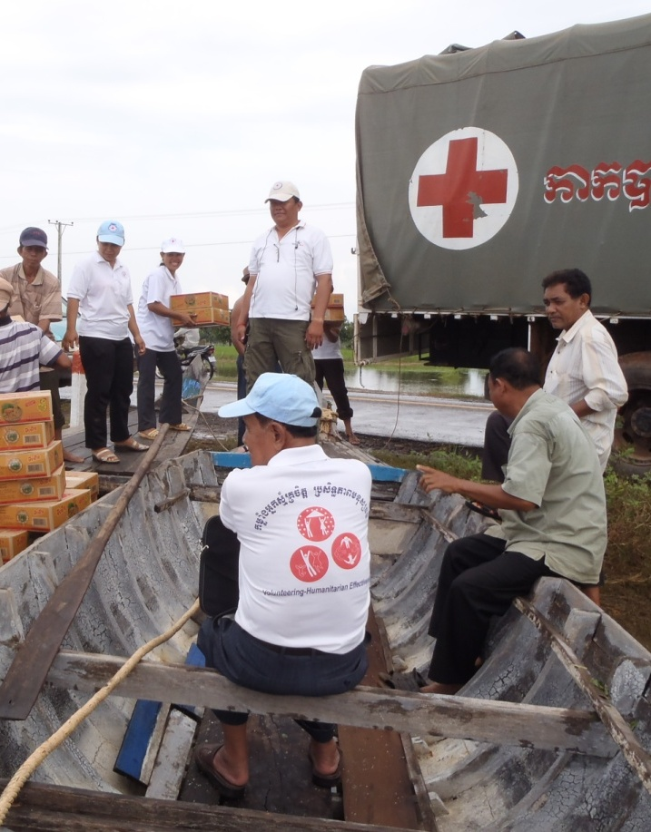
Role of National Societies in IDRL
Disseminate Resolution 7 adopted at the 31st International Conference
Provide advice and support to their governments to strengthen legal frameworks by undertaking a review against the IDRL Guidelines
Promote the IDRL Guidelines and the Model Act to relevant Public Authorities
Build partnerships
Notes:
In resolution 7 of the 31st International Conference, National Societies are “encouraged” to provide advice and support to their governments in the development of effective legal and policy frameworks relevant to disaster management generally, and in particular with regard to the legislative reviews.
The resolution furthermore encourages National Societies to disseminate and promote the use of the Guidelines and the International Conference’s resolution and to build effective partnerships with other stakeholders to highlight the need to be more prepared for international disaster response.

Slide 13
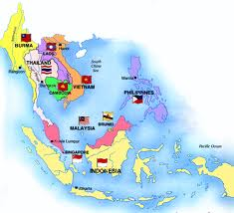
Progress in SEA on IDRL
Legal preparedness studies (legislative reviews)
undertaken in 2009 in Cambodia, Laos and Vietnam
    A Mekong Regional Forum was held in 2010 to discuss findings
    In Cambodia, the draft new law on disaster management has a chapter on international assistance
    In Vietnam, VNRC (together with IFRC) has provided comments and suggestions for the draft DM law
An IDRL Impact Study is currently being finalised in Indonesia
Two IDRL workshops (2011 and 2012) held in Philippines and research soon to start
Any others to add? What should be next?
Notes:
In 2009, ‘Legal preparedness studies’ were undertaken in Cambodia, Laos and Vietnam, where the legal framework was comprehensively assessed against the IDRL Guidelines, and recommendations were developed on how to strengthen the legal framework for large scale disasters. All of these studies were conducted in cooperation with the National Society and the Government. In 2010, a Mekong Regional Forum was held to discuss the findings of these studies and to issues faced by the region in cross-border disaster relief.
Since that time, we’ve seen some impact of the studies. In Cambodia, the draft new law on disaster management has a chapter on international assistance, following advice and input provided by the IFRC and CRC. In Vietnam, the study was one precursor leading to the government and UNDP initiating the process to draft a new law on disaster management. Last year, VNRC (together with IFRC) provided comments and suggestions for the draft DM law.
In Indonesia in 2012 a study on the impact and implementation of the regulations and guidelines on international assistance – which implement the IDRL Guidelines - was undertaken and is now currently being finalised, with discussions underway for a consultation workshop.
Multi-stakeholders
Others may like to talk about plans or developments in their own countries – e.g in Myanmar, the NS did provide feedback on their disaster management law and Malaysia is developing a plan on holding an IDRL workshop with the MKN (security council) .

Slide 14
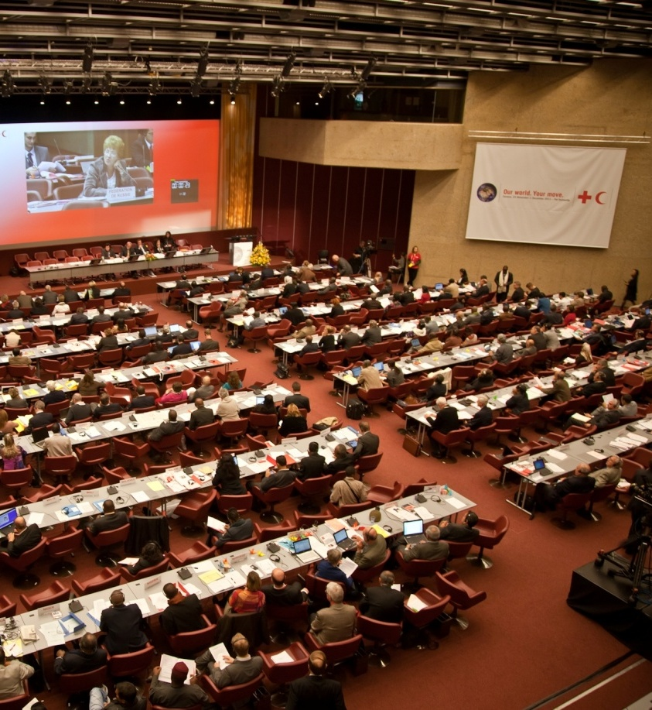
SEA Pledge at the 31st International Conference
1. Legal preparedness for international disaster response - review existing national regulatory frameworks and support governments to develop legislation, policies and procedures to better facilitate and regulate international disaster assistance
2. Enhancing disaster risk reduction through legislation - review and advise on legal frameworks to empower communities in DRR.
Progress??

Slide 15

Collaborations with partners in the region on IDRL
          ASEAN
The ASEAN Agreement on Disaster Management and Emergency Response (and SOPs) incorporates elements of the IDRL Guidelines
AADMER Work plan requires the undertaking of legislative reviews for international assistance
ASEAN Secretariat has shown interest in IDRL
National Societies can offer support to Governments in AADMER implementation and institutionalisation .. Who could champion this?
Notes:
The ASEAN Agreement on Disaster Management and Emergency Response incorporates elements of the IDRL Guidelines, and the SOPs in particular, draw from the IDRL Guidelines.
The AADMER Work plan, which is a document that sets out the steps and activities for all the states to successfully implement the AADMER, requires the undertaking of legislative reviews for international assistance
The ASEAN Secretariat has also shown interest in IDRL and in states using the IDRL Guidelines as means to strengthen the implementation of the AADMER. IFRC has worked with the ASEAN Secretariat to develop methods to review legislation, for example, through developing a questionnaire for member states to use to see whether they need to revise their legislation.
The IFRC has also been asked to contribute to ASEAN Regional Forum events and Table Top Exercises, as well as training the ASEAN Partnership Group on IDRL
National Societies can offer support to their Government in AADMER implementation and institutionalisation, because of their expertise on IDRL.
Perhaps a NS leader could take the lead with this engagment and to raise awareness of IDRL?

Slide 16
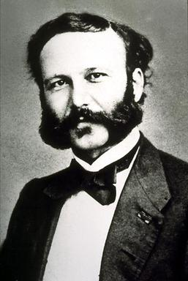
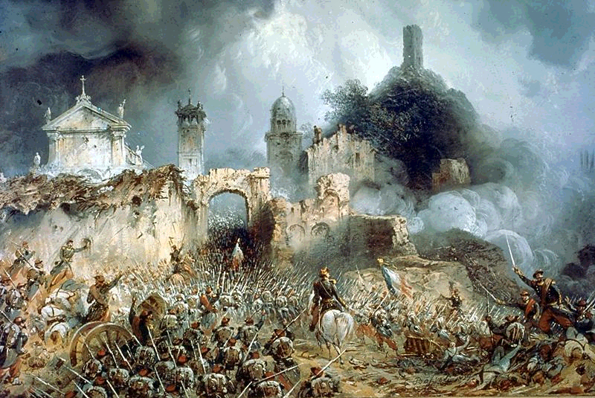

Sources
of IHL
1859 – Battle of Solferino
1862 – "A Memory of Solferino"
  creation of relief societies for the care
  of the wounded
  international treaty for the protection of the sick and the wounded on the battlefield

Slide 17
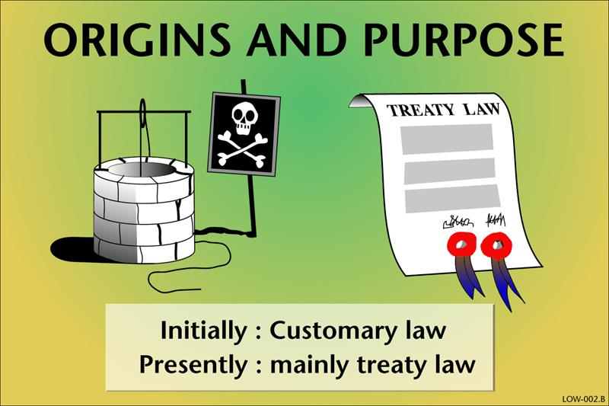
The Birth of Modern
International Humanitarian Law
Sources
of IHL
1863 – Lieber Code
1868 – Declaration of St-Petersburg
1899/1907 – The Hague Conventions

Slide 18
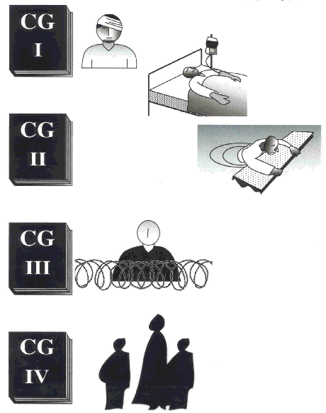
Geneva Conventions of 1949
Sources
of IHL
Wounded and Sick (Land)
Wounded, Sick and Shipwrecked (Sea)
Prisoners of War
Civilian Persons in the Power of the enemy

Slide 19
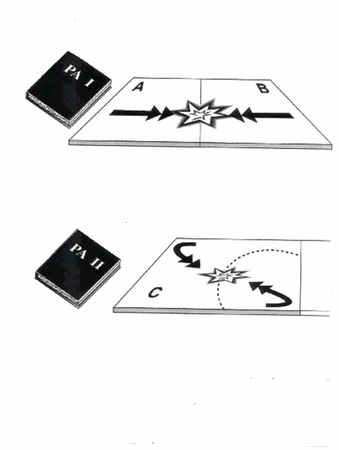
Additional Protocols of 1977
Sources
of IHL
International Armed Conflicts
Internal Armed Conflicts

Slide 20
Sources
of IHL
Geneva Conventions
    195 States parties
    universal adherence
Additional Protocol I
    172 States Parties
Additional Protocol II
    166 States Parties

Slide 21
Sources
of IHL
Summary of formal sources of IHL
1864: Geneva Convention (sick and wounded soldiers)
1868: Declaration of Saint-Petersburg (certain ammunition)
1899/1907: The Hague Conventions (laws & customs of war)
1925: Protocol for the Prohibition of the Use of Asphyxiating Gases
1929: Geneva Convention (prisoners of war)
1949: Four Geneva Conventions
1954: Hague Convention on the Protection of Cultural Property (and Protocol)
1972: Biological Weapons Convention
1977: Two Additional Protocols to the GC
1980: Conventional Weapons Convention (and Protocols)
1993: Chemical Weapons Convention
1997: Ottawa Treaty on Anti-personnel landmines
1998: Statute of the International Criminal Court
1999: Second Protocol to the Hague Convention of 1954
2000: Optional Protocol on the Involvement of Children in Armed Conflict
2008 – Convention on Cluster Munitions
Notes:
The Hague law
Prohibits certain weapons
Limits the usage of some combat means;
Limits actions in occupied territories;
And protects neutral states.

Slide 22



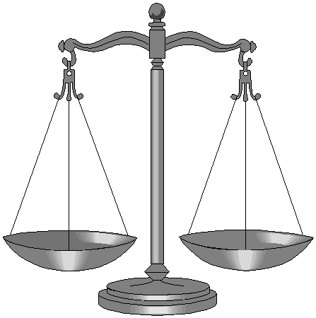

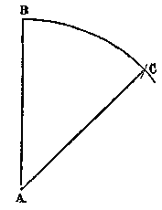
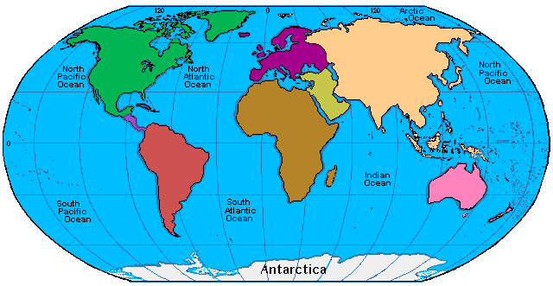
Sources of IDRL
RC /RC (Soft) Law
Global & Regional Institutions
No Flagship Treaty
Soft Law
Human Rights & Refugee Law
Bilateral Agreements
Sectoral Law
Regional Law
Notes:
Unlike the area of armed conflict – there are no comprehensive flagship international treaties for disaster response. But this does not mean that there is no international law. In fact there is quite a lot, in various areas.
Global and Institutions – with legal mandates to work in disasters
Human rights norms – can be very relevant to disaster relief issues
Sectoral Law – there are scattered provisions on disaster response in treaties in various sectors – like marine transport, civil aviation, pollution, etc.
Increasing number of regional and bilateral agreements
A lot of « soft law » or non binding international standards
The RC/RC has some specific international hard and soft law related to its work.

Slide 23
Key Materials for IDRL
Introduction to the IDRL Guidelines
Introduction to IDRL online module: http://www.ifrc.org/what-we-do/idrl/research-tools-and-publications/idrl-interactive-online-training-module/
Humanitarian Diplomacy Guidance Note 2: Legislative Issues in Disaster Management and Epidemic Response
31st International Conference Background Paper: Progress in the implementation of the IDRL Guidelines
Disasters in Asia: The Case for Legal Preparedness
‘Law and Legal Issues in Disaster Response: A Desk Study (2007)
Contact the DLP Team in KL!

