Slide 1

MEETING
Date
Names of presenters

Slide 2


Statutory meetings International Red Cross Red Crescent Movement
National Societies
Council
of
Delegates
meeting every 2 years
International Conference
meeting every 4 years
States party to the Geneva Conventions
IFRC
ICRC
Notes:
Reminder on the statutory meetings of the Movement
Each has its own purpose
With agendas of each meetings handled well, they complement and reenforce eachother without duplication
In 2013
Mid-term review of Intl. Conference – as 2 years after 31st, 2 years before 32nd
CoD – where amongst other things, we will decide the Movement’s agenda to propose to Govts for 32nd IC
Intenational Federation will hold it’s General Assembly just before CoD
Today
Will outline Mid Term Review approach
Update and consult you on CoD agenda
Outline agenda of Federation’s General Assembly

Slide 3

Mid-term review
because
Intl. Conference every 4 years
reminder - 2 more years to implement
what successes, challenges can be shared?
how can futher implemention be promoted?
outcomes
pledges/resolutions support working relationship between Movement components and with Govts.
follow-up Intl. Conference enhances its positioning as a major humanitarian conference valued by Govts
Intl. Conference followed up nationally & internationally
Notes:
1. Explain the ‘because’
Remind IC members of their commitments
Focus on pledges because they are voluntary commitments & likely to get good response
Key of MTR is not reporting, rather hoping to get some examples of best practice. This is what Govts have told us they want. Reports on implementation of IC resolutions is traditionally short on examples of best practice that are useful for IC participants and we are trying to change this for reporting on the 31st IC at the 32nd IC in 2015
2. After the ‘because’
Ask for examples from participants how they are working with their Govts on pledges/resolutions
ask what works well or do NS need additional support to work with their Govts.

Slide 4

Council of Delegates
the Movement meeting that counts
where the Movement talks & decides how to meet challenges
150 years theme - decided
- dialogue 8 May & before & during CoD
Agenda – under development
items out for consultation
25 March Standing Commission – review feedback
Convocation xx May
Notes:
Remind that the CoD is the only meeting where the whole Movement is present to debate & discuss
In the changing humanitarian environment – this CoD will be focusing on the future of the Movement
Next slide, we outline some of the issues currently slated for the agenda
These reflect the agenda sent out for consultation by the Standing Commission (itself made up of ICRC & Fed Presidents & ICRC Director of Intl. Law & Cooperation & Fed Sec Gen
Standing Commission has already decided that the theme is 150 years
This is also the theme of 8th May RCRC day
In the lead up to the CoD, building dialogue including social media on the future of the Movement
The outcomes and some participants will be featured at the opening of the CoD
Aim is to have youth members, volunteers ICRC & Fed staff involved to reach out from the statutory meetings and make a link between RCRC working lives and the statutory meetings

Slide 5
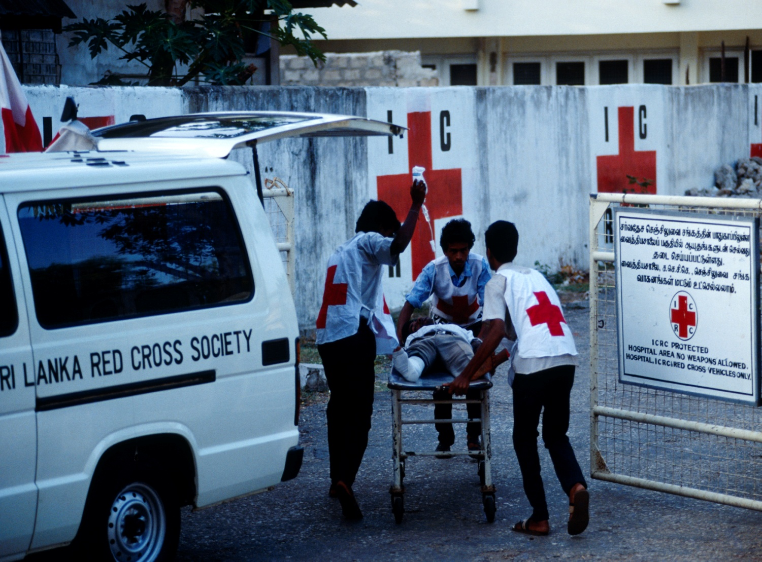
The Power of Humanity: 150 Years of Humanitarian Action
- Elements from SC letter
Elimination of nuclear weapons
Red Cross and Red Crescent Branding Initiative
Working together on partnership and accountability
Unity Movement:
Working with external humanitarian actors
The Fundamental Principles in action
Strengthening NS for the future
Supporting NS in Armed Conflict, OSV
PRCS MDA
MoU
Disseminating IHL – Movement approach
Strategy for the Movement & Movement For a
Health Care and Volunteering in Danger
Agenda – 32nd International Conference
31st IC follow up: Successes, challenges and next steps
Notes:
Suggest
List the issues currently proposed for the 2 day CoD meeting
Refer to the content of the Standing Commission letter to all NS
(it êxplains why issues are on the agenda (because requested by 2011 CoD Resolution; because NS/ICRC/Fed have requested it)
Standing Commission will review feedback from NS at its next meeting in 25,26 March
There will need to be some consolidation, probably building around 1- 2 main themes
The issues listed are quite different.
Some of your NS may already be part of a reference group or have been consulted on the development of one of the issues listed (e.g NS working in AC/OS, Health Care in Danger)
Others are in earlier stages of development.
Aim
All issues brought to the CoD are developed in consultation between NS, ICRC & Federation. This is logical for this MOVEMENT meeting
Right now
What should be the priority for the CoD?
What’s missing?
Are there topics listed that you think are not important for the CoD?

Slide 6
Now until the 2013 Council of Delegates --- tentative timetable
2013
March – Standing Commission to review agenda
May – Convocation (formal invitation)
August – draft ‘0’ resolutions
Oct – Official documents mailing (45 days in advance of CoD)
Nov – CoD in Sydney: Setting the Movement’s agenda for 32nd IC
2013/4
MID TERM REVIEW – 31st Intl. Conference possibl
2015
CoD/32nd IC
6
Notes:
Aim to maximise consultations, interaction, dilogue with NS.
6

Slide 7

General Assembly
12 – 15 November 2013
Follow up reports from previous General Assembly
Accountability and Follow up Reports
Elections for the IFRC President, Vice-Presidents and Governing Board members
In view of the 2015 and the deadline for MDG
Notes:
Follow up reports from previous GA
Elections for the IFRC President, Vice-Presidents and Governing Board
Process for the mid-term review of S2020
In view of the 2015 and the deadline for MDG
7

Slide 8
GA 2013 – Substantive items Strategy 2020
Function effectively as the International Federation of Red Cross/Red Crescent Societies. The imperative to tackle major but avoidable suffering is a Federation-wide obligation. The practical means for doing this is through improving the way we work together in our Federation. These build on the complementary mandates of the Movement’s components to achieve closer cooperation, quality and efficiency, and the better development of National Societies.
Key note address followed by Panel debate:“The Challenges of working together in our Federation and within the Movement
Henry Davison, Youth and volunteers awards
8
Notes:
8

Slide 9
General Assembly
Workshops and awards ceremony
8 Workshops in total 4 held in parallel per day.
So far the workshop themes proposed:
Delivering on the business of vulnerability and long term development
The UN Decade of Action for Road Safety 2011-2020
National Societies implementing the IFRC Youth Strategy
IFRC position on the post MDGs
IFRC Strategic Framework on Gender and Diversity Issues
Capacity building: institutional and community.

