Slide 1

APFN Updates & Plans
“on becoming bigger and better
by working together...”
By: Gwendolyn Pang
Chair of APFN and Secretary General,
Philippine Red Cross
SEA Leaders Meeting, Laos, March 25-27, 2013
Do More ∙ Do Better ∙ Reach Further

Slide 2
Outline of the Presentation
Brief overview of APFN
2012 APFN Highlights and Achievements
2013 APFN Plan of Action
Working together with South East Asia National Societies
Highlights of South East Asia National Societies in Resource Mobilization
Challenges of APFN in strengthening NS Capacity
Leadership role in the development of resource mobilization
Do More ∙ Do Better ∙ Reach Further

Slide 3
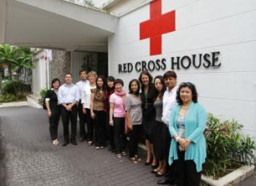
Brief Overview
2006 | During the 2006 Regional Conference in Singapore, the NS Leaders directed the establishment of a sustainable network for fundraising professionals.
2009 | Preparations for the Inagural Meeting of APFN With Steering Group from 5 NSs in Malaysia (Clare Cain of NZRC as Chair)
2010 | First APFN “Hui “ Meeting, Auckland, New Zealand (30 participants from 18 NSs)
2011 | Refomation of the Steering Group (New Chair:Gwendolyn Pang, SG, Phil RC) Establishment of the membership structure NSs started signing up for memberships
2012 | Steering Group Planning Meeting, Singapore January 2012 23 NSs as of December 2012 2nd APFN “Jer Kan” Meeting, Bangkok, July 15-17, 2012 Established Working Groups based on strategic priorities
Do More ∙ Do Better ∙ Reach Further

Slide 4
APFN Structure
Chair:
Ms. Gwendolyn Pang, Secretary General, Philippine RC
Chair
Member NSs
Steering Group
Steering Group:
  Australia RC: Mr. David Armstrong
  Bangladesh RC: Mr. Sirajul Islam Molla
  Thai RC: Ms. Janprapa Vichitcholchai,
  Japan RC: Mr. Otohiko Hori
Member NSs:
  23 members NSs with Annual Membership fee of CHF 500
Secreta-riat
IFRC Secreta-riat
Do More ∙ Do Better ∙ Reach Further

Slide 5
How Does APFN Work?
ENA
B
L
E
R
S
BENCH-MARKING
CAPACITY BUILDING
RESOURC-ING
LEARNING/
NETWORKING
FACILI-
TATION
CB Programmes
Peer to Peer support
Webinar
Events
Academic partnership
Reg. Corp partnership
Glob. Corp partnership
Promote RCRC speaker
Link HD/Comms/Pr serv
Income figures
Soft data collection
Recognition (APFN Awards)
Assessment (OCAC)
Investment Programme
HR
Partnership Resource Alliance
BUILDING
BLOCKS
CONTENT
PLATFORM
SUPPORT
Website
Knowledge Base
Community of Practise
P2P ‘marketplace’
Chair & SG
Members
APFN Secretariat
Guidebooks
Training materials
Do More ∙ Do Better ∙ Reach Further

Slide 6
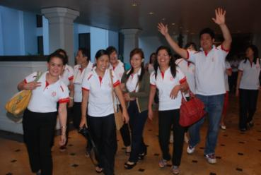
Achievements in 2012
23 Members Signed Up
Afghanistan, Australian, Bangladesh, Fiji, Kiribati, Japan, Hong Kong, Indonesia, Laos, Macau, Myanmar, Maldives, Mongolia, Nepal, New Zealand, Pakistan, Philippines, Singapore,, Samoa, Thailand, Tonga, Vanuatu, Vietnam
(as of the end of 2012)
Do More ∙ Do Better ∙ Reach Further
Notes:
Most important achievement is that 23 members are signed up through the year of 2012
NS leader commitment in investing in RM of NS
This means for APFN to more closely communicate with the members, respond to their needs by mobilizing the members and other resources APFN mobilizes
We have received positive responses on renewals

Slide 7
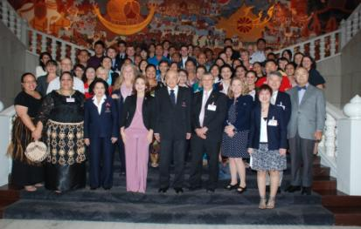
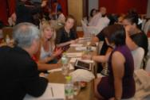
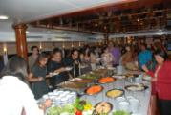
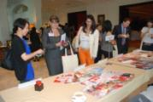
Achievements in 2012
2nd APFN “Jer Kan” Meeting, July 15-17, 2012
Bangkok, Thailand
3 days of fun-filled learning, sharing and networking
52 participants from 20 NSs
19 high-caliber internal and external speakers from around the world
Do More ∙ Do Better ∙ Reach Further

Slide 8
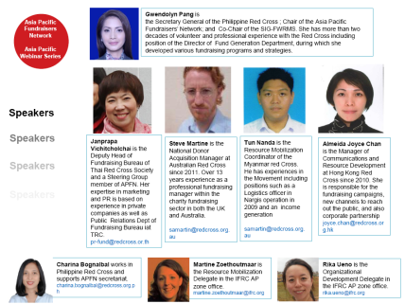
Achievements in 2012
Shared Learning: Webinar
Webinar “Learning from the Global Fundraising Skillshare” (Oct. 2012)
Do More ∙ Do Better ∙ Reach Further
Notes:
Webinar planned in April – approaching fundraising consultants working with Australian RC - major Donors, corporate, online giving etc.

Slide 9

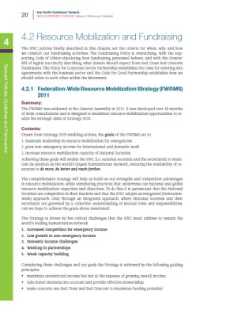
Achievements in 2012
APFN RM Guidebook series
Volume 1:
Policies & Guidelines
To highlight all fundraising policies
available within RCRC
Volumes coming up:
Inspiring NS Practices
NS reflection on income stream
Yellow Page
Do More ∙ Do Better ∙ Reach Further
Notes:
Volume 1 focusing on Policies and guidelines in the Movement relevant to NS Resource Mobilization – FWRMS, code for good partnership, OCAC, HD, Communication, social media guidelines…

Slide 10
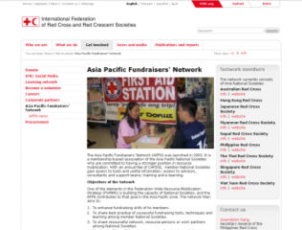
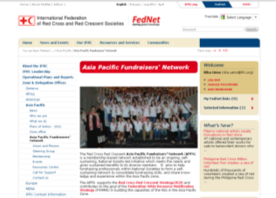

Achievements in 2012
APFN Communication platforms
www.ifrc.org: Public entry point
FedNet: for all the resources
Do More ∙ Do Better ∙ Reach Further

Slide 11
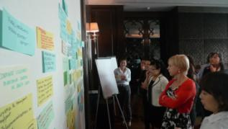
Achievements in 2012
Contribution to shared learning
SEA Leaders Forum
International Fundraising Skillshare
Asia Pacific Communications Forum
International Workshop on Resource Mobilization (IWRM)
Learning
Inspiration
Awareness
Promotion
Facilitating partnerships
IFRC TCCC South East Asia Workshop
Do More ∙ Do Better ∙ Reach Further
Notes:
SEA RCRC leaders that took place on July 11-12, 2012 in Nay Pyi Taw, Myanmar.
International Fundraising Skillshare on September 5-7 2012 in London. From the Asia Pacific,
9 NSs with 13 delegates attended – with 5 NSs making presentations.
International Workshop on Resource Mobilization (IWRM) held on July 3–16, 2012 in Kuala Lumpur, Malaysia.
Facilitation of global partnerships and promoting local engagement between National Societies and important global partners.
IFRC– The Coca-Cola Company (TCCC) partnership
IFRC TCCC South East Asia Workshop held in Thailand on February 9, 2012. 6 countries of the Southeast Asia/ASEAN region to share strategies.
Focal points from Coca-Cola and the Red Cross Red Crescent Societies in Indonesia, Malaysia, Philippines, Singapore, Thailand and Viet Nam came together to share ideas and brainstorm on working together around disaster relief, important country programmes and public engagement.
Two follow up webinars have taken place to share updates and to follow up on progress at country level, bringing country level focal points together on a regular basis. In 2013 similar meetings will take in South Asia and East Asia.
Besides that APFN has played a role in advocating, promoting and sharing information on the partnership when possibilities occurred. APFN messages sent out to members also involved the partnership: we have sent out the new years message featuring the speech of Muhtar Kent,
The Coca-Cola Company to all NSs. The overall aim in AP Zone is to have many local partnerships in place before the end of the 2013 and of course many more contacts made between National Societies and Coca-Cola.

Slide 12
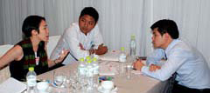
Achievements in 2012
Facilitating collaboration
among members
RM Contact list
Networking
Exchange visit
Do More ∙ Do Better ∙ Reach Further

Slide 13
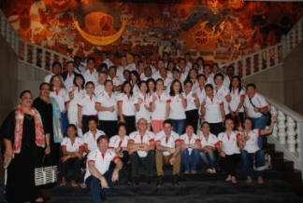
Plan of Action 2013
Knolwledge Management and Sharing
Publishing of Resource Mobilization Guidebook which covers different volumes each with a specific focus. Vol. 1 is now published which highlights different fundraising policies available in RC/RC. 27 Case Studies made available on Fed Net.
APFN Meeting
Annual Meeting open to all Asia Pacific fundraisers to discuss opportunities, common issues, and celebrate fundraising. The 3rd APFN Annual Meeting in 2013 will be held in Manila on July 4-6. This will be called “Pulong.”
Do More ∙ Do Better ∙ Reach Further

Slide 14
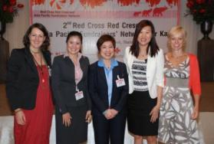
Plan of Action 2013
Income Stream Development
The APFN shall work closely with its NS members on developing support on each income stream including regional and global partnerships
PR/Communications
The APFN shall continue to promote knowledge exchange and sharing through various platforms including FedNet, newsletters, and social networking sites.
Do More ∙ Do Better ∙ Reach Further

Slide 15
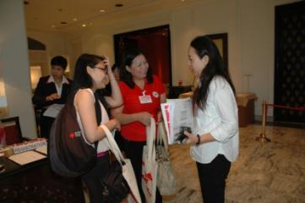
Plan of Action 2013
Capacity Building
The APFN shall develop and facilitate access to various capacity building opportunities including “investment programme, peer-to-peer support, webinars, and liaise with strong fundraising NSs in Europe and other parts of the world through EPSG, among others.
APFN Fundraising Award
This aims to document, share, recognize and celebrate success in fundraising. First APFN Awardees will be presented in this year’s APFN meeting.
Do More ∙ Do Better ∙ Reach Further

Slide 16
Plan of Action 2013
Other Strategic Priorities
Broadening the membership base and ensuring support to its members
APFN sustainability, networking and cooperation
APFN Secretariat support
Do More ∙ Do Better ∙ Reach Further

Slide 17
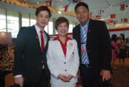

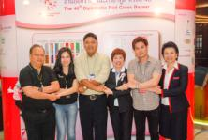
Plan of Action 2013
Launch of Peer-toPeer Support Program
In Thailand in partnership with Thai Red Cross Society
2 NS Practitioners from Singapore RC & Myanmar RC took part in a Campaign Visit
to learn how to organize a big fundraising bazaar in Thailand on March 2-3, 2013
The practitioners got a hands-on learning experience and had a an opportunity to
sit down with the organizer and discuss details of preparations
The practitioners are looking forward to replicate the strategy in their respective NSs
Do More ∙ Do Better ∙ Reach Further

Slide 18
APFN Working Together
With SEA National Societies
National Society | APFN Support/Collaboration
Singapore Red Cross | Recipient of the campaign visit/peer-to-peer support program launched in Thailand; “free seat” opportunity during the APFN Meeting, “Jer Kan” in July 2012
Myanmar Red Cross | Recipient of the campaign visit/peer-to-peer support program launched in Thailand; “free seat” opportunity during the APFN Meeting, “Jer Kan” in July 2012
Philippine Red Cross | “free seat” opportunity during the APFN Meeting, “Jer Kan” in July 2012;
Vietnam Red Cross | “free seat” opportunity during the APFN Meeting, “Jer Kan” in July 2012; ongoing discussion to support their FR Capacity Building Plan
Indonesia Red Cross | “free seat” opportunity during the APFN Meeting, “Jer Kan” in July 2012;
Laos Red Cross | APFN facilitated request for funding during the APFN Meeting, Jer Kan in July 2012
Thai Red Cross | “free seat” opportunity during the APFN Meeting, “Jer Kan” in July 2012; Official partner of APFN during the APFN Meeting, Jer Kan in July 2012; partner of APFN in launching the peer to peer support program
Do More ∙ Do Better ∙ Reach Further

Slide 19
Highlights of SEA NS members
In Resource Mobilization
National Society | Key efforts in stepping up their Resource Mobilization Development (based on those documented by APFN)
Singapore Red Cross | Re-structuring of Fundraising and Communications; aims to improve the strategies of the current Singapore Red Cross International Bazaar
Myanmar Red Cross | Enhancing fundraising strategies; application of strategies learned during the Campaign Visit in Thailand
Philippine Red Cross | Formulation of Fund Generation Strategy 2012-2016; successful implementation of Million Volunteer Run 2; reviving of the Annual Fund Generation Kick Off
Vietnam Red Cross | Formulationof Fundraising Framework Program 2012-2017
Indonesia Red Cross
Laos Red Cross | Developing fundraising strategies
Thai Red Cross | Looking at re-launching of Direct Mail; collaboration with Asia Pacific NSs;
Do More ∙ Do Better ∙ Reach Further
Notes:
Based on those documented by APFN, the following are the highlights of RM in the following NS members in SEA

Slide 20

Linking the Resource Mobilization
Link of Resource Mobilization with
Humanitarian Diplomacy and Communications
Resource Mobilization
Communi-cations
Humanitarian Diplomacy
Do More ∙ Do Better ∙ Reach Further
Notes:
We would like to encourage NS to be great humanitarian actors in resource mobilization by linking it to Communications and Humanitarian Diplomacy

Slide 21

Challenges of APFN
in Strengthening NS Capacity
Funding and sustainability
Members participation and involvement
Human Resources
Leadership support
Do More ∙ Do Better ∙ Reach Further
Notes:
Funding and sustainability (funding in terms of long-term sustainability; sustainability in terms of succession planning as well
Members participation and involvement (APFN to have strengthened one on one communications with members to actively support their RM efforts as well as to explore members to contribute in various ways
Human Resources (secretariat, support team to give support to members)
Leadership support

Slide 22

Open sharing and discussion
Can you share with us what you can contribute as leaders for resource mobilization development in your respective NSs and through APFN
as well?
Do More ∙ Do Better ∙ Reach Further

Slide 23
Proposed role of leadership in
Resource Mobilization Development
Making Resource Mobilization a priorty in the National Society
Support in investing in fundraising personnel and programs
Support in the development of fundraising plan and strategy
Support in involving NS fundraising practitioners to local and international activities
Collaboration and networking
Register your NS as a member of APFN!
Do More ∙ Do Better ∙ Reach Further

Slide 24

Let us continue working together!
Let us know your strengths and targets
Inspire, share & get involved – your contribution, technical expertise, financial support, or join a Working Group
Utilize the APFN in your RM work!
  Resource Centre on FedNet
  Leaning opportunity: APFN Meeting, webinar etc
  Peer-to-peer support
Contact us – APFN Secretariat at your service
Do More ∙ Do Better ∙ Reach Further

Slide 25

Let us continue working together!
The APFN is a mutual support network. Becoming a member is not only about what you can get but also what you can share and contribute.
Nothing comes bigger and better than the achievement of working together...
Do More ∙ Do Better ∙ Reach Further

Slide 26
Let us connect and keep in touch
APFN Website
http://www.ifrc.org/en/get-involved/asia-pacific-fundraisers-network/
APFN Resource Center on FedNet
https://fednet.ifrc.org/en/ourifrc/offices/AP/asia-pacific-fundraisers-network-apfn/
For More Information:
Ms. Charina C. Bognalbal
APFN Secretariat/Philippine Red Cross
Email: charina.bognalbal@redcross.org.ph
Do More ∙ Do Better ∙ Reach Further

