Slide 1


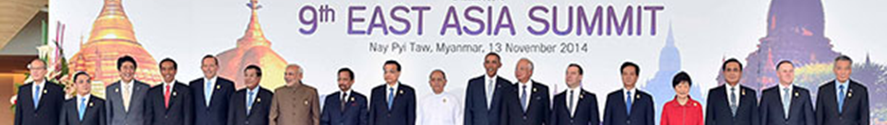
9th East Asia Summit (KL, Nov 2015)
Cambodia 25-27 February 2015

Slide 2


The East Asia Summit (EAS) is a regional leaders' forum for strategic dialogue and cooperation on key challenges facing the East Asian region.
Six priority areas of regional cooperation within the framework of the EAS:
  energy and environment,
  finance,
  education,
  natural disaster management,
  pandemics,
  Connectivity
Membership of the EAS – 18 countries including 10 ASEAN countries, Australia, China, India, Japan, New Zealand, Republic of Korea, the US and Russia.
The last East Asia Summit took place in Myanmar, November 2014
Cambodia 25-27 February 2015

Slide 3
Key Outcomes of Relevance to the Red Cross:
EAS Statement on Rapid Disaster Response
Joint Statement on Regional Responses to the Outbreak of Ebola Virus Disease
EAS Statement on the Rise of Violence and Brutality Committed by Terrorist/Extremist Organisations in Iraq and Syria
A common goal of an ‘Asia Pacific free of malaria by 2030’ under the Asia Pacific Leaders Malaria Alliance
Further reading:
Chairman’s statement of 9th EAS Summit
http://www.asean.org/images/pdf/2014_upload/9th%20EAS%20Chairman's%20Statement%20(Fnial).pdf
EAS Statement on Rapid Disaster Response http://www.asean.org/images/pdf/2014_upload/EAS%20Statement%20on%20RDR.pdf
Cambodia 25-27 February 2015

Slide 4

Thank you

