Slide 1
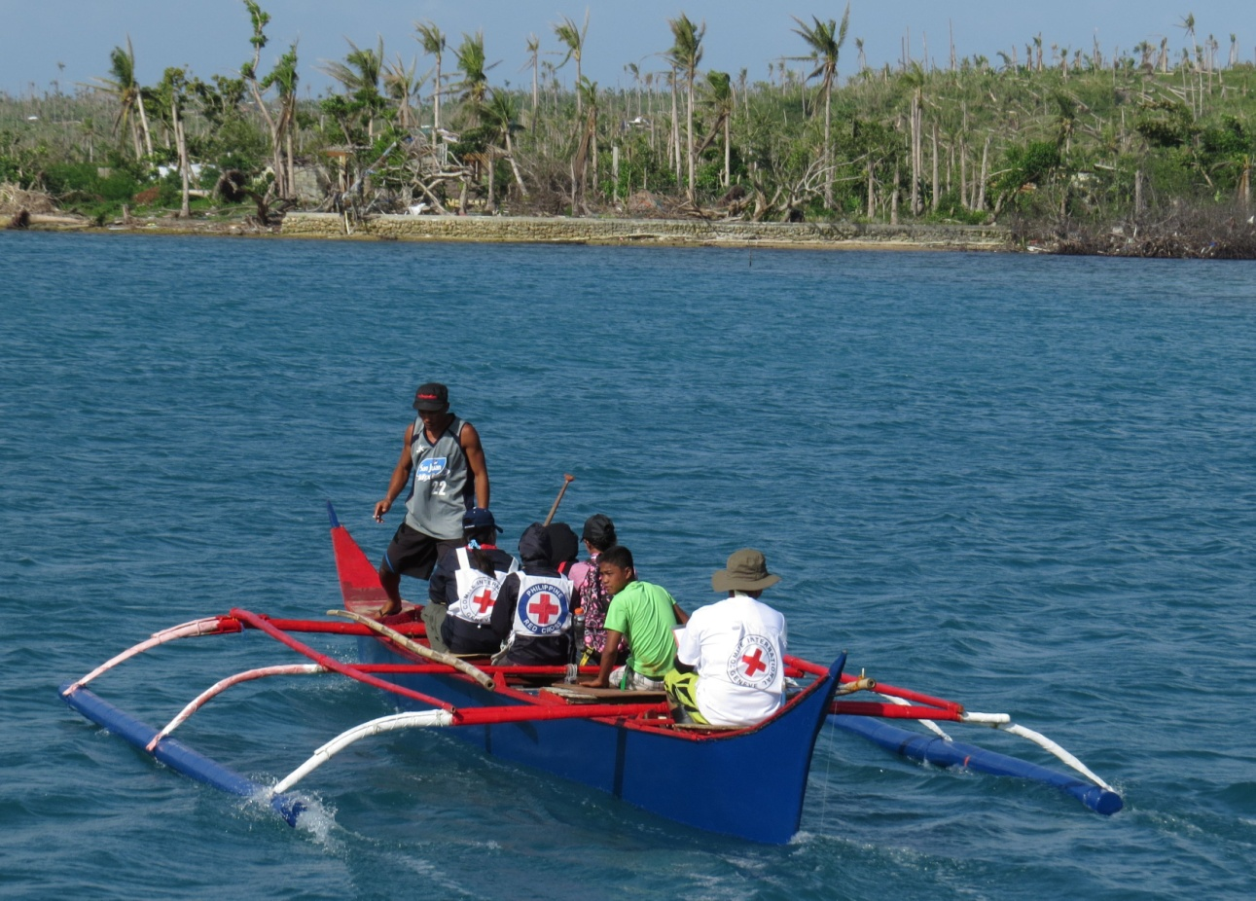
Working with National Societies in Southeast Asia
Alain Aeschlimann
Head of Operations East Asia, Southeast Asia
and the Pacific, ICRC
Notes:
1

Slide 2
Some issues of possible common strategic concern
Promotion of IHL and humanitarian issues in SEA
Strengthening understanding of Fundamental Principles with external actors
Strengthening of the Red response/pillar
Regional training
Integration of SEA NS staff into international operations
Strengthening the RFL network
Developing forensic response

Slide 3
Human Resources Collaboration
SEA NS supporting the PRC/ICRC action: Singapore RC, PMI
Health staff recommended by Philippine Red Cross
Types of support possibly provided
Rapid Deployment mechanism | Medical assistance …possibilities in the Logistics, Water/sanit
RFL pool of experts | Regional experts
Secondment | Duration, profile, conditions: open
Support for recruitment | Networks, professional circles

Slide 4
Way forward on HR collaboration
Wish to increase HR collaboration with SEA NS (short and long term missions)
Will to build on and if necessary invest in NS capacities
Current deployment mechanism through established RDUs (Finnish, Norwegian, Japanese, Hong Kong) but also interest in direct bilateral collaboration
Regional SEA IMPACT training (Singapore) or other (?)
Which NS would be interested to further explore such collaboration?
What do NS leaders recommend as next steps? What to do to become concrete?

Slide 5
RFL challenges
New technologies (innovative approach)
Separation due to conflict/violence, natural disaster, detention, migration
Importance of disaster preparedness and contingency
Link to DM; issue of caseload, trained staff and volunteers
RFL and forensic activities

Slide 6
Forensic activities, part 1
ICRC Forensic expert based in Jakarta at disposal of delegations and NS: advice, training, techn, support
Supporting the forensic management and identification of human remains after conflict and catastrophes
Mapping of situation, national capacities, risks in the countries: identification of gaps, needs and contribution of the Movement
Development of policies and standards of best practice (legal framework): Philip., Indon., T Leste, Bougainville, Bengladesh

Slide 7
Forensic activities, part 2
Provision of tools for the management of human remains and related information facilitating victims identification (ICRC AMPM Database, ICRC manuals and reference documents)
Integration within DM/DP, defining role of NS (agreed by authorities), training of NS staff/volunteers, contingency (regional, national level)

Slide 8
Safer access framework (SAF)
Linking SAF with NS development (OCAC and CAS processes) and institutional preparedness

